Slide 1
Results summary
A technical overview of the data exploration
Marco Carnini

Slide 2
Exploring Data with Machine Learning
Questions from data description
What can be learned?
Exploring “Ordini”
Exploring “Fornitori”
A predictive model: who will get the contract?

Slide 3
Questions from data description
No time series approach: only two years, no possible trend study:
Increase/decrease costs for Public Administration
Costs for different economic situation (recession, economic growth)
Not representative sampling, but voluntary registration to the project for cost rationalization
No local/regional assessment of efficiency
Not reliable inference on the total costs of the Public Administration
Missing identification of some administrations:
“Comuni” type is available in table “Ordini diretti MePA” but without identifier (only Province)
Notes:
I think that even negative results are results, and expressing limitations of the current approach/data is relevant

Slide 4
What can be learned?
I chose the two completes data for the two full years available: 2018, 2019
Selecting the table with the most observations available: “ordini diretti MePA” with a continuous variable “Valore_economico_Ordini”
Can I predict the amount of money spent in 2019 by the different administrations using the data from 2018?

Slide 5
Adversarial validation
Train a classification model: can I distinguish the data from 2018 from those from 2019?
If I can distinguish the data (I get a good classification model), a drift in data happened and I should not trust the model predictions for costs in 2019.
If I assess the feature importance in the model predicting if the observation comes from 2018 or 2019, then I discover which features have a drift. In other terms, what changed between those two years?
Data are not balanced between the years: accuracy is not a good target function (predicting that all data are from 2019 I would be roughly 66% accurate)
I use Area under the curve (AUC)

Slide 6
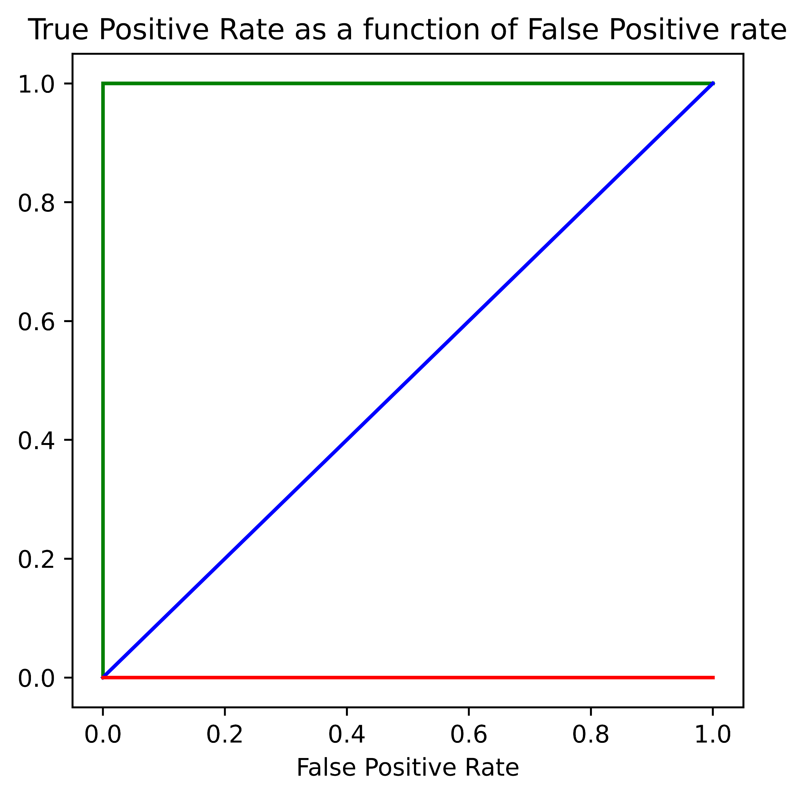
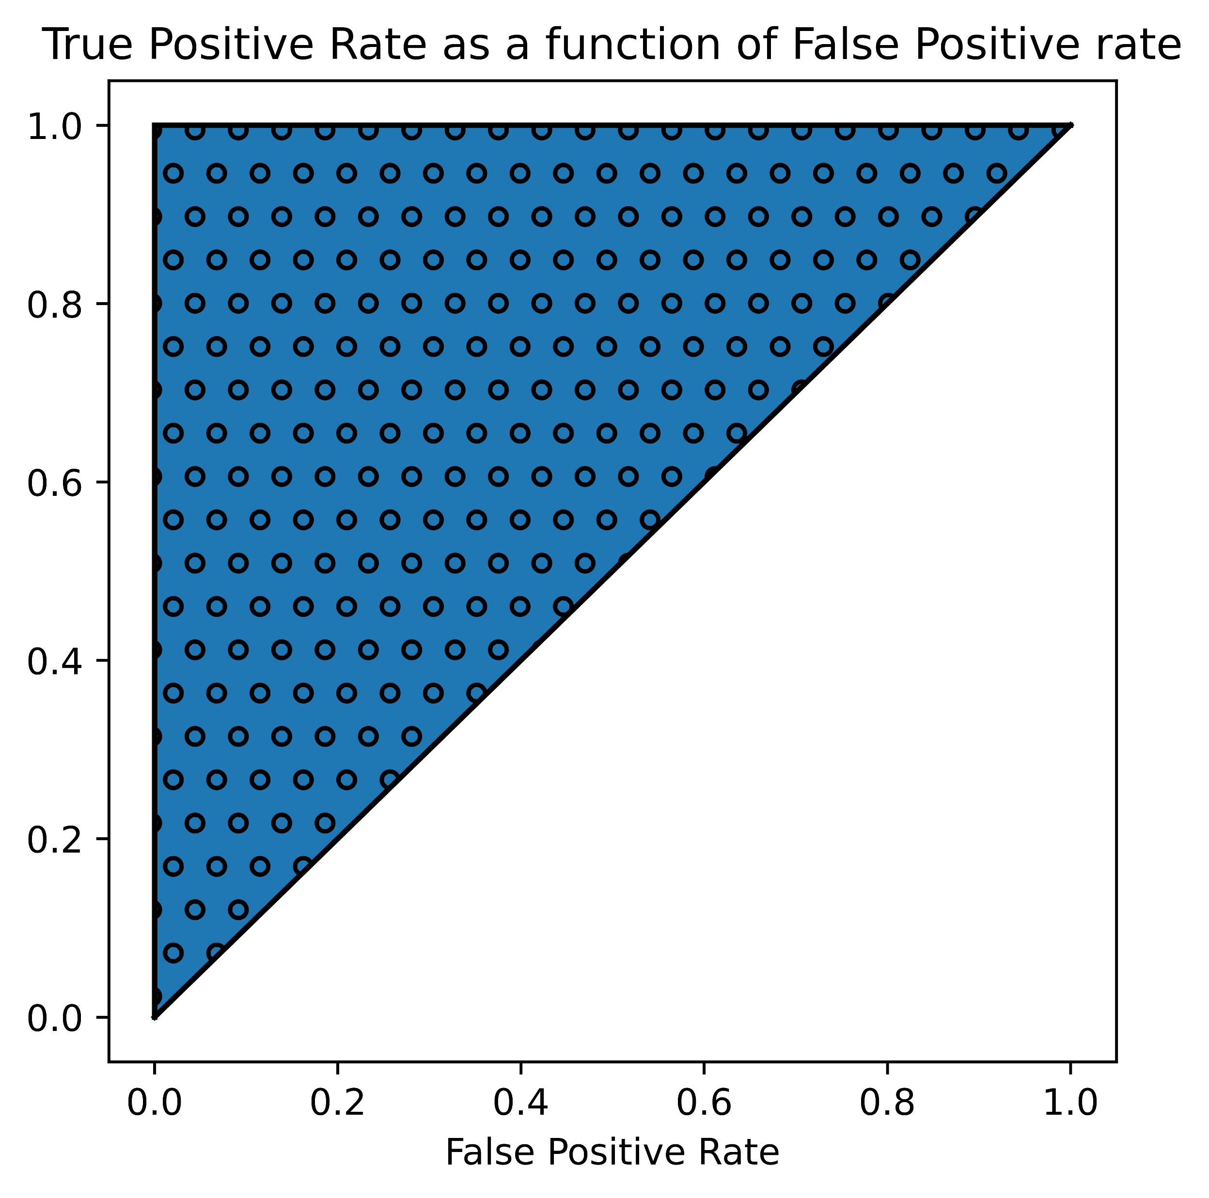
What is the AUC?
Notes:
Plotting the True positive rate as a function of false positive rate and determining the are under the curve I can get a measure of the quality model.
A model that never predict correctly (red in the left figure) will have an area of 0 (worst model).
A model that predict perfectly (green in the left figure) will have an area of 1 (area of the unitary square).
A model that has many false positive as negative (blue in the figure) will have an area of 0.5.
The models that have some relevance are those in the shaded triangle on the right figure.

Slide 7
Can I distinguish orders from 2018 and 2019?
Embedding categorical variable with CatBoost encoder
Skipping missing observations (numerically irrelevant)
Training model (no hyperparameters tuning for simplicity)
Using Random Forest (not strongly dependent on hyperparameters)
Xgboost to check the results
AUC:
0.67 RF
0.73 XGB
I can distinguish data from 2018 and 2019
Notes:
Relatively to Ordini
Catboost encoder: online target encoding

Slide 8
What changed between 2018 and 2019?
Assessing performance with Feature Permutation
Algorithm independent
If a feature is permuted, how much the performance will be worse on the validation set?
Slightly worse/equal : variable not very relevant
Slightly better: variable is detrimental for the model
The variables that are relevant for the adversarial validation model have a shift between 2018 and 2019

Slide 9
Feature importance
0.0660 ± 0.0006 | Tipologia_Amministrazione
0.0530 ± 0.0005 | bene_servizio
0.0521 ± 0.0010 | N_PA
0.0509 ± 0.0009 | Regione_PA
0.0447 ± 0.0016 | Regione_Fornitore
0.0419 ± 0.0006 | N_PO
0.0152 ± 0.0005 | Valore_economico_Ordini
0.0133 ± 0.0011 | descrizione_CPV
0.0088 ± 0.0005 | N_Ordini
0.0083 ± 0.0004 | Categoria_Abilitazione
0.0075 ± 0.0002 | N_fornitori
0.0019 ± 0.0006 | codice_CPV
0.0017 ± 0.0001 | Bando_Mepa
Notes:
These are the importance (left) and the variable name. This means that the Type of administration composition in the sample changed (e.g., some type of administration have different amount of samples for the two years). This feature is the one
Also the composition of expenditures changed (``bene_servizio``).
Even the territorial coverage changed (Regione_PA).

Slide 10
Can I distinguish suppliers from 2018 and 2019?
I want to know if I can predict which company will get the orders
Adversarial validation between 2018 and 2019 (AUC):
0.34 RF
0.43 XGB
There is not apparent shift in the data
Build a model to predict which supplier is more likely to sign at least one contract with the PA.
Random Forest, optimizing the AUC (class unbalanced: less than 1% od the supplies sign at least one contract).
Notes:
A new research question

Slide 11
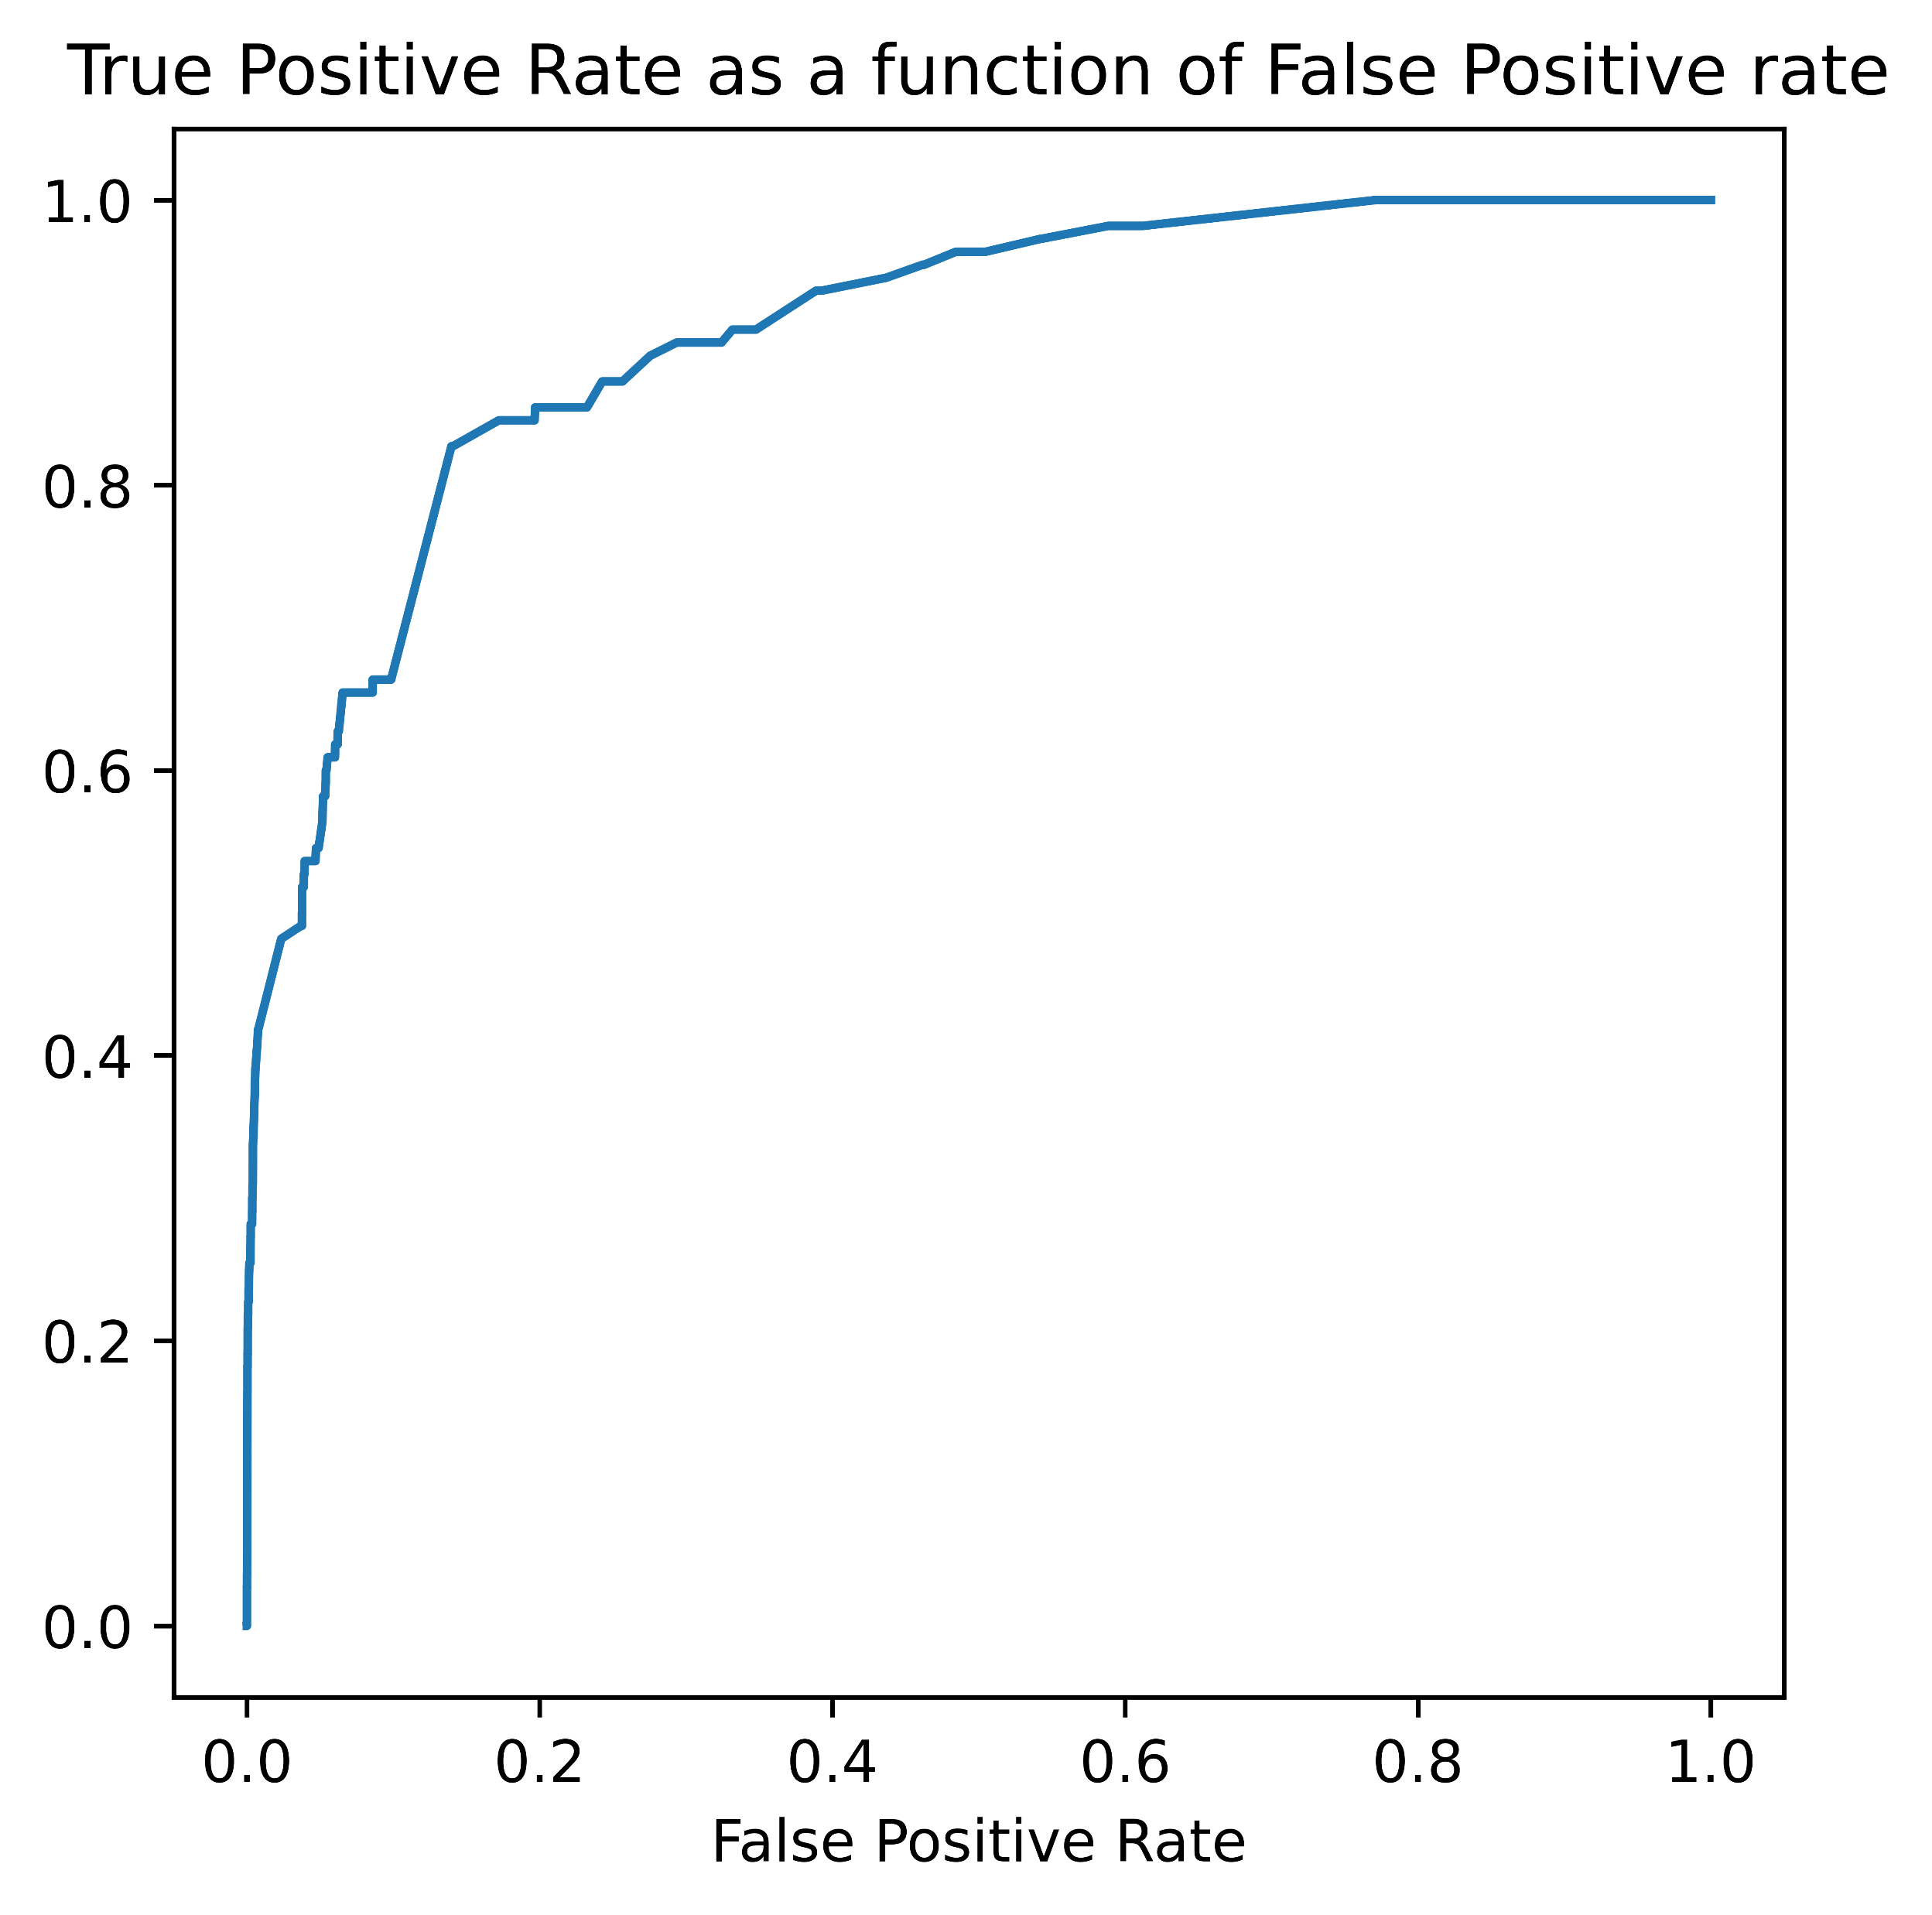
Results
A good model:
AUC: 0.90
Not aggressive hyperparameters fine-tuning

Slide 12
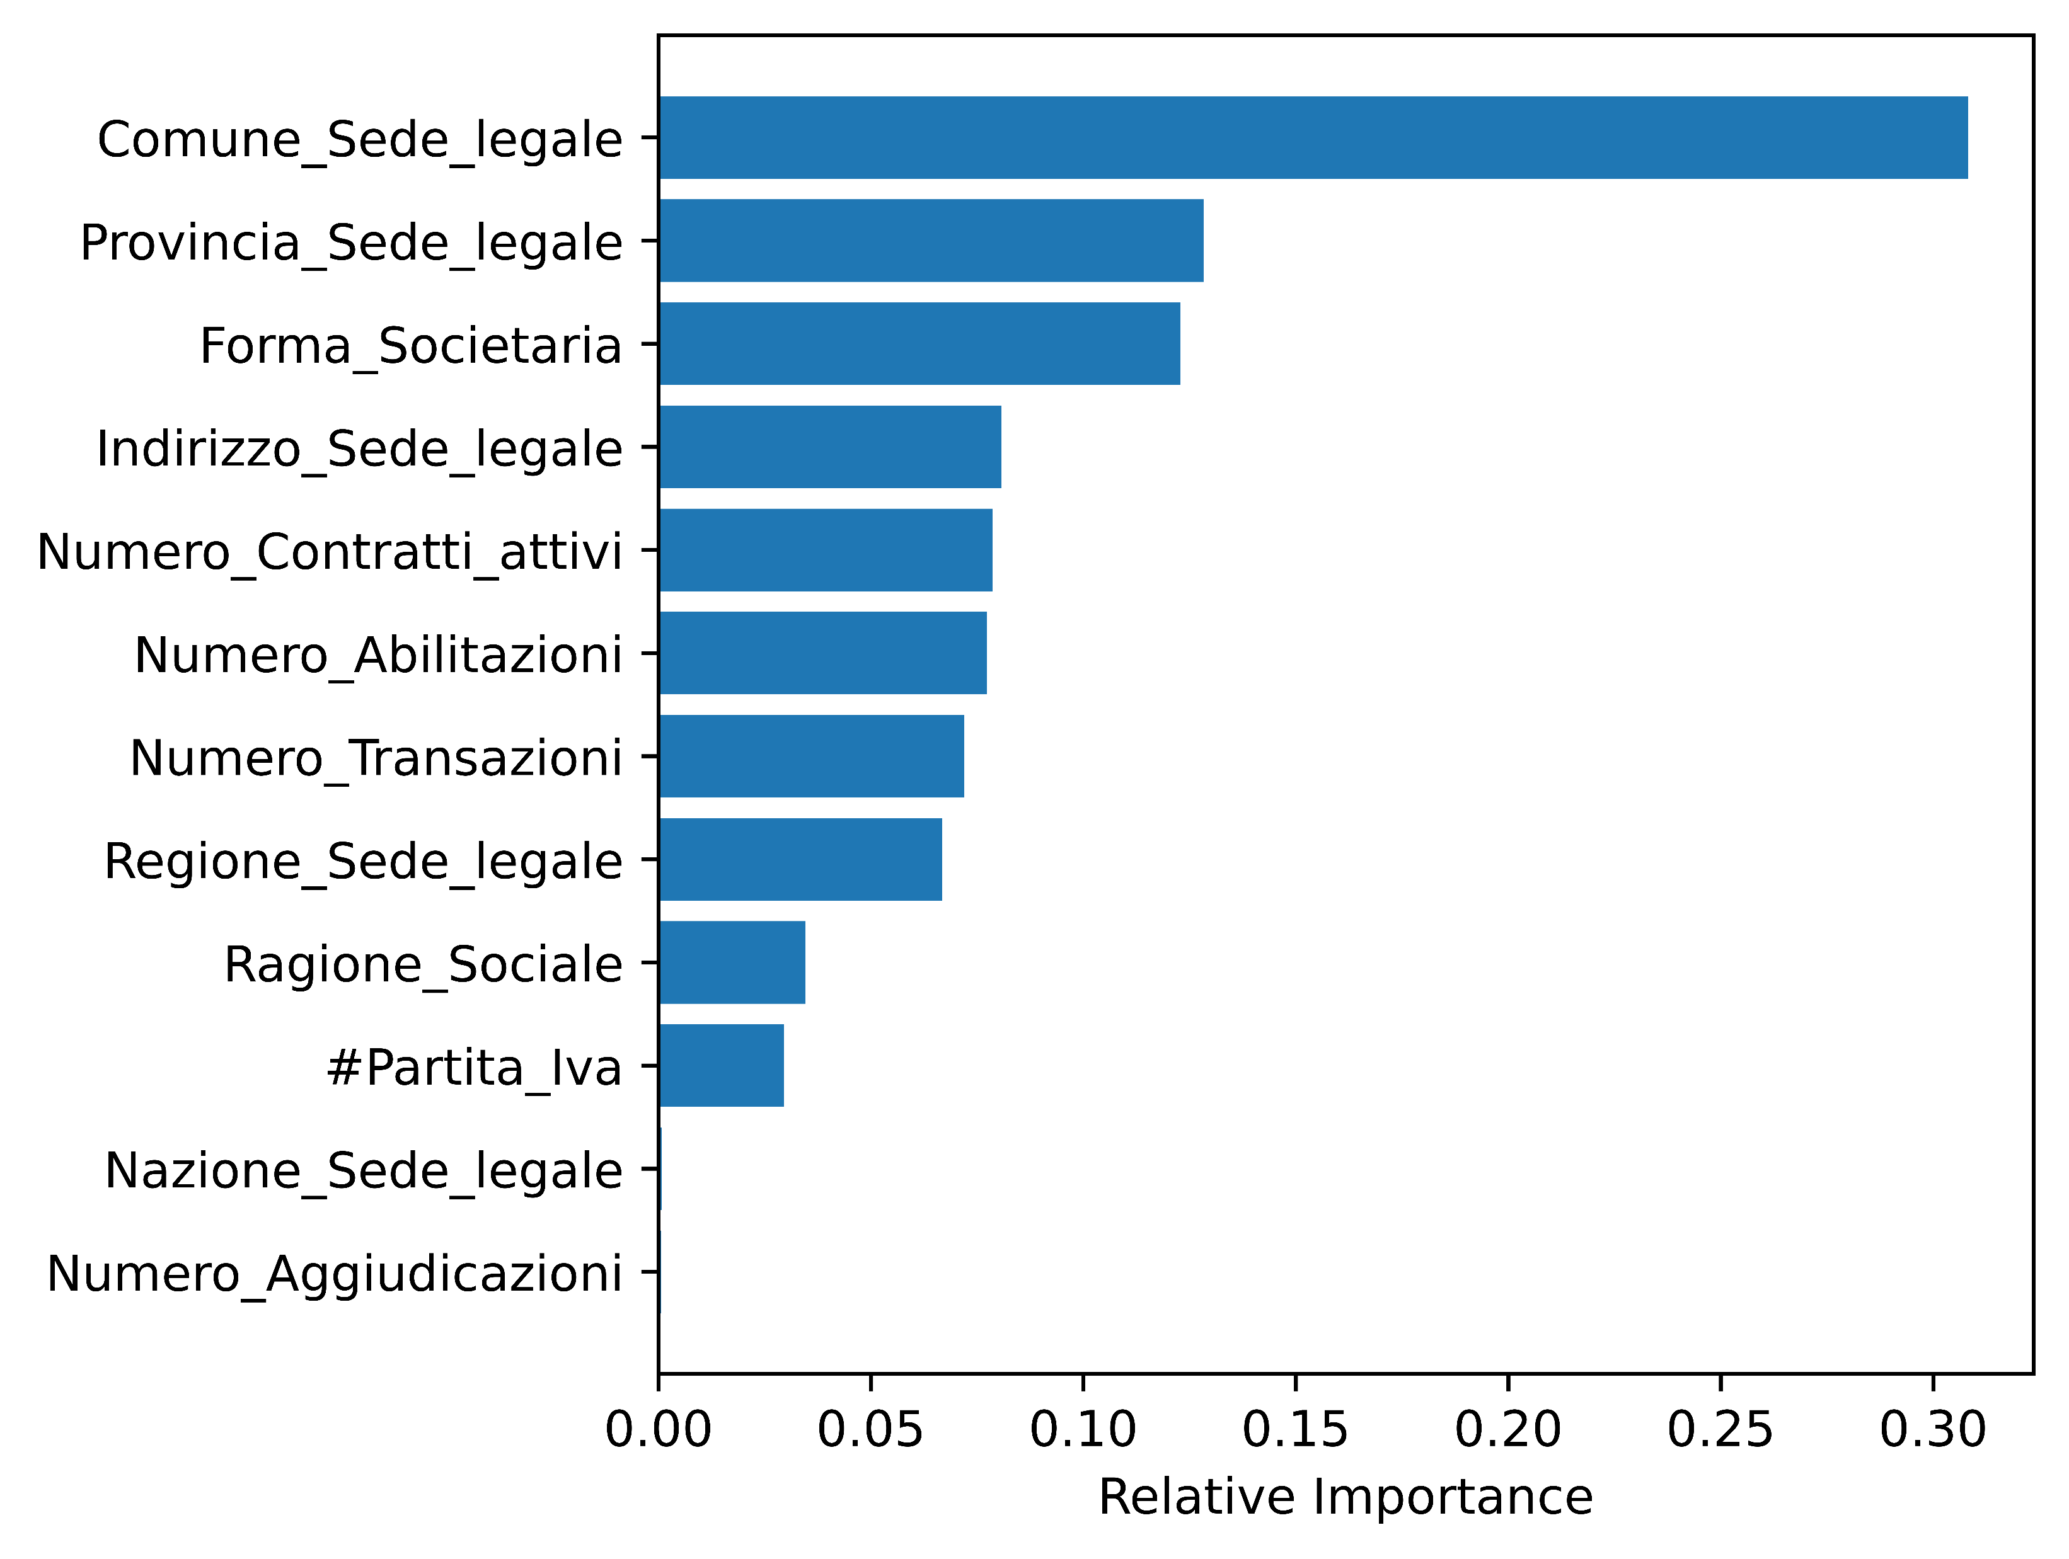
Features importance
Notes:
Eli5 does not normalize the weight to one and cut after few digits. Using the default importance from scikit learn, the above figure is generated.

Slide 13
Conclusion
Failed to build a model predicting the expenses for PA
I built a model to predict which suppliers are more likely to sign a contract with PA
After the model, better performance should be built by adding features (joining with other tables/information)

