Slide 1



Master Degree in Embedded Computing Systems
From natural language requirements to
Simulation Monitors: Synthesis through
code generation
Supervisors:
Prof. Marco Di Natale
Prof. Giorgio C. Buttazzo
Candidate:
Marco E. Celia

Slide 2
Outline
Introduction
Requirements Fundamentals
Formal Languages
The Framework
Modelling Libraries
Requirement Editor
Conclusion
M.Celia

Slide 3
Introduction
The V-Model
Individual V-Process for Requirement V&V
System-Level
Requirements
Verification
Functional
Specification
Functional
Modeling
Integration
Testing
Architecture Exploration
Component Modeling
Module
Testing
Behaviour Modeling
Implementation
M.Celia
Notes:
Within RM project we customize the v-model as follow:
Left hand is validation(completeness and correctness of requirements) fro top level to component level requirements
Right hand side is testing and verification (satisfaction of the requirements in the product design)

Slide 4
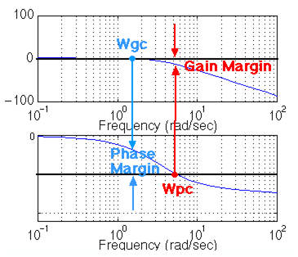
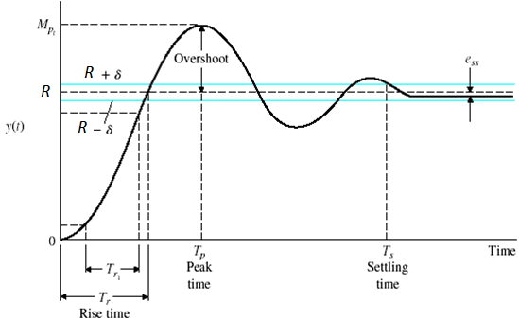
Introduction
Control Systems Performance Requirements
Individual V-Process for Requirement V&V
System Level
User Requirements
Time Domain
Frequency Domain
M.Celia

Slide 5
Outline
Introduction
Requirements Fundamentals
Formal Languages
The Framework
Modelling Libraries
Requirement Editor
Conclusion
M.Celia

Slide 6
Requirements Fundamentals
User Requirements
Benefits of well-defined Product Requirements
Provide careful assessment of the needs that a system has to fulfil
Reduce the development effort and erroneous interpretations
Serve as base line for a Validation and Verification (V&V) process
Establish the basis for contractual agreement among stakeholders
In order to let them understandable from people having a non-technical background they quite often comes as many pages of plain text…
M.Celia

Slide 7
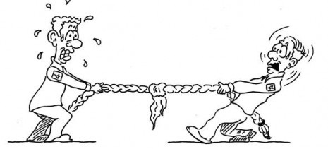
Requirements Fundamentals
Specification Languages
Formal
Semi formal
Informal
Mathematical Syntax
Improve comprehension
High verifiability
Require strong technical skills
Graphical (or structured) Syntax
Unambiguous
Reduced verifiability
Steeper learning curve
No technical skills required
Not verifiable
Ambiguous, Inconsistent, Redundant
Formality
Readability
M.Celia

Slide 8

Requirements Fundamentals
Requirements Verification
Requirements can be validated during simulation (or after) by means of Monitors
Monitors are based on the formal specification of a property.
They take as input a set of signals and returns flags telling whether the internal properties are satisfied, violated or (possibly) undecided.
Recalling the V-Model the flow from User Requirement To Validation can be then
manual
Formal Properties
Informal Requirements
Document
manual
Input
Signals
Monitor
manual
Signal
List
Top-Level Requirements - Text Editor
Verification- Simulation Environment
M.Celia

Slide 9
Outline
Introduction
Requirements Fundamentals
Formal Languages
The Framework
Modelling Libraries
Requirement Editor
Conclusion
M.Celia

Slide 10

Formal Languages
From Informal To Formal
Bridging the gap between informal and formal languages by identifying Patterns
Patterns are parameterizable forms of properties having a well-defined and independent semantic. They allow to achieve formal specification from properties expressed in informal language
Informal Specification
Patterns
Formal Specification
Identification
Formalization
Property:
absence of P
absence of P after (before) Q
existence of P
existence of P between Q and R
Domain Specific (e.g. Control systems):
Overshoot (Undershoot)
Rise-time (Fall-time)
Settling-time
M.Celia

Slide 11
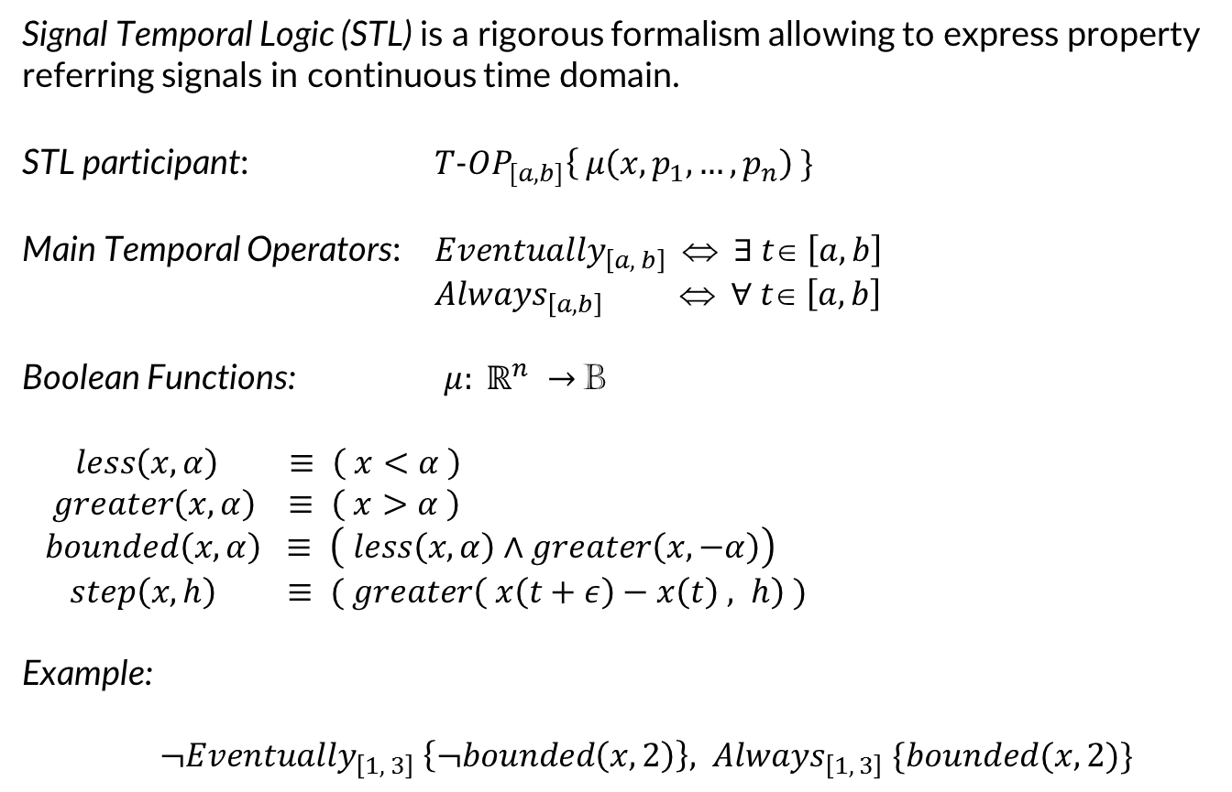
Formal Languages
Signal Temporal Logic (STL)
Signal Temporal Logic (STL) is a rigorous formalism allowing to express property referring signals in continuous time domain.
STL participant: ${T−OP}_{[a,b]}\left\{ μ\left(x, p_{1},…,p_{n}\right) \}\right.$
Main Temporal Operators: ${Eventually}_{\left[a, b\right]} ⇔ ∃ t∈ \left[a, b\right]$
${Always}_{\left[a, b\right]} ⇔ ∀ t∈ \left[a, b\right]$
Boolean Functions: $μ: ℝ^{n} →$B
$$less\left(x,α\right) ≡ \left( x<α \right)$$
$$greater\left(x, α\right) ≡ \left( x>α \right)$$
$$bounded\left(x,α\right) ≡ \left( less\left(x,α\right)∧greater\left(x,−α\right)\right)$$
$step\left(x, h\right) ≡ ( greater\left( x\left(t+ε\right)−x\left(t\right) , h\right) )$
Example:
${¬Eventually}_{\left[1, 3\right]} \left\{¬bounded\left(x,2\right)\right\}, { Always}_{\left[1, 3\right]}\{bounded(x,2)\}$
M.Celia
Notes:
can be view as a composition of a (un)bounded temporal operator and a Boolean expression

Slide 12
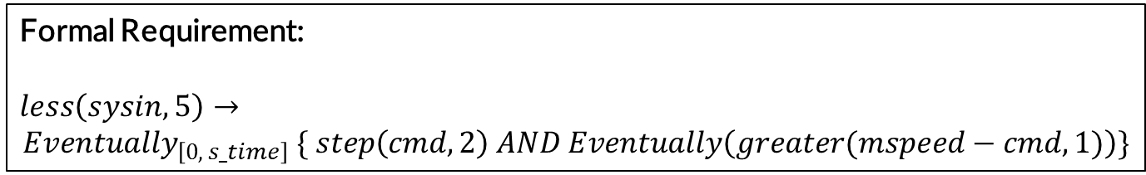
Formal Languages
STL in action
Informal (lacking) Requirement:
“the motor speed overshoot shall be lass than or equal to 1 rpm with a system inertia less than 5 kgm2”
Semi-formal Requirement (Contract-Based Paradigm):
Assumption: system inertia (sysin) less than 5 kgm2 and reference input (cmd) is a step with amplitude 10
Assertion:
the motor speed (mspeed) overshoot shall be lass than or equal to 1
Formal Requirement:
$$less\left(sysin,5\right)→$$
$${Eventually}_{\left[0, s_time\right]} \{ step\left(cmd, 2\right) AND Eventually\left(greater(mspeed−cmd,1)\right)\}$$
M.Celia

Slide 13
Outline
Introduction
Requirements Fundamentals
Formal Languages
The Framework
Modelling Libraries
Requirement Editor
Conclusion
M.Celia

Slide 14
The Framework
Objectives
Force user to write well-defined requirements
Provide a user-friendly environment and GUI for engineers
Provide support for a (wide) number of patterns
Exploit the power of formal logics without using it directly
Automatic generation of monitor for specific modelling environments
Particularly care in extensibility and flexibility
M.Celia
Notes:
Provide a set of users-relieving features when they typing requirements
Use an easily readable loose syntax

Slide 15
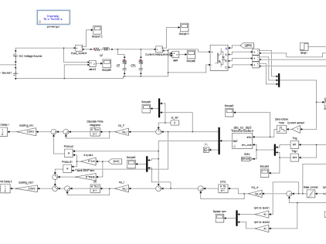
The Framework
Workflow
Modelling Tools
Tool
Simulink
Data dictionary Importers
CSV Reader
XML Reader
import
Model
Editor
.req
.req
.req
Monitor
Platform Generators
export
Parser
Simulink Gen
M.Celia

Slide 16
Outline
Introduction
Requirements Fundamentals
Formal Languages
The Framework
Modelling Libraries
Requirement Editor
Conclusion
M.Celia

Slide 17
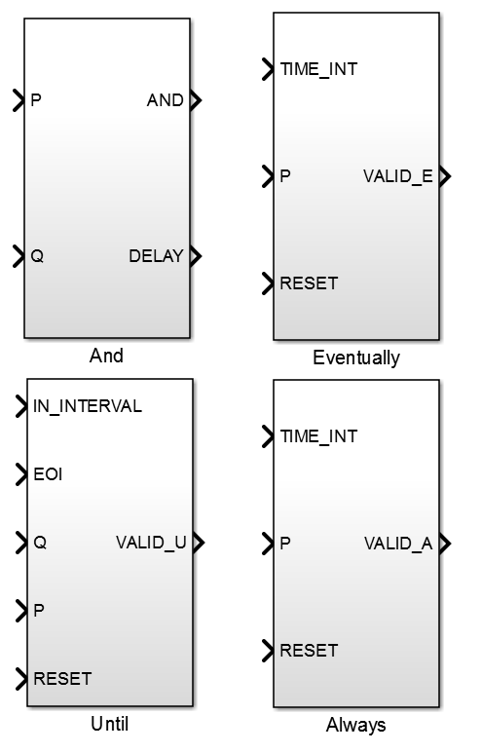
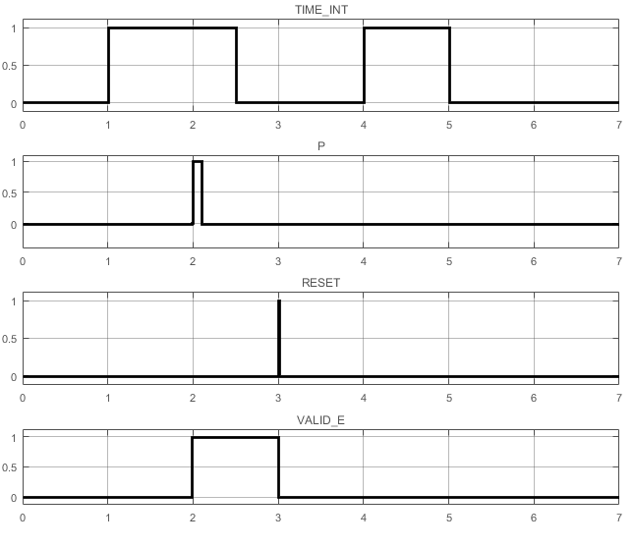
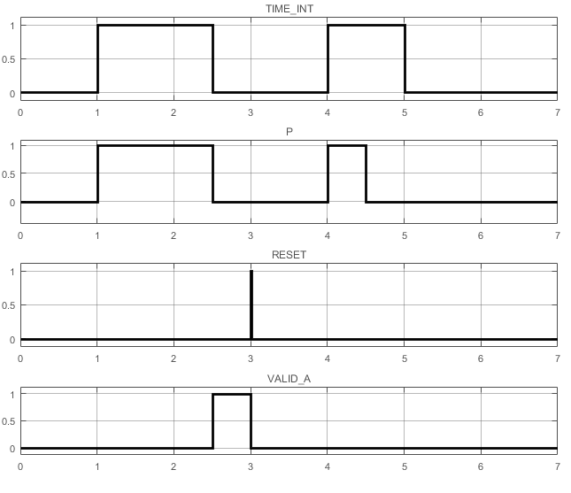
Modelling Libraries
STL Library
M.Celia

Slide 18
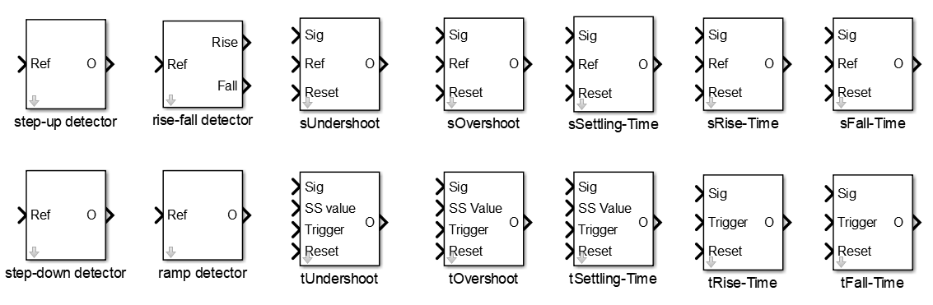
Modelling Libraries
System Performance Control Library (SPCL) (1/2)
Detectors
Implicit Checkers
Explicit Checkers
M.Celia

Slide 19
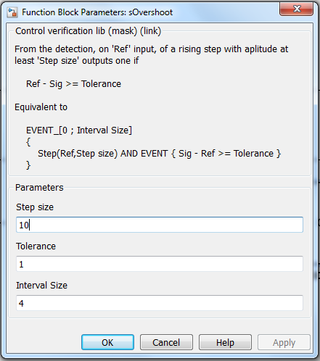
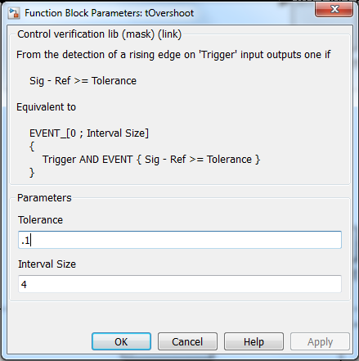
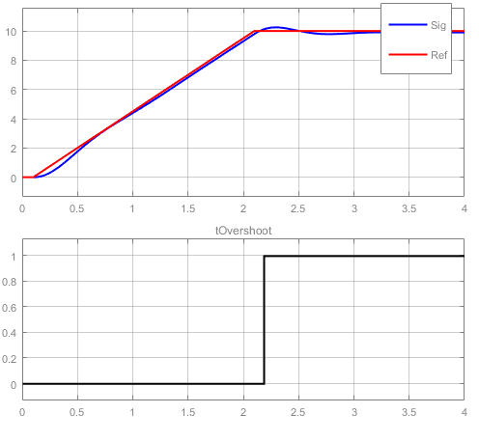
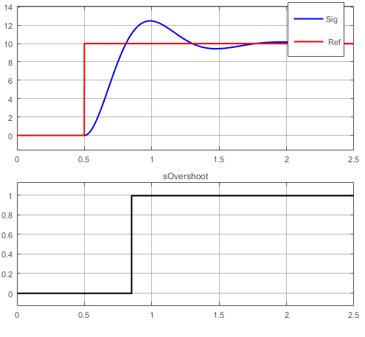
Modelling Libraries
SPC Library (2/2)
M.Celia

Slide 20
Outline
Introduction
Requirements Fundamentals
Formal Languages
The Framework
Modelling Libraries
Requirement Editor
Conclusion
M.Celia

Slide 21
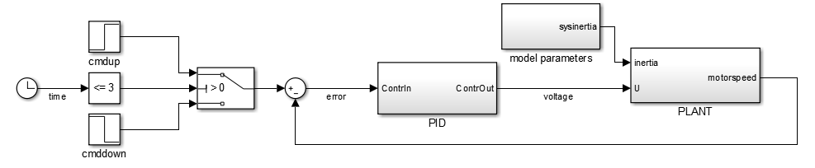
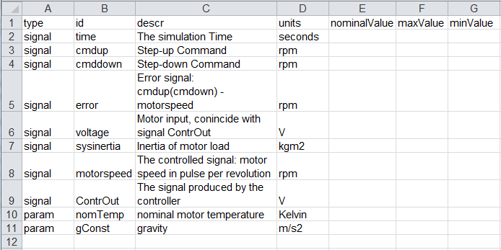

Requirements Editor
Data-Dictionary example
sig_exporter.m
M.Celia

Slide 22
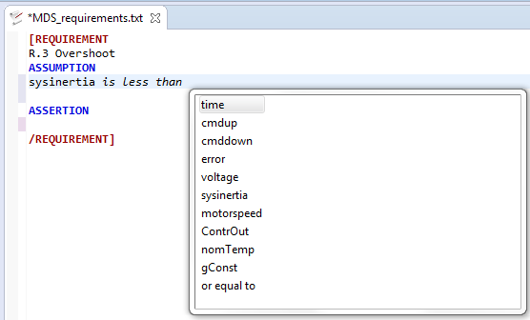
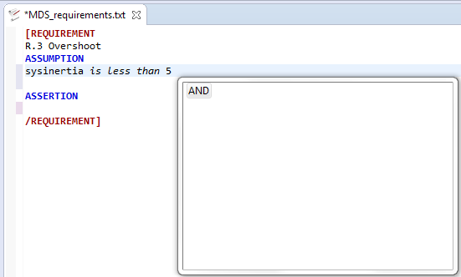
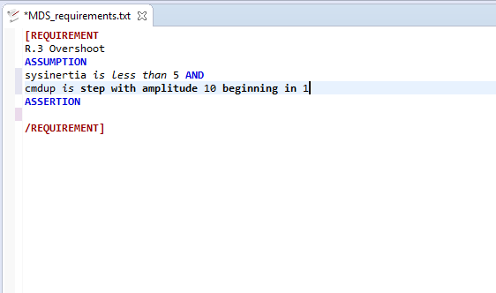
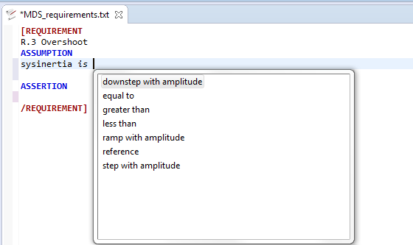
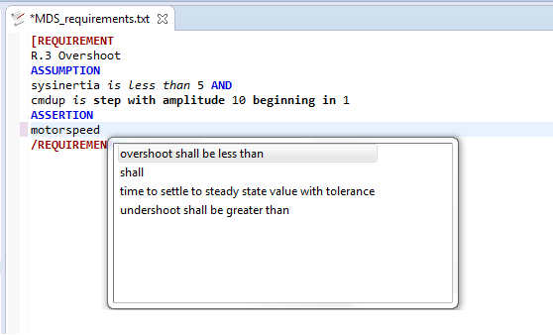
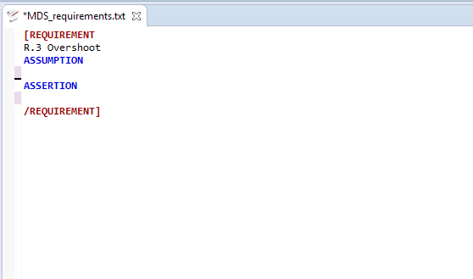
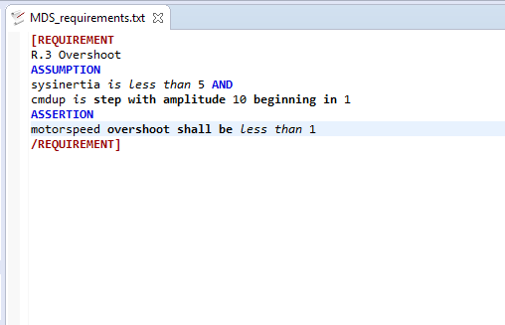
Requirements Editor
Context Helper
Word-by-Word Completion
Context Aware Completion
M.Celia

Slide 23
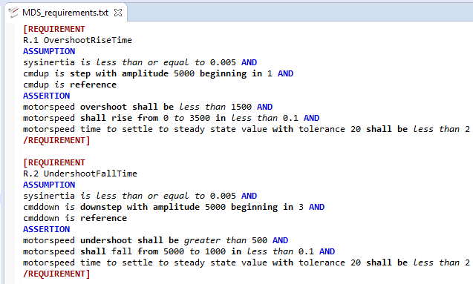
Requirement Editor
A Complete Example
M.Celia

Slide 24
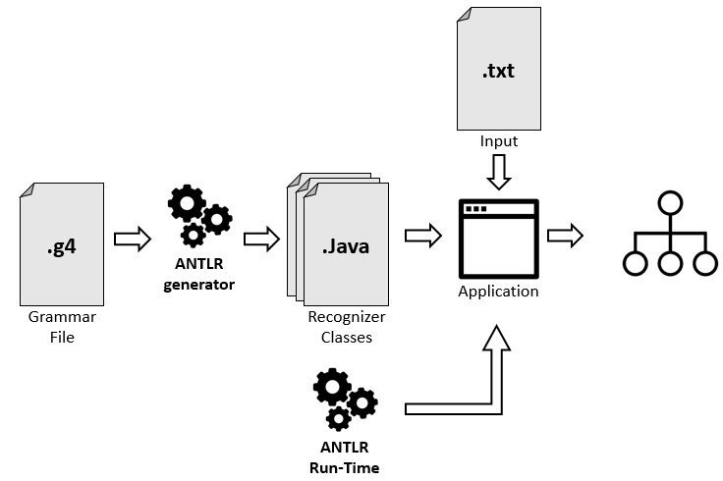
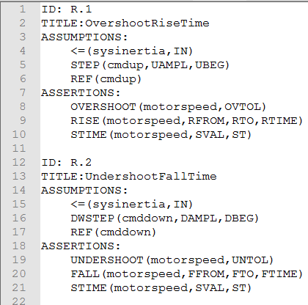
Requirement Editor
Parser
Non-transparent to users
M.Celia

Slide 25
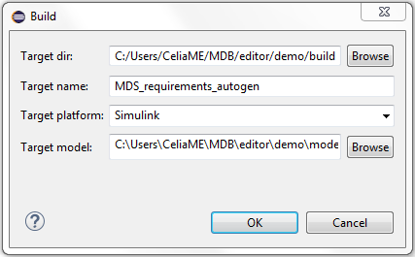
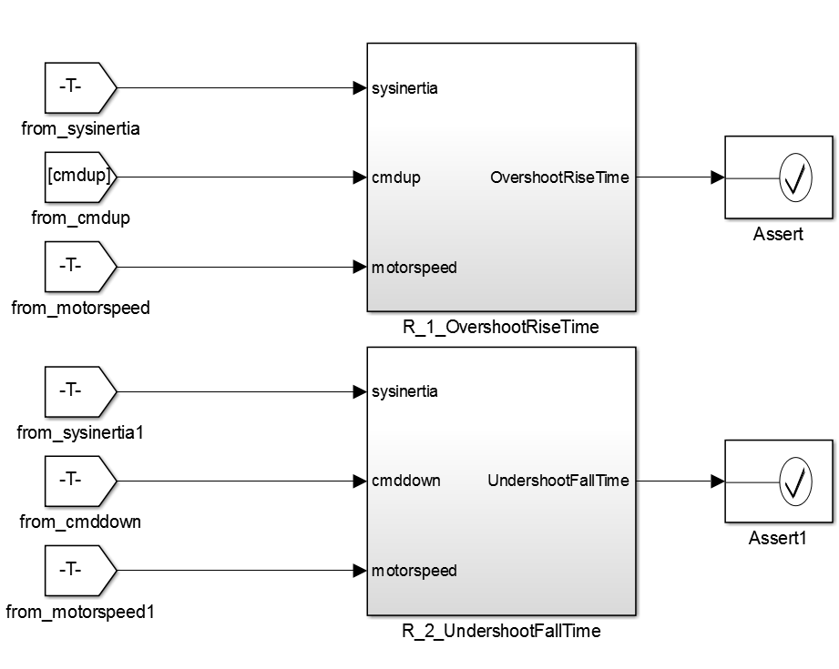
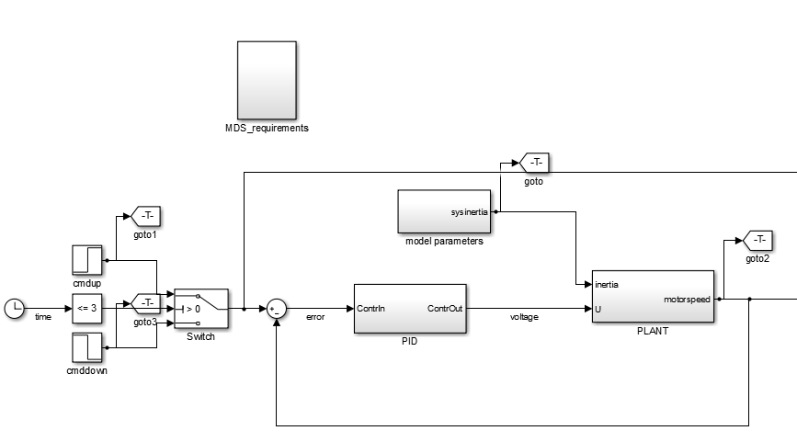
Requirement Editor
Auto-generation
MDS_requirement_augogen.m
M.Celia

Slide 26
Outline
Introduction
Requirements Fundamentals
Formal Languages
The Framework
Modelling Libraries
Requirement Editor
Conclusion
M.Celia

Slide 27
Outline
Introduction
Requirements Fundamentals
Formal Languages
The Framework
Modelling Libraries
Requirement Editor
Conclusion
M.Celia

Slide 28
Conclusion
Future Work
Current pilot framework was developed as a proof of concept…
Future work
Add typical features of Requirements Editors
Add more patterns
Improve Interactions with supported modelling platforms
Support more modelling platforms
M.Celia

Slide 29
Acknowledgement
Thanks for the attention
M.Celia

