Slide 1
Design for Control System Performance Requirements Validation & Verification: A synthesis framework from natural language requirements to simulation monitors Marco Celia Vassilios A. Tsachouridis (PI) July 7, 2017

Slide 2
contents
Introduction
Requirements Fundamentals
Formal Languages
The Framework
Modelling Libraries
Requirement Editor
Frequency Response
Conclusion
Notes:
Introduction on V-developing models, and their refinement for intermediate stage verification
General discussion about system requirements, their features and why their specification represents a challenging stage
Very small discussion about formal languages, in particular Signal Temporal Logic, just to give hints of what is needed for formal verification. The most important thing is that we will see how they can be abstracted, so how we exploit their potentialities without directly using them.
Then we will introduce the developed framework, with its tree fundamental tools : the supporting external libraries, the requirement smart editor and, finally, a bit of the work done in frequency response property monitoring.

Slide 3
The v-model
Introduction
Individual V-Process for Requirement V&V
System-Level
Requirements
Verification
Functional
Specification
Functional
Modeling
Integration
Testing
Architecture Exploration
Component Modeling
Module
Testing
Behaviour Modeling
Implementation
Notes:
I suppose that many of you are familiar with V-Model, for those not, activities on the left side regards the development, those on the right side the testing and verification
Sometimes this model is further expanded, and it is possible to apply it at every stage, especially for what regards the system-level requirements thy can follow their own development process to ensure
Their completeness ad correctness.
As you probably already understood, in this work we are focusing on the first levels of the v-model, providing a tool for typing system-level requirements and their verification

Slide 4
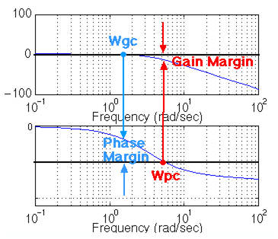
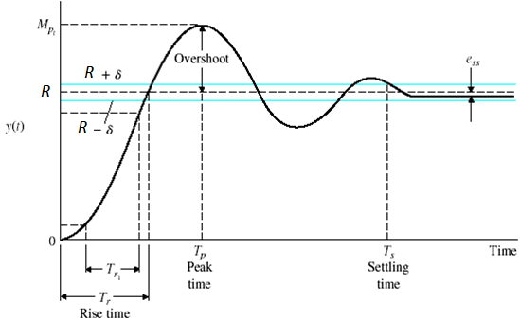
Control Systems performance requirements
Introduction
Individual V-Process for Requirement V&V
System Level
User Requirements
Time Domain
Frequency Domain
Notes:
In particular, we focus on the domain of control systems, targeting, in particular, performance requirements.
They are also known as top-level requirements since they refer the system from an high level of abstraction. They can be divided in time domain (left) and frequency domain (right)
Time domains property are usually defined with the assumption of a step input (the command)
Overshoot: telling how much the output of the system is going beyond the reference (or command). Usually requirements on overshoot aim to verify that it is less than a maximum allowed value
Rise time: telling how “fast” the system is responding. Usually requirements on rise time aim to verify that the output of the systems reaches a percentage of the command in less than a certain amount of time
Settling time: telling how “fast” the system reaches the steady state value. Usually requirements on settling time ensure that after the command reception, within a certain amount of time the system outputs is bounded in whit a certain tolerance
For all of them we can define their complementary, i.e. undershoot and fall time
For what concerns frequency response we can have
Gain margin : telling the amount of gain increase or decrease that makes the system unstable
Phase margin

Slide 5
outline
Introduction
Requirements Fundamentals
Formal Languages
The Framework
Modelling Libraries
Requirement Editor
Frequency Response
Conclusion

Slide 6
User requirements
Requirements Fundamentals
Benefits of well-defined Product Requirements
Provide careful assessment of the needs that a system has to fulfil
Reduce the development effort and erroneous interpretations
Serve as base line for a Validation and Verification (V&V) process
Establish the basis for contractual agreement among stakeholders
In order to let them understandable from people having a non-technical background they quite often comes as many pages of plain text…

Slide 7
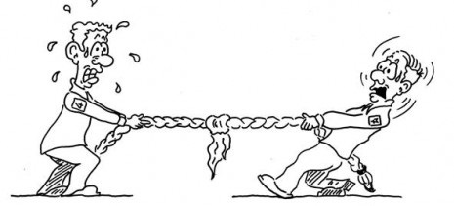
Specification Languages for Requirements Definition
Requirements Fundamentals
Formal
Semi formal
Informal
Mathematical Syntax
Improve comprehension
High verifiability
Require strong technical skills
Graphical (or structured) Syntax
Unambiguous
Reduced verifiability
Steeper learning curve
No technical skills required
Not verifiable
Ambiguous, Inconsistent, Redundant
Formality
Readability

Slide 8

Requirements Virtual Verification (Testing)
Requirements Fundamentals
System Level
User Requirements
Individual V-Process for Requirement V&V
Virtual verification
Monitor Design
Requirements can be verified during simulation (or after) by means of Monitors
Monitors are based on the formal specification of a property.
They take as input a set of signals and returns flags telling whether the internal properties are satisfied, violated or (possibly) undecided.
Recalling the V-Model the flow from Requirement To Verification can be then
manual
Formal Properties
Informal Requirements
Document
manual
Input
Signals
Monitor
manual
Signal
List
User Requirement - Text Editor
Validation - Simulation Environment

Slide 9
outline
Introduction
Requirements Fundamentals
Formal Languages
The Framework
Modelling Libraries
Requirement Editor
Frequency Response
Conclusion

Slide 10

From informal to formal
Formal Languages
Bridging the gap between informal and formal languages by identifying Patterns
Patterns are parameterizable forms of properties having a well-defined and independent semantic. They allow to achieve formal specification from properties expressed in informal language
Informal Specification
Patterns
Formal Specification
Identification
Formalization
Property:
absence of P
absence of P after (before) Q
existence of P
existence of P between Q and R
Domain Specific (e.g. Control systems):
Overshoot (Undershoot)
Rise-time (Fall-time)
Settling-time

Slide 11
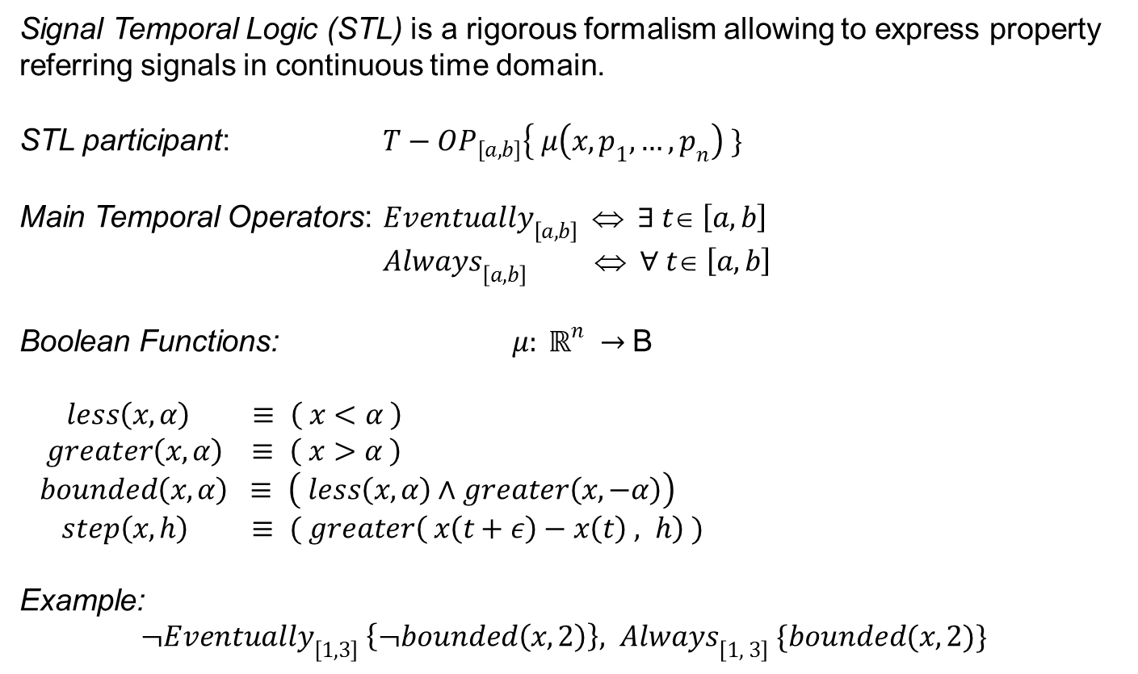
Signal temporal Logic (Stl)
Formal Languages
Signal Temporal Logic (STL) is a rigorous formalism allowing to express property referring signals in continuous time domain.
STL participant: ${T−OP}_{[a,b]}\left\{ μ\left(x, p_{1},…,p_{n}\right) \}\right.$
Main Temporal Operators: ${Eventually}_{\left[a, b\right]} ⇔ ∃ t∈ \left[a, b\right]$
${Always}_{\left[a, b\right]} ⇔ ∀ t∈ \left[a, b\right]$
Boolean Functions: $μ: ℝ^{n} →$B
$$less\left(x,α\right) ≡ \left( x<α \right)$$
$$greater\left(x, α\right) ≡ \left( x>α \right)$$
$$bounded\left(x,α\right) ≡ \left( less\left(x,α\right)∧greater\left(x,−α\right)\right)$$
$step\left(x, h\right) ≡ ( greater\left( x\left(t+ε\right)−x\left(t\right) , h\right) )$
Example:
${¬Eventually}_{\left[1, 3\right]} \left\{¬bounded\left(x,2\right)\right\}, { Always}_{\left[1, 3\right]}\{bounded(x,2)\}$

Slide 12
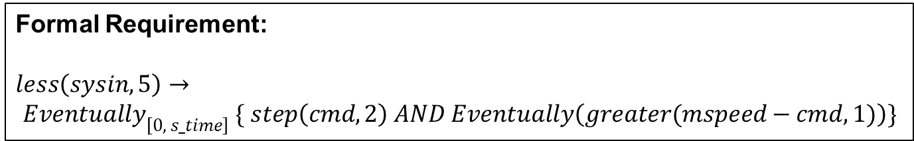
Stl in action
Formal Languages
Informal (lacking) Requirement:
“the motor speed overshoot shall be lass than or equal to 1 rpm with a system inertia less than 5 kgm2”
Semi-formal Requirement (Contract-Based Paradigm):
Assumption: system inertia (sysin) less than 5 kgm2 and reference input (cmd) is a step with amplitude 10
Assertion:
the motor speed (mspeed) overshoot shall be lass than or equal to 1
Formal Requirement:
$$less\left(sysin,5\right)→$$
$${Eventually}_{\left[0, s_time\right]} \{ step\left(cmd, 2\right) AND Eventually\left(greater(mspeed−cmd,1)\right)\}$$

Slide 13
outline
Introduction
Requirements Fundamentals
Formal Languages
The Framework
Modelling Libraries
Requirement Editor
Frequency Response
Conclusion

Slide 14
objectives
The Framework
Force user to write well-defined requirements
Provide a user-friendly environment and GUI for engineers
Provide support for a (wide) number of patterns
Exploit the power of formal logics without using it directly
Automatic generation of monitor for specific modelling environments
Particularly care in extensibility and flexibility

Slide 15
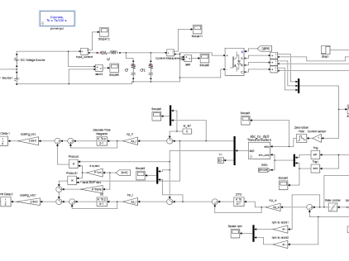
Auto-generation process
The Framework
Modelling Tools
Tool
Simulink
Data dictionary Importers
CSV Reader
XML Reader
import
Model
Editor
.req
.req
.req
Monitor
Platform Generators
export
Parser
Simulink Gen

Slide 16
outline
Modeling Libraries
Introduction
Requirements Fundamentals
Formal Languages
The Framework
Modelling Libraries
Requirement Editor
Frequency Response
Conclusion

Slide 17
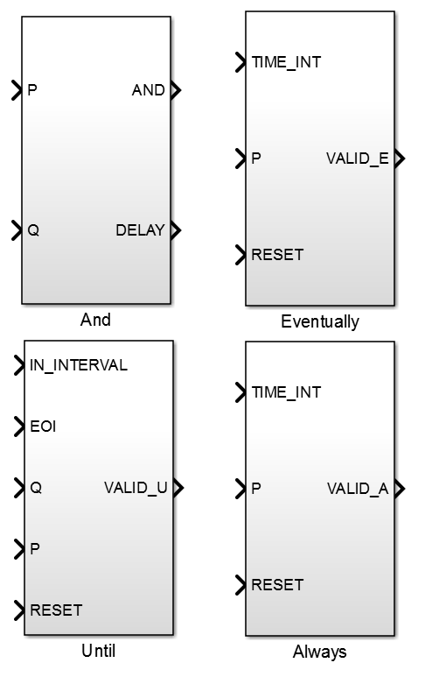
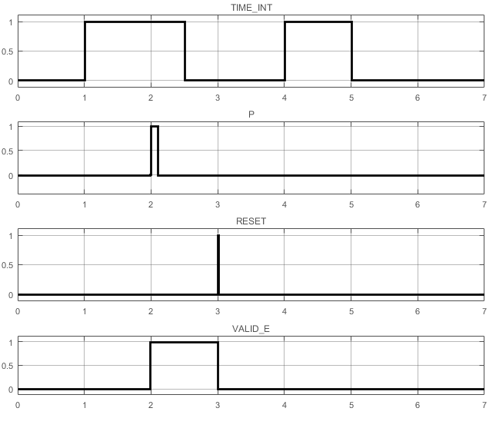
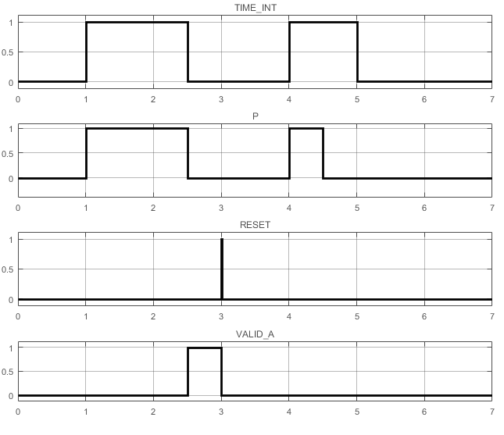
Stl library
Modelling Libraries

Slide 18
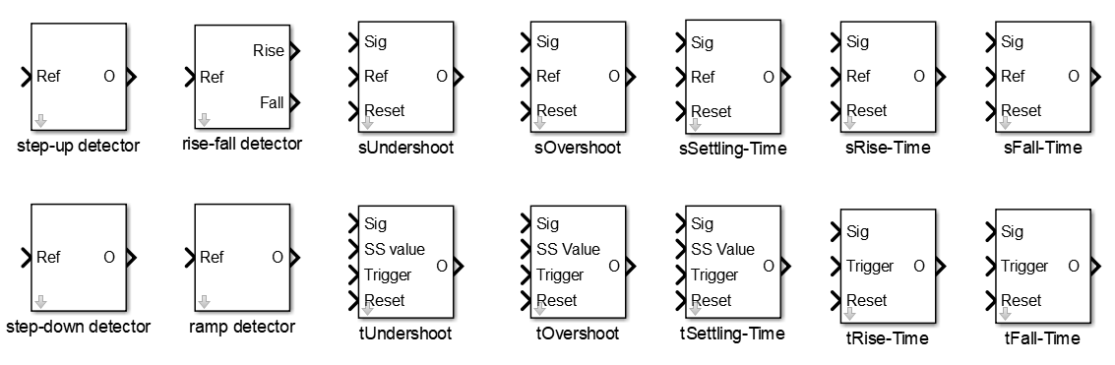
System performance control library (spcl) (1/2)
Modelling Libraries
Detectors
Implicit Checkers
Explicit Checkers

Slide 19
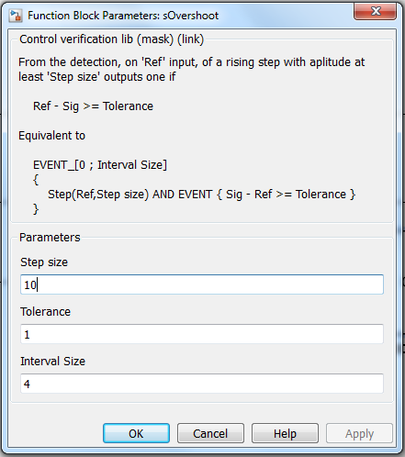
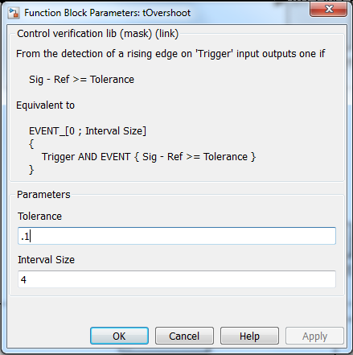
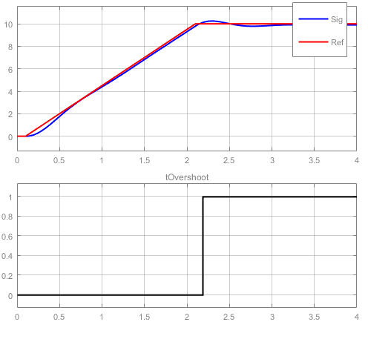
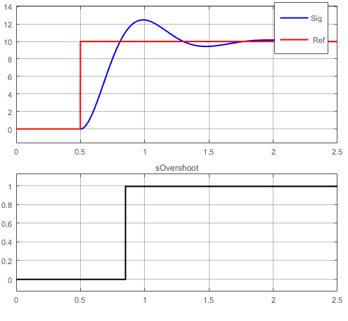
System performance control library (spcl) (2/2)
Modelling Libraries

Slide 20
outline
Introduction
Requirements Fundamentals
Formal Languages
The Framework
Modelling Libraries
Requirement Editor
Frequency Response
Conclusion

Slide 21
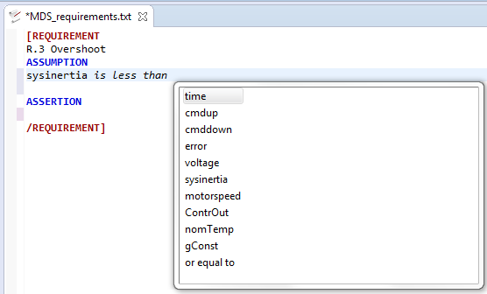
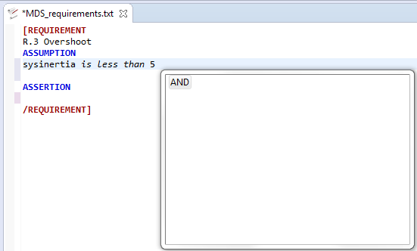
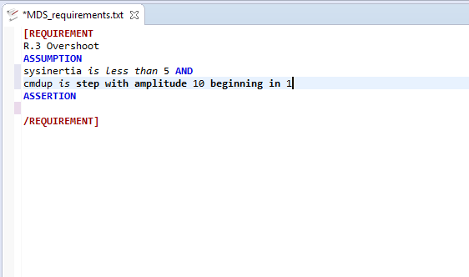
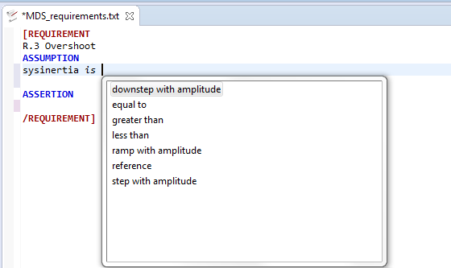
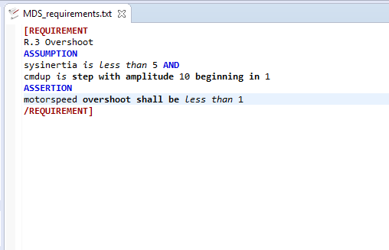
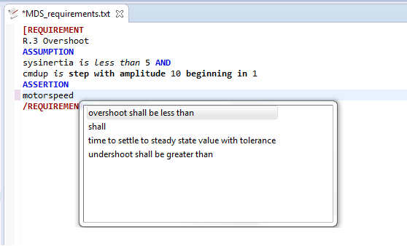
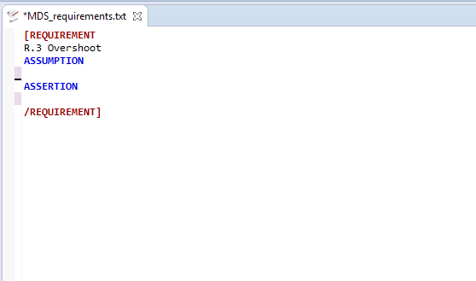
Context helper
Requirements Editor
Word-by-Word Completion
Context Aware Completion

Slide 22
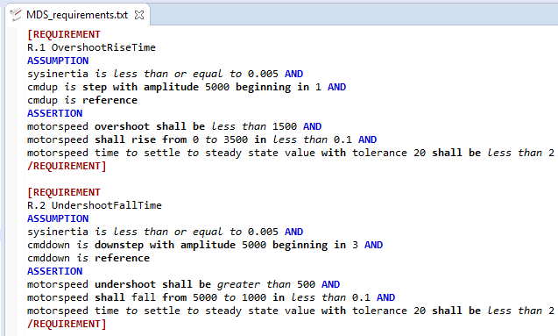
A complete example
Requirements Editor

Slide 23
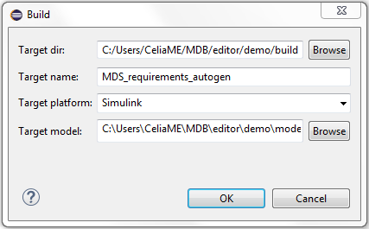
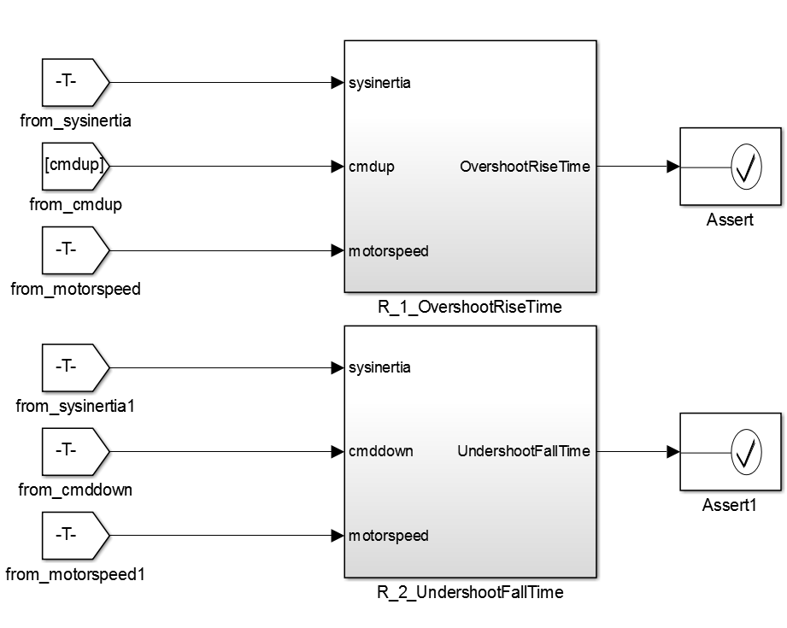
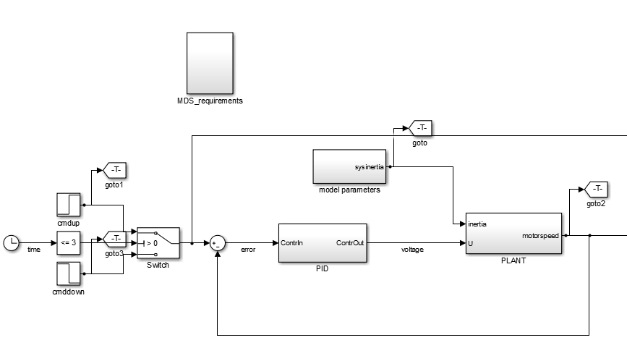

A complete example
Requirements Editor
MDS_requirement_augogen.m

Slide 24
outline
Introduction
Requirements Fundamentals
Formal Languages
The Framework
Modelling Libraries
Requirement Editor
Frequency Response
Conclusion

Slide 25
Fresp monitor (tips) (1/2)
Frequency Response
Challenges of frequency domain property monitoring
Fourier Transform
System Identification
Explore the frequency spectrum
Results strongly affected from configurations of the above
Automatic Generation is powerful but, unfortunately, not invincible…
Objectives
Online Monitoring
Involve, whenever possible, formal logic

Slide 26
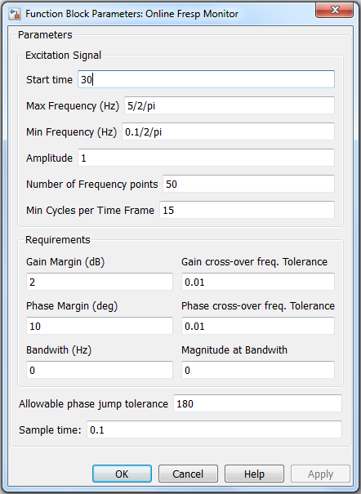
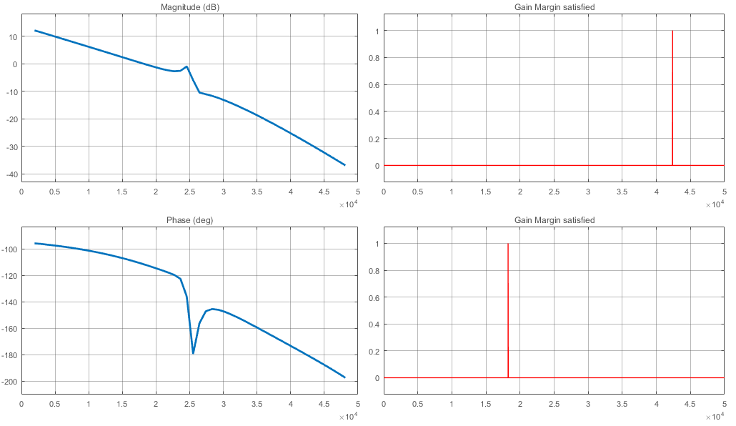
Fresp monitor (tips) (2/2)
Frequency Response

Slide 27
Future work
Conclusion
Current pilot framework was developed as a proof of concept…
Future work
Add typical features of Requirements Editors
Add more patterns
Improve Interactions with supported modelling platforms
Support more modelling platforms

Slide 28
Acknowledgement
Thanks for attention

