Slide 1

Study of Quantum Convolutional Neural Network (QCNN) applied to the MINST dataset
Authors: Marco Dall’Ara, Giulio Albertin, Joan Verguizas I Moliner
14/07/2023

Slide 2
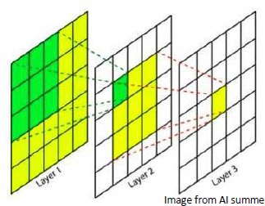
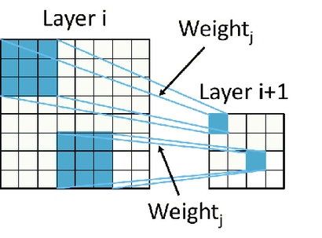
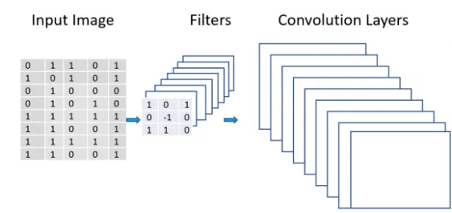
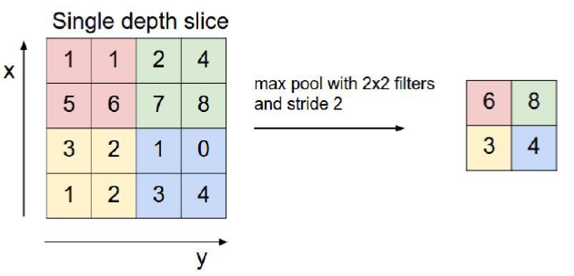
Convolutional Neural Network
Local connectivity
Shared weights
Multiple feature maps
Max Pooling

Slide 3
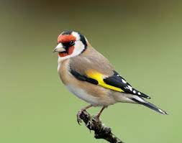
Example: «beak detector»
Some patterns are much smaller than the whole image:
«Beak» signal

Slide 4
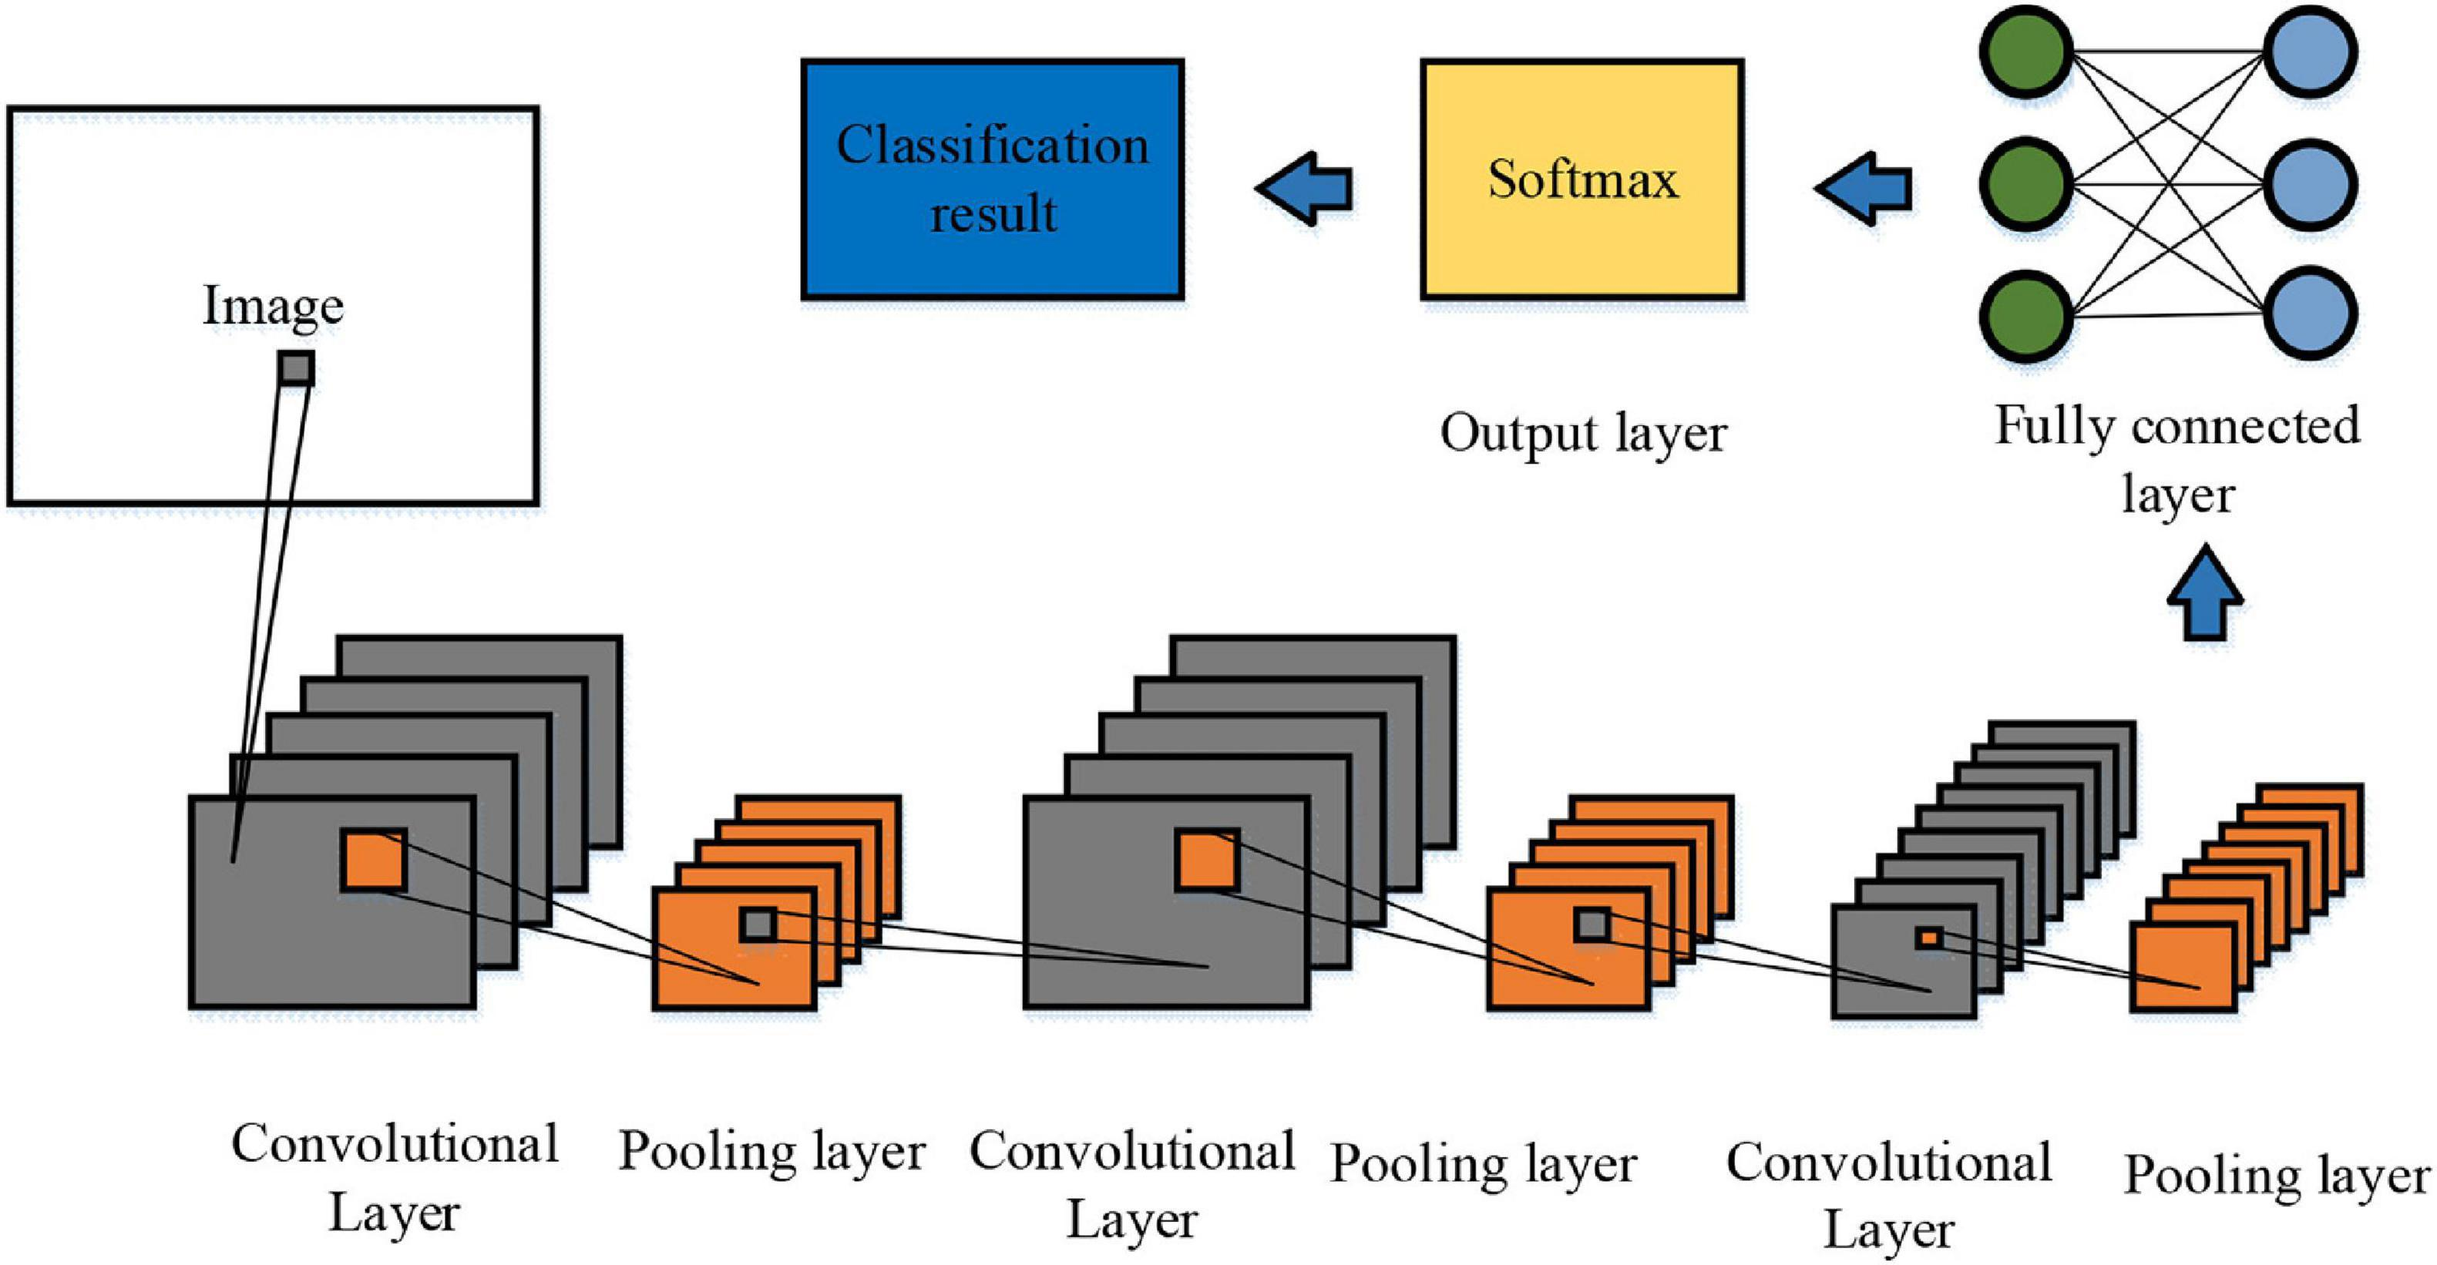
Convolutional NN vs Fully Connected NN

Slide 5
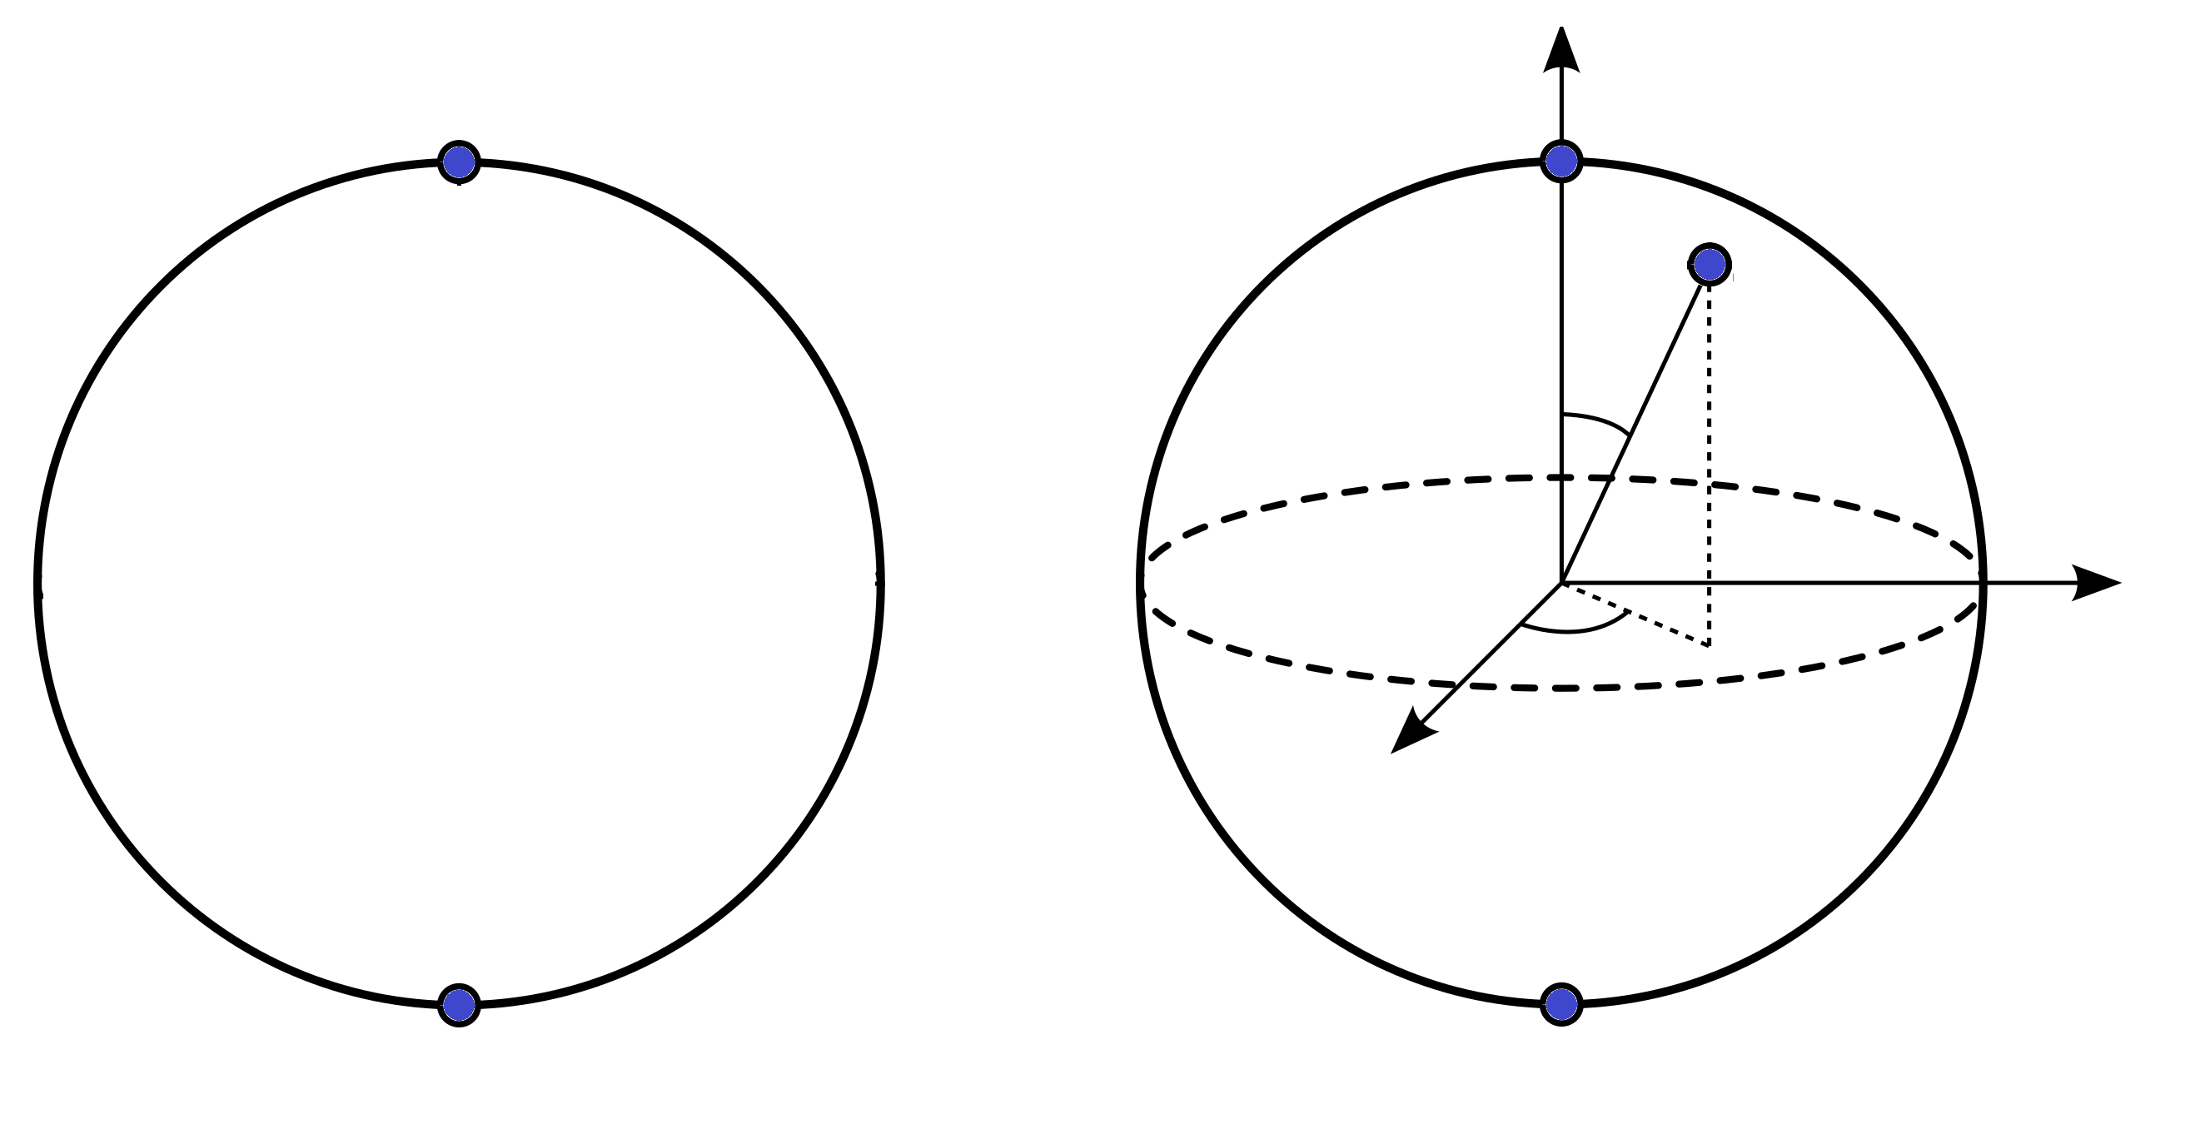
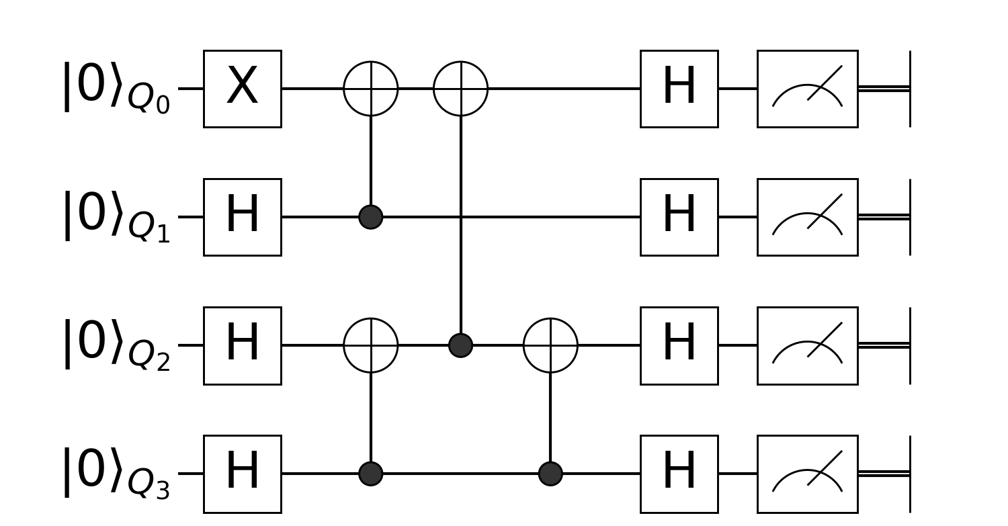


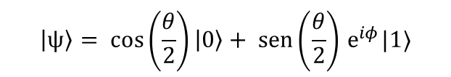
Quantum Computing
Bit
Qubit
Some quantum algorithms are demonstrated to be more efficient than classical ones (Shor’s algorithm).
$$\left|0\right\rangle$$
0
$$\left|ψ\right\rangle$$
$$θ$$
Every quantum algorithm can be decomposed with a finite set of gates (universal set of gates):
Single qubit gate
Multi-qubits gate
$$φ$$
1
$$\left|1\right\rangle$$
$$\left|ψ\right\rangle = cos\left(\frac{θ}{2}\right)\left|0\right\rangle + sen\left(\frac{θ}{2}\right){ e}^{iφ}|1⟩$$

Slide 6
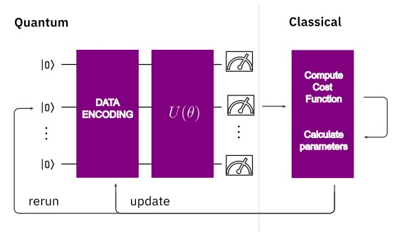
Quantum Neural Network
Theory
Why? Superposition and entanglement
Quantum algorithms are able to extract patterns of a function (Deutsch–Jozsa algorithm)
Entanglement is a unique feature of Quantum Systems
Theoretically, can be stored more information in N qubits than in N bits

Slide 7
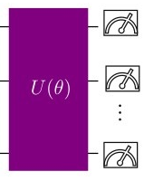
Quantum Neural Network
Parametrized quantum circuit (PQC)
Non-linearity of the model comes from measurements.
Expressibility : extent to which a PQC can generate states within the Hilbert space.
Entangling capability : ability of a PQC to generate entangled states.

Slide 8
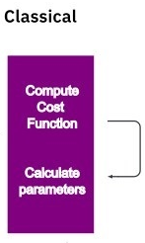
Quantum Neural Network
Classical Optimization
Parameter Shift Rule: Permits to analytically find the gradient of a linear function of expectation values of Pauli matrixes.
Minimize Mean Squared Error (MSE) between <Z> and true label.

Slide 9
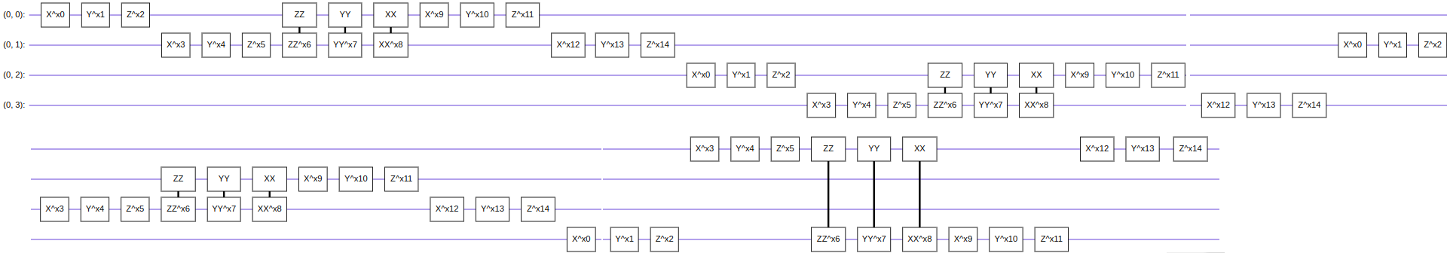
Quantum Convolutional Neural Network
Convolutional Layer
Same Features as Classical CNN: Local Connectivity and Parameters Sharing.
Consists of Two Qubit Unitary Operations U_{i.}
Y. Lu,et al., 40th CCC, 52363, (2021).

Slide 10
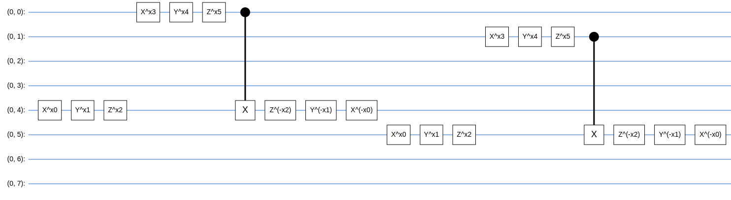
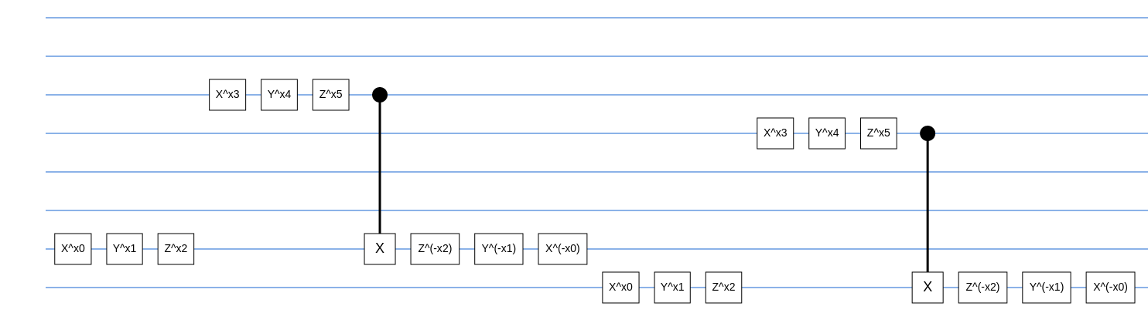
Quantum Convolutional Neural Network
Pooling Layer
Qubits are traced out in the calculation of the expected value of Z in the end.
The outcome determines whether apply a single-qubit gate on neighbors’ qubits.
Reduces dimensionality and introduces nonlinearities.
Y. Lu,et al., 40th CCC, 52363, (2021).

Slide 11
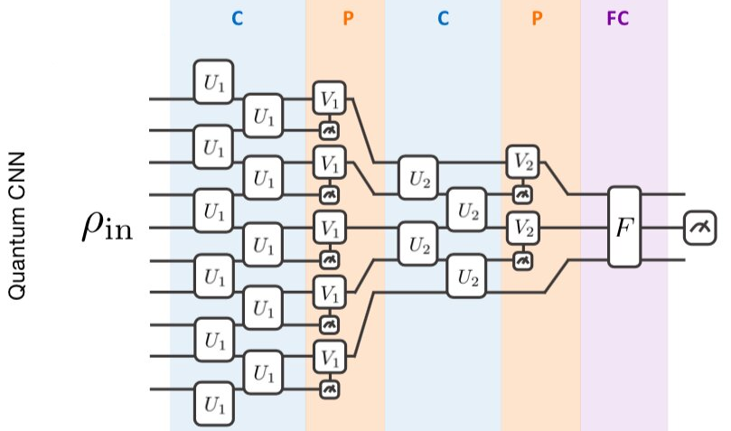
Quantum Convolutional Neural Network
FC layer is applied to perform classification on the extracted features.
The output of the QCNN model for
x_{in} is -> f(θ, x_{in}) ≡ <Z> .
Binary classification:
<Z> ≥ 0 -> one class
<Z> < 0 -> other class
Y. Lu,et al., 40th CCC, 52363, (2021).

Slide 12
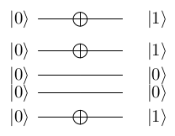

Basis encoding
Theory
Advantages: Simple and straightforward approach. Low encoding circuit depth.
Disadvantages: At least N qubits per image of N pixels. The data input discretization produces information loss.

Slide 13
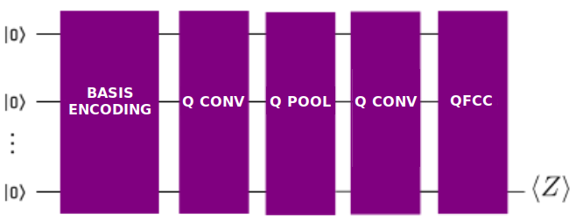
Basis encoding
Model
3x3 input images
9 qubits
30 parameters
21 sec/epoch

Slide 14
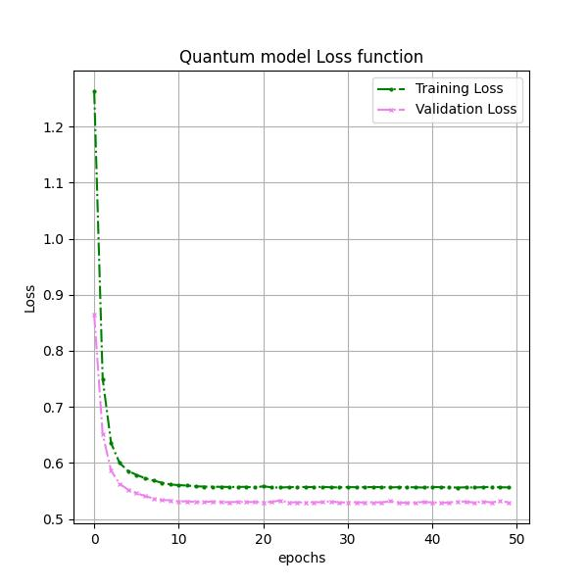
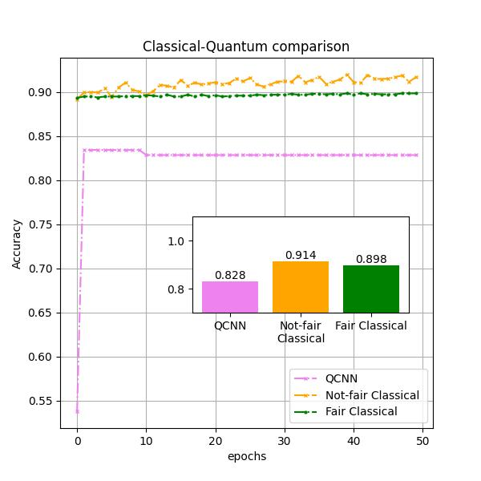
Basis encoding
Model results

Slide 15
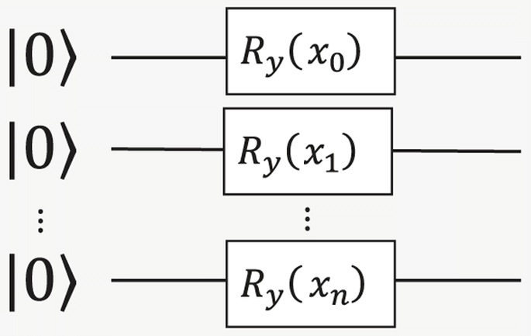

Angle encoding
Theory
Advantages: Low depth of the encoding circuit. No information loss due to a continuous representation of the input.
Disadvantages: Use of N qubits per pixel. Susceptible to noise.

Slide 16
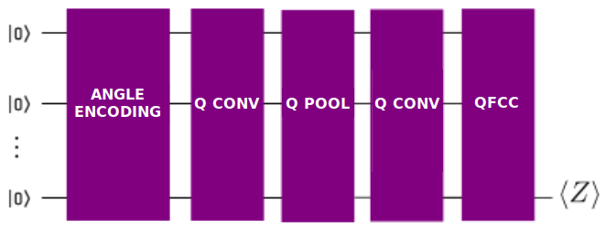
Angle encoding
Model
3x3 input images
9 qubits
57 parameters
40 sec/epoch

Slide 17
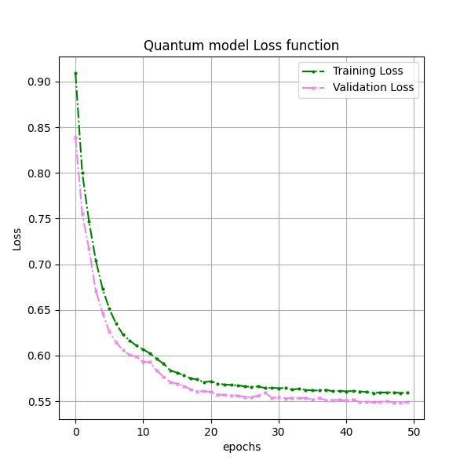
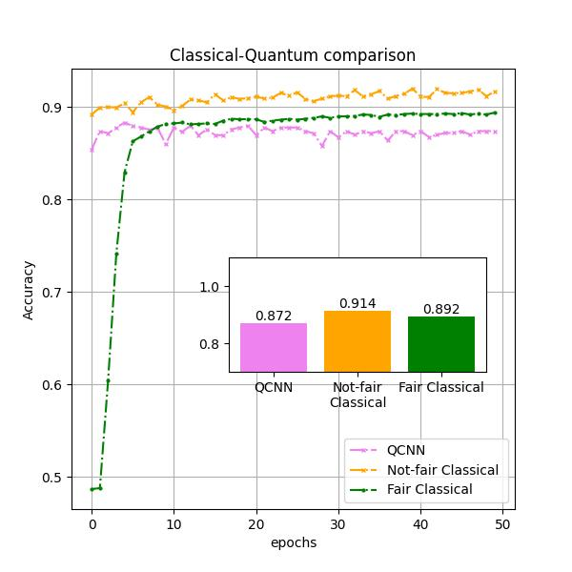
Angle encoding
Model results

Slide 18
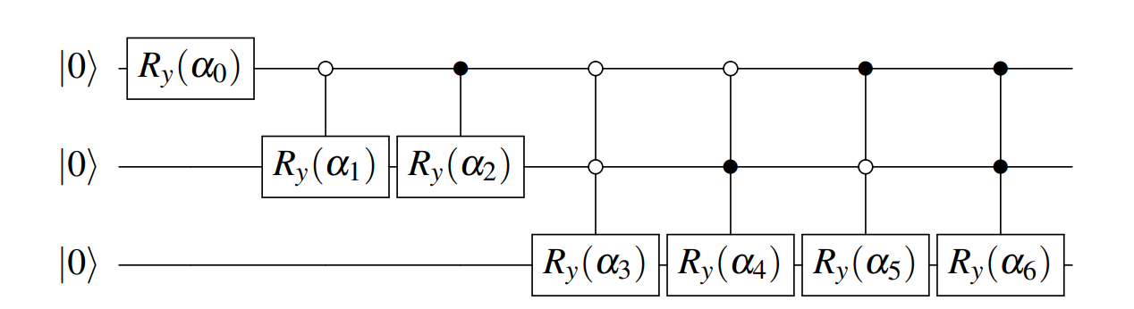
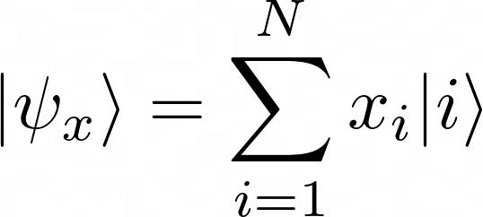
Amplitude encoding
Theory
Advantages: number of data encoded scales exponentially with the number of qubits.
Disadvantages: depth of the encoding circuit scales exponentially with the number of qubits.

Slide 19
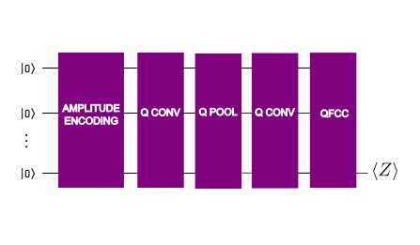
Amplitude encoding
First model
8x8 input images
6 qubits
51 parameters
35 sec/epoch

Slide 20
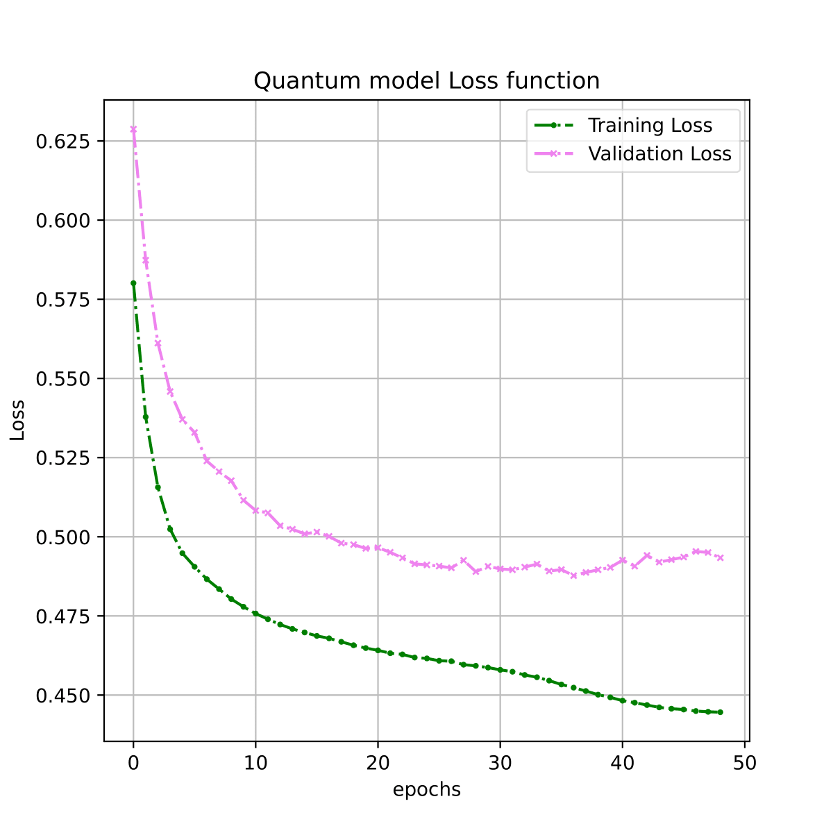
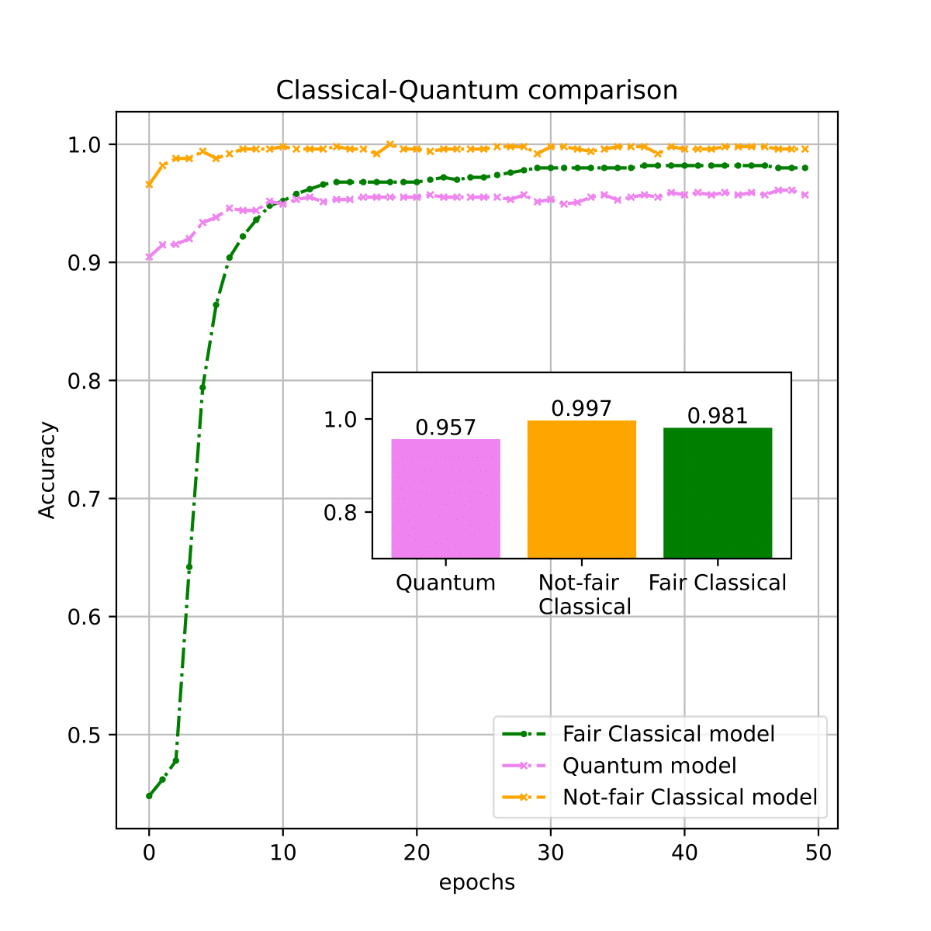
Amplitude encoding
First model results

Slide 21
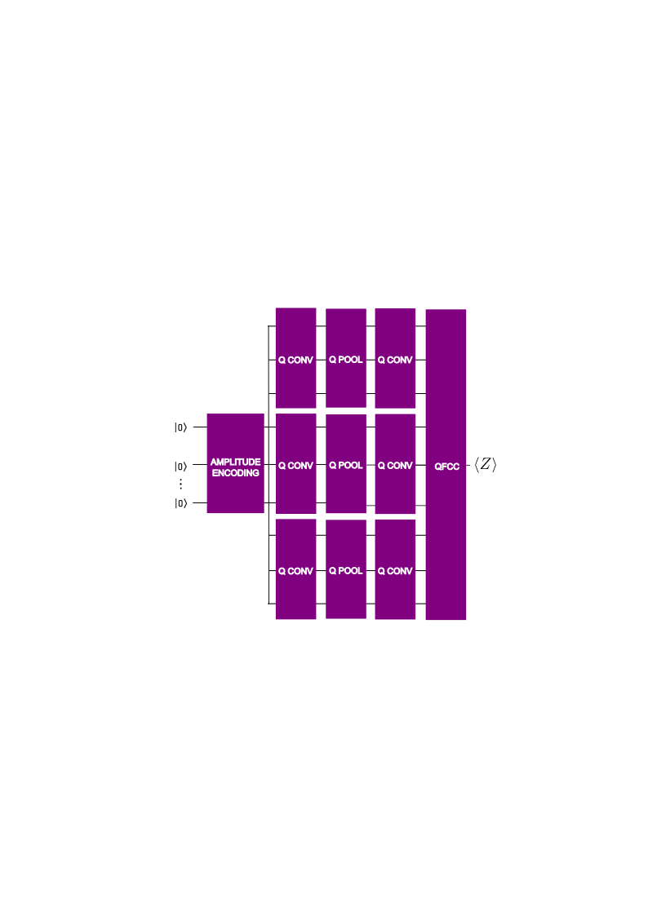
Amplitude encoding
Second model
4x4 input images
4 qubits/filter (12qubits)
168 parameters
45 sec/epoch

Slide 22
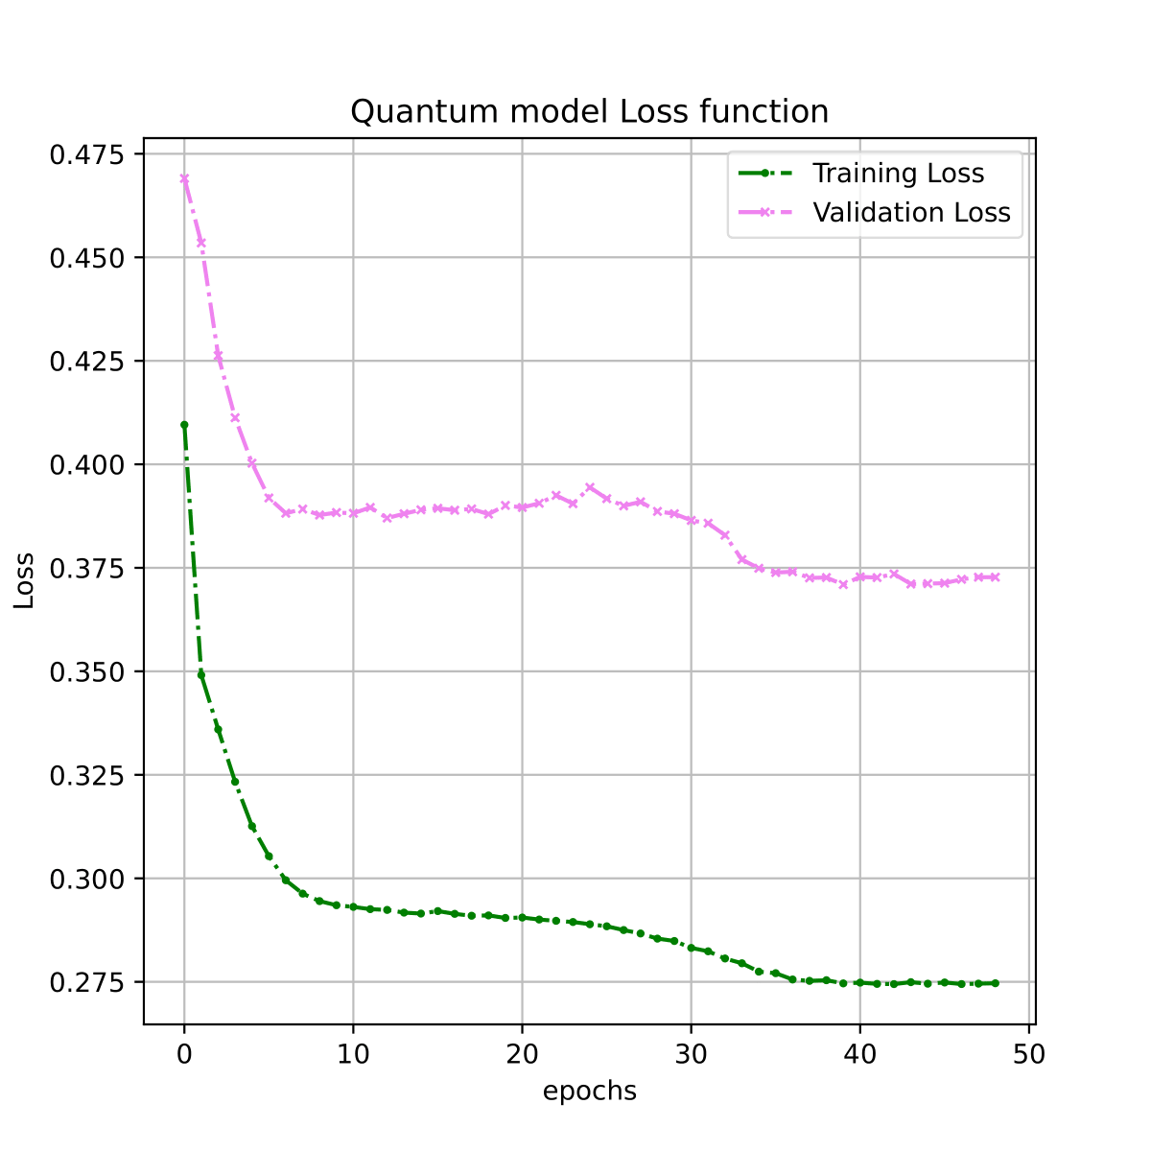
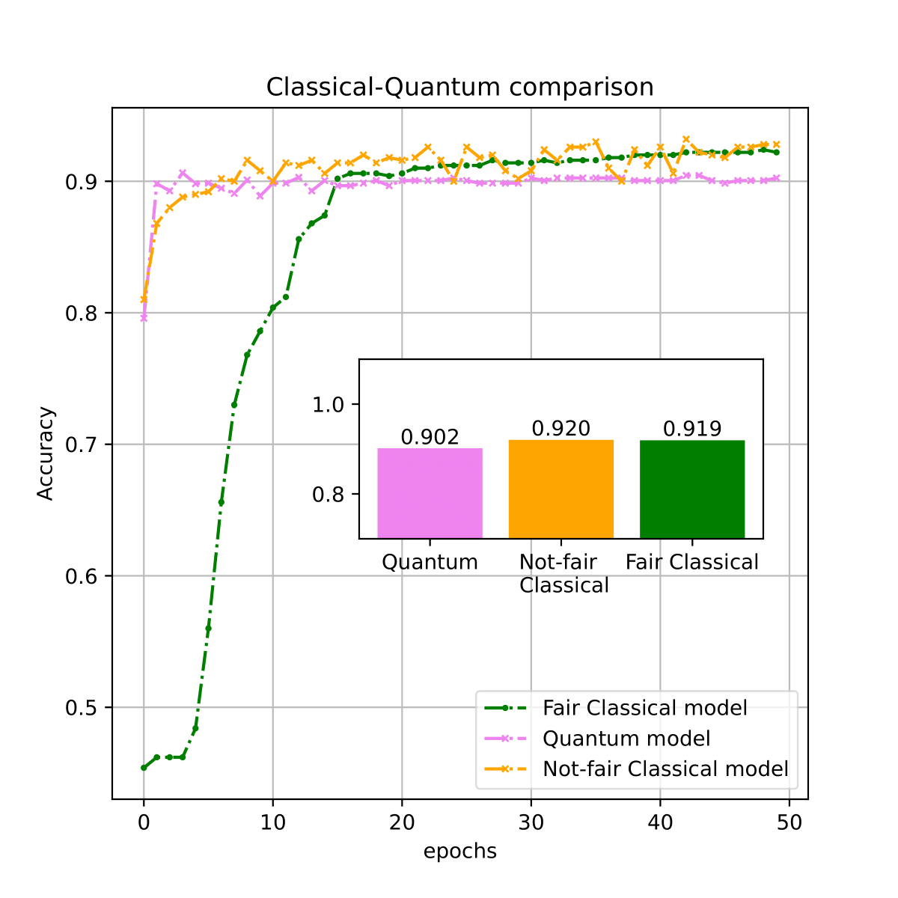
Amplitude encoding
Second model results

Slide 23
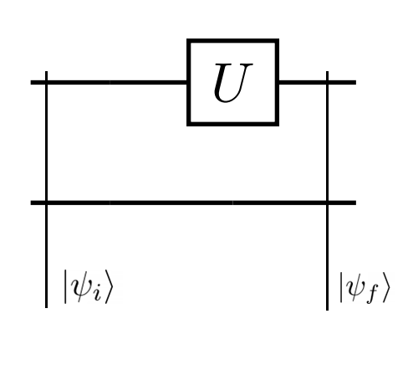
Amplitude encoding
Locality problem
Applying a local gate will mix information on amplitudes losing local connectivity.
We need unitary block matrixes to preserve local connectivity.

Slide 24
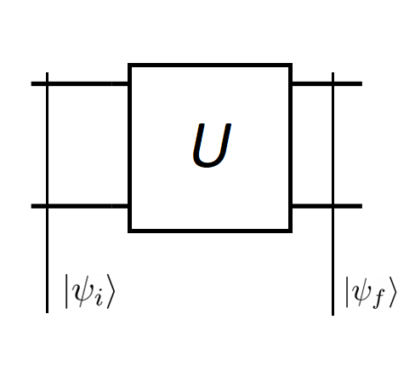
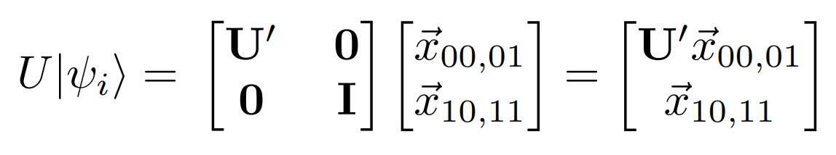
Amplitude encoding
Locality problem
Applying a local gate will mix information on amplitudes losing local connectivity
We need unitary block matrixes to preserve local connectivity

Slide 25
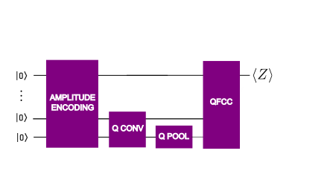
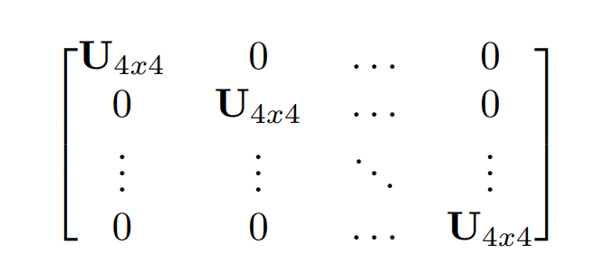

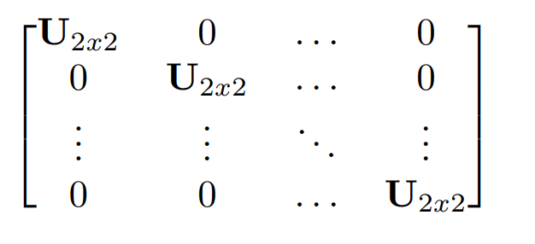

Amplitude encoding
Third model
8x8 input images
6 qubits
=
=
78 parameters
24 sec/epoch
=
=

Slide 26

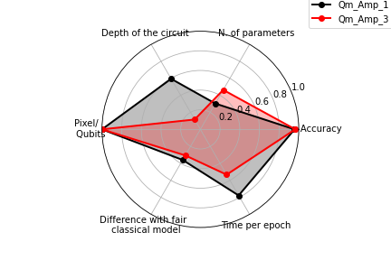
Amplitude encoding
Third model results and comparison

Slide 27
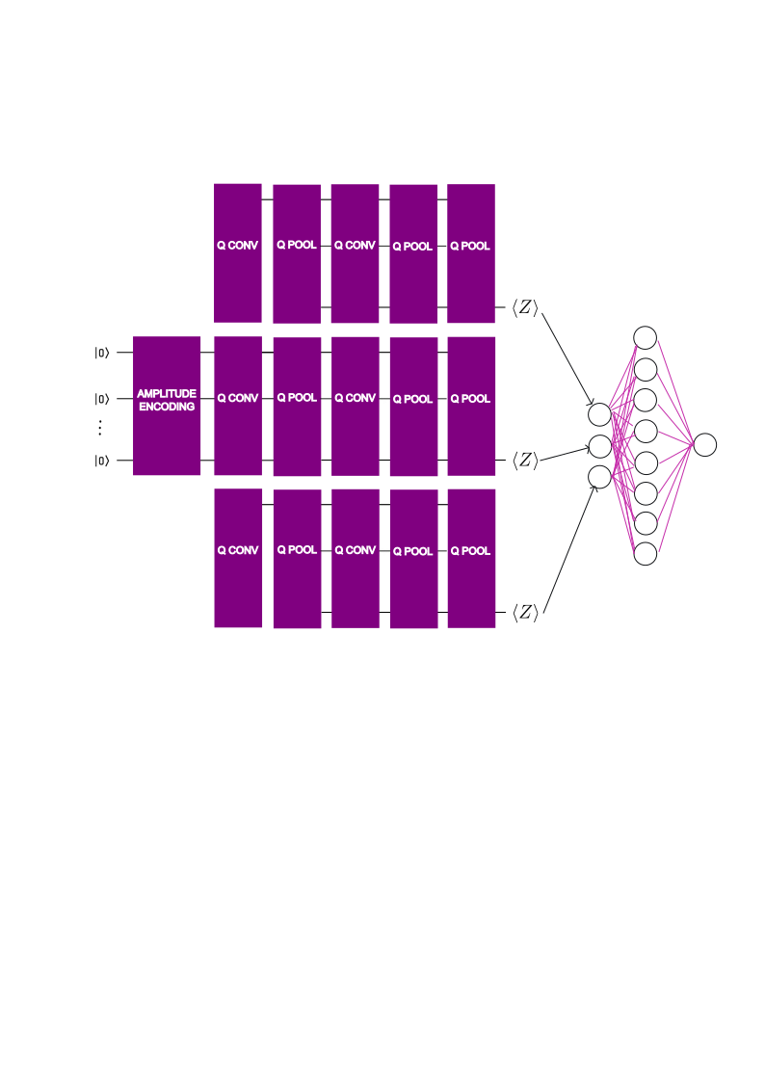
Amplitude encoding
Hybrid model
8x8 input images
6 qubits
168 parameters
45 sec/epoch

Slide 28
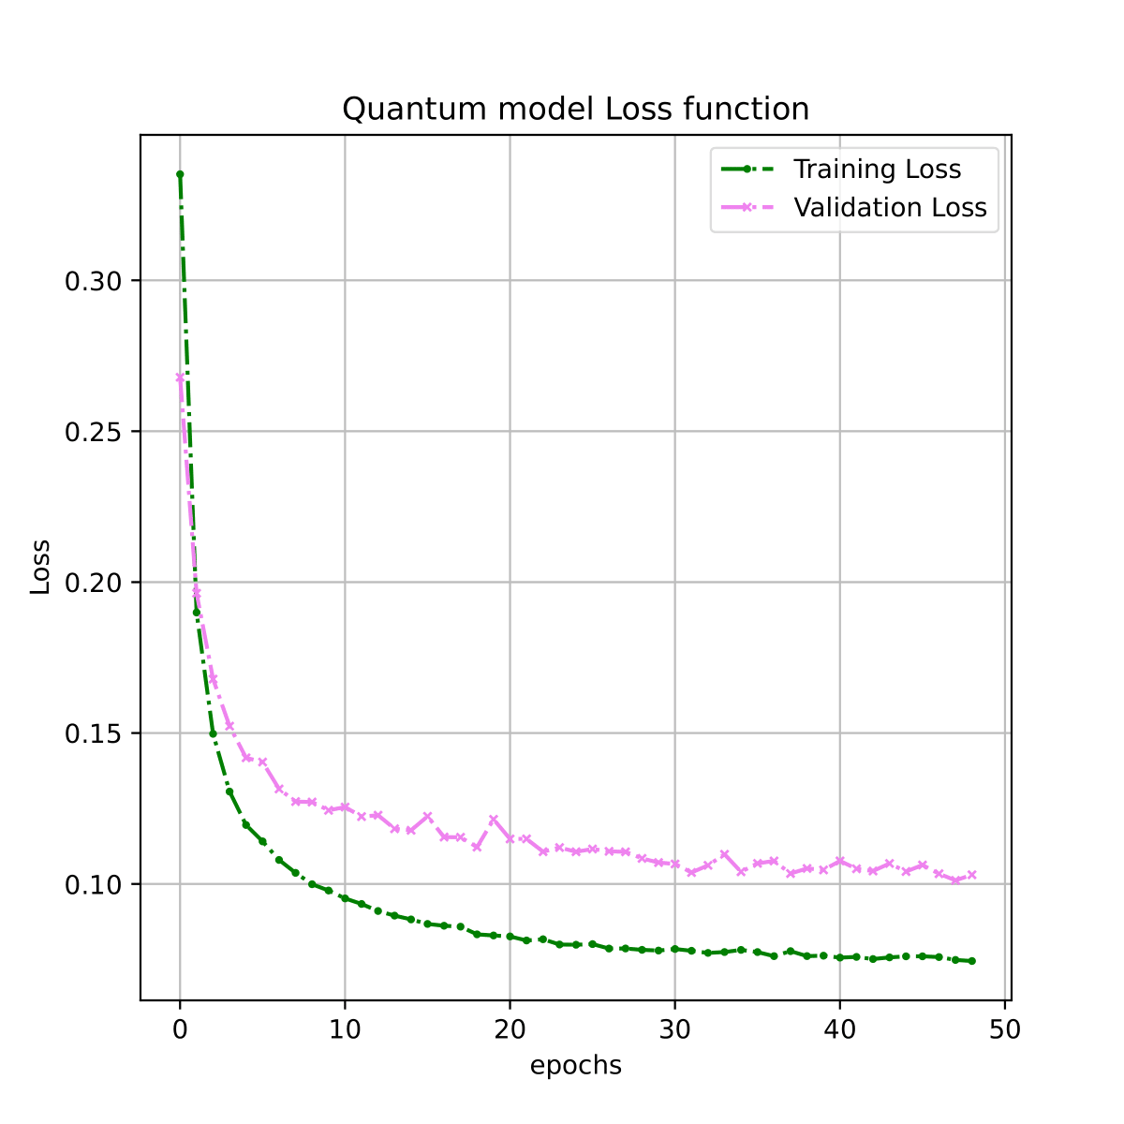

Amplitude encoding
Hybrid model results

Slide 29
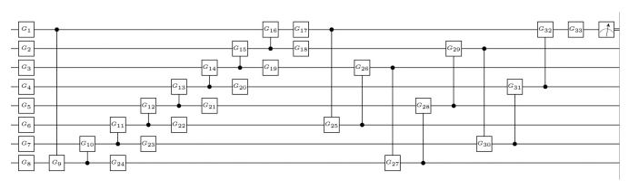
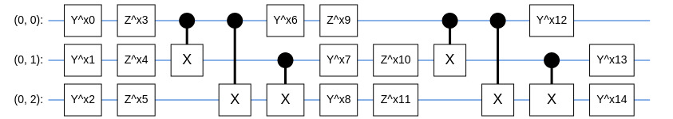
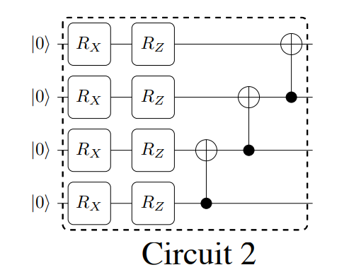
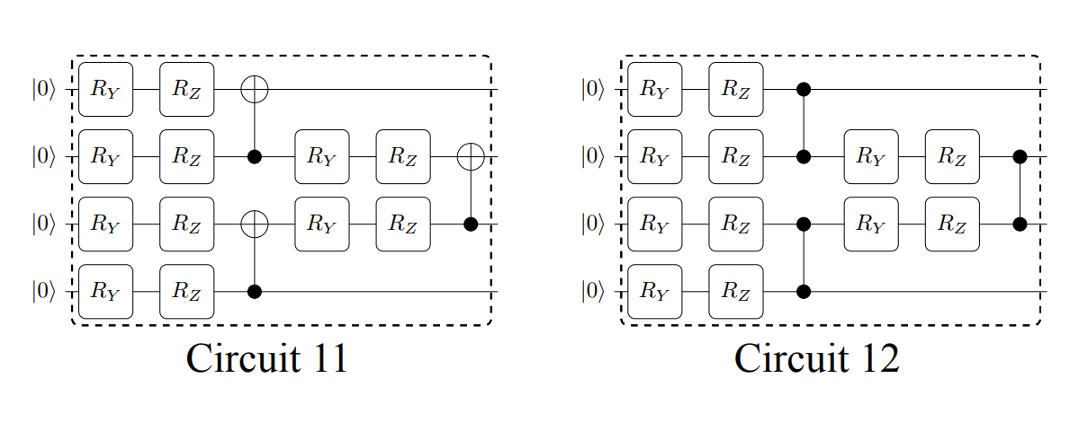
Convolutional Neural Network
15 parameters,
our QFCC
42 parameters,
Maria Schuld et al.,Phys. Rev. A 101, 032308 (2019)
6 parameters, Sukin Sim et al., Adv. Quantum Technol. 2, 1900070 (2019)
10 parameters, Sukin Sim et al., Adv. Quantum Technol . 2, 1900070 (2019)

Slide 30
Training parameters during the QFCC analysis
Each QFCC is adapted on 3 qubits to match the output of the QCNN
Training set size: 5000 samples
Test set size: 500 samples
Gradient Descent: Adam optimizer
Loss function: MSE
Minibatch size: 75 samples
Epochs: 50

Slide 31
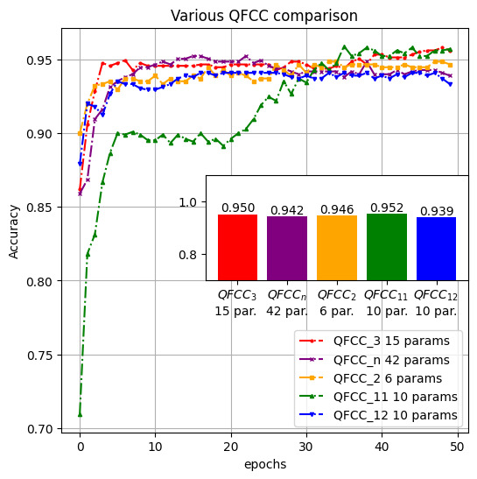
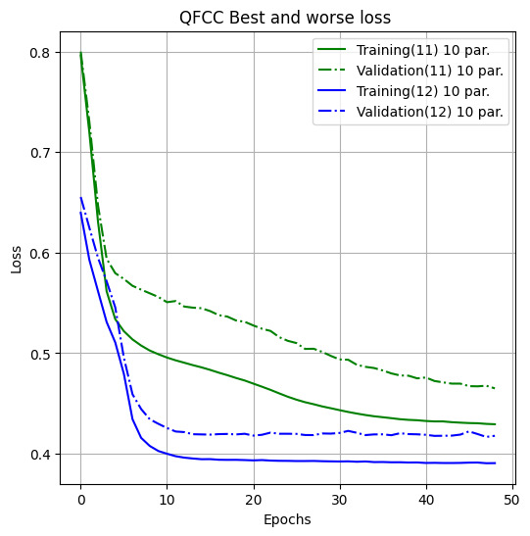
QFCC Results

Slide 32
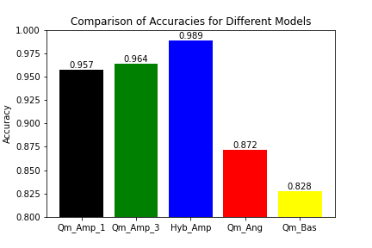
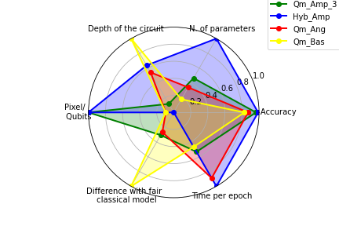
Summary

Slide 33
Conclusions
1
Y. Lu,et al., 40th CCC, 52363, (2021).
We were not able to evaluate Basis and Angle encoding in QCNN accurately due to limitations in simulating a large quantum algorithm.
We reproduced similar models to with amplitude encoding and found slightly smaller accuracies than classical fair models. However, thanks to amplitude encoding data capacity is higher in the quantum model.
1
We slightly improved that model’s speed, depth, and accuracy (Qm_Amp_1) with a simpler model (Qm_Amp_3) by accurately considering local connectivity in amplitude encoding. By changing the final QFCC we have not found significant results.
With the Hybrid model with amplitude encoding, we improved the accuracy of the classical fair model.

