Slide 1

RUN AWAY FROM ELISA

Slide 2
DATA
We will use the following data:
An .shp file, containing some information about municipi of Rome, downloaded by the official site of 'Comune di Roma'.
An .shp file, containing some information about municipi of Milan, downloaded by the official site of 'Comune di Milano'.
The wikipedia's page of Comune di Milano.
A .csv file, containing the addresses of the municipi of Milan.
Foursquare, that we will use to get the venues of all municipi.
Municipio is the italian for borough.

Slide 3
DATA
The .shp file of Rome contains information about the population, the municipalities, the shape of the municipi (hence the area and the coordinates).
The .shp file of Milan contains information about the shape of the municipi.
The wikipedia's page contains information about the population.

Slide 4
DATA
We will use Foursquare get methods 'https://api.foursquare.com/v2/venues/explore' (to search all venues of each municipio) and 'https://api.foursquare.com/v2/venues/search' (to search all venues of each municipio in a fixed category).
We will focus on the following categories:
Food
Bars
Transportation categories (metro, ferries, tram...)
Fun venues (cinemas, theaters...)

Slide 5
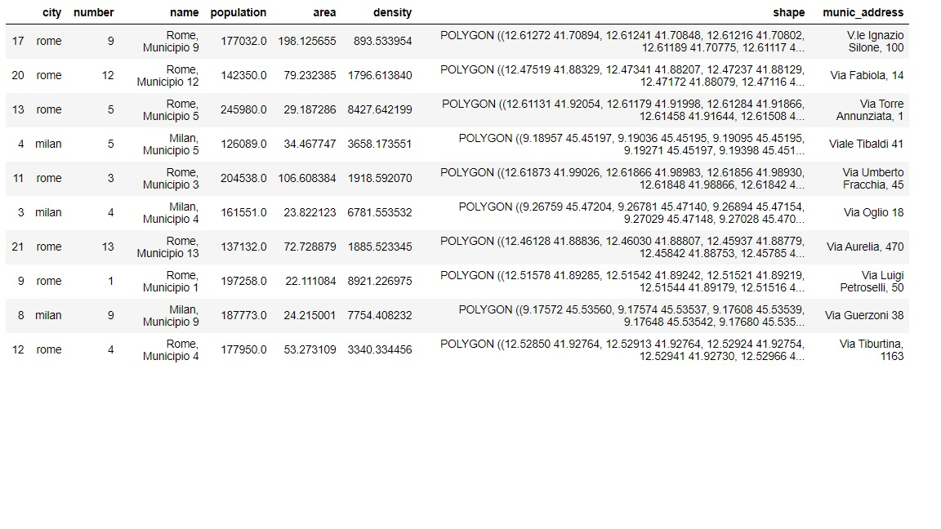
DATA
The following is a sample of the dataframe that we will create and that we will work with.

Slide 6
METHODOLOGY/RESULTS
In a first part of the work we will create a dataframe (df3) with all the information that we need. Every row will refer to a municipio and the columns contain information about:
Municipio's city
Municipio's number
Municipio's name
Municipio's shape (the column geometry of the .shp file)
Municipality latitude and longitude
Representative latitude and longitude
Centroid latitude and longitude
Municipio's population
Municipio's area
Municipio's density of population

Slide 7
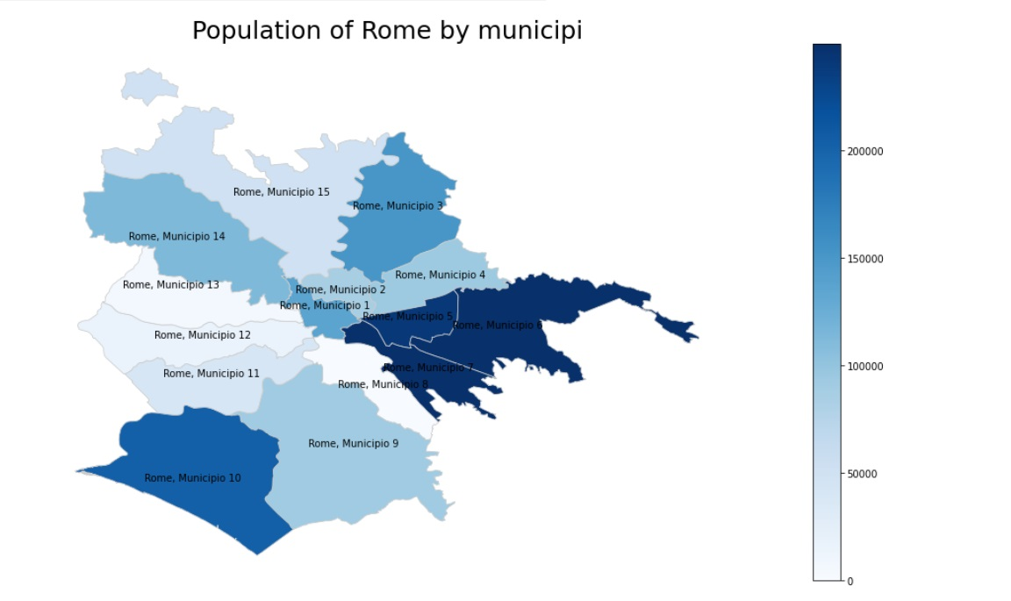
METHODOLOGY/RESULTS
First we will visualize our data.

Slide 8
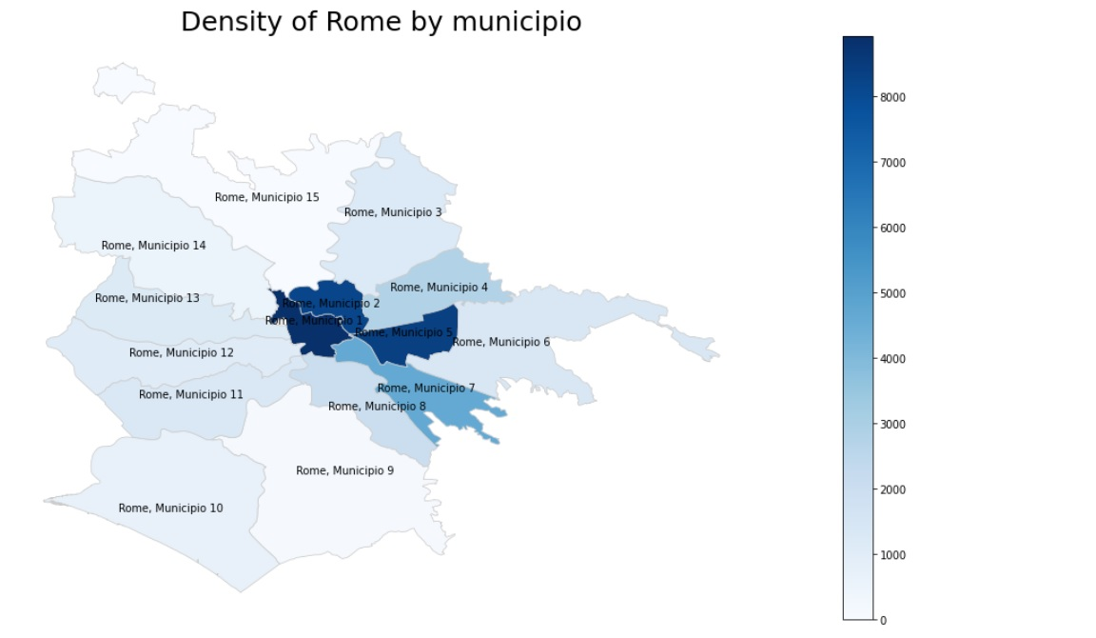
METHODOLOGY/RESULTS

Slide 9
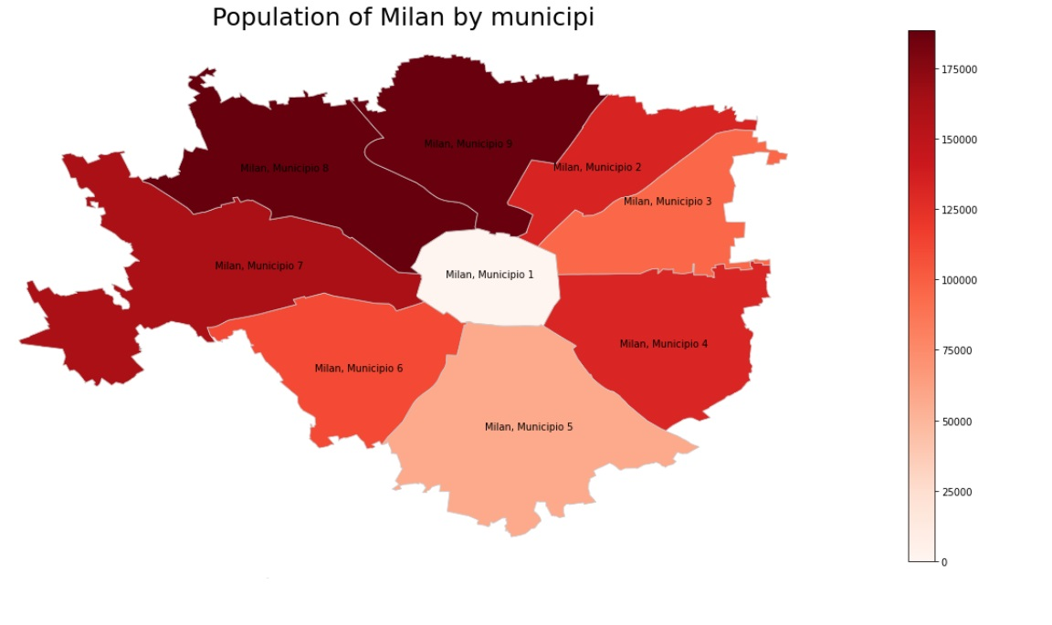
METHODOLOGY/RESULTS

Slide 10
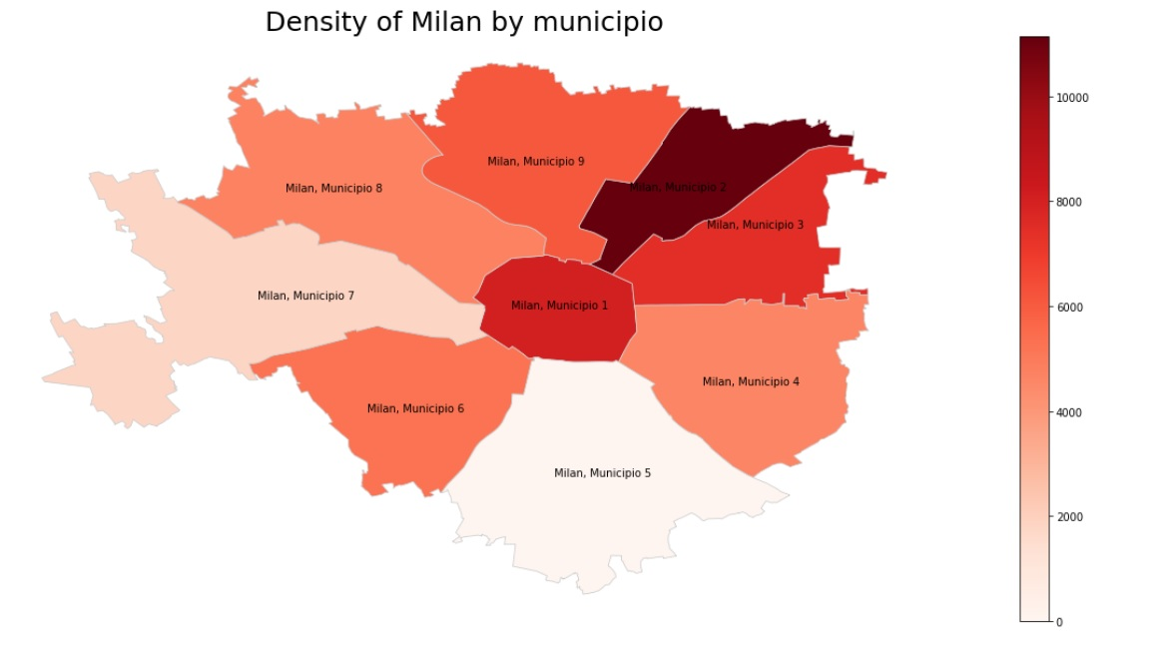
METHODOLOGY/RESULTS

Slide 11
METHODOLOGY/RESULTS
Next we will use Foursquare.
In order to use Foursquare we will assign to each municipio a circle. We will choose the center of the circle between the municipality, the representation point and the centroid (our choice will be the representative point) and we will calculate the radius of each circle (see the notebook).
The following pictures justify the choice of the representative points.

Slide 12
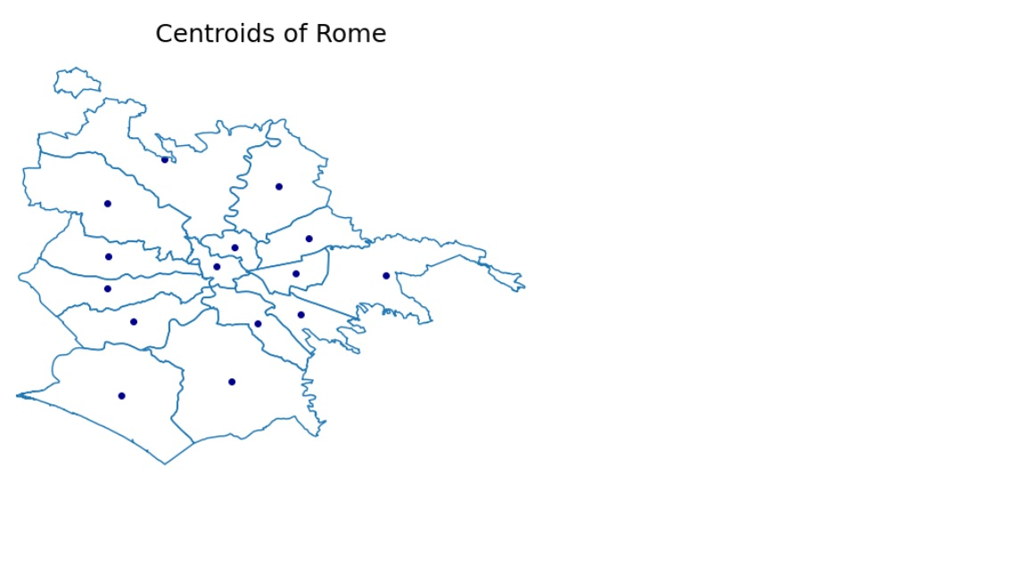
METHODOLOGY/RESULTS

Slide 13
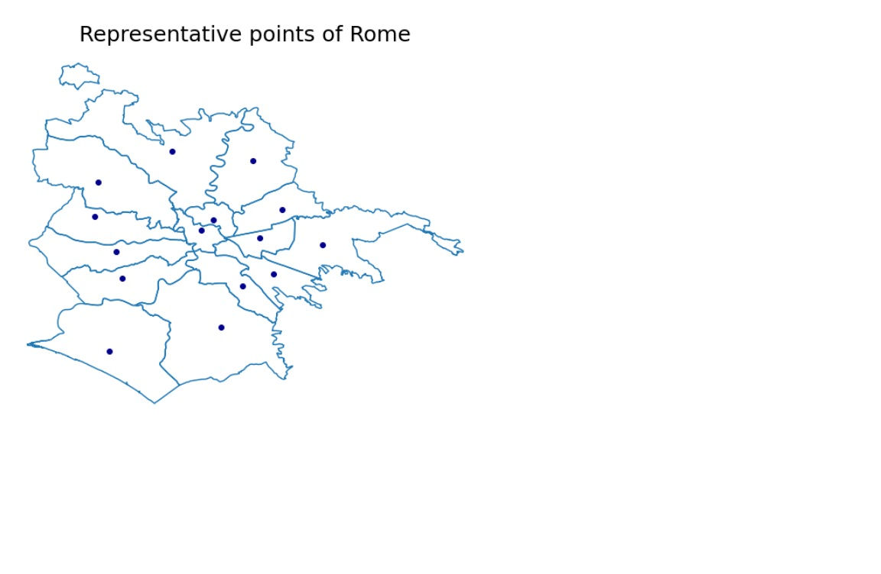
METHODOLOGY/RESULTS

Slide 14
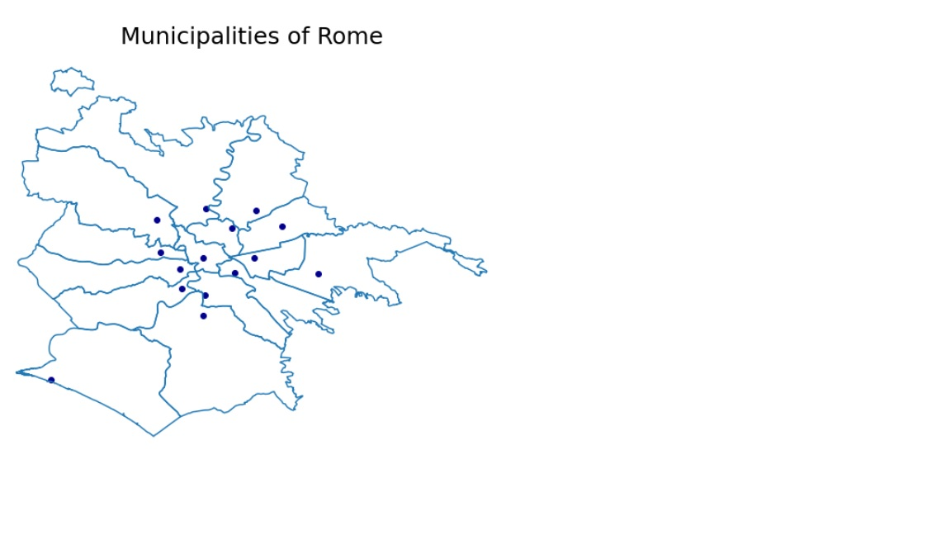
METHODOLOGY/RESULTS

Slide 15
METHODOLOGY/RESULTS
We will use the Foursquare get method 'https://api.foursquare.com/v2/venues/search' to get all the venues of each municipio in the following two categories:
Food venues
Bar venues
Then we will analyze all the venues retrieved and we will get two different clusterizations of the municipi, using KMeans and choosing the best K with the elbow method (see the notebook).
The following pictures show the result of the two clusterizations.
The first two images refer to the food clusterization, the section two images to the bar clusterization.

Slide 16
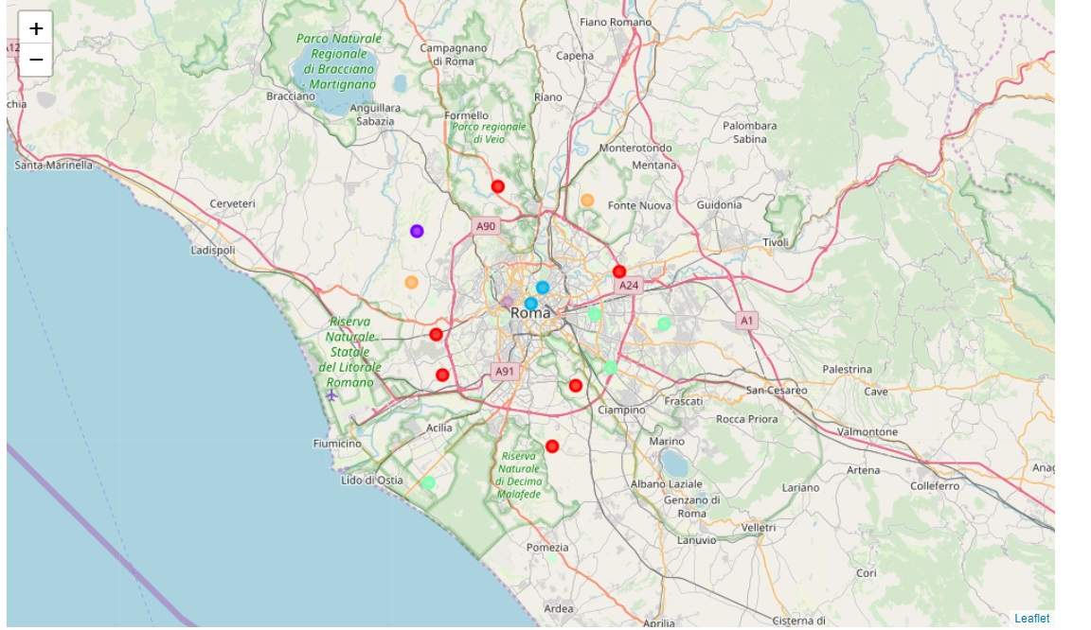
METHODOLOGY/RESULTS

Slide 17
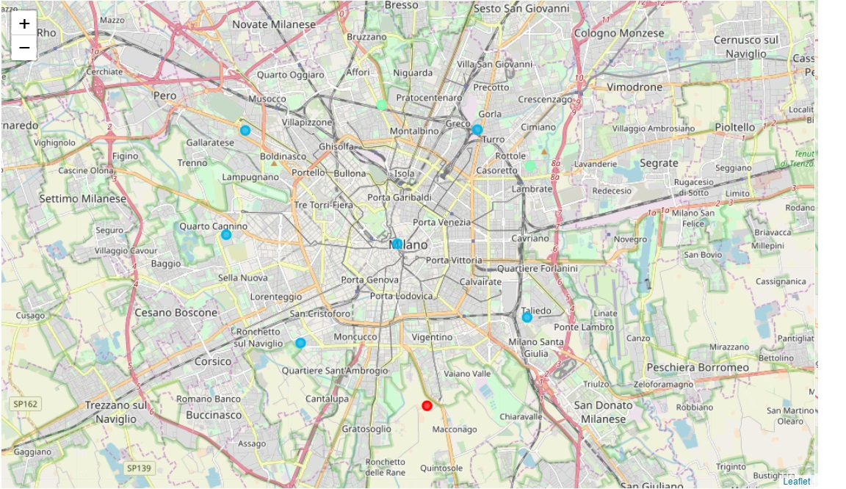
METHODOLOGY/RESULTS

Slide 18
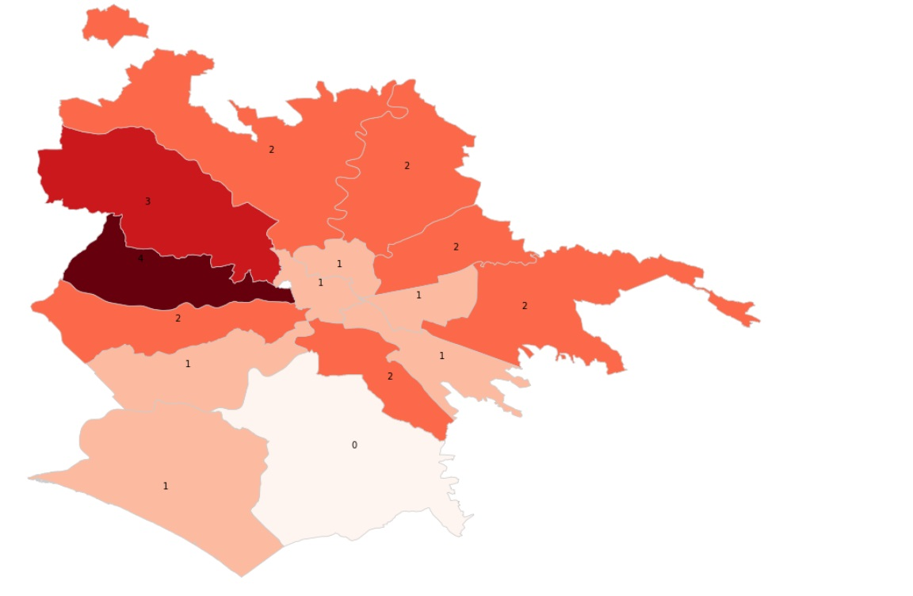
METHODOLOGY/RESULTS

Slide 19
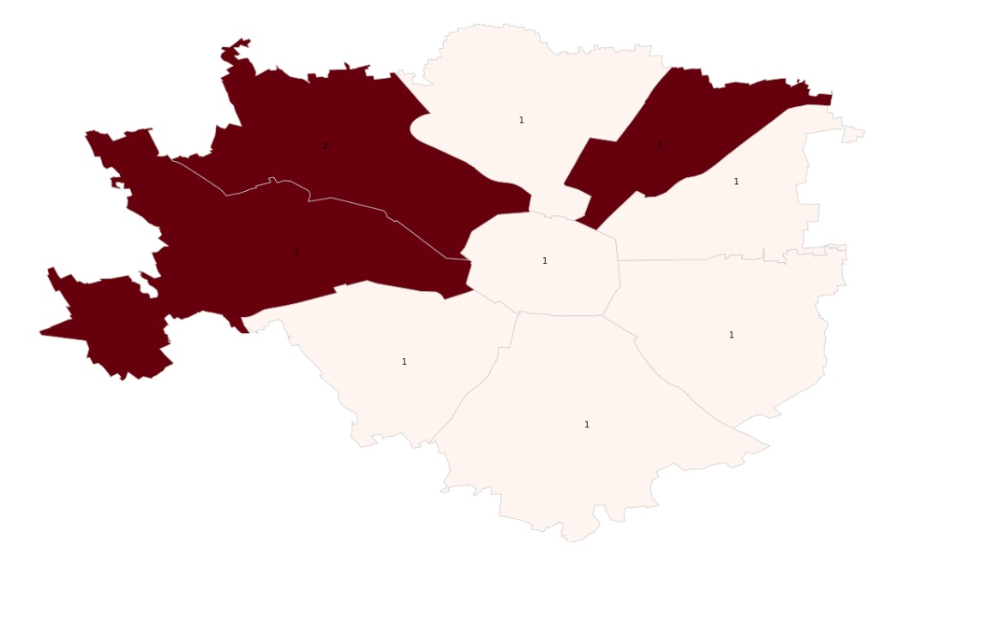
METHODOLOGY/RESULTS

Slide 20
METHODOLOGY RESULTS
In the last part of the work, we will use the Foursquare get method 'https://api.foursquare.com/v2/venues/search' to get all the venues of each municipio in the following categories:
Transportation venues (metro, ferries, tram...)
Fun venues (cinemas, theaters...)
Then we will assign a transportation score and a fun score to each municipio, dividing all municipi in four quartiles (see the notebook).
We will get the following dataframe. Foursquare does not work so well in Italy, that's why NaN values.

Slide 21
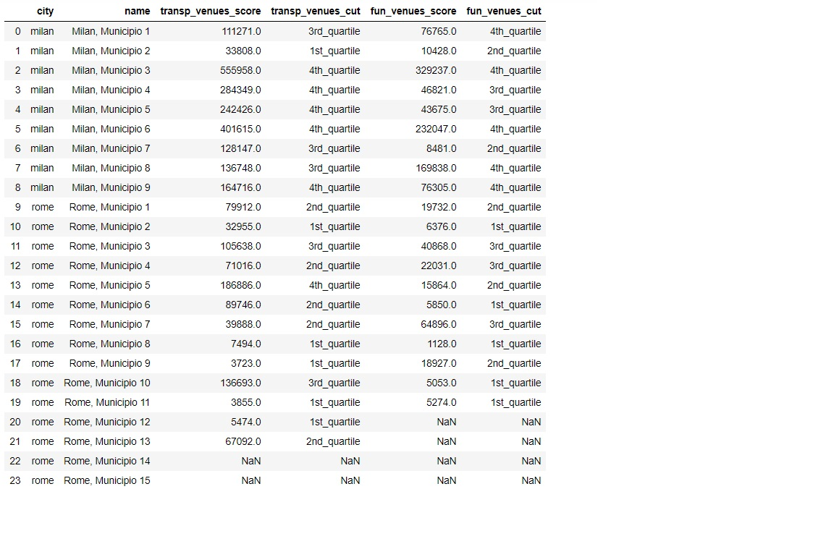
METHODOLOGY/RESULTS

Slide 22
METHODOLOGY/RESULTS
We will finally select all the municipi of Rome and Milan that satisfy the following criteria:
They are not municipio 2 of Rome (where my ex-girlfriend live).
They are in the same food cluster of municipio 2 of Rome.
They are in the same bar cluster of municipio 2 of Rome.
They are in the 1st and 2nd quartile according to transportation score.
They are in the 1st and 2nd quartile according to fun score.
The only municipio that satisfies those conditions is Rome, municipio 1.

Slide 23
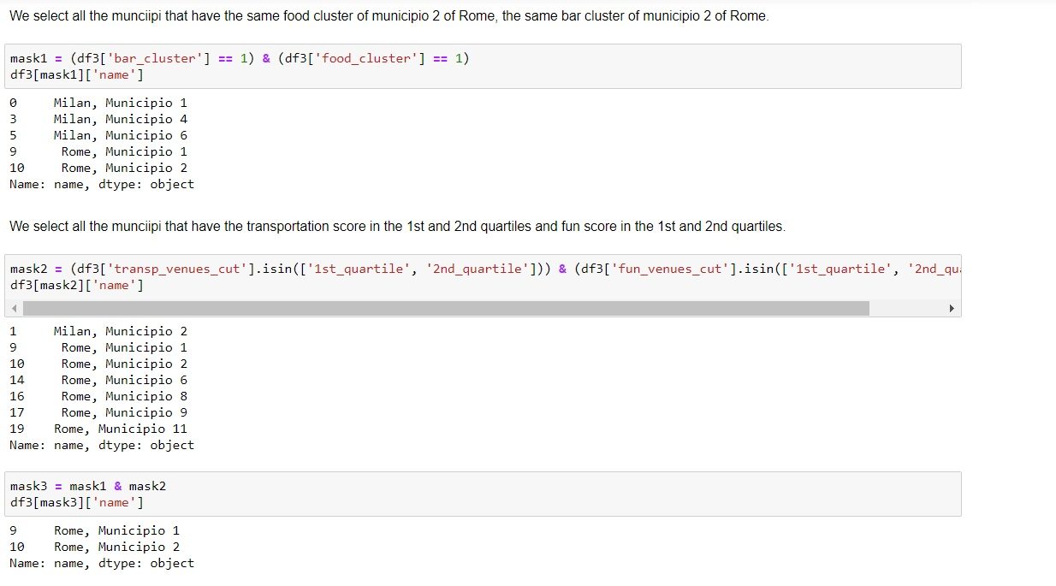
METHODOLOGY/RESULTS

Slide 24
DISCUSSION
The analysis is not exhaustive. Clearly other criteria may be used to infer the best municipio. I choose those criteria according to my personal taste, other choices may be done.
I remark that Foursquare does not perform very well in Italy. That's why the results can appear limited.
However, the employed methods and all the functions that I wrote can work with every city in the world. You only need a .shp file of the city, with municipi's shape and information about population.

Slide 25
DISCUSSION
You can also change the criteria, just changing the foursquare categories (food, bar, transportations, fun).
The majority of data are not updated and incoherent. For example the information about population of Rome and Milan refer to different years. I focused on the consistence of my code and not on the reliability of the data that I used.
To be honest, if you download the .shp file from the official website of Comune di Roma, you have a problem, because the don't specify which CRS they used. They work with EPGS 3004, I converted it, with an external program, to the standard EPGS 4326 to use the same CRS of Milan data. I really don't now how to do it in my code.

Slide 26
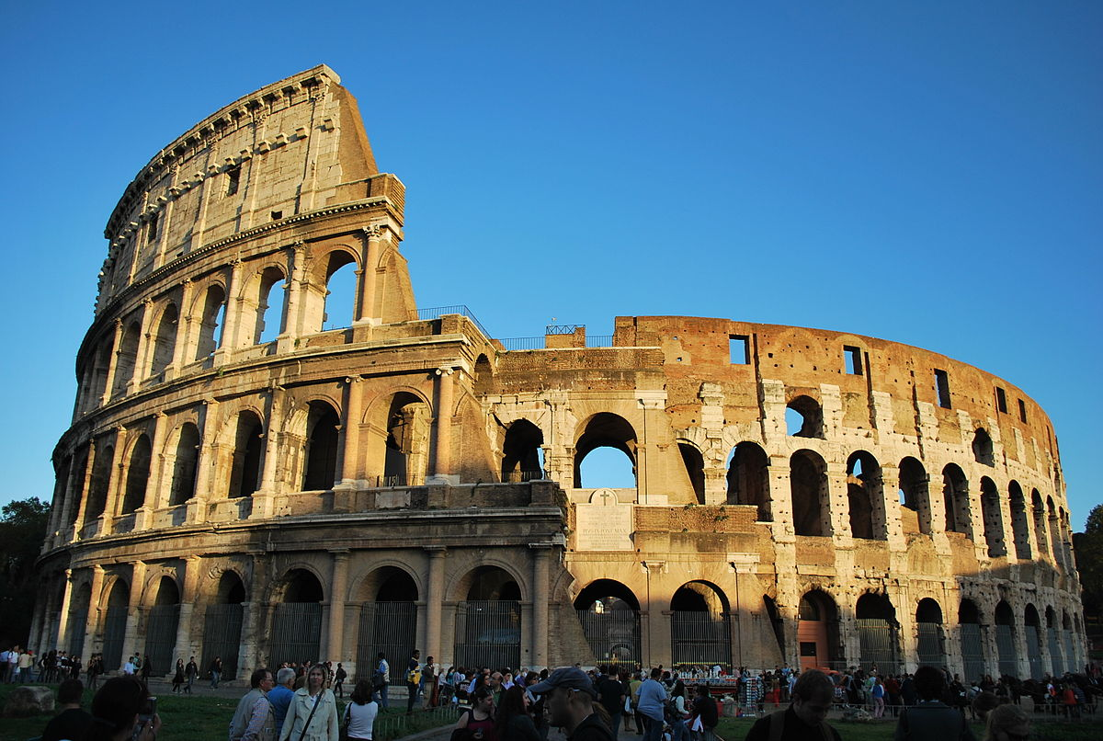
CONCLUSIONS
The optimal municipio is municipio 1 in Rome.
I will move next to the Coliseum!!!

Slide 27
THANK YOU!

