Slide 1
Coursera Report: Battle of the Neighbourhoods

Slide 2
Business problem:
Is there some objective data that the general public (or tour operators) can use to make recommendations instead of relying on the often deceitful marketing material issued by the cities themselves or by the cities' tourist boards?
Can we use data science to tell us whether it is worth visiting an English city without being disappointed or mislead by advertising?

Slide 3
Data
list of cities and towns in England
https://www.thegeographist.com/uk-cities-population-1000
scrape the data and then clean it, removing localities in Wales and Scotland and taking the top 500 or so remaining places to analyze

Slide 4
Data (2)
Data example:
1 1 London London London 8,907,918
2 1 Birmingham West Midlands West Midlands 1,153,717
3 1 Glasgow Glasgow Scotland 612,040
4 1 Liverpool Merseyside North West 579,256
5 1 Bristol Bristol South West 571,922
6 2 Manchester Greater Manchester North West 554,400
need to clean it, removing unnecessary columns and all the entries which do not relate to England.

Slide 5
Data (3)
Use a geocoder service to find the latitude and longitude of the center of these localities
Example:
Birmingham, UK
Birmingham, West Midlands Combined Authority, West Midlands, England, United Kingdom
1 City/Town Birmingham
Ceremonial county West Midlands
latitude 52.4797
longitude -1.90269

Slide 6
Data (4)
Use FourSquare venue explorer to find what venues are available within a reasonable distance to the city center
Example output:
0 A 52.449601 -1.819154 Costa Coffee 52.446411 -1.822441 Café
1 A 52.449601 -1.819154 Wilko 52.446645 -1.823626 Store
2 A 52.449601 -1.819154 Sainsbury's 52.445749 -1.820319 Supermarket
3 A 52.449601 -1.819154 Subway 52.446418 -1.823159 Restaurant
4 A 52.449601 -1.819154 The Spread Eagle (Wetherspoon) 52.446488

Slide 7
Methodology
Looked at how accurate the data was at representing English localities
Locality names were misspelled ("Corsett"="Consett")
Others ambiguous (representing localities in Scotland instead of England) "Ferryhill"="Ferryhill, County Durham"
The data was cleaned to correct these errors

Slide 8
Methodology (2)
FourSquare output was analysed
For very small localities the FourSquare data was too sparse
The data was filtered to take the top 300 localities instead of the top 1000

Slide 9
Methodology (3)
K-means clustering algorithm was used to attempt to cluster the data in a meaningful way
Another problem with FourSquare: inconsistency of nomenclature
Example: “art gallery” and “art museum”, “coffe shop” and “cafe” being different categories
Algorithm corrected to ensure consitency

Slide 10
Methodology (4)
Elbow Method was used to get an idea of the optimal number of clusters.
k=3 as the optimal number
Seemed very low so experiments were carried out using both k=3 and k=5

Slide 11
Results
Venue data was gathered from FourSquare.
Abundance of information for particular locations...
BUT
It was evident that the venue information was incomplete
Large number of venues were not contained within the FourSquare data.

Slide 12
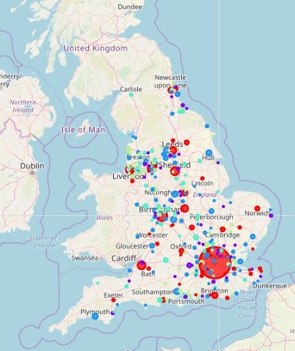
Results (2): K=5

Slide 13
Results (3): K=5
big cities with a vibrant restaurant and coffee culture as well as some smaller towns with the same vibe.
smaller "downmarket" towns with a mix of various shops, pubs and cafes and for which FourSquare has incomplete data
slightly more upmarket towns with an interesting mix of various types of shops, restaurants and cafes.
towns where the main attraction is an abundance of mainstream shops, complemented by fast food places, pubs and cafes
towns where inexplicably there is very little FourSquare data. This inclues large towns such as Portsmouth, Luton and Blackpool which certainly don't lack in venues!

Slide 14
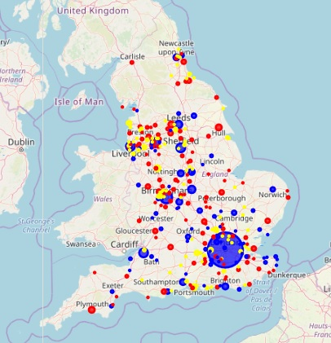
Results (4): K=3

Slide 15
Results (5): K=3
Towns where the main attraction is an abundance of mainstream shops, complemented by fast food places, pubs and cafes
Big cities with a vibrant restaurant and coffee culture, perhaps with Art and Concert venues as well as some smaller towns with the same vibe.
Towns where inexplicably there is very little FourSquare data. This inclues large towns such as Portsmouth, Luton and Blackpool which certainly don't lack in venues!

Slide 16
Discussion
Clustering in 5 or in 3 groups didn’t result in any noticeable difference.
In the case of the 5 clusters, three of the clusters didn’t seem to be distinguishable
the division in 3 clusters made sense, as predicted by the Elbow Method.
the FourSquare data was very unreliable, with a very large number of important venues missing even in big cities where there appeared to be a good amount of data.

Slide 17
Conclusion
Cities and towns in England are really "identikit", bland city centres as far as venues such as shops, cafes etc. is concerned.
BUT:
FourSquare data was hopelessly incomplete, with very little in terms of landmarks and very incomplete data as regards shops and other amenitie

Slide 18
Conclusion (2)
If you want to discover something new perhaps you should try one of the many cities for which FourSquare has no data
Best for "coffee culture" are big cities such as London, Birmingham, Manchester, Leeds.
Best for a more traditional feel are smaller ones such as Bradford and Plymouth
FourSquare is woefully incomplete and cannot be relied upon fully for this task.

