Slide 1
Facial Emotion Recognition Project
Marco Defilippi
MIT Applied Data Science Program
April 2024

Slide 2
Problem description
Facial Emotion
Vital in human interactions.
Increasingly significant in many fields, e.g., diagnostic and social robotics.
Around 55% of sentiments takes place through facial emotions.
Finding Solutions
Evolving from baseline to advanced models.
Project Objective
Address class distinction challenges.
Prioritizing neural networks for classification.
Balancing hardware limitations and efficiency.
Extensive testing across different model architectures.
Evaluate the model's generalization and reliability.
Acknowledge and manage potential risks.

Slide 3
Workflow analysis
Data exploration
Build and testing of baseline CNN models
Comparison between color and grayscale setting
Transfer learning
Build and testing custom CNN solution
Implementation and business recommendations

Slide 4
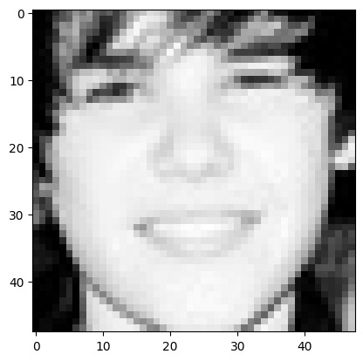
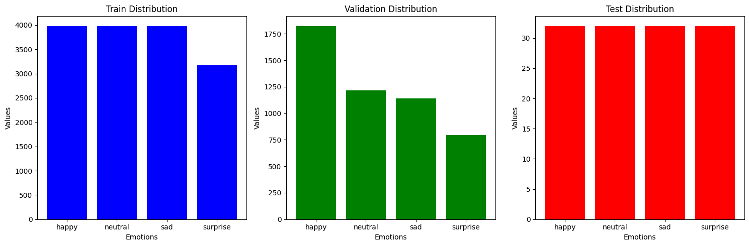
Data Exploration
Image size: 48x48 pixel
Grayscale colour
Class | Train dataset | Validation dataset | Test dataset
Happy | 3976 | 1825 | 32
Sad | 3978 | 1216 | 32
Neutral | 3982 | 1139 | 32
Surprise | 3173 | 797 | 32
Total Nbr of Images | 15109 | 4977 | 128

Slide 5
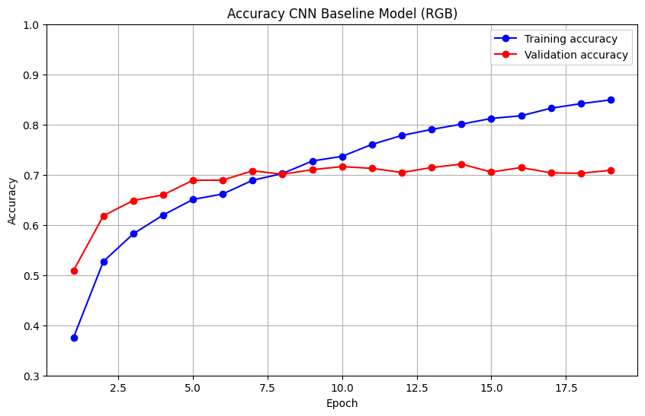
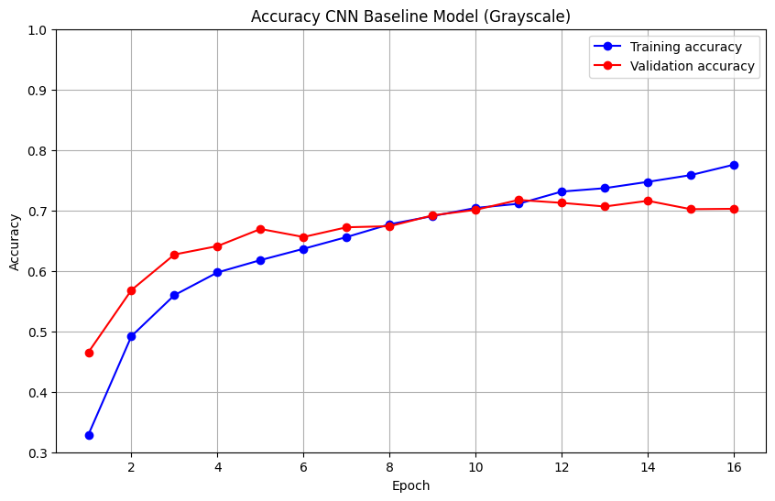
Comparative Analysis of CNN Baseline Models: Accuracy for RGB vs Grayscale Image Inputs

Slide 6
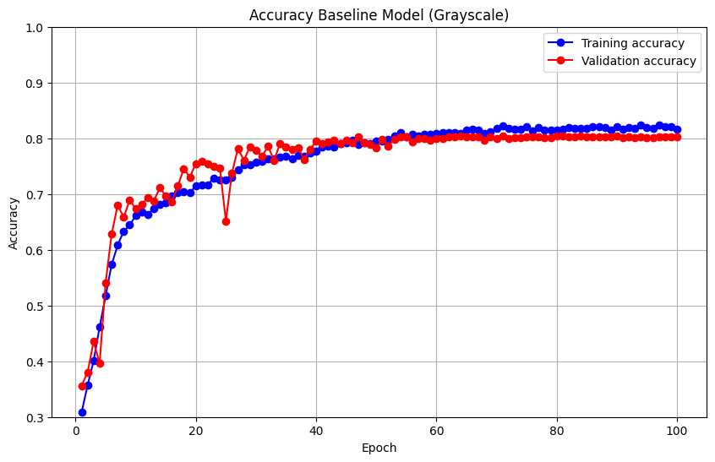
Evaluating Performance: Baseline CNN vs Large-Scale CNN Models
Added convolutional layers
Data augmentation

Slide 7
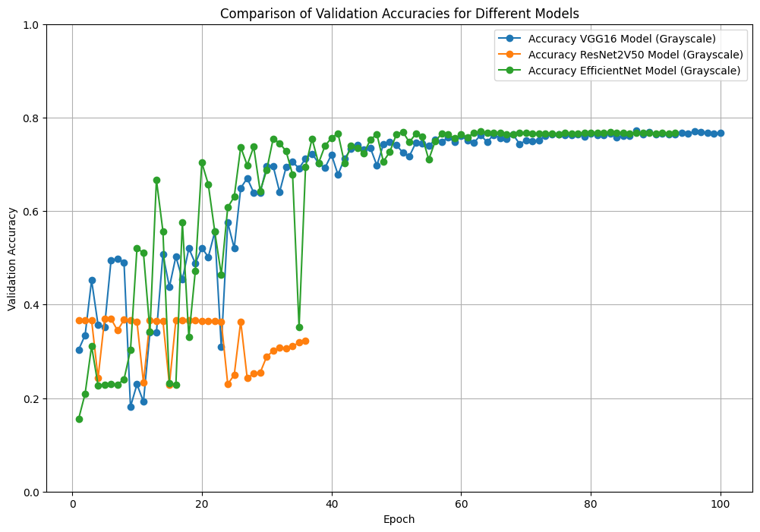
Evaluating Performance Across Different Transfer Learning Models

Slide 8
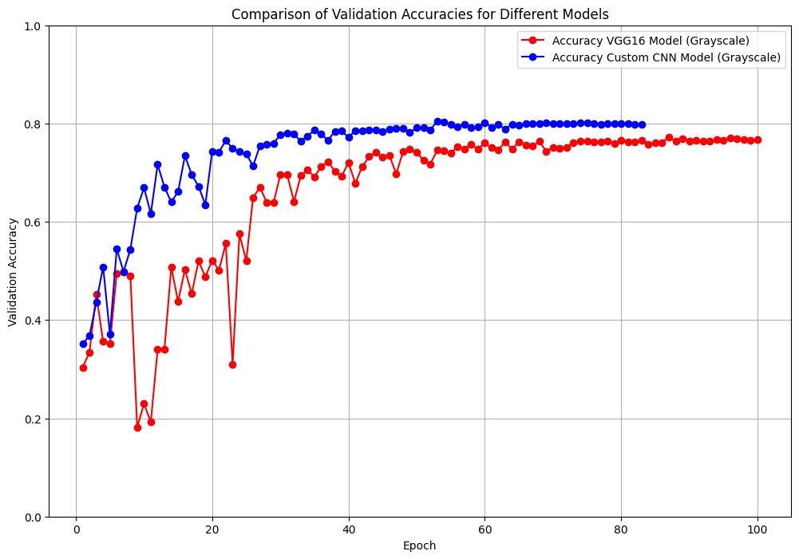
Evaluating Performance: Custom CNN model
Custom CNN model:
8 sets convolutional layers.
BatchNormalization, pooling and dropout layers.
Number of filters increases in each set, capturing hierarchical features.
Total params: 5,941,444 comparable to VGG16
Custom CNN model as final solution!

Slide 9
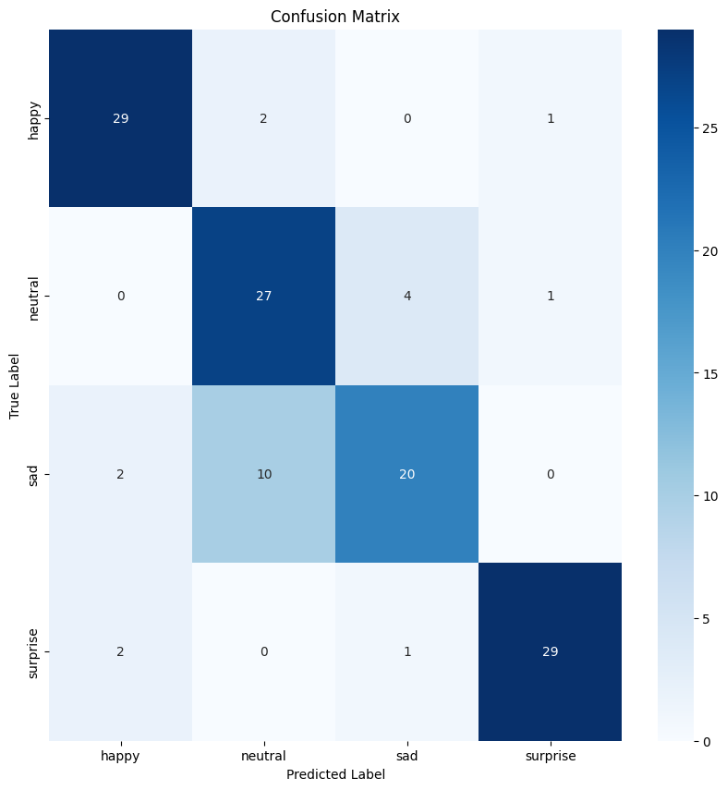
Custom CNN model: In-depth Performance Evaluation
Class | Precision | Recall | F1-Score | Support
Happy | 0.88 | 0.91 | 0.89 | 32
Sad | 0.8 | 0.62 | 0.70 | 32
Neutral | 0.69 | 0.84 | 0.76 | 32
Surprise | 0.94 | 0.91 | 0.92 | 32
Accuracy |  |  | 0.82 | 128
Macro Avg | 0.83 | 0.82 | 0.82 | 128
Weighted Avg | 0.83 | 0.82 | 0.82 | 128
Confusion Matrix
Classification Report

Slide 10
Implementation Recommendations
Proposed model solution
Specialized and adaptable solution.
Ideas for improvements
Integration of additional information, in-depth studies on the variability of emotional expressions across different cultures .
Risks and challenges.
Careful management of privacy, ethical considerations in sensitive settings such as healthcare and education.
Future Steps
Integration into end-user applications, user feedback on the model's accuracy and usefulness, correct privacy management
Balancing between performance and operational constraints (real-time application, mobile application, etc.)

Slide 11
Expected Benefits and Costs for Business
Benefits
Enhanced interactivity and personalization of user interfaces.
Costs
Healthcare, safety monitoring, live customer interactions, social robotics.
Data acquisition, software development tools, technical staff.
Hardware, maintenance, data storage, security updates.
Improvements based on user feedback.

Slide 12
Thank You!

Slide 13
APPENDIX

Slide 14
CNN Models Comparison
CNN Model | Total Params | Accuracy
Baseline CNN | 388,484 | 0.69
Larger CNN | 2,395,204 | 0.79
VGG16 | 14,714,688 | 0.79
ResNet50V2 | 25,613,800 | 0.46
EfficientNet | 5,330,571 | 0.78
Custom CNN | 5,941,444 | 0.82

Slide 15

VGG16 Model In-Depth Performance
Class | Precision | Recall | F1-Score | Support
Happy | 0.90 | 0.88 | 0.89 | 32
Sad | 0.83 | 0.59 | 0.69 | 32
Neutral | 0.64 | 0.88 | 0.74 | 32
Surprise | 0.90 | 0.84 | 0.97 | 32
Accuracy |  |  | 0.80 | 128
Macro Avg | 0.82 | 0.80 | 0.80 | 128
Weighted Avg | 0.82 | 0.80 | 0.80 | 128

