Slide 1
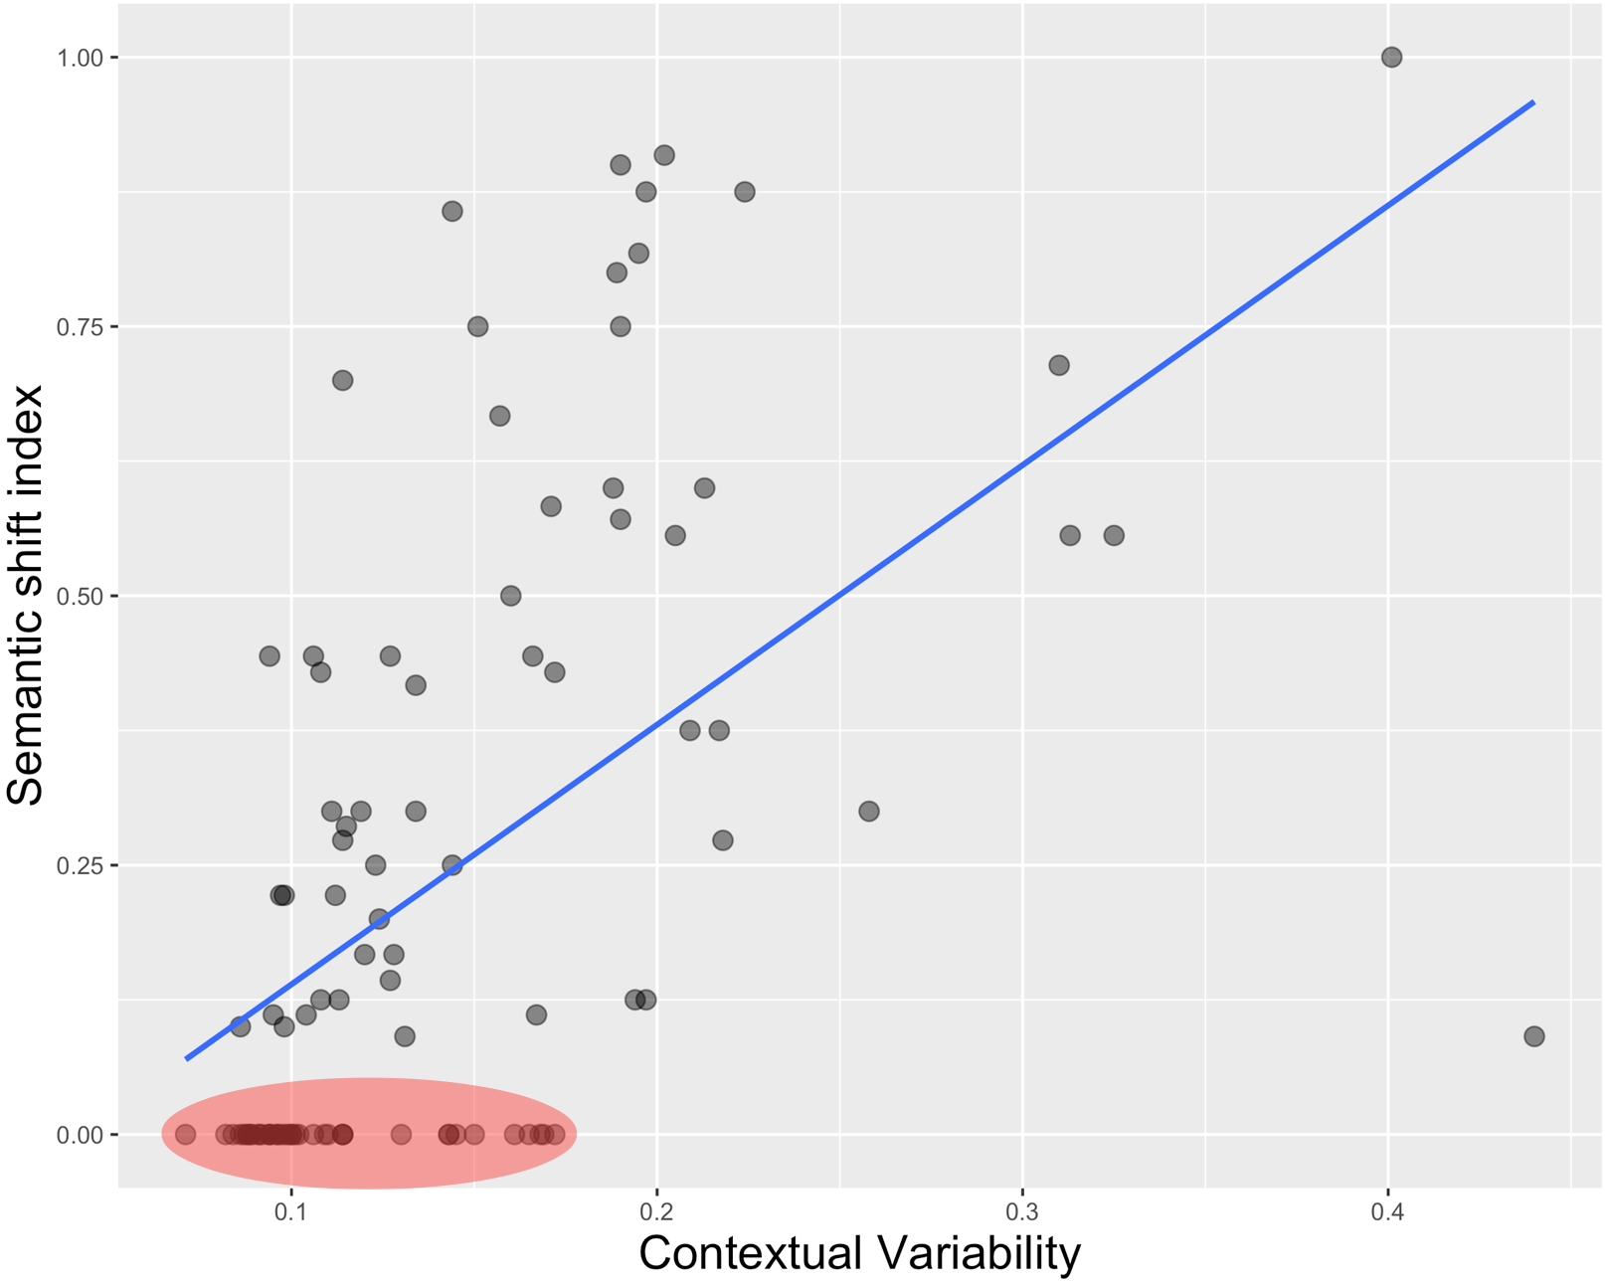
1.0
0.75
Semantic Shift Index
0.5
0.25
0.0
0.1
0.2
0.3
0.4
Contextual Variability
Contextual Variability

Slide 2
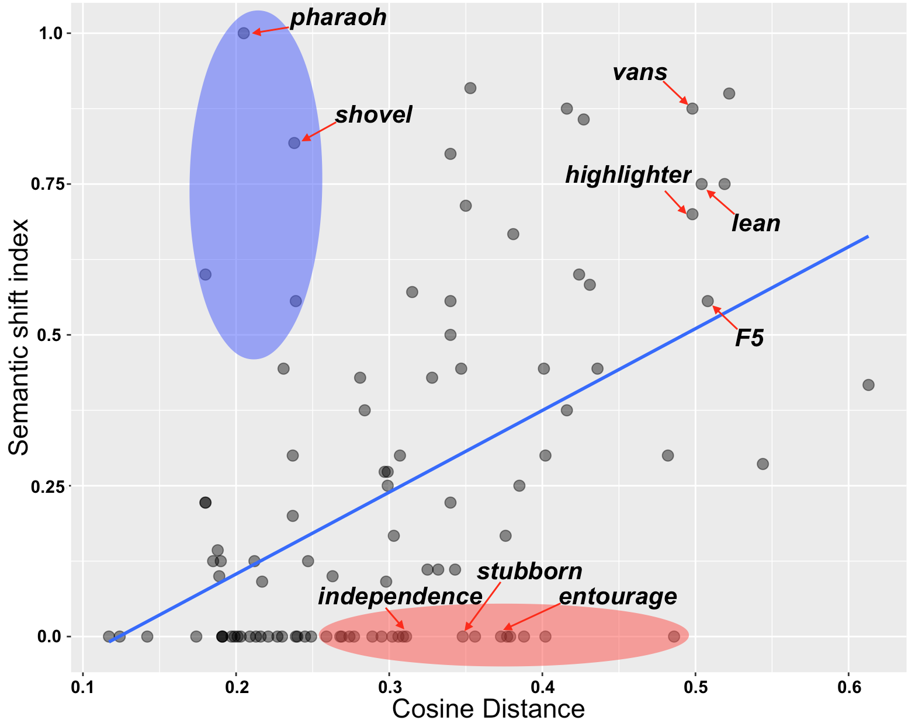
1.0
0.75
0.5
Semantic Shift Index
0.25
0.0
0.1
0.2
0.3
0.4
0.5
0.6
Cosine Distance
Contextual Variability

Slide 3
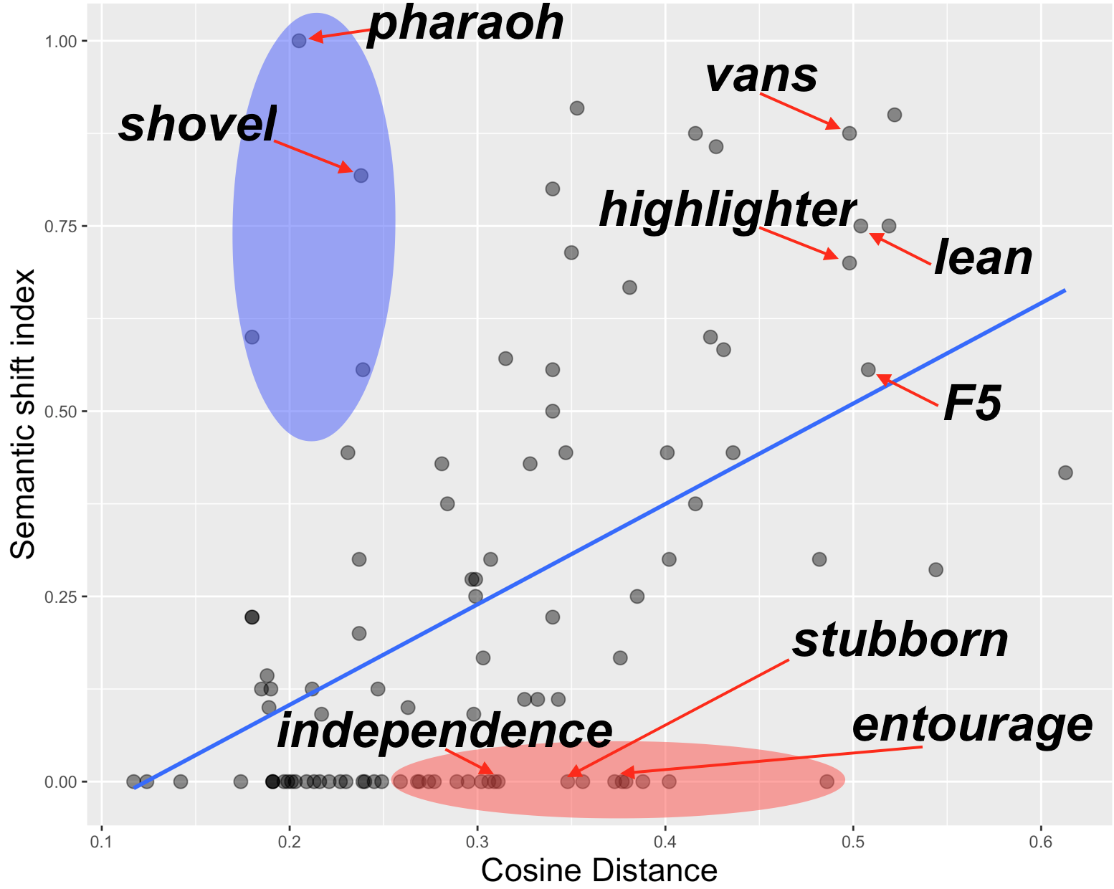
1.0
0.75
0.5
Semantic Shift Index
0.25
0.0
0.1
0.2
0.3
0.4
0.5
0.6
Cosine Distance
Contextual Variability

