Slide 1


High performance computing Exam Exercise 1
Created by
Marco De Rito

Slide 2
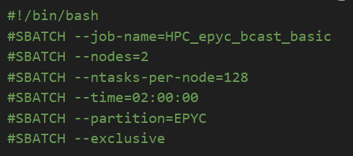
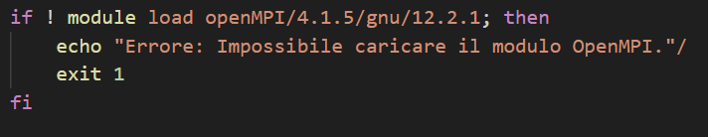
The Sbatch code
These lines define the parameters for executing the script using SLURM, a workload manager for HPC systems. These parameters include the job name (--job-name), the number of nodes (--nodes), the number of tasks per node (--ntasks-per-node), the maximum execution time (--time), the partition where the job will be executed (--partition), and the --exclusive option that requires exclusive node usage.
It’s the path of the CSV file where the benchmark results will be written.
This block checks if it's possible to load the required OpenMPI module for running the benchmark. If the module cannot be loaded, the script exits with an error message.
Before executing the benchmark, the script creates the specified CSV file in output_file and writes the header with column names ("Processes", "Size", "Latency").
It defines the number of benchmark repetitions to obtain an average of the results.

Slide 3
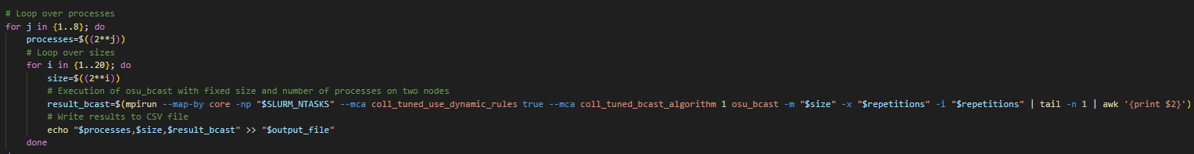
The Sbatch code
These loops are used to execute the benchmark with different configurations of processes and data sizes. The outer loop varies the number of processes from 2 to 256, while the inner loop varies the data size from 2^1 to 2^20.
Within the nested loops, the script uses mpirun to execute the OSU Micro-Benchmarks for broadcast with the current sizes and number of processes. The results are extracted and written to the CSV file.
Let's see in detail:
Outer Loop (Number of Processes):
This loop varies the number of processes involved in executing the benchmark.
Using the syntax {1..8}, the loop iterates through values from 1 to 8, corresponding to 2^1, 2^2, 2^3, ..., 2^8, meaning the number of processes exponentially increases from 2 to 256.
For example, when j is 1, the number of processes will be 2; when j is 2, the number of processes will be 4, and so on.
Inner Loop (Data Size):
This loop varies the size of the data used in the benchmark.
Using the syntax {1..20}, the loop iterates through values from 1 to 20.
The variable i represents the exponent of 2 to calculate the data size. For example, when i is 1, the data size will be 2^1, which is 2 bytes; when i is 2, the data size will be 2^2, which is 4 bytes, and so on.
In practice, this loop varies the data size from 2 bytes to 2^20 bytes, covering a wide range of sizes for the benchmark.
Notes:
L'opzione --exclusive specifica che il lavoro richiede l'uso esclusivo dei nodi all'interno del sistema di calcolo ad alte prestazioni (HPC). Questo significa che nessun altro lavoro può essere eseguito sui nodi assegnati a questo lavoro durante il suo periodo di esecuzione.
Questa opzione è utile quando un lavoro richiede risorse computazionali dedicate su un nodo e non può essere eseguito in parallelo con altri lavori su quegli stessi nodi. L'uso esclusivo dei nodi può garantire che il lavoro abbia accesso a tutte le risorse del nodo senza interferenze da parte di altri processi o utenti.

Slide 4
Run
SLURM (Simple Linux Utility for Resource Management) is a queue management system for high-performance computing (HPC) clusters. It efficiently allocates and manages cluster resources by scheduling and monitoring running jobs. sbatch is a command used with SLURM to submit jobs for execution in the system, allowing users to specify parameters such as the number of nodes, runtime, and other options for the job.

Slide 5
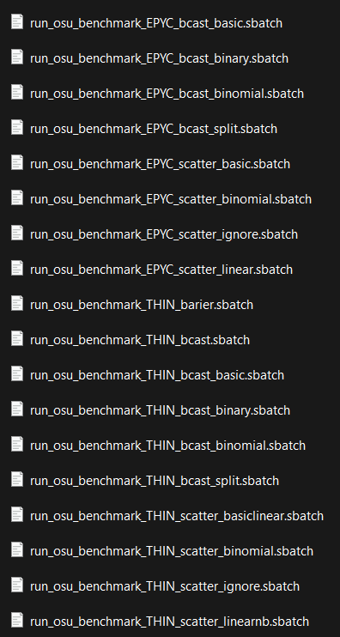
Nodes
The present study aims to evaluate the performance of Thin and Epyc nodes using various communication algorithms, specifically broadcast and scatter. The goal is to provide a detailed overview of the performance of these nodes in distributed communication contexts.
Node Types:
Thin Nodes: This category of nodes is characterized by limited computational resources, often with lower computing power compared to high-end systems. Thin nodes are commonly used in environments where efficient resource distribution and reduced management costs are required. However, their performance may be limited in tasks with high computational intensity.
Epyc Nodes: In contrast, Epyc nodes are designed to offer high computational performance, thanks to their advanced architecture and the presence of high-end processors such as those from the AMD EPYC family. These nodes are ideal for intensive workloads that require a large number of calculations, such as data analysis and numerical simulation.
This benchmark execution provides an in-depth analysis of the performance of Thin and Epyc nodes through a series of communication algorithms. The obtained results can be used to optimize network configurations and improve the overall performance of applications distributed across these systems.

Slide 6
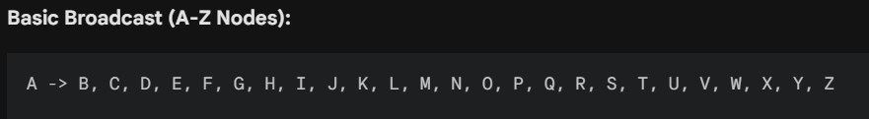
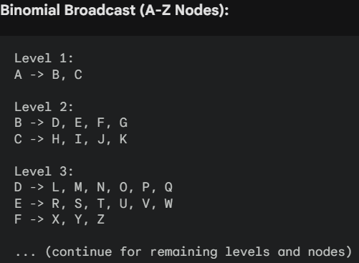
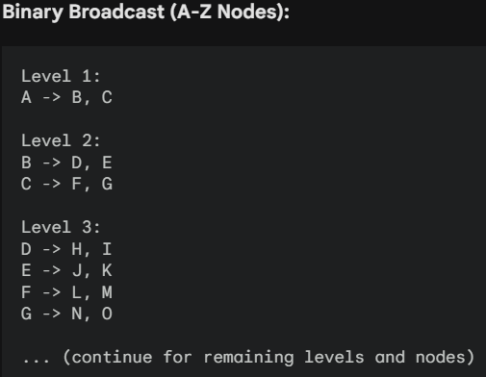
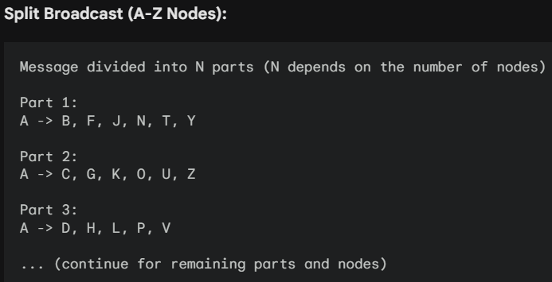
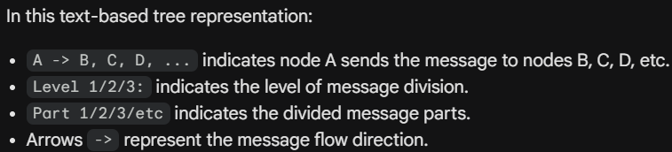
Communication Algorithms / Broadcast
Basic: The basic algorithm is the simplest method for transmitting a message from a single node to all other nodes in the network. Each node sends the message to all its neighbors, ensuring uniform distribution but potentially inefficient use of network resources.
Binary: This algorithm iteratively divides the message into two parts and sends it to two subsets of nodes. This process repeats until all nodes receive the complete message. The binary approach can reduce network load compared to the basic method but requires a greater number of steps.
Binomial: Similar to the binary algorithm, but it uses a more structured organization of the network to reduce the total number of steps required to deliver the complete message. This method can further improve message transfer efficiency.
Split: This algorithm divides the message into smaller parts and simultaneously sends them to different groups of nodes. This approach is particularly

Slide 7
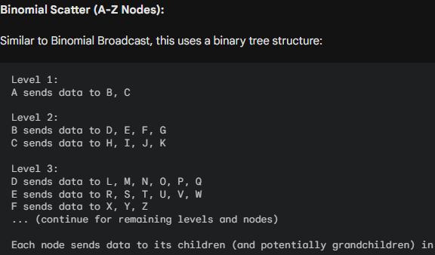
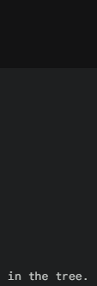



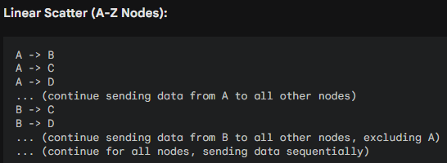
Communication Algorithms / Scatter
Basic: The basic scatter algorithm involves each node transmitting different data to every other node in the network. It is a straightforward method but can become inefficient as the number of nodes increases.
Binomial: Similar to the binomial broadcast algorithm, this method organizes the network in a binomial structure to efficiently transmit data to all nodes. It reduces the number of steps required for data delivery.
Ignore: This algorithm allows nodes to ignore data that is not intended for them, thus reducing processing load on uninterested nodes. It doesn't use a tree structure. Nodes simply discard data not meant for them.
Linear: The linear scatter algorithm sends data one after another to each node in the network, in a sequential order. While it may be straightforward to implement, it can become inefficient in large networks due to its sequential approach.

Slide 8
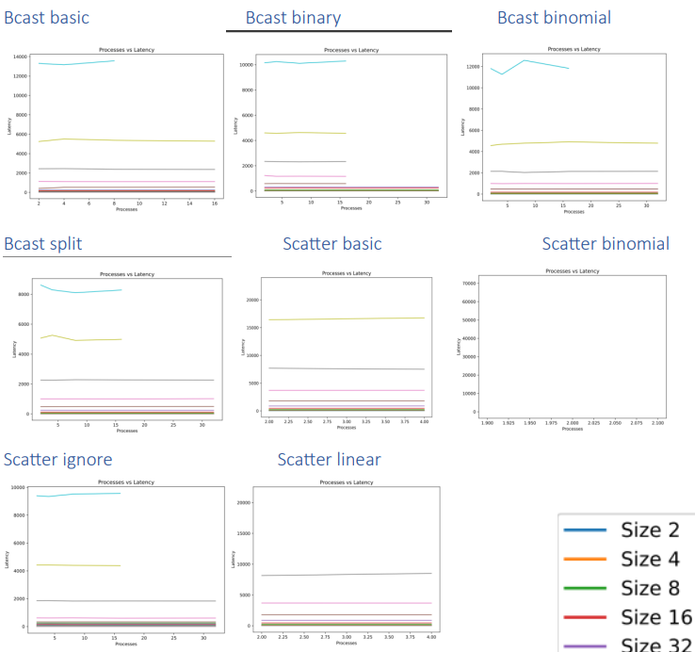
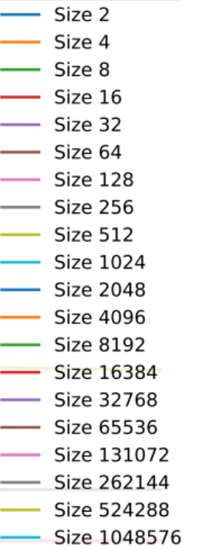
Epyc Node graphs
The graphs indicate that latency increases as both the number of processes and data sizes grow. However, this increase doesn't follow a linear trend. In some cases, latency increases more rapidly compared to the increase in both the number of processes and data sizes.
Specific comments on the graphs:
Bcast basic, Bcast binary, Bcast binomial, Bcast split: the split mode is the fastest, followed by binary, and finally binomial. Latency increases as both the number of processes and data sizes increase in all three modes.
Scatter basic, Scatter binomial, Scatter ignore, Scatter linear: the scatter ignore mode is the most efficient, followed by the linear mode. In all modes, latency increases with the increase in both the number of processes and data sizes.
For some experiments, not all set trials occurred, possibly due to high memory consumption that caused execution to halt.
Generally, it's observed that Bcast outperforms Scatter.

Slide 9
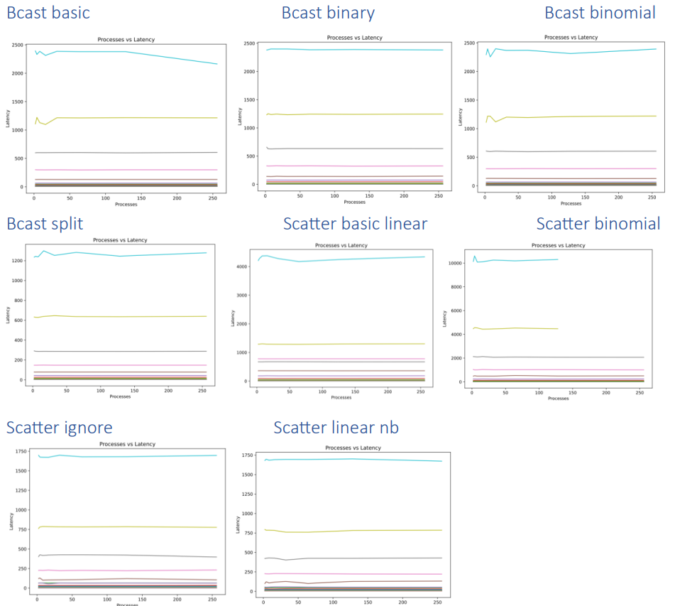
Thin Node graphs
The graphs indicate that latency increases with both the number of processes and the size of the data. However, this increase does not follow a linear trend. In some cases, latency increases more rapidly than both the number of processes and the size of the data.
Specific comments on the graphs:
Bcast basic, Bcast binary, Bcast binomial, Bcast split: the split mode is the fastest; among the others, there is not much difference. Latency increases with both the number of processes and the size of the data in all three modes.
Scatter basic, Scatter binomial, Scatter ignore, Scatter linear: the scatter ignore mode is the most efficient, followed by the scatter linear nb mode. In all modes, latency increases with both the number of processes and the size of the data. For scatter binomial, some data is missing as the number of processes increases; it seems to be the most efficient, but execution likely halted due to excessive memory usage.
For some experiments, not all set trials were completed; there may have been excessive memory usage that halted execution. For the Thin Node, it cannot be stated that Bcasts perform better than Scatters.

Slide 10
Conclusion
Allocation of tasks: 128 tasks assigned to the two epyc nodes, each with 264 cores, while 50 tasks are allocated to the thin node, which has 212 cores.
Performance: The results show a superiority of the thin node in terms of performance and scalability compared to the epyc nodes.
Influential factors: It's important to note that performance differences could be influenced by various factors, including the specific nature of workloads, software configurations, and code optimization methods.
Performance analysis clearly indicates that the thin node has a significant advantage in efficiency and scalability over the epyc nodes. However, to fully understand the reasons behind this difference, further analysis is needed, taking into account the initial settings as well.

