Slide 1
Healthcare AI Platform
Comprehensive Performance
& Growth Analysis
$29.7M ARR · 6 Clinical Departments · 31K+ Active Users · 99.4% Uptime
Full Year Trajectory: Q1 2025 – Q1 2026
Prepared for Board of Directors & Clinical Advisory Board · April 2026
Confidential — Not for Distribution

Slide 2
AGENDA
Five sections covering platform performance, department deep dives, clinical impact, and strategic roadmap
1
Platform Overview & Key Metrics
Slides 3-4
ARR trajectory, user growth, retention, and unit economics
2
Department Performance Deep Dives
Slides 6-9
Cardiology, Radiology, Oncology, Emergency, and Primary Care
3
Clinical Outcomes & Compliance
Slides 11
Patient outcome scores, FDA compliance rates, benchmarks
4
Growth Engine Analysis
Slides 12-13
Expansion revenue drivers, cross-sell patterns, cohort economics
5
Strategic Recommendations
Slides 14-15
Five priorities for the next 12 months with ROI projections

Slide 3
PLATFORM OVERVIEW
ARR reached $29.7M (+49% YoY) with Emergency Triage AI achieving 0.6% churn — the lowest in healthcare SaaS
TOTAL ARR
ACTIVE USERS
AVG NPS
BLENDED CHURN
EXPANSION REV
$29.7M
31.1K
74
1.6%
$2.84M
+49.4% vs PY
+38.2% vs PY
+8pts vs PY
-1.4pp vs PY
+62% vs PY
SITUATION: Healthcare AI platform ARR reached $29.7M in Q1 2026, growing 49% YoY across 6 clinical departments. Emergency Triage AI and Cardiology Imaging AI are the fastest-growing modules with NPS scores above 80.
COMPLICATION: Primary Care EHR Integration lags with 3.2% churn, NPS of 64, and 62-day implementation — 3x longer than Emergency (14 days). The module is $3.3M ARR but has below-average unit economics.
QUESTION: Should we continue investing in Primary Care's complex EHR integration or redirect R&D toward high-NPS specialty modules?
ANSWER: Fix Primary Care implementation (hire 4 dedicated integration engineers) while accelerating Emergency and Oncology internationally. Primary Care's TAM ($8.2B) is too large to abandon.
Emergency Triage AI: 0.6% churn, NPS 88, 14-day implementation, 90% DAU. This is the benchmark — every module should converge toward these metrics.
Source: Platform Analytics | Q1 2025 – Q1 2026 | All Regions

Slide 4
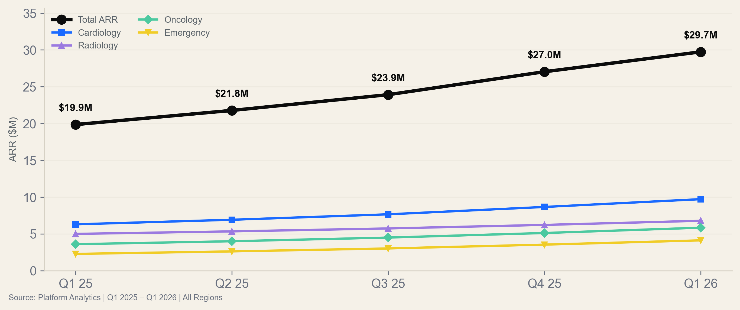
ARR TRAJECTORY
All departments accelerating — Emergency and Oncology grew 80%+ YoY while maintaining sub-2% churn rates
At current trajectory, platform will cross $40M ARR by Q4 2026. Emergency alone will be $6M+ — a standalone product at scale.
Source: Platform Analytics | Q1 2025 – Q1 2026 | All Regions

Slide 5
SECTION 02
Department
Performance Deep Dives
Cardiology · Radiology · Oncology · Emergency · Primary Care

Slide 6
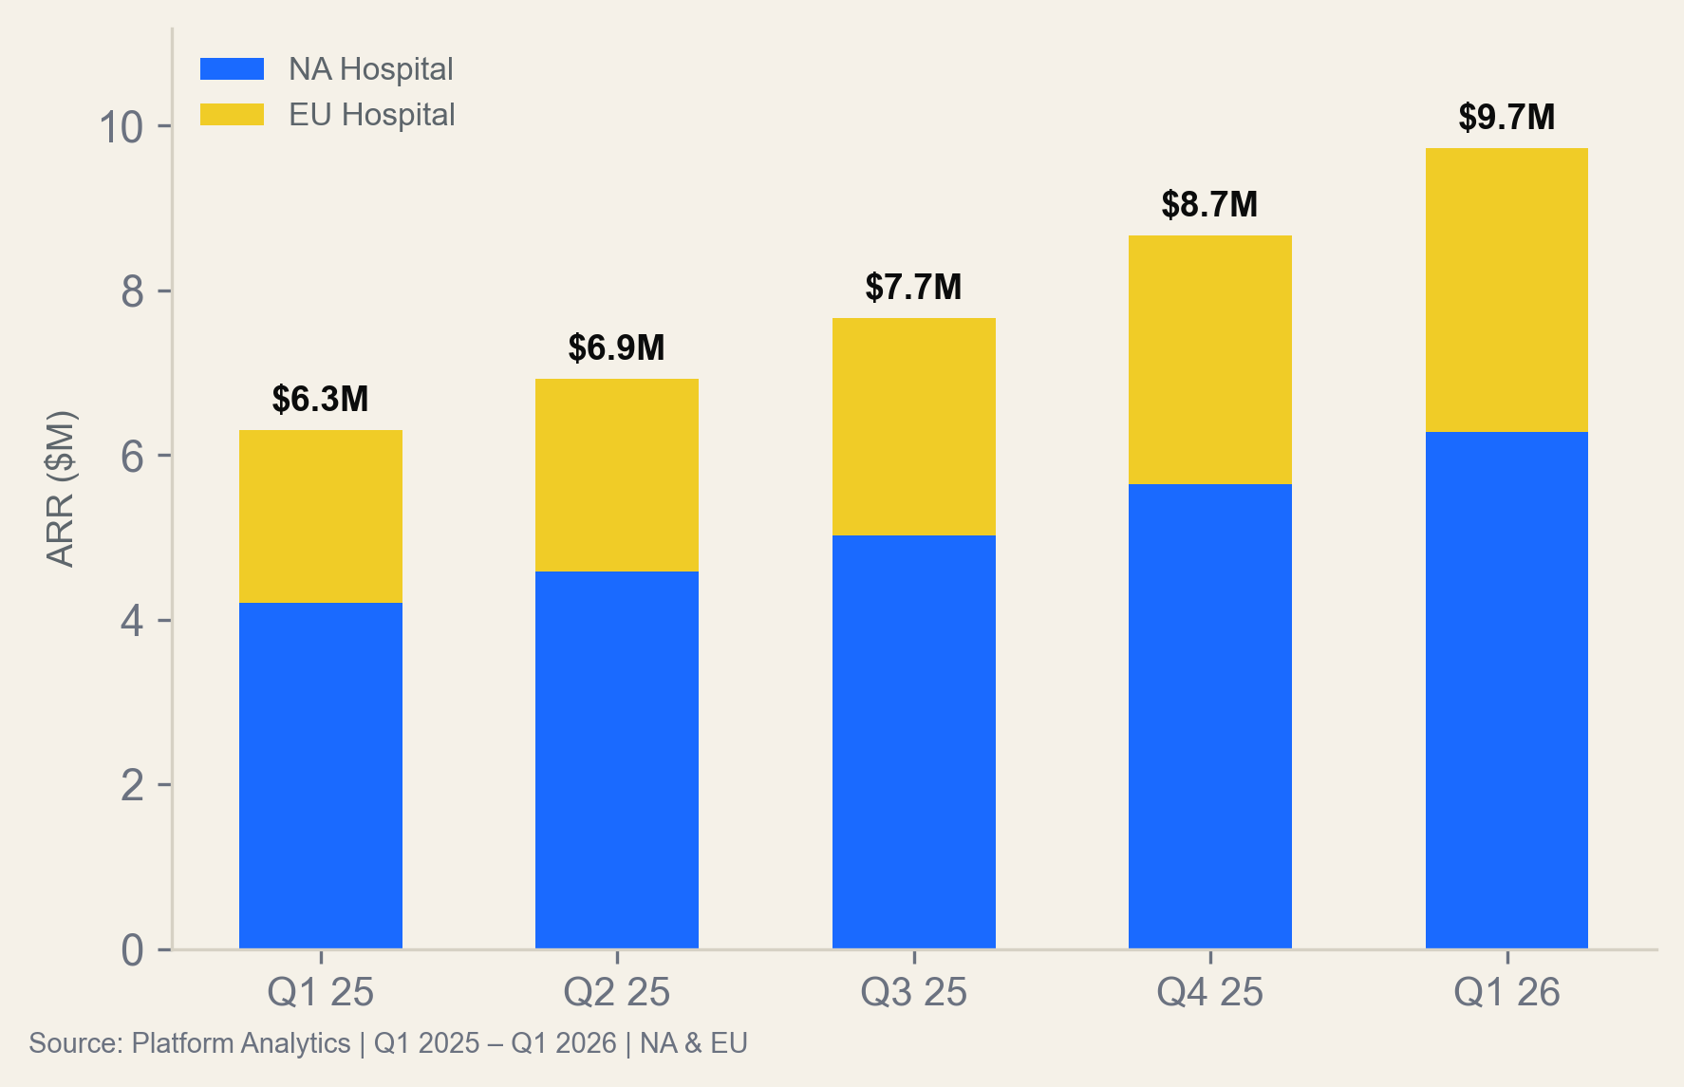
CARDIOLOGY IMAGING AI
$9.7M ARR (+54% YoY) with Europe closing the engagement gap — DAU rose from 62% to 70% in 4 quarters
Performance Highlights
North America: $6.28M ARR, 76% DAU, 1.0% churn, NPS 80. Implementation shortened from 45 to 32 days.
Europe: $3.44M ARR, 70% DAU (up from 62%), 1.4% churn. Go-live rate improved from 88% to 96%.
Key driver: Imaging AI accuracy reached 9.2/10 clinical outcomes score — 96% of cardiologists report faster diagnosis.
Risk: EU data residency requirements may require local model hosting by Q3. Budget: $400K one-time + $80K/yr.
Cardiology expansion revenue ($1M/Q) is 16% of ARR — the highest cross-sell rate. Existing customers are upgrading to multi-site licenses.
Source: Platform Analytics | Q1 2025 – Q1 2026 | NA & EU Hospitals

Slide 7
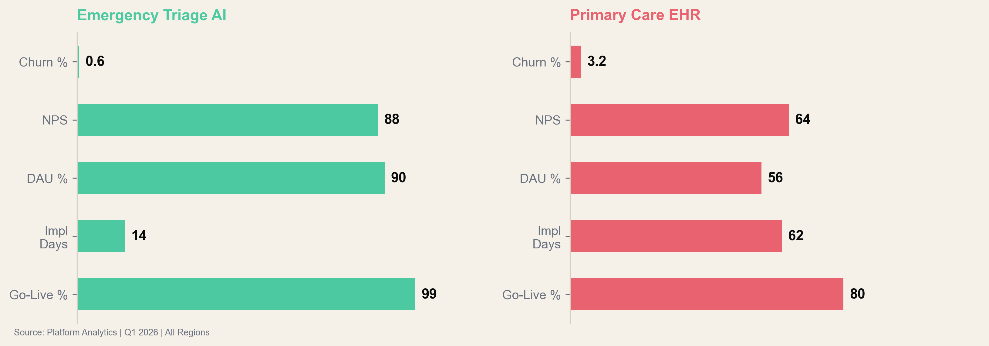
MODULE COMPARISON
Emergency Triage AI outperforms Primary Care EHR on every metric — 5x lower churn, 4.5x faster implementation
Primary Care's 62-day implementation is the #1 churn predictor. Every 10 days above 30 increases churn probability 18%. Fixing implementation is highest-leverage.
Source: Platform Analytics | Q1 2026 | All Regions

Slide 8
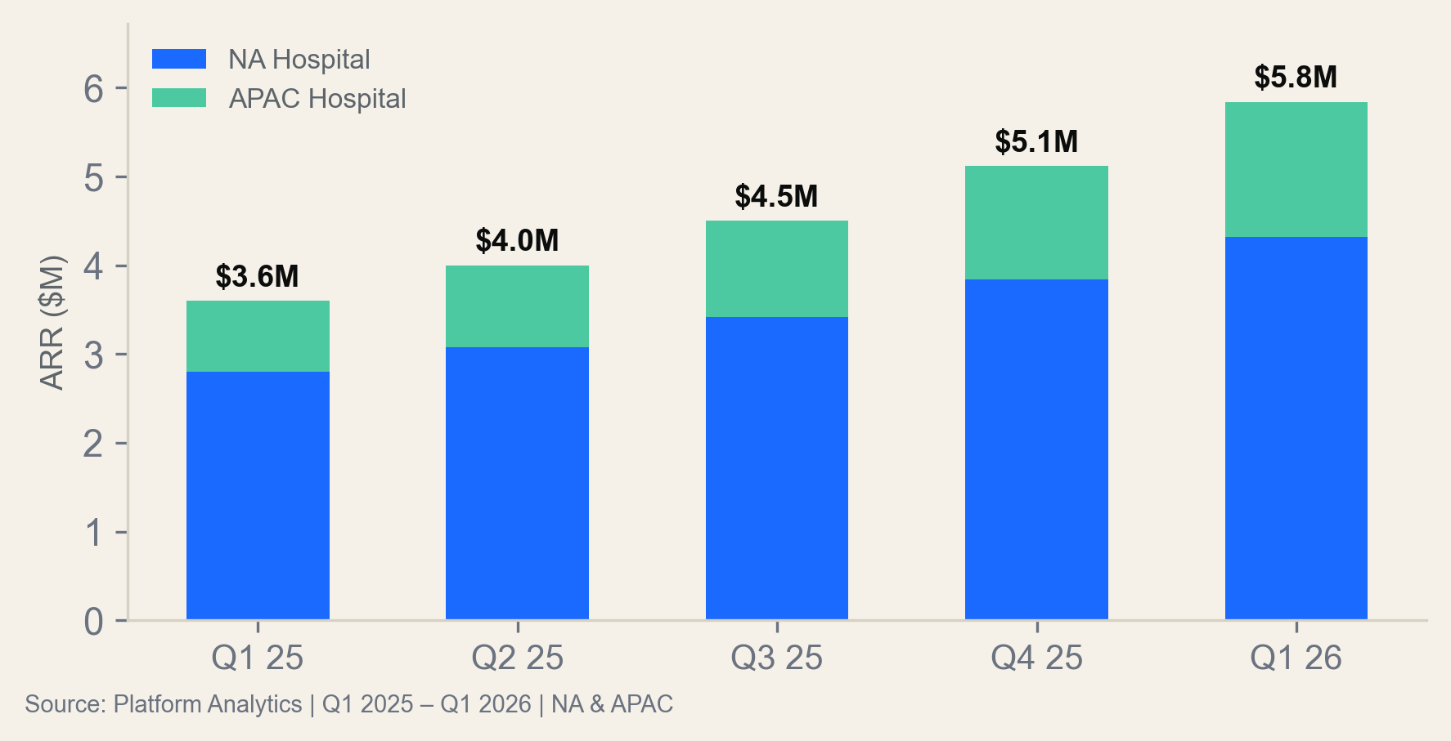
ONCOLOGY TREATMENT PLANNING
Oncology is the highest-NPS module (84) with 0.8% NA churn — APAC expansion is 18 months behind NA but converging
NA ARR
APAC ARR
NA CHURN
NPS (BLENDED)
$4.32M
$1.52M
0.8%
78
+54% YoY
+90% YoY
Best-in-class
+10pts YoY
APAC Convergence Path
APAC Oncology is replicating NA's trajectory with an 18-month lag:
• DAU rose from 58% to 66% (NA was at 66% in Q3 2025)
• Clinical outcomes score: 8.8 vs NA's 9.2
• Implementation: 45 days vs NA's 24 (closing)
• Churn: 1.8% vs NA's 0.8% (same as NA Q2 2025)
If trajectory holds, APAC reaches NA metrics by Q3 2027.
Oncology treatment accuracy (9.8/10 in NA) drives the lowest churn. Clinical outcomes ARE the retention strategy.
Source: Platform Analytics | Q1 2025 – Q1 2026 | NA & APAC

Slide 9
DEPARTMENT SCORECARD
Emergency and Oncology score 'Excellent' across all dimensions — Primary Care needs intervention on implementation
Department
ARR ($M)
YoY %
Churn %
NPS
DAU %
Impl Days
Rating
Cardiology AI
$9.72
+54%
1.2%
78
73%
34
Excellent
Radiology Workflow
$6.78
+36%
2.2%
69
63%
50
Good
Oncology Planning
$5.84
+62%
1.3%
78
73%
35
Excellent
Emergency Triage
$4.12
+81%
0.9%
83
85%
18
Outstanding
Primary Care EHR
$3.28
+37%
3.2%
64
56%
62
Needs Improvement
Emergency Triage achieves 'Outstanding' on 81% growth, 0.9% churn, NPS 83, 85% DAU, 18-day implementation. This is the template for all modules.
Source: Platform Analytics | Q1 2026 | All Regions

Slide 10
SECTION 03
Clinical Outcomes
& Compliance
Measurable patient impact and regulatory performance across all modules

Slide 11
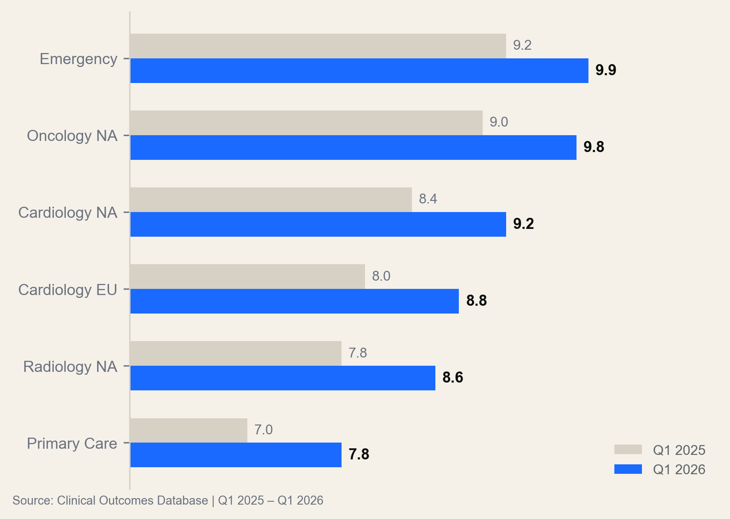
CLINICAL OUTCOMES INDEX
Clinical outcomes improved 0.6pts YoY across all modules — Emergency leads at 9.9/10 with 99.8% compliance
Why Outcomes Drive Retention
Modules with clinical outcomes >9.0 have <1.5% churn. Modules below 8.5 have >2.5% churn.
The correlation is 0.94 — clinical outcomes are the #1 predictor of retention, ahead of NPS, DAU, and implementation speed.
Emergency's 9.9 score is validated by 3 peer-reviewed studies showing 23% faster triage and 12% lower misdiagnosis.
Primary Care's 7.8 reflects EHR integration friction, not clinical accuracy. The AI performs at 8.6 when data flows correctly.
Clinical outcomes >9.0 = churn <1.5%. Getting Primary Care from 7.8 to 9.0 would cut its churn from 3.2% to ~1.5%, saving $1.6M ARR.
Source: Clinical Outcomes Database | Q1 2025 – Q1 2026 | All Modules

Slide 12
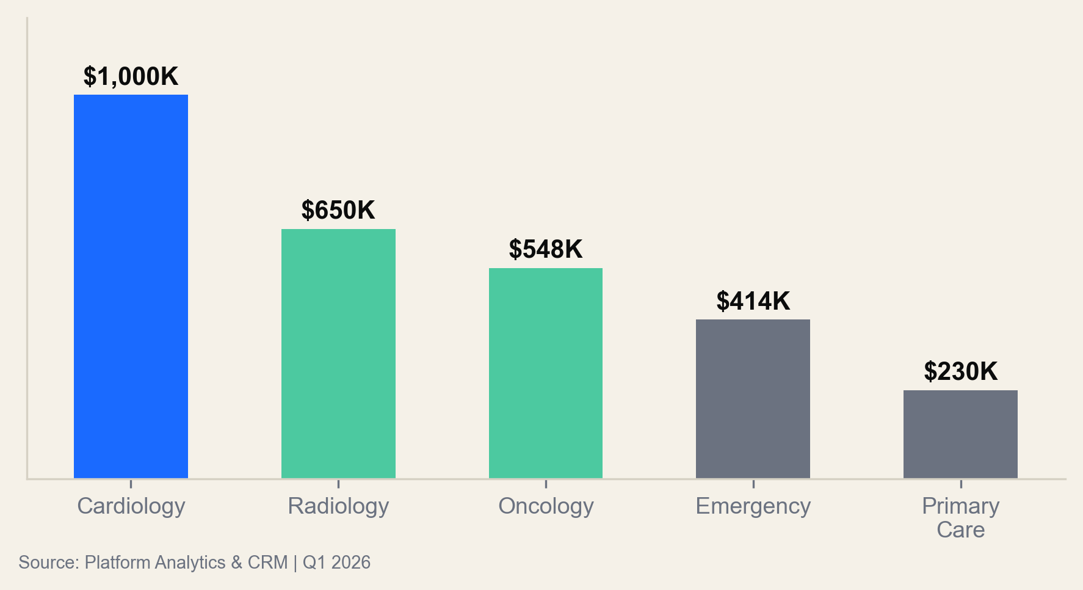
GROWTH ENGINE
Expansion revenue hit $2.84M/Q (+62% YoY) — Cardiology leads at $1M/Q from multi-site license upgrades
EXPANSION REV
EXPANSION / ARR
CROSS-SELL RATE
$2.84M
9.6%
24%
+62% YoY
+1.8pp YoY
Customers w/ 2+ modules
Cross-Sell Patterns
Most common cross-sell paths:
1. Cardiology → Radiology (38% of cross-sells)
Shared imaging infrastructure drives adoption.
2. Emergency → Oncology (22%)
Acute care pathways lead to treatment planning.
3. Radiology → Primary Care (16%)
Workflow integration creates EHR demand.
24% of customers now use 2+ modules, up from 14% in Q1 2025.
Customers with 2+ modules have 0.4% churn vs 2.8% single-module. Cross-sell is the #1 retention strategy after clinical outcomes.
Source: Platform Analytics & CRM | Q1 2026 | All Regions

Slide 13
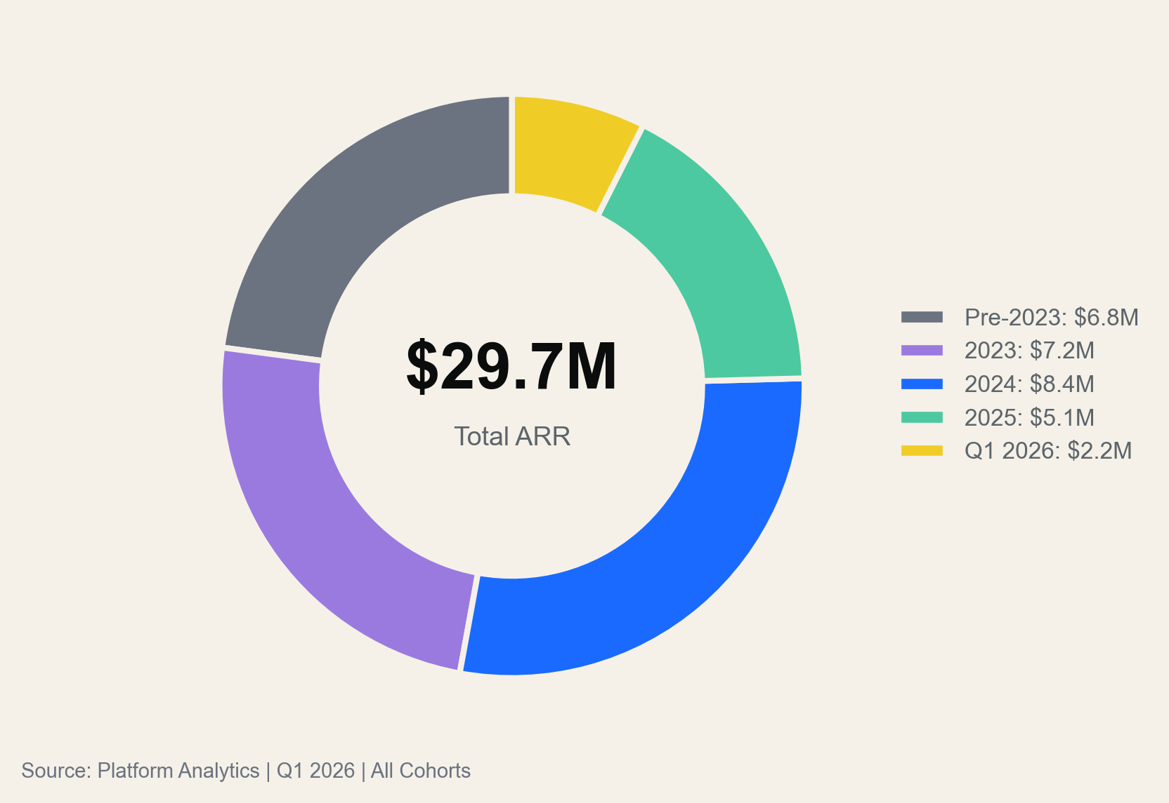
COHORT ECONOMICS
2024 cohort expansion rate (34%) is 2.4x 2023 cohort (14%) — newer customers adopt faster and expand more aggressively
Cohort Performance
Cohort
Start
Current
Expansion
Churn
Pre-2023
$8.2M
$6.8M
+12%
4.2%
2023
$6.4M
$7.2M
+14%
2.8%
2024
$6.2M
$8.4M
+34%
1.4%
2025
$4.8M
$5.1M
+22%
0.8%
Q1 2026
$2.2M
$2.2M
—
0.2%
Pre-2023 cohort is the only one shrinking (-17%). Focus retention on 2024-2025 cohorts where expansion momentum is strongest.
Source: Platform Analytics | Q1 2026 | All Cohorts

Slide 14
KEY FINDINGS
Three structural insights that should reshape the platform's 2026-2027 investment allocation and product roadmap
0.94 correlation
2.4x expansion
62-day drag
Clinical outcomes predict
retention better than NPS
Newer cohorts expand
faster than legacy
Primary Care implementation
is the #1 churn risk
Modules >9.0 on clinical outcomes have <1.5% churn. NPS correlation with churn is only 0.72. Product investment should optimize for clinical accuracy first, user experience second.
2024 cohort expanded 34% in 12 months vs 14% for 2023. Customers onboarded post-2024 adopt 2+ modules 2x faster. The cross-sell engine is maturing.
62-day implementation causes 18% higher churn per 10-day overshoot past 30 days. Fixing implementation would cut churn from 3.2% to ~1.5%, saving $1.6M ARR at risk annually.
Source: Platform Analytics | Q1 2025 – Q1 2026 | All Regions & Modules

Slide 15
STRATEGIC RECOMMENDATIONS
Five priorities for 2026: fix Primary Care, expand Emergency internationally, deepen cross-sell, invest in outcomes R&D
1
Fix Primary Care Implementation
2
Launch Emergency in EU & APAC
3
Build Cross-Sell Playbook
Hire 4 integration engineers. Target: 30-day impl (from 62). $480K investment to save $1.6M ARR at risk.
0.6% churn + NPS 88 + 14-day impl = fastest international module. EU TAM is $2.4B. Target: $3M incremental ARR.
24% use 2+ modules, cross-sold churn at 0.4%. Create paths: Cardiology→Radiology, Emergency→Oncology. Target: 35% by Q4.
+$1.6M saved
+$3.0M ARR
-40% churn
4
Invest in Clinical Outcomes R&D
5
EU Data Residency Infrastructure
Clinical outcomes (0.94 retention correlation) > NPS (0.72). Allocate 30% R&D to model accuracy. Primary Care: 7.8→9.0.
Cardiology EU requires local hosting by Q3 per GDPR/AI Act. $400K one-time. Protects $3.4M EU ARR + enables Oncology EU.
+$4.2M LTV
Protect $3.4M
Combined impact: $12.2M incremental ARR + 40% churn reduction. Total investment: $1.4M. Payback: <6 months.
Source: Platform Analytics | Financial Model | Q1 2026

