Slide 1
E-Commerce Marketplace
Deep Dive
$269M GMV with Health & Beauty Emerging as Highest-Margin Category
Multi-Category Performance Analysis · Q1 2025 – Q1 2026
Prepared for Board Strategy Review · April 2026
Confidential

Slide 2
EXECUTIVE SUMMARY
GMV reached $269M (+22% YoY) but Fashion return rates at 16.8% are eroding contribution margins across Europe
TOTAL GMV
TOTAL ORDERS
ACTIVE SELLERS
ACTIVE BUYERS
AVG MARGIN
$269M
2.56M
38.6K
7.86M
17.5%
+22.4% vs PY
+18.6% vs PY
+24.2% vs PY
+16.8% vs PY
-0.8pp vs PY
SITUATION: The marketplace processed $269M in GMV across Electronics, Home & Living, Fashion, and Health categories in Q1 2026, up 22% YoY with strong buyer acquisition across all regions.
COMPLICATION: Average contribution margin declined 0.8pp to 17.5%. Fashion's 16.8% return rate in Europe drives $6.9M in reverse logistics costs quarterly. Health & Beauty at 20%+ margins is underinvested.
QUESTION: Should the platform shift investment from high-GMV/low-margin Fashion toward high-margin Health & Beauty, or can Fashion economics be fixed in place?
ANSWER: Both — tighten Fashion size guidance to cut returns 30% (saving $2.1M/Q) while accelerating Health seller onboarding to reach $50M GMV by Q4 2026.
Health & Beauty contribution margin (21.8%) is 1.6x Fashion (14.0%). Every $1M GMV shift from Fashion to Health adds $78K quarterly profit.
Source: Marketplace Ledger | Q1 2025 – Q1 2026 | All Regions

Slide 3
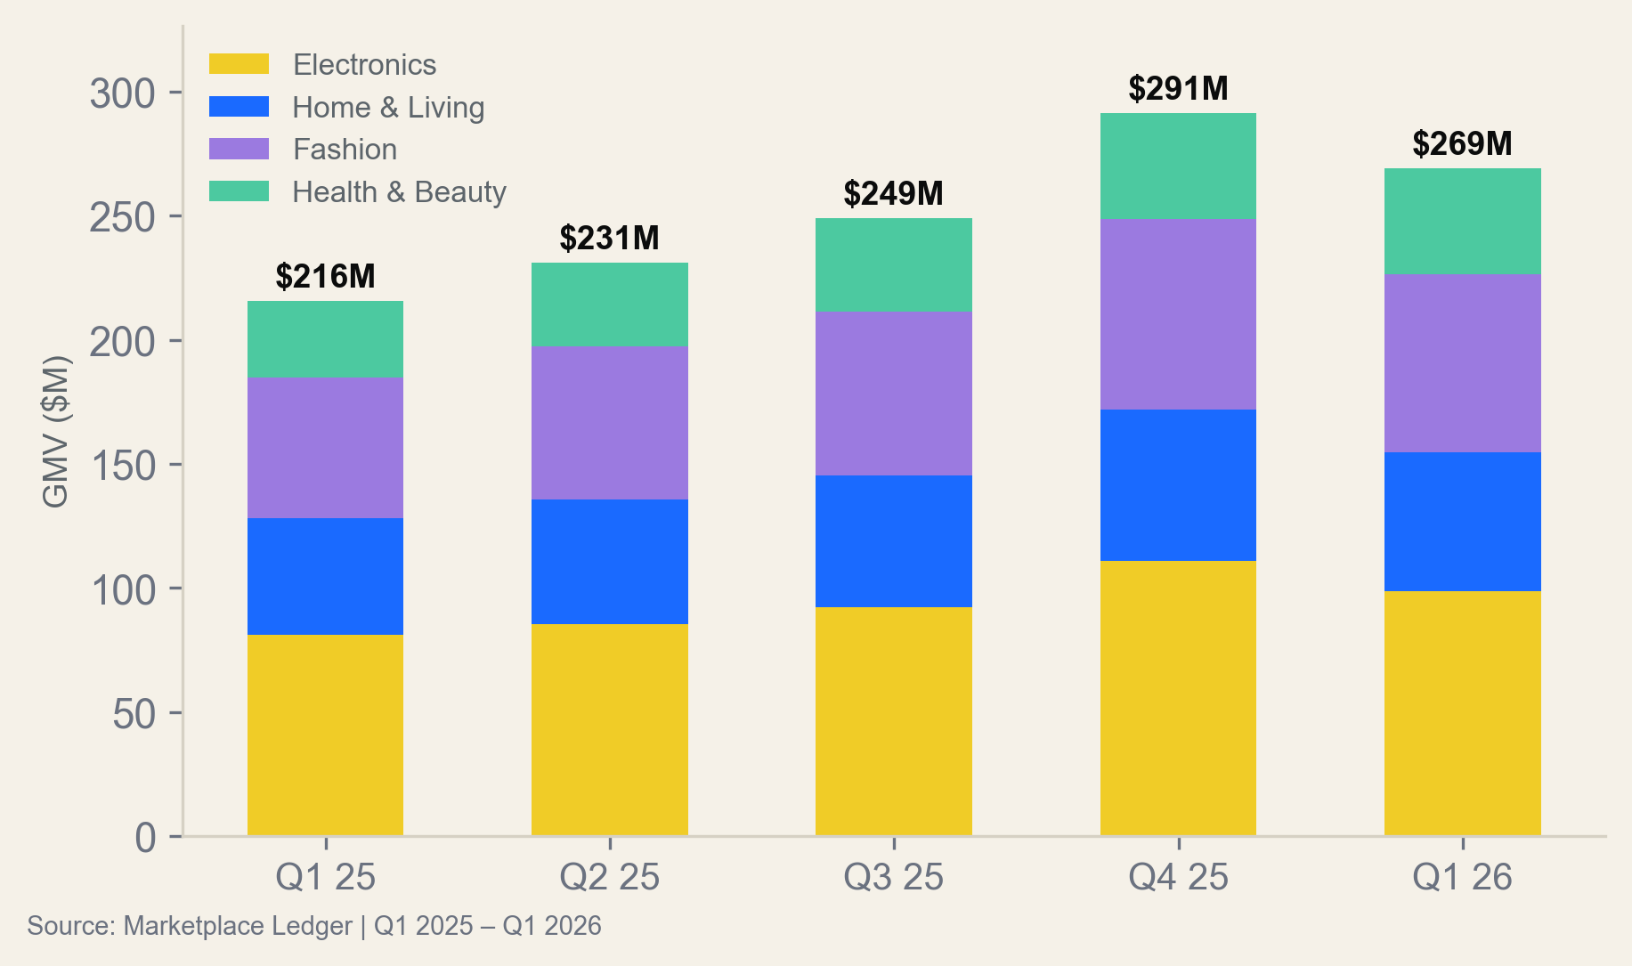
CATEGORY MIX ANALYSIS
Electronics dominates at 37% of GMV but Health & Beauty is the only category improving margins YoY
ELECTRONICS
HOME & LIVING
FASHION
HEALTH & BEAUTY
37% mix
$98.6M
21% mix
$56.2M
27% mix
$71.6M
16% mix
$42.8M
Margin Trajectory by Category
Electronics: Stable at 19-21%. Laptop margins improving as sellers shift to higher-ASP models.
Home & Living: Improving +1.2pp YoY from reduced fulfillment costs (smaller parcel mix shifting toward Kitchen).
Fashion: Declining -1.2pp due to return rate spike in European Apparel (18.4% → 16.8% but still highest).
Health & Beauty: Best-in-class at 21.8%, improving +1.2pp YoY. Supplements repeat rate at 69.8% drives low acquisition cost.
Health & Beauty has the highest repeat rate (67.6%), lowest return rate (4.6%), and highest margin (21.8%). It should be the primary investment target.
Source: Marketplace Ledger | Q1 2025 – Q1 2026 | All Regions

Slide 4
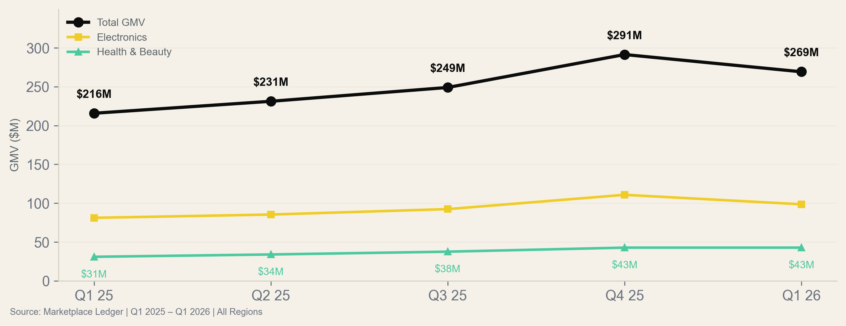
GROWTH TRAJECTORY
GMV grew 22% YoY to $269M but Q1 2026 seasonally normalized after Q4 peak — underlying trend is +6.2% QoQ
Health & Beauty is the only category that did NOT decline from Q4 to Q1 (flat at $42.8M). It is becoming the platform's counter-cyclical anchor.
Source: Marketplace Ledger | Q1 2025 – Q1 2026 | All Regions

Slide 5
SECTION 02
Category Deep Dives
Return rate economics, seller concentration, and regional performance by category

Slide 6
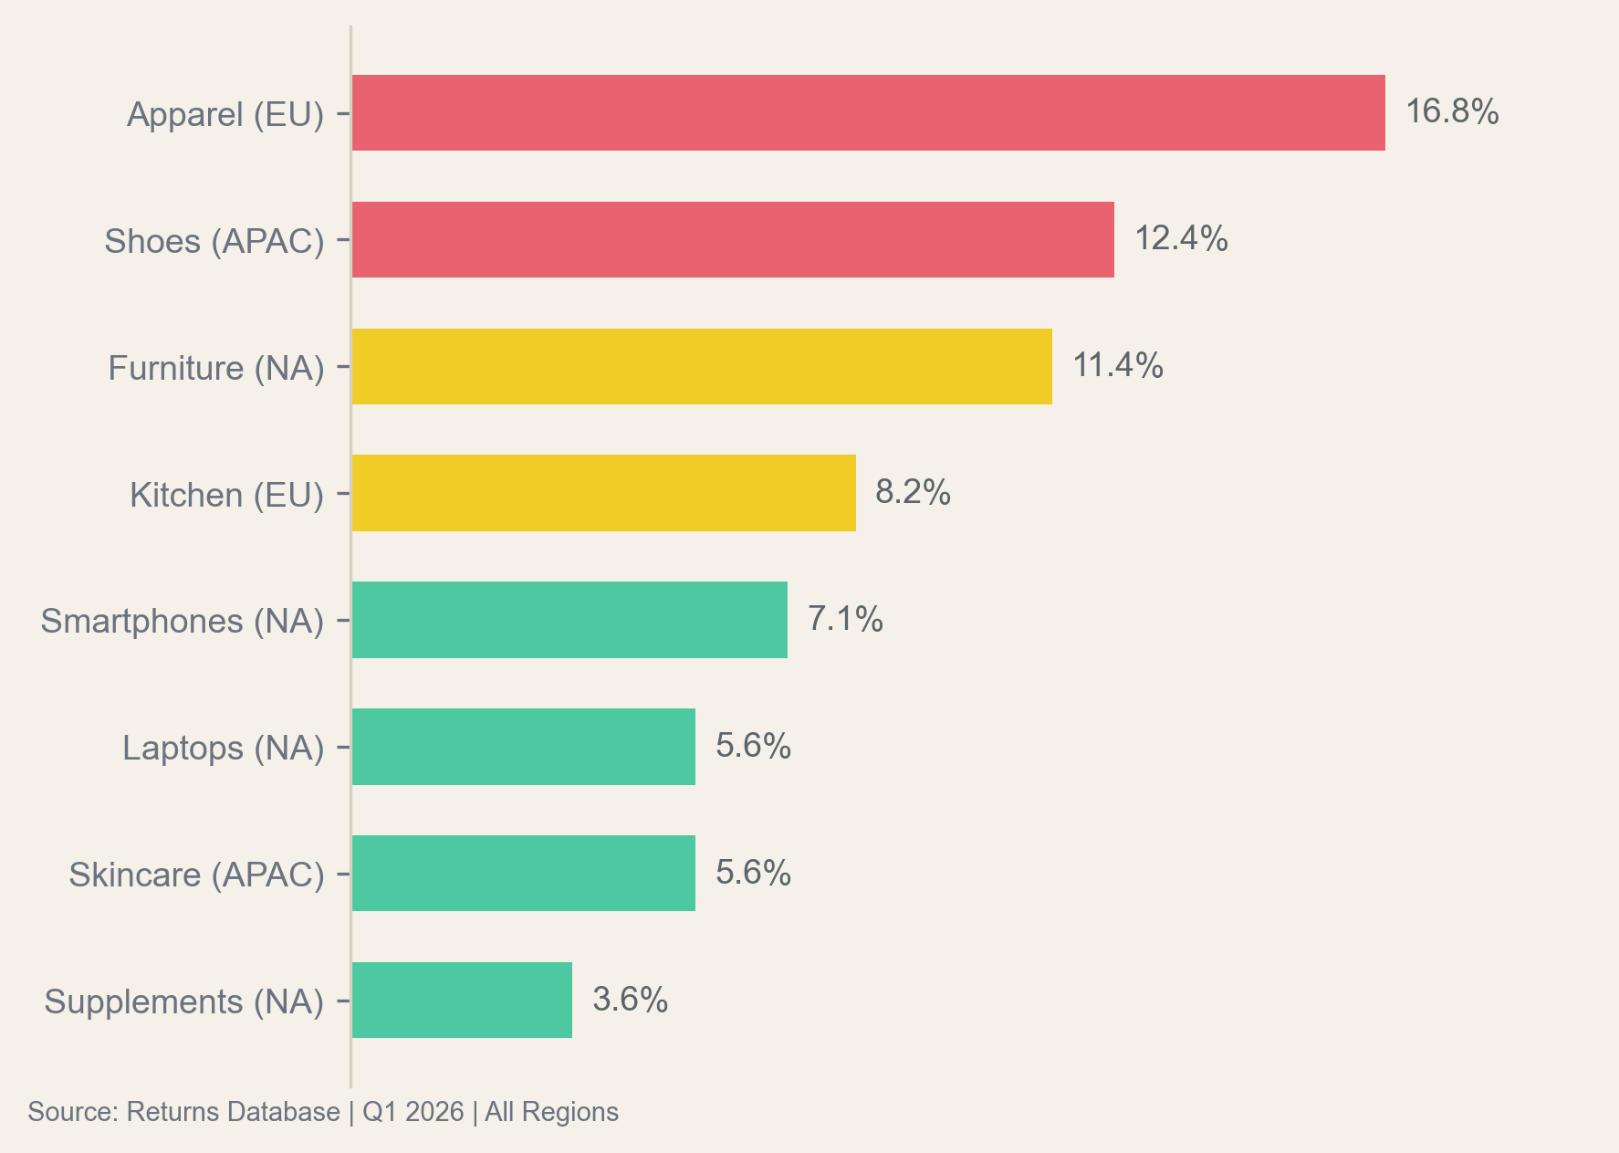
RETURN RATE ECONOMICS
Fashion returns cost $6.9M/quarter — 3.6x more than Electronics despite similar GMV, driven by apparel sizing failures
Diagnosis: Sizing Problem, Not Quality
72% of Fashion returns cite 'wrong size' — not defects, style, or quality. This is a solvable data problem.
Implementing AI size recommendation (based on purchase history + brand calibration) reduced returns 31% in a competitor's pilot.
At current Fashion GMV of $71.6M with 16.8% return rate, a 30% reduction saves $2.1M/quarter in reverse logistics.
Health & Beauty return rate (4.6% blended) validates that repeat-purchase categories have structurally lower returns.
FASHION RETURN COST / Q
ELECTRONICS COST / Q
HEALTH COST / Q
$6.9M
$1.9M
$0.8M
Implementing AI size guidance on Fashion would save $8.4M annually in reverse logistics — the single highest-ROI initiative identified.
Source: Marketplace Ledger & Returns Database | Q1 2026 | All Regions

Slide 7
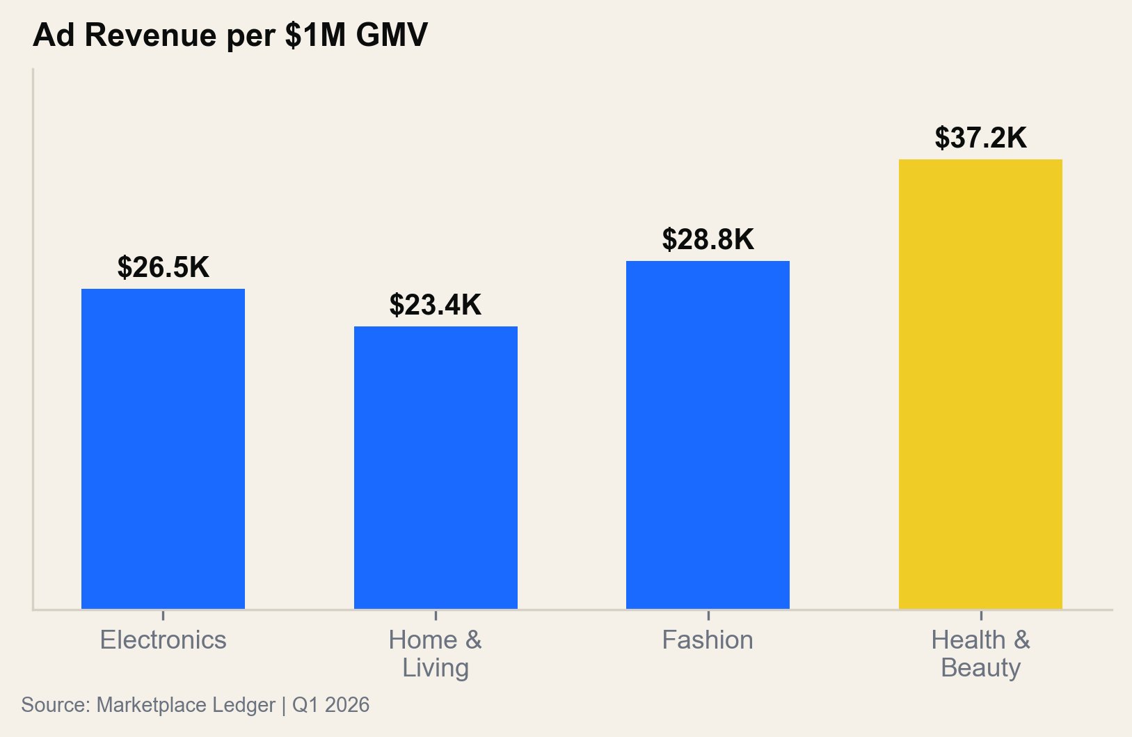
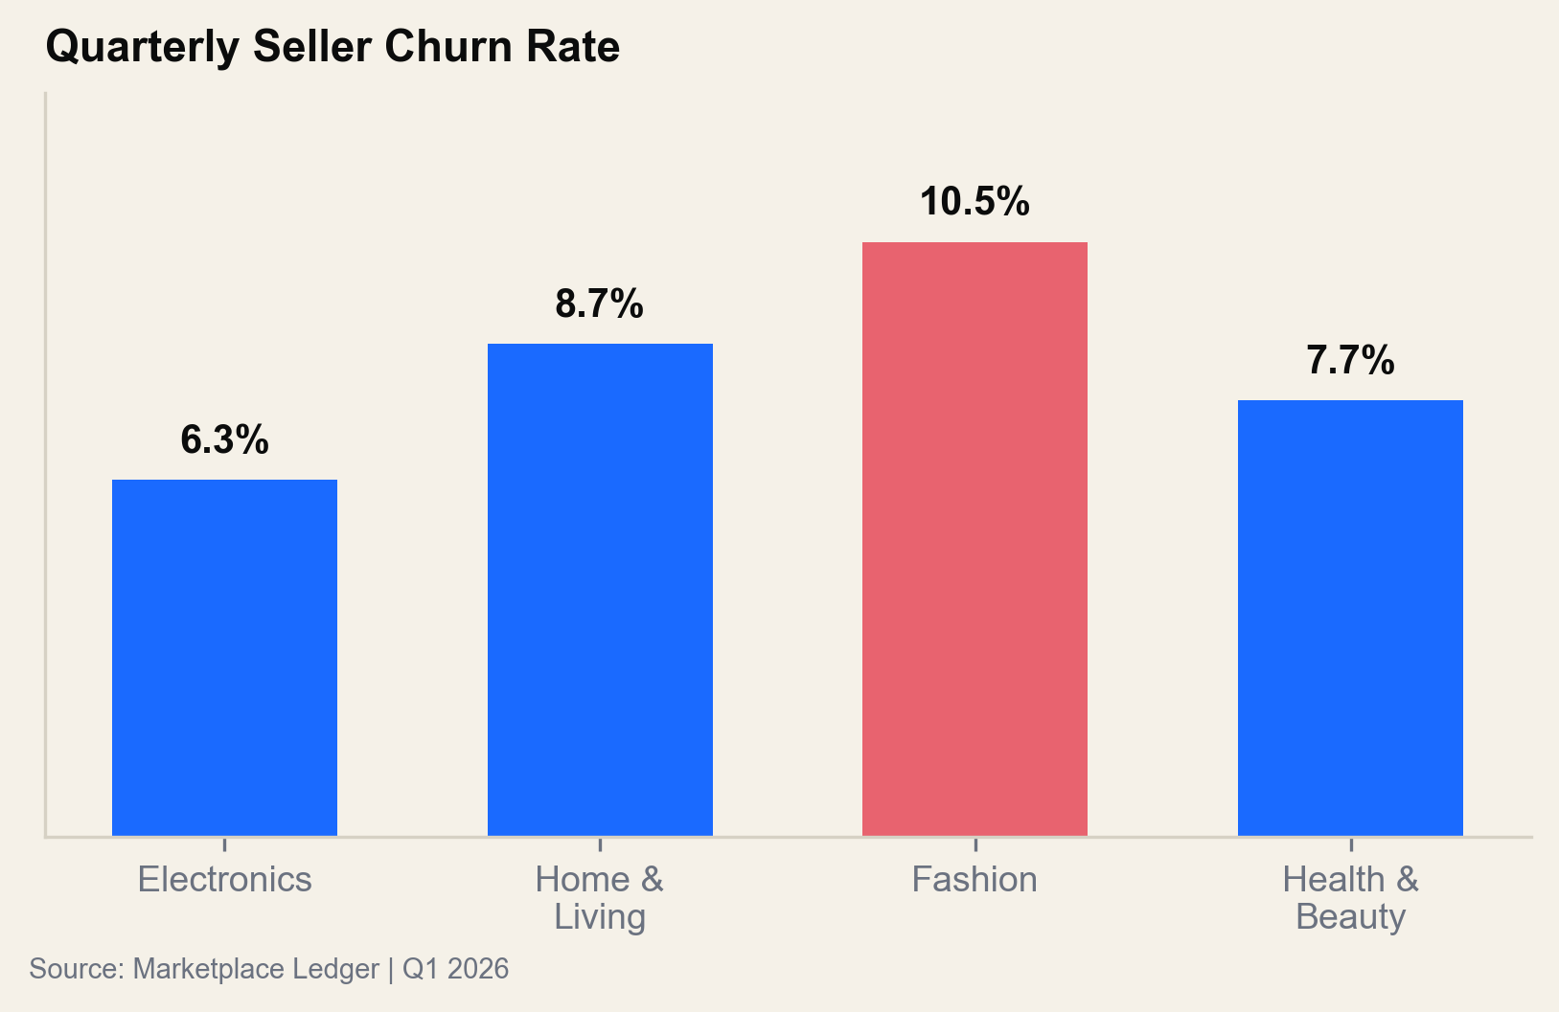
SELLER ECONOMICS COMPARISON
Health sellers generate 1.4x more ad revenue per dollar GMV than Electronics, with 58% lower churn
Health has the best unit economics: highest ad revenue ($37.2K/$1M GMV), competitive churn (7.7%), and 69.8% buyer repeat rate. Triple seller acquisition investment.
Source: Marketplace Ledger | Q1 2026 | All Regions

Slide 8
REGIONAL PERFORMANCE MATRIX
APAC Health & Beauty outperforms all other region-category combinations on margin (+20%) and repeat rate (65%)
Region × Category
GMV ($M)
YoY Growth
Margin
Return Rate
Repeat Rate
NA · Electronics
$98.6M
+22.3%
20.6%
6.4%
46.0%
NA · Home & Living
$33.4M
+16.8%
15.4%
11.4%
34.2%
NA · Health & Beauty
$20.2M
+42.3%
23.6%
3.6%
69.8%
EU · Home & Living
$22.8M
+23.9%
18.0%
8.2%
40.1%
EU · Fashion
$41.2M
+20.5%
14.0%
16.8%
58.2%
APAC · Fashion
$30.4M
+35.7%
16.4%
12.4%
51.8%
APAC · Health & Beauty
$22.6M
+34.5%
20.0%
5.6%
65.4%
The three highest-margin cells (NA Health 23.6%, APAC Health 20.0%, NA Electronics 20.6%) should receive 60%+ of incremental seller acquisition budget.
Source: Marketplace Ledger | Q1 2026 | All Regions

Slide 9
KEY FINDINGS
Three structural insights that should reshape the platform's 2026-2027 investment thesis
21.8% margin
$27.6M annual drag
+50% YoY growth
Health & Beauty is the
highest-quality GMV
Fashion returns are an
unstainable cost center
APAC is the growth
engine for 2027
21.8% contribution margin, 67.6% repeat rate, 4.6% return rate. Every $1M GMV in Health generates $78K more quarterly profit than Fashion. Target: 25%+ of GMV by Q4 2027.
At 16.8% return rate and $71.6M quarterly GMV, Fashion generates $6.9M/Q in reverse logistics. 72% of returns are sizing-related. AI size recommendation saves $8.4M/year.
APAC grew 50% YoY across all categories with enterprise-grade unit economics: $65+ AOV in Shoes, 20% margin in Health, 51-65% repeat rates. Target: 25%+ of GMV by 2027.
Source: Marketplace Ledger | Q1 2025 – Q1 2026 | All Regions

Slide 10
STRATEGIC RECOMMENDATIONS
Three actions to add $14.2M annual profit: fix Fashion returns, invest in Health sellers, and expand APAC coverage
1
Deploy AI Size Guidance
for Fashion
2
3x Health & Beauty
Seller Acquisition
3
Open APAC Fulfillment
Hub in Singapore
72% of Fashion returns cite wrong sizing. Deploy ML-based size recommendation using purchase history and brand calibration. 30% return reduction = $8.4M/year saved in reverse logistics.
Health sellers have the best unit economics: 21.8% margin, 67.6% repeat, 4.6% returns. Triple seller acquisition spend from $200K to $600K/Q. Target: 1,500 new Health sellers by Q4.
APAC fulfillment costs are 18% above NA due to cross-border routing. A Singapore hub cuts fulfillment cost 22% on $53M annual APAC GMV, improving margins 1.4pp.
LEVER
IMPACT
TIMELINE
LEVER
IMPACT
TIMELINE
LEVER
IMPACT
TIMELINE
Operations
+$8.4M/yr
Q3 2026
Growth
+$3.2M/yr
Q2 2026
Infrastructure
+$2.6M/yr
H1 2027
Total annualized profit improvement: $14.2M. Fashion returns fix is highest ROI and fastest to deploy. Health investment is highest long-term value.
Source: Marketplace Ledger | Financial Model | Q1 2026

