Slide 1

K-Means clustering
OpenMP and CUDA
Marco Di Rienzo
Final-term assignment

Slide 2
Introduction

Slide 3


Abstract
The goal of this project is to parallelize the K-Means Clustering algorithm and analyze the performance gain with respect to the sequential version.
One parallel versions has been created using the OpenMP framework and another using CUDA to run on the GPU.
The performance gain is measured in terms of
3

Slide 4
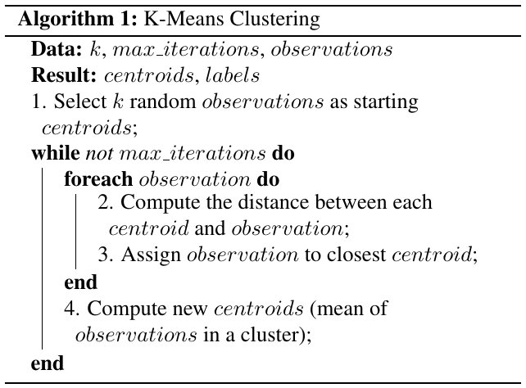
Pseudocode
The algorithm can be divided in 4 steps.
The embarassingly parallel portion of the algorithm is the FOR loop (steps 2. and 3.), every iterarion is independent from one another.
Observations can be distributed among any number of threads.
4

Slide 5
Implementation

Slide 6
Sequential
The sequential implementation is basically a C++ translation of the pseudocode, with some nuances:
observations and centroids are organized as Structure of Arrays to improve the alignment with cache lines and benefit of the memory bursts when accessing the various coordinates;
step 4. is partially executed in the for loop, in particular the sum required to compute the mean is updated as soon as a point is assigned to a centroid. This avoids having to loop again on every observation.
6

Slide 7
OpenMP
The directive #pragma omp parallel for allows splitting observation indices among threads, so that each one will be assigned a different subset of the dataset.
N = coresNumber threads
Thread 1
for (int i=0;
i<datasetSize/N; i++) {
• assign point[i] to centroid
• update local partial sum
}
Thread 2
for (int i=datasetSize/N; i<datasetSize*2/N; i++) {
• assign point[i] to centroid
• update local partial sum
}
Thread N
for (int i=datasetSize*(N-1)/N; i<datasetSize; i++) {
• assign point[i] to centroid
• update local partial sum
}
7

Slide 8
Since a partial sum of points in a cluster is maintained in each thread, a final reduction is needed to extract the total sum and be able to compute the mean; this is accomplished with the directive #pragma omp declare reduction(...) which allows to specify a reduction function to conglomerate the data of each thread.
Thread 1
Thread 2
Thread N
Calculate new centroids
8

Slide 9
CUDA
Each thread is assigned a single observation, this way, the FOR loop can be removed and so the maximum parallelization possible is achieved.
N = datasetSize threads
Thread idx=1
• assign point[idx] to centroid
• atomically update global partial sum
Thread idx=2
• assign point[idx] to centroid
• atomically update global partial sum
Thread idx=N
• assign point[idx] to centroid
• atomically update global partial sum
9

Slide 10
Step 1. is done on the host.
Two kernels are used to complete step 2., 3. and 4.
Kernel 1:
assign points to centroids
update partial sums
cudaDeviceSynchronize();
Kernel 2:
use final sums to calculate new centroids
Two kernels are necessary because the whole grid needs to be synchronized to get final sums.
10

Slide 11
The memory management is as follows:
observations and centroids are copied from host to device global memory
At each kernel execution:
centroids are pulled by threads into shared memory
threads atomically update sums into global memory
When final centroids are found, structures are copied back to host.
11

Slide 12
Tests

Slide 13
Hardware:
CPU Intel Core i5-4670 (4-core)
GPU Nvidia GeForce GTX 770 (compute capability 3.0)
Dataset:
Number of elements: 100,000
Points dimension: 2
Number of centroids: 10 (if not stated otherwise)
13

Slide 14
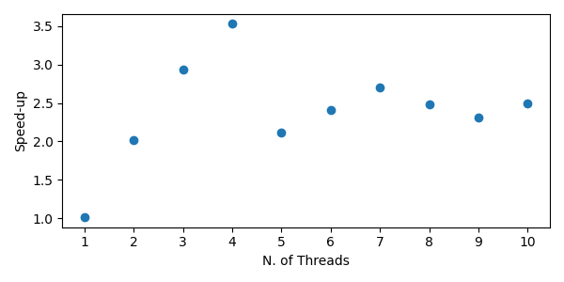
OpenMP
The parallel program was run with varying number of threads with the purpose to find the optimum value.
Max speed-up: 3.53
with 4 threads
Around 2.4 with more threads
14

Slide 15
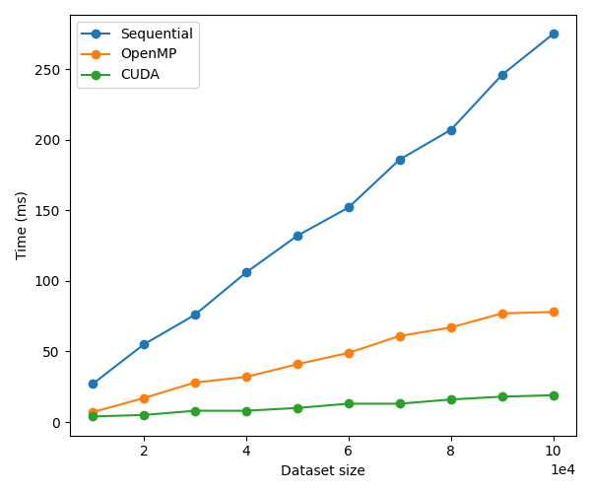
CUDA
The first test was done increasing the dataset size to appreciate the scaling of the various parallelization methods.
Max speed-up: 14.47
with 100k elements
Scaling to dataset size:
Sequential: linear
OpenMP: linear
CUDA: sub-linear
15

Slide 16
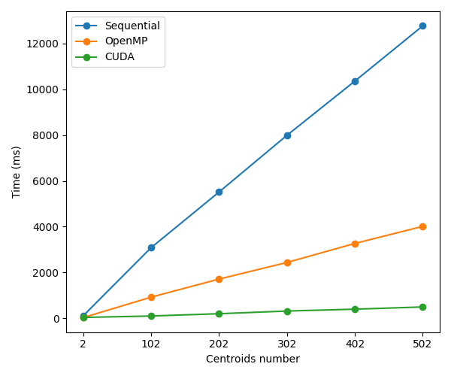
Another test was done by increasing the number of centroids.
Since the loop on the centroids is executed inside the thread, the execution time grows linearly for every implementation, but the greater the parallelizzation, the greater the speed-up.
OpenMP Max speed-up: 3.32
CUDA Max speed-up: 29.13
Scaling to centroids number:
Sequential: linear
OpenMP: linear
CUDA: linear
16

