Slide 1

C++11 Thread Pool
Marco Di Rienzo
Mid-term assignment

Slide 2
Introduction

Slide 3

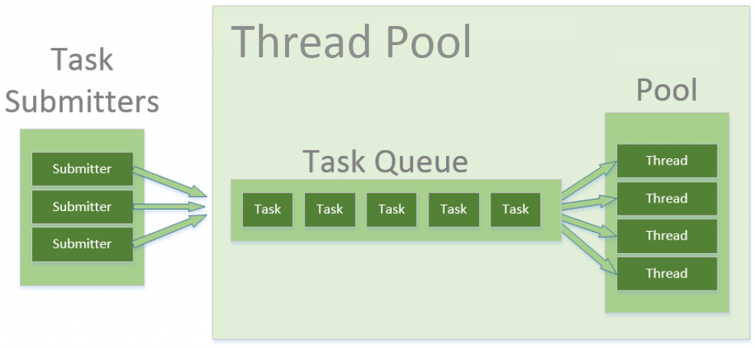
Thread pools
Thread pools provide a way
to reduced per-task invocation overhead
to manage resources, including threads, consumed when executing a collection of tasks
When you use a thread pool, you submit concurrent tasks for execution to an instance of a thread pool. This instance controls several reused threads for executing these tasks.
3

Slide 4
Advantages
threads can be created beforehand, allowing to put a strict upper limit on the total number of threads and hence resources that are allocated concurrently
threads of the pool are not destroyed until the pool itself is terminated and can be reused for multiple tasks, avoiding the overhead of creating a thread for each one of your tasks
thread pools can also maintain some basic statistics such as the number of completed tasks
The trade-off is that once the pool is saturated, the execution of a new task will be delayed until a previous task is completed.
4

Slide 5
Abstract
The goal of this project is to implement a simple thread pool library in C++11.
The pool should have this features:
fixed size
threads of the pool may consume tasks as they become available
be able to get a Future representing the task
The API of the library is inspired by the Java class ThreadPoolExecutor.
5

Slide 6
Classes

Slide 7
Runnable
The Runnable interface should be implemented by any class whose instances are intended to be executed by a FixedThreadPool.
The class must define a method of no arguments called run.
Methods
void run()
Submitting an object implementing interface Runnable to a FixedThreadPool will cause the object's run method to be called in a separately executing thread.
7

Slide 8
FixedThreadPool
This class allows the creation of a pool that reuses a fixed number of threads operating off a shared unbounded queue.
At any point, at most a fixed number of threads will be active processing tasks.
If additional tasks are submitted when all threads are active, they will wait in the queue until a thread is available.
The threads in the pool will exist until it is explicitly shutdown.
8

Slide 9
Methods (refer to the paper for a complete list)
void execute(Runnable *command)
Executes the given command at some time in the future. The command will be executed by a thread of the pool.
template<class T>
std::future<T> submit(Runnable *task, T result)
Submits a Runnable task for execution and returns a Future representing that task. The Future's get method will return the given result upon successful completion.
The task will be executed by a thread of the pool.
9

Slide 10
Implementation

Slide 11
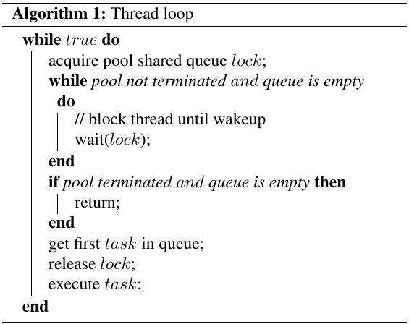
Thread loop
Every thread will wait for tasks to enter the shared queue, at which point one of them synchronously removes a task that can then be executed in parallel with others.
11

Slide 12
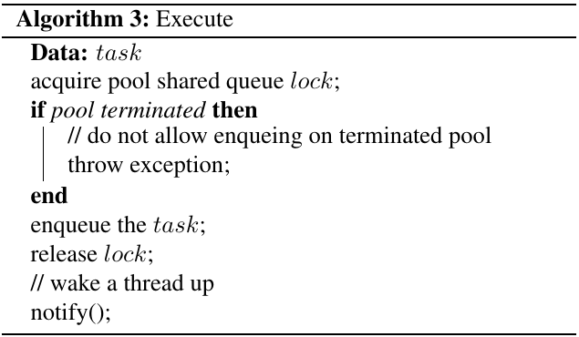
Execute
The execute method acquires the lock to add the task to the shared queue, then notifies a thread that a job has been added.
12

Slide 13
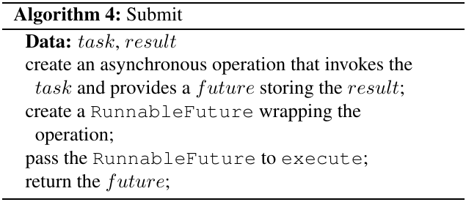
Submit
The submit method it is similar to the execute method but it returns a Future to the caller which is able to retrieve the result at a later time. To do this, a std::future representing the task is created and returned.
An adapter class RunnableFuture has been implemented to be able to pass the future operation to the execute method.
13

Slide 14
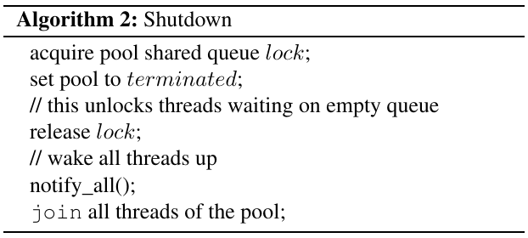
Shutdown
The shutdown method sets the pool to terminated state to allow threads waiting on empty queue to exit.
14

