Slide 1
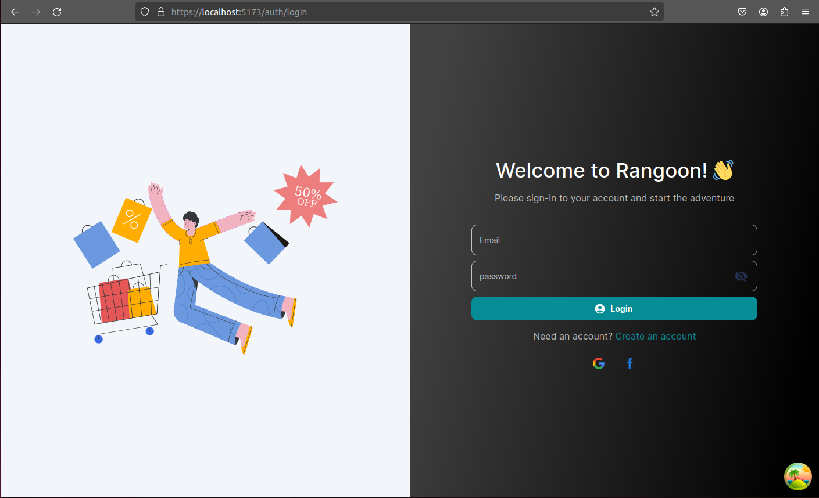
email: marco@admin.com
pass: 12345678@Abc
email: boo@shopowner.com
pass: 12345678@Abc
email: bob@user.com
pass: 12345678@Abc
Users

Slide 2
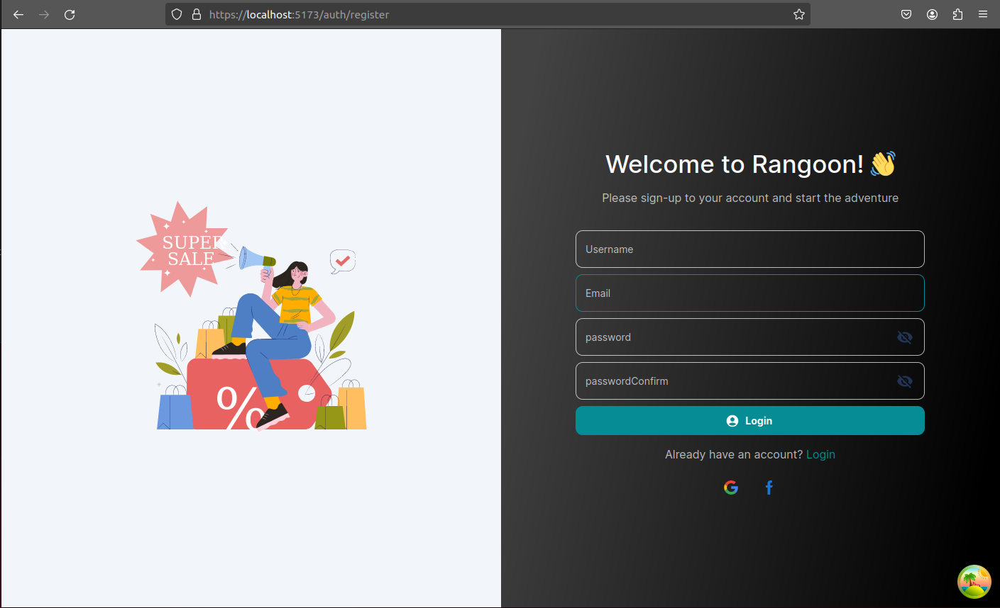
not supported yet
Oauth facebook or google

Slide 3
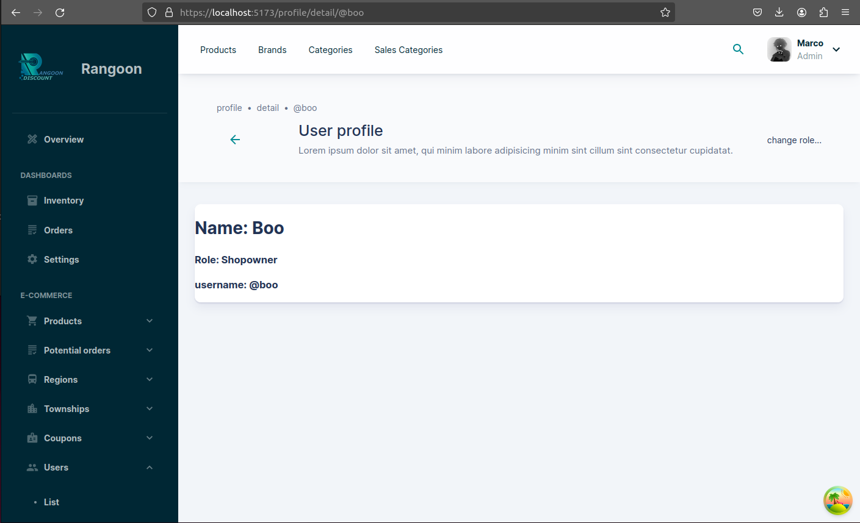
Exchange rate
Add categories
Create sale card

Slide 4
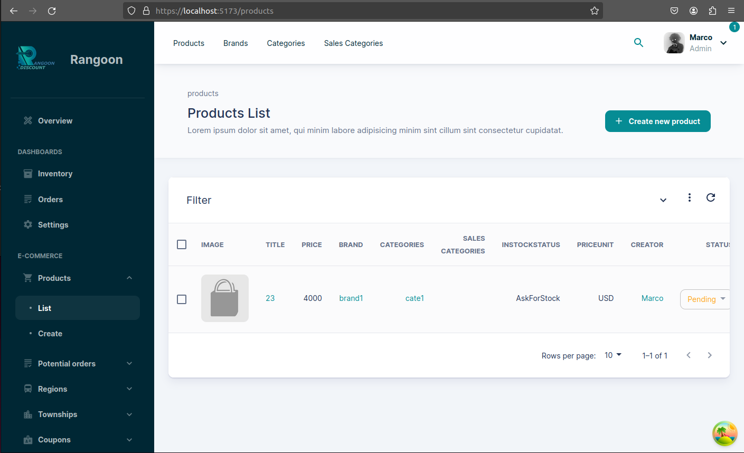
Create new
refresh

Slide 5
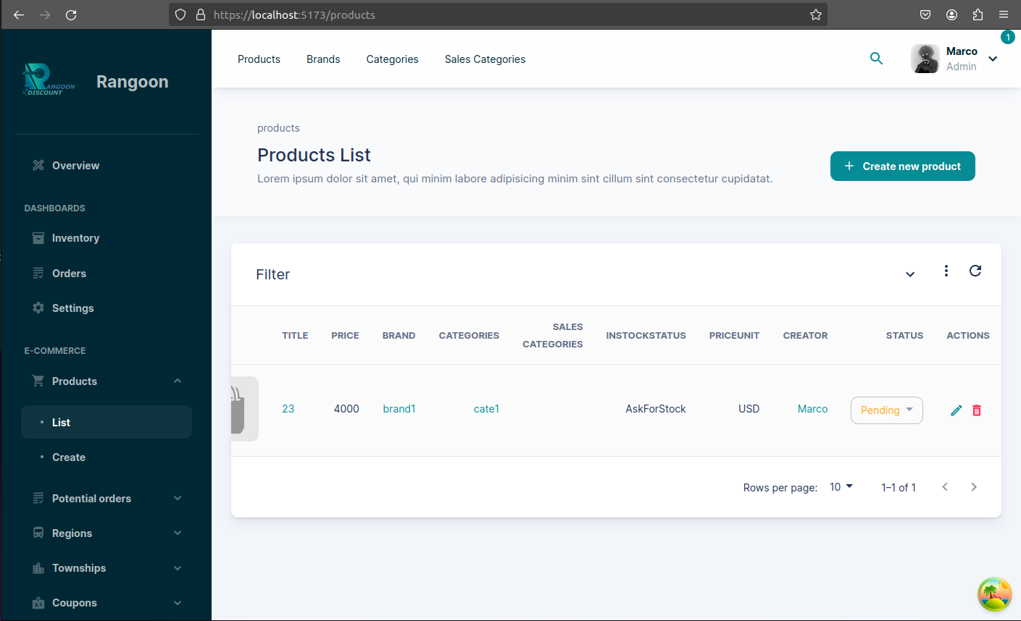
PENDING: admin need confirm
DRAFT: To edit product
PUBLISH: cant edit any more
delete
edit

Slide 8
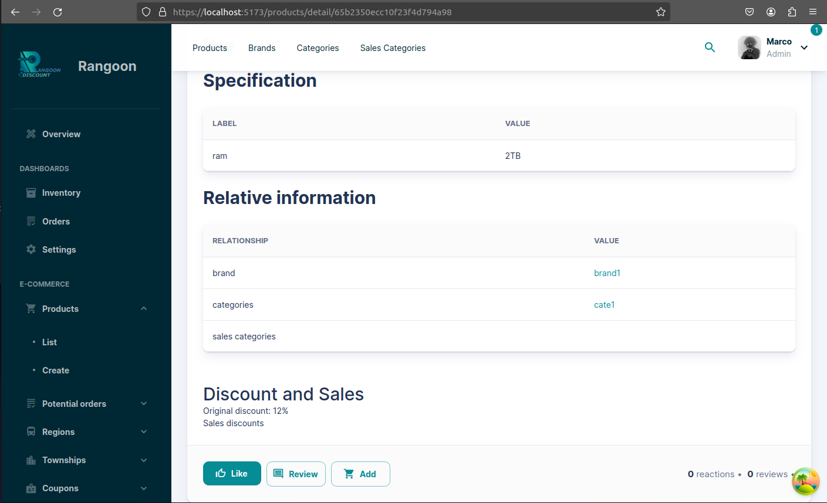
Add to wishlist
Add to cart

Slide 9
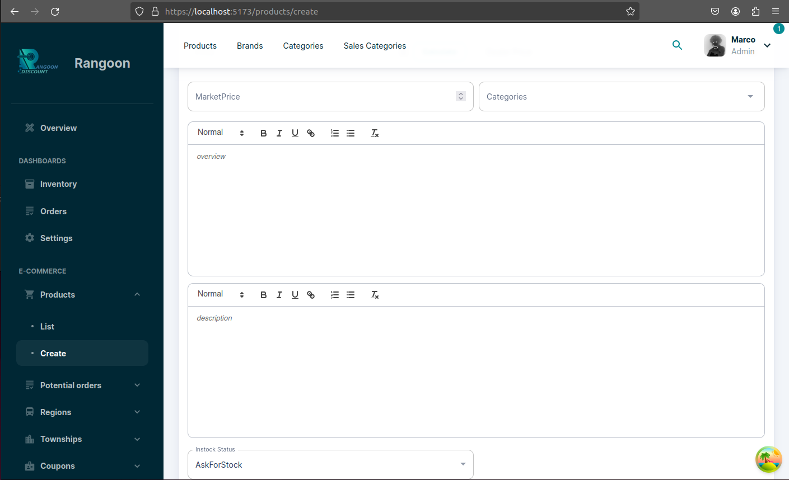
Rich text edit for `Overview` and `Description `

Slide 10
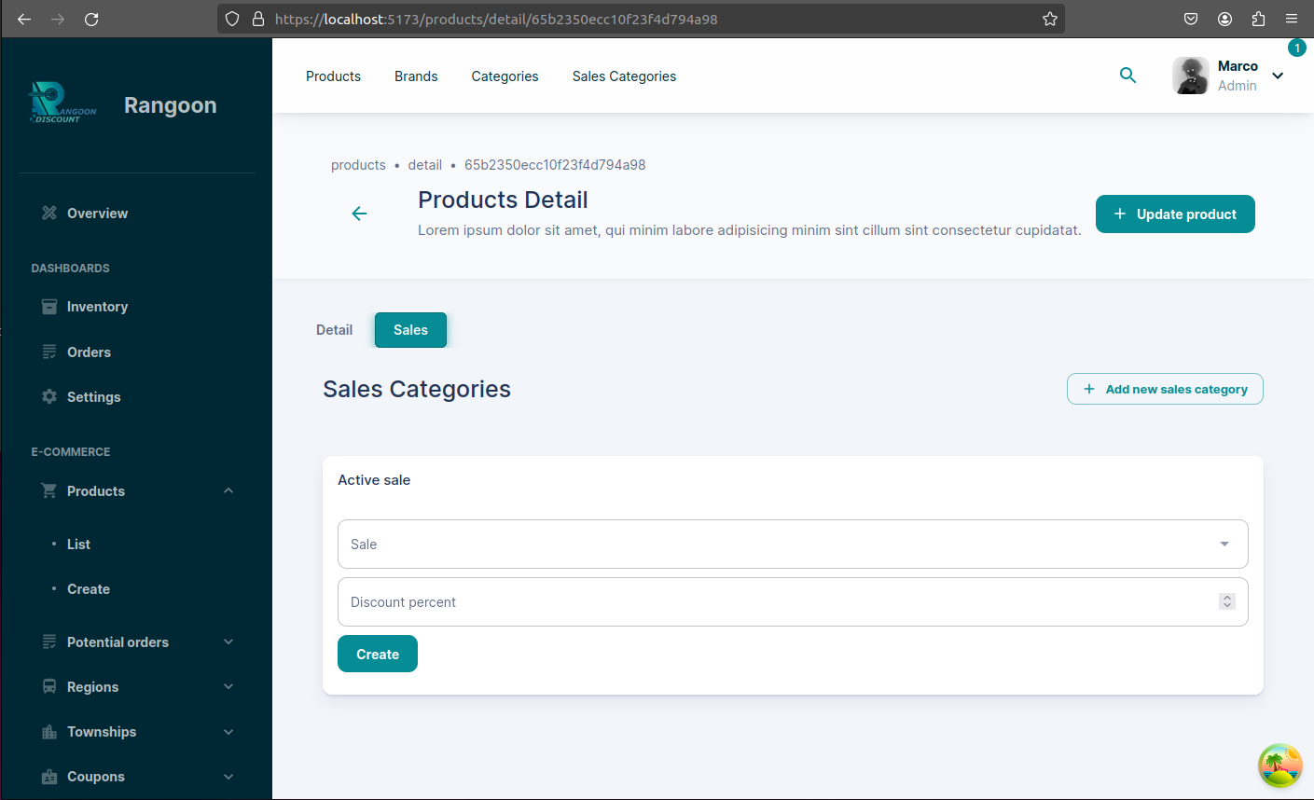
Add sale NOT to product
Add sales to product
This sale discount

Slide 11
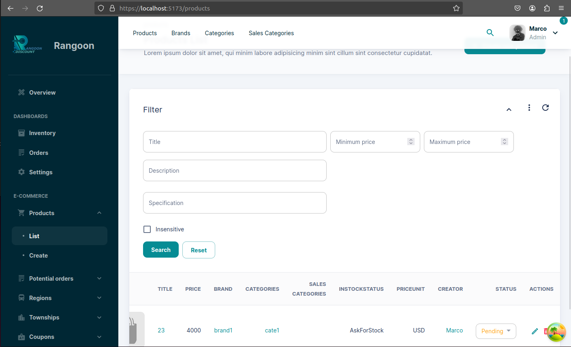
For string are case insensitive

Slide 12

Save as excel, current rows in table
Import data with excel

Slide 13
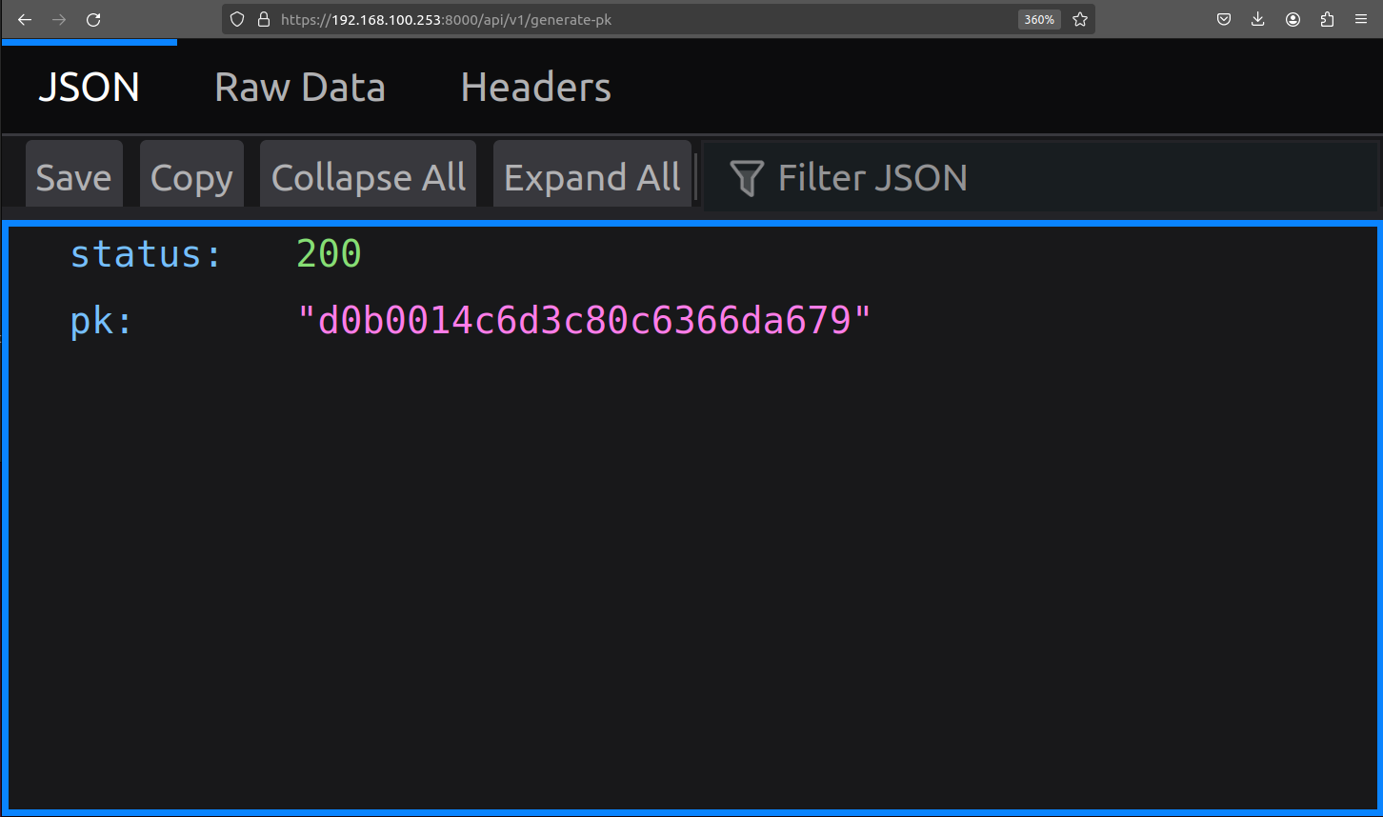
Just copy to excel procut id
This is how to generate product id

Slide 14
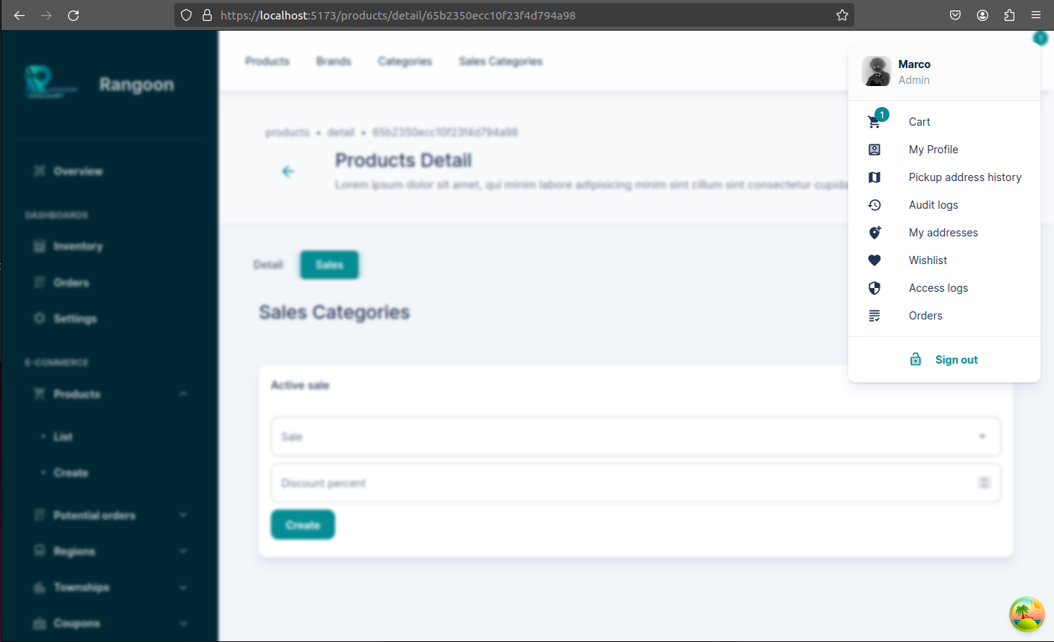

Slide 15
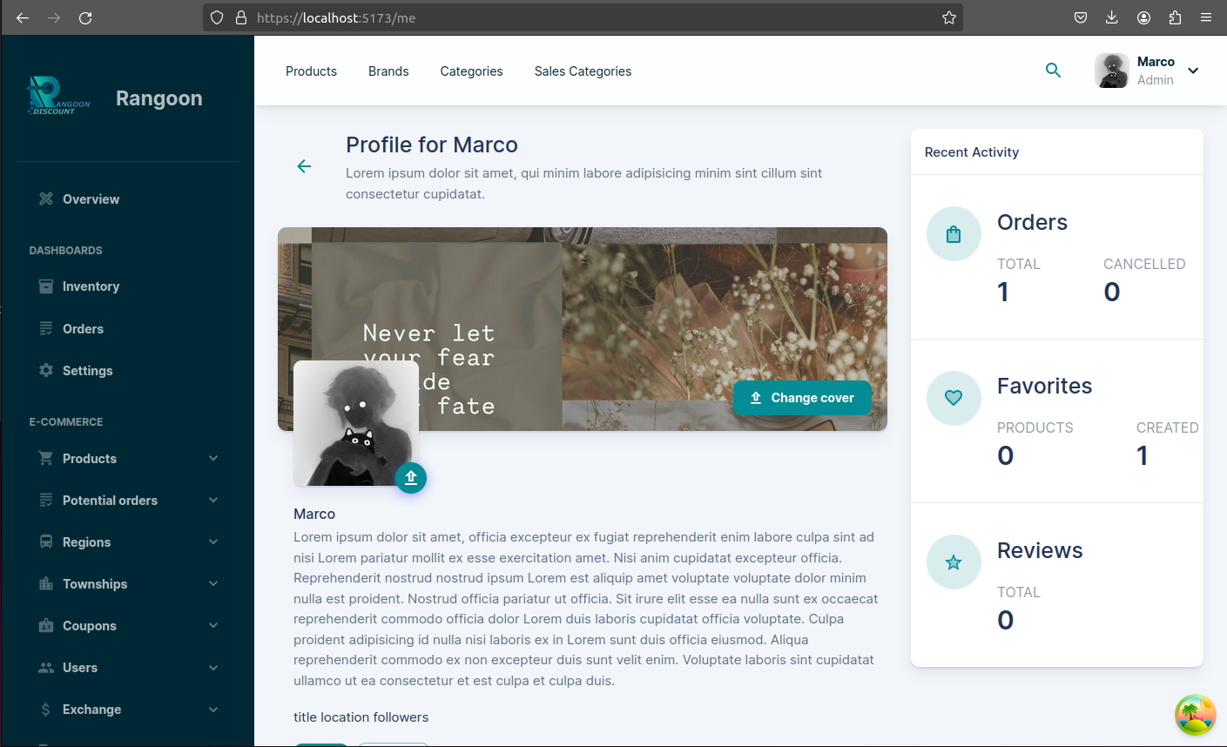

Slide 16
This is `view as` user profile or other user’s profile

Slide 17
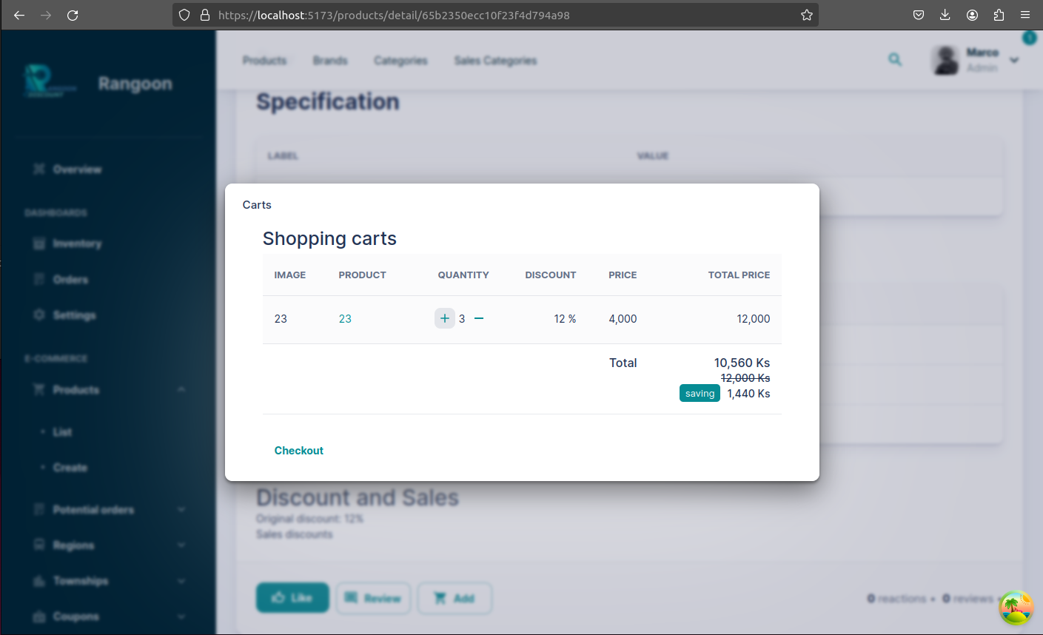
Product link
Active sale discount or original product sale discount
Go to checkout page

Slide 19
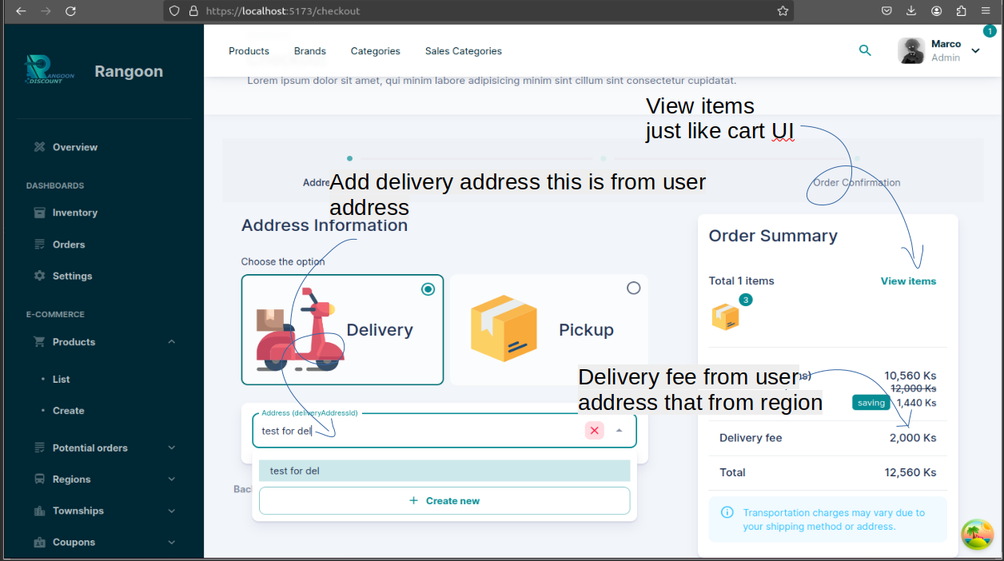

Slide 20
Add billing address that from user address
Continue and create potential order
after create potemtial order
cannot modify cart items quantity

Slide 21
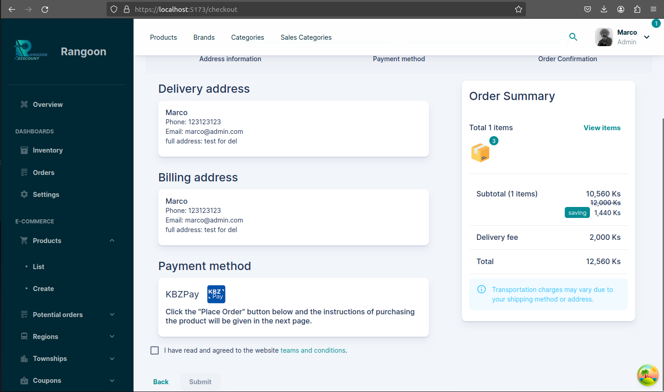
Confirm and order,
to create real order
After submit
that will delete potential order

Slide 22
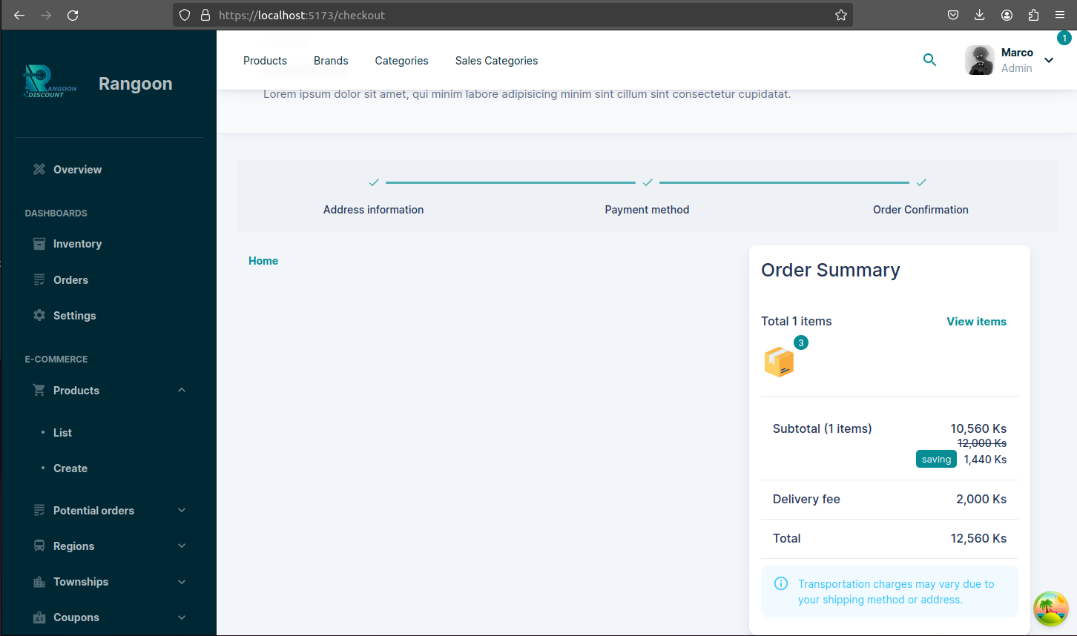
Go home can clean all cart history

Slide 23
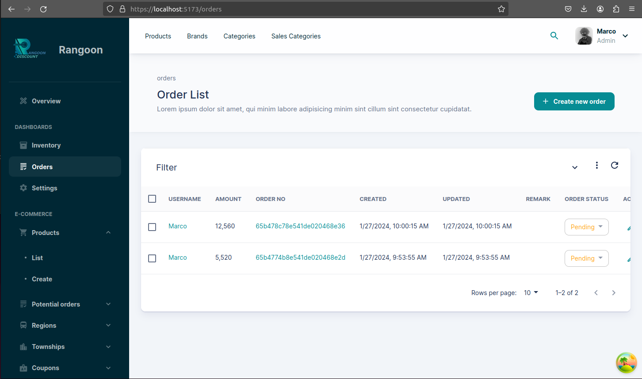

Slide 24
