Slide 1
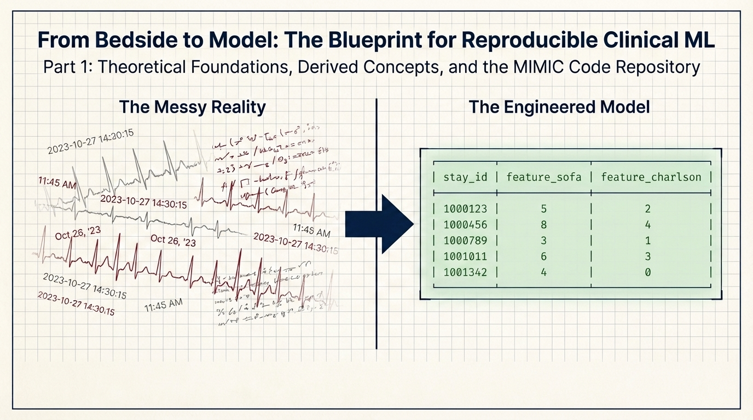
Graphics for most of the presentation made with Nano Banana Pro
Notes:
Welcome to this self learning project. This slide describes what we are going to learn today. On the left is raw EHR data , the actual state of clinical records: multiple types of data, handwritten timestamps, no consistent structure. On the right is what a machine learning model needs: a clean table where each row is a patient stay and each column is a numeric feature. The arrow represents the result of weeks of domain-specific data engineering. This tutorial teaches you what that arrow contains and why it is so important.
Project repository: https://github.com/marcofanti/mimic-iv-derived-concepts-tutorial
Additional Derived Concepts examples: https://github.com/marcofanti/mimic-iv-derived-concepts-tutorial/blob/main/concepts_tutorial.ipynb Graphics done with Nano Banana Pro

Slide 2
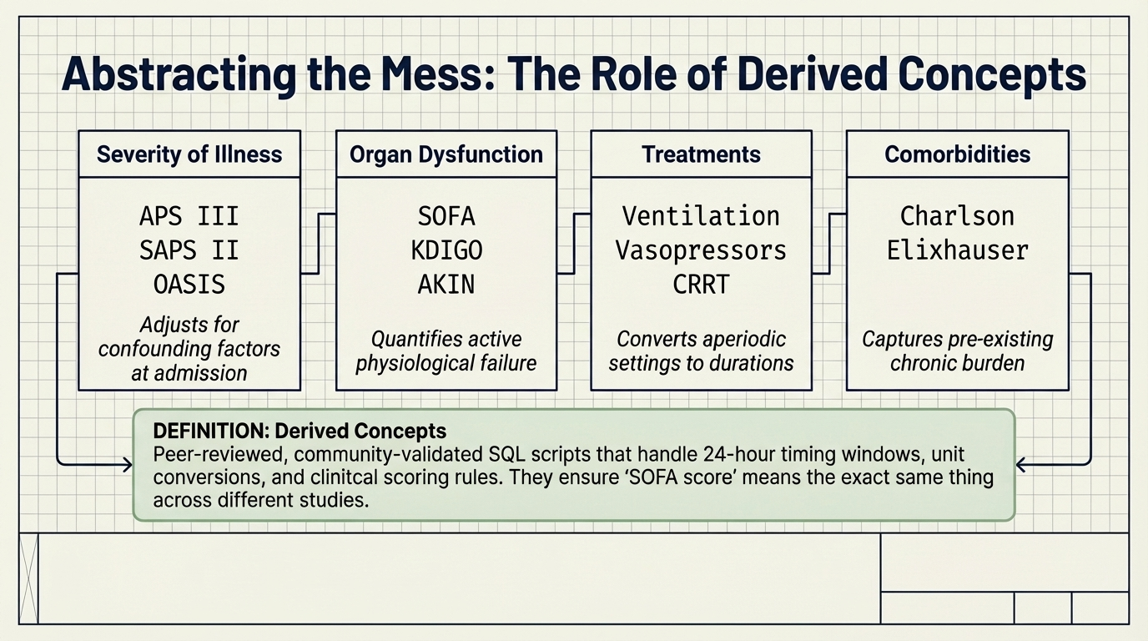
Notes:
This slide introduces "Derived Concepts" the core idea of the tutorial. A derived concept is a pre-computed, community-validated summary of raw EHR data. Instead of writing your own SQL to calculate a SOFA score from scratch (which requires joining five or more tables and knowing clinical scoring rules), you use the pre-calculated "first_day_sofa" table from the MIMIC Code Repository.
The four columns show the main categories: severity of illness scores (how sick at admission), organ dysfunction scores (which organ systems are actively failing), treatments (what interventions were given and for how long), and comorbidities (what chronic conditions the patient had before this admission).
The definition box at the bottom is the key: "peer-reviewed, community-validated SQL scripts." These are not one person's interpretation of a clinical score. They are scripts reviewed and refined by a community of clinicians and data scientists to ensure that "SOFA score" means exactly the same thing across different studies.

Slide 3
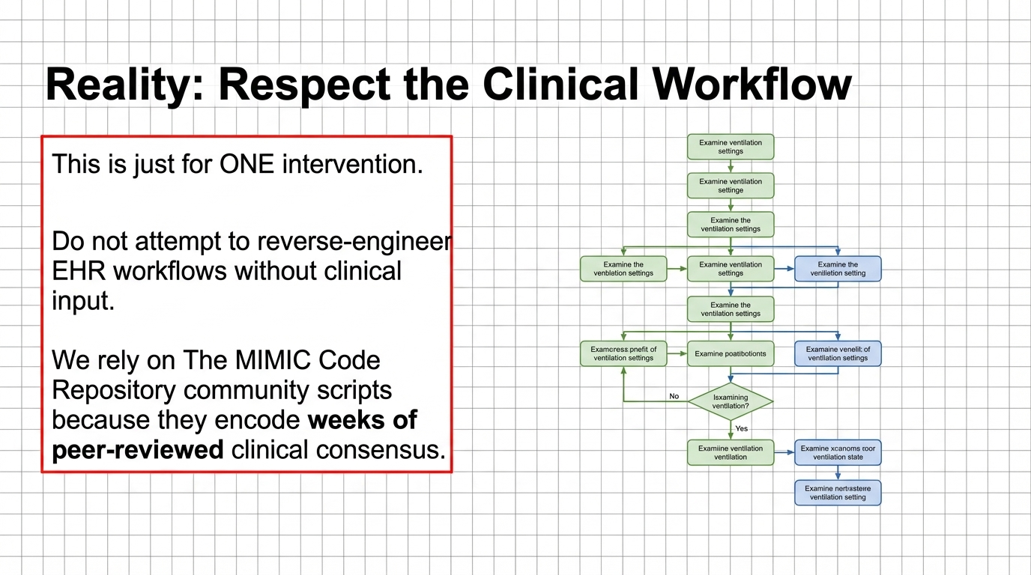
Notes:
Another example of why we should use the Derived Concepts tables. It shows what the full ventilation logic actually looks like in the MIMIC Code Repository: a multi-branch flowchart for a single treatment type.
The community scripts in the MIMIC Code Repository represent peer-reviewed consensus on how to correctly identify, for example, when a ventilation event begins and ends.

Slide 4
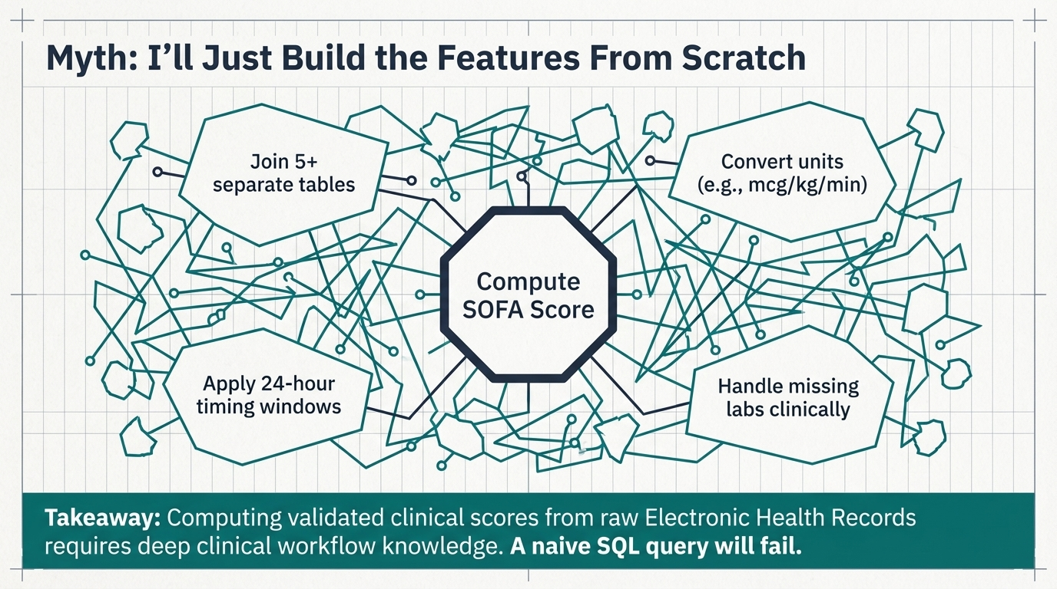
Notes:
If you haven’t learnt yet, this is another reason to use the pre-calculated derived concept tables instead of computing SOFA from raw tables.
Each node in the "Compute SOFA Score" diagram joins at least five source tables, uses a strict 24-hour window from ICU admission, converts vasopressor doses to mcg/kg/min with patient weight, and handles missing PaO2 values using a validated SpO2-based formula.
This explains why Cell 2 uses “mimiciv_derived.first_day_sofa” instead of building from "chartevents".

Slide 5
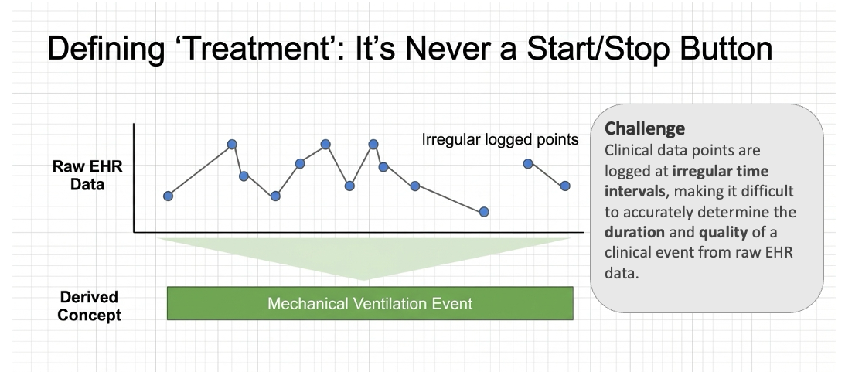
Notes:
This slide explains why computing treatment duration from EHR data is harder than it sounds. Ventilator settings are not logged at regular intervals, they are charted whenever a nurse checks the machine, which is irregular. There is no "start ventilation" or "stop ventilation" button that creates a clean event record. So how do you determine whether a patient was on a ventilator for 6 hours or 60 hours? You must infer duration from a series of point measurements. The MIMIC Code Repository handles this by scanning settings chronologically and applying domain rules (the 8-hour gap rule in the next slide).

Slide 6
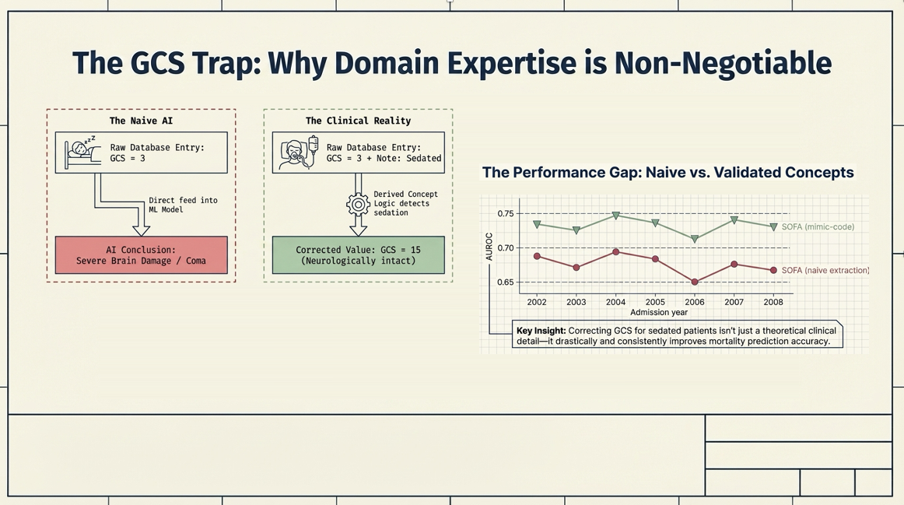
Notes:
This is the most important motivating example in the tutorial. The Glasgow Coma Scale (GCS) measures neurological responsiveness: 15 means fully alert, 3 means unresponsive. When a patient is given sedation drugs for mechanical ventilation, they are intentionally rendered unconscious. Their GCS is charted as 3 , not because they have brain damage, but because the sedation protocol requires it. A naive model fed the raw GCS=3 value will learn to predict high mortality for this patient. The MIMIC Code Repository's "first_day_sofa" concept detects the sedation flag in chartevents and corrects the GCS to 15 before computing the score. This is not a minor adjustment, we can see in the next slide that it changes AUROC by approximately 0.05-0.08 across every year of data. This is the reason you use Derived Concepts instead of raw tables.

Slide 7
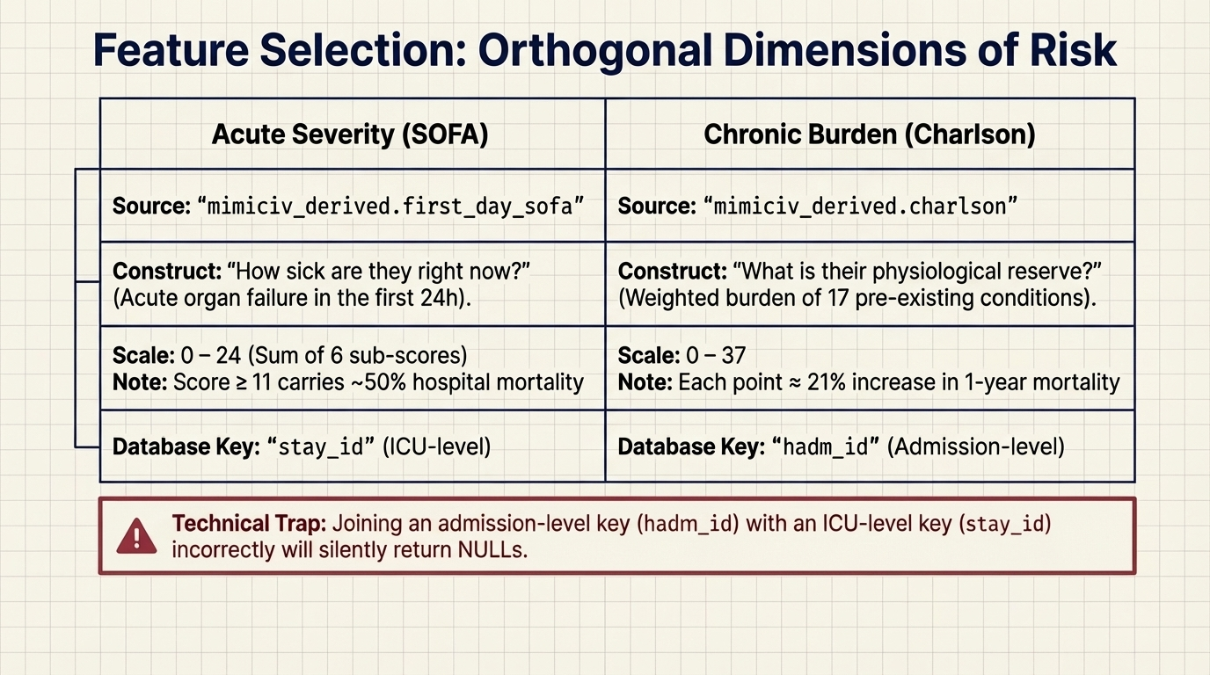
Notes:
For this tutorial we will use two features from the list of Derived Concepts.
SOFA answers: "How severely is this patient's body failing right now, in the first 24 hours of their ICU stay?"
Charlson answers: "What chronic disease burden did this patient bring with them into the hospital?" One looks forward in the current admission, the other looks backward at medical history.
SOFA is keyed on "stay_id" (one row per ICU stay), while Charlson is keyed on "hadm_id" (one row per hospital admission). Joining on the wrong key will return silent NULLs with no error message. This is one of the most common and hardest-to-detect bugs in clinical data pipelines.

Slide 8
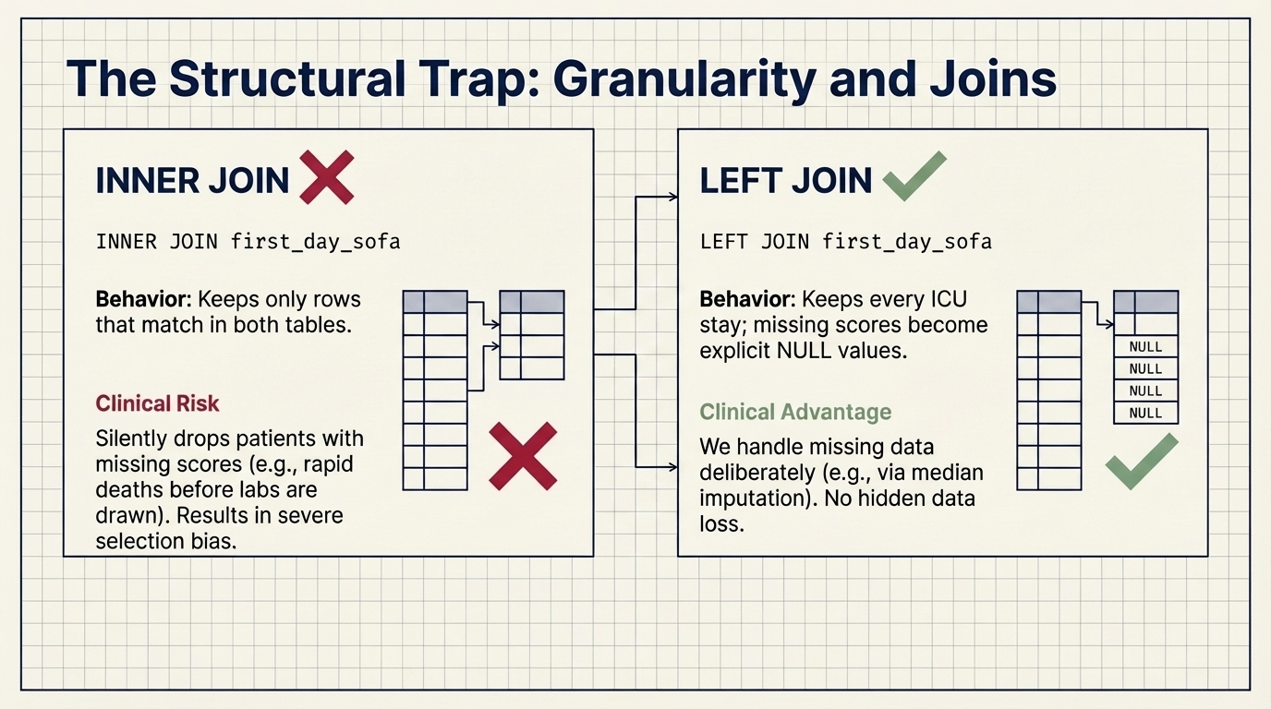
Notes:
This slide explains the common bug described in the previous slide. An INNER JOIN keeps only patients who appear in both the "icustays" table and the "first_day_sofa" table. Who gets dropped? Patients who died so quickly that their first-day labs never resulted. Dropping them does not cause an error; the query just silently returns a smaller, biased cohort. A LEFT JOIN keeps all ICU stays and fills missing SOFA values with NULL, which you then handle deliberately in the preprocessing step (as shown in the notebook).

Slide 9
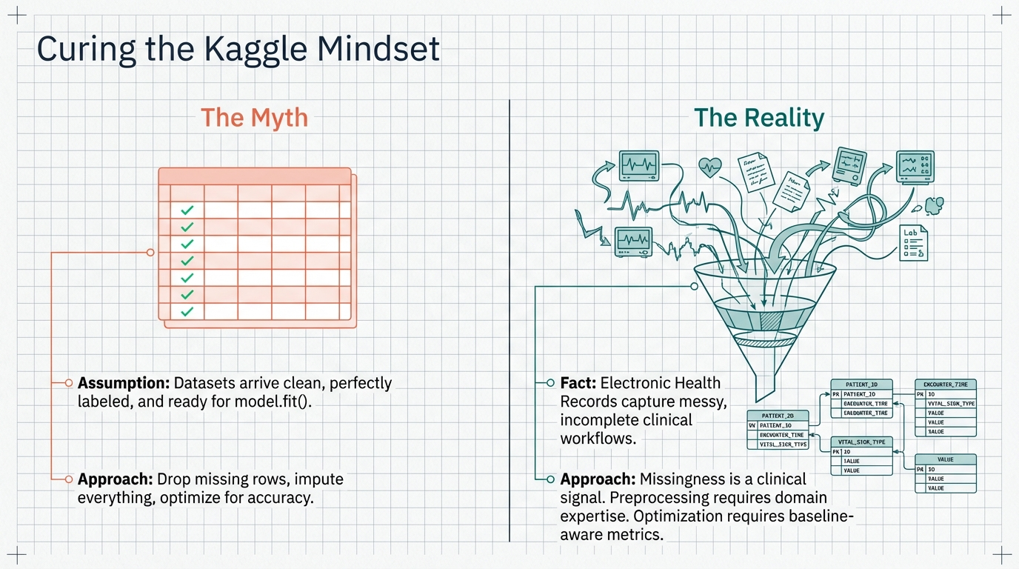
Notes:
Most people in standard machine learning courses use datasets such as the ones used in Kaggle competitions. In a Kaggle competition, datasets are pre-cleaned, and accuracy is the standard metric. This is not true for clinical EHR data. Missing SOFA values are not data entry errors, they often mean the patient was too unstable or died before labs could be drawn. That is clinically meaningful information, and discarding those patients biases your cohort toward the easier cases. A model that predicts “everyone survives” achieves 88% accuracy but identifies zero actual deaths.

Slide 10
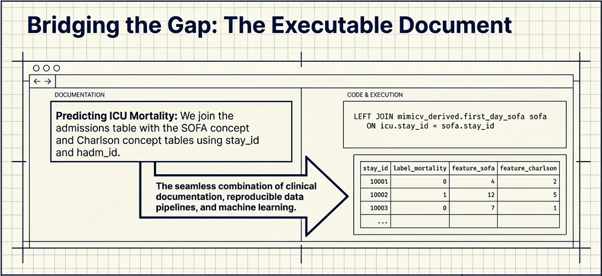
Notes:
This slide introduces the concept of an "executable document," which is what the Jupyter notebook you will use is. In a traditional research paper, you read the methods section separately from the results. In an executable document, the clinical rationale and the code that operationalizes it sit side by side in the same file.
This is the technical infrastructure the MIMIC Code Repository was designed to support. From here the tutorial transitions from theory to hands-on practice.

Slide 11
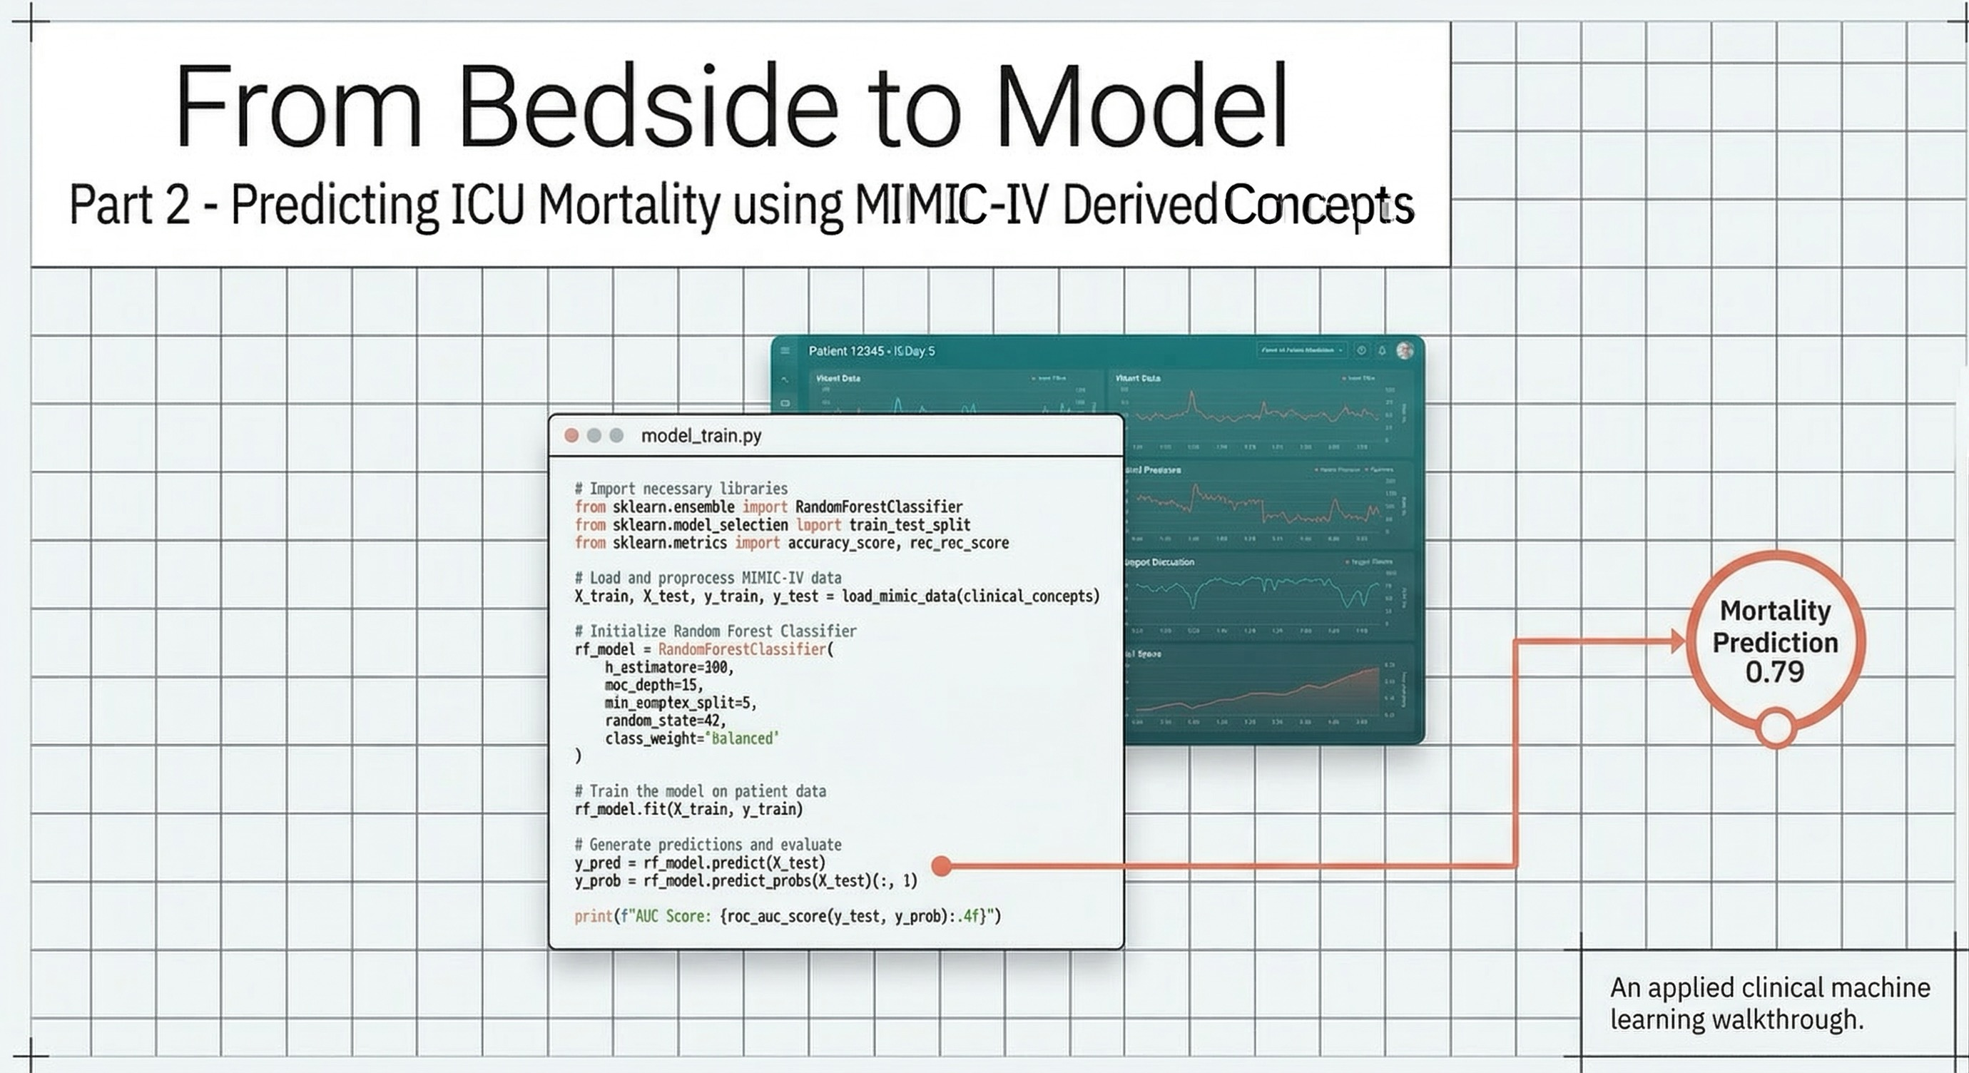
Notes:
We finally get to the interesting part. Part 2 and the Jupyter notebook. Before opening the notebook, make sure you understand why Derived Concepts exist, what traps they protect you from (GCS sedation, INNER JOIN bias, wrong join keys), and how the two features SOFA and Charlson were chosen.
Part 2 creates an “Executable Document” for all that. The clinical question is: “Can severity scores calculated at ICU admission predict whether a patient survives to hospital discharge?”

Slide 12
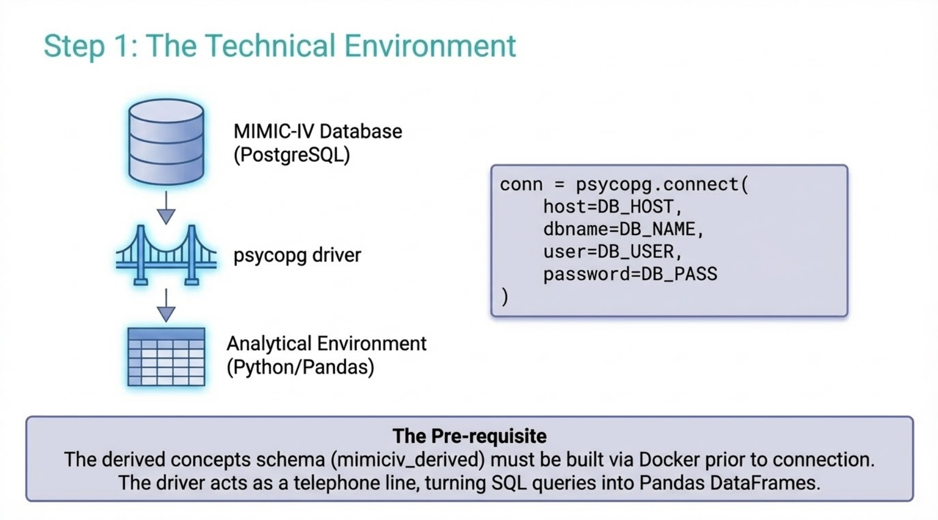
Notes:
We now start the execution of the notebook: Establishing the database connection.
Before running this cell, confirm that PostgreSQL is running, the MIMIC-IV schemas are loaded, and the Derived Concepts schema has been built from the ~65 SQL scripts in the MIMIC Code Repository (those requirements, and code to create the PostgreSQL database is included in the Github repository for this project).

Slide 13
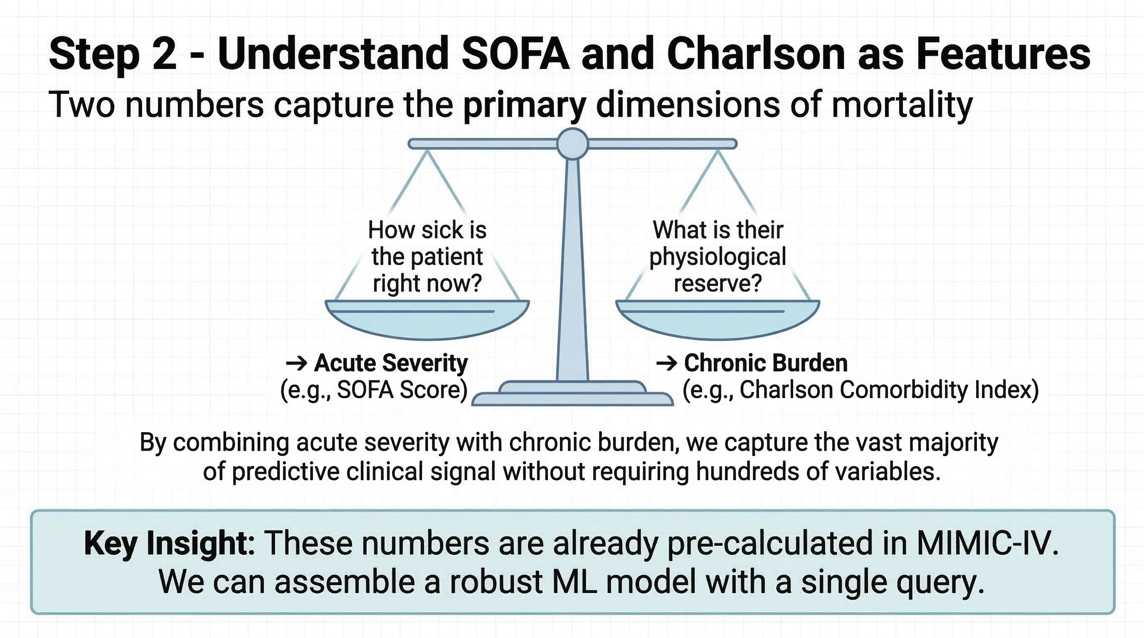
Notes:
This slide simplifies mortality prediction into two core dimensions: acute severity (how sick the patient is right now) and physiological reserve (their underlying chronic burden). By balancing these two signals (the immediate crisis versus the patient's baseline resilience) we capture the vast majority of predictive power without needing to use hundreds of messy variables. The major efficiency gain here is that these metrics are already pre-calculated in derived tables.

Slide 14
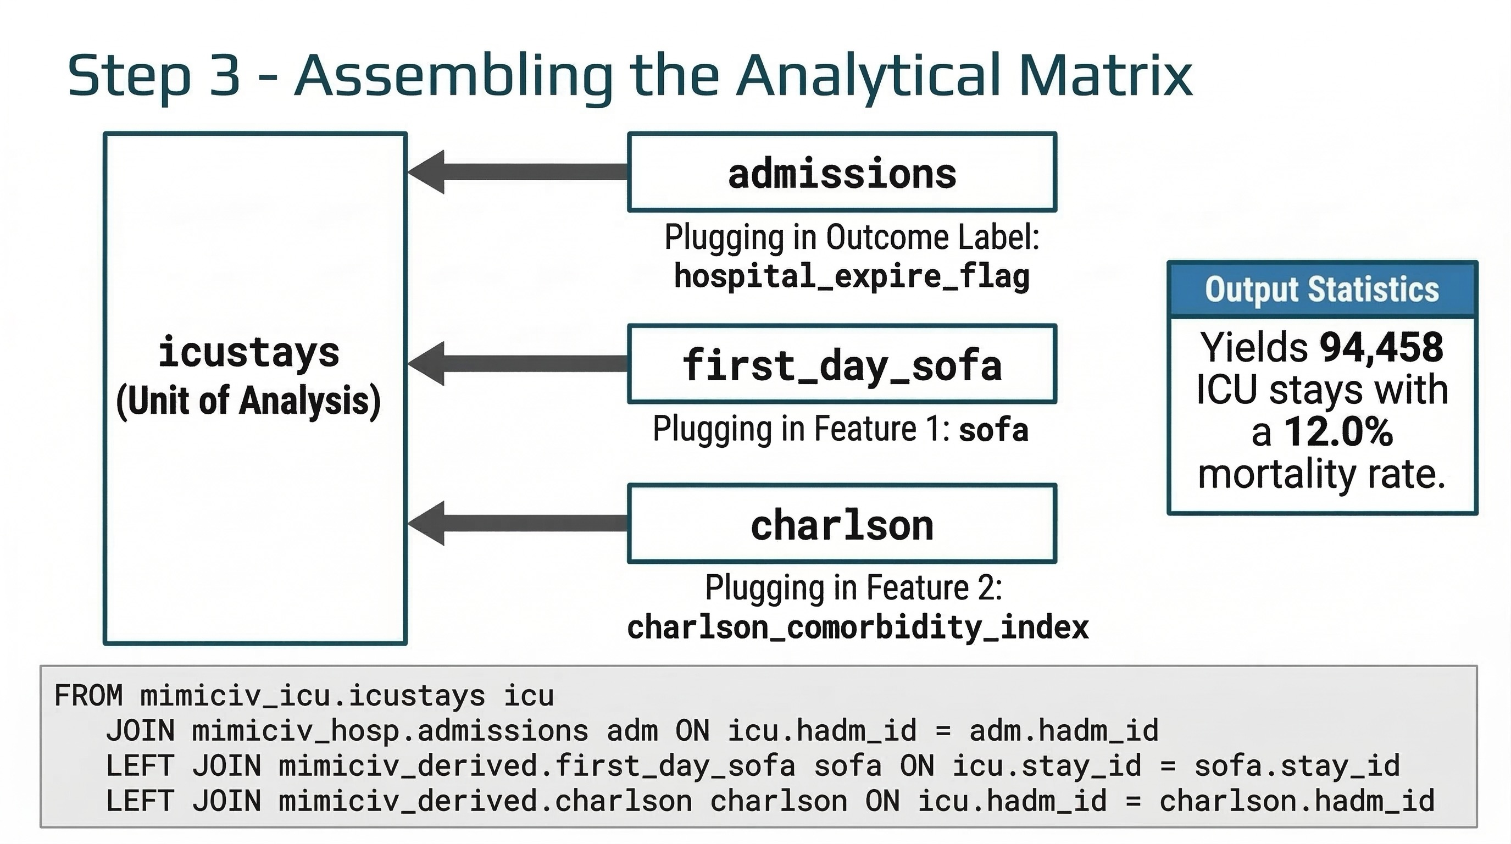
Notes:
This slide outlines the technical execution of our data strategy, where we transition from clinical concepts to a structured analytical matrix.
The SQL logic at the bottom illustrates how straightforward the process is when we use Derived Concepts. With just three joins, we assemble a high-quality cohort of over 94,000 ICU stays with a 12% mortality rate, providing a robust and well-balanced foundation for the machine learning engine that follows.

Slide 15
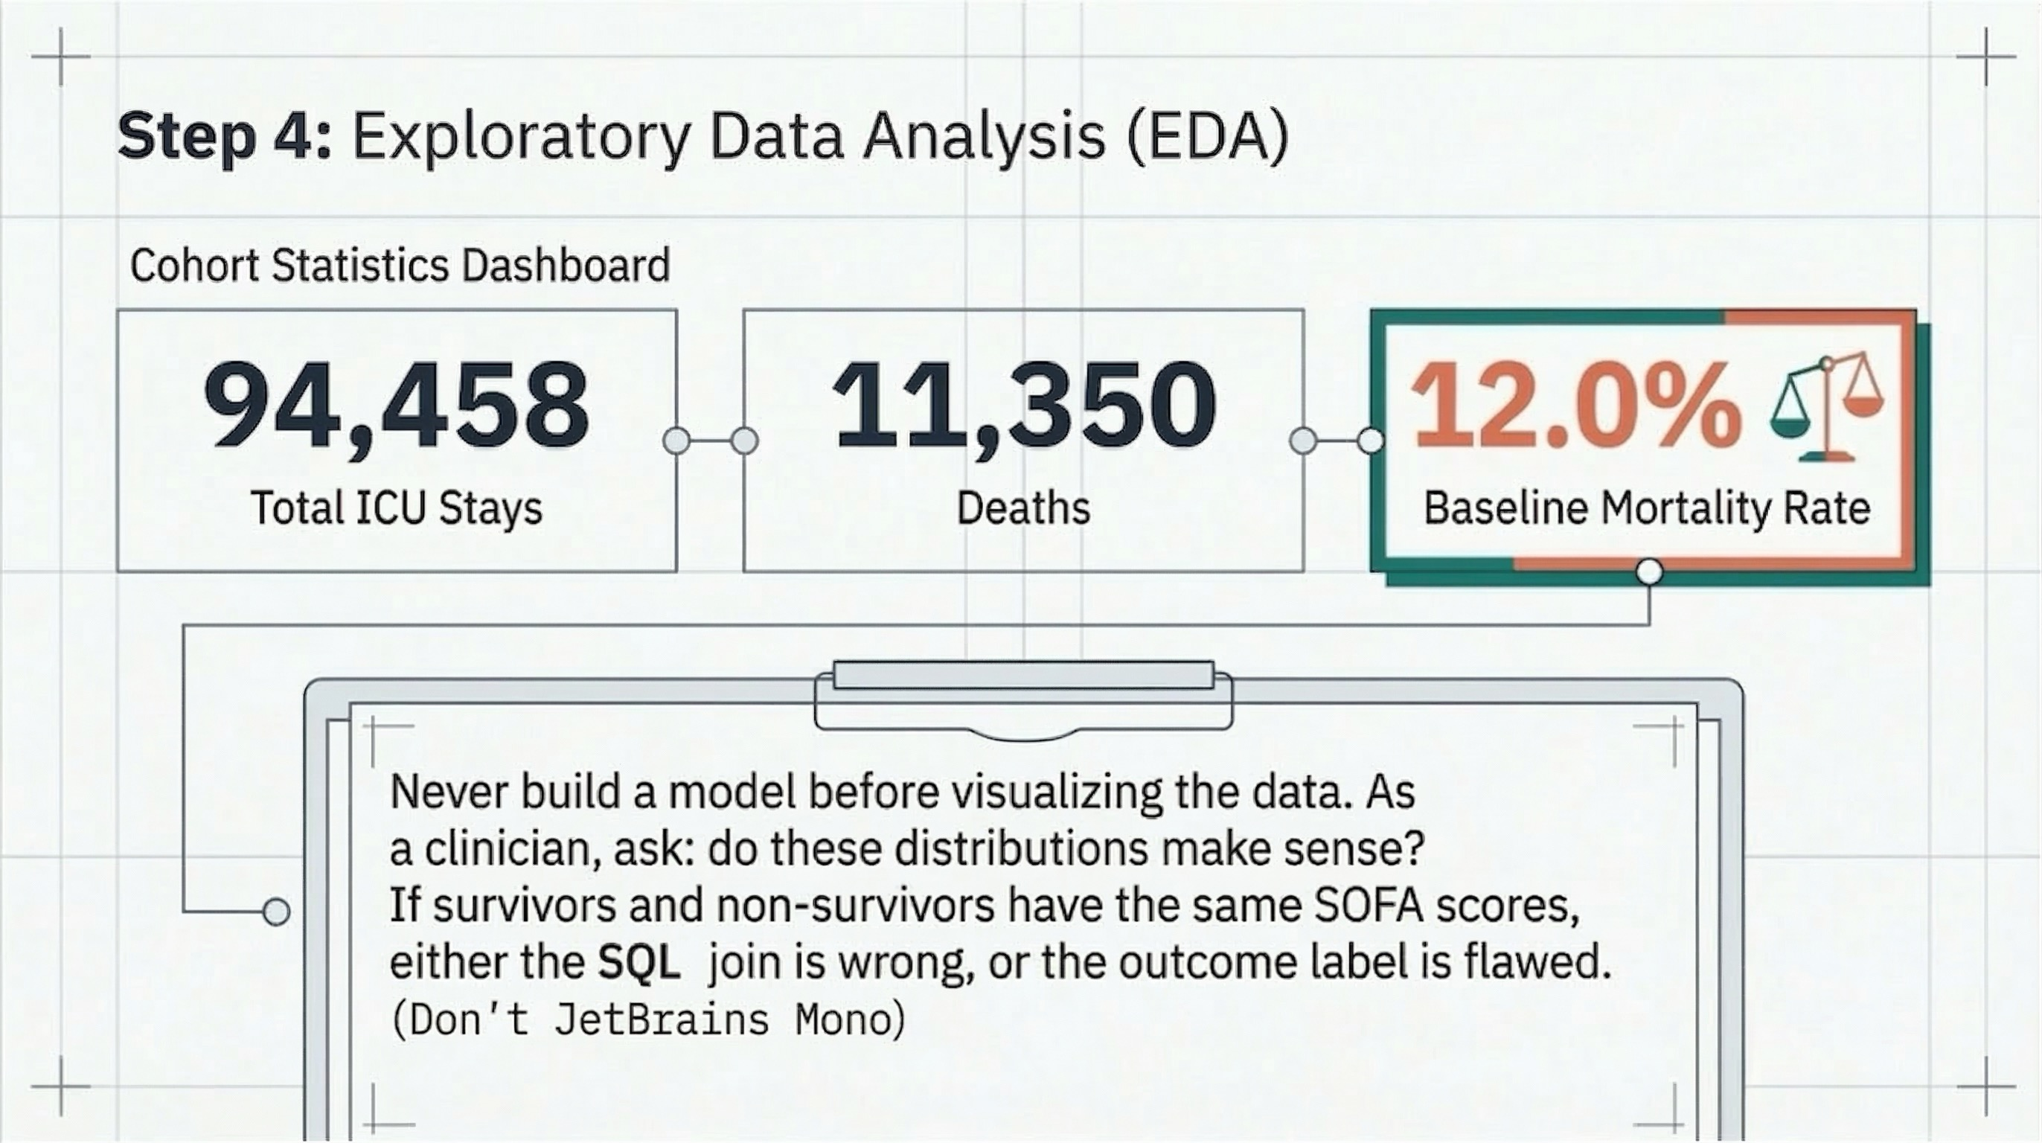
Notes:
Step 4 in the notebook is where we first look at the data. Three numbers are important for the rest of the analysis. 94,458 total ICU stays: this is the group size after combining the data, with no patients left out. 11,350 deaths: This shows the label column is working as it should. 12% baseline mortality rate: this number guides every decision we make next. A model that predicts everyone survived would be right 88% of the time, but would not be helpful for doctors. It also means the training data has about 8 patients who survived for every 1 who died, which is why we use class_weight=‘balanced’ in the Random Forest in Cell 6 to prevent the model from focusing only on the group with more patients.

Slide 16
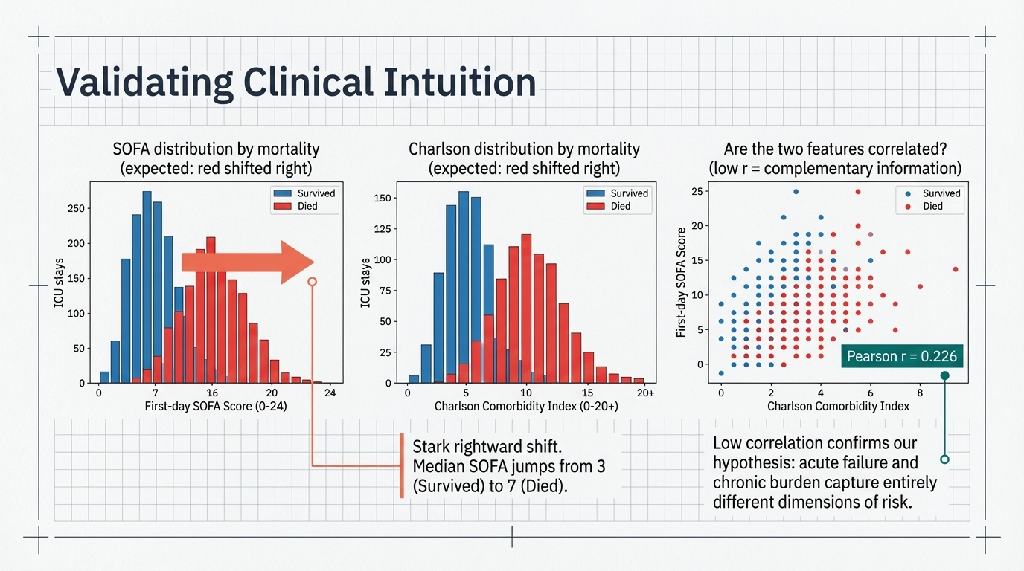
Notes:
These three charts are your clinical sanity checks before modeling. Read them left to right. SOFA distribution: the red bars (died) are shifted strongly to the right compared to the blue bars (survived). Median SOFA jumps from 3 in survivors to 7 in non-survivors. This is exactly what clinical intuition predicts , higher organ failure severity means higher short-term mortality risk. If this shift did not appear, the join query or the outcome label would be wrong. Charlson distribution: also shifted right for deceased patients, but less dramatically. SOFA is the stronger signal. Scatter plot: Pearson r = 0.226 confirms the features are nearly independent , each captures distinct information. If r were high, you would drop one feature. Because it is low, including both is justified. Running these checks in Cell 4 before building any model is non-negotiable.

Slide 17
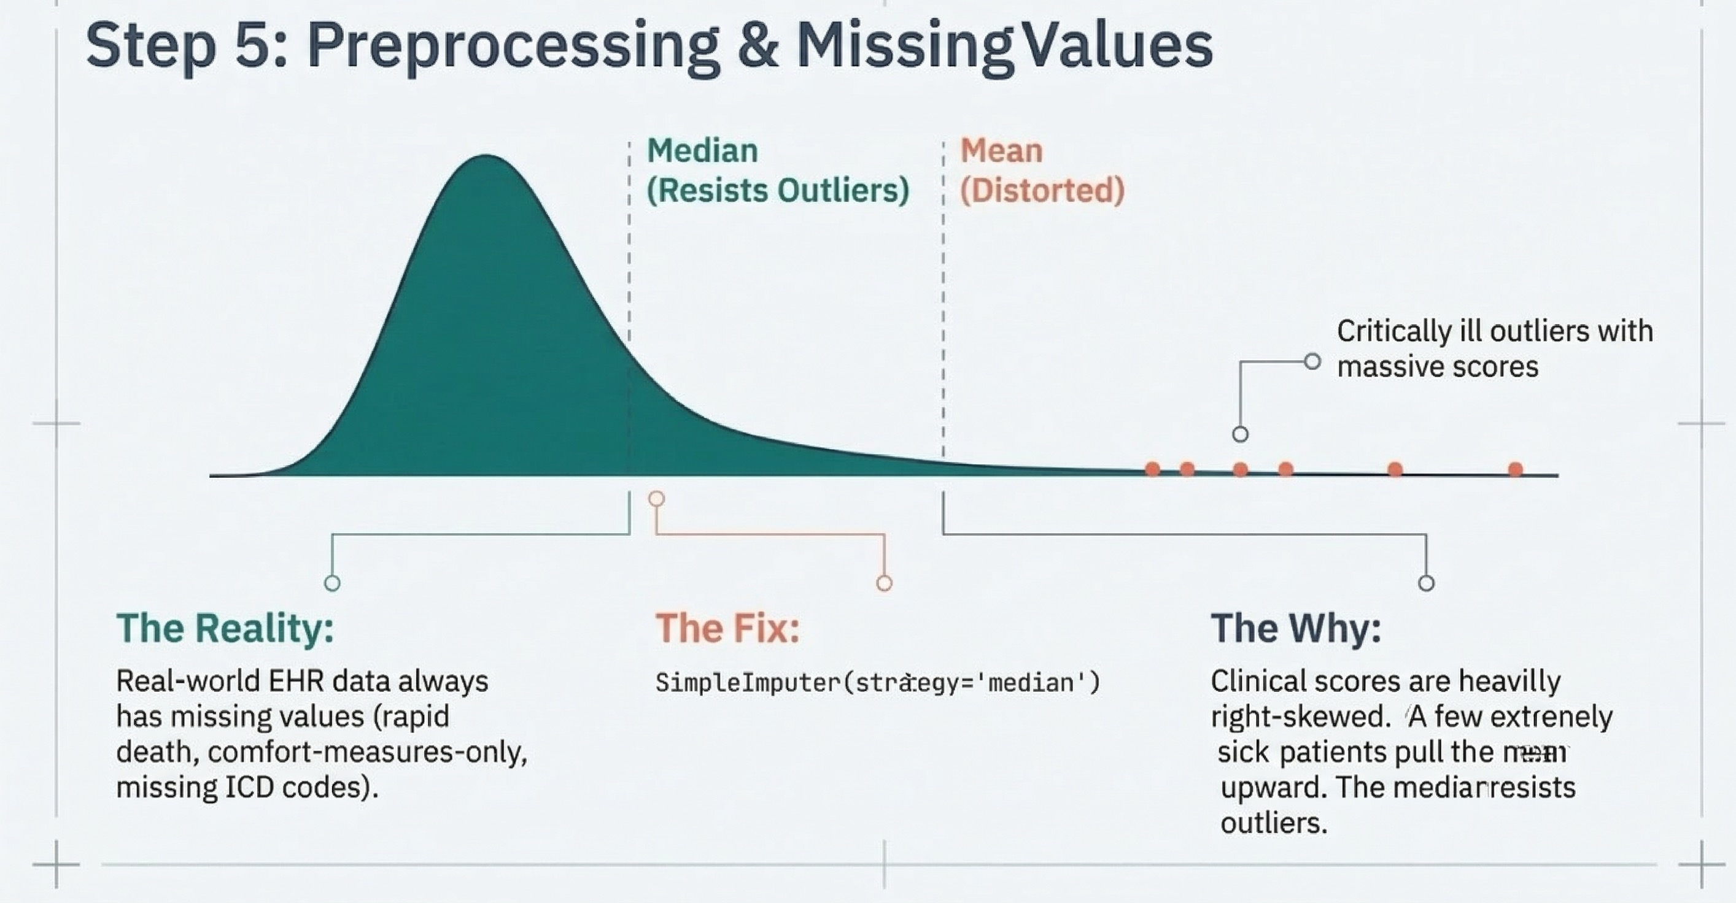
Notes:
This slide explains the data cleaning choice made in Cell 5 of the notebook. Missing SOFA values occur when some patients die or are moved before all first-day lab results are received. Missing Charlson values happen when there are no ICD codes for a hospital stay. These are not random mistakes in the data, but follow medical patterns. We fill in these missing values with the middle value (not the average) because clinical scores are not evenly distributed: a few very sick patients have very high scores that make the average too high, so it does not reflect what is normal for most patients. The middle value is not changed by these extreme values. The key rule shown here is "split first, then impute": find the middle value using only the training set, then use it for both training and test sets. The next slide shows what can go wrong if you do not follow this order.

Slide 18
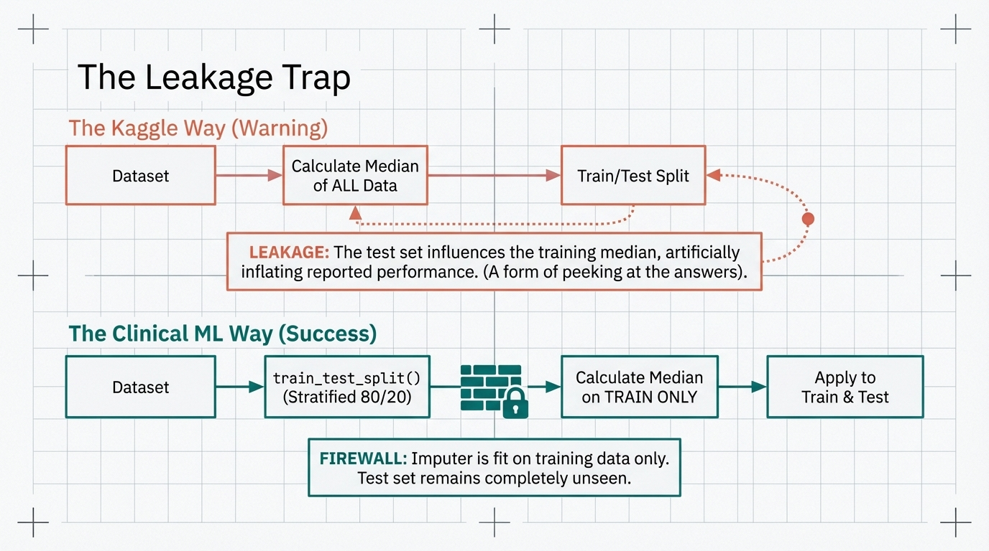
Notes:
Data leakage is the most common and serious mistake in clinical machine learning. The top path ("The Kaggle Way") shows the wrong order: calculate the middle value for missing data from all data, then split into train and test. The problem is that the test set's patient details have already affected the values used to fill in missing data. When the model is tested, it has already "seen" those patients during data preparation. This makes the results look better than they really are. The bottom path ("The Clinical ML Way") keeps information separate: split first (using 80/20 to keep the 12% mortality rate), fit the imputer on training data only, then use the same imputer on the test set. In Cell 5 of the notebook, "imputer.fit(X_train)" followed by "imputer.transform(X_test)" does this exactly.

Slide 19
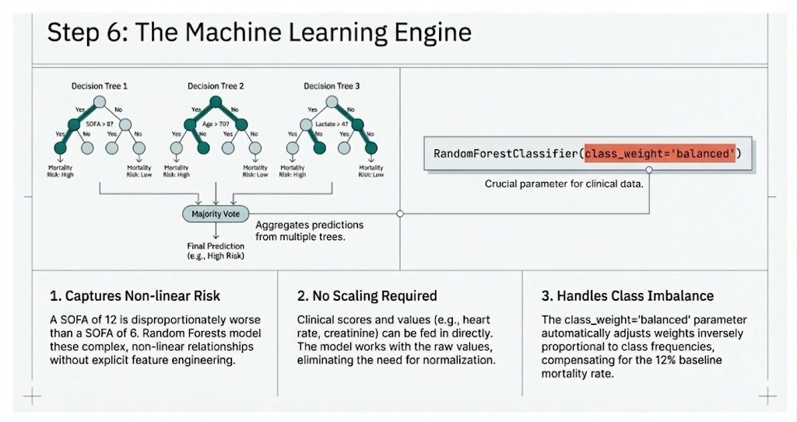
Notes:
The next step involves choosing Random Forest in Step 6 for three reasons. First, it captures non-linear risk: for example, the difference between SOFA 12 and 6 is not simply twice as large, and Random Forest models these jump points naturally. Second, Random Forest requires no feature scaling. SOFA (0-24) and Charlson (0-37) can be used directly, unlike in methods such as logistic regression or neural networks. Third, setting "class_weight=balanced" addresses the class imbalance detected earlier; otherwise, the model would predict "survived" for most and still score high accuracy. In Cell 6, these reasons shape our modeling approach.

Slide 20
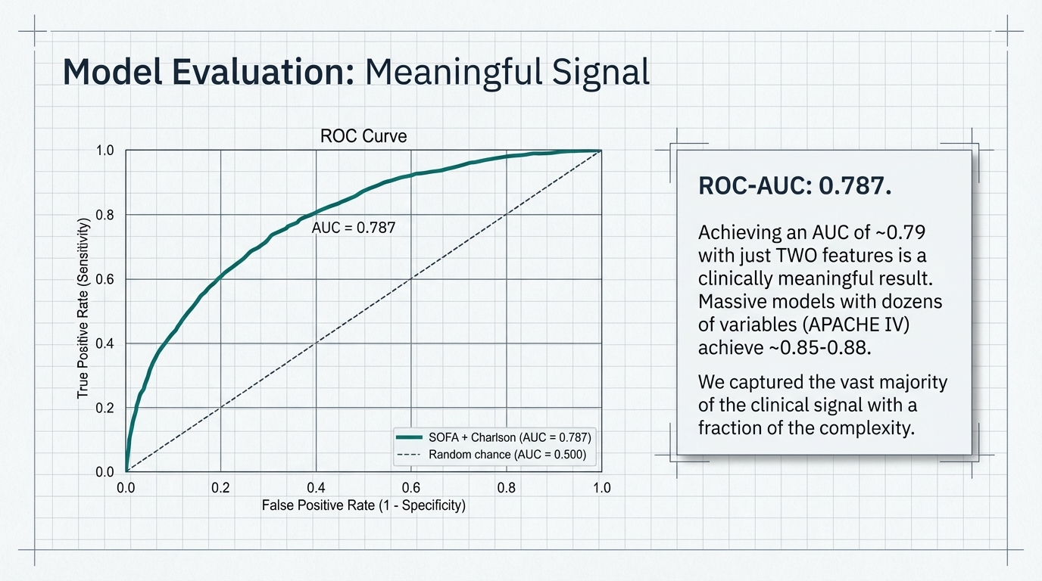
Notes:
This is the result of running Cell 6 in the notebook. AUC = 0.787 using just two features. With two already-checked concepts, the tutorial model achieves about 75-80% of the Apache IV, the standard ICU death-prediction model used in hospital performance evaluations. This does not mean two features are enough for real clinical use, but it shows how much can be packed into well-chosen concepts. The ROC curve rises quickly, indicating the model is especially good at finding high-risk patients when you need to be very sure (for example, deciding who gets a palliative care consultation).

Slide 21
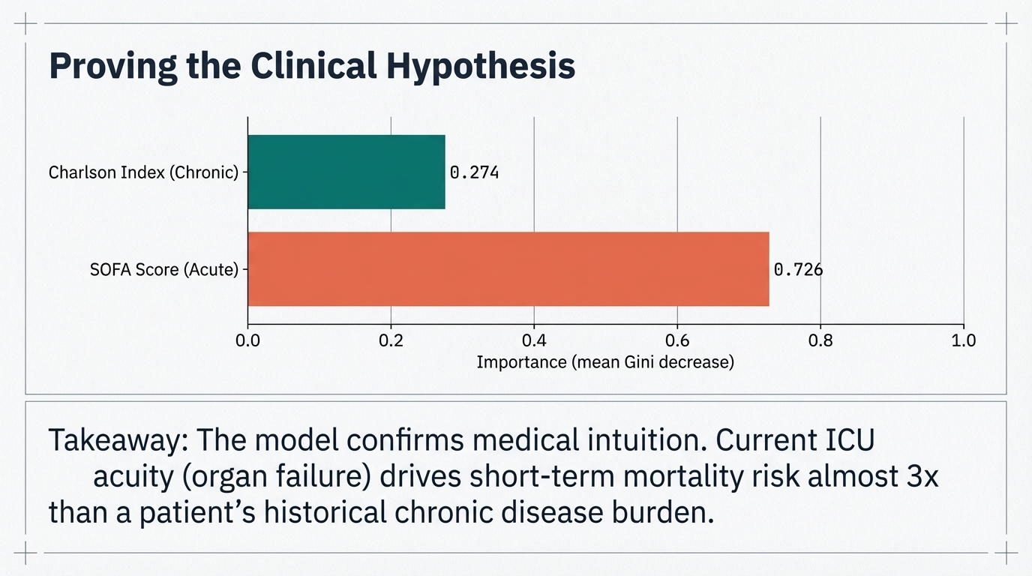
Notes:
The “Feature Importance” graph for Cell 6 shows which of the two Derived Concepts most strongly drove the model's predictions. SOFA (acute organ failure, first 24h) has an importance of 0.726; Charlson (chronic comorbidity burden) has 0.274. This confirms the clinical hypothesis: for short-term hospital mortality, what is happening to the patient's organs right now matters roughly three times more than the chronic disease burden they arrived with. Charlson still contributes; it explains why two patients with identical SOFA scores can have different outcomes, but SOFA still dominates. The model learned this from the data and agrees with clinical intuition.

Slide 22
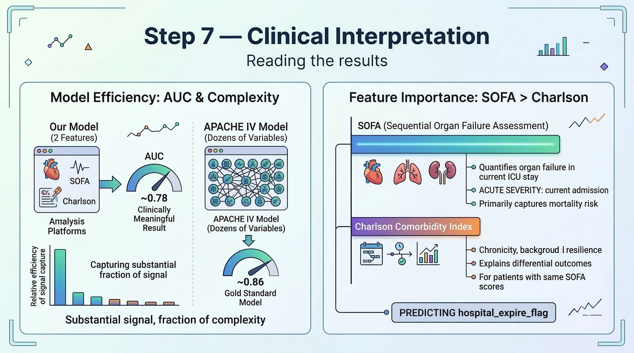
Notes:
By achieving a clinically meaningful AUC of ~0.78 using only two features from Derived Concepts queries, this slide highlights the model’s ability to capture the mortality signal by prioritizing acute organ dysfunction (SOFA) while using chronic health history (Charlson) to provide essential physiological context for patient resilience.

Slide 23
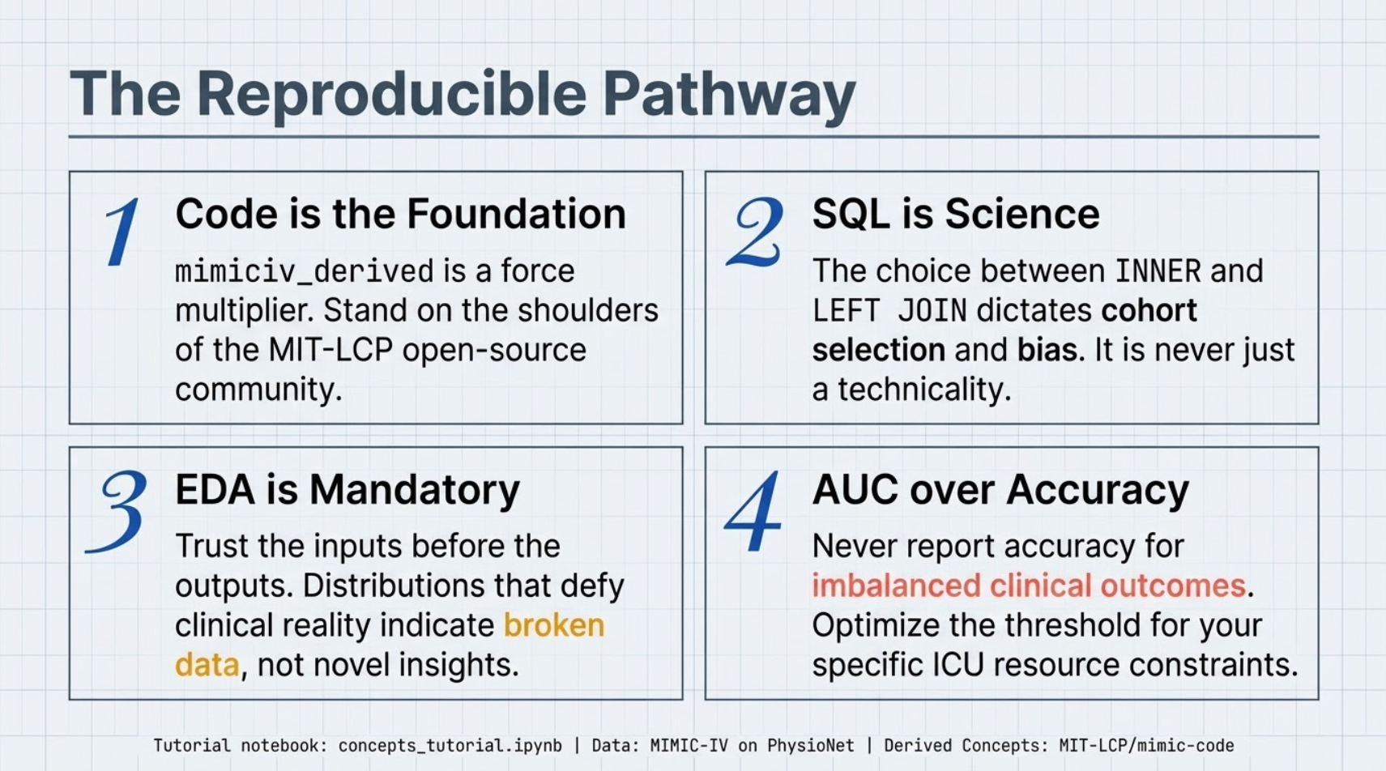
Notes:
Main Lessons from this tutorial: Never engineer clinical features without clinical input or community review. EHR data reflects real clinical processes, not perfect records. Treat missing values in EHR data as signals, not just noise to delete. They often reflect real clinical events. Use the MIMIC Code Repository to avoid redoing established clinical logic, such as GCS correction and Charlson weighting.
AUC is preferred over accuracy because accuracy can be a deceptive vanity metric in imbalanced datasets, while AUC measures a model's true ability to distinguish between classes regardless of the population split.

