Slide 1
Recap Monday 10.03.2014
Roman Brun, Marco Fischlin

Slide 2
Table of Contents
Overview Sumo
S19 File
Events

Slide 3
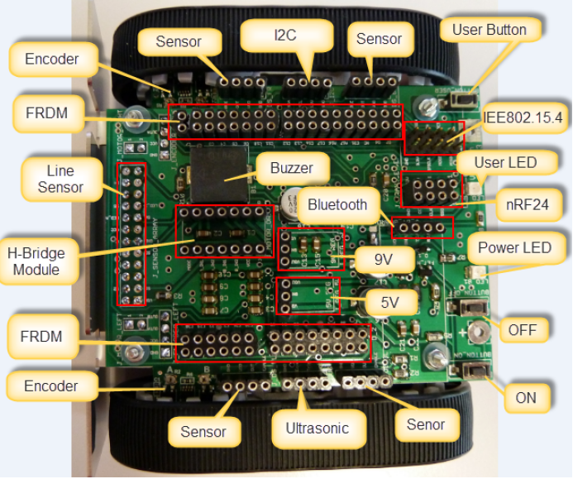
Sumo Component Overview

Slide 4
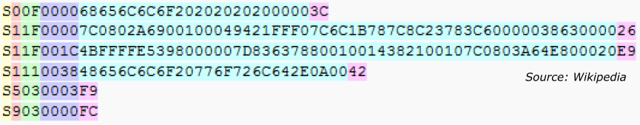
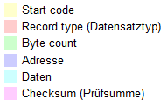
What’s an S19 File?
Text files with code

Slide 5
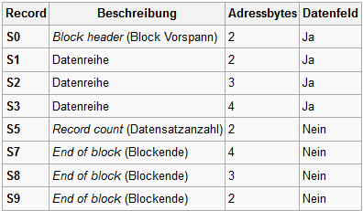
S19 Record types

Slide 6
Events
Synchronous Events
Timer interrupt
Periodic Task output
Need Infrastructure
Set/clear/chek if event happend
Asynchronous Events
Button pressed
Transceiver packet received
Implementation
RTOS
Flags
Possible implementation
Queue,List,Array

Slide 7
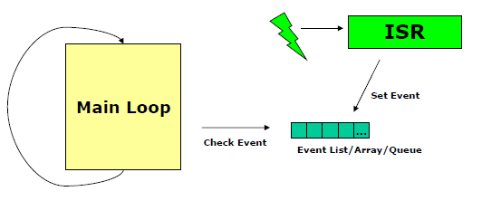
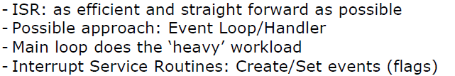
Interrupt Execution Speed

Slide 8
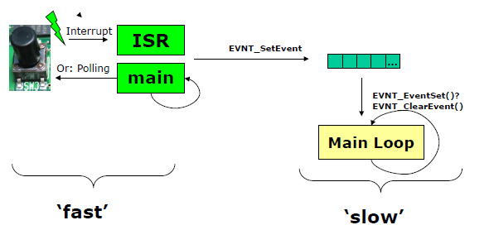
Decoupling Event Processing

Slide 9
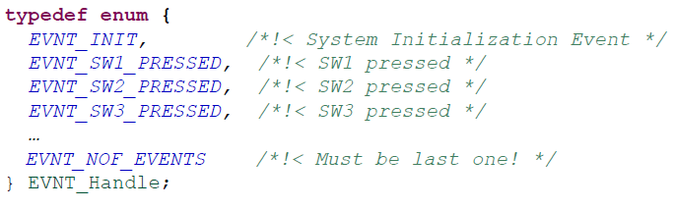

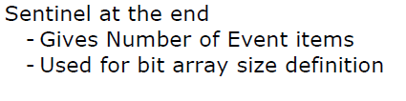
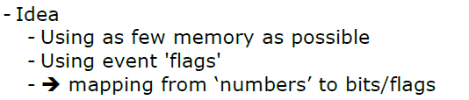
Storing Events

Slide 10
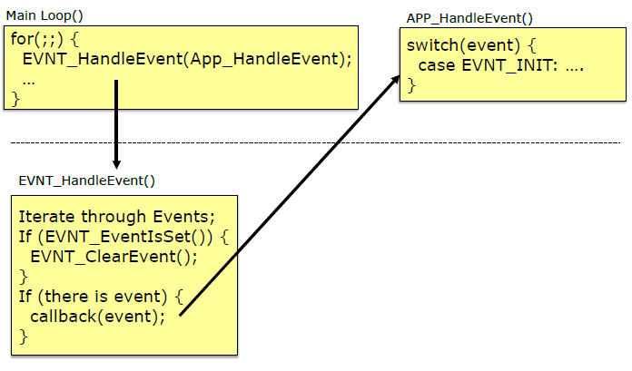
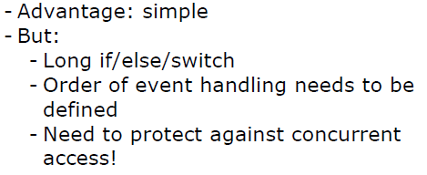
Handling Events from Main Loop

Slide 11
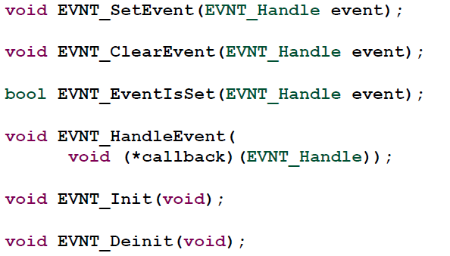
Event Interface

Slide 12
Thanks for your attention!

Slide 13
Questions

Slide 14
What is an S19 file?
It is a file with code.

Slide 15
What is the meaning of S1 in a S19 file?
It means, that a stream of data follow with a two byte adress.

Slide 16
What kind of events does exist?
Synchronous Events
Timer interrupt
Periodic Task output
Asynchronous Events
Button pressed
Transceiver packet received

Slide 17
What is the sentinel at the end of the enum type EVNT_Handle for?
EVNT_NOF_EVENTS

Slide 18
What are the advantages and disandvantages of handling events from the main loop?
Advantage: simple
Disadvantages:
Long if/else/switch (in APP_HandleEvent())
Order of event handling needs to be defined
Need to protect against concurrent access!

