Slide 1



Automated real-time journalism, using Topic Detection and Tracking (TDT) in twitter
Dr. Ghassan Z. Qadah
Suha Glal Ahmed @4109

Slide 2

Outlines
Related Work
Problem Definition
Methodologies
Results
Conclusion

Slide 3
Related Works
Using Twitter to Recommend Real-Time Topical News October 23–25, 2009.
Emerging Topic Detection on Twitter based on Temporal and Social Terms Evaluation, July 25th, 2010.
What is Twitter, a Social Network or a News Media?, April 26–30, 2010.
Earthquake Shakes Twitter Users:Real-time Event Detection by Social Sensors, 2010, April 26–30,

Slide 4
Problem Definition
Identify trending topics from streaming Twitter data. (FSD) (“on-line detection” )
Get more details about the detected topic

Slide 5
Methodologies
Segmentation Task
Detection Task
Tracking Task

Slide 6
Segmentation Task
Definition: automatically dividing a text stream into topically homogeneous blocks
Motivation: facilitating topic detection and tracking task
Filtering
Notes:
Average of 30 tweets/sec
With the translation on average 1tweet/sec

Slide 7
Detection Task
Undirected Graph using Lucene Indexer method
Prefix Tree using estMax Method

Slide 8
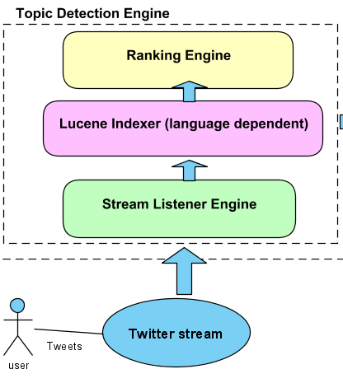
Undirected Graph using Lucene Indexer method

Slide 9
Undirected Graph using Lucene Indexer method(2)
"aaa bbb ccc zzz"
"aaa bbb ccc yyy"
"aaa bbb ccc qqq uuu"
"aaa ddd"
"aaa ddd mmm"
"aaa ddd xxx"
"aaa ddd rrr"
"aaa eee fff ttt"
"aaa eee fff lll"
"aaa eee fff www"
"aaa eee fff sss"
"ggg hhh iii vvv"
"ggg hhh iii wewe"
"ggg hhh iii usus"
"ggg jjj kkk opop"
"ggg jjj kkk ppp"

Slide 10
Undirected Graph using Lucene Indexer method(3)
 | a | g | d | e | f | b | c | h | i | j | k
a
g | 0
d | 4 | 0
e | 4 | 0 | 0
f | 4 | 0 | 0 | 4
b | 3 | 0 | 0 | 0 | 0
c | 3 | 0 | 0 | 0 | 0 | 3
h | 0 | 3 | 0 | 0 | 0 | 0 | 0
i | 0 | 3 | 0 | 0 | 0 | 0 | 0 | 3
j | 0 | 2 | 0 | 0 | 0 | 0 | 0 | 0 | 0
k | 0 | 2 | 0 | 0 | 0 | 0 | 0 | 0 | 0 | 2

Slide 11

Undirected Graph using Lucene Indexer method (4)
Before Removing Duplicate (Complexity : )
aaa ddd
aaa eee
aaa eee fff
aaa bbb
aaa bbb ccc
ggg hhh
ggg hhh iii
ggg jjj
ggg jjj kkk
After Removing Duplicate ( Complexity : )
aaa ddd
aaa eee fff
aaa bbb ccc
ggg hhh iii
ggg jjj kkk

Slide 12
Undirected Graph using Lucene Indexer method (5)
The problem with this method:
False Positive Error
Collect N Tweets To Start Processing
Maximum : 40000 tweets took 28 minutes to collect and 43 minutes to process
Consumes Memory
Discarding Detected Topics

Slide 13
Prefix Tree using estMax Method
Finding MFIs without any checking superset/subset mechanism
Extracting MFIs at any moment over online data streams

Slide 14
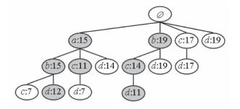
Prefix Tree using estMax Method(2)

Slide 15
Prefix Tree using estMax Method(3)
Cons:
Computationally Expensive
Becomes slower with big tree (1 hour and 15 minutes to process 1000 tweet)
Needs very clean data

Slide 16
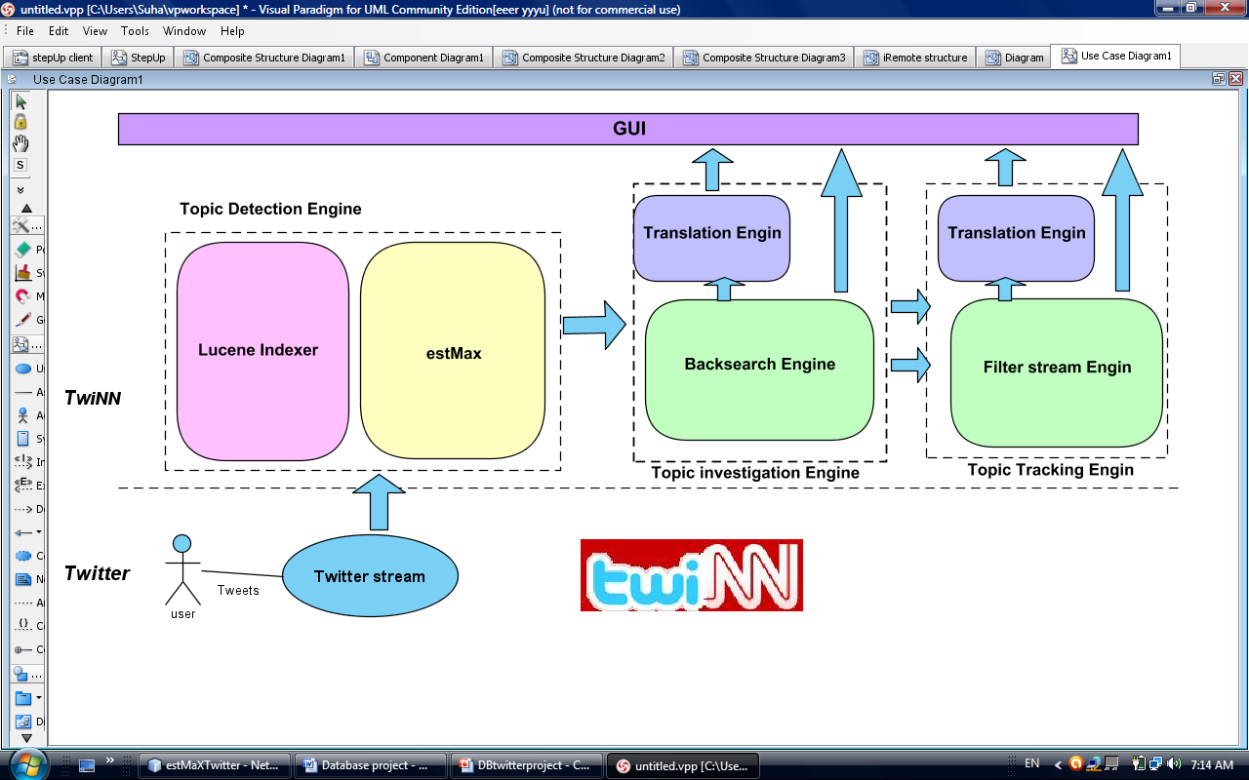
Tracking Task

Slide 17
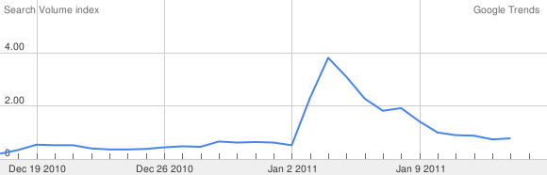
Results (Lucene Indexer Method)
Time Topic detected | Topic detected
2011-01-03 10:42:42 | justin selena

Slide 18
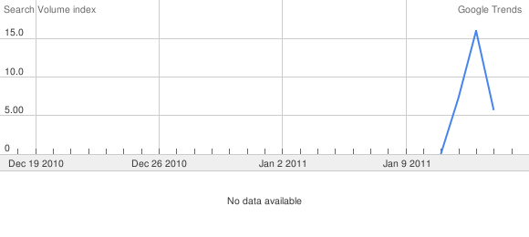
Results (Lucene Indexer Method)
Time Topic detected | Topic detected
2011-01-11 23:28:42 | palin blood sarah libel

Slide 19
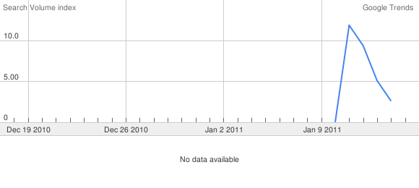
Results (Lucene Indexer Method)
Time Topic detected | Topic detected
2011-01-12 14:33:41 | australia qld floods

Slide 20
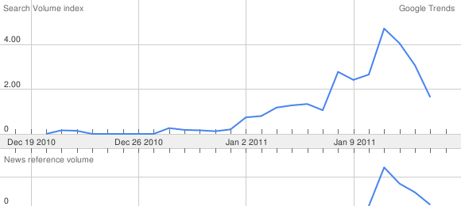
Results (Lucene Indexer Method)
Time Topic detected | Topic detected
2011-01-13 00:16:24 | ronaldinho flamengo

Slide 21
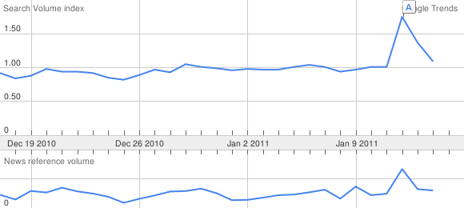
Results (estMax Method)
Time Topic detected | Topic detected
2011-01-16 00:00:01 | nelson

Slide 22
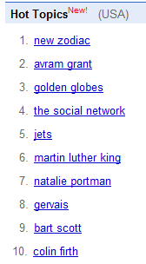
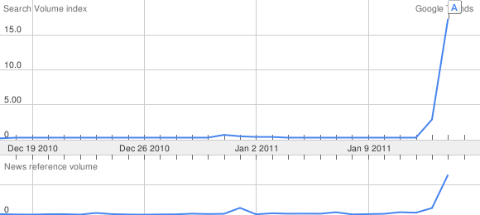
Results (estMax Method)
2011-01-17
11:21 AM
Time Topic detected | Topic detected
2011-01-16 09:39:30 AM | zodiac

Slide 23
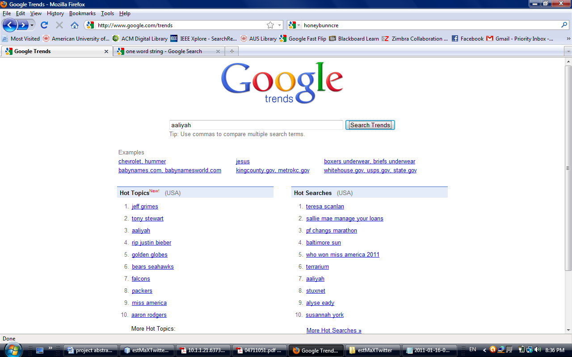
Results (estMax Method)
Time Topic detected | Topic detected
2011-01-16 09:39:30 | aaliyah
Figure : Google Hot topic list in 2011-01-16 at 20:42

Slide 24
Conclusion
Filtering
NPL
Parallel Processing

Slide 25

Thanks

Slide 26
Questions?

Slide 27
References
Ho Jin Woo, Won Suk Lee, "estMax: Tracing Maximal Frequent Item Sets Instantly over Online Transactional Data Streams," IEEE Transactions on Knowledge and Data Engineering, vol. 21, no. 10, pp. 1418-1431, Oct. 2009, doi:10.1109/TKDE.2008.233
“Twitter User Statistics REVEALED” http://www.huffingtonpost.com/2010/04/14/Twitter-user-statistics-r_n_537992.html
http://gadgetidol.com/mobile-application/Twitter-firehose-too-intense-take-a-sip-from-the-garden-hose-or-sample-the-spritzer.html
http://www.marketingpilgrim.com/2010/11/gnip-gets-its-hands-on-Twitters-firehose.html
http:// www.pcpro.co.uk/news/enterprise/.../Twitter-earned-dell-9-million
M. Cheong, V. Lee, “Integrating Web-based Intelligence Retrieval and Decision-making from the Twitter Trends Knowledge Base,” In Proceedings of CIKM 2009 Co-Located Workshops: SWSM 2009, pp. 1-8,2009.
T. Sakaki, M. Okazaki, Y. Matsuo,“Earthquake shakes Twitter users: real-time event detection by social sensors,” In Proceedings WWW 2010, April 26–30, 2010, Raleigh, North Carolina, USA.
Owen Phelan, Kevin McCarthy, Barry Smyth, “Using Twitter to Recommend Real-Time Topical News,” RecSys’09, October 23–25, 2009, New York, New York, USA.
Mario Cataldi , Luigi Di Caro , Claudio Schifanella “Emerging Topic Detection on Twitter based on Temporal and Social,” MDMKDD '10 ,In proceedings of the Tenth International Workshop on Multimedia Data Mining ACM ,New York, NY, USA, 2010
H. Kwak, C. Lee, H. Park, and S. Moon, “What is Twitter, a Social Network or a News Media?” WWW 2010, April 26–30, 2010, Raleigh, North Carolina, USA.
M. E. J. Newman and J. Park. “Why social networks are different from other types of networks.” Phys. Rev. E, 68(3):036122, Sep 2003.
Twitter API Documentation,http://apiwiki.Twitter.com/w/page/22554679/Twitter-API-Documentation
The Twitter Streaming API — How It Works and Why It’s A Big Deal (Update 2010-11-21)http://borasky-research.net/2010/01/06/the-Twitter-streaming-api-how-it-works-and-why-its-a-big-deal/
J. Allan, R. Papka, and V. Lavrenko, “On-line New Event Detection and Tracking,” In Proceedings of ACM SIGR, pp. 37-45, 1998.
www.twitter4j.org

