Slide 1
IACV Project
S.12 - Parcel Classification
Ghitti Marco

Slide 2
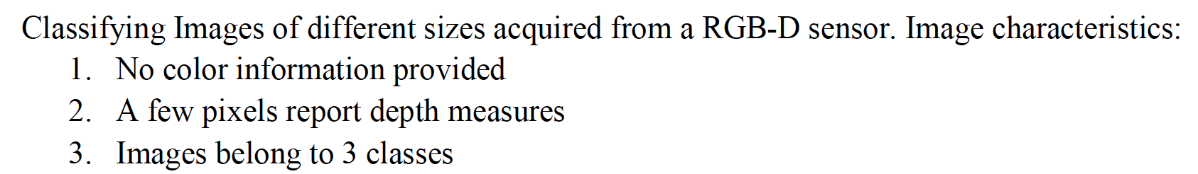



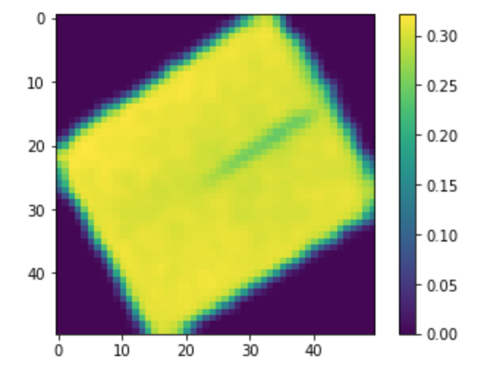
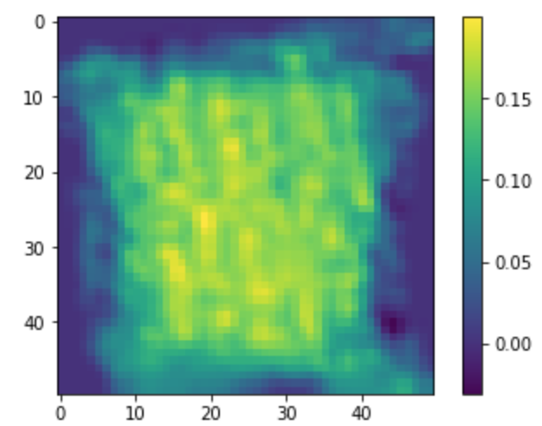
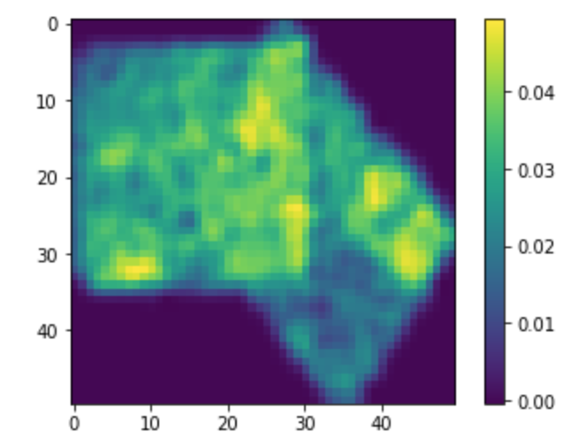
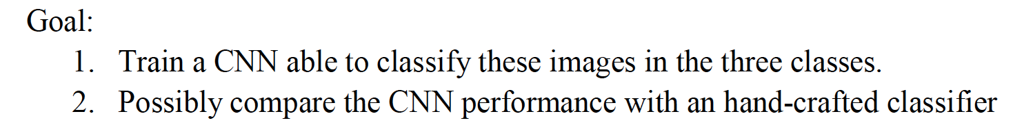
S.12 Parcel Classification

Slide 3
Dataset and preprocessing
Dataset composed of 2052 images
Double: 471
Envelope: 879
Parcel: 702
All images have been resized to 50x50 pixels.

Slide 4
Hand-Crafted Classifier Selected features: H5

Slide 5
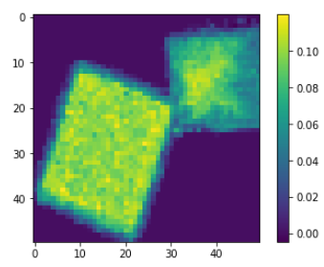
Hand-Crafted Classifier Selected features: H5
Load the image

Slide 6
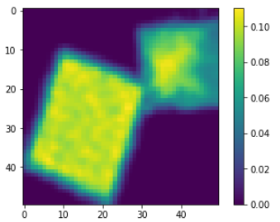
Hand-Crafted Classifier Selected features: H5
Load the image
Blur 3x3 kernel

Slide 7
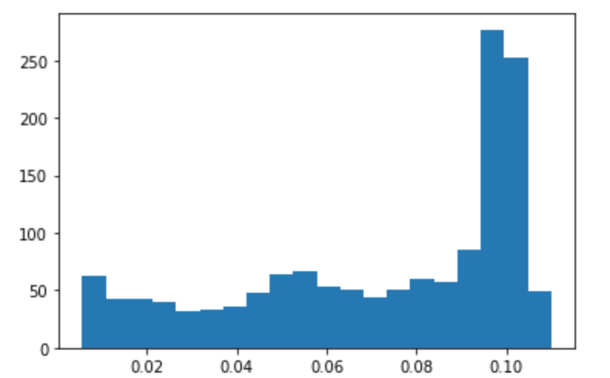
Hand-Crafted Classifier Selected features: H5
Load the image
Blur 3x3 kernel
Compute np.histogram

Slide 8
Hand-Crafted Classifier Selected features: H5
Load the image
Blur 3x3 kernel
Compute np.histogram
Divide the histogram in 5 bins
(H1,…,H5)
H1
H2
H3
H4
H5

Slide 9
Hand-Crafted Classifier Selected features: H5
Load the image
Blur 3x3 kernel
Compute np.histogram
Divide the histogram in 5 bins
Take H5
(H1,…,H5)
H1
H2
H3
H4
H5

Slide 10
Hand-Crafted Classifier Selected features: MaxMagOnArea

Slide 11
Hand-Crafted Classifier Selected features: MaxMagOnArea
Load the image

Slide 12
Hand-Crafted Classifier Selected features: MaxMagOnArea
Load the image
Blur 3x3 kernel

Slide 13
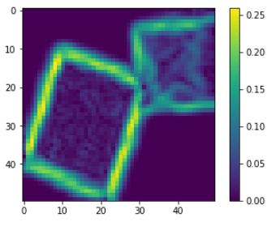
Hand-Crafted Classifier Selected features: MaxMagOnArea
Load the image
Blur 3x3 kernel
Compute derivatives and gradient magnitude

Slide 14
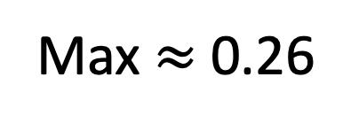
Hand-Crafted Classifier Selected features: MaxMagOnArea
Load the image
Blur 3x3 kernel
Compute derivatives and gradient magnitude
Take the max value
Max $≈$ 0.26

Slide 15
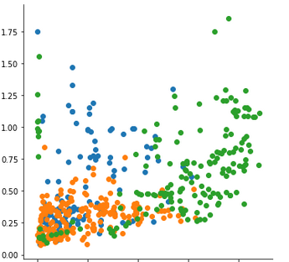
Hand-Crafted Classifier Scatterplot
MagMagOnArea
H5

Slide 16
Hand-Crafted Classifier Training
Split Train and Test set
TRAIN
TEST

Slide 17
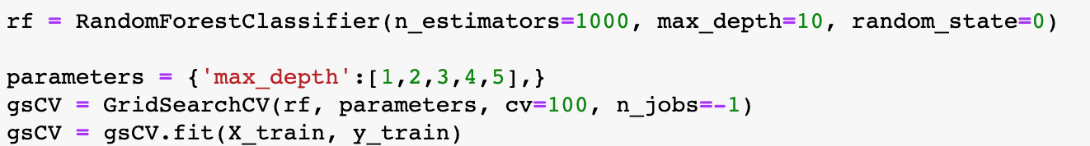
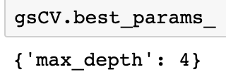
Hand-Crafted Classifier Training
Grid Search to find good Hyperparameters
Found best hyperparameter

Slide 18
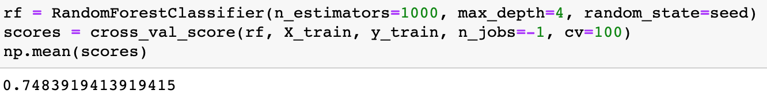

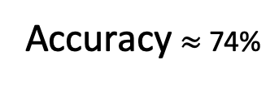
Hand-Crafted Classifier Training
CV score on training set
Final score on test set
Accuracy $≈$74%

Slide 19
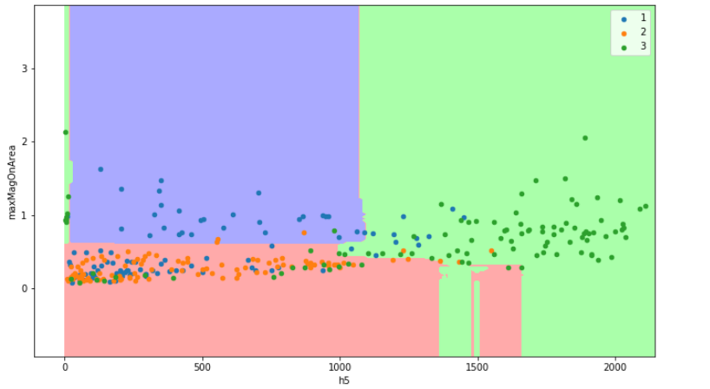
Hand-Crafted Classifier Explainability

Slide 20
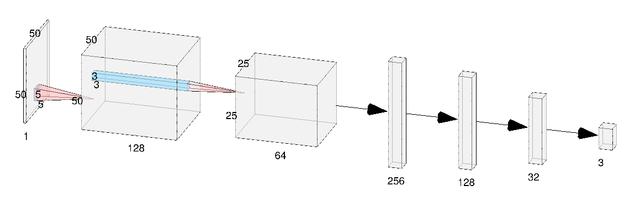
CNN Architecture

Slide 21
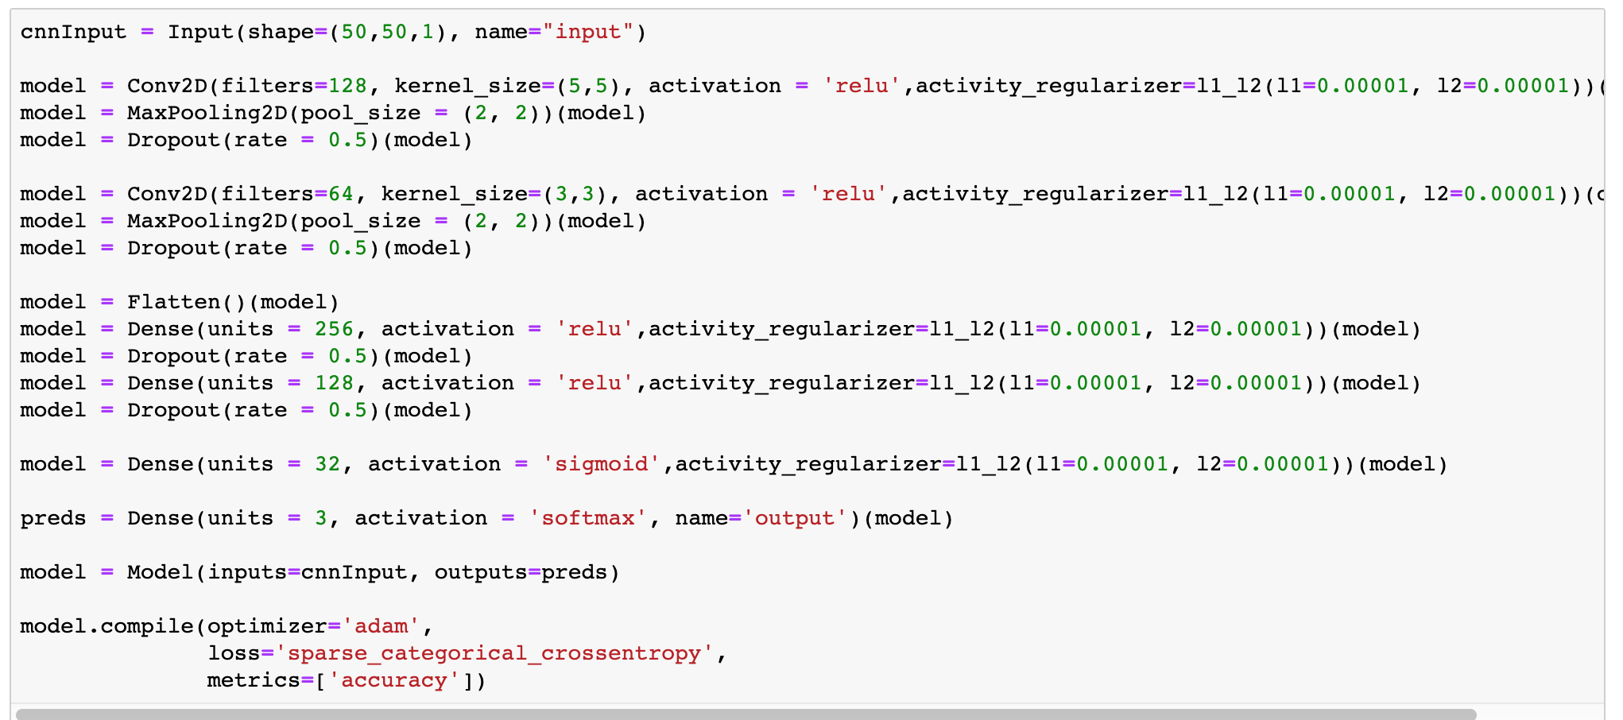
CNN Architecture
2 Conv2D layers and 4 dense
Regularized with L1,L2 and dropout.
Relu activations except for the last two layers
Adam optimizer
Crossentropy loss

Slide 22
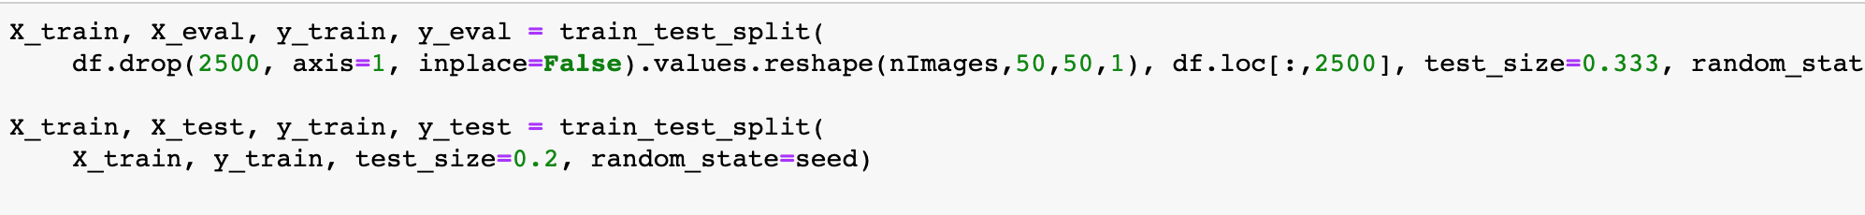
CNN Train-Dev-Test split
As before one third of the dataset is kept as Test dataset.
One fifth of the remaining test datatset is kept to perform early stopping.

Slide 23
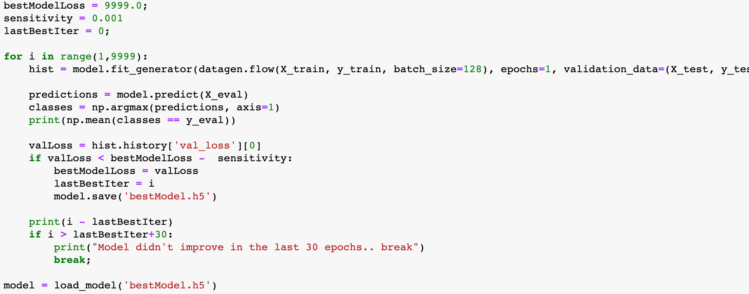
CNN Training procedure
Model trained until the validation loss do not improve for 30 epochs
Batch size 128
Best model saved in .h5 file

Slide 24
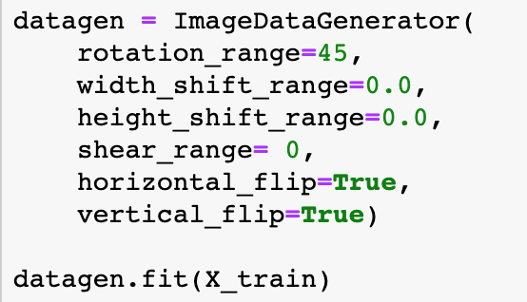
CNN Data augmentation
Data augmentation has been used to enhance the training dataset.

Slide 25
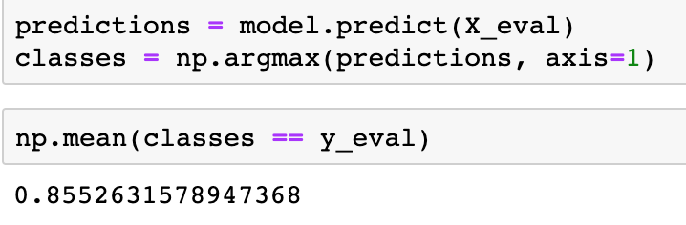
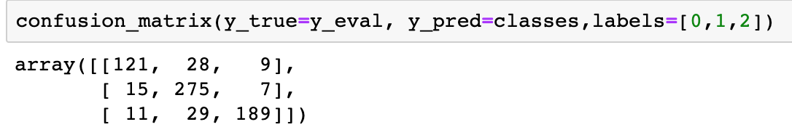

CNN Test dataset results
The trained model have an accuracy of $≈$ 85%
Errors evenly spread across classes.

Slide 26
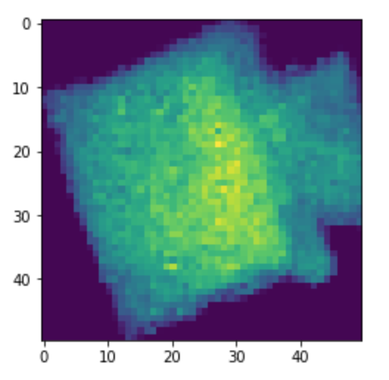
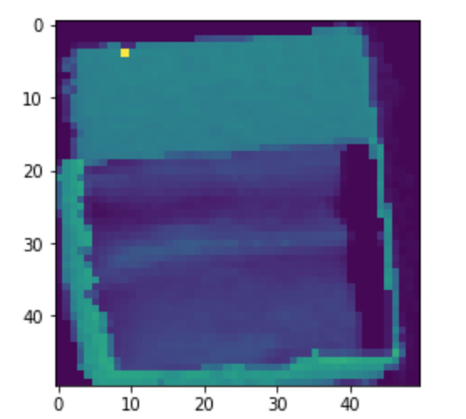
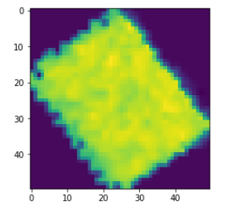
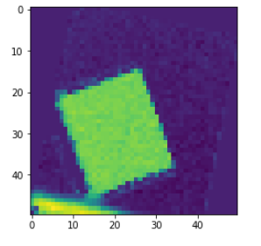
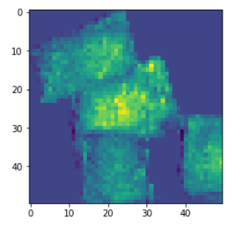
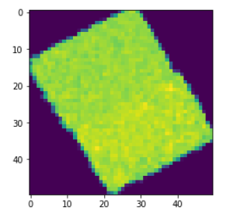
CNN False negatives - Double

Slide 27
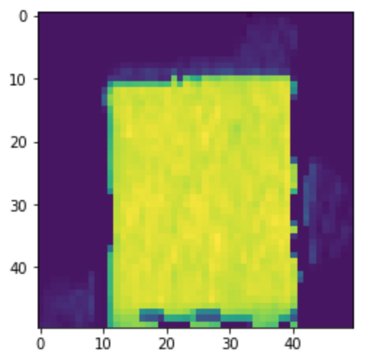
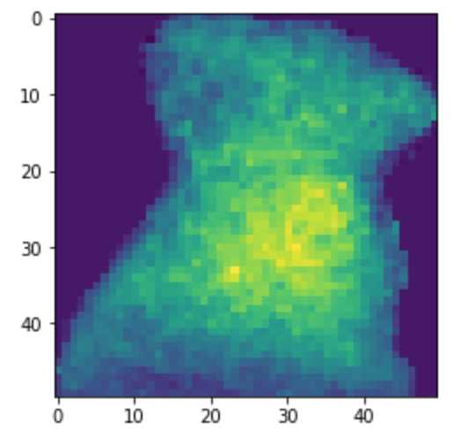
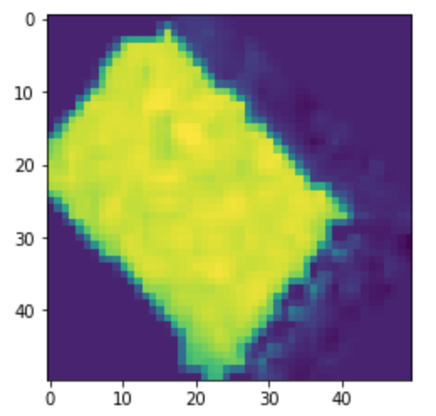
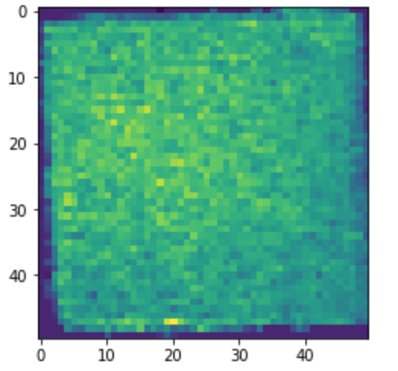
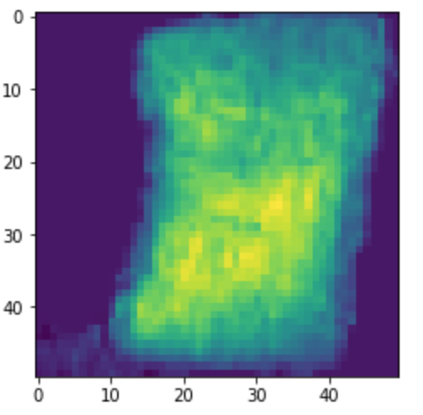
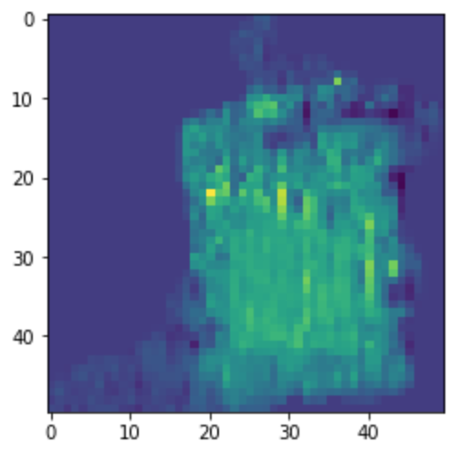
CNN False positives - Double

Slide 28
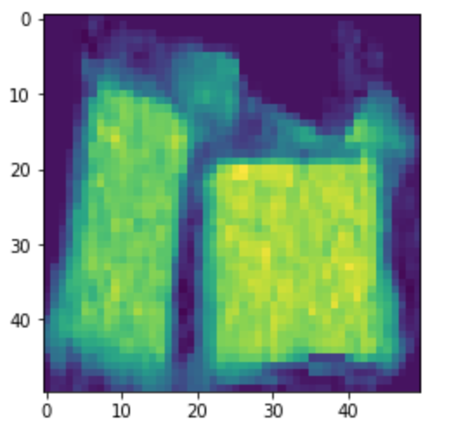
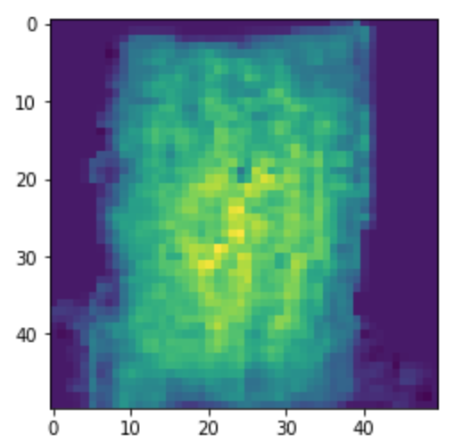
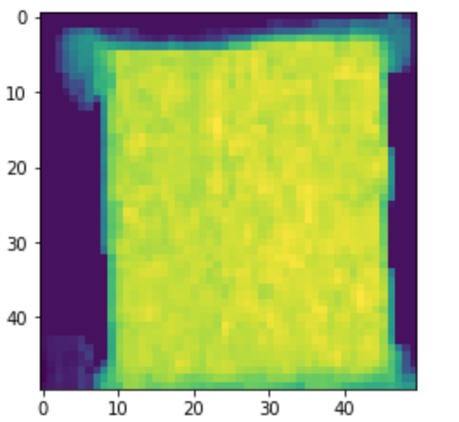
CNN False negatives - Envelope

Slide 29
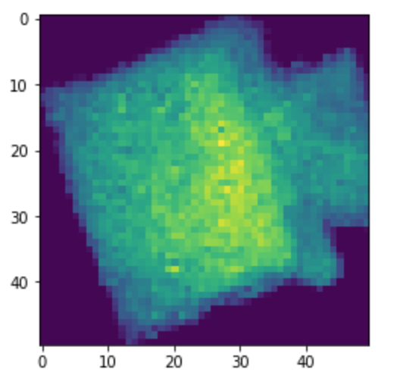
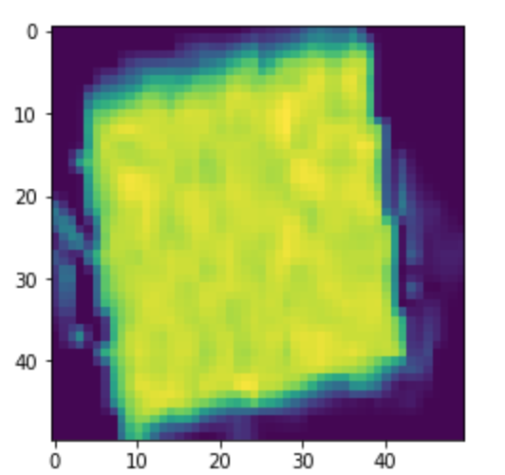
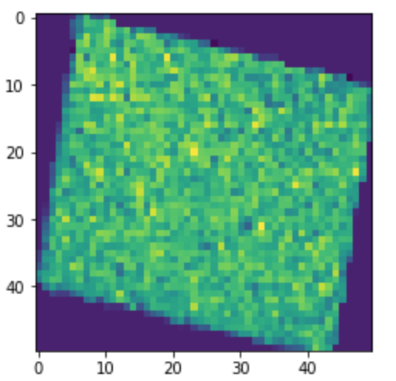
CNN False positives - Envelope

Slide 30
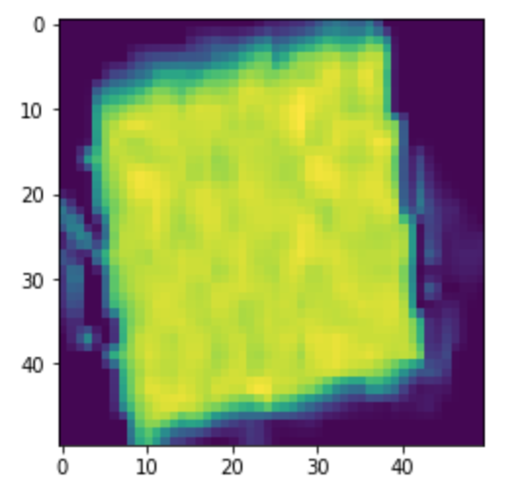
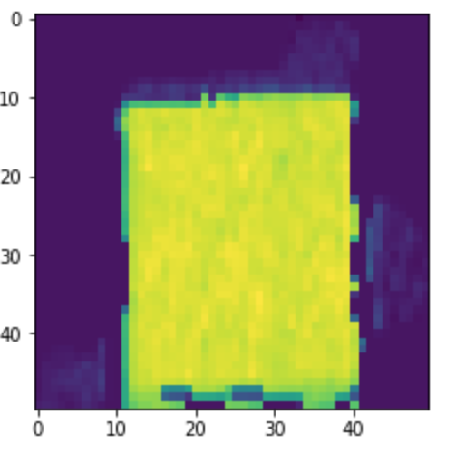
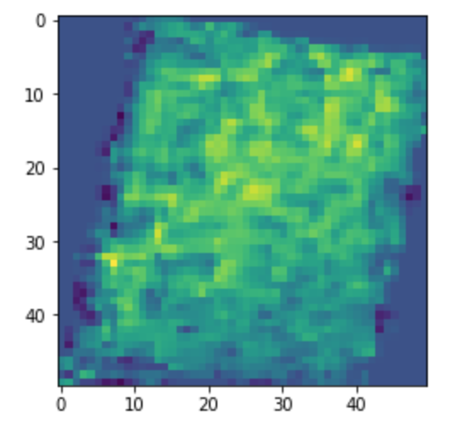
CNN False negatives - Parcel

Slide 31
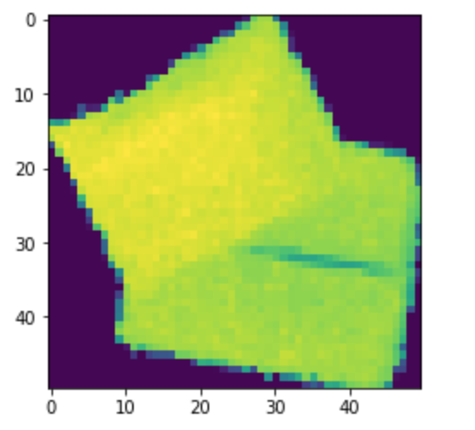
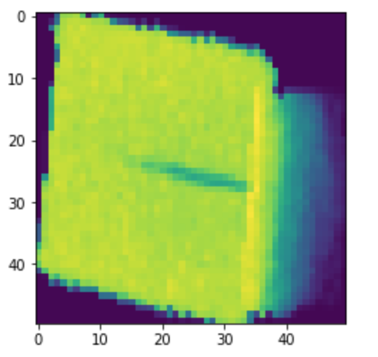
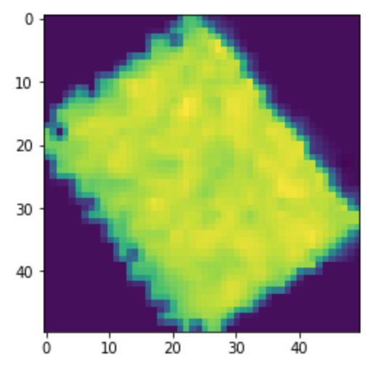
CNN False positives - Parcel

Slide 32
Final thoughts
CNN models lead to better models at the expense of the possibility to explain the results.
Better hand-crafted features might improve the model (e.g. Clustering).
More data points whould improve performances of CNN model.
To deploy the final models we should retrain both models on the whole dataset without the test set, that would improve accuracy.

