Slide 1
Strongly connected components algorithm
Advanced algorithms and parallel programming project
- Ghitti Marco

Slide 2
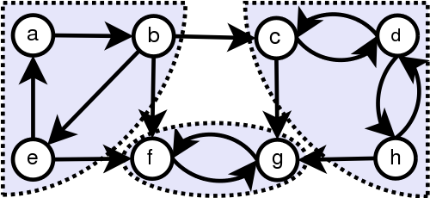
Introduction - Problem
1 - Introduction
2 - Implementation
3 - Testing
4 - Performance
For a directed graph D = (V, E), a Strongly Connected Component (SCC) is a maximal induced subgraph S = (VS, ES) where, for every (x, y) ∈VS, there is a path from x to y (and vice-versa).
Find all the Strongly Connected Components (SCCs) in a
directed graph.
1/17
Notes:
Find all the SCC in a directed graph

Slide 3
Introduction - Tarjan Algorithm
- Exploit the Depth First Visit algorithm to find the SCCs of a directed graph.
- Worst case time Complexity: O(|V| + |E|).
Worst case space Complexity: O(|V| ∙ (1 + 3w)). (Pearce implementation)
1 - Introduction
2 - Implementation
3 - Testing
4 - Performance
2/17
Notes:
Space Complexity: O( |V| • ())

Slide 4
Implementation - Boost / C++
1 - Introduction
2 - Implementation
3 - Testing
4 - Performance
Implemented by using the Boost Graph Library (BGL)
Same interface as the BGL for Python
template <class Graph, class ComponentMap>
typename property_traits<ComponentMap>::value_type
strong_components(Graph& g, ComponentMap comp)
Implemented with C++ 11
3/17
Notes:
- Implemented by using the Boost Graph Library (BGL)

Slide 5
Implementation - Iterative Impl.
1 - Introduction
2 - Implementation
3 - Testing
4 - Performance
Iterative implementation as in the Pearce paper plus some changes to work with the BGL:
Stack containing the index of the last explored edge substituted with stack of the iterator over the edge set.
Changed the behaviour of the visitLoop and beginVisiting to work with the iterator.
4/17

Slide 6
Testing – Boost tests
1 - Introduction
2 - Implementation
3 - Testing
4 - Performance
Boost test library to run unit tests
10 test cases where the last one has been replicated for all the possible combinations of containers for a adjacency_list and adjacency_matrix.
5/17
Notes:
100

Slide 7
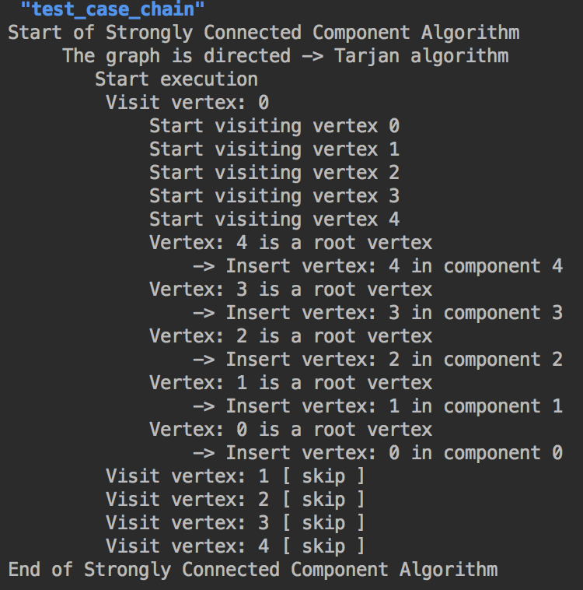
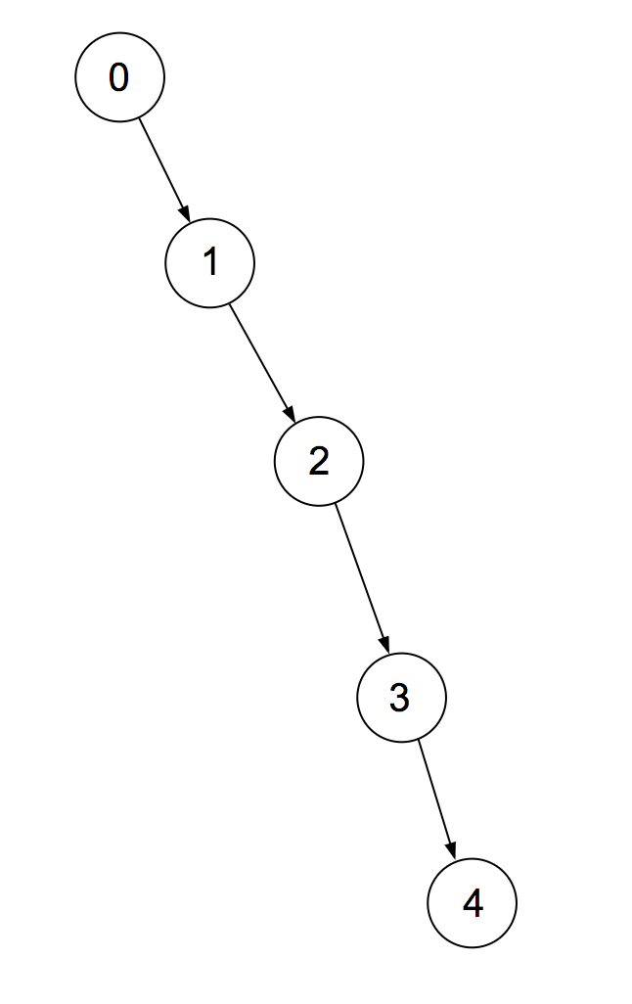
Testing – Test cases
1 - Introduction
2 - Implementation
3 - Testing
4 - Performance
Chain:
6/17

Slide 8
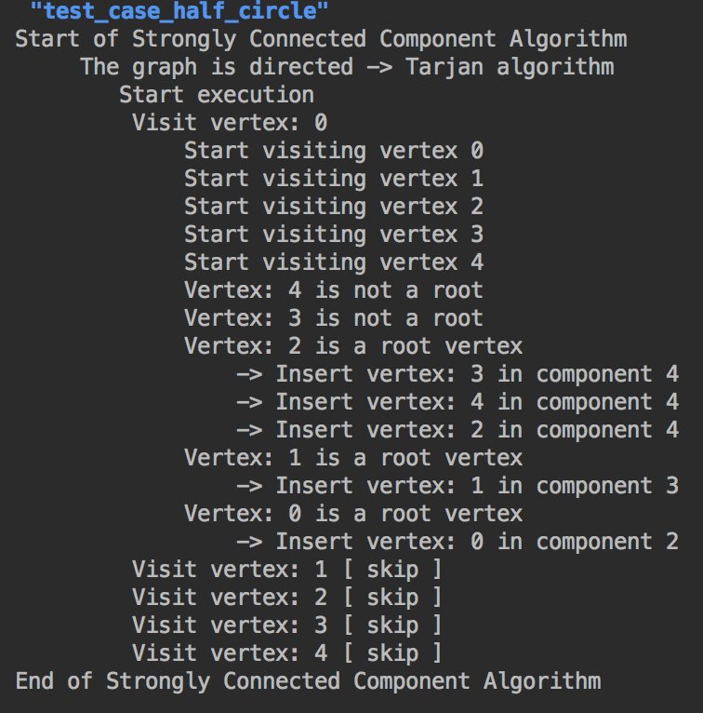
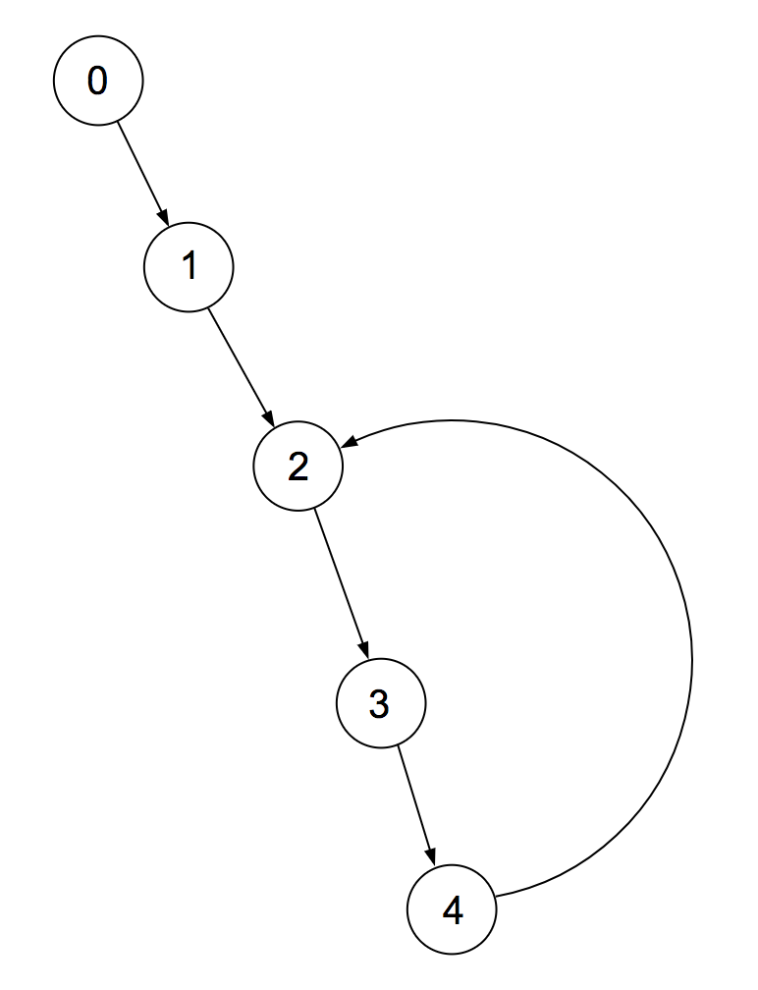
Testing – Test cases
1 - Introduction
2 - Implementation
3 - Testing
4 - Performance
Half circle:
7/17
Notes:
100

Slide 9
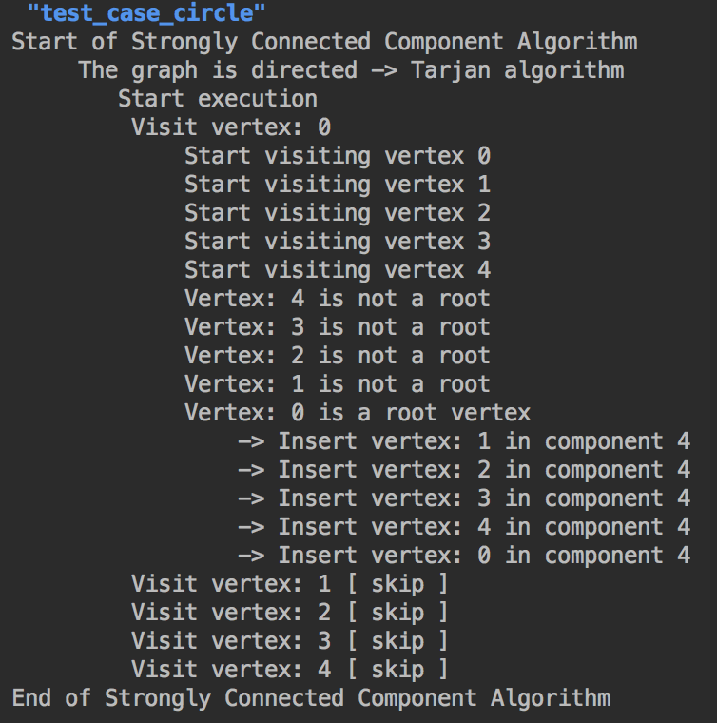
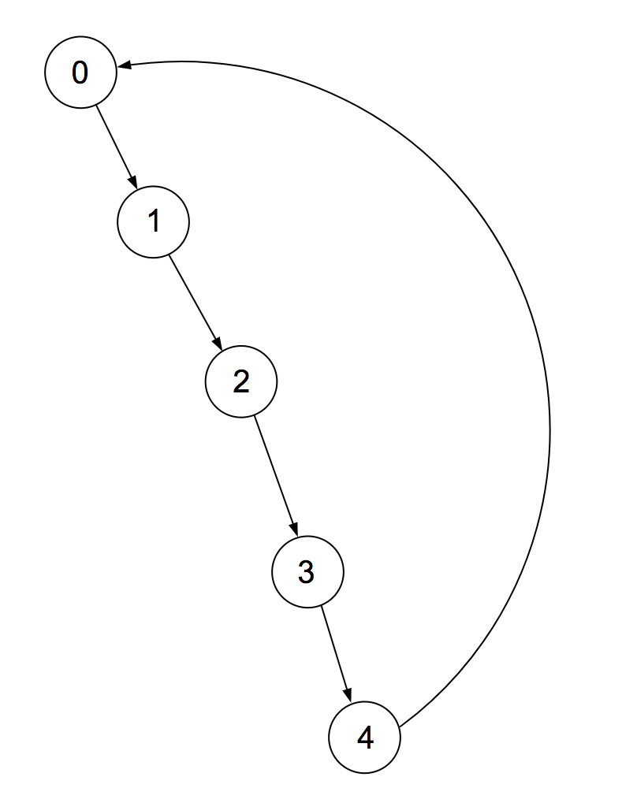
Testing – Test cases
1 - Introduction
2 - Implementation
3 - Testing
4 - Performance
Circle:
8/17

Slide 10
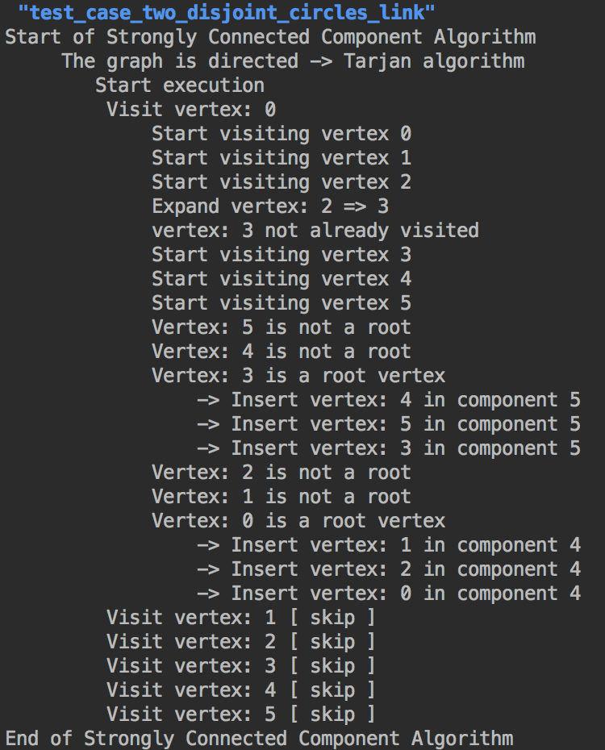
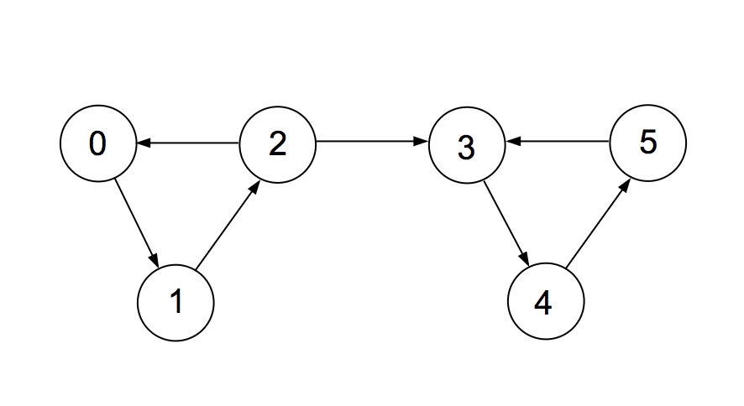
Testing – Test cases
1 - Introduction
2 - Implementation
3 - Testing
4 - Performance
Two circles with link:
9/17

Slide 11
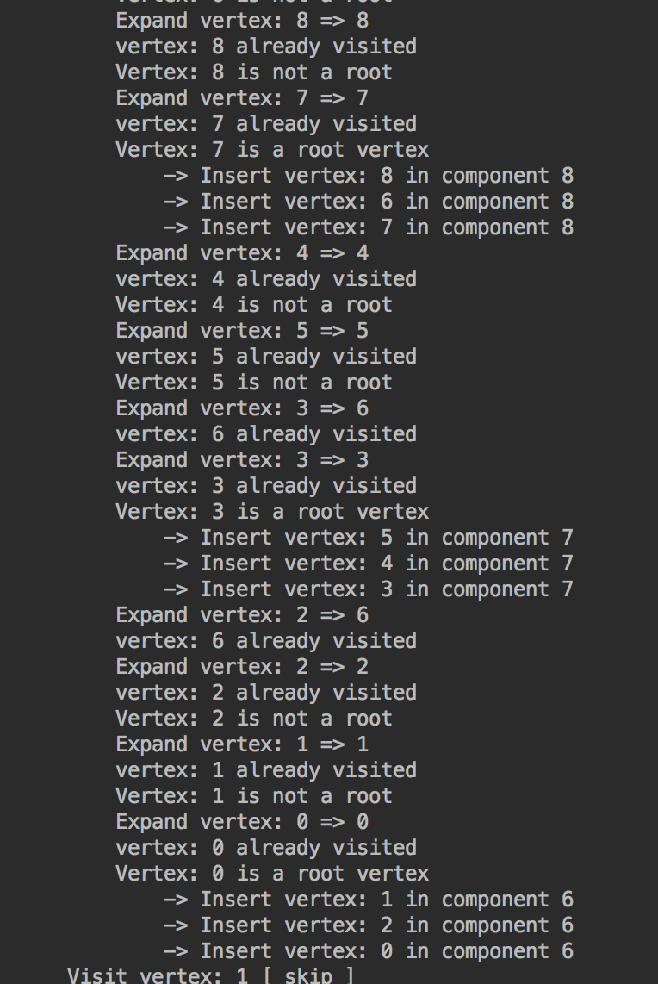
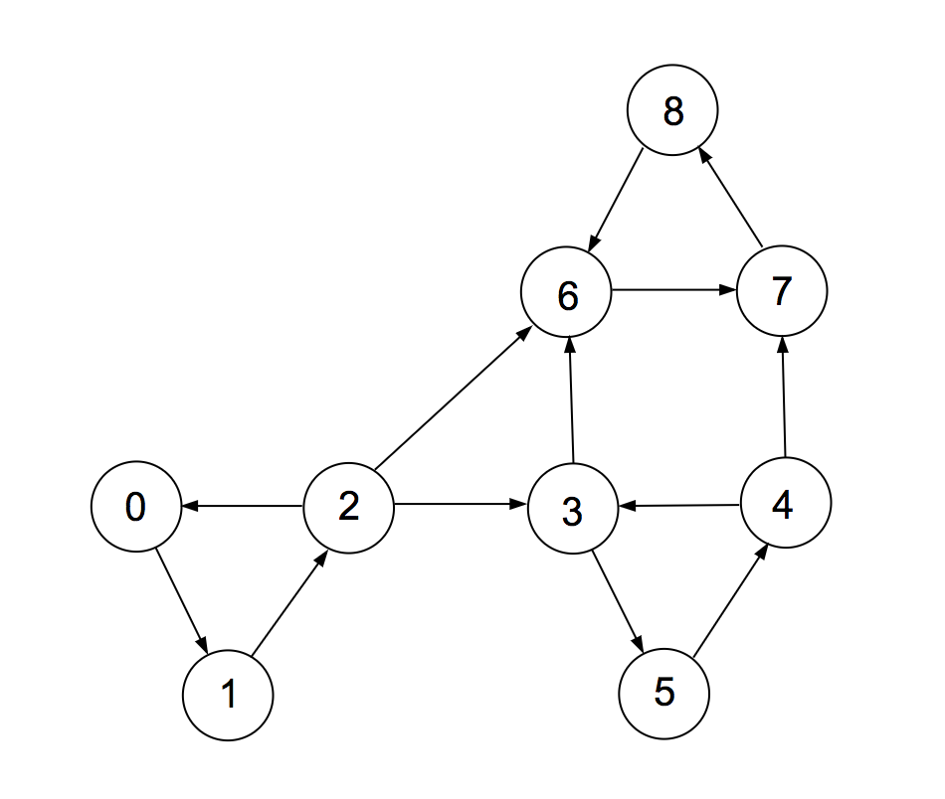
Testing – Test cases
1 - Introduction
2 - Implementation
3 - Testing
4 - Performance
Complete:
10/17
Notes:
100

Slide 12
Performance – Compiler
1 - Introduction
2 - Implementation
3 - Testing
4 - Performance
Intell c++ compiler 18.0
Optimization flag –O3
11/17
Notes:
Used the Intell c++ compiler 18.0

Slide 13
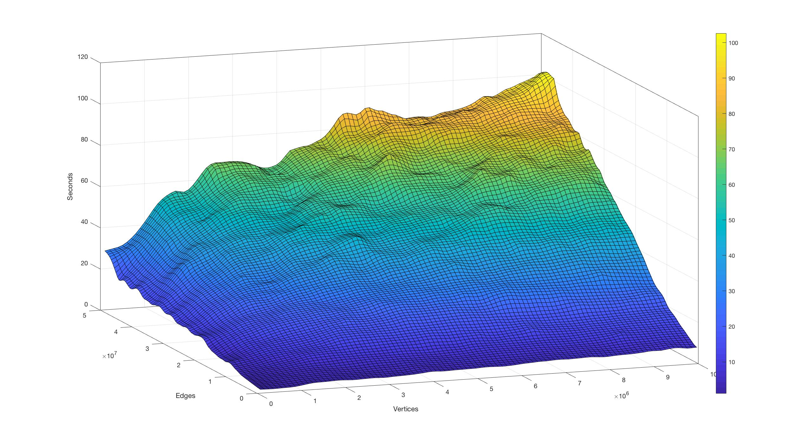
Performance – BGL comparison
1 - Introduction
2 - Implementation
3 - Testing
4 - Performance
Time:
The time required by the two algorithm is nearly the same.
On the average the algorithm is 5.2% faster than BGL implementation on test samples.
2.000 samples
12/17

Slide 14
Performance – BGL comparison
1 - Introduction
2 - Implementation
3 - Testing
4 - Performance
Space:
Take into account only the space required by the algorithm without the graph representation.
Calculated as maximum sampled resident memory during the execution minus the resident memory before the invocation of the algorithm.
13/17

Slide 15
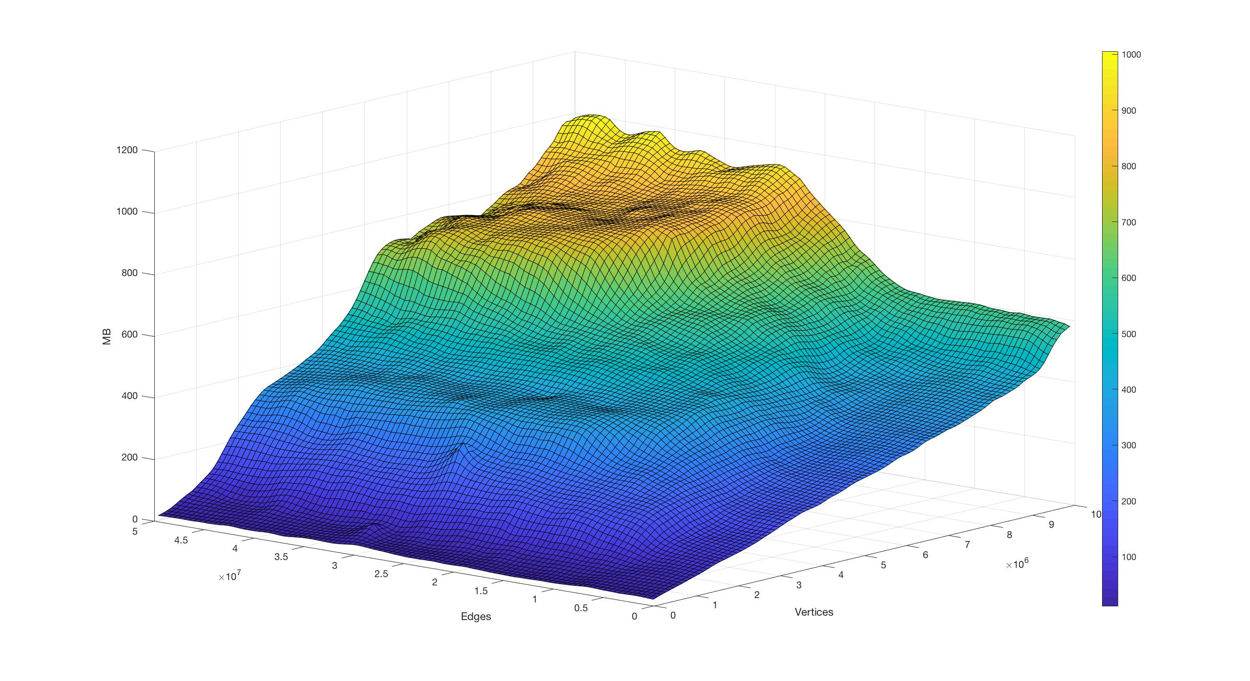
Performance – BGL comparison
1 - Introduction
2 - Implementation
3 - Testing
4 - Performance
BGL algorithm:
4.000 samples
14/17

Slide 16
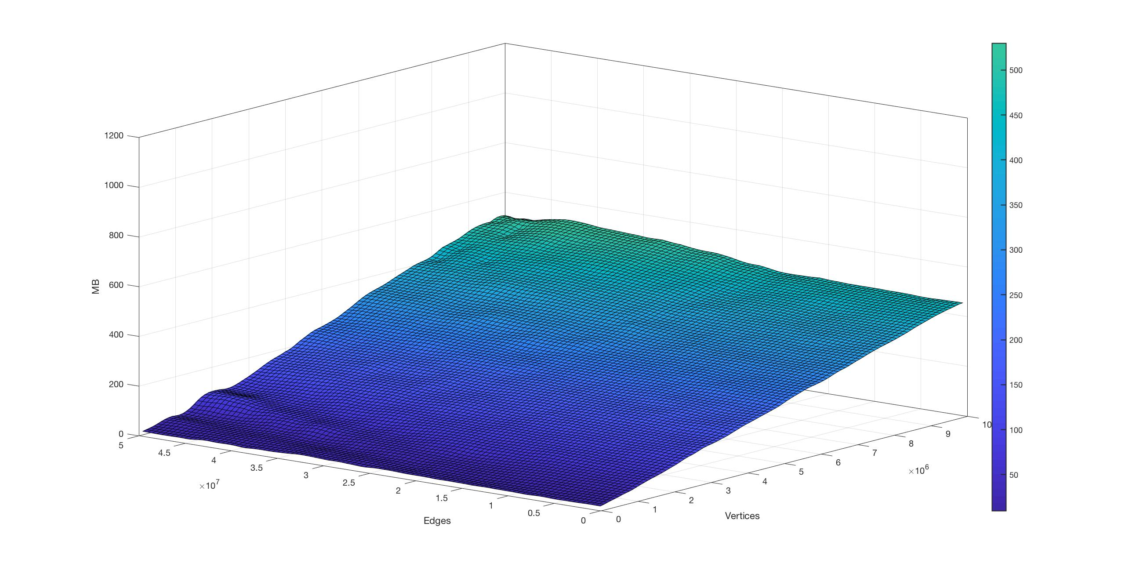
Performance – BGL comparison
1 - Introduction
2 - Implementation
3 - Testing
4 - Performance
New algorithm:
4.000 samples
15/17

Slide 17

Performance – Profiling
1 - Introduction
2 - Implementation
3 - Testing
4 - Performance
Profiled with instruments
95% of the time spent inside two functions
Boost::get
Boost::put
16/17

Slide 18
Performance – Conclusion
1 - Introduction
2 - Implementation
3 - Testing
4 - Performance
Space efficient implementation while supporting all the possible type of graph of the BGL
For better perfomances use just a adjacency list with VecS as container and return an array instead of a map (avoid get/put and just need to save the index instead of the iterator)
17/17

