Slide 1
DATA MINING & MACHINE LEARNING
Loan Default Prediction
Data Mining & Machine Learning Project M.Sc. in Artificial Intelligence and Data Engineering — Academic Year 2025–2026
Marco Lari — ID: 635737 | Tommaso Pellegrini — ID: 635452
18/06/2025

Slide 2
OVERVIEW
Presentation Outline
01
Problem & Dataset
Task definition · features · EDA
02
Pipeline & Experiments
PART 1
Preprocessing · model selection · hyperparameter optimization
03
Evaluation & Results
Metrics · cross-validation · final model performance
04
Explainability
PART 2
Global & local techniques · consistency with domain knowledge
05
Critical Discussion
Error analysis · limitations · future directions

Slide 3
PART 1 — TECHNICAL
Problem, Pipeline & Results
Problem definition · feature engineering · model selection
hyperparameter optimization · evaluation · test-set results

Slide 4
PROBLEM
Problem Definition & Dataset
The Problem
Dataset at a Glance
Predict whether an applicant will default on a loan using structured borrower and loan information.
The task is a binary classification problem with mixed numerical and categorical features.
Predicting default risk at the application stage allows lenders to price risk correctly, reduce credit losses, and allocate capital more efficiently.
The main challenges are class imbalance, heterogeneous variables, and highly informative missingness patterns.
Task
Binary Classification
Dataset
Kaggle, 148,670 samples, 34 features
Target
Status ( 1 = loan default, 0 = no default)
Features
13 numerical, 21 categorical
Missing values
3.58 % overall, present in ~25% of 4 features
Class balance
Imbalance – no default 75% / default 25%
Split
Stratified nested CV (outer 5-fold / inner 3-fold)
Metric(s)
AUC (primary), Recall, Balanced Accuracy, F1, FNR

Slide 5
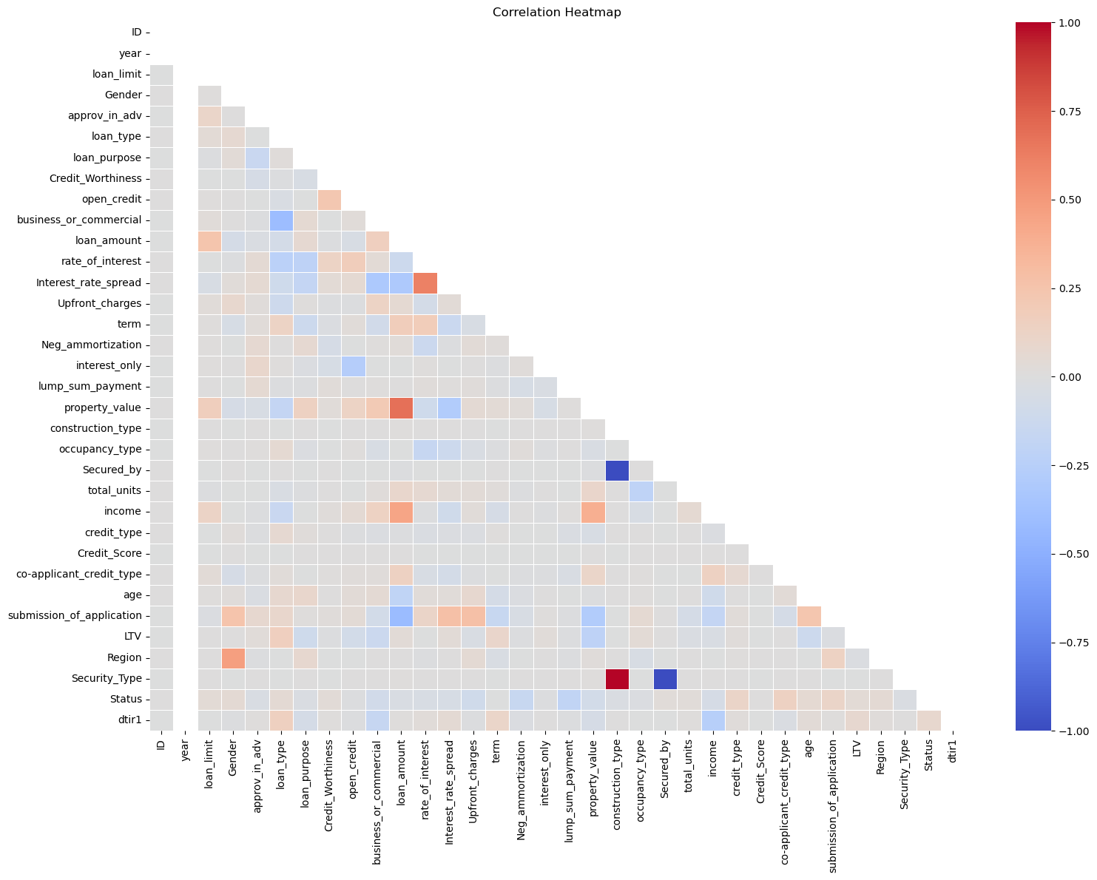
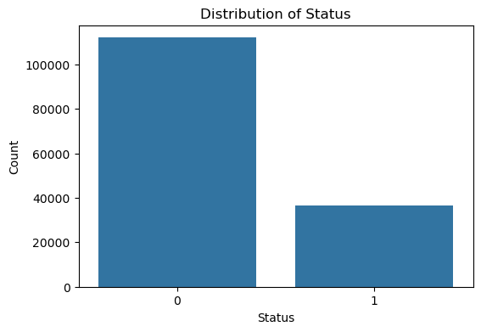
PROBLEM
Exploratory Data Analysis
Key findings from EDA:
The target is heavily imbalanced. Defaults represent a minority, making accuracy a misleading metric and motivating the use of AUC, recall and balanced accuracy primarily. Weak linear correlations overall (no multicollinearity), supporting tree-based models that capture non-linear effects. Features like income that show right skew (mean far above median), justifying a log1p transformation for Naive Bayes. Some features like rate_of_interest, Upfront_charges, Interest_rate_spread, each one with ~25% of missing values (and others with less percentage), seem to be post-approval variables unavailable at decision time — including them would cause data leakage. Also credit_type, even though it has no missing values seems to be a post-approval variable.

Slide 6
PIPELINE
Feature Engineering & Selection
Engineering
Selection Method
Why These Features?
log1p transformation on income to correct strong right skew in NB
StandardScaler on all numerical features (fitted on train fold only)
OneHotEncoder for all categorical features; term moved from numerical to categorical in NB.
Median imputation for numericals; mode imputation for categoricals; ~200 rows with structurally missing values dropped.
Manual domain-driven removal (no automated wrapper/filter)
Criterion: leakage detection (post-approval features), redundancy very high-missingness in positive class (>40%), constant values
Decisions validated by checking missing-value contingency vs. target and cross-referencing domain knowledge
26 features retained from original 34 (8 dropped: 5 leakage + 3 useless/redundant)
Upfront_charges, rate_of_interest, Interest_rate_spread are informations about the loan
LTV and property_value are information about the applicant
rate_of_interest, Upfront_charges, Interest_rate_sprea, credit_type (set after approval — leakage);
LTV, property_value (>40% of missing); ID, year (no predictive value)
All transformations wrapped in sklearn Pipeline preventing any leakage by construction

Slide 7
PIPELINE
ML Pipeline: Avoiding Data Leakage & Bias
Raw
Data
Preprocessing
Feature
Selection
Model
Training
Validation
(held-out fold)
Final
Evaluation
▶
▶
▶
▶
▶
Data Leakage Prevention
Class Imbalance Handling
Metric Justification
All preprocessing fitted only on training folds
sklearn Pipeline: ColumnTransformer (numerical branch: imputer → log1p (NB) → scaler; categorical branch: imputer → OHE) → classifier
Pipeline.fit() called exclusively on the inner training fold in each CV iteration
class_weight=“balanced” for Logistic Regression, Decision Tree, and Random Forest; no SMOTE (avoids oversampling leakage)
class_weight is a model parameter — no data transformation, so no risk of leakage across folds
AUC, Recall, Balanced Accuracy, F1, FPR, FNR — all threshold-independent or class-weighted to avoid accuracy inflation on imbalanced data
AUC — measures discrimination ability across all thresholds; robust to class imbalance, also used for ranking quality
FN (missed default) = full loan loss exposure; FP (rejected solvent borrower) = lost interest revenue FN cost is typically higher, motivating high-recall operation
Precision, Balanced Accuracy F1, and FNR reported per fold to give a complete picture of the trade-off across all models

Slide 8
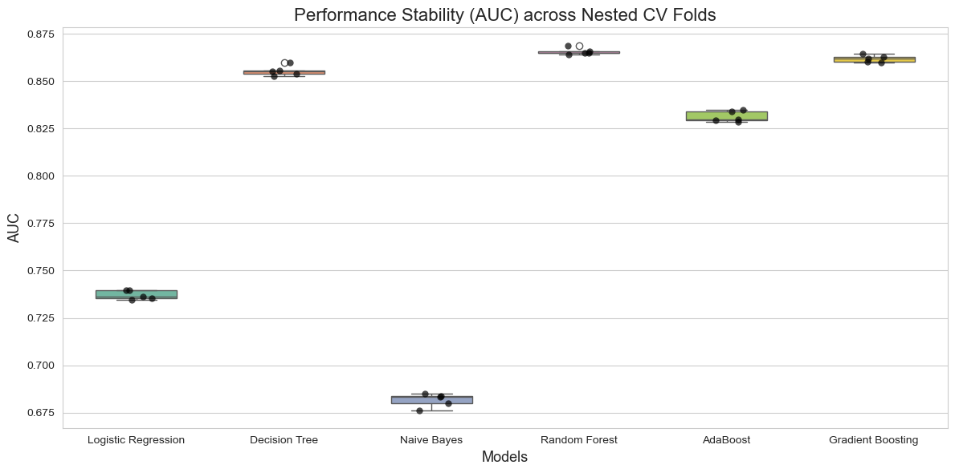
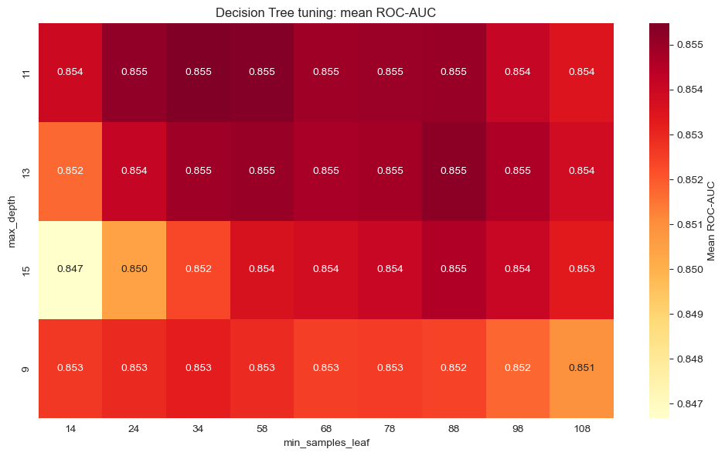
PIPELINE
Model Selection & Hyperparameter Optimization
Key Decisions
Candidate models
LogReg, Naive Bayes, Decision Tree, Random Forest, AdaBoost, Gradient Boosting
CV strategy
Stratified Nested CV: outer 5-fold, inner 3-fold
Selection criterion
AUC (scoring) + Wilcoxon test
Chosen model
Decision Tree (no significant diff. from RF — parsimony)
Search strategy
RandomizedSearchCV, then local GridSearchCV
Search space
max_depth, min_samples_leaf, criterion, class_weight
Best config
13, 88, entropy, None
Statistical test
Wilcoxon (RF vs DT vs GB): p = 0.0625 > 0.05 (n.s.)

Slide 9
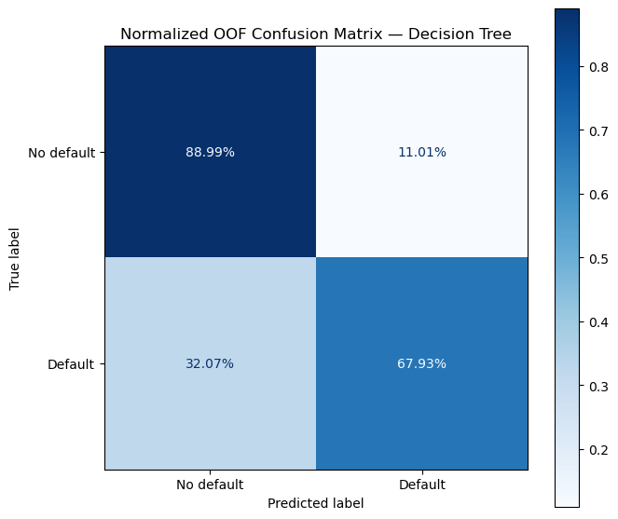
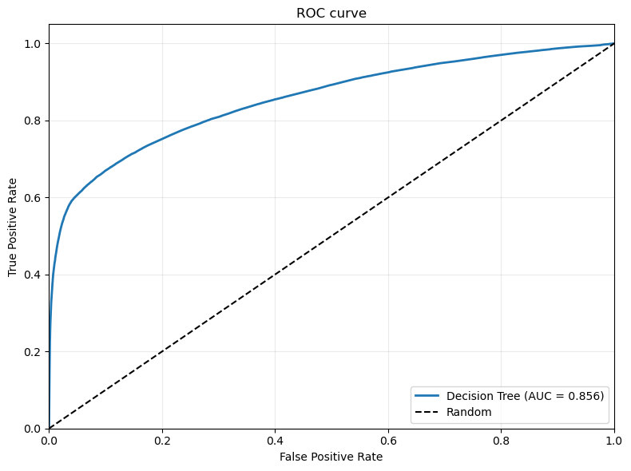
RESULTS
Final model performance
Primary result figure
Classification: confusion matrix | Regression: predicted vs. actual
Forecasting: actual vs. predicted time series | Clustering: 2D projection
Key Metrics (Test Set)
0.855
0.679
0.784
0.320
AUC
Recall
Balanced Acc.
FNR

Slide 10
PART 2 — CRITICAL ANALYSIS
Explainability &
Critical Discussion
How does the model work? · What did it get wrong and why?
Limitations · future directions · domain impact

Slide 11
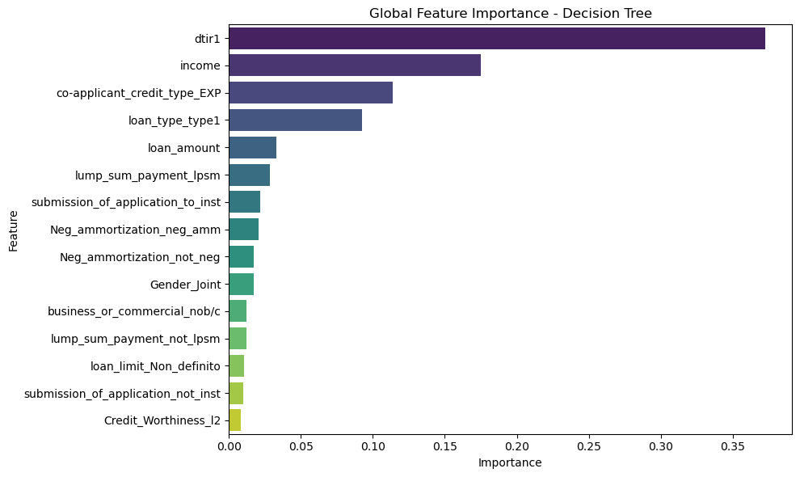
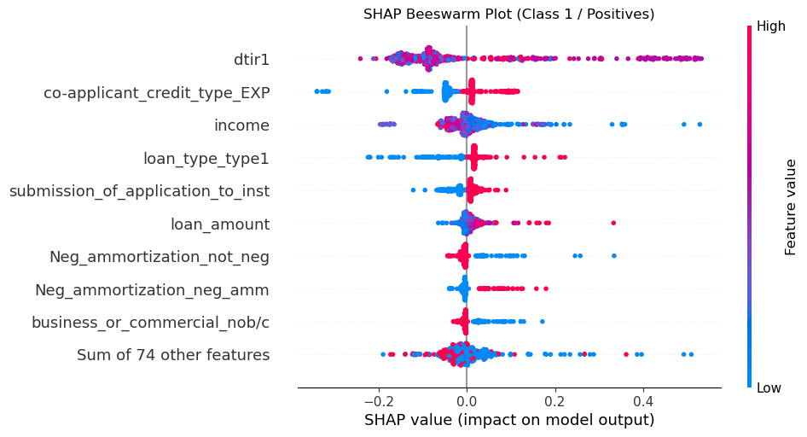
EXPLAINABILITY
Global Explainability: What Drives the Model Overall?
Interpretation
SHAP TreeExplainer, exact (not approximate). SHAP values for tree-based models; computationally efficient and theoretically grounded in cooperative game theory
Top drivers are dtir1 (debt-to-income ratio), income and applicant_credit_type — fully consistent with standard credit risk practice and risk factors
No counterintuitive results: features follow solid financial logic: high-income reduces risk, while high dtir1 increases it significantly.
Global explanation fully supports model performance: features with highest SHAP magnitude are those domain experts consider most predictive — the model has learned a meaningful signal, not noise

Slide 12
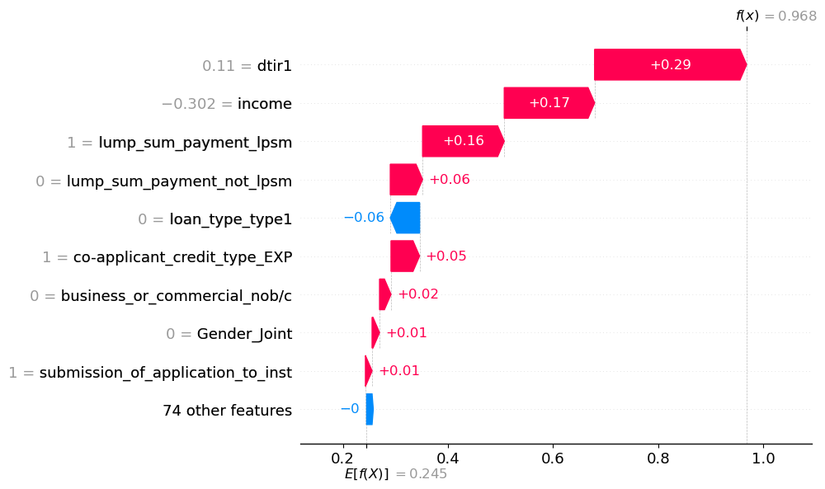
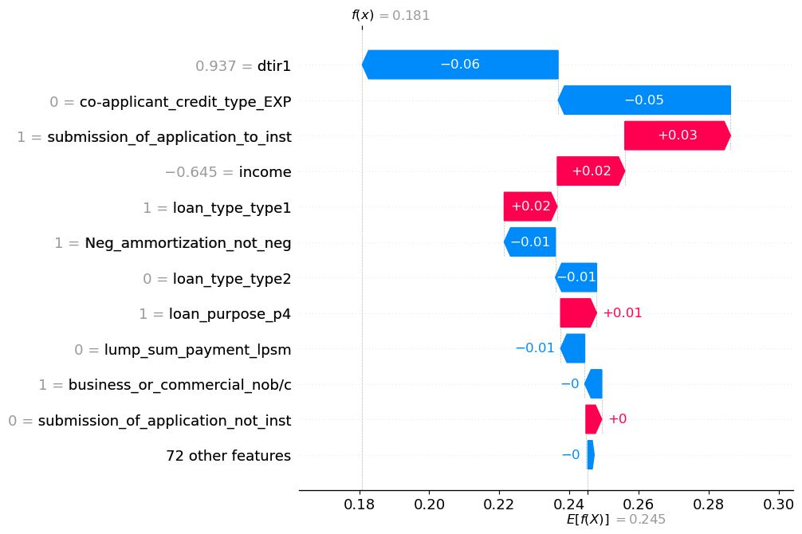
EXPLAINABILITY
Local Explainability: Why This Specific Prediction?
Case Analysis
The first image represents a default, correctly classified.
The default prediction is driven mainly by the high dtir1 and the low income. The presence of a payment in a single solution (lump_sum_payment_lpsm) also increased the risk.
The local explanation is in line with the global model: dtir1 and income are confirmed as the most decisive variables in guiding the algorithm's decision. Even if in this case lump_sum_payment_lpsm assumes more importance
Fully consistent with the logic of credit: a customer with a low income and a high load of pre-existing debts (high ditr1), represents a high risk of insolvency for the bank.
The second image shows a default, classified by the model as a non-default, a False Negative

Slide 13
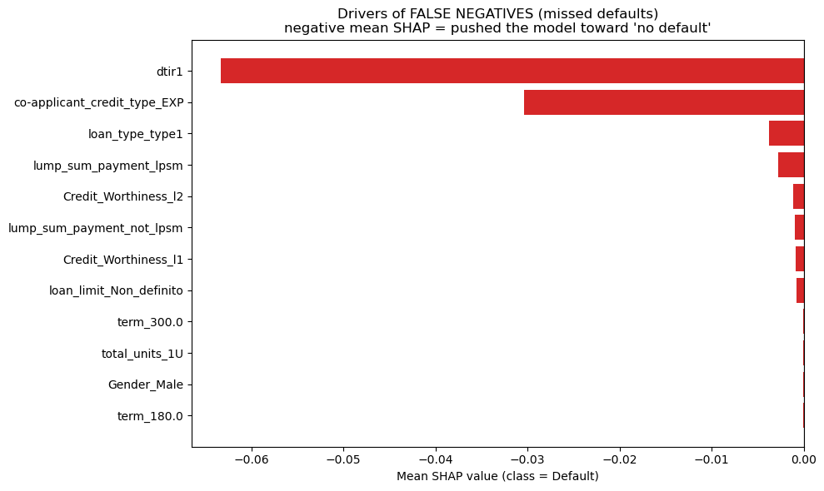
CRITICAL DISCUSSION
Error Analysis: What Did the Model Get Wrong and Why?
Reverse-Engineering Errors
Dominant misclassified pattern is FN, they are not random.
dtir1 dominates: debt-to-income wrongly pulls FN toward "no default".
Representative FN is dominated by a favourable dtir1 that masks the underlying risk. Symmetrically, representative FP is driven almost entirely by the same feature in opposite direction. Model over-relies on it.
dtir is a legitimate primary risk signal. Hard cases where true risk diverges from dtir1. FN ≫ FP
Errors load on the same few features — a coverage gap (missing LTV), not noise.
Comparison with Prior Work
Kaggle notebook on this same dataset report >90% accuracy or AUC, seemingly above our Decision Tree. We detected and removed post-approval leakage features that such notebooks typically retain. The numbers are therefore not directly comparable.

Slide 14
CRITICAL DISCUSSION
Domain Impact, Limitations & Future Directions
Domain Impact
Limitations
Future Directions
Integrated into a loan officer’s decision dashboard — flags high-risk applications for manual review rather than making fully automated rejections
Supports loan approval, risk-based pricing, and capital allocation decisions; a calibrated probability output would enable tiered interest rates instead of binary accept/reject
FN (missed default) >> FP (rejected solvent borrower) in financial cost
Since the model have a very low FPR, it can serve as a skimming of customers to be checked again later. Not reliable to be used alone
No timestamp in the dataset — temporal drift is undetectable; static training cannot adapt to macroeconomic shocks such as interest rate changes
LTV and property_value (two strong credit-risk predictors) dropped due to >40% missingness. Also other fundamental features in financials dropped due to probable data leakage. Their absence likely caps model performance.
Decision Tree assumes axis-aligned splits. It may miss interaction effects other methods would capture
Evaluation on a single dataset, with no deployment test.
Collect and restore the most information-rich credit-risk features
Introduce walk-forward (time-aware) cross-validation to simulate deployment and detect temporal drift early
Although Random Forest was not statistically superior here (Wilcoxon p = 0.0625), calibrated ensembles or gradient boosting on an enriched feature set may pay off.
Pilot deployment with human-in-the-loop feedback to monitor live FN/FP rates and recalibrate the decision threshold against realised default costs.

Slide 15
Thank You
Conclusions:
Pipeline to predict loan default (binary classification), handling class imbalance and high number of missing values.
A Decision Tree was selected via nested 5×3 cross-validation; the Wilcoxon test showed no significant difference from Random Forest, so parsimony favoured the simpler, more interpretable model. AUC 0.855, BAcc 0.784, recall 0.679.
SHAP revealed the model leans heavily on dtir1 (debt-to-income): the same feature drives both error types in opposite directions, and FN far outnumber FP (81). Model rarely cries wolf but misses harder-to-spot defaults.
Possibly stronger predictors LTV and property_value dropped (>40% missing); recovering them, plus time-aware validation and a fairness audit, is the priority next step.
Marco Lari · m.lari12@studenti.unipi.it – Tommaso Pellegrini · t.pellegrini3@studenti.unipi.it

