Slide 1










$$H_{U}=\{x∈R^{n}|−c^{T}x≥β\}$$
$$c^{T}x≤−β$$
$$−c$$
$$−β−2$$
$$−β−1$$
$$H_{L}=\{x∈R^{n}|−c^{T}x≤β\}$$
$$−β$$
$$c^{T}x≥−β$$
$$−β+1$$
$$−β+2$$

Slide 2
Two different ways to comprehend convex set.
From inner points’ perspective
From boundary points’ perspective

Slide 3

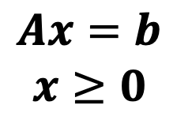

$$−c$$
$$−(c+αc′)$$
$$Ax=b$$
$$x≥0$$

Slide 4
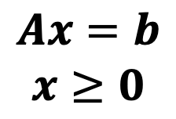

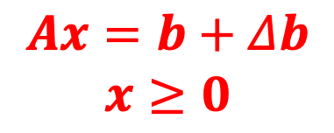
$$−c$$
$$x^{∗}$$
$$Ax=b+Δb$$
$$x≥0$$
$$Ax=b$$
$$x≥0$$

Slide 5


$$−c$$
$x^{∗}$is involved.
$$x^{∗}$$
$x^{∗}$is not involved.

Slide 6




$$x^{2}$$
$$x^{∗}$$
$$x^{3}$$
$$x^{1}$$

Slide 7









$$x_{2}$$
$$x_{4}=0$$
$$15$$
$$−c$$
$$x_{1}=0$$
$$x_{3}=0$$
$$x_{1}$$
$$15$$
$$30$$
$$x_{2}=0$$

Slide 8




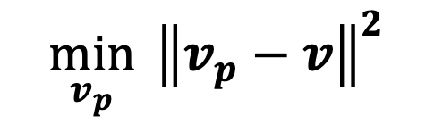
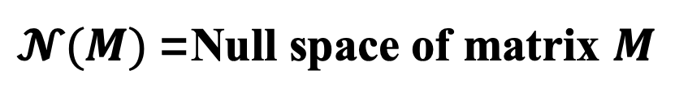


$$Convex QP$$
$$v=v_{p}+v_{q}$$
$$\min_{v_{p}}{ {\left\|v_{p}−v\right\|}^{2}}$$
$$v$$
$$v_{q}$$
$$s.t. Av_{p}=0$$
$$v_{p}$$
$𝓝(M)$=Null space of matrix $M$

Slide 9



$$x^{1}$$
$$x^{2}$$
$$x^{∗}$$

Slide 10
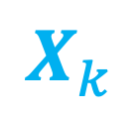
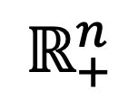
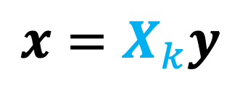
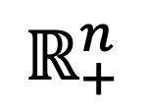
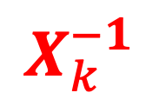
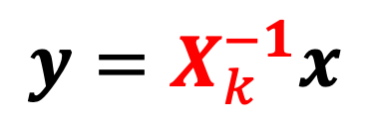

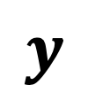
$$X_{k}^{−1}$$
$$x$$
$$y=X_{k}^{−1}x$$
$$ℝ_{+}^{n}$$
$$ℝ_{+}^{n}$$
$$x=X_{k}y$$
$$y$$
$$X_{k}$$

Slide 11

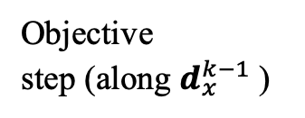

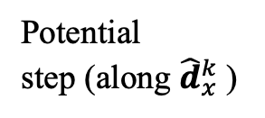


Constant objective planes
Potential
step (along ${\hat{d}}_{x}^{k}$)
Objective
step (along $d_{x}^{k−1}$)
$$x^{k}$$
$$x^{k−1}$$
$$x^{∗}$$
$${\hat{x}}^{k}$$
Recentered solution

