Slide 1
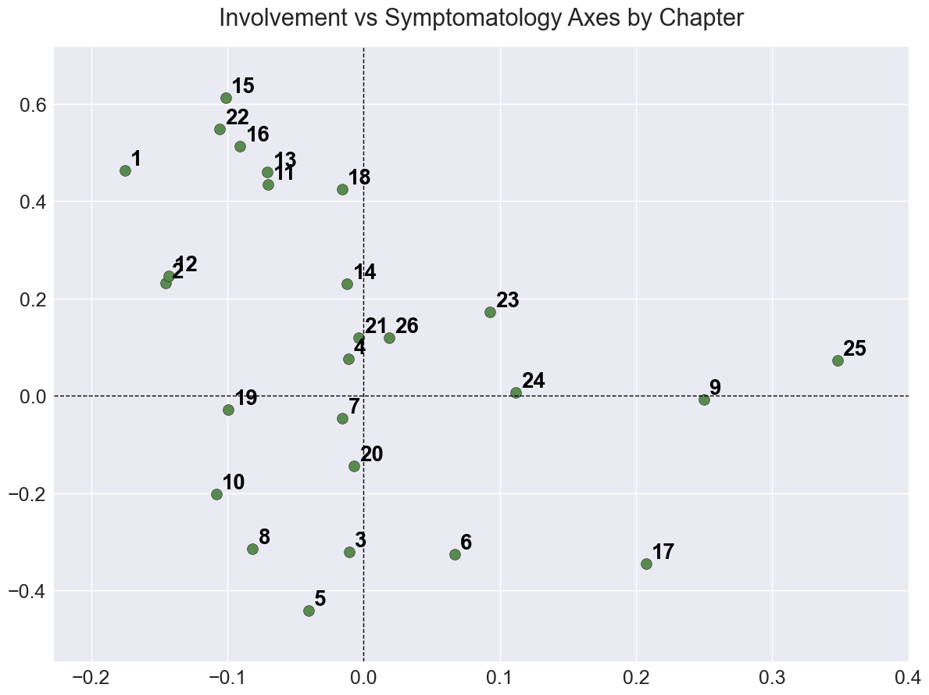
Pain
Localised
Systemic
Dysfunction

Slide 2
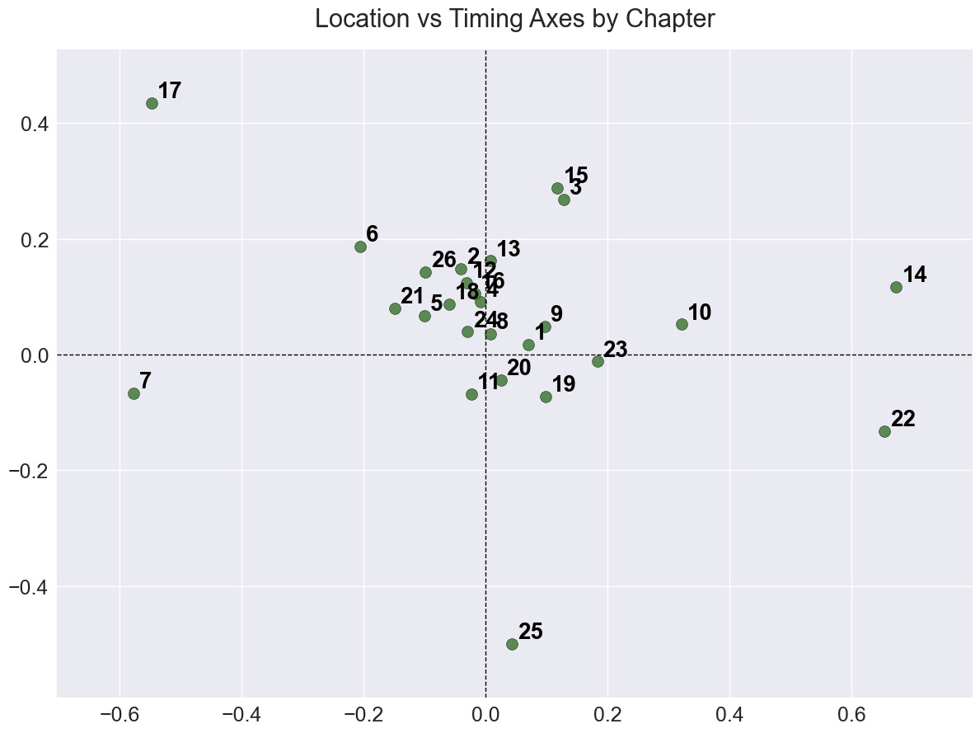
Long Term
Internal
External
Short Term

