Slide 1
To cast denzel washngton or not?
Charge Sheet
Masterminds: Aaron and Bo
Conspirator: Revanth Reddy Garlapati
Co-Conspirator: Brain K.im
Logistics: Nicky, Potato "Pickle" Chip, Trevor,
Ilya, Ha, Danny, Luc, Tohei, Jacky, Jerad,
google, Wikipedia …

Slide 2


introduction
Client: Charlie the Producer/Director
Client's question:
Would the Gross revenue collections be
higher if Denzel Washington is casted
instead of someone else in the next movie.
?

Slide 3


Data
Sources:
Boxofficemojo.com
Wikipedia
Entities of interest:
Movie
Year
Gross Domestic Revenue
Production Budget
Date released

Slide 4
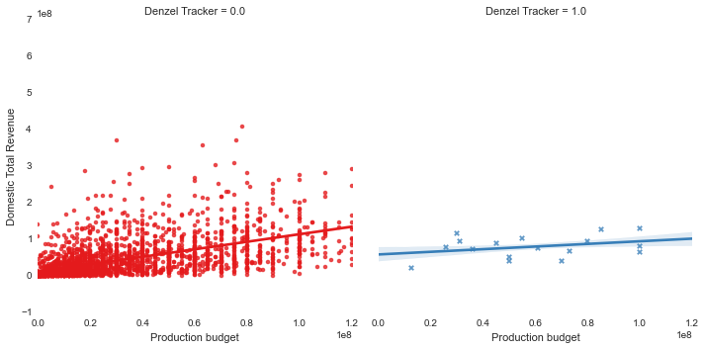
Statistical analysis and results

Slide 5



Interpretation
There goes the last shred of my credibility…
Is it better to cast someone else instead?

Slide 6
Recommendations for detailed analysis
Segmentation with respect to Year.
Segmentation with respect to season.
Comparison of movies of same Genre/Run time.
Missing data/Bootstrapping

