Slide 1
Resource Managers
and how do they treat INP resources

Slide 2
Goal
Resource model for server and network resources
Capable of describing current INP solutions
Capable of describing any kind of network topology
Descriptive, yet simple
Placement algorithm
It must allocate both server and network resources
Using the previous model as input
Better than a random allocation

Slide 3
RMs’ network awareness levels
VMs proximity-aware
Most of the RMs out there can spread VMs across different failure domains
Not worth discussing since they do not consider any other kind of network resource
E.g., Omega, YARN, Mesos, …
Bandwidth-aware
Some RMs allow tenants to specify bandwidth demands
E.g., CloudMirror, Oktopus, Kraken, Proteus, …
Network resources-aware
Rabbani, Md Golam, et al. "On tackling virtual data center embedding problem." IM 2013: IFIP/IEEE International Symposium on Integrated Network Management. 2013.

Slide 4
Bandwidth-aware RMs
They use “virtual network” models
Virtual Custer (VC) used by Oktopus and Kraken
Time-Interleaved Virtual Cluster (VC with time-varying bandwidth requirements) used by Proteus
Virtual Oversubscribed Cluster (VOC) used by Oktopus
Tenant Application Graph (TAG) used by CloudMirror
None of them handle INP resources
Oktopus and Kraken assume that every VM can be place everywhere
They completely ignore server-local resource requirements
Kraken allows tenants to upgrade their bandwidth requirements (replacement)

Slide 5
Network resource-aware RM
Rabbani, Md Golam, et al. "On tackling virtual data center embedding problem." IM 2013: IFIP/IEEE International Symposium on Integrated Network Management. 2013.
Embedding solution that allows tenants to explicitly specify
Server resources
Switch resources
Bandwidth demands

Slide 6
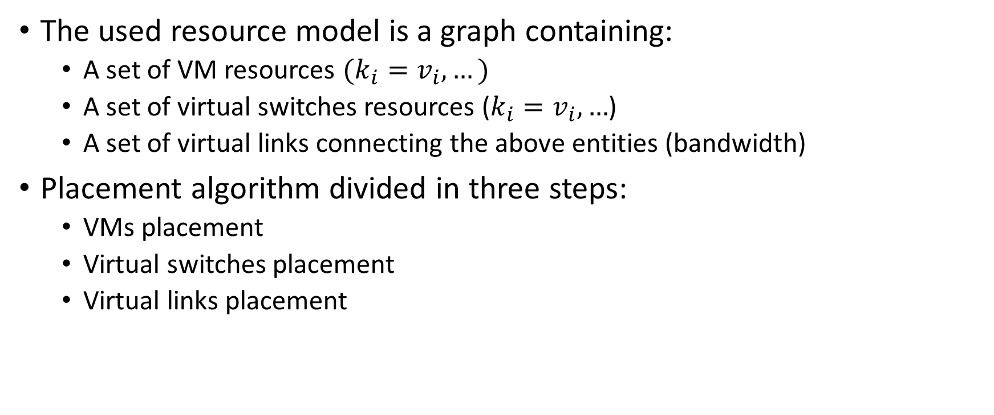
Network resource-aware RM
The used resource model is a graph containing:
A set of VM resources $(k_{i}=v_{i}, …)$
A set of virtual switches resources ($k_{i}=v_{i}, …$)
A set of virtual links connecting the above entities (bandwidth)
Placement algorithm divided in three steps:
VMs placement
Virtual switches placement
Virtual links placement

Slide 7
Step 1: VMs placement
The problem is reduced to a min-cost flow problem

Slide 8
Step 2: virtual switches placement
Same min-cost flow problem as before

Slide 9
Step 3: virtual links placement
Given two already-placed entities (e.g., a VM and a virtual link), a virtual link is mapped to the physical shortest path

Slide 11
Network resource-aware RM: 1st problem
Inefficient virtual switches placement
Virtual switches are mapped to physical ones without considering where VMs have been previously mapped in the physical topology
Bad switch mapping example in the next slide

Slide 13
Network resource-aware RM: other problems
One resource dimension considered
The model supports multiple resource dimensions (CPU cores, memory, etc.)
The algorithm and the example consider just one dimension
Crucial when ordering VMs during the VM mapping phase
VMs are ordered according to just one “requested resource capacity” so that a request can be instantly rejected in case there is at least one VM requesting for too many resources
The placement algorithm tries to map as most VMs to the same physical server in order to minimize server resource fragmentation
It is not aware of failure domains
Not fault tolerant

