Slide 1
IncBricks: basic topology and entities
In-network caching system
SDN controller
Setting and updating global registration tables
< key, destination, next hop, caching (y/n) >
Switch
Query and response
Query and response
Query issuer
Data owner
Rack
Rack

Slide 2
IncBricks: extended topology
In-network caching system
SDN controller
Switch chain
Switch
Switch
Switch
Query issuer
Data owner
Rack
Rack

Slide 3
IncBricks: logical communication pattern
In-network caching system
SDN controller
2. Some switch may intercept the query
Switch
Switch
Switch
1. Direct communication with the destination
Query issuer
Data owner
Rack
Rack

Slide 4
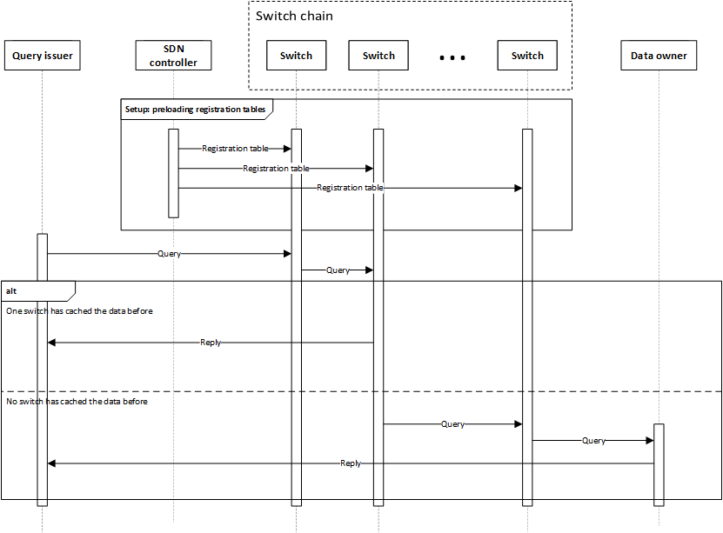

Slide 5
NetChain: basic topology and entities
In-network solution for coordination services
SDN controller
System reconfigurations
Head switch
Tail switch
Write requests
Read requests
Data producer and consumer
Read/write replies
Rack

Slide 6
NetChain: extended topology
In-network solution for coordination services
SDN controller
Switch chain
Head switch
Intermediate switch
Tail switch
Data producer and consumer
Another data producer and consumer
Rack
Rack

Slide 7
NetChain: logical communication pattern
In-network solution for coordination services
SDN controller
Head switch
Intermediate switch
Tail switch
1. Direct communication either with the head switch or with the tail switch
Data producer and consumer
Another data producer and consumer
2. Tail switch always reply
Rack
Rack

Slide 8
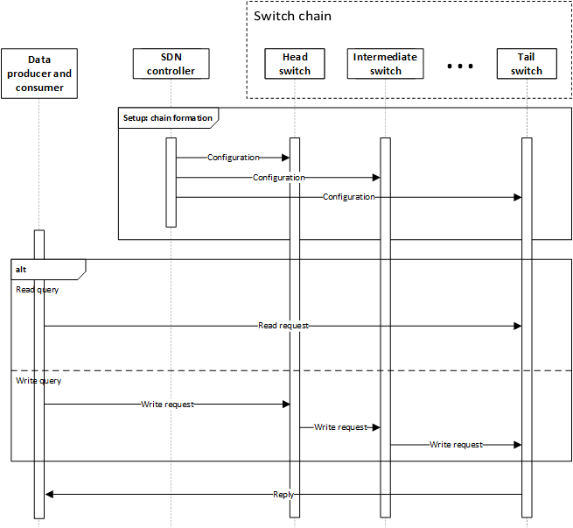

Slide 9
Daiet: basic topology and entities
In-network data aggregation
Reducer
Aggregated data
Job allocation
Aggregated split data
Data producer and consumer
Job allocator (master)
SDN controller
Aggregator switch
Input data
Job allocation
Flow rules
Key-value pairs
Mapper
Job allocation and split input data

Slide 10
Daiet: extended topology
In-network data aggregation
Tree
*
Mapper
Aggregator switch
Aggregator switch
Reducer
*
Mapper
*
*
*
Mapper
*
SDN controller
Aggregator switch
*
Mapper
Data producer and consumer
Job allocator (master)
*

Slide 11
Daiet: logical communication pattern
In-network data aggregation
3. Aggregated data is returned to the client
2. Data is partitioned and aggregated
*
Mapper
Aggregator switch
Aggregator switch
Reducer
*
Mapper
*
**
*
Mapper
**
SDN controller
Aggregator switch
*
Mapper
Data producer and consumer
Job allocator (master)
*
1. Client sends data

Slide 12
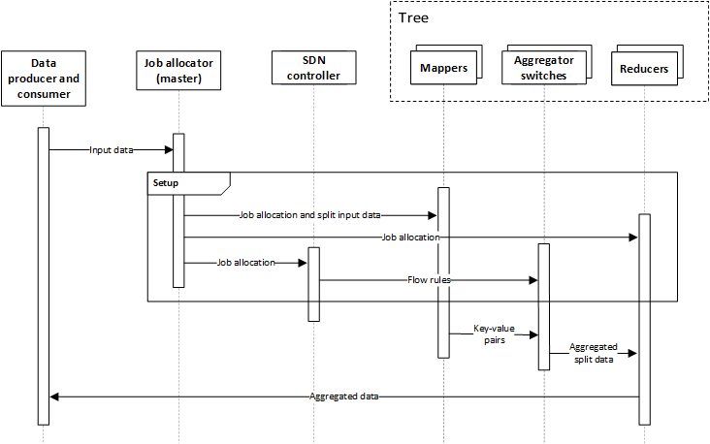

Slide 13
SHArP: basic topology and entities
Protocol for reduction operations
Data producer
Aggregation request
Aggregation node
Aggregated data
Data consumer
Dedicated aggregation node
Dedicated local resources
List of dedicated SHArP resources
Cluster resource manager
Aggregation manager
Requesting SHArP resources

Slide 14
SHArP: extended topology
Protocol for reduction operations
Tree
Data producer
Aggregation node
…
Aggregation node
Group
Data producer
Aggregation node
…
Cluster resource manager
Aggregation manager
Data consumer
Data consumer

Slide 15
SHArP: logical communication pattern
Protocol for reduction operations
1. Group sends data
Data producer
Aggregation node
2. Data is aggregated
…
Aggregation node
Data producer
Aggregation node
3. Aggregated data is returned
…
Cluster resource manager
Aggregation manager
Data consumer
Data consumer

Slide 16
