Slide 1
Some terminology
A top-down approach

Slide 2
Composites
A composite is a template that describes high-level logical components
It can be of two types:
Server (e.g., “web server”, “database”, …)
INP (e.g., “IncBricks caching system”, “NetChain locking system”, …)
With generic groups it would be possible to specify generic application types (like “in-network data aggregation”) rather than specifying specific solutions (like Daiet)
It can be made out of
Other composites
A composite loop must not be valid, since it would be impossible to place
Logical resources (next slide)

Slide 3
Logical resources
Logical resources are logical representations of physical resources
They can be of three types:
Server (e.g., VMs, containers, …)
Switch (performing specific in-network functions)
Edge (expressing bandwidth/latency demands)
They represent the input of the placement algorithm

Slide 4
Mapping composites to logical resources
Composites must be translated into logical resources
This is done by using a template database managed by the RM

Slide 5
Physical resources
The placement algorithm places logical resource into physical ones
Three types of physical resources:
Server
Switch
Links

Slide 6
The whole picture

Slide 7
1st alternative: passive template mapping

Slide 8
2nd alternative: active template mapping

Slide 9
Resource model
Model capable of describing composites and logical resources.
The model exposed to tenants and the one internally used by the RM could be different.
Tenant-side model: resource model exposed to tenants by the system API.
RM-side model: resource model internally used by the placement algorithm in order to allocate logical resources.

Slide 10
A model for INP resources
Requirements

Slide 11
Some model requirements
FR1 The tenant-side model must be able to describe server and INP composites.
FR2 The tenant-side model must be able to describe all kinds of logical resources.
FR3 The RM-side model must be able to describe all kinds of logical resources.
FR4 The tenant-side model must allow the tenant to specify different bandwidth demands for different composites and logical resources.

Slide 12
Some model requirements
FR5 The tenant-model must be able to describe any kind of network topology.
FR6 The tenant-side model (and the corresponding APIs) must not change upon the release of new INP solution or version.
FR7 The translation from composite requirements to logical resource requirements must be done by the RM and not by the tenant application.

Slide 13
A model for INP resources
Design sketch

Slide 14
Virtual Cluster (VC)
All VMs require the same bandwidth (✗FR4)
A one-level tree topology is restrictive (✗FR5)
No switch chains
No switch trees
It is not possible to express logical switch resources (✗FR2)

Slide 15
Virtual Oversubscribed Cluster (VOC)
VM groups might require different bandwidth values (✗FR4)
Still a fixed-height tree topology (✗FR5)
Still not possible to express logical switch resources (✗FR2)

Slide 16
A VOC variant

Slide 17
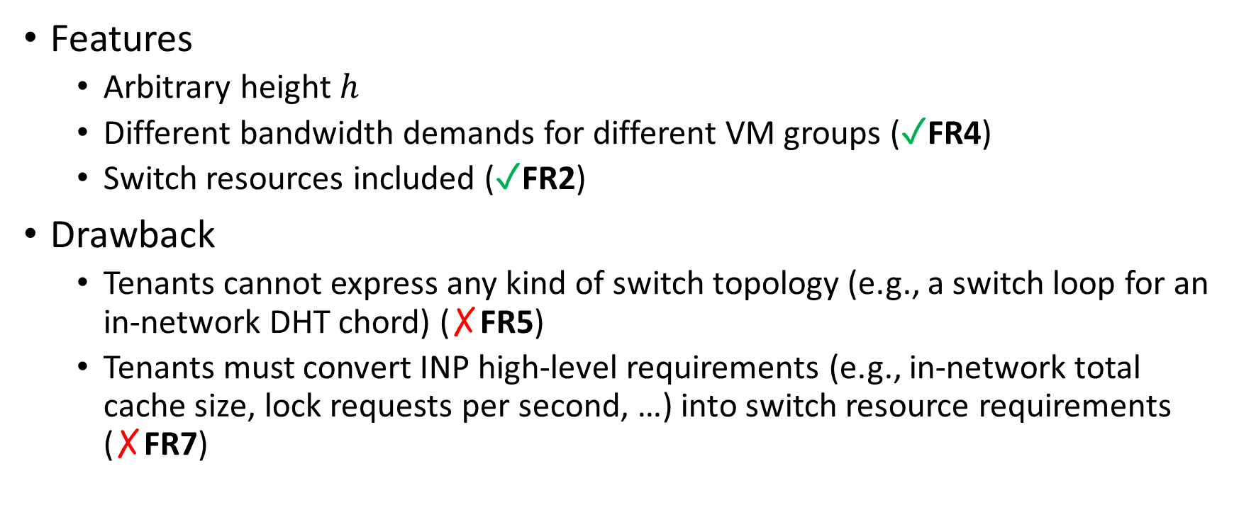
A VOC variant
Features
Arbitrary height $h$
Different bandwidth demands for different VM groups (✓FR4)
Switch resources included (✓FR2)
Drawback
Tenants cannot express any kind of switch topology (e.g., a switch loop for an in-network DHT chord) (✗FR5)
Tenants must convert INP high-level requirements (e.g., in-network total cache size, lock requests per second, …) into switch resource requirements (✗FR7)

Slide 18
Tenant Application Graph (TAG)
It cannot describe INP composites (✗FR1)
It cannot describe logical switch resources (✗FR2)

Slide 19
A TAG variant
Capable of describing all composites (✓FR1) and logical res. (✓FR2)
Different bandwidth demands (✓FR4) and topologies (✓FR5)
Composite → logical res. translation not made by the tenant (✓FR7)

