Slide 1
Introduction to Python
Marco Moretto, PhD

Slide 2
Course overview
Lecture (slides) followed by practical examples (done by us) and exercises (done by you) using Jupyter Notebook or Visual Studio Code
Feedback, questions, discussions are always welcomed
You will do mistakes and I will do mistakes as well (mistake == opportunity to learn)
Start general (programming language) and move to Python specific/advanced topics.

Slide 3
Course overview
Day 1
General introduction to computer programming and Python
Tool introduction: Jupyter notebook and Visual Studio Code
Data structures and data types
Day 2
Algorithms: operators and control structures
I/O
Day 3
Functions and Lambda functions
Iterators and generators
Day 4
Object oriented programming
Packages: extend Python functionalities
Day 5
Overview of Python most used packages for data analysis
Structure complex applications
Debugging, the mystery game where you play as the detective, the victim and the murderer!
Versioning?

Slide 4
Programming languages
Programming language is about language not mathematics
Programming language and problem solving (the way in which we think about problems and solutions)
Python is an imperative programming language, what does it mean?
Data structures and algorithms (the guitar example) - Manipulation of information

Slide 5
Programming languages
DRY KISS (Don’t Repeat Yourself and Keep It Simple, Stupid)
If all you have is a hammer, everything looks like a nail
Early optimization is the root of all evil (Donald Knuth)
(Don’t overthink. Don’t use too many abstractions just because you think you should)
Simple is better than complex, complex is better than complicated. (Zen of Python https://www.python.org/dev/peps/pep-0020/)

Slide 6
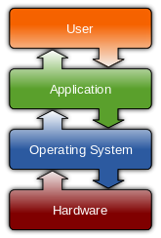
The Python programming language
History of Python: Guido van Rossum and Monty Python from the 80’s to to Python 3
Why is it so popular?
It’s slow but users don’t care (high-level, interpreted, dynamically typed, garbage collected)
Concise and expressive (less code, less mistakes)
It might runs slower but it takes less time to write something that works (and learn how to do it)
Rich set of libraries
Huge community
How does a programming language work?

Slide 7
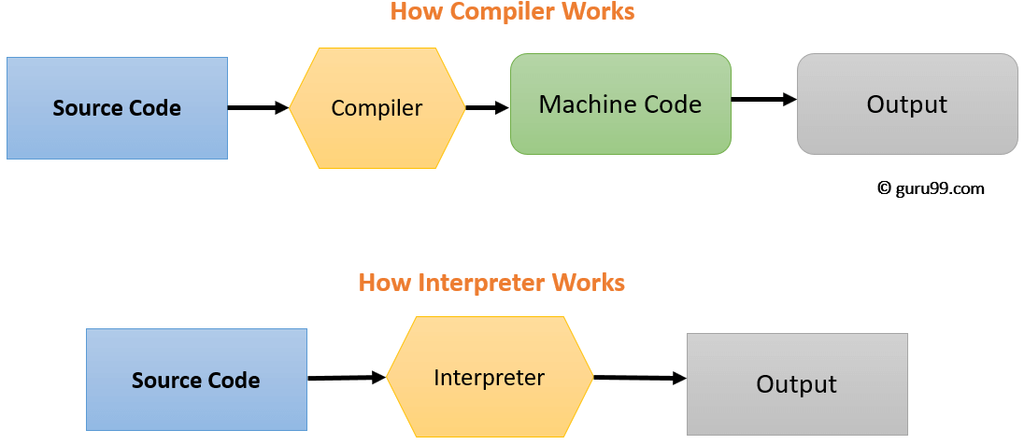
The Python programming language
How does a programming language work?
Compilation vs Interpretation.

Slide 8
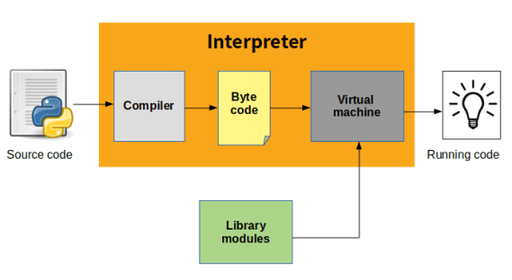
The Python programming language
How does a programming language work?
Compilation vs Interpretation.

Slide 9
The Python programming language
Compilation vs Interpretation.
Language syntax VS language implementation
(in Python everything is an object)

Slide 10
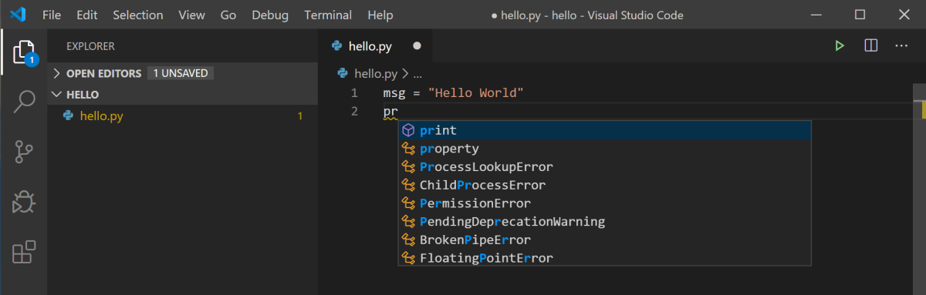
Visual Studio Code
https://code.visualstudio.com/docs/python/python-tutorial

Slide 11
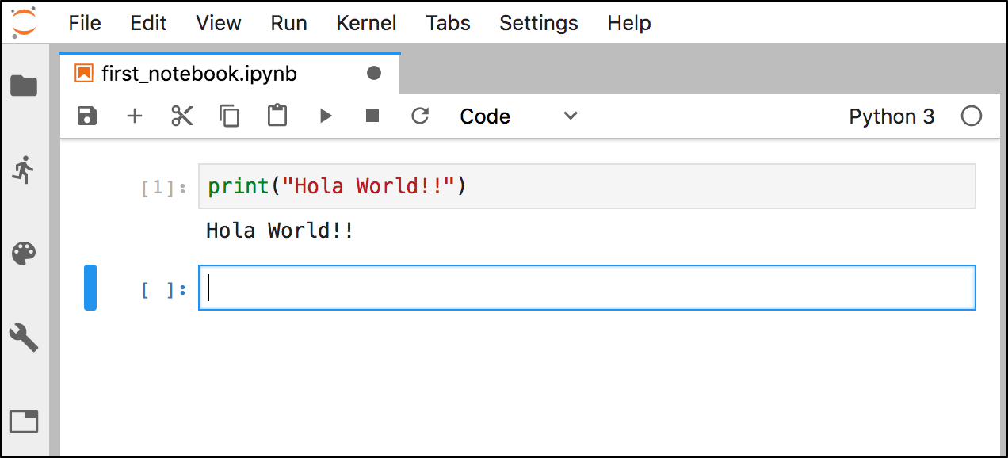
Jupyter Notebook

Slide 12
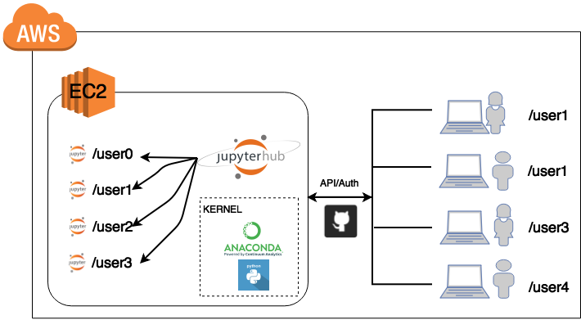
Jupyter Notebook

