Slide 1







Final Module Project: Data Science Capstone
Marco Mudenge
September 6th 2023

Slide 2
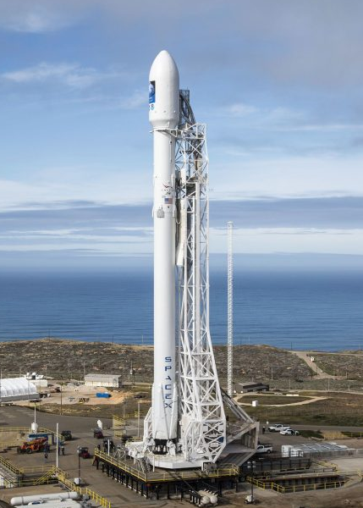
EXECUTIVE SUMMARY
Determining the landing success of SpaceX Falcon 9 rocket has a importance for competitors biding
SpaceX provides data sets that allow us to investigate the problem
Exploratory Data Analysis, Data Visualization and Predictive Analysis helps us better determine the landing success

Slide 3
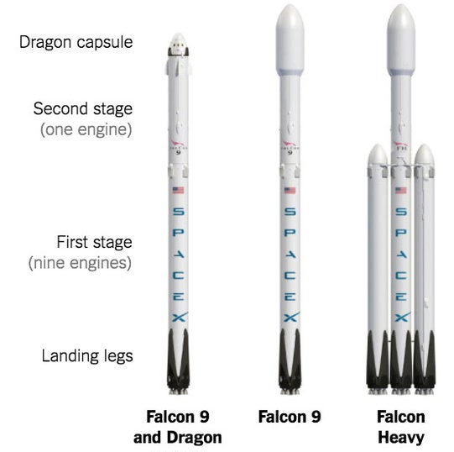
INTRODUCTION
SpaceX advertises the Falcon 9 rocket at 62 millions
The Falcon 9 cost way less than competition because its first stage can be reused
Determining if the first stage will land is of great importance
Goal of this project: predict the Falcon 9 landing success according to data

Slide 4
METHODOLOGY: DATA COLLECTION & WRANGLING
METHODS
GOALS
Collect base data using the SpaceX API
Replace key IDs with info using the API
Filter data, keep only Falcon 9 launches
Replace missing values with mean
Retrieve the relevant SpaceX data
Reorganize the data
OUTCOME
Data set #1 created for data wrangling

Slide 5
METHODOLOGY: EDA - Wrangling (Part 1)
METHODS
GOALS
Using data set #1
Explore occurrences of landing site and orbits
Explore occurrences of different mission outcomes
Create a binary column for the landing outcome success
Find patterns in the data
Determine a label for our predictive supervised models
OUTCOME
Data set #2 created for predictive analysis to be used as labels

Slide 6
METHODOLOGY: EDA with Visuals (Part 2)
METHODS
GOALS
Using data set #2
Explore relations between variables using scatter plots & bar charts
Explore launch success yearly trend with line plot
Features engineering : Use One-Hot encoding to create new numeric features
Find patterns in the data
Perform data feature engineering
OUTCOME
Data set #3 created for predictive analysis used for the features

Slide 7
METHODOLOGY: PREDICTIVE ANALYSIS
METHODS
GOALS
Using data set #2 (label) & #3 (features)
Standardize the features
Split the data into training/test sets
Train & test supervised models :
Logistic regression, SVM, Decision trees & KNN
Use a Grid Search to find the best parameters
Evaluate the models
Find best hyperparameters for each models
Determine the best models
OUTCOME
Results for each predictive models

Slide 8

METHODOLOGY: VISUAL ANALYTICS
Point1
Point2
Point3
Point4
Sub Point1
Sub Point2

Slide 9
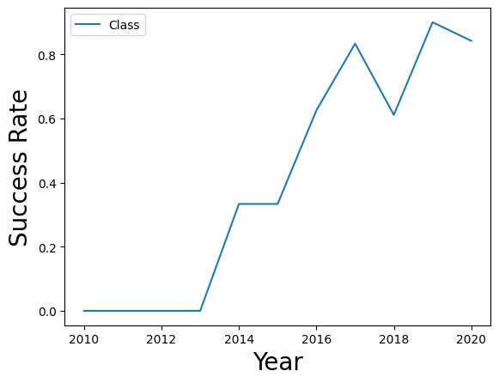
RESULTS: EDA with Visualisations
Variables | Plot | Findings
FlightNumber, Payload, LaunchSite, Orbit (Multiple combinations) | Scatter | No patterns
Orbit vs Class | Bar | No patterns
Year vs Class | Line | Growing success rate since 2013
No conclusive patterns detected
Possibles causes : attributes like FlightNumber & LaunchSite are not values with empirical meaning.
Growing success rate may be attributed to multiple external reasons such as growing expertise.

Slide 10
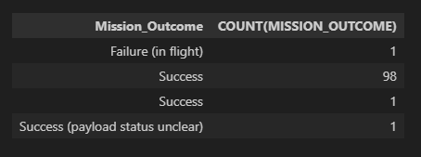
RESULTS: EDA with SQL
Better understanding of our dataset
Knowledge of distincts values and counts of:
- Landing outcome
- Mission outcome
- Launch site
- Booster versions
- Sum and average payloads

Slide 11
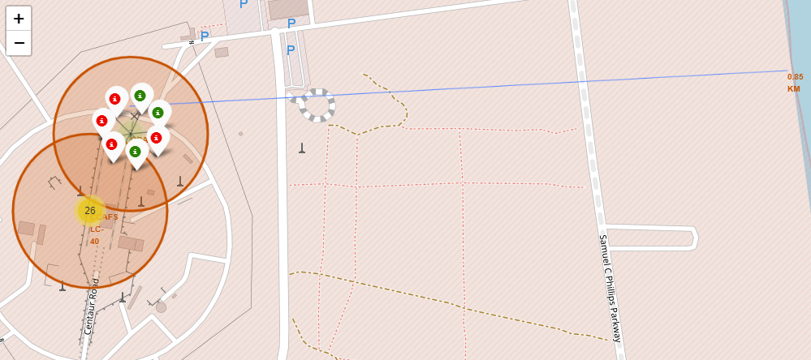
RESULTS: Interactive Map
Features of the interactive map:
- Each launch sites marked on the map
- Clear indication of success/failure of each launch (green/red)
- Annotation of distance between a launch site and the nearest coastline

Slide 12
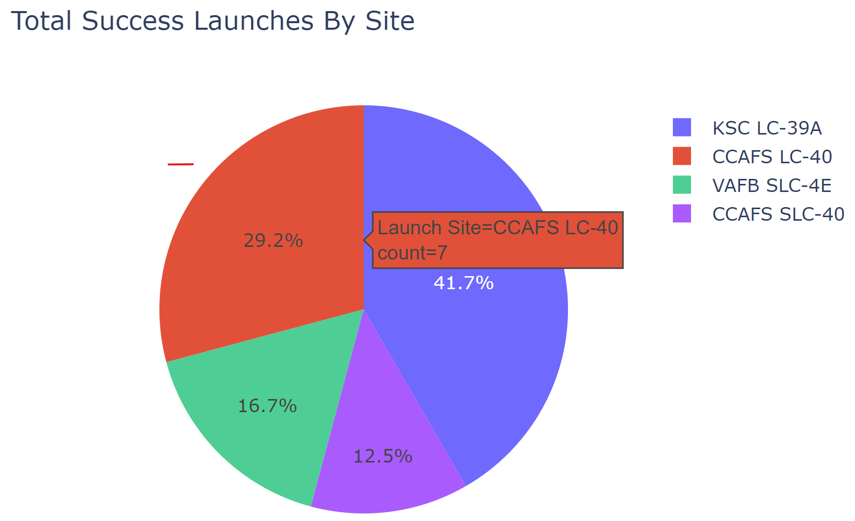
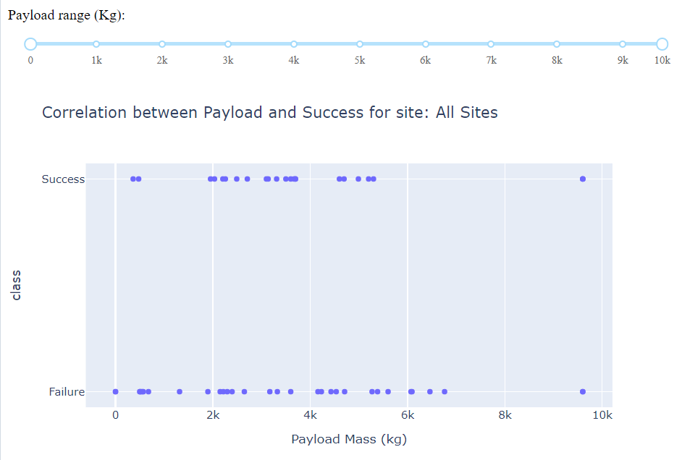
RESULTS: Plotly Dashboard
The pie chart shows a majority of successful launches are within 2 sites
We can not observe a pattern when plotting the payload against launch success

Slide 13
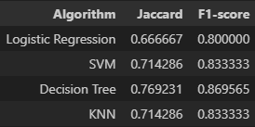
RESULTS: PREDICTIVE ANALYSIS
BEST PARAMETERS
Logistic Regression
'C': 0.01, 'penalty': 'l2', 'solver': 'lbfgs’
SVM
'C': 1.0, 'gamma': 0.03162277660168379, 'kernel': 'sigmoid’
Decision Trees
'criterion': 'gini', 'max_depth': 4, 'max_features': 'sqrt', 'min_samples_leaf': 2, 'min_samples_split': 10, 'splitter': 'random’
KNN
{'algorithm': 'auto', 'n_neighbors': 4, 'p': 1}
MODEL RESULTS

Slide 14

DISCUSSION
While no clear patterns were detected through EDA, supervised method were still able to predict landing outcome with up to 80% of accuracy.
This lab provided an overview of different tasks of Data Sciences (Collection, Wrangling, Analysis, Visualization & Machine Learning).

Slide 15

CONCLUSION
Data collection & Wrangling prepared SpaceX data
EDA through visualisations and SQL provided a better understand of our data
No clear patterns observed through the EDA
Interactive map shows the location of landing sites
Plotly Dash app was created to complete analysis
Supervised models are around 80% accurate in predicting the outcome of landing

