Slide 1

Software Engineering
Modern Approaches
Eric Braude and Michael Bernstein

Slide 2
Chapter 6: Configuration Management

Slide 3
Planning
Maintenance
Testing
The Software Development
Lifecycle
Requirements analysis
Implementation
Learning goals of this chapter
What is the purpose of software configuration management?
What activities does it consist of?
How do you plan for configuration management?
What tools are available to support it?
How is configuration management handled in large projects, in practice?
Design
Phase most relevant to this chapter is shown in bold

Slide 4
Software Configuration Management (SCM)
Process of identifying, tracking and storing all the artifacts on a project
Each artifact referred to as a Configuration Item (CI)
Provides a reliable way to control a project's artifacts
  For example, the SCM process ensure that the proper source files are included when building the software, system and that the correct project documentation is retrieved when required

Slide 5
Sample Artifacts
Specifications
  Requirements
  Design
Source and Executable Code
Test Plans
Test Data
User Documentation
  Manuals, tutorials, references, etc,
Supporting Software
  Compilers, editors, IDEs, DLLs, APIs

Slide 6
Software configuration management goals
Baseline Safety: a process of accepting new or changed CIs for the current version of the developing product
Overwrite safety: means that team members can safely work on CIs simultaneously
Reversion: ability to revert to an earlier version
Disaster Recovery: retains backup copies in case of disaster

Slide 7
SCM Activities
SCM activities and best practices are techniques implemented to successfully meet the CM goals. They include:
Configuration identification
Baselines
Change control
Version control
Configuration audits
Configuration status reporting
Release management and delivery

Slide 8
Configuration Identification
First step in SCM
Candidate CI’s include:
  source and object code
  project specifications
  user documentation
  test plans and data
  supporting software such as compilers, and editors
  any artifact that will undergo modification or need to be retrieved at some time after its creation
Once selected, a CI is attached with identifying information that stays with it for its lifetime. Typical information include:
  A unique identifier,
  name,
  date,
  author,
  revision history, and status

Slide 9
Baselines
An approved artifact (such as source code, design documents, manuals, references, etc.) that has been approved through identification and review
IEEE Std 1042 defines a baseline as a “specification or product that has been formally reviewed and agreed to by responsible management, that thereafter serves as the basis for further development, and can be changed only through formal change control procedure”
  Could be one CI or collections of Cis
  Usually assigned a version number at key project milestones
    Such as internal release
    Package and customer release

Slide 10
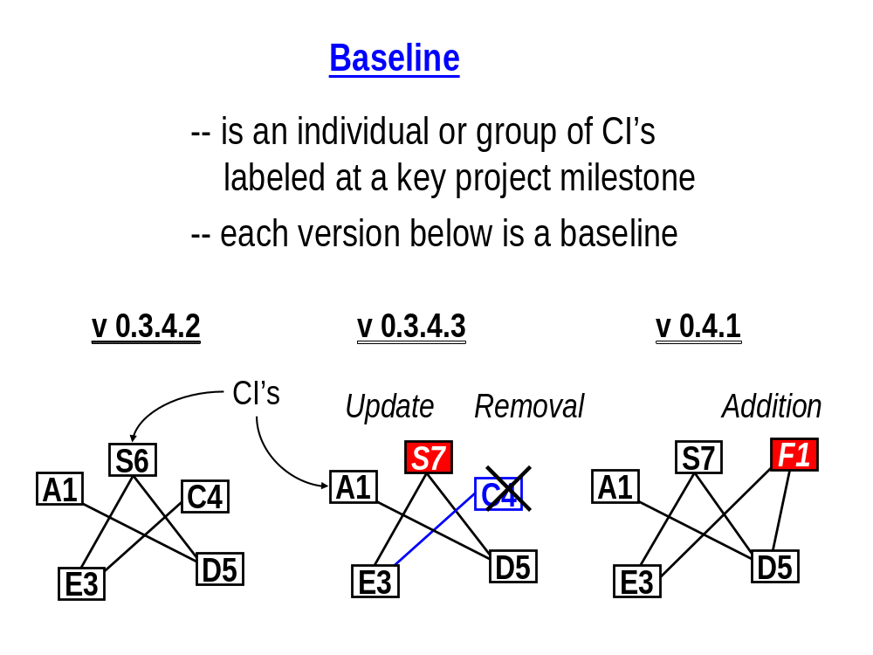
Baselines
Baseline Uses
1. Reproducibility
2. Traceability
3. Reporting

Slide 11
Baselines
Baseline Uses
Reproducibility
  Reproducibility means that you can reproduce a particular software version or set of documentation when necessary as in during release or maintenance
Traceability
  that relationships between various project artifacts can be established and recognized
Reporting
  that all the elements of the baseline can be determined and the contents of various baselines can be comparted.

Slide 12
Change Control
Set of activities to request, evaluate, approve or disapprove, and implement changes to baselined CI’s
  As a results of fixing errors, enhancing functionalities, addition of new functionalities, etc.
Steps:
  identification and documentation
  analysis and evaluation
  approval or disapproval
  verification, implementation and release

Slide 13
Identification and Documentation
Name of requester
Description and extent of the change
Reason for the change (e.g. defects fixed)
Urgency
Amount of time required to complete change
Impact on other CI’s or impact on the system

Slide 14
Analysis and Evaluation
Reason for the change (e.g. bug fix, performance improvement, cosmetic)
Number of lines of code changed
Complexity
Other source files affected
Amount of independent testing required to validate the change

Slide 15
Version Control (Version Control System)
Version control supports the management and storage of CIs as they are created and modified throughout the software development life cycle. It supports the ability to reproduce the precise state of a CI at any point in time.
Must have the following capabilities:
Automated
Repository
Check-in/Check-out
Branching and merging
Builds
Version labeling

Slide 16
Version Control (Version Control System)
Repository: a centralized database that stores all the artifacts of a project and keeps track of their various versions.
Check-in/Check-out: Keeps track of check-ins and check-outs by assigning version numbers.
Branching and merging: Allows team members to work on the same set of files concurrently (branching ) and correctly apply changes to common files so that none are lost or overwritten (merging ).
Builds: allows the build of the latest version of software files into an executable, usable file.
Version labeling: to allow referencing and reconstruction as necessary

Slide 17
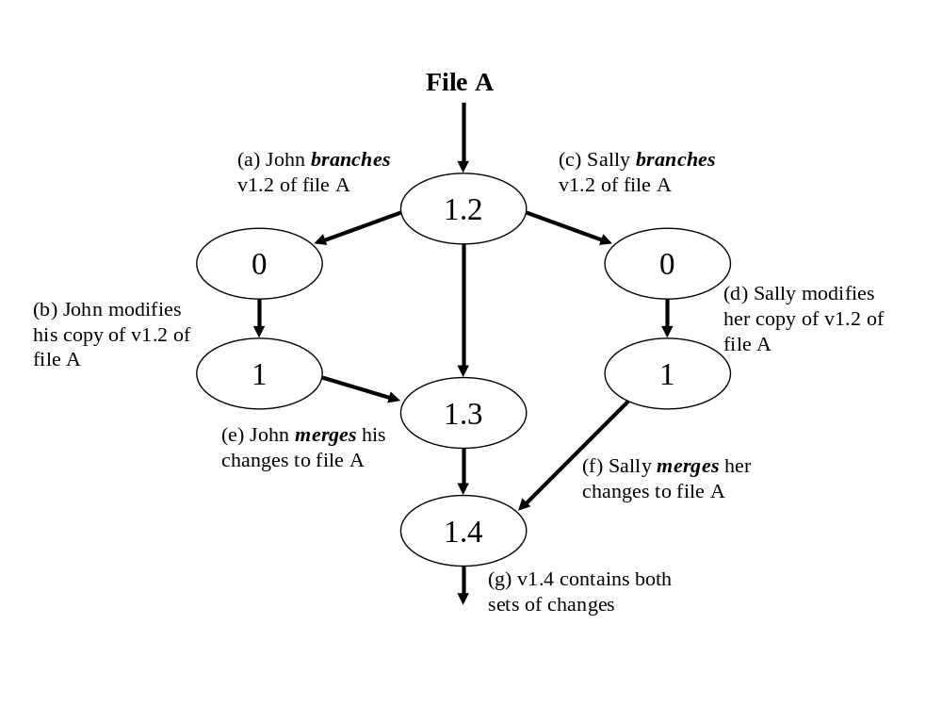
Branching and Merging

Slide 18
Configuration Audits
a software audit is “an independent examination of a software product, software process, or Set of software processes performed by a third party to assess compliance with specifications, standards. contractual agreements, or other criteria.”
Verify proper procedures are followed, such as formal technical reviews
Verify SCM policies, such as those defined by change control, are followed
Determine whether a software baseline is comprised of the correct configuration items
  for example, are there extra items included? Are there items missing? Are the versions of individual items correct?
Typically conducted by quality assurance group

Slide 19
Configuration Status Reporting
Extraction, arrangement and formation of configuration reports
  Name and version of CI’s
  Approval history of changed CI’s
  Software release contents and comparison between releases
  Number of changes per CI
  Average time taken to change a CI

Slide 20
Release Management and Delivery
Policies to ensure that once software and documentation is released it is archived safely and reliably, and can always be retrieved for future use
  master copy, of code and documentation shall be maintained for the life of the software product.
  code and documentation shall be handled, stored, packaged and delivered in accordance with the policies of the organizations involved.

Slide 21
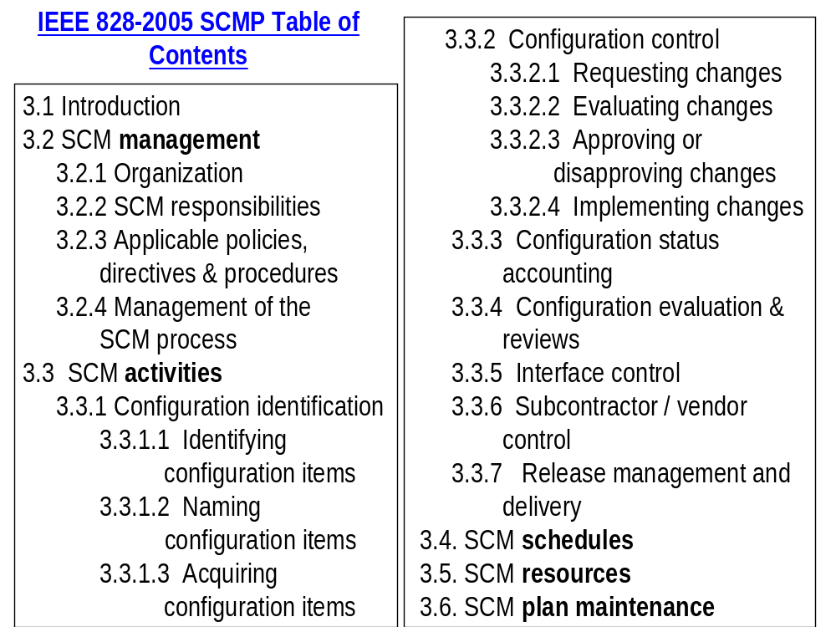

Slide 22
SCM Systems
Two architectures
  Client Server
    CVS, SourceSafe, Subversion
  Distributed
    Git

Slide 23
SCM Systems
Subversion
CVS
Rational Clearcase
Microsoft’s SourceSafe
Perforce
Git and HitHub
www.cmtoday.com/yp/commercial.html

Slide 24
Configuration Management Schedule
Month 1
Month 2
Month 3
Month 4
Month 5
1
2
3
4
1
2
3
4
1
2
3
4
1
2
3
4
1
2
3
4
Stable CM
Vendor backup plan due
CM reviews
CM process improvement session
Random IV&V audits
© 2010 John Wiley & Sons Ltd.

Slide 25


Eclipse Configuration Management
Official
Eclipse
Code
Base
(CVS)
read-only
access
write access
with password
SSH
General
User
Commiter
© 2010 John Wiley & Sons Ltd.

Slide 26
Eclipse Plug-in Version Numbering
First development stream
- 1.0.0
Second development stream
- 1.0.100 (indicates a bug fix)
- 1.1.0 (a new API has been introduced)
The plug-in ships as 1.1.0
Third development stream
- 1.1.100 (indicates a bug fix)
- 2.0.0 (indicates a breaking change)
The plug-in ships as 2.0.0
Maintenance stream after 1.1.0
- 1.1.1
The plug-in ships as 1.1.1 http://wiki.eclipse.org/Version_Numbering
© 2010 John Wiley & Sons Ltd.

Slide 27
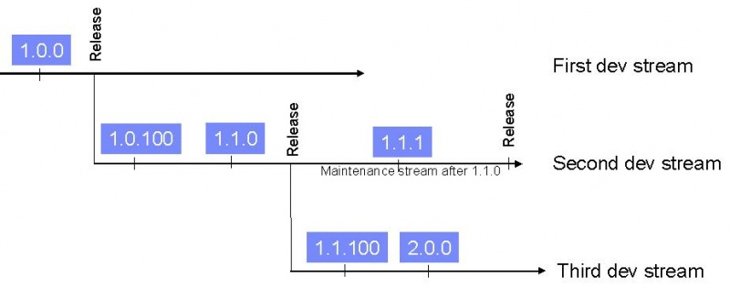
Eclipse Plug-in Version Numbering
© 2010 John Wiley & Sons Ltd.
http://wiki.eclipse.org/Version_Numbering

Slide 28
Planning Configuration Management
1. Roughly sketch out your SCMP
  Determine procedures for making changes
  Omit tool references unless already identified one
  See the case study for an example
2. Specify what you need from a CM tool
  For class use, maybe only locking and backup
3. Evaluate affordable tools against needs and budget
  Commercial tools are in wide use
  For class use, try free document storage web sites; simple method of checking out, e.g. renaming, can be too simple
5. Finalize your SCMP

