Slide 1




Chapter 2
COLLECTION OF DATA
METHODS OF COLLECTING DATA

Slide 2
OBJECTIVES
In this lesson, you are expected to:
Identify the different methods
of data gathering.

Slide 3

Can you identify the pictures that I will show to you?

Slide 4
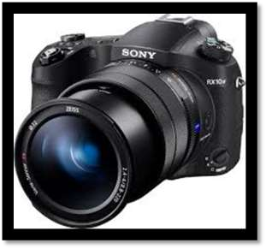
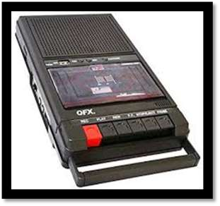

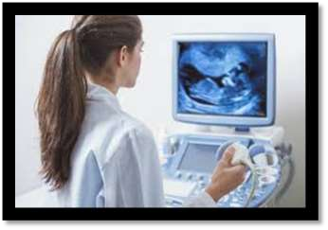

Slide 5
Questions to ponder:

1. What are their functions?
2. Can you identify their
similarities?

Slide 6

A. INTERVIEW
METHOD

Slide 7

1.
DIRECT METHOD

Slide 8
DIRECT METHOD
The researcher personally interviews the respondents. Usually, the interviewer calls for a meeting with the interviewee or visits him or her at home .

Slide 9

2.
Indirect Method

Slide 10

Indirect Method
The researcher uses a telephone to interview the respondents.

Slide 11
B. QUESTIONNAIRE METHOD
-planned questions written on paper, which can be either written personally administered or mailed by the researcher to the respondents using any of the following forms.

Slide 12
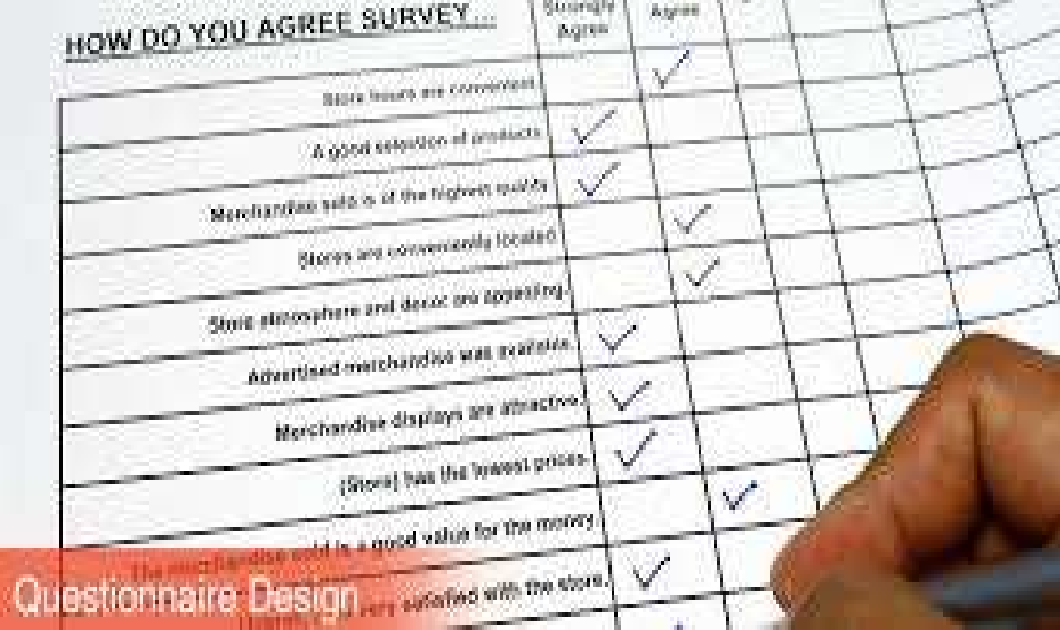


Slide 13

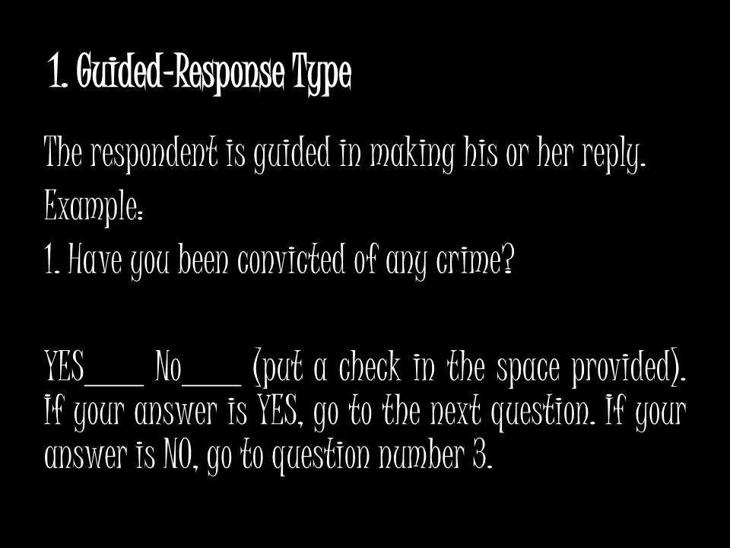


Slide 14
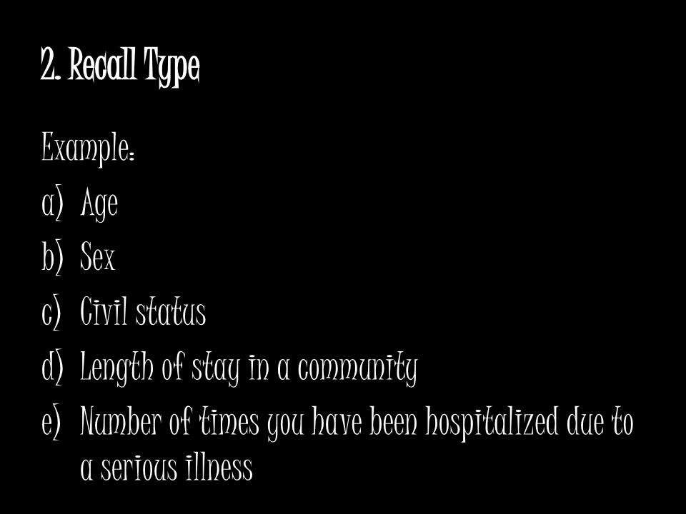


Slide 15
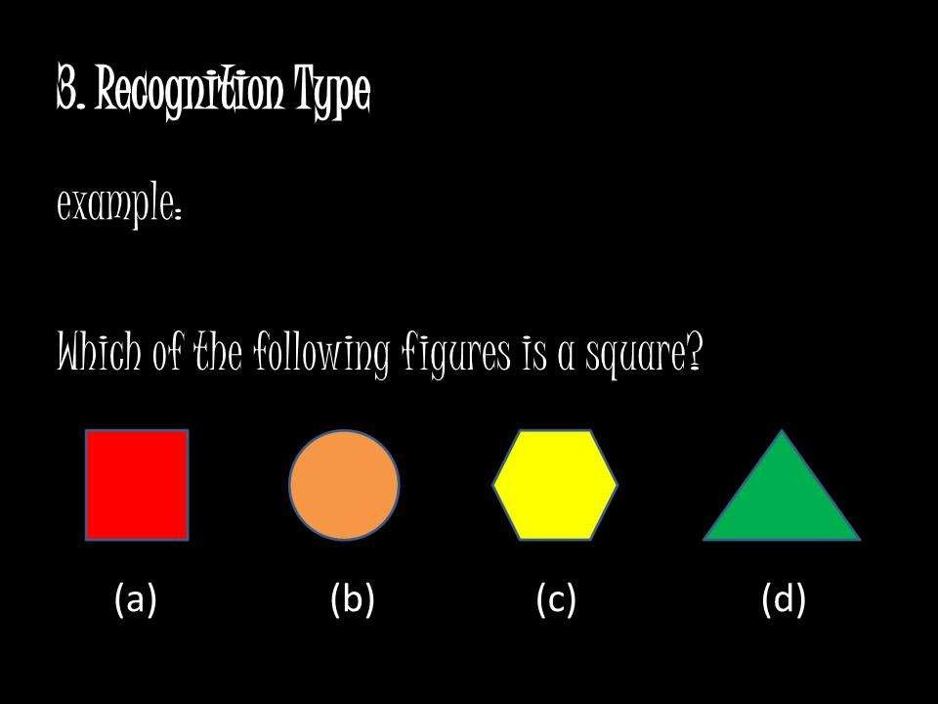

Slide 16
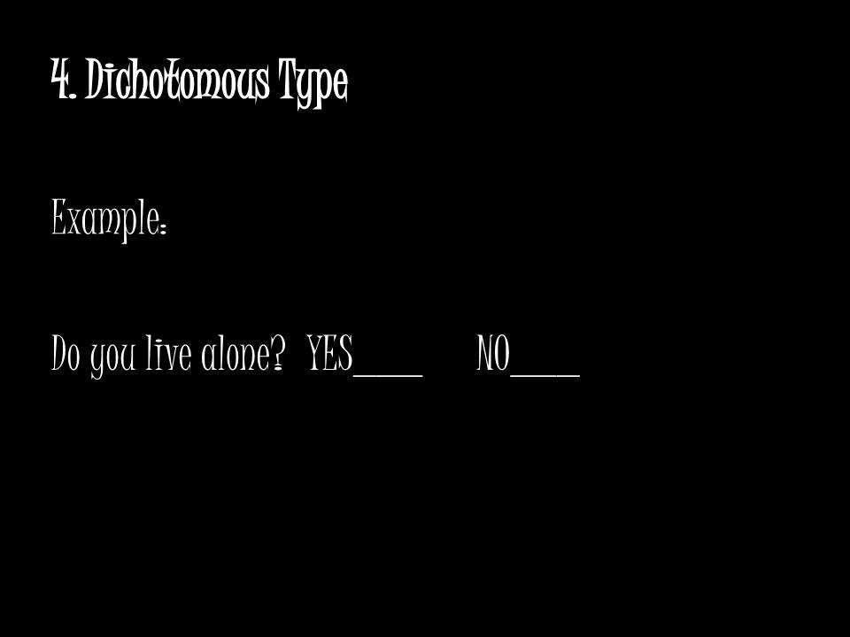

Slide 17

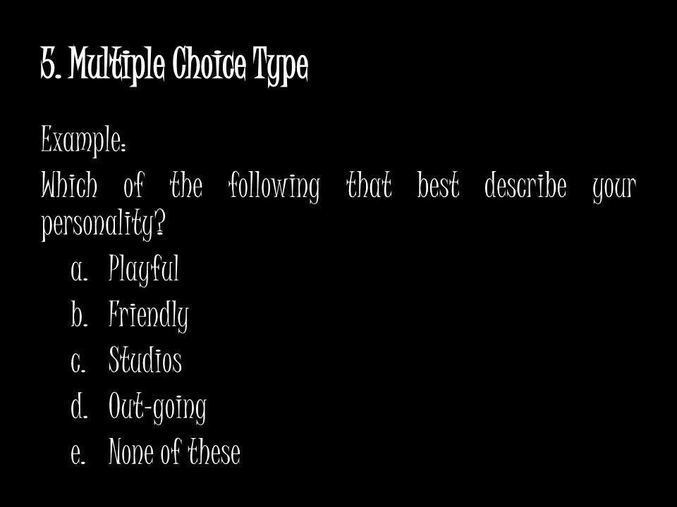

Slide 18

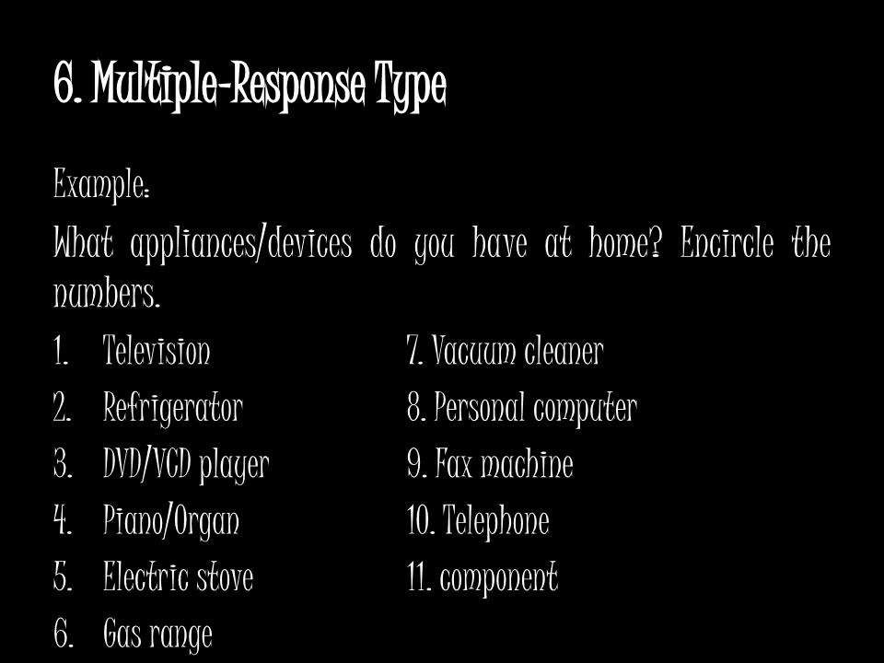

Slide 19
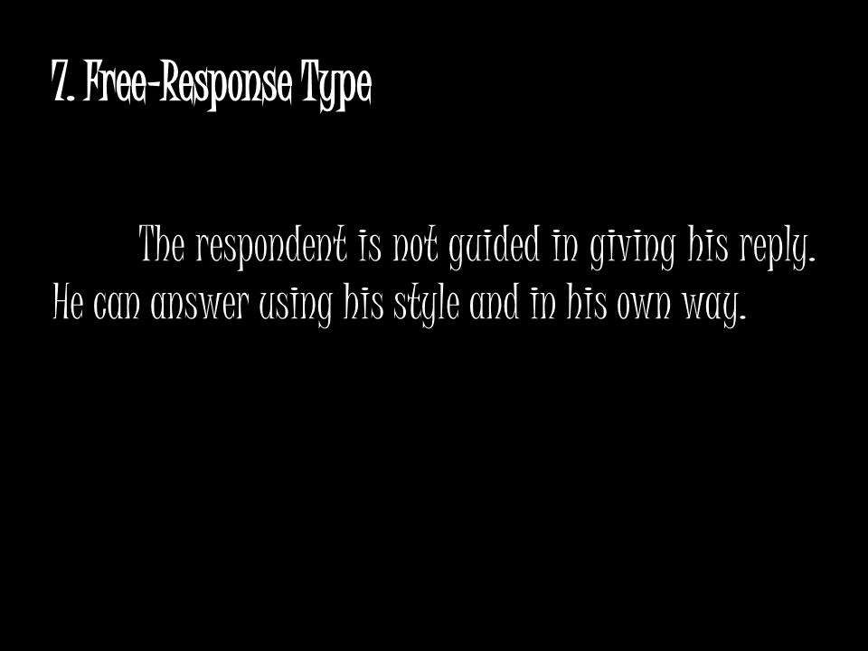

Slide 20
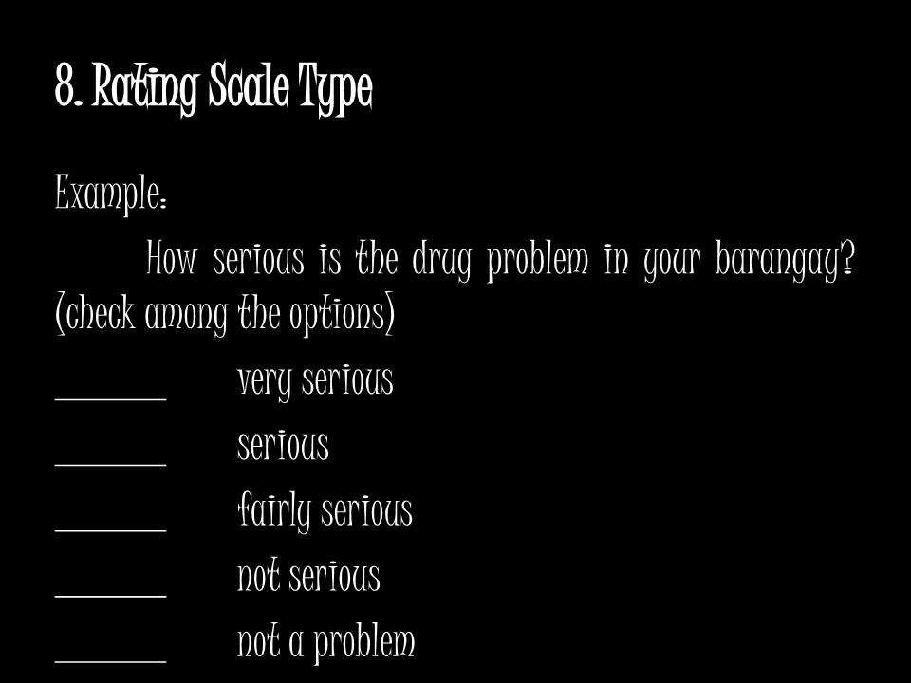

Slide 21
C. EMPIRICAL OBSERVATION
METHOD

The observation method is commonly used in psychological and anthropological studies. It is a method of obtaining data by seeing, hearing, testing, touching and smelling. Through observation, additional information, which cannot be obtained using the other methods like questionnaire, may be gathered.

Slide 22
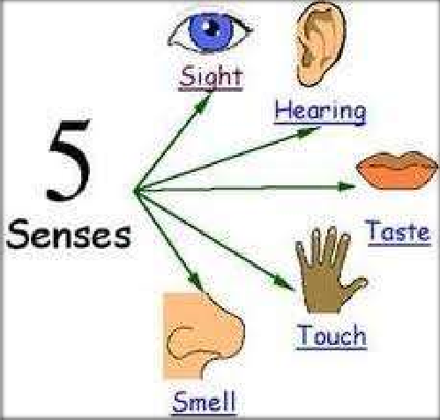

Slide 23
D. TEST METHOD
This method wi d e l y used in psychological research and psychiatry. Standard test are used because of their validity, reliability and usability.
Example:
Aptitude test, IQ test, Achievement
test

Slide 24
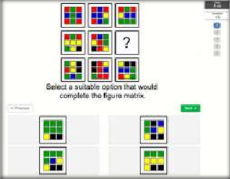



Slide 25
E. REGISTRATION METHOD

Example of data gathered using this method are those that are obtained from the Philippine Statistics Authority, Land Transportation Office, Department of Education, CHED, SEC and other government agencies.

Slide 26



Slide 27
F. MECHANICAL DEVICES

The devices that can be used when gathering data for social and educational researcher are the camera, projector, videotape, tape recorder, etc. in chemical, biological and medical researches , the common devices are x- ray machine, microscope, ultrasound, weighing scales, CT scan, etc.

Slide 28
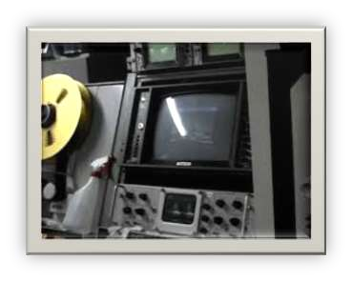

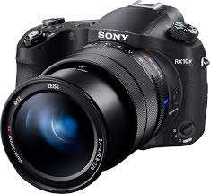

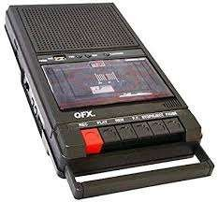

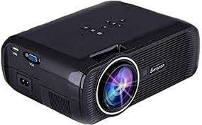

Slide 29


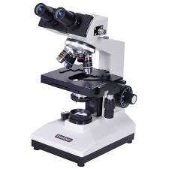
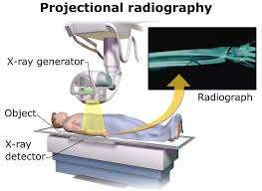

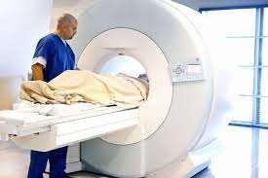

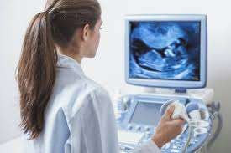

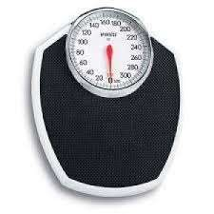

Slide 30

SAMPLING TECHNIQUES

Slide 31
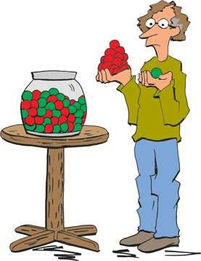
CONTENTS
Introduction
Need for sampling
Sampling Process
Essentials of Sampling
Methods of Sampling
Non Probability Sampling
Probability Sampling
Errors in Sampling
References

Slide 32
INTRODUCTION
Population/Universe: in statistics denotes the aggregate from which sample (items) is to be taken.
A population can be defined as including all people or items with the characteristic one wishes to understand.
Because there is very rarely enough time or money to gather information from everyone or everything in a population, the goal becomes finding a representative sample (or subset) of that population.

Slide 33
INTRODUCTION
Sampling frame is the list from which the potential respondents are drawn .
A sample is “a smaller (but hopefully representative) collection of units from a population used to determine truths about that population” (Field, 2005)

Slide 34
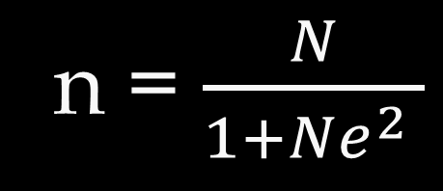
Before the collection of data, it is necessary
to determine the sample size.
To compute for the sample size,
the SLOVIN’S Formula is used.
Where :
n = sample size
N = number of cases
E = margin of error
n = $\frac{N}{1+Ne^{2} }$

Slide 35



Sample computation using
the SLOVIN’S Formula
Given: N = 2500 e = 0.05
n = $\frac{N}{1+Ne^{2} }$
n = $\frac{2500}{1+2500({0.05)}^{2} }$
n = 344.8
$≈$ 345

Slide 36
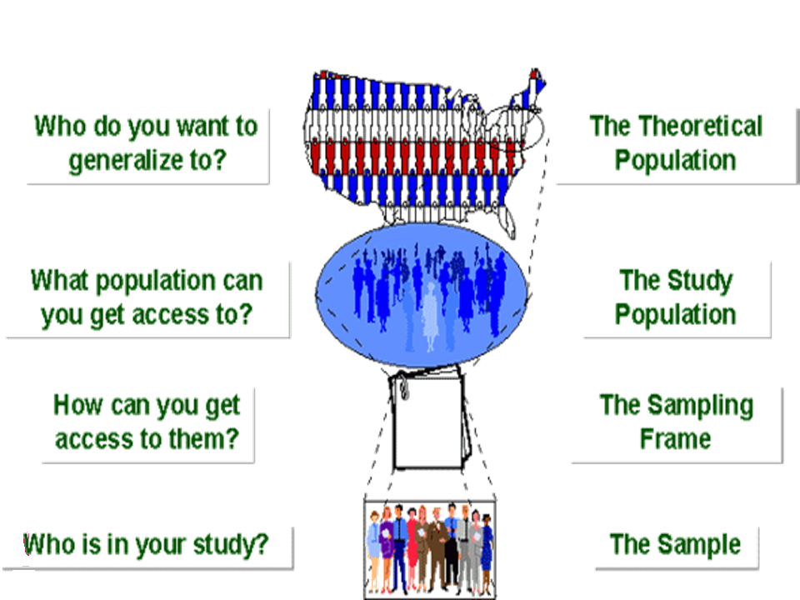
SAMPLING BREAKDOWN

Slide 37
SAMPLING
Sampling: the process of learning about population on the basis of sample drawn from it.
Three elements in process of sampling:
Selecting the sample
Collecting the information
Making inference about population
Statistic: values obtained from study of a sample.
Parameter: such values from study of population.

Slide 38
NEED FOR SAMPLING
DATA
(acc. to source)
Primary
Secondary
ORIGINAL IN CHARACTER
2. GENERATED IN LARGE
NO. OF SURVEYS
OBTAINED FROM
PUBLISHED SOURCES
UNPUBLISHED SOURCES

Slide 39
NEED FOR SAMPLING
When secondary data are not available for the problem under study , primary data is collected.
Two methods –
Census method or complete enumeration method
Sample method

Slide 40
CENSUS (Complete Enumeration Survey)
Merits
Data obtained from each and every unit of population.
Results: more representative, accurate, reliable.
Basis of various surveys.
Demerits
More effort ,money , time.
Big problem in underdeveloped countries.

Slide 41
ADVANTAGES OF SAMPLING
Less resources (time, money)
Less workload.
Gives results with known accuracy that can be calculated mathematically.

Slide 42
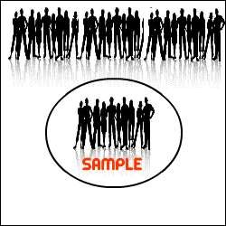
THEORETICAL BASIS OF SAMPLING
On the basis of sample study we can predict and generalize the behavior of mass phenomena.
There is no statistical population whose elements would vary from each other without limit.

Slide 43
THEORETICAL BASIS OF SAMPLING
Law of Statistical Regularity-
Sample is taken at random from a population, it is likely to possess same characteristics as that of population.
Law of inertia of large numbers-
Larger the size of sample, more accurate the results are likely to be.

Slide 44
SAMPLING PROCESS
Defining the population of concern.
Specifying a sampling frame, a set of items or events possible to measure.
Specifying a sampling method for selecting items or events from the frame.
Determining the sample size.
Implementing the sampling plan.
Sampling and data collection

Slide 45
ESSENTIALS OF SAMPLING
Representativeness- ensure by random selection
Adequacy - sample size
Independence - same chance of selection
Homogeneity - no basic difference in nature of units.

Slide 46
SAMPLING METHODS
NON PROBABILITY
PROBABILITY
MIXED
SIMPLE RANDOM
MULTISTAGE
JUDGMENT
STRATIFIED
RANDOM
QUOTA
MULTIPHASE
CONVENIENCE
SYSTEMATIC
SNOWBALL
CLUSTER

Slide 47
NON PROBABILITY SAMPLING

Slide 48
JUDGMENT SAMPLING
Judgment/Purposive/Deliberate sampling.
Depends exclusively on the judgment of investigator.
Sample selected which investigator thinks to be most typical of the universe.

Slide 49
JUDGMENT SAMPLING
Merits
Small no. of sampling units
Study unknown traits/case sampling
Urgent public policy & business decisions
Demerits
Personal prejudice & bias
No objective way of evaluating reliability of results

Slide 50


JUDGMENT SAMPLING - EXAMPLE
Sample size for a study=8
JUDGMENT
CLASS OF 20 STUDENTS
SAMPLE OF 8 STUDENTS

Slide 51
CONVENIENCE SAMPLING
Convenient sample units selected.
Selected neither by probability nor by judgment.
Merit – useful in pilot studies.
Demerit – results usually biased and unsatisfactory.

Slide 52
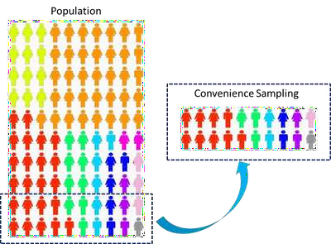
CONVENIENCE SAMPLING - EXAMPLE
Class of 100 students
20 Students selected as per
convenience

Slide 53
QUOTA SAMPLING
Most commonly used in non probability sampling.
Quotas set up according to some specified characteristic.
Within the quota , selection depends on personal judgment.
Merit- Used in public opinion studies
Demerit – personal prejudice and bias

Slide 54


QUOTA SAMPLING - EXAMPLE
Radio listening survey
60%
housewives
300
Quota
Formation
25%
farmers
125
Personal
judgement
15% children
under age 15
75
Interview 500 people
500 people

Slide 55
SNOWBALL SAMPLING
A special non probability method used when the desired sample characteristic is rare.
It may be extremely difficult or cost prohibitive to locate respondents in these situations.
Snowball sampling relies on referrals from initial subjects to generate additional subjects.

Slide 56
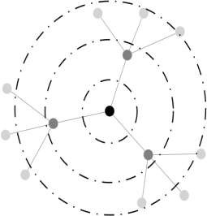
SNOWBALL SAMPLING - STEPS
Make contact with one or two cases in the population.
Ask these cases to identify further cases.
Ask these new cases to identify further new cases.
Stop when either no new cases are given or the sample is as large as is manageable.

Slide 57
SNOWBALL SAMPLING
Merit
access to difficult to reach populations (other methods may not yield any results).
Demerit
not representative of the population and will result in a biased sample as it is self-selecting.

Slide 58
PROBABILITY SAMPLING

Slide 59
SIMPLE RANDOM SAMPLING
Each unit has an equal opportunity of being selected.
Chance determines which items shall be included.

Slide 60
SIMPLE RANDOM SAMPLING
The sample is a simple random sample if any of the following is true :
All items selected independently.
At each selection , all remaining items have same chance of being selected.
All the possible samples of a given size are equally likely to be selected.

Slide 61

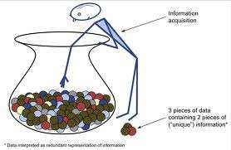

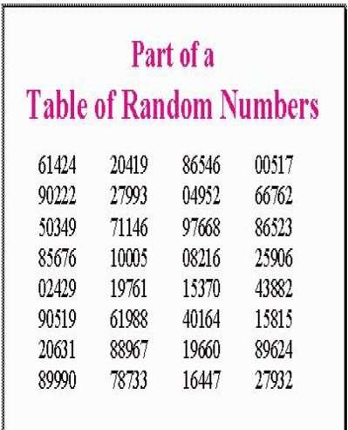
Simple or unrestricted random sampling
Lottery method
Random number tables

Slide 62
LOTTERY METHOD -
With replacement-
Probability each item: 1/N
Without replacement –
Probability 1st draw: 1/N
Probability 2nd draw: 1/N-1

Slide 63

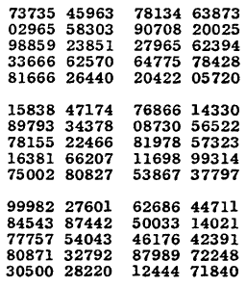
TABLE OF RANDOM NUMBERS

Slide 64
SIMPLE RANDOM SAMPLING
Merits
No personal bias.
Sample more representative of population.
Accuracy can be assessed as sampling errors follow principals of chance.
Demerits
Requires completely catalogued universe.
Cases too widely dispersed - more time and cost.

Slide 65
STRATIFIED RANDOM SAMPLING
Universe is sub divided into mutually exclusive groups.
A simple random sample is then chosen independently from each group.

Slide 66
STRATIFIED RANDOM SAMPLING
Issues involved in stratification
Base of stratification
Number of strata
Sample size within strata.
Proportional (proportion in each stratum)
Sample size within strata
Disproportional (equal no. in each stratum)

Slide 67


STRATIFIED RANDOM SAMPLING - EXAMPLE
URBAN (30%)
SUB-URBAN (15%)
RURAL (25%)
SUB-RURAL (30%)
Strata Formation
150
Random
sampling
LUCENA CITY
For sample size of 1000

Slide 68
STRATIFIED RANDOM SAMPLING
Merits
More representative.
Greater accuracy.
Greater geographical concentration.
Demerits
Utmost care in dividing strata.
Skilled sampling supervisors.
Cost per observation may be high.

Slide 69


SYSTEMATIC SAMPLING
Selecting first unit at random.
Selecting additional units at evenly spaced intervals.
Complete list of population available.
k=N/n
k=sampling interval N=universe size n=Sample size
Class of 95students : roll no. 1 to 95
Sample of 10 students
k=9.5 or 10
1st student random then every 10th

Slide 70
SYSTEMATIC SAMPLING
Merits
Simple and convenient.
Less time consuming.
Demerits
Population with hidden periodicities.

Slide 71
CLUSTER SAMPLING
A sampling technique in which the entire population of interest is divided into groups, or clusters, and a random sample of these clusters is selected.
Each cluster must be mutually exclusive and together the clusters must include the entire population .
After clusters are selected, then all units within the clusters are selected. No units from non-selected clusters are included in the sample.

Slide 72
CLUSTER SAMPLING
In cluster sampling, the clusters are the primary sampling unit (PSU’s) and the units within the clusters are the secondary sampling units (SSU’s)

Slide 73
STRATIFICATION V/S CLUSTERING
Stratification | Clustering
All strata are represented in the sample. | Only a subset of clusters are in the sample.
Less error compared to simple random. | More error compared to simple random.
More expensive to obtain stratification information before sampling. | Reduces costs to sample only some areas or Organizations.

Slide 74
CLUSTER SAMPLING- STEPS
Identification of clusters
List all cities, towns, villages & wards of cities with their population falling in target area under study.
Calculate cumulative population & divide by 30, this gives sampling interval.
Select a random no. less than or equal to sampling interval having same no. of digits. This forms 1st cluster.
Random no.+ sampling interval = population of 2nd cluster.
Second cluster + sampling interval = 3rd cluster.
Last or 30th cluster = 29th cluster + sampling interval

Slide 75

CLUSTER SAMPLING
Freq |  | c f | cluster | XVI | 3500 | 52500 | 17
I 2000 |  | 2000 | 1 | XVII | 4000 | 56500 | 18,19
• | II 3000 | 5000 | 2 • XVIII 4500 61000 20
III 1500 |  | 6500
IV 4000 |  | 10500 | 3
V 5000 |  | 15500 | 4, 5
• | VI 2500 | 18000 | 6
VII 2000 |  | 20000 | 7
VIII 3000 |  | 23000 | 8
XIX 4000 65000 21,22
XX 4000 69000 23
XXI 2000 71000 24
XXII 2000 73000
XXIII 3000 76000 25
XXIV 3000 79000 26
XXV 5000 84000 27,28
XXVI 2000 86000 29
XXVII 1000 87000
88000
89000
90000
90000/30 = 3000 sampling interval
IX 3500 26500 9
X 4500 31000 10
XI 4000 35000 11, 12
XII 4000 39000 13
44000 14,15
46000
49000
3500
2000
3000
XXVIII XXIX XXX
1000
1000
1000
30
16

Slide 76
CLUSTER SAMPLING
Merits
Most economical form of sampling.
Larger sample for a similar fixed cost.
Less time for listing and implementation.
Reduce travel and other administrative costs.
Demerits
May not reflect the diversity of the community.
Standard errors of the estimates are high, compared to
other sampling designs with same sample size .

Slide 77
MULTISTAGE SAMPLING
Sampling process carried out in various stages.
An effective strategy because it banks on multiple randomizations.
Used frequently when a complete list of all members of the population does not exist and is inappropriate.

Slide 78
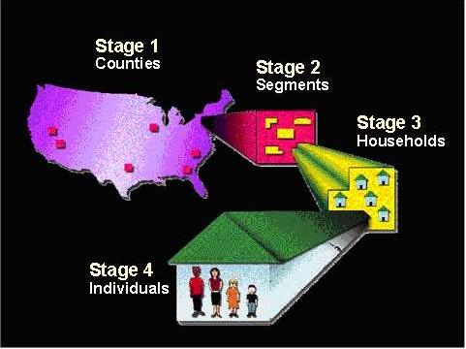
MULTISTAGE SAMPLING

Slide 79
MULTISTAGE SAMPLING
Merits
Introduces flexibility in the sampling method.
Enables existing divisions and sub divisions of population to be used as units.
Large area can be covered.
Valuable in under developed areas.
Demerits
Less accurate than a sample chosen by a single stage process.

Slide 80
MULTIPHASE SAMPLING
Used for studies to be carried out in multiple phases.
For e.g. A cross - sectional study on nutrition may be carried out in phases
Phase-1: K.A.P. study in all families
Phase -2: Dietary assessment in subsample
Phase-3:anthropometric examination in sub-
sample of family members covered in 2nd phase

Slide 81
ERRORS DUE TO NON - SAMPLING
Data specification inadequate & inconsistent with respect to objective of census.
Inaccurate or inappropriate methods of interview, observation, definitions.
Lack of trained & experienced investigators.
Errors due to non response.
Errors in data processing operations
Errors committed during presentation.
MORE IN COMPLETE ENUMERATION SURVEY

Slide 82


