Slide 1


PERFORMANCE EVALUATION
The Carrefour
Leonardo Bacciottini Federico Pacini Marco Pettorali
A.A 2019/2020

Slide 2
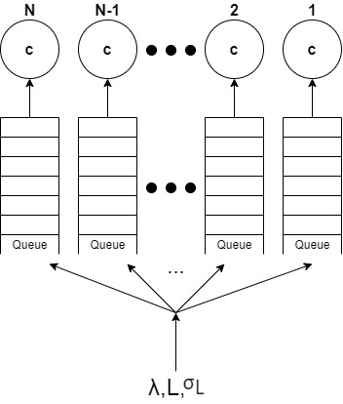
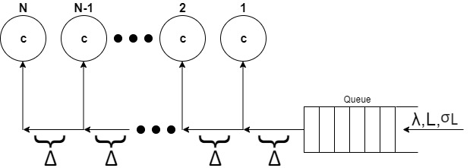
Project description
VS
N: number of tills
c : capacity of a till (number of items checked per second)
λ : inter-arrival rate of customers
L : average amount of items in a cart
σ_{L} : variance of the distribution of the items in a cart of an arriving customer.
Only for P1:
Δ is the time needed to reach from the j^{th} till the (j+1)^{th}

Slide 3
Objectives
Customer’s point of view
Minimize mean waiting time
98% guarantee not to wait more than a certain threshold
Manager’s point of view
Less crowded market’s region of the tills
Fairness of the system
Incrementing number of tills vs upgrading capacity

Slide 4
Performance indexes
Waiting time: mean value, variance, median, 98th percentile and Lorenz curve gap
Response time: mean value, median, 98th percentile and Lorenz curve gap
Customers in the market: mean value

Slide 5
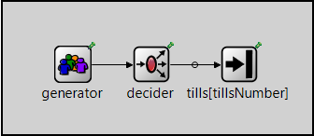
Model
Generator: generates customers
Decider: sortes customers to the tills
according to the policy P1 or P2
Tills[tillsNumber]: is a vector of tills

Slide 6
Verification
P1
Deterministic inter-arrival and service time with high load
Exponential inter-arrival and service time with Δ=0 for P1
Exponential inter-arrival and service time with N=1 for P2
P2
Continuity test incrementing N, upgrading c and raising λ
Exponential inter-arrival and service time with N>1 for P2

Slide 7

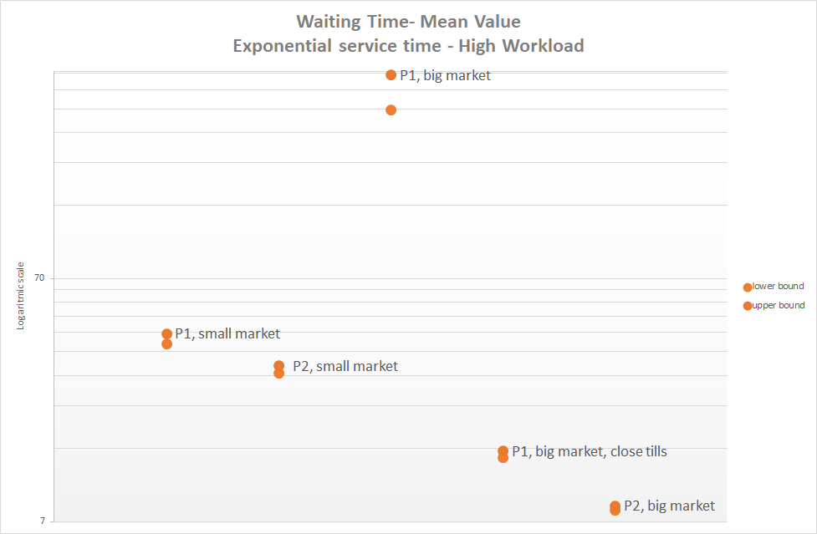
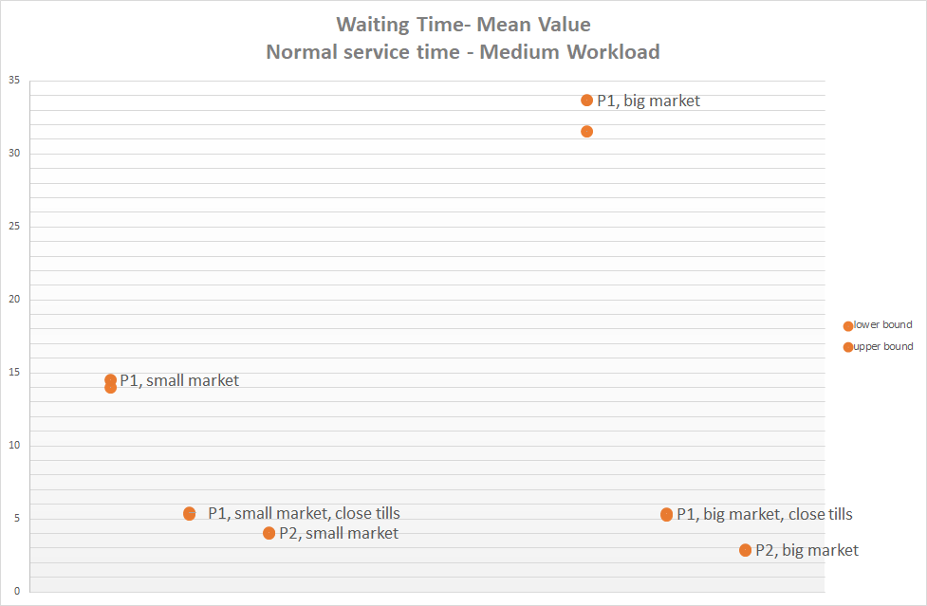
Mean waiting time

Slide 8
LCG waiting time

Slide 9
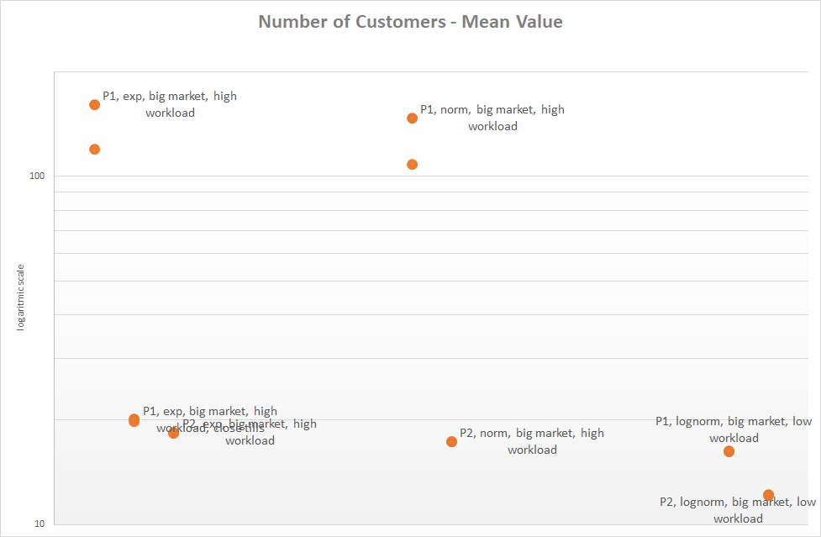
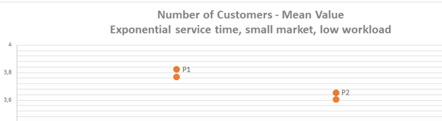
Mean customers

Slide 10
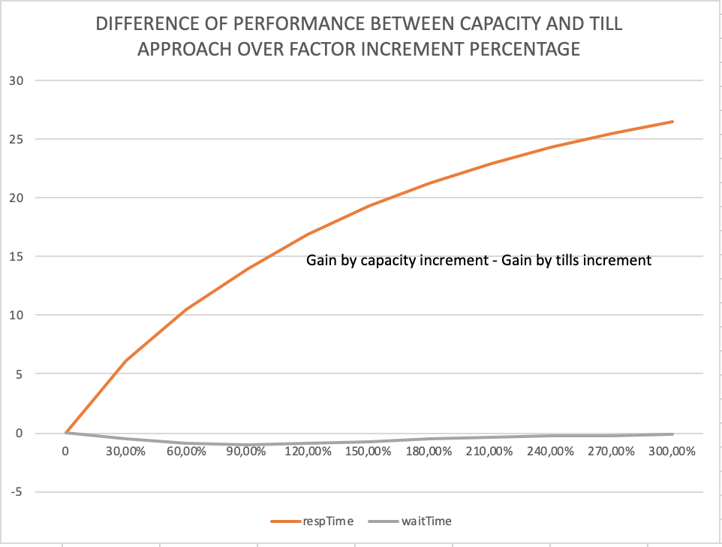
Increasing tills VS Upgrading capacity

