Slide 1
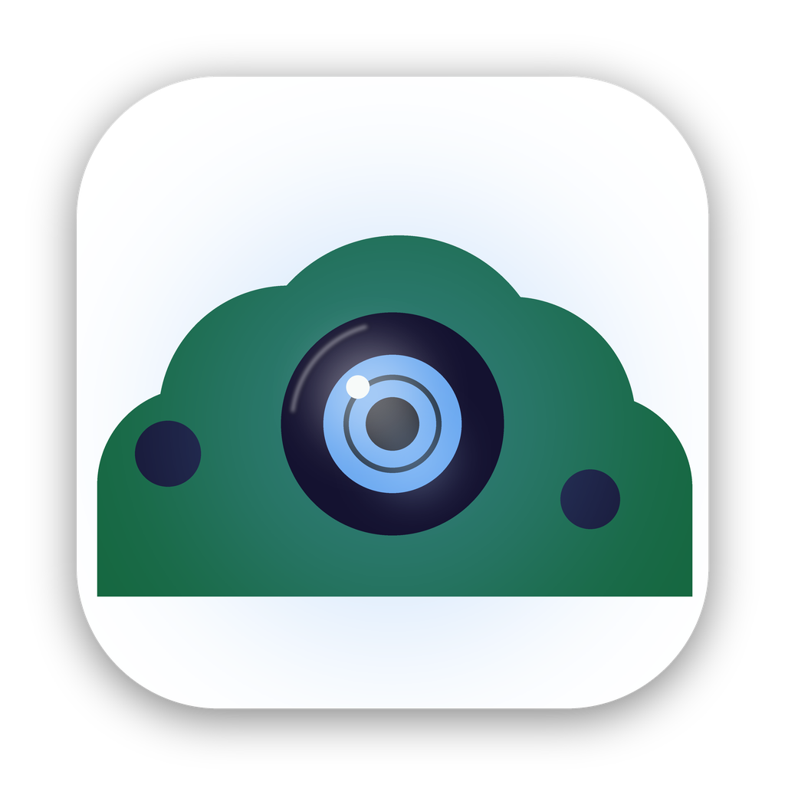
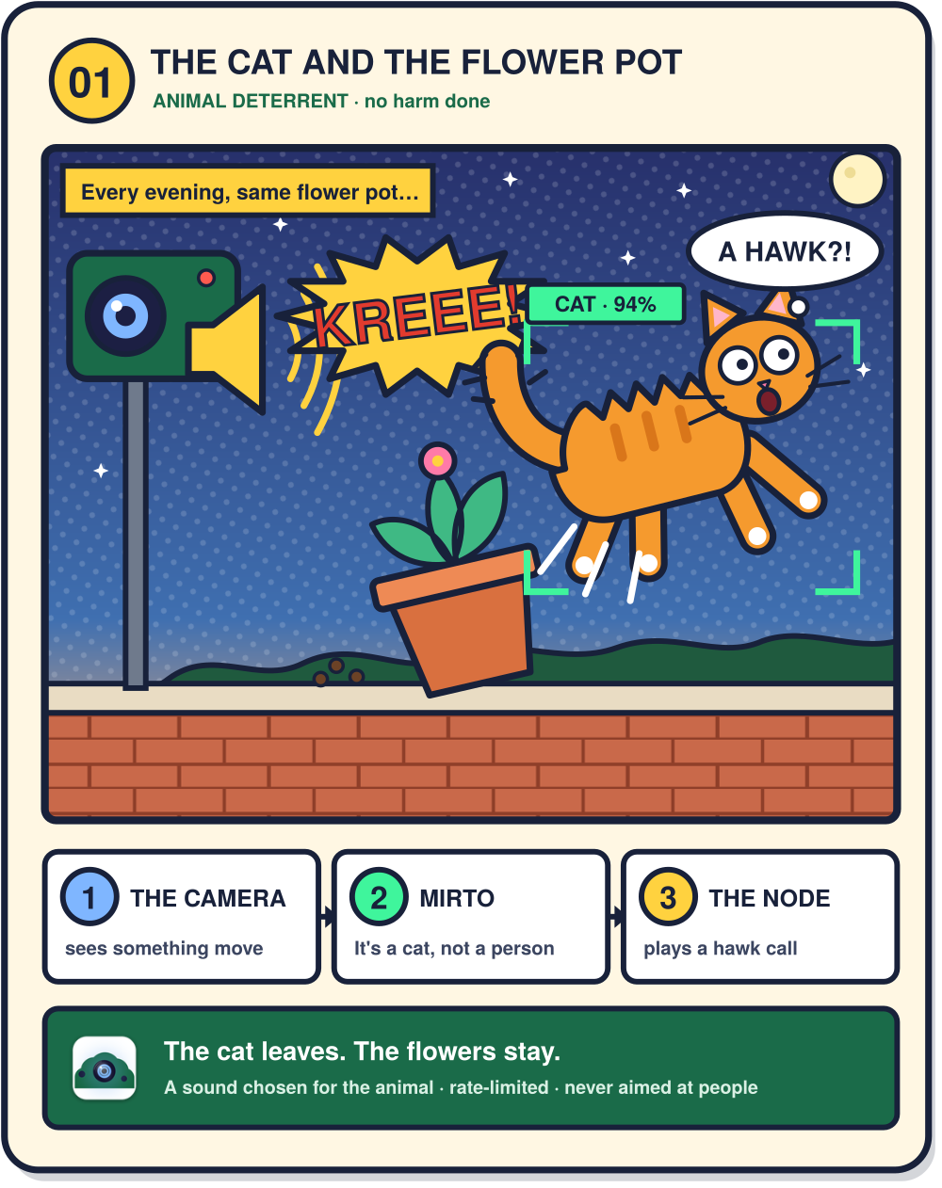
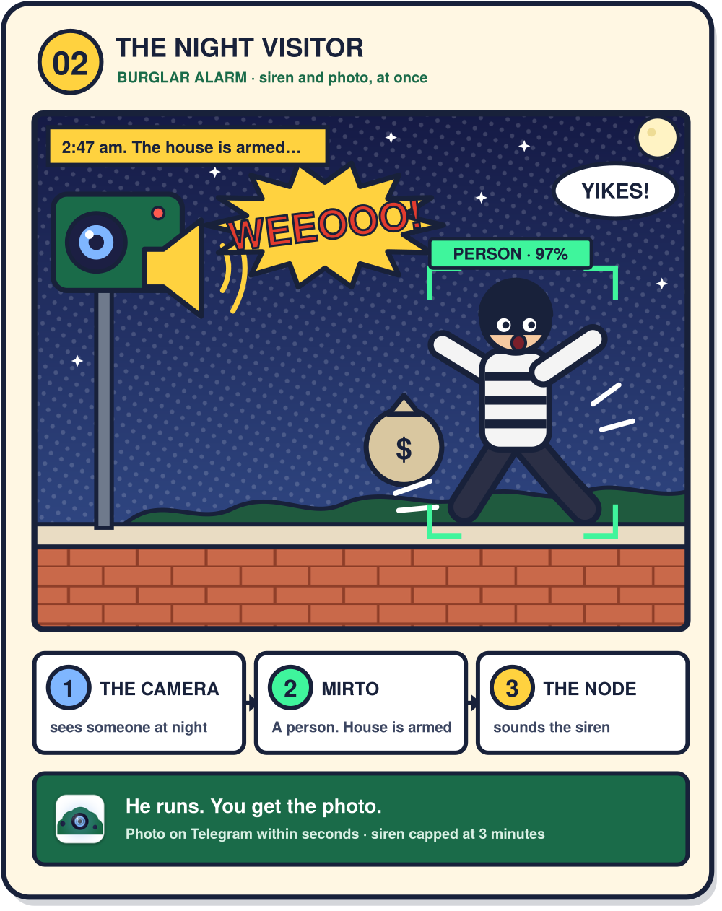
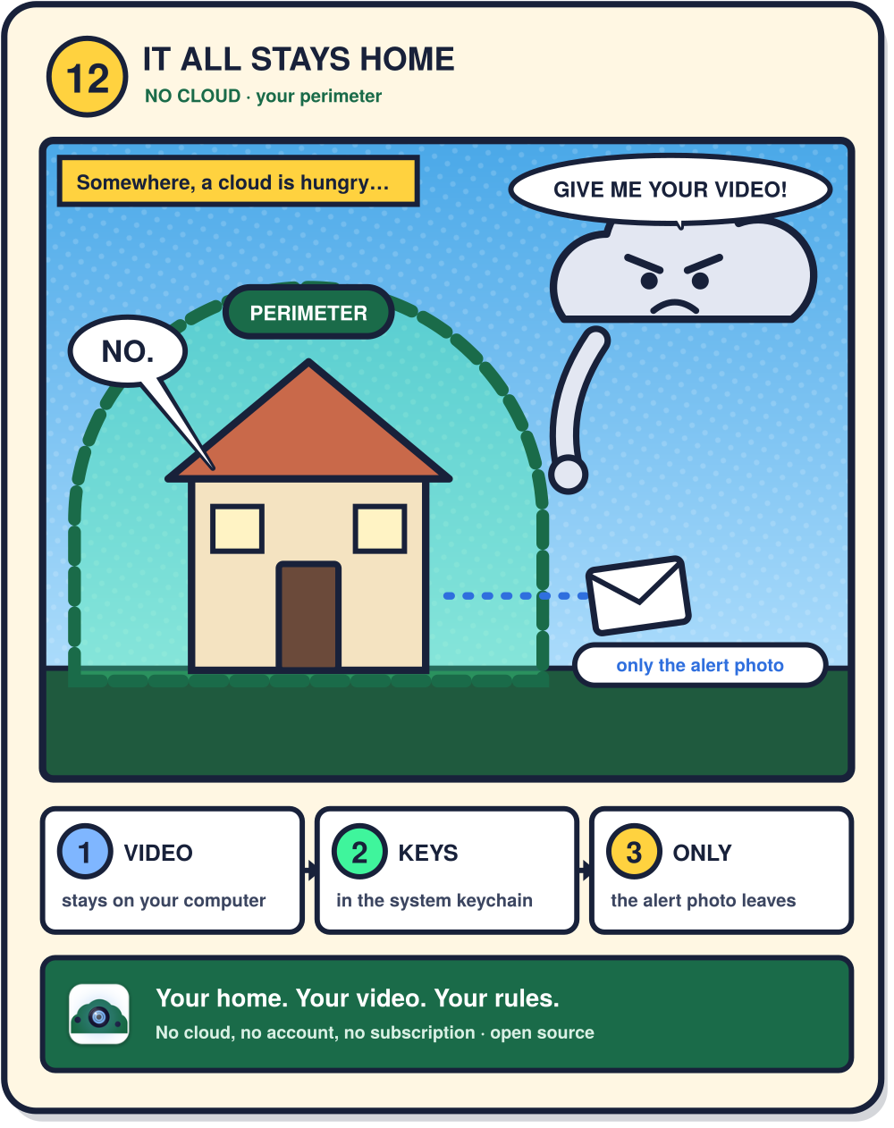
Mirto
Home video surveillance that stays in your home
Desktop app for macOS and Windows · open source · no cloud
Notes:
Mirto in one line: it watches your cameras, decides on your own computer whether a person is there, tells you on Telegram, and can sound a siren outside. Nothing goes to a cloud.

Slide 2




Your cameras, someone else's computer
Your video leaves the house
Cloud cameras send what happens in your home to a server you do not control.
A fee every month, for ever
Recording, history and smart alerts sit behind a subscription.
Your living room, on someone else's server
The alternatives are for experts
Self-hosted NVRs want Docker, a server, a broker and an afternoon.
That is the trade Mirto exists to refuse.
Notes:
Three pains: privacy, recurring cost, and complexity of the do-it-yourself route. Mirto answers all three with a desktop app.

Slide 3



Mirto in three steps
1
2
3
It watches
It checks, on your machine
It tells you, and it can act
Every camera the computer can reach: built-in, USB, or RTSP on the network. Unplug one and it comes back by itself.
When something moves, a model on your own computer answers one question: is that a person? No frame leaves to be looked at.
A photo on Telegram within seconds, email too. And a Raspberry Pi outside can sound a siren or switch on a light.
Notes:
Watch, check locally, tell and act. The third step is what the other NVRs do not ship: a ready-made node outside.

Slide 4
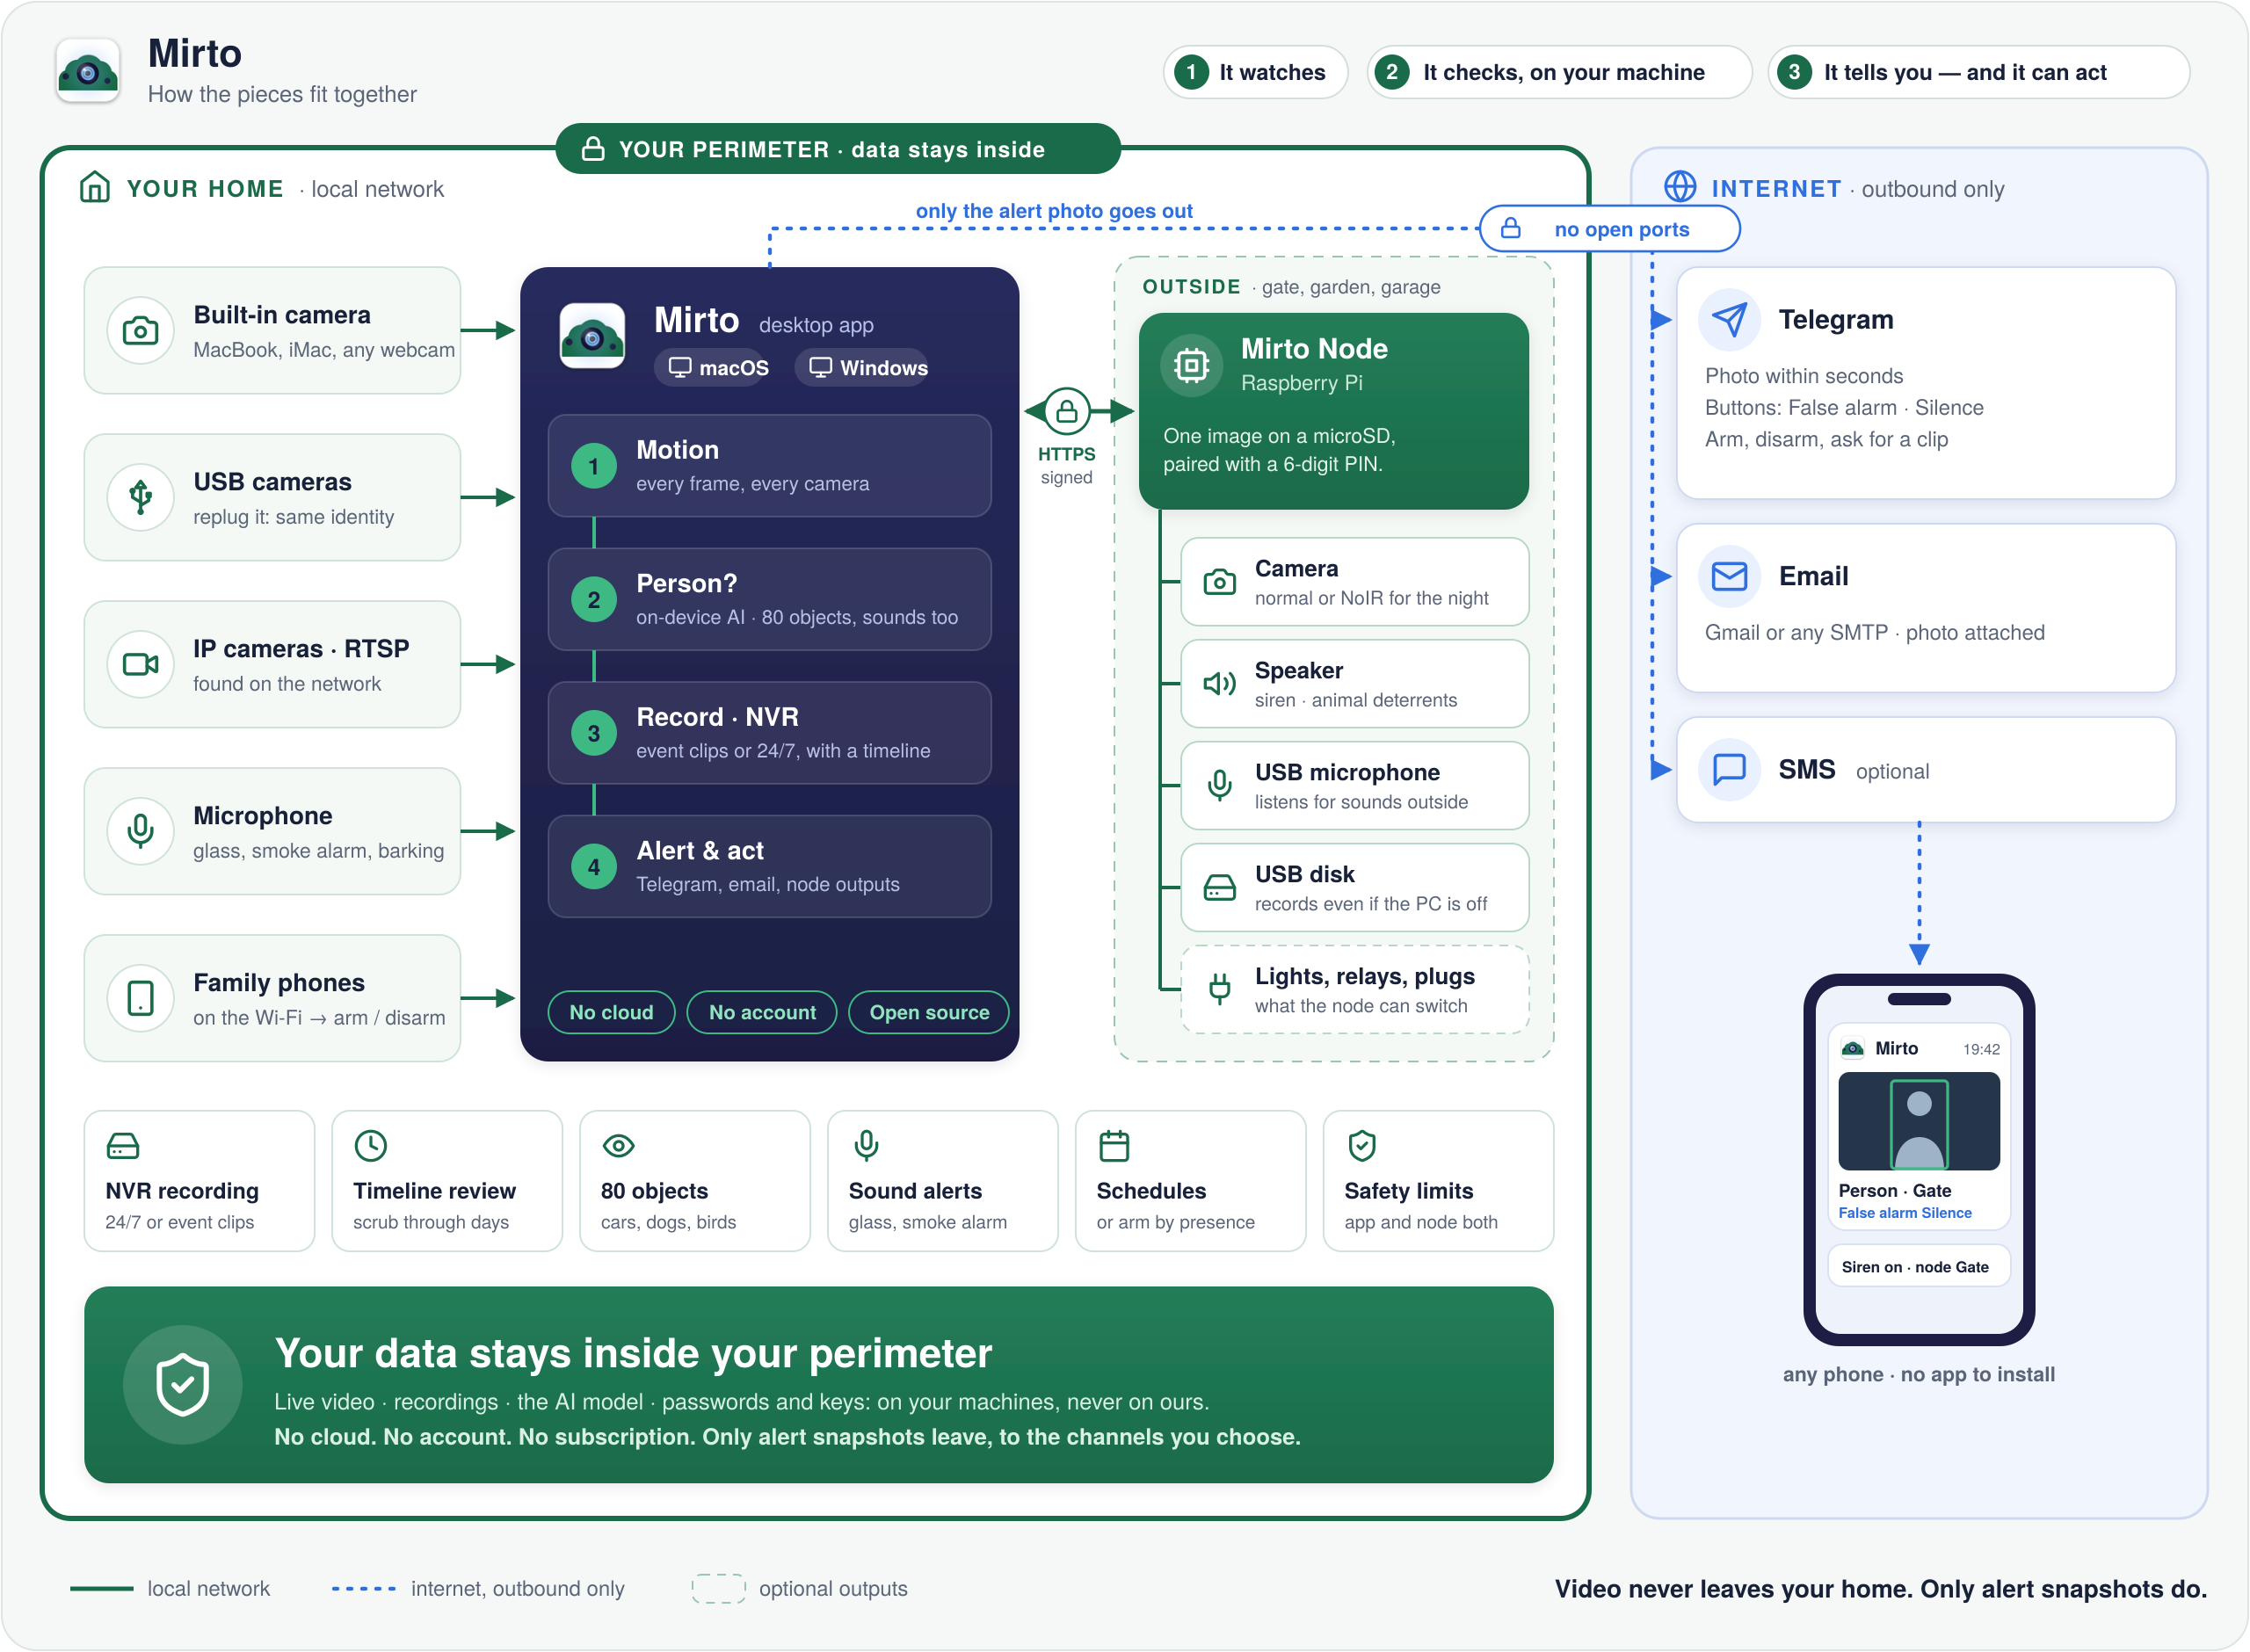
How the pieces fit together
Inside
Cameras, the app, the node. Everything talks on your own network.
Outside
Only the alert photo, outbound, to the channels you set up. No open ports.
Notes:
Green is the home network, blue is the internet. The only line that crosses is the alert photo, and it is outbound.

Slide 5

Your data stays inside your perimeter
Stays inside
Goes out
✓
Live video
never streamed anywhere
The alert photo
to Telegram, email or SMS: only the channels you configure.
Outbound only. No open ports. No account on anything of ours.
✓
Recordings
on your disk, deleted by age or quota
✓
Detection
the AI model runs on your machine
✓
Passwords and keys
in the system keychain, never in a file
Also: the model is downloaded once, the first time it is needed. Usage statistics exist and stay off until you say yes.
Notes:
The key slide. Four things never leave; one thing does, and only where the owner sends it. Be upfront about the model download and the opt-in statistics.

Slide 6
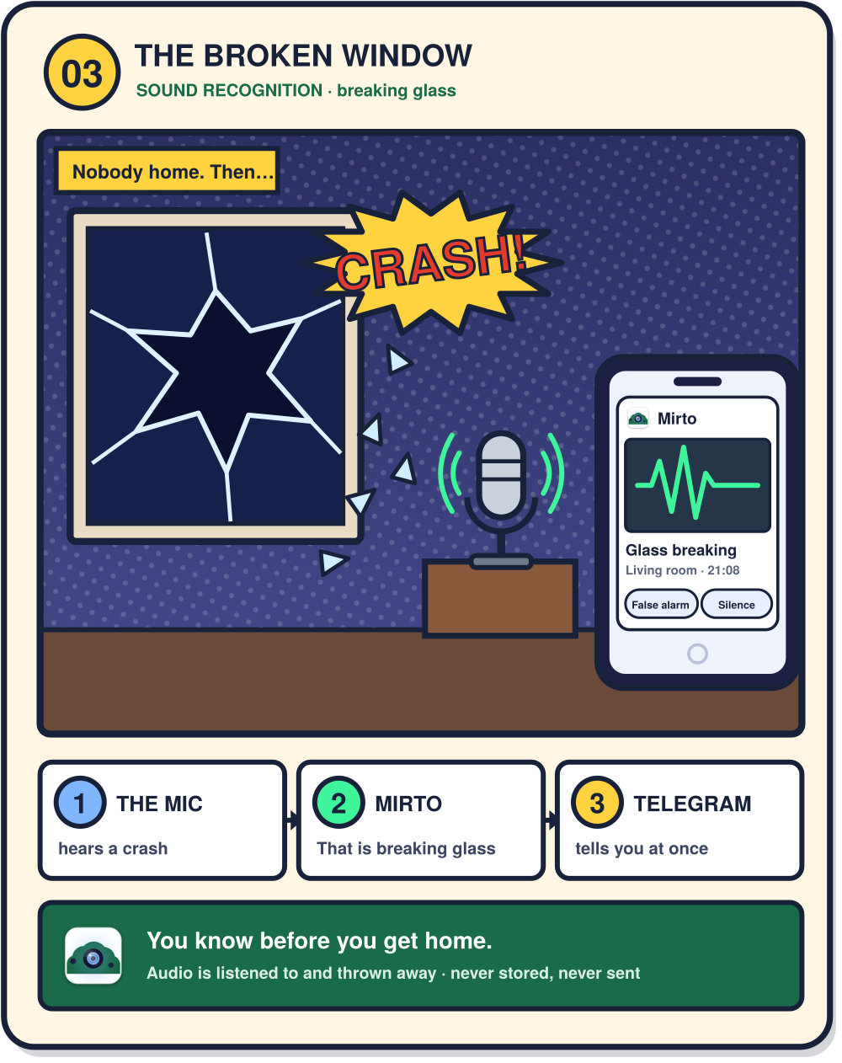
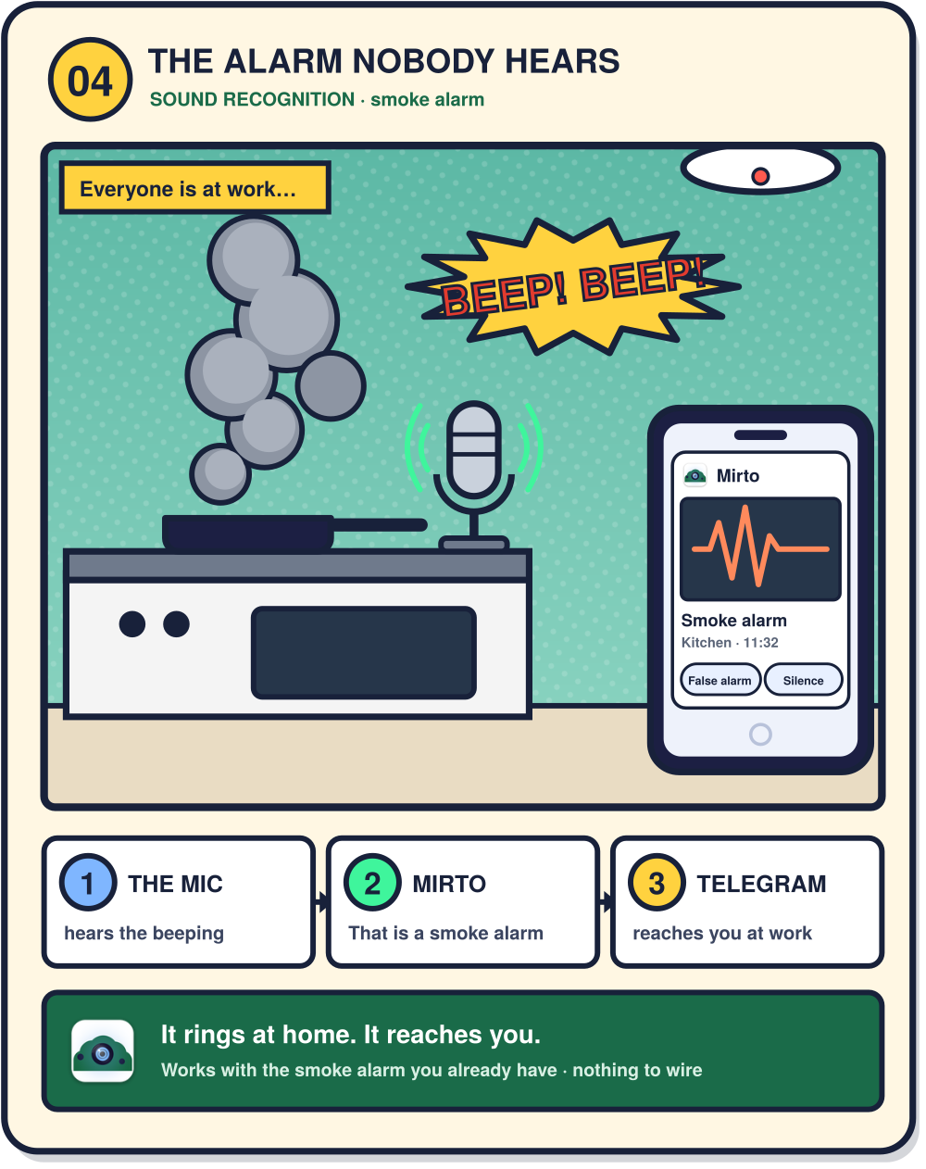
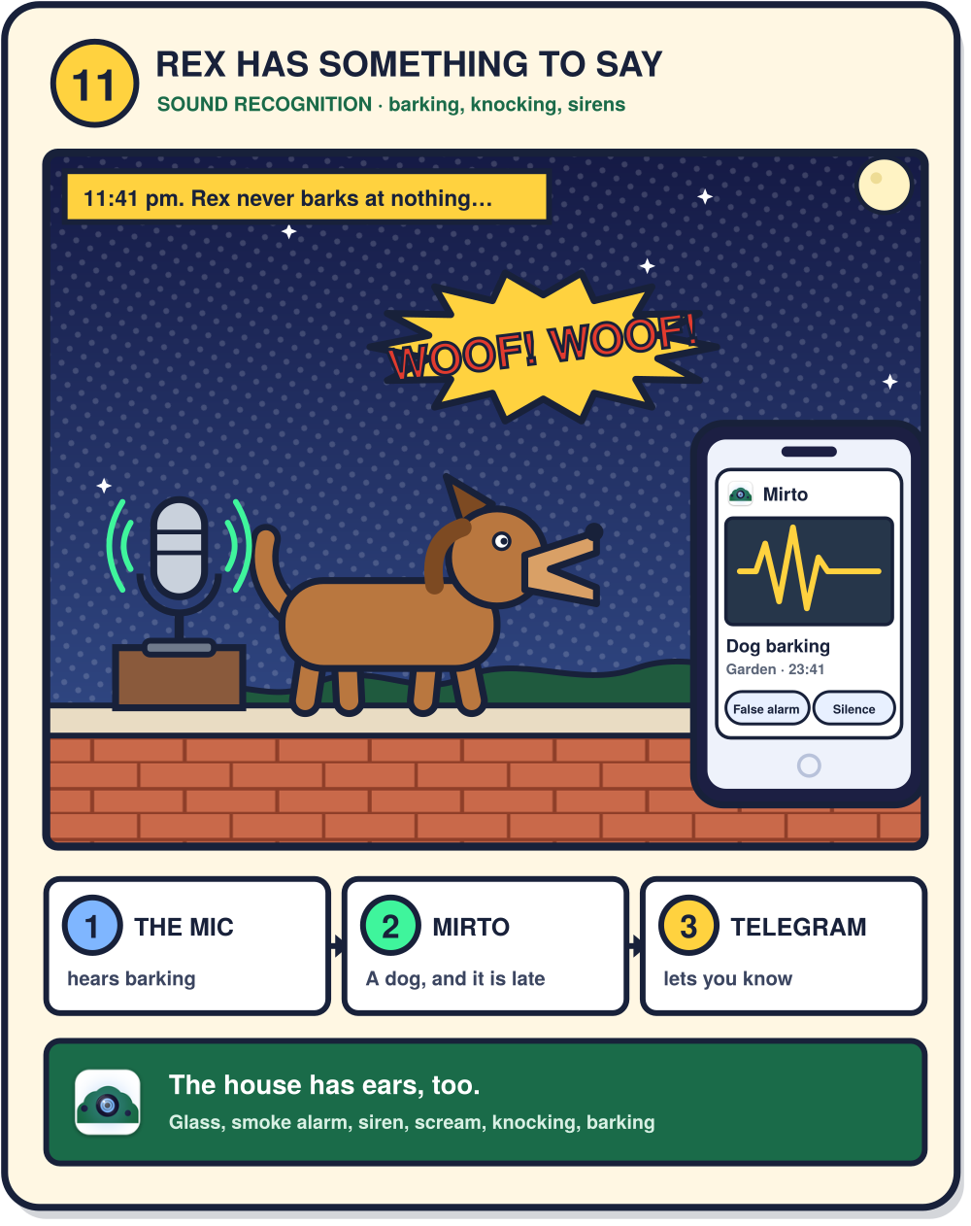
Something is wrong: you know in seconds
Burglar, broken glass, smoke alarm, barking: camera or microphone notices, Mirto recognises, Telegram tells you.
Notes:
Burglar, broken glass, smoke alarm, barking: camera or microphone notices, Mirto recognises, Telegram tells you.

Slide 7
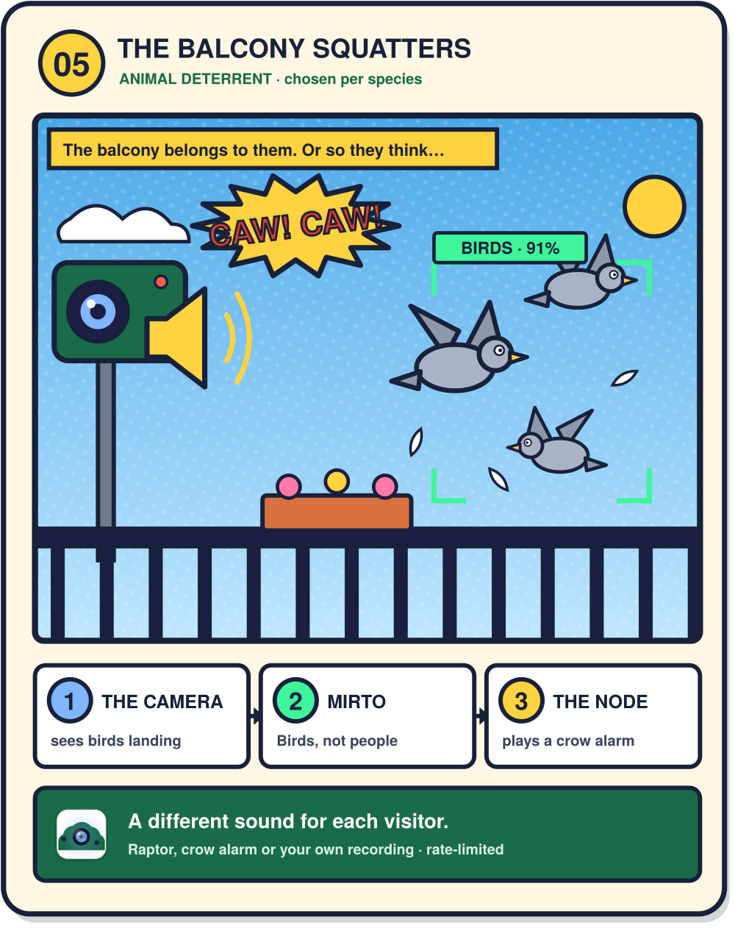
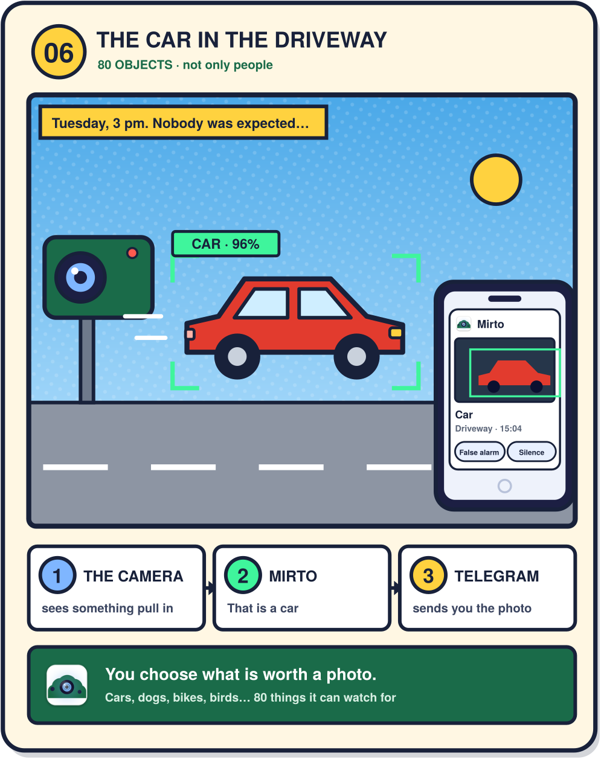
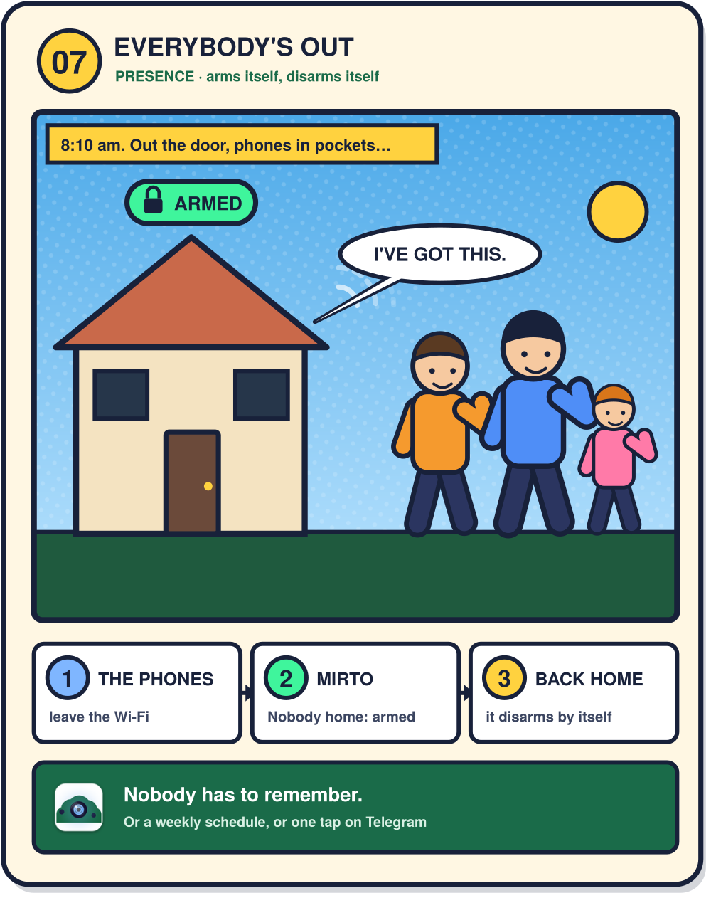
Everyday life, handled
Deterrents for animals, objects beyond people, and a house that arms itself when everyone leaves.
Notes:
Deterrents for animals, objects beyond people, and a house that arms itself when everyone leaves.

Slide 8
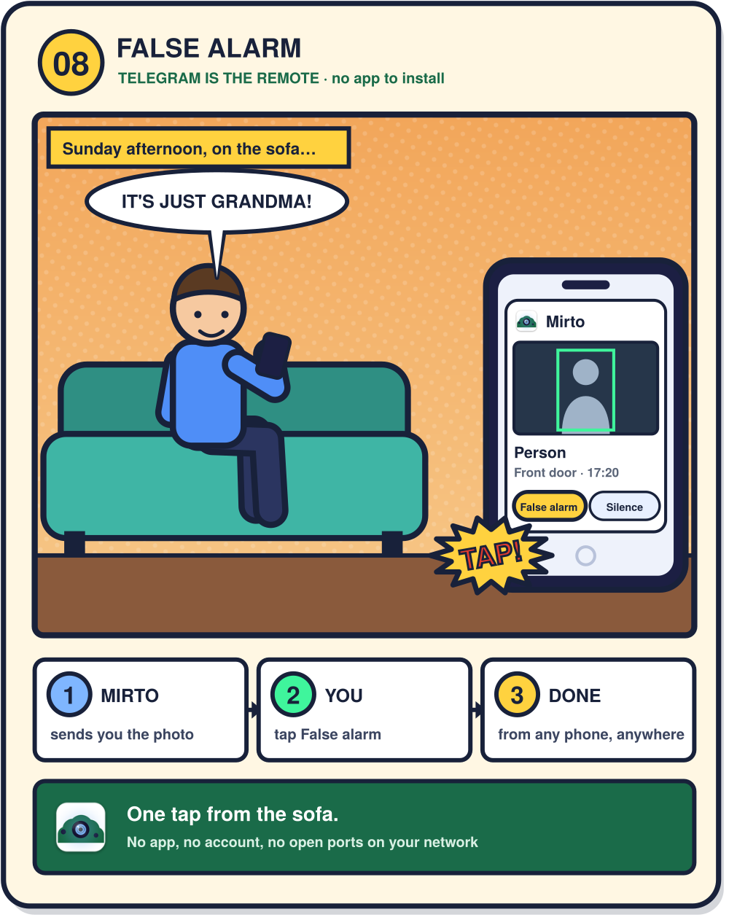
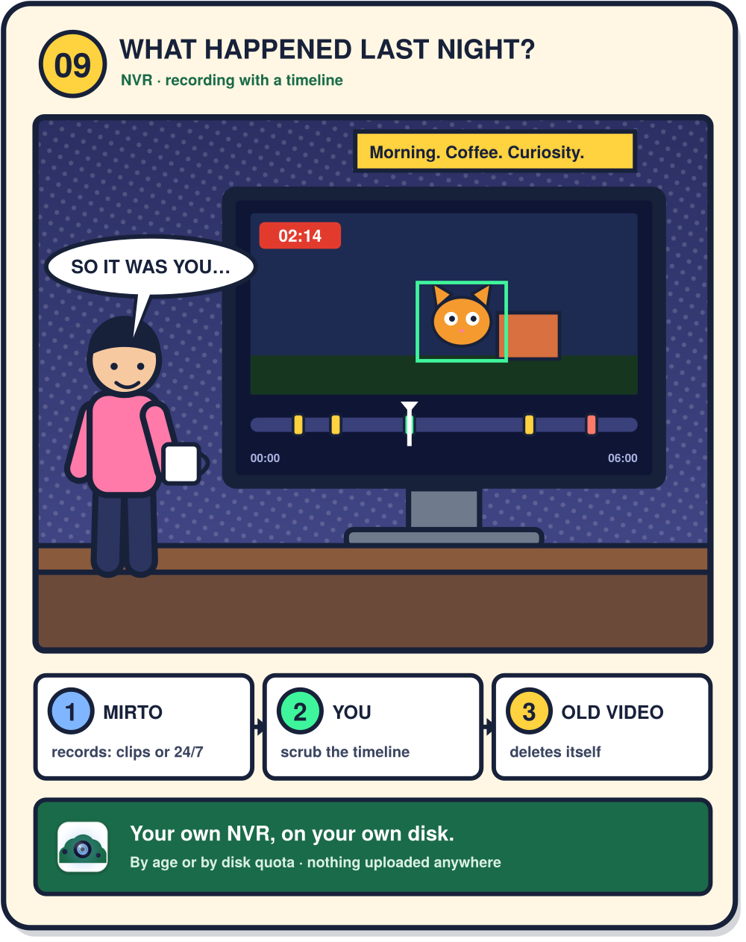
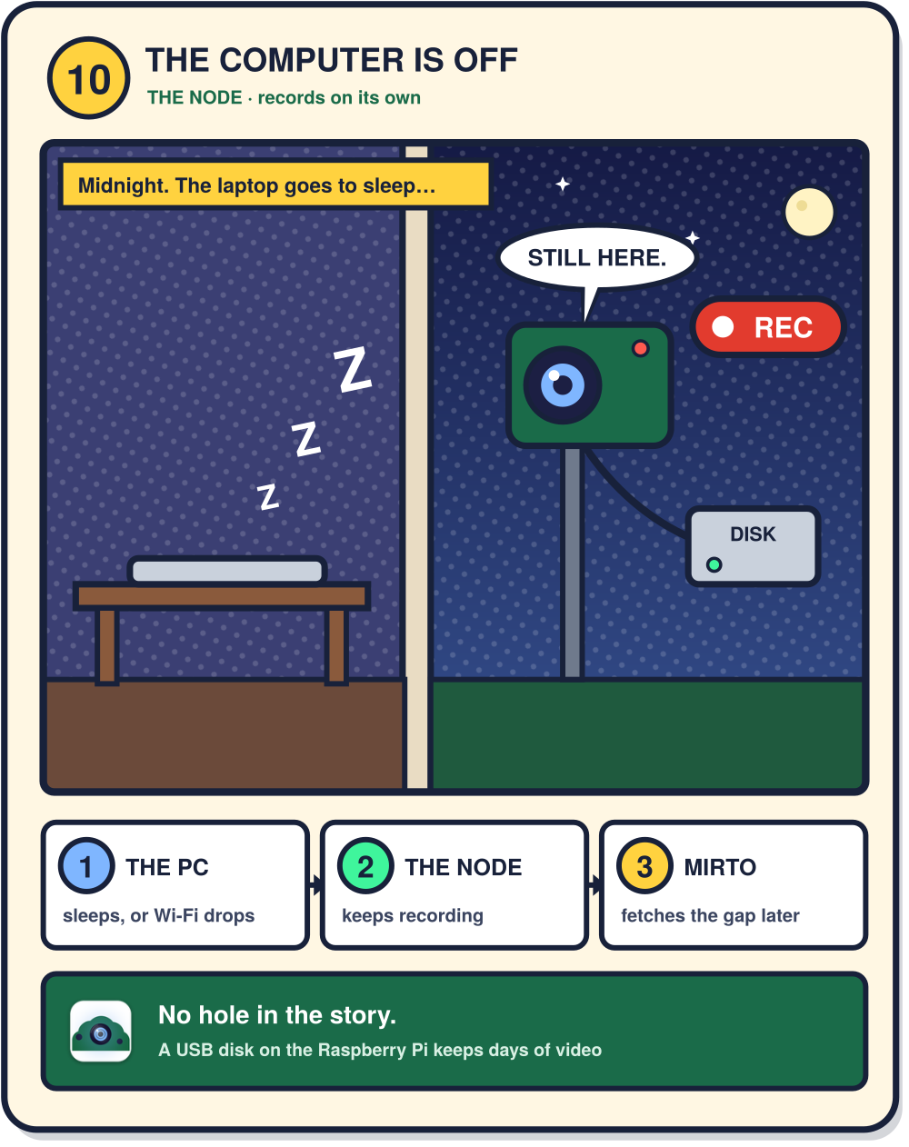
You stay in control
Telegram is the remote, the NVR is yours, the node keeps recording, and nothing leaves the perimeter.
Notes:
Telegram is the remote, the NVR is yours, the node keeps recording, and nothing leaves the perimeter.

Slide 9




The node: a camera, a siren and ears, outside
1
Write one image to a microSD
Mirto Node
Raspberry Pi · obeys only the computer it is paired with
Every copy makes its own identity the first time it boots.
2
Put it in a Raspberry Pi
Camera
Speaker
Power it up near the gate, the garden, the garage.
normal or NoIR for the night
siren and animal deterrents
3
Pair it with a 6-digit PIN
USB microphone
USB disk
No terminal, no key to copy. About ten minutes in all.
listens for sounds outside
records even if the PC is off
Notes:
The node is what nobody else hands you ready-made. The service runs unprivileged and enforces its own safety limits.

Slide 10


A real NVR, and detection that runs at home
Record
Review
Recognise
Clips around each event: 10 s before, 20 s after
Or continuous, 24/7
Old footage deletes itself by age or disk quota
A timeline to scrub through
Events marked where they happened
Clips to Telegram on request
A person, or 80 other things: a car, a dog, a bird
Sounds: glass, smoke alarm, siren, barking
On the Mac's Neural Engine or the Windows GPU
Notes:
Recording, review and recognition. All three happen on the owner's machines.

Slide 11


Security by design, not by promise
Signed and pinned
Keychain, not files
Limits enforced twice
Every request to a node is signed (HMAC-SHA256) with replay protection, over TLS with a pinned certificate.
Bot token, camera passwords and node keys live in the system keychain or Credential Manager. Never in a file.
Siren: 3 minutes at most, 3 in any 30. Written in the app and again in the node, which does not trust the app.
No open ports on your network: Telegram is reached outbound, by long polling.
Notes:
Three pillars. The safety limits are the part to dwell on: the node refuses an unsafe request even if the app asks.

Slide 12
How it compares
 | Mirto | Frigate | Fregata | SecuritySpy | Blue Iris | Scrypted
What it is | desktop app | Docker container | macOS port of Frigate | Mac NVR | Windows NVR | self-hosted hub
Runs on | macOS, Windows | Linux, Docker | Apple Silicon only | Mac only | Windows only | Docker
Price | free, no paid tier | free; Frigate+ $50/yr | $10 once | £35.90 to £739 | $39.95 to $99.95 | paid NVR plan
Open source | all of it | yes | core yes, port no | no | no | core only
Sirens and lights | built in, with a node | through MQTT | no | no | through plugins | through the hub
Ready-made outdoor node | yes | no | no | no | no | no
Faces, plates | no, by choice | yes | via Frigate+ | faces | plugins | plugins
Where they win: deeper detection, Home Assistant integration, phone apps, more cameras on one machine.
Prices and claims from each vendor's own pages, checked between 18 October and 9 November 2026.
Notes:
An honest table: several of these are better NVRs. What only Mirto has is the ready-made node and the outputs built in, on both macOS and Windows, fully open source.

Slide 13

Open source, and where it is going
Now
Next
Never
Apache 2.0
First release, 0.2.0
Downloads for macOS and Windows, not signed yet
Windows tested on a real PC
Signed downloads: the first thing funding buys
Home Assistant and MQTT
Windows parity
More cameras, more languages
Video in a cloud
A closed Pro version
Faces or licence plates
No paid tier, no open-core
No cloud to sell you
No CLA: signed-off commits
Funded by sponsors, not by your data
Notes:
The licence and the roadmap, including what will never be built. The roadmap has no dates on purpose: one maintainer should not promise them.

Slide 14


Next steps: what the others have, open source
Direction
On the roadmap
MQTT devices
Home Assistant
Try it. Read it. Break it.
Plugs, relays and sensors that speak MQTT, driven from Mirto without a cloud in the middle.
Events and armed state published locally, so Mirto fits the setups people already have.
github.com/marcopogo81/mirto
Download, source, guide and roadmap
Notes:
MQTT device control is a direction, not something that exists today: say so. Home Assistant and MQTT events are on the public roadmap. Close on the repository.

