Slide 1
Spiking Neural Networks
A Rust crate
Davide Miola, S296526
Samuele Pino, S303332
Marco Pratticò, S294815

Slide 2
Issues
What is a neural network anyway?
Creating a NN
Generalizing the model
LIF!
Feeding the beast (i.e. Spikes)
Simulating the network
Ensuring correctness (i.e. testing)
How to go faster
async
simd

Slide 3
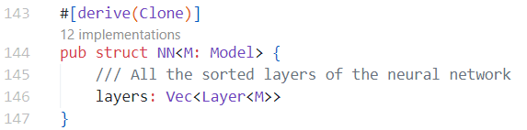
What is a neural network anyway?
Well, it’s just a bunch of (ordered) layers!
src/nn/mod.rs, 144

Slide 4
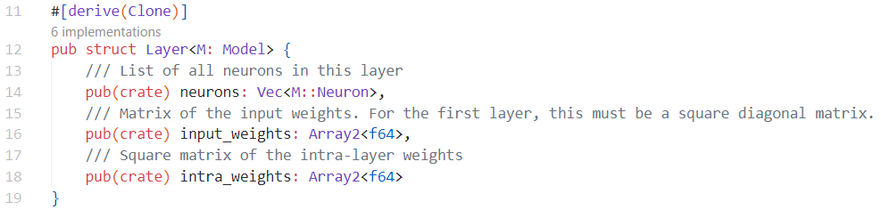
What is a neural network anyway?
src/nn/layer.rs, 12
These Vecs’ dimensions must be tightly validated inside each Layer and across consecutive Layers!
How do we ensure correct NNs? → Enter the NNBuilder

Slide 5
Creating a NN
Problems:
Inside a NN, the number of neurons in each layer and the dimensions of the weight matrices are closely correlated
Trusting the user to provide a correct network is a bad idea
Solution:
Implement the builder pattern
Leverage Rust’s powerful type system to perform static, compile-time checks on the sizes of the layers whenever possible

Slide 6
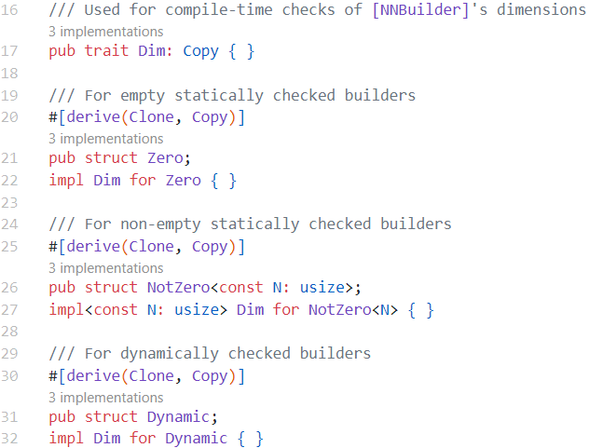
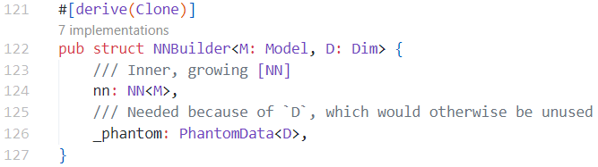
Creating a NN: the NNBuilder
src/nn/builder.rs, 17,122

Slide 7
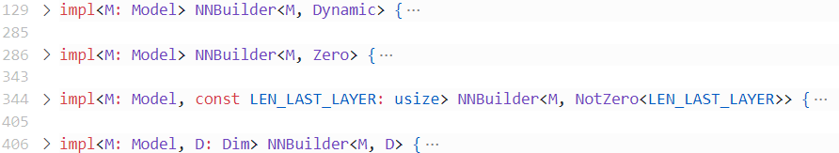
Creating a NN: the NNBuilder
src/nn/builder.rs, 129
Generic type D allows us to provide different implementations for different variants of the builder
→ method layer is reimplemented for each of them

Slide 8
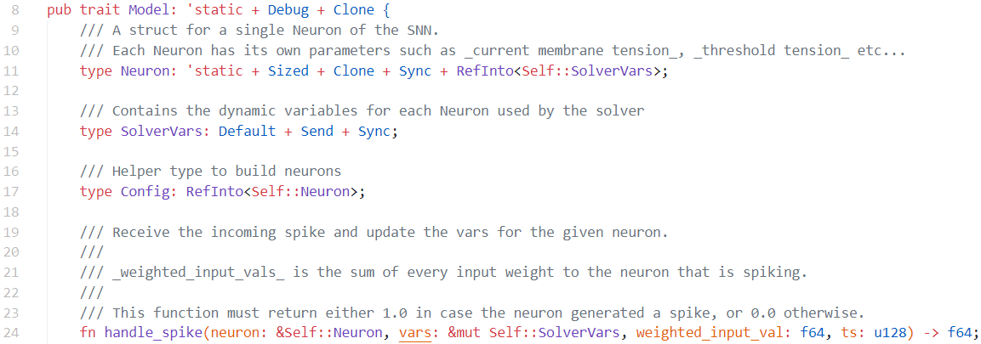
Generalizing the model
We want to make the library as general as possible.
Make the NN depend on a generic type that implements the Model trait:
src/nn/model/mod.rs, 8

Slide 9
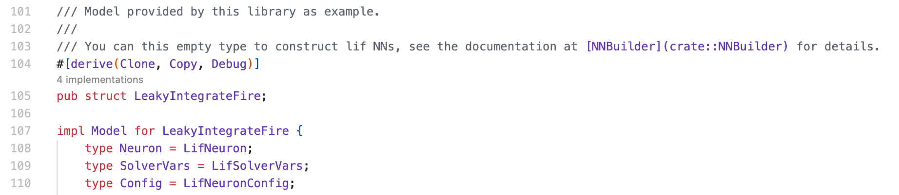
LIF (Leaky Integrate Fire)
The Model trait is implemented for the LeakyIntegratedFire struct, in which the types Neuron, SolverVars, and Config are associated respectively to LifNeuron, and LifSolverVars, LifNeuronConfig.
src/nn/model/lif.rs, 101

Slide 10
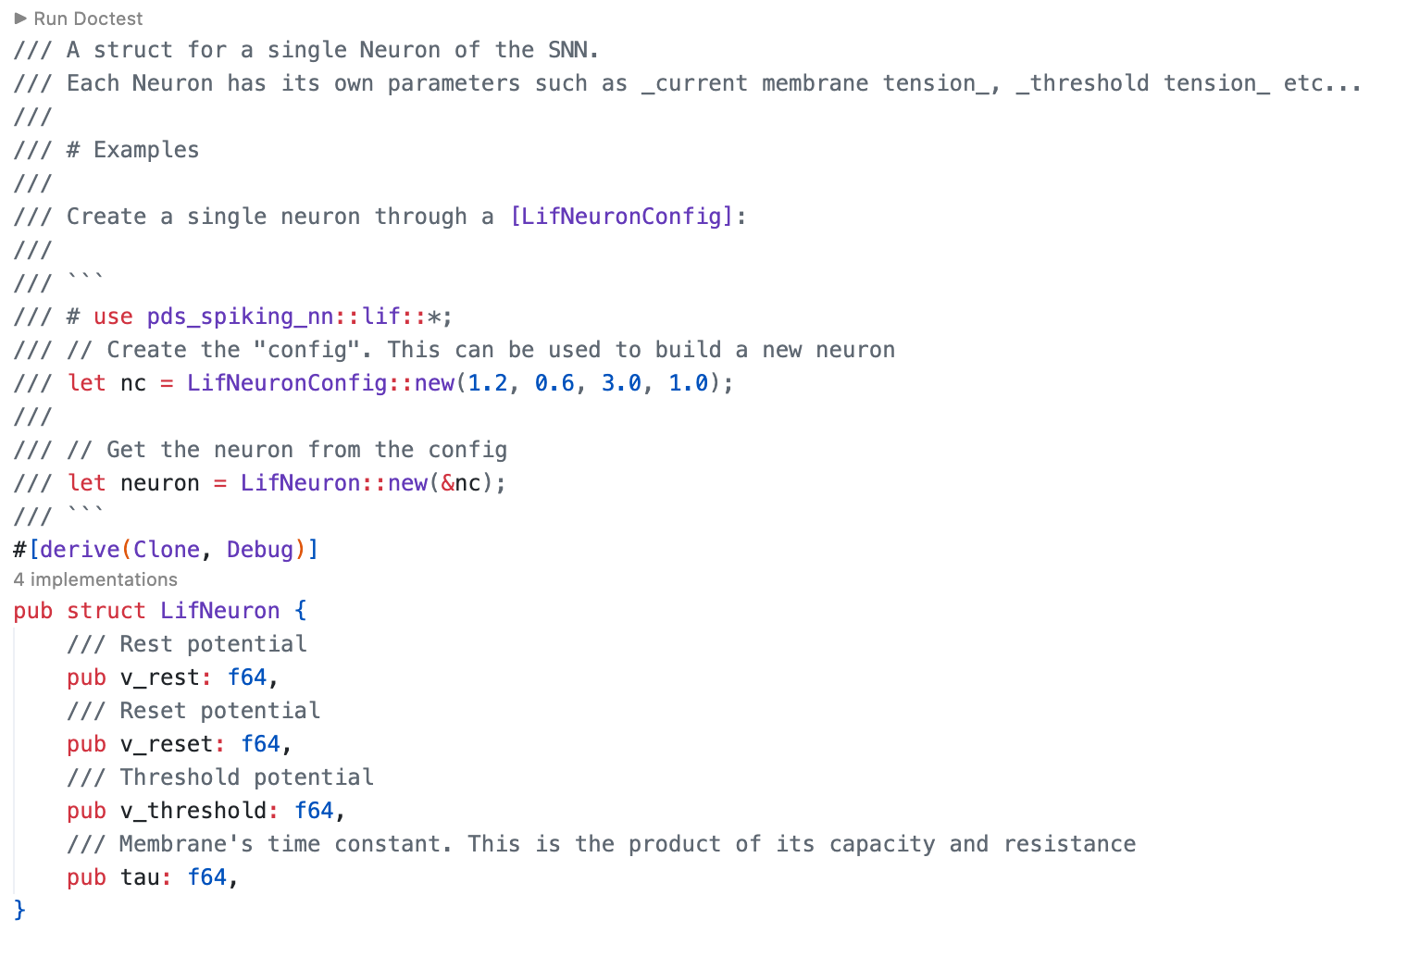
LIF: the LifNeuron struct
The LifNeuron struct contains the fixed parameters of a single neuron, such as the rest potential, the reset potential, the threshold potential, and the membrane’s time constant.
src/nn/model/lif.rs, 5

Slide 11
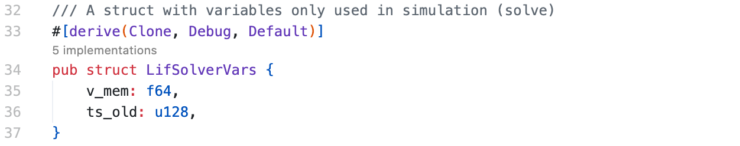
LIF: the LifSolverVars struct
src/nn/model/lif.rs, 32
The LifSolverVars struct contains a single neuron’s variable parameters, which change when a spike is received from the neuron. In this case, the struct contains the Membrane potential and the old timestamp.
This struct is only used in simulation, and its variables are updated when the network is solved.

Slide 12
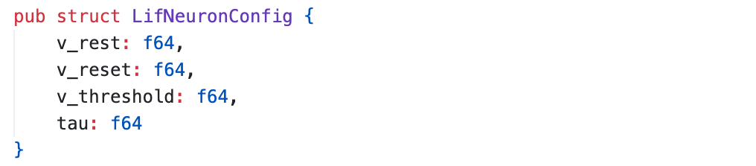
LIF: the LifNeuronConfig struct
src/nn/model/lif.rs, 72
The LifNeuronConfig is a struct used to create a specific configuration, reusable for other neurons.

Slide 13
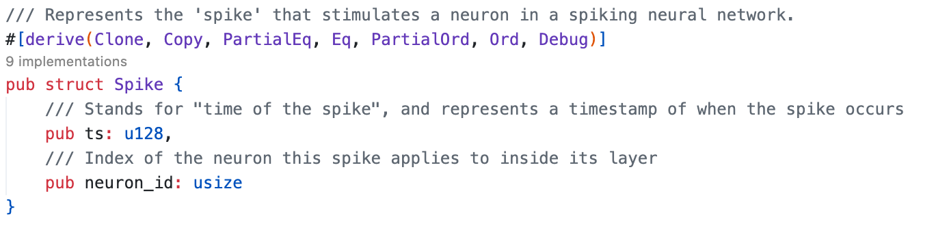
Feeding the beast
(i. e. Spikes)
We decided to create a struct to represent the Spikes. The Spike struct contains two parameters: one represents the timestamp of when the spike occurs, and the other represents the neuron id, which indicates the specific neuron in which the spike is applied.
src/nn/model/lif.rs, 5

Slide 14
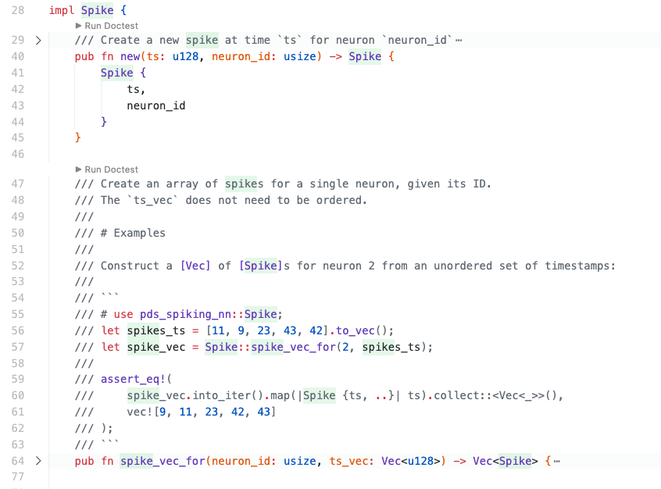
Feeding the beast: Spike Methods
The Spike struct has several useful methods, used during the simulation to pre-process the input spikes.
The spike_vec_for method creates an array of Spikes for a single neuron, given its ID.
src/nn/mod.rs, 28

Slide 15
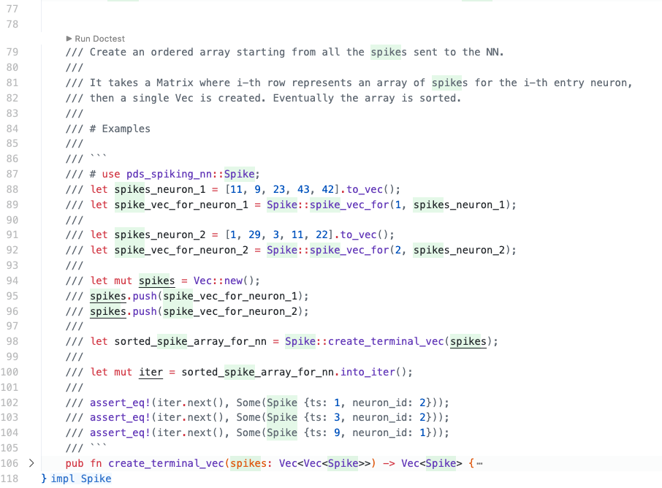
Feeding the beast: Spike Methods
The create_terminal_vec method creates an array of Spike given all the spikes sent to the NN, sorted by the Spike timestamp.
src/nn/mod.rs, 77

Slide 16
Simulating the network
Apparently a simple problem, but…
…concurrency!
→ two plausible approaches
per-neuron parallelism
per-layer parallelism

Slide 17
Simulating the network: per-neuron parallelism
Q: how do we ensure the correct order of spikes at neuron input?
A: tight synchronization across neurons of the same layer
Barrier-like approach
mpsc channels to link consecutive layers
UnsafeCell to share data across neurons
Lots of unsafe code
Spike handling in lockstep throughout the neurons of a given layer

Slide 18
Simulating the network: per-neuron parallelism
Results:
Functionally correct, but
Extremely slow (20-40x slower than single-threaded test solver)
Implementation of per-neuron parallelism first relegated to cargo feature, then completely purged from source tree (commit f6810b0).

Slide 19
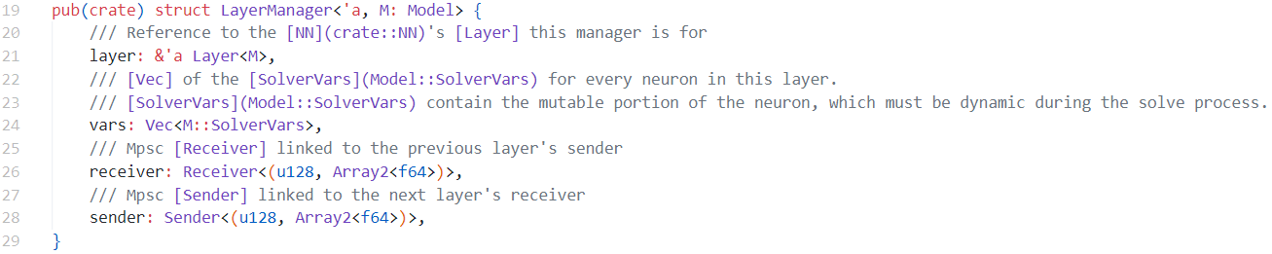
Simulating the network: per-layer parallelism
Approach:
One thread per layer
One LayerManager per thread
Sequential processing of neurons in each LayerManager
Much simpler compared to previous attempt
No unsafe
src/sync.rs, 19

Slide 20
Ensuring correctness
(i.e. testing)
How can we be sure our results are correct?
Manually solving networks is painful (and not feasible for larger NNs)
Solution: have two separate solvers, stimulate them equally, and compare the results
Also:
Extensive unit testing (src/nn/tests.rs)
Sample-based system testing (tests/tests.rs)
Extensive documentation w/ doc-tests

Slide 21
How to go faster
Multi-threaded solver already provides adequate performance, but we can go faster:
Two optional cargo features:
async
simd

Slide 22
How to go faster: async
Why: larger networks spawn many kernel threads → app becomes a scheduler stress test
How: swap kernel thread (std::thread::spawn) with tokio’s async tasks
Treat tasks as “green threads”, an async runtime can then allocate fewer kernel threads for them
Results: higher initialization overhead, but much better CPU utilization (fewer context switches)
~20%
faster

Slide 23
How to go faster: simd
Group neurons in batches of four
Implement the model for batches of neurons
Execute the handle_spike routine for one batch at a time via SIMD instructions
Roll back to the sequential approach for leftovers
~9-10%
faster (on AVX capable hardware with “target-cpu=native”)

