Slide 1
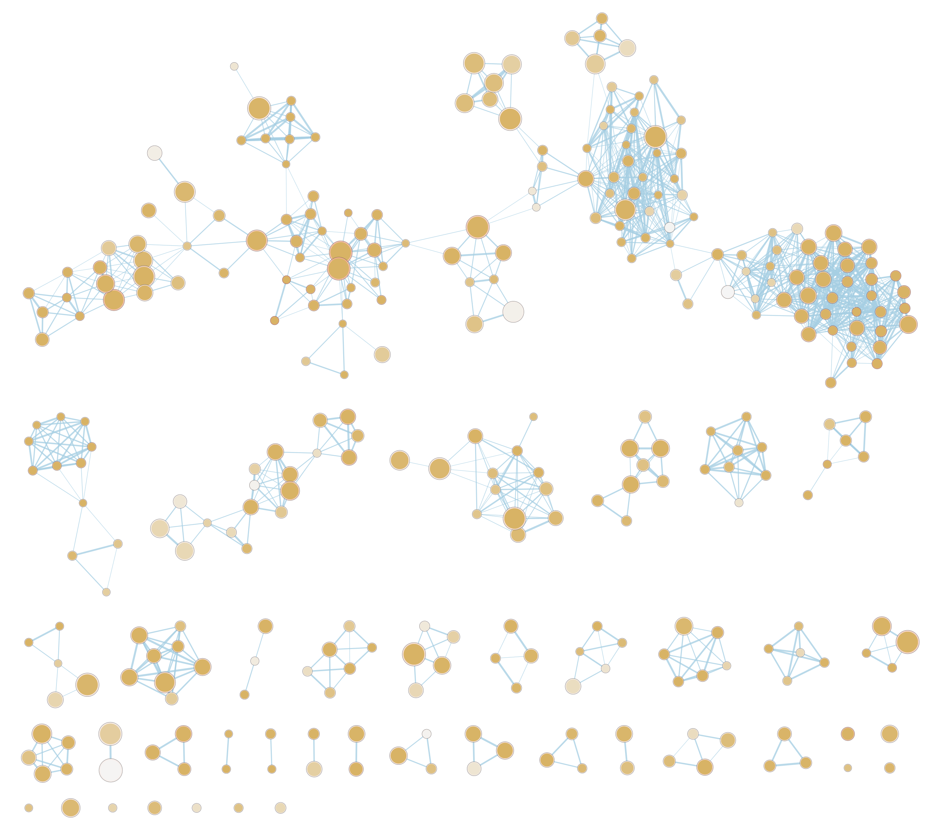
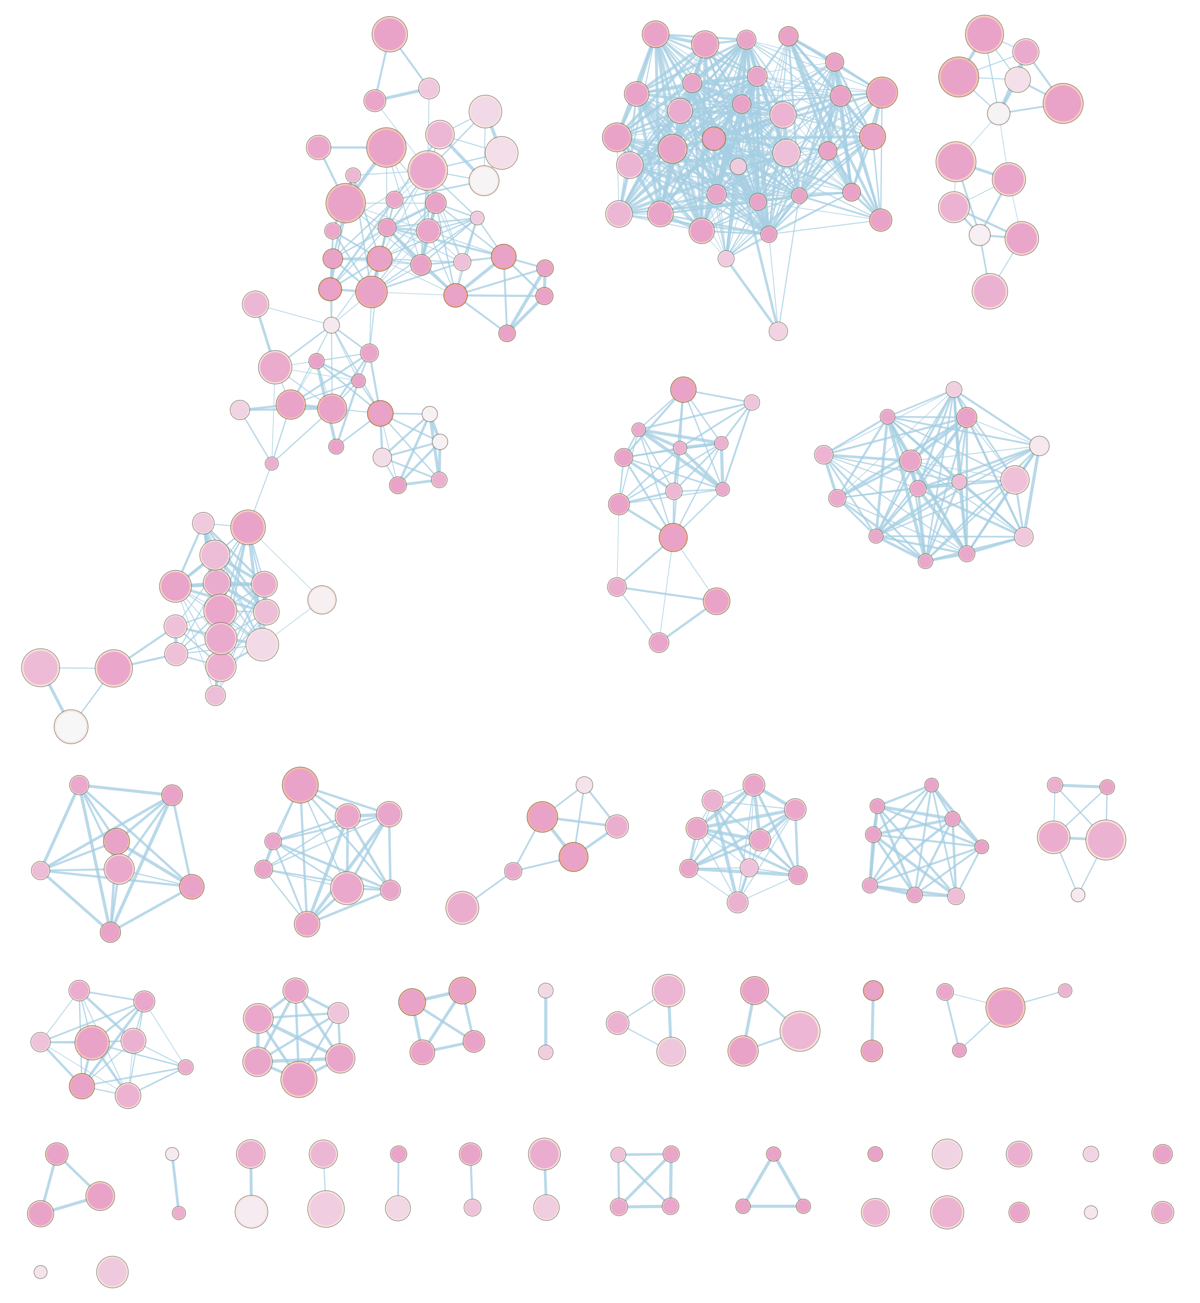
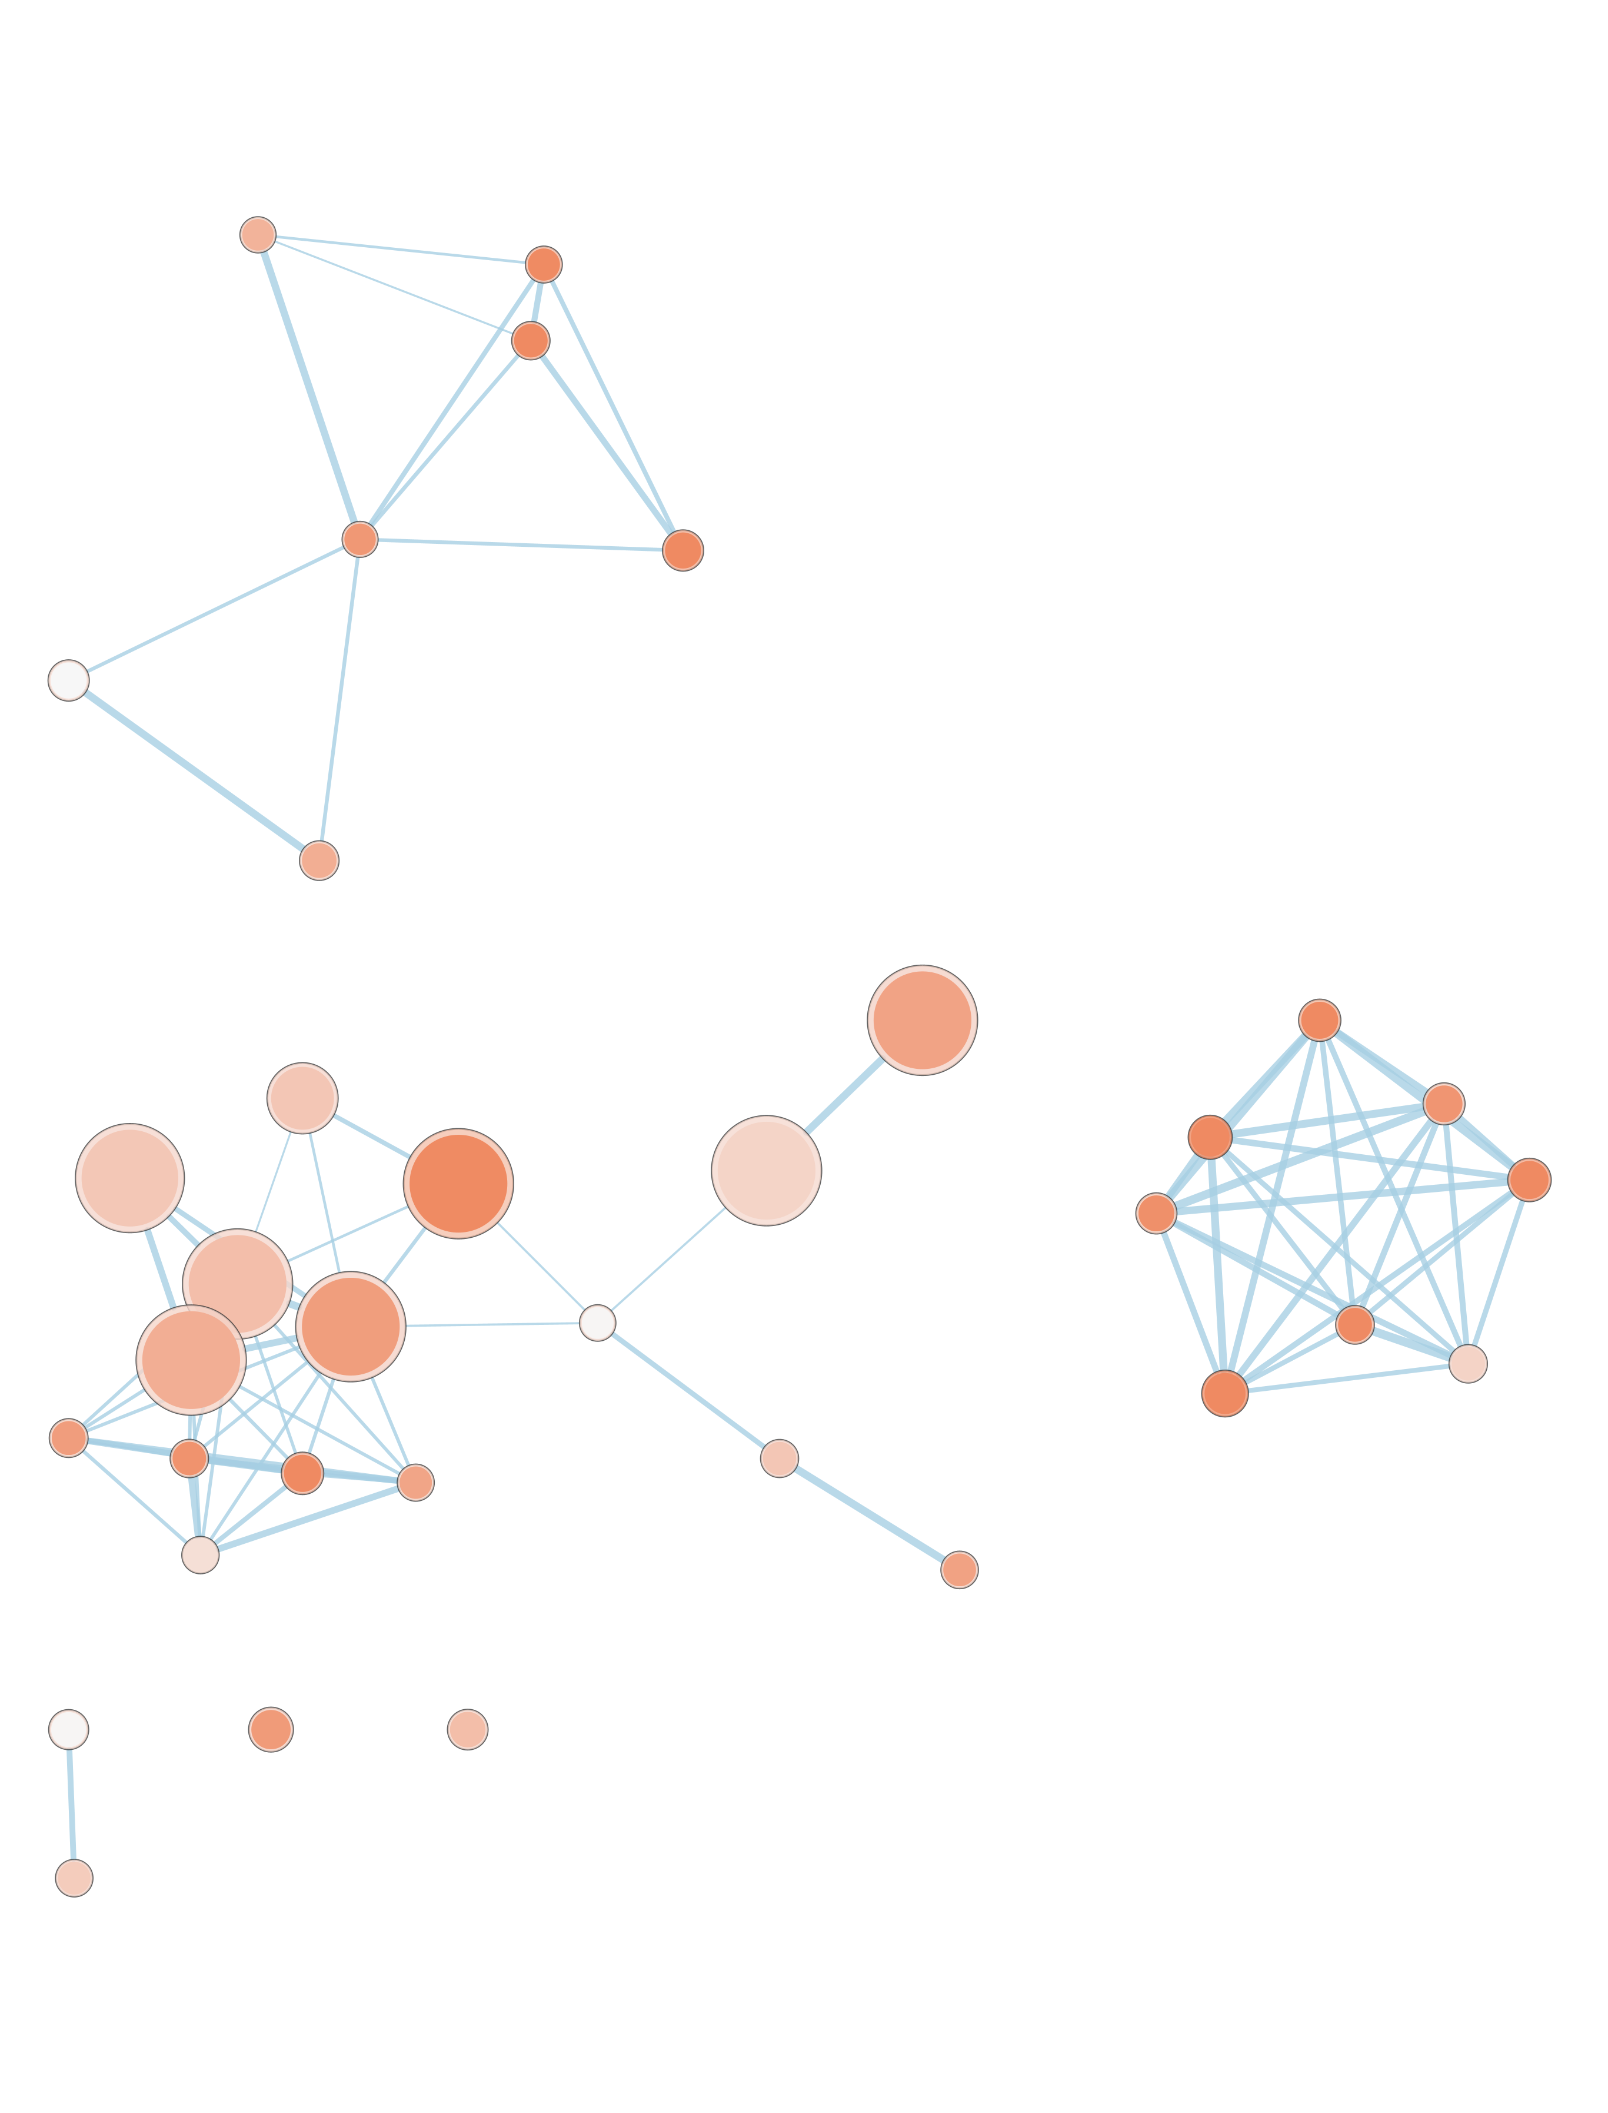
GVC
Agora
Open Targets
aerobic respiration
foam cell formation
cholesterol efflux
lipid transport
neurite development
efferocytosis
cholesterol efflux
Aβ clearance
synaptic transmission
synaptic transmission
aerobic respiration
immune response leukocyte adhesion
lipid transport
endocytosis
nuclear transport
amyloid fibril formation
APP processing
neurite development
immune response
kinase activity
GABAergic transmission
endopeptidase activity
immune response
response to Aβ
APP processing
miRNA transcription
wound healing
APP processing
cell migration
immune response
cell cycle
response to Aβ
lipid transport
cell migration
response to ROS
endocytosis
Notes:
Run Agora genetics and omics separate
Run another neurod disease and a non-neurod disease

