Slide 1
CAPSTONE PROJECT
OPENING A CLIMBING GYM IN LONDON

Slide 2
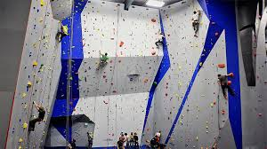
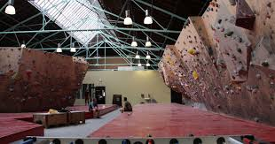
PROBLEM DESCRIPTION
Based on Foursquare data of existing climbing gyms in London, we want to know where to open a new gym
The borough of choice will lack a climbing gym and will have its five closest boroughs also lacking a gym

Slide 3
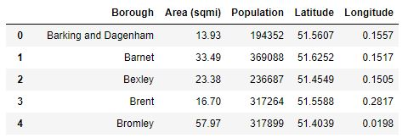
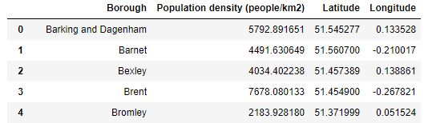
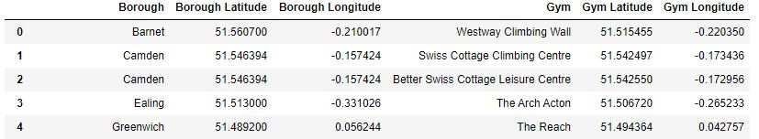
DATA
Geolocation data of the boroughs in London
From Wikipedia
https://en.wikipedia.org/wiki/List_of_London_boroughs
From Github:
https://github.com/naomiggg/the-best-borough-in-london/blob/master/boroughs.json
Geolocation data of the climbing gyms in London from Foursquare

Slide 4
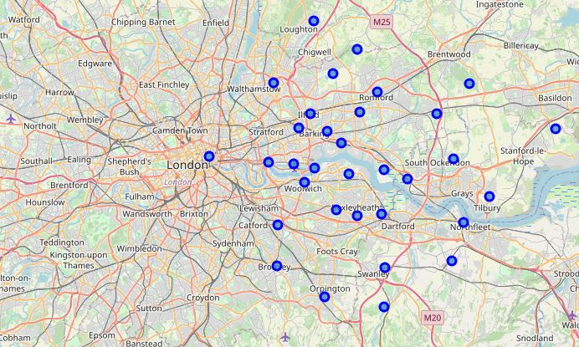
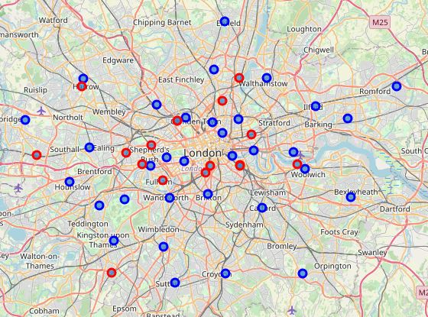
METHODOLOGY
The data was organised into dataframes and plotted on a Folium map
In blue, the boroughs; in red, the gyms
Left: Wikipedia data, right: Github data

Slide 5

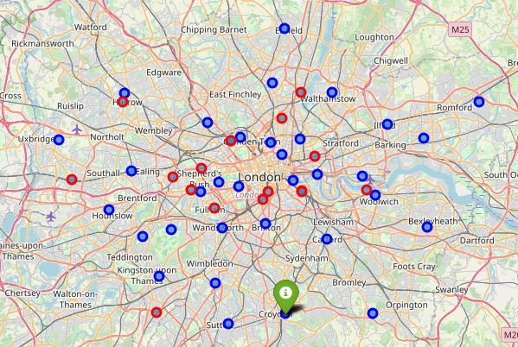
RESULTS
After filtering out the boroughs whose neighbours already have a climbing gym, we are left with the borough of Croydon

Slide 6
CONCLUSION
The data was scraped, imported into Python and analised with the help of Folium maps
Different datasets had to be used, highlighting the importance of working with reliable data
The results suggest that Croydon might be a reasonable choice for opening a new climbing gym

