Slide 1
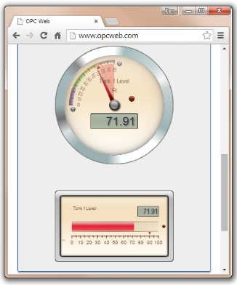



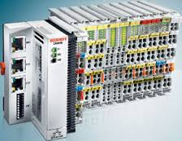

Web HMI
ADS.js
HTML
CSS
JAVASCRIPT
EMBER JS
TCP/IP
ADS
ADS* Router
Fabrico Aditivo
* Automation Device Specification

