Slide 1

BLOQUE 1. R

Slide 2
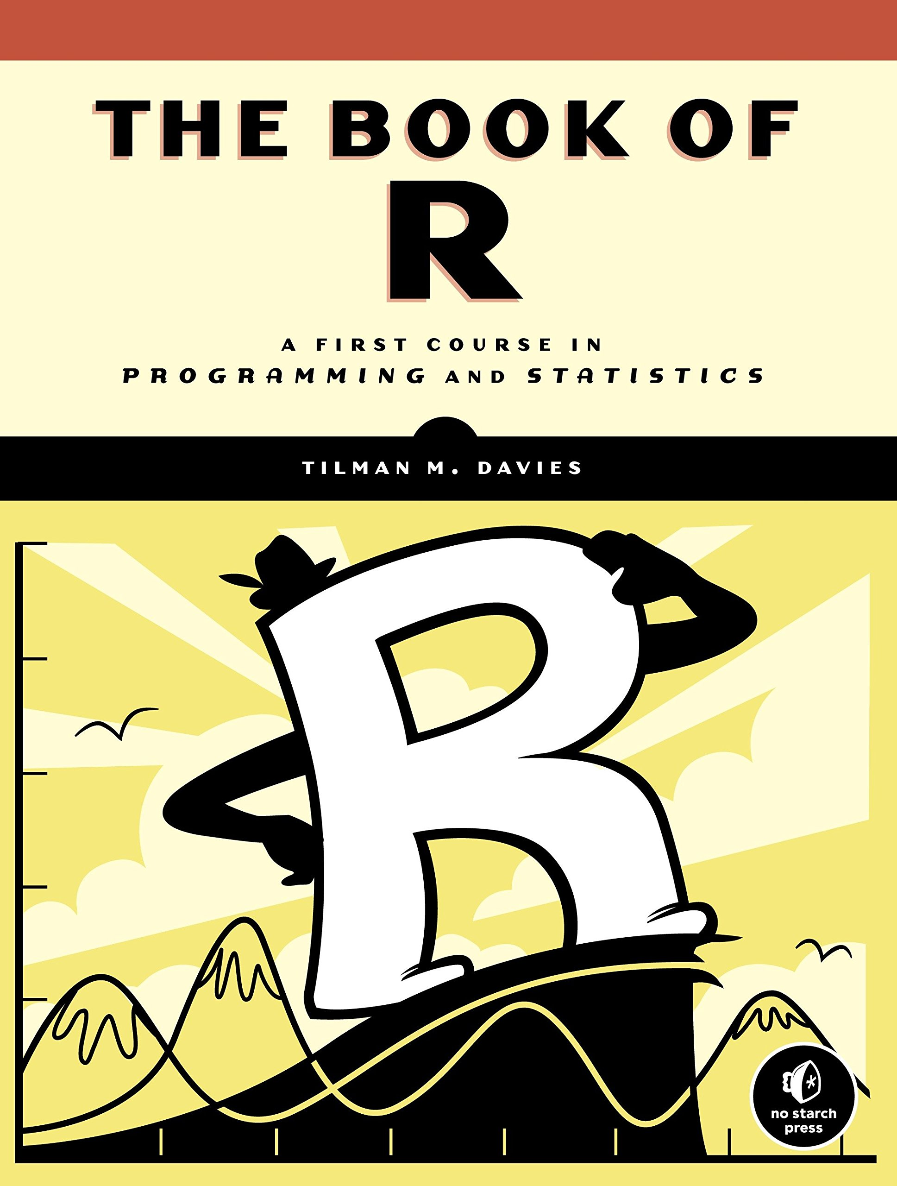
Bloque 1: R
Introduction to R and R-Studio
Types of data
Vectors
Matrices
Logical values
Characters
Factors
Data Frames
Special values
Data importing
Data cleaning
Basic plotting

Slide 3

R
- R es un lenguaje de programación diseñado para hacer análisis estadístico
- Creado en 1993 por Robert Gentleman y Ross Ihaka en la Universidad de Auckland

Slide 4
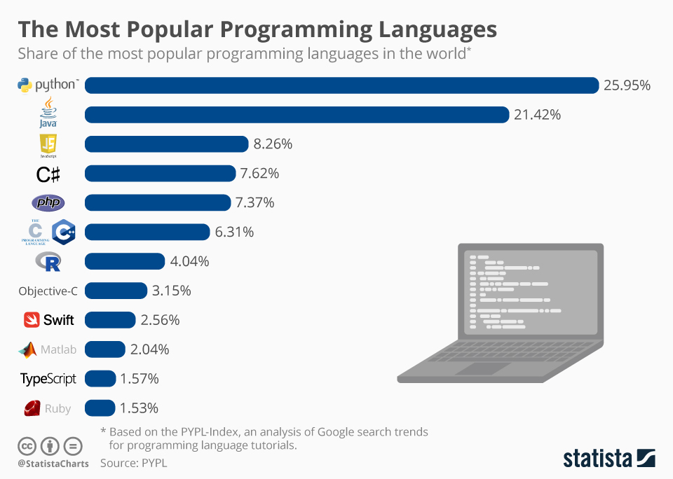

Slide 5
Why R?
It’s open-source. No fees or licenses are needed, so it’s a low-risk venture if you’re developing
a new program.
It’s platform-independent. R runs on all operating systems, so developers only need to
create one program that can work on competing systems.
It has lots of packages. For example, the R language has more than 10,000 packages stored in the
CRAN repository, and the number is continuously increasing.
It’s great for statistics. Statistics are a big thing today, and R shines in this regard. As a result,
programmers prefer it over other languages for statistical tool development.

Slide 6
What are R’s weaknesses?
It’s a complicated language. R has a steep learning curve. It’s a language best suited for people
who have previous programming experience.
It’s not as secure. R doesn’t have basic security measures. Consequently, it’s not a good choice for
making web-safe applications. Also, R can’t be embedded in web browsers.
It’s slow. R is slower than other programming languages like Python or MATLAB.
It takes up a lot of memory. Memory management isn’t one of R’s strong points. R’s data must be stored
in physical memory. However, the increasing use of cloud-based memory may eventually make
this drawback moot.
It doesn’t have consistent documentation/package quality. Docs and packages can be patchy
and inconsistent, or incomplete. That’s the price you pay for a language that doesn’t have
official, dedicated support and instead is maintained and added to by the community.

Slide 7

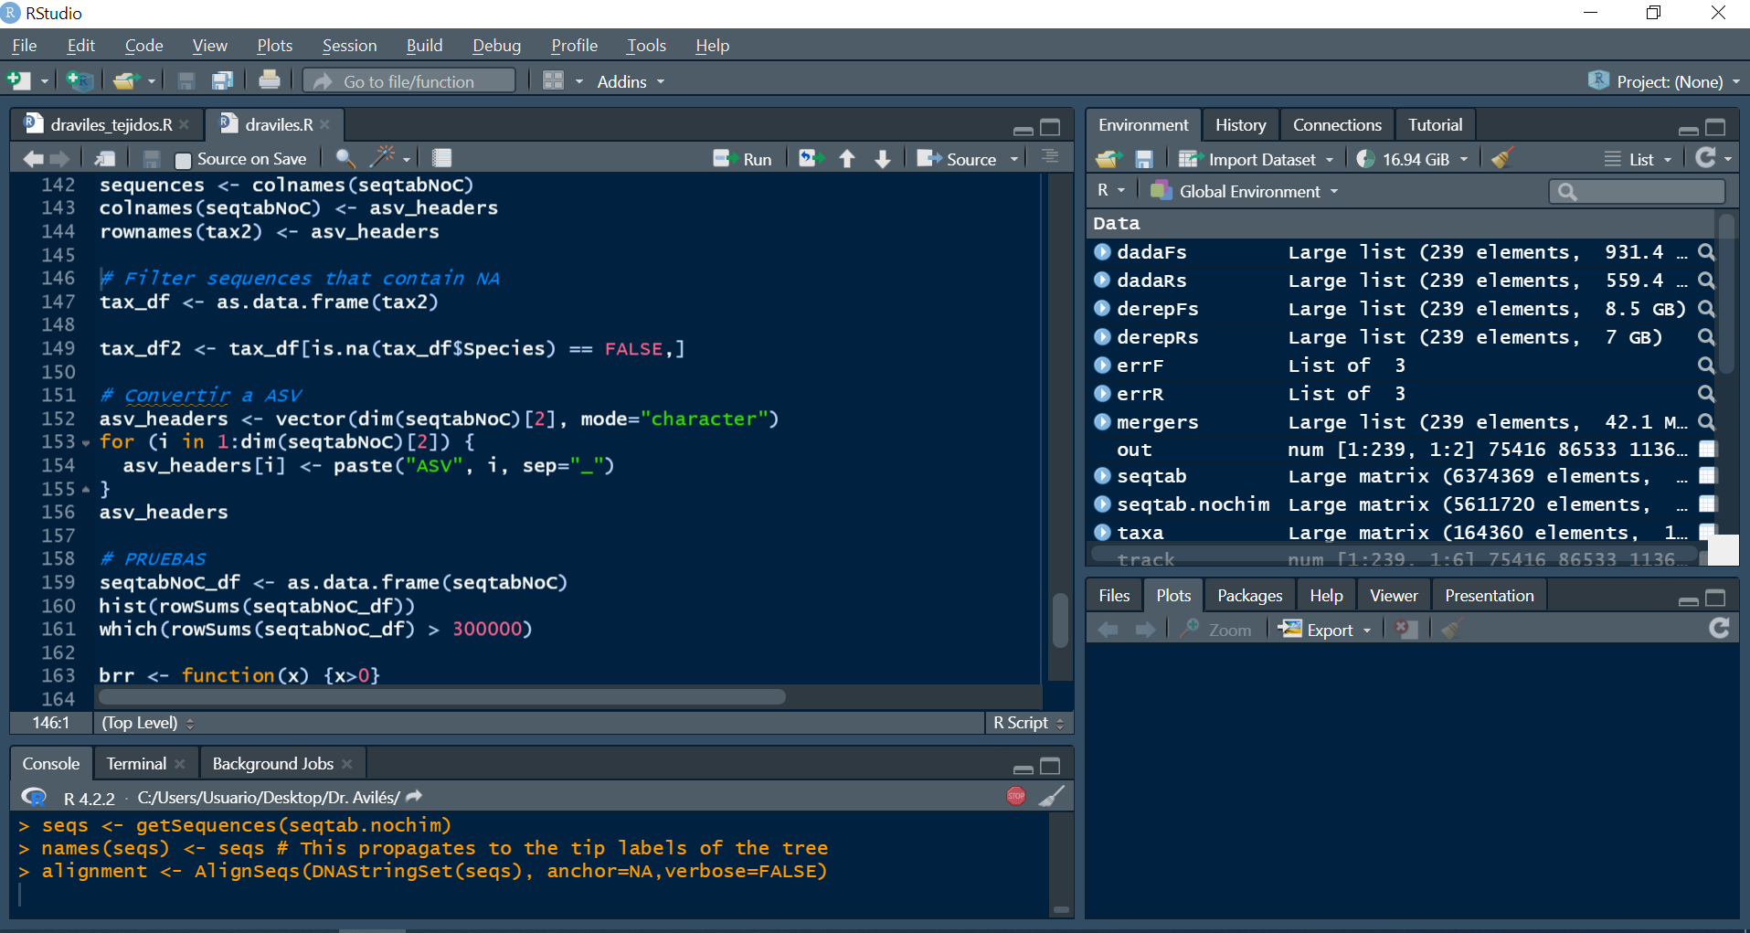
R-Studio
Entorno de desarrollo integrado (IDE) creado para trabajar con R.

Slide 8

Setting the working directory
getwd() gets us the location of the current working directory
setwd(“directory”) sets the location of the working directory

Slide 9
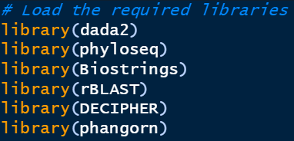
Installing and loading R packages
R comes with many packages that load every session. But we will be usually installing and loading many packages.
install.packages(“package_name”) installs the specifed package
library(“package_name”) loads the specified package

Slide 10

Bioconductor
The mission of the Bioconductor project is to develop, support, and disseminate free open source software that facilitates rigorous and reproducible analysis of data from current and emerging biological assays.

Slide 11
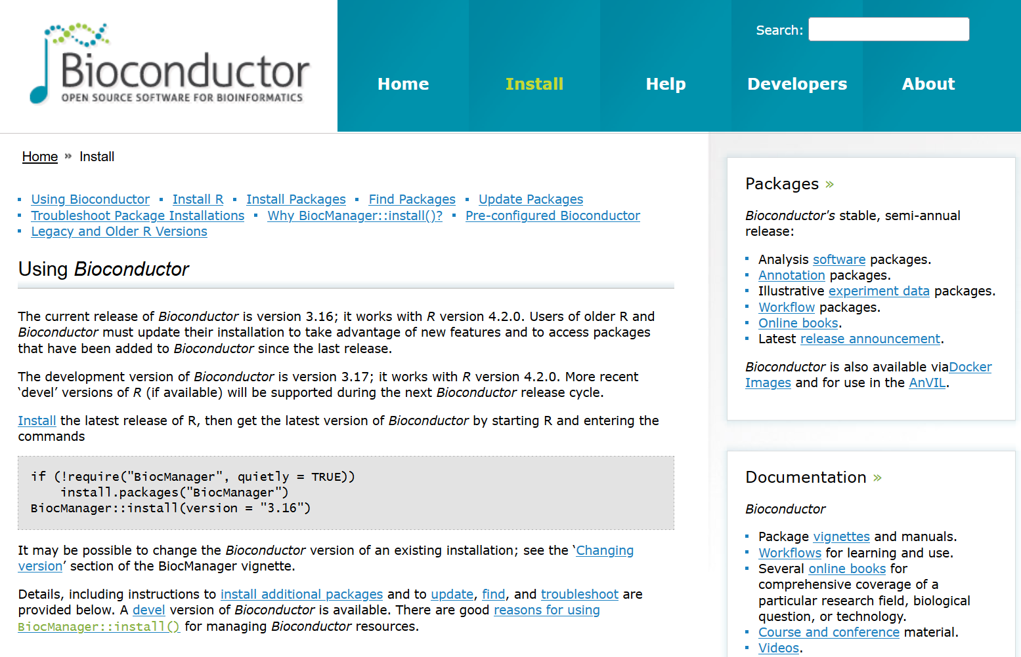

Slide 12
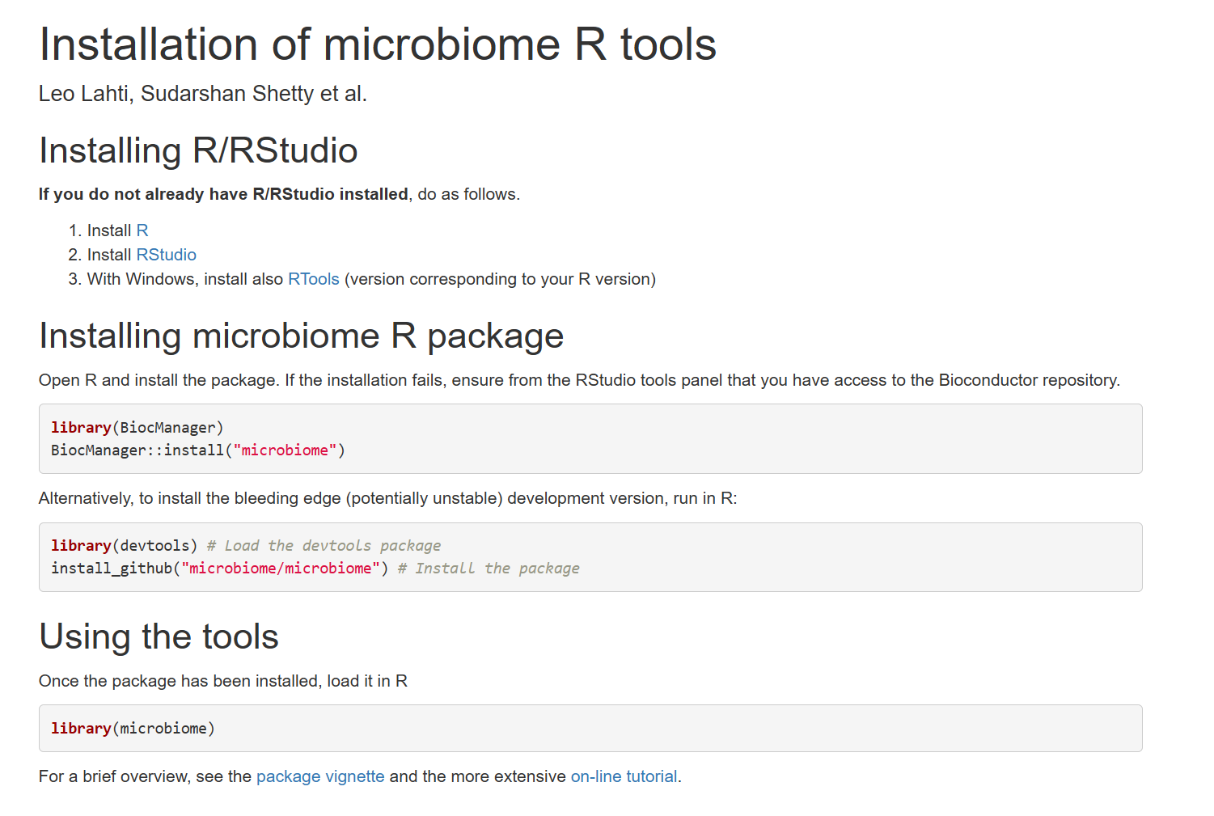

Slide 13

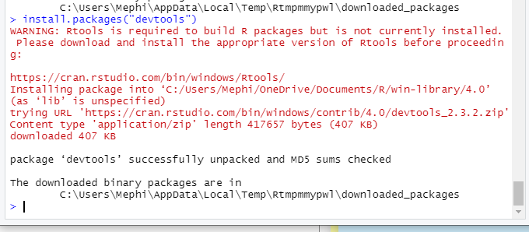
Updating packages
Most R packages are continously being developed as we speak.
update.packages() simply updates every installed package

Slide 14
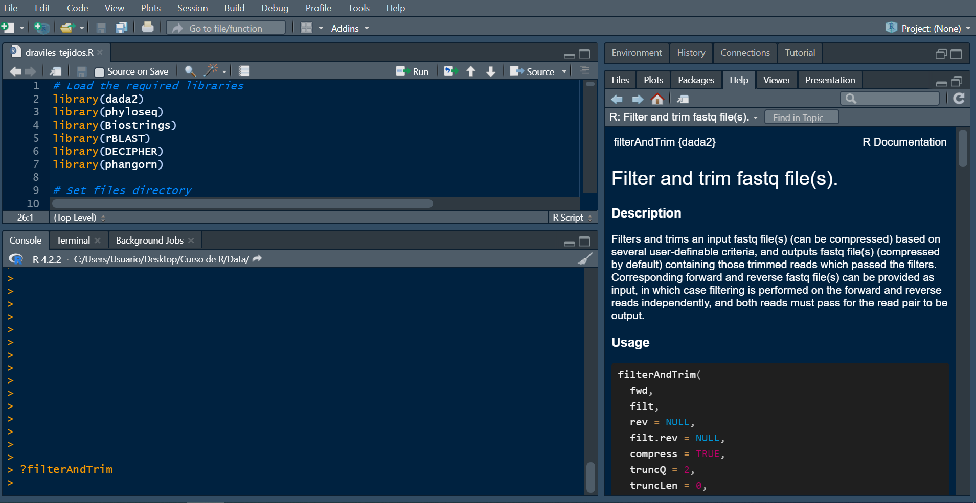
Help files and Function Documentation

Slide 15
Saving work and exiting R
File -> save will save your script
CTRL + S will do the same thing
save(file = “filename.RData”) saves the current workspace
load(“path_to_file”) loads the specified workspace

Slide 16
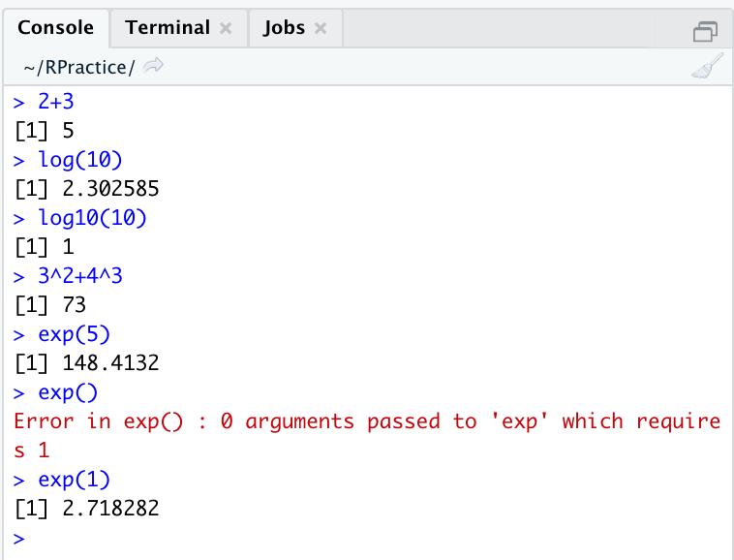
R as a calculator
We can perform any operations in R!

Slide 17

Vectors
The vector is the essential building block for handling multiple items in R. In a numeric sense, you can think of a vector as a collection of observations or measurements concerning a single variable, for example, the heights of 50 people or the number of coffees you drink daily.
c() is the function for creating a vector
A vector can contain numbers or characters, but not both!

Slide 18

Sequences, repetition, sorting, length
Another easy way to create a numeric vector:

Slide 19
Sequences, repetition, sorting, length
There are a lot of functions that help us create more complex vectors:
seq(from = X, to = Y, by = Z)
Creates a sequence from X, to Y, by Z steps.
rep(x = number/vector/character, times = X, each = X)
Repeats a number/vector/carácter X times, each Y.

Slide 20
Sequences, repetition, sorting, length
There are a lot of functions that can be applied to a vector:
length(myvector) calculates the number of elements
is.vector(myvector) checks if the object is a vector
as.vector(myvector) coerces the object into a vector
any(mycondition) checks if there is any element satisfying the condition
all(mycondition) checks if all the elements satisfy the condition
sort(myvector, sort = TRUE / FALSE) sorts the vector
lapply(myvector, FUNCTION) applies a function to each element

Slide 21
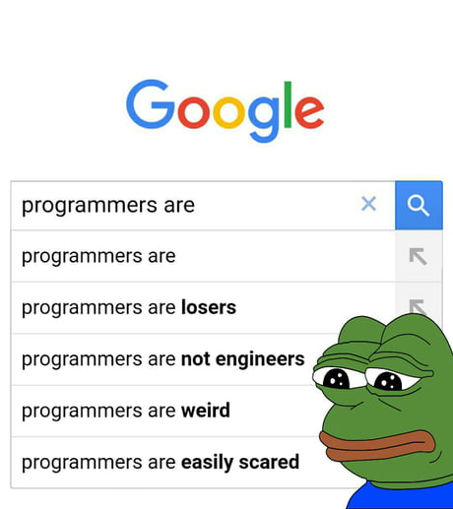
Vector operations
We can perform any arithmetic operations with and between vectors, as long as they have the same length!

Slide 22
Types of data in R
There are 6 types of data in R: logical, numeric, integer, complex, character.
Logical: it can only have two values: TRUE and FALSE
Numeric: represents all real numbers with or without decimal values
Integer: specifies real values without decimal values. Suffix L.
Complex: for working with imaginary values. Suffix i.
Character: for representin a character o a string of characters. Double quoutes.

Slide 23
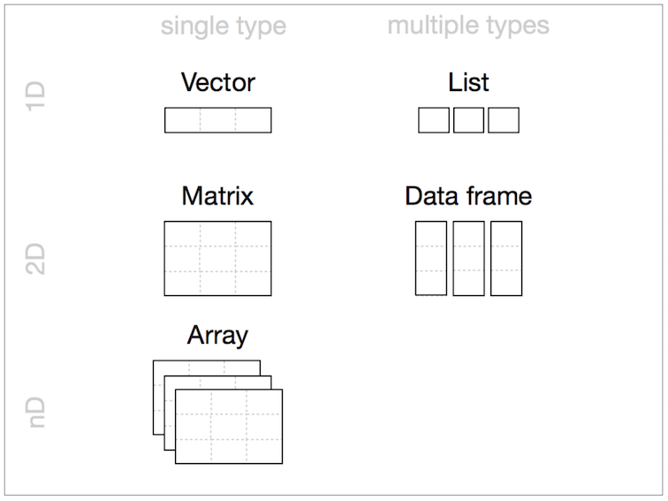
Matrices and arrays

Slide 24
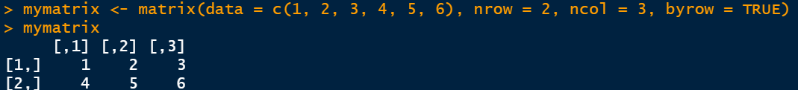
Matrices and arrays
A matrix is simply several vectors stored together. Usually, we describe a matrix A as an m x n matrix (m rows and n columns)
matrix(data, nrow = number, ncol = number, byrow = TRUE / FALSE)

Slide 25
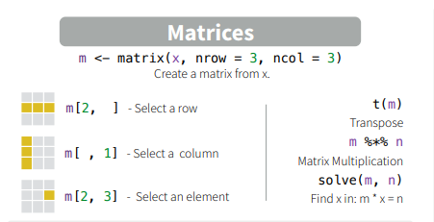

Slide 26
Matrices and arrays
There are a lot of functions that can be applied to a matrix:
dim(matrix) dimensions of a matrix
nrow(matrix) number of rows
ncol(matrix) number of columns
dimnames(matrix) allows to set the names for rows and columns
sum(matrix) sum all elements from the matrix
colSums(matrix) sum all elements from all columns
rowSums(matrix) sum all elements from all rows

Slide 27

Logical values and relational operators
Logical values in R are just TRUE and FALSE, which can be abbreviated by T and F.
Relational operators are:
    == Equal to
    != Not equal to
    ! Negation
    > Greater than
    < Less than
    >= Greater than or equal to
    <= Less than or equal to
    & AND
    | OR
    %in% IN

Slide 28
Characters
Character strings are a common data type, and are used to represent text. You can create a string just using quotes. Some useful functions are:
as.character(string/vector) coerces into character
length(string) calculates the number of characters in a given string
toupper(string/vector) coerces all characters to upper
tolower(string/vector) coerces all characters to lower
paste(string/vector, NUMER/string) pastes to a string/vector a number or a string
cat(string/vector, sep = separator) concatenates strings and/or numbers

Slide 29
Factors
Factors represent datapoints that fit in one of a finite number of distinct categories, and are really useful in data science.
factor(vector, levels = vector, labels = vector) creates a vector with factor levels
is.factor(vector) checks if a vector has factors
as.factor(vector) coerces a character vector into factors
levels(vector) shows the factor’s levels
nlevels(vector) shows the number of levels of a factor

Slide 30
Data Frames
Data frames are probably the most natural way of presenting data in R. They are made of vectors, which have to be of equal length. Data frames have no restrictions on the data types of the variables.
data.frame(vector1, vector2, .... , vectorN) creates a data frame
We can create a data frame like this but we will usually just import data in this format from different sources: excel, SPS, fastaq, etc.

Slide 31

Data Frames
Some useful functions you can apply to a data frame are:
nrow(df)
ncol(df)
rownames(df)
colnames(df)
str(df)
summary(df)
But the most interesting thing it’s going to be the $ sign!!

Slide 32
The dollar sign $
The dollar sign $ in R Programming is an operator that is used to access, add, update, and delete elements from a named list or a complex R object, and it is also used to access, add, update, and delete columns from a dataframe.
dataframe$column_name (if that column exists) will print the values of that column
dataframe$column_name <- vector_of_same_length (if that column doesn’t exists) will create it.

Slide 33
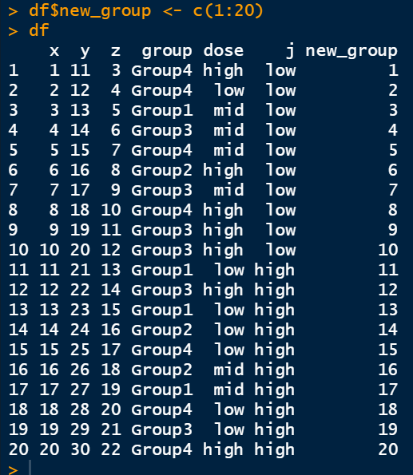

Slide 34
Subsetting a dataframe
There are many ways to manipulate dataframes and select columns or rows by value or by name.
R base
dataframe[filas, columnas]
Dplyr
dataframe %>%
dplyr_verb(condition)

Slide 35
Subsetting a dataframe with R base
R base
dataframe[condition, ] take those rows that satisfy the condition
dataframe[, condition] take those columns that satisfy the condition
R is not so smart, so we have to specify the columns with a $ sign!
dataframe[dataframe$column > 5, ]
dataframe[, dataframe$column == “group4”]

Slide 36
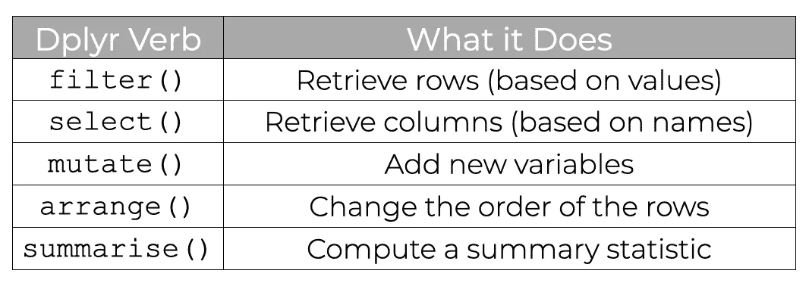
Subsetting a dataframe with dplyr

Slide 37
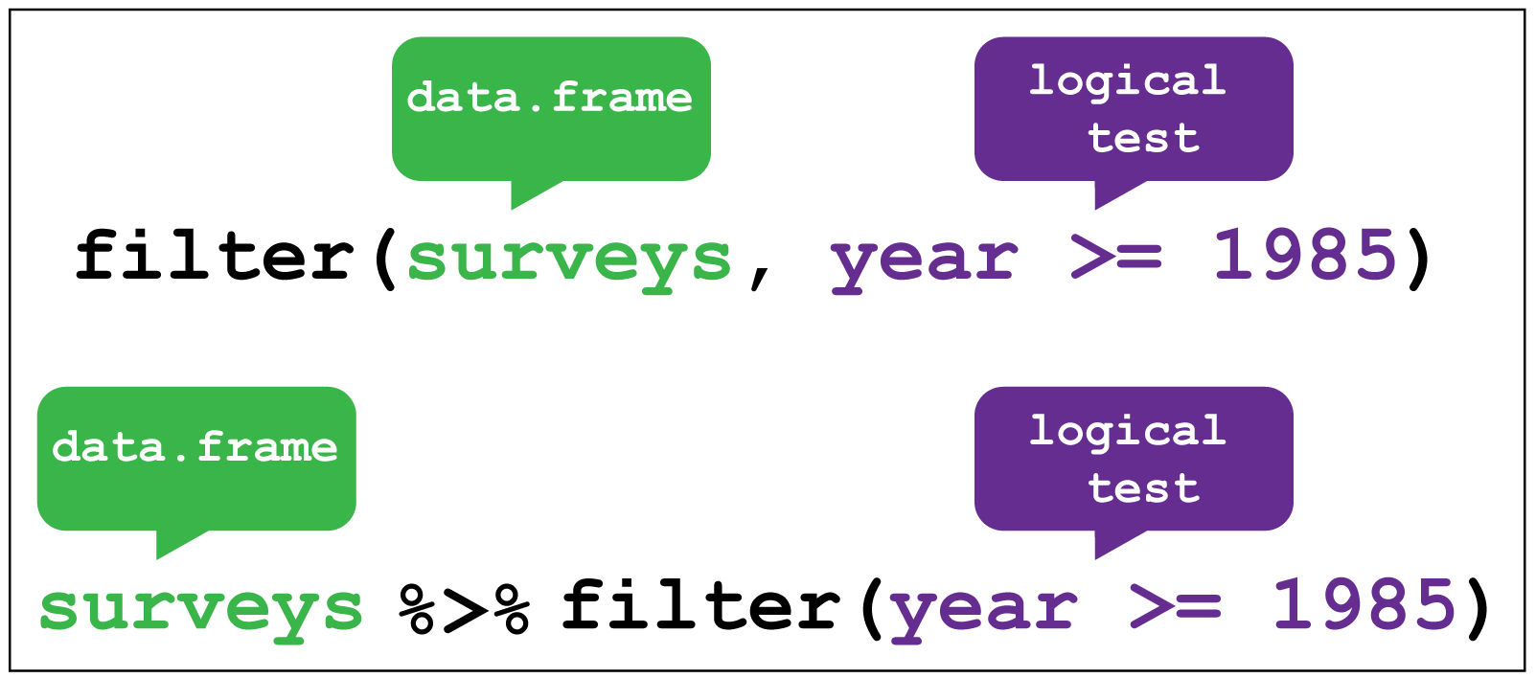
Subsetting a dataframe with dplyr

Slide 38
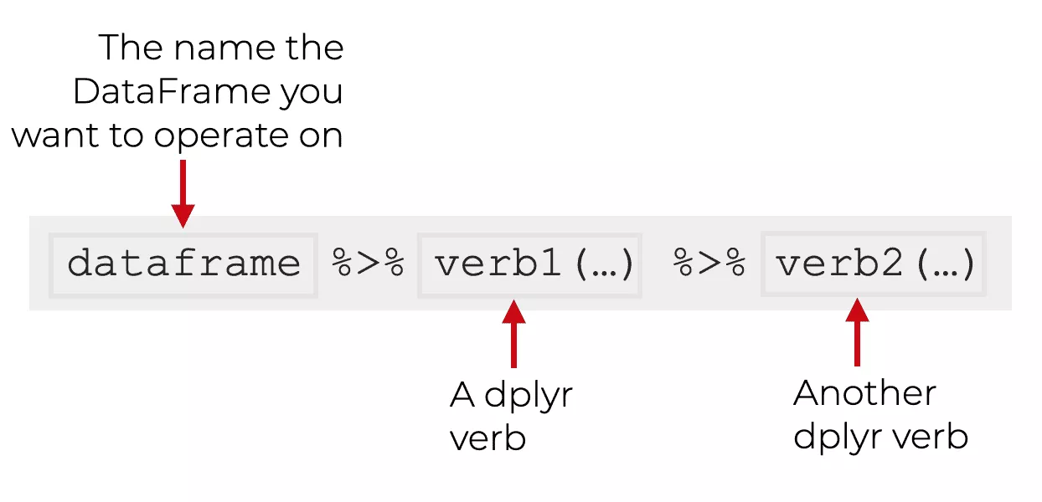
Subsetting a dataframe with dplyr

Slide 39
Special Values
There are some special values in R that we should know about:
  Inf or infinity
  NaN or not assigned
  NA or not available
  NULL or empty

Slide 40
Reserved and protected names
Some names are forbidden in R as they serve a concrete purpose. We should not name any variable to the following names:
  • if and else
  • for, while, and in
  • function
  • repeat, break, and next
  • TRUE and FALSE
  • Inf and -Inf
  • NA, NaN, and NULL

Slide 41
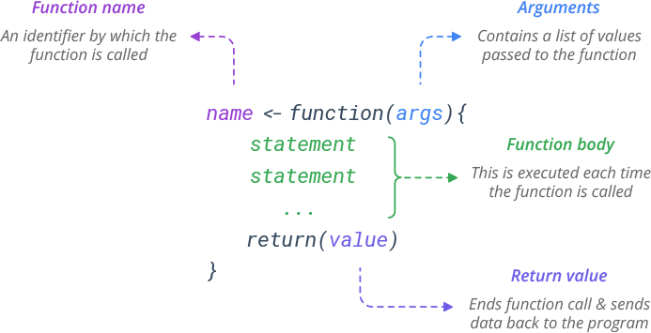
Functions
Functions can perform complex or repetitive operations using a single command.

Slide 42
dollar_to_euro <- function(dollar) {
euro <- dollar * 0.94
return(euro) }
dollar_to_euro(100)
> 94

Slide 43
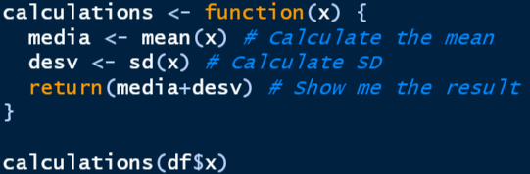
HOW CAN THIS BE USEFUL?
Imagine you want to calculate the value of something that stands 1 standard deviation from the mean. We would have to:
Calculate the mean
Calculate the standard deviation
Sum that standard deviation for the mean

Slide 44

Conditionals and loops
We can use more sophisticated techniques in our functions using conditional statements and loops. In a research-enviroment, knowing this will be useful even if we don't code our own functions on a regular basis, as conditionals and loops are core programming techniques used by lots of built functions.

Slide 45
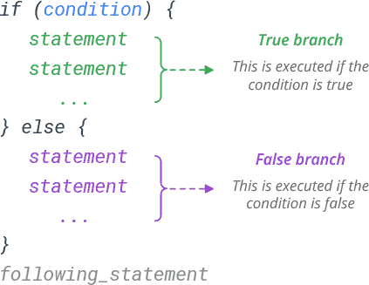
IF statements
Functions can perform complex or repetitive operations using a single command.

Slide 46
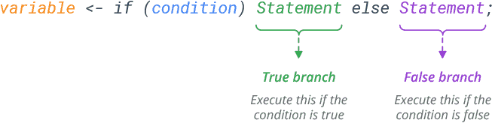
HOW CAN THIS BE USEFUL?
The ifelse() function simplifies this!

Slide 47
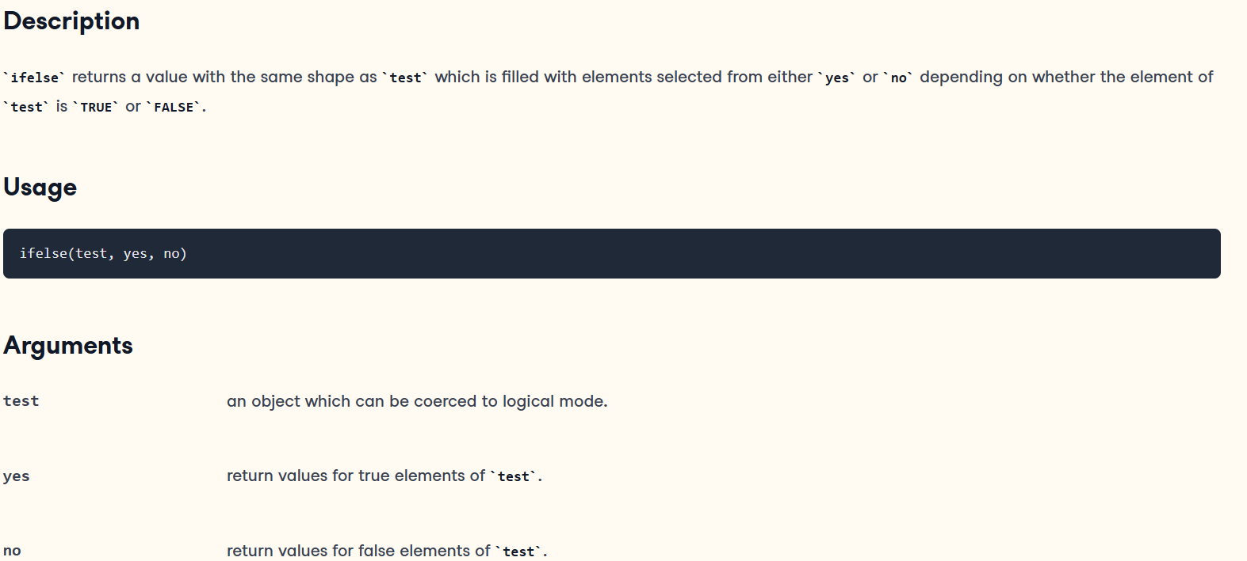

Slide 48
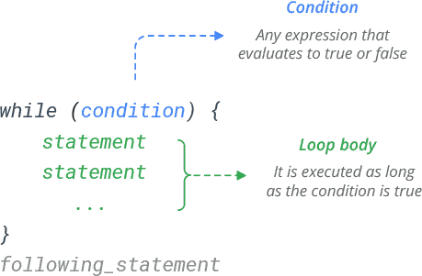
While loops
To use for loops, you must know, or be able to easily calculate, the number of times the loop should repeat. In situations where you don’t know how many times the desired operations need to be run, you can turn to the while loop. A while loop runs and repeats while a specified condition returns TRUE, and takes the following general form:
If we make a mistake and the condition is always TRUE, the loop will run infinitely, and we might need to restart R-Studio or even our computer!!

Slide 49
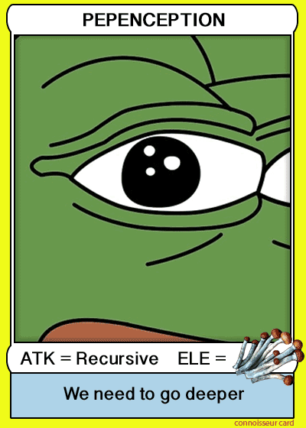

HOW CAN THIS BE USEFUL?

Slide 50
Practical Exercise: experimental design
Create a dataframe for a genome mouse study, with 12 samples, and the following variables. You can choose any design you want for the factor variables.
sample_name (chr)
age (num) (from 0 to 24 months)
genotype (factor) (WT/KO)
weight (num) (from 19 to 29gr)
height (cm) (from 3-5cm)
dose (factor) (high/low)

Slide 51
Practical Exercise: experimental design
Once you got the dataframe, do the following:
Set sample_names as rownames and eliminate sample_name's column
Convert age from months to days
Get the mean and standard deviation of age
Get the mean and standard deviation of weight
Create a new column that calculates the BMI: weight/(height)^2
Split the dataframe by genotype in two: WT samples and KO samples
Save each dataset in any format you like (using write.csv() or write.csv2()

Slide 52
Practical Exercise: experimental design
The exercises will be available in three formats:
Empty (Exercise some R skills here)
With suggested functions that have to be filled (Exercise some R skills here light version)
Correction (R script located in your main folder)

