Slide 1
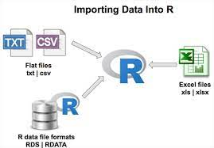
Importing data in R
Importing data into R is pretty straightforward. You have to know well the nature of your input file and find the appropriate function to do it. You will have to specify where the path of the file and some other arguments if needed.

Slide 2
Importing data in R
We have to know our input data file, and search for a function with the appropriate arguments that will be able to import it correctly.

Slide 3
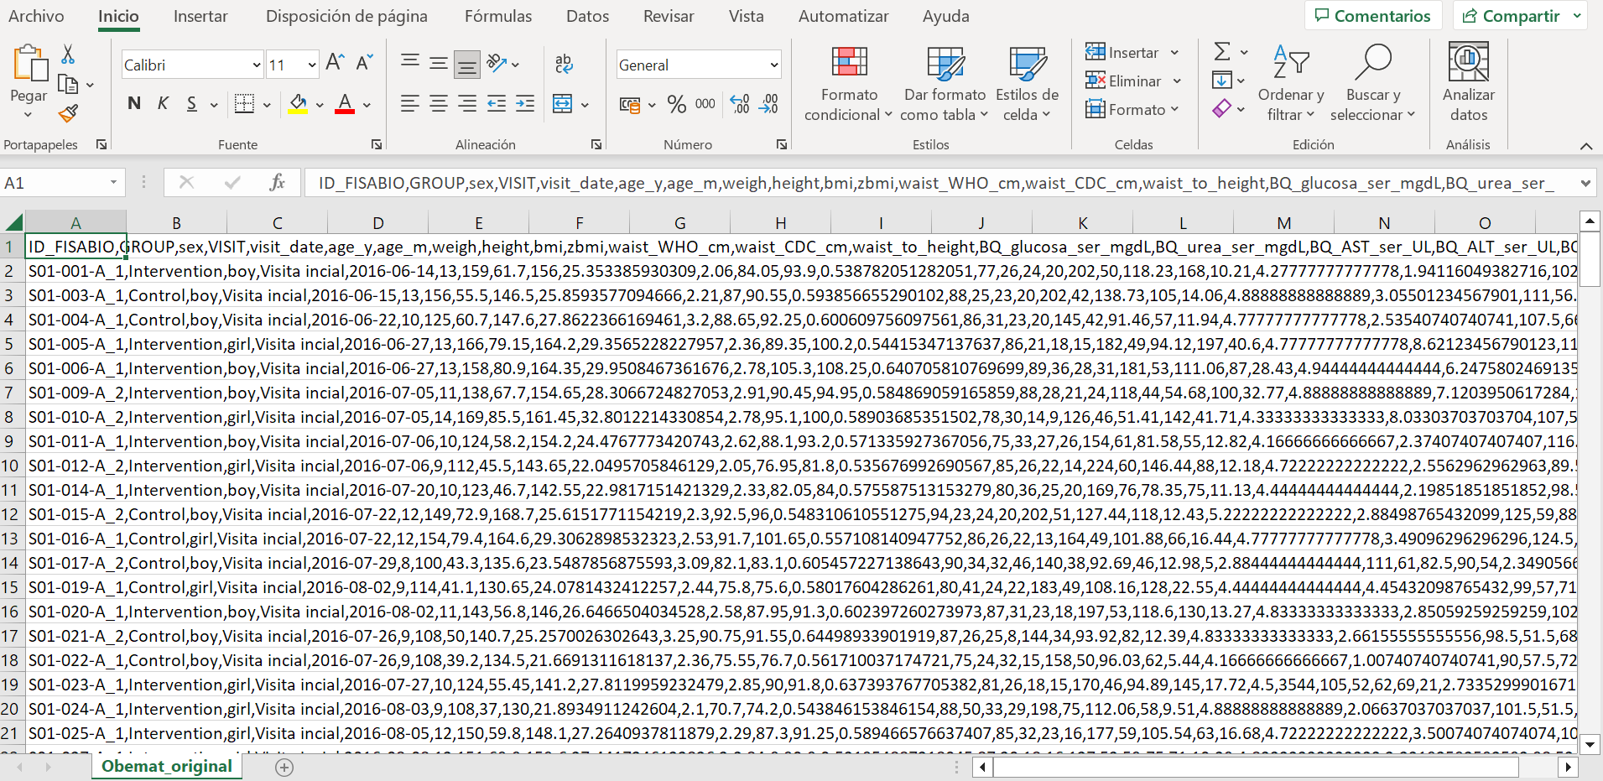
Importing .csv files
CSV stands for coma separated values, but this coma can be other symbol.

Slide 4
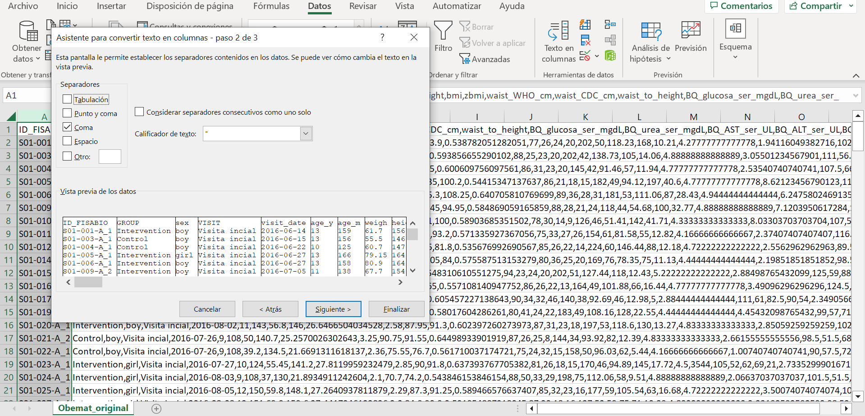

Slide 5
Importing .csv files
read.csv and read.csv2 allows us to import .csv files correctly
read.csv(path_to_filename,
sep = ",”)
read.csv and read.csv2 are identical to read.table except for the defaults. They are intended for reading ‘comma separated value’ files (‘.csv’) or (read.csv2) the variant used in countries that use a comma as decimal point and a semicolon as field separator.

Slide 6
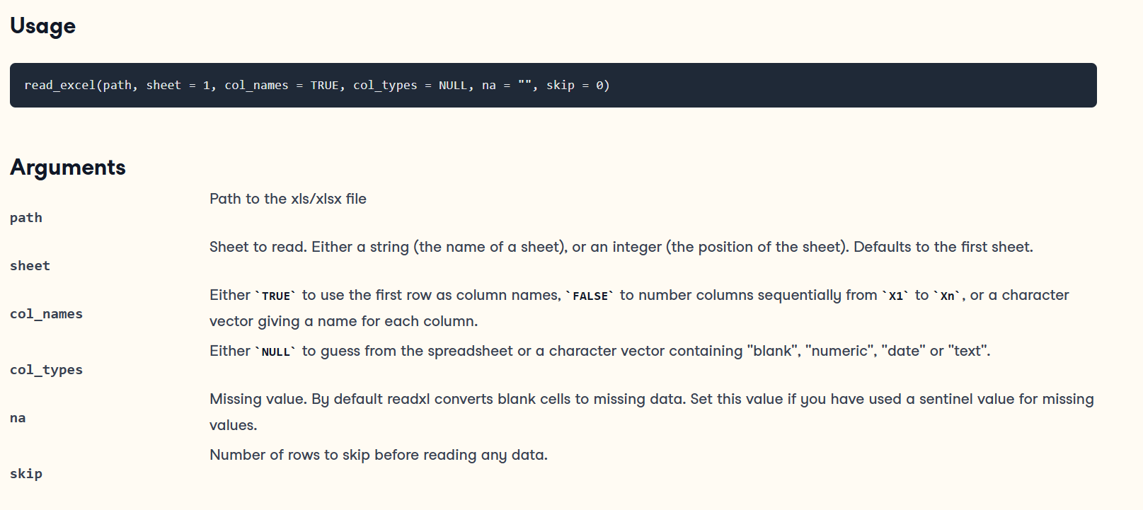
Importing Excel files
The package readxl is the best tool to load Excel files in R.

Slide 7
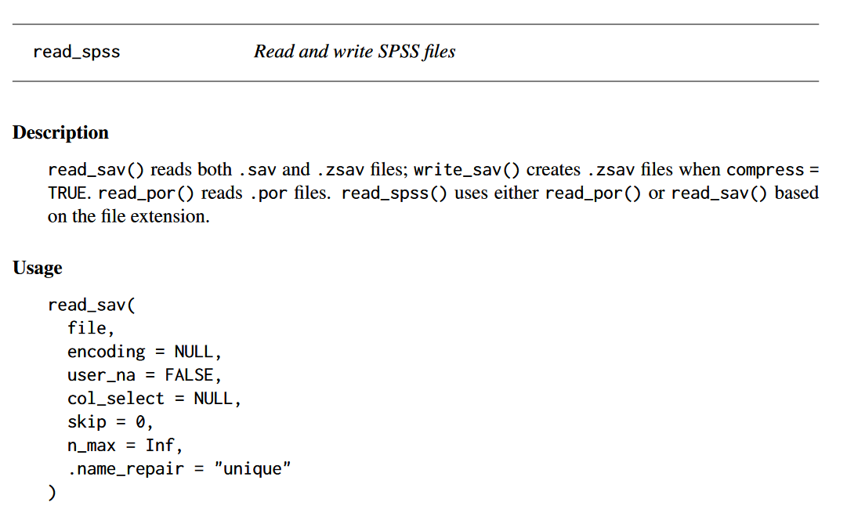
Importing SPSS files
Importing .sav FILEs with read_sav from the haven package

Slide 8
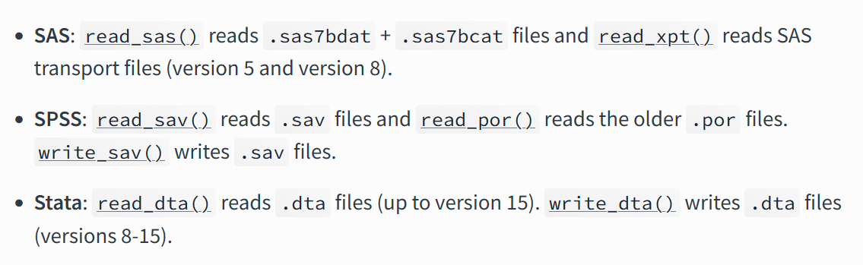
Importing other files

Slide 9
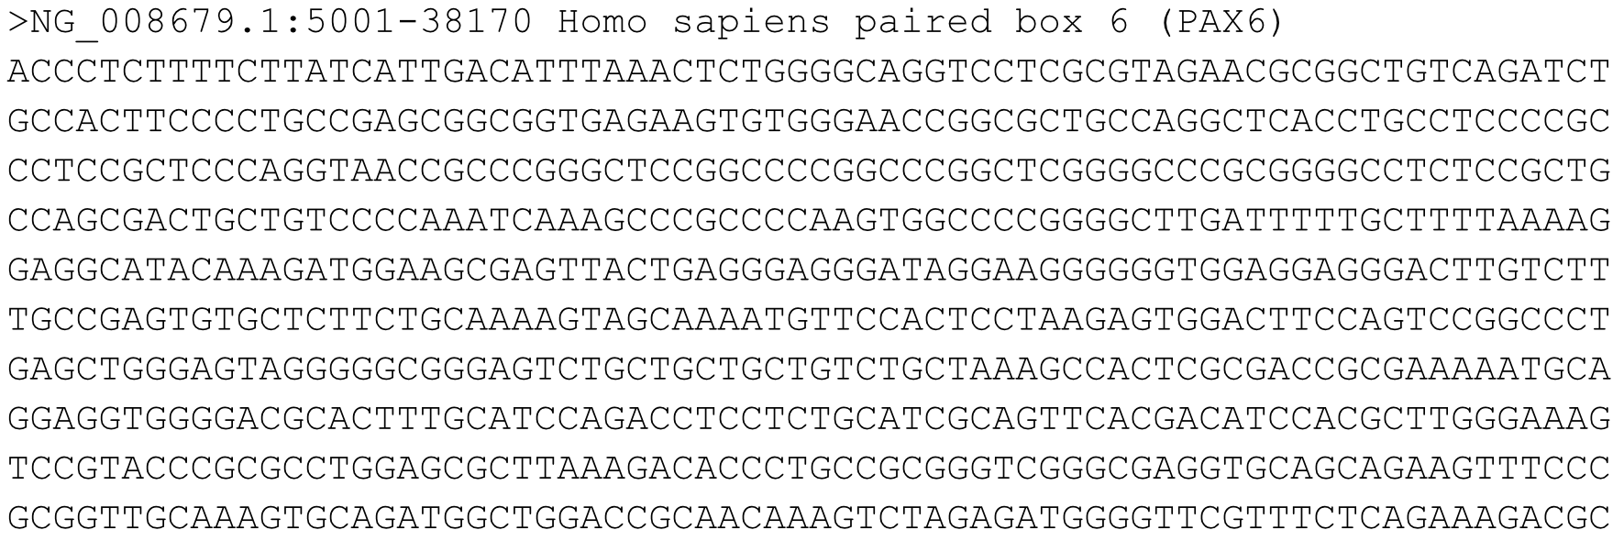
Importing other files
What about fasta files?
We can use read.fasta() (see documentation)

Slide 10
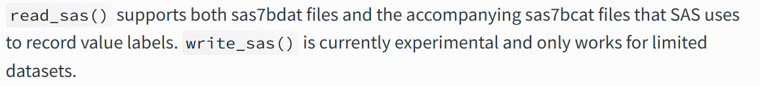
Saving data
We can use multiple functions depending on the input data.
write.csv()
write.csv2() better for European countries
write.table()
write_excel()
write_sas() **

Slide 11
Exploratory data analysis (EDA)
Exploratory data analysis is the process of getting to know your data in depth.
Understanding your variables
  Type of data
  Summary statistics
  Basic plotting
Cleaning your dataset
  Duplicates
  Errors
  Missing Values
  Other
Analyzing your variables
  Univariate/bivariate statistics
  Unsupervised machine learning methods (PCA, clustering)

Slide 12
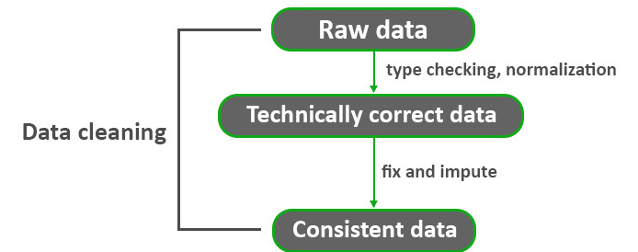
Data cleaning
Data cleaning is the process of fixing or removing incorrect, corrupted, incorrectly formatted, duplicate, or incomplete data within a dataset.

Slide 13
Cleaning data
Cleaning data can be harsh, and there are so many things that can be wrong or misplaced in research or clinical data. We should ask the following questions first:
  Do we trust the source of the data? It has been processed/manipulated?
  Does the data seem OK just opening the file?
  Does the data seem OK when loading into R?
  Do we have access to the unprocessed-raw data?

Slide 14

Cleaning data
We can face many different issues when loading a dataframe in R:
The columns can be mismatched
The columns can have weird names or contain multiple symbols
Duplicates
Missing values (just empty space or NA)
Extreme values or outliers
Excess of zeros (sparse data)
Values that shouldn’t exist or are forbidden

Slide 15
Useful functions for exploring/cleaning data
There are multiple R base functions and lots of packages and functions that will allow us to inspect and clean data, let’s dive in from the beginning.
str(dataframe) displays the internal structure of an R object
glimpse(dataframe) similar to the previous function
summary(dataframe) returns summary statistics for each column
descr(dataframe) from summarytools package

Slide 16
Useful functions for exploring/cleaning data
There are multiple R base functions and lots of packages and functions that will allow us to inspect and clean data, let’s dive in from the beginning.
duplicated(vector/dataframe) returns duplicated elements as TRUE/FALSE
table(vector/dataframe) builds a contingency table of the counts of each factor level
which(condition) returns the position of the element(s) that match the condition

Slide 17
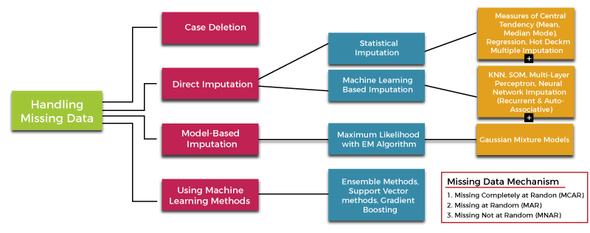
What about imputation?
Imputation is a sensitive topic, specially when the data is really missing.

Slide 18
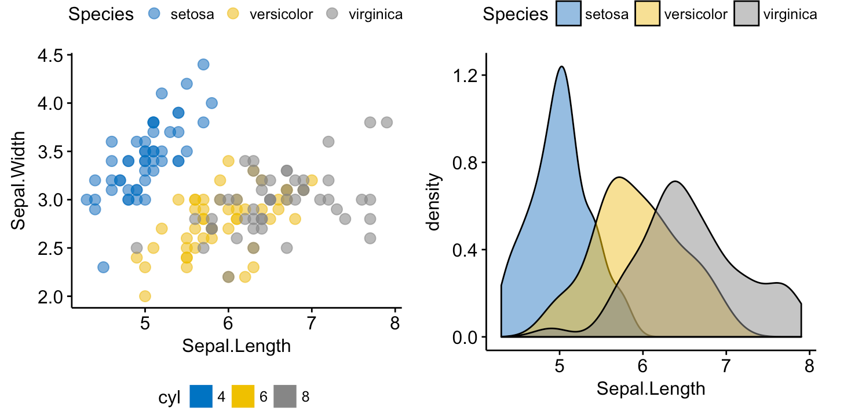

Basic R plotting
Constructing plots is essential to get a quick insight abour our data. We are going to learn the most basic and useful way to plot quantitative/qualitative variables with base R. There are some deep-plotting packages such as ggplot2 that won’t be covered in this course.

Slide 19
Barplot
barplot(table(error$age), We will usually plot a table of counts
main = "This is a barplot", Title
xlab = “This is the x-axis label”, X-axis label
ylab = “This is the y-axis label”, Y-axis label
col = "pink", Column color
border = "midnightblue", Border color
density = 100)

Slide 20
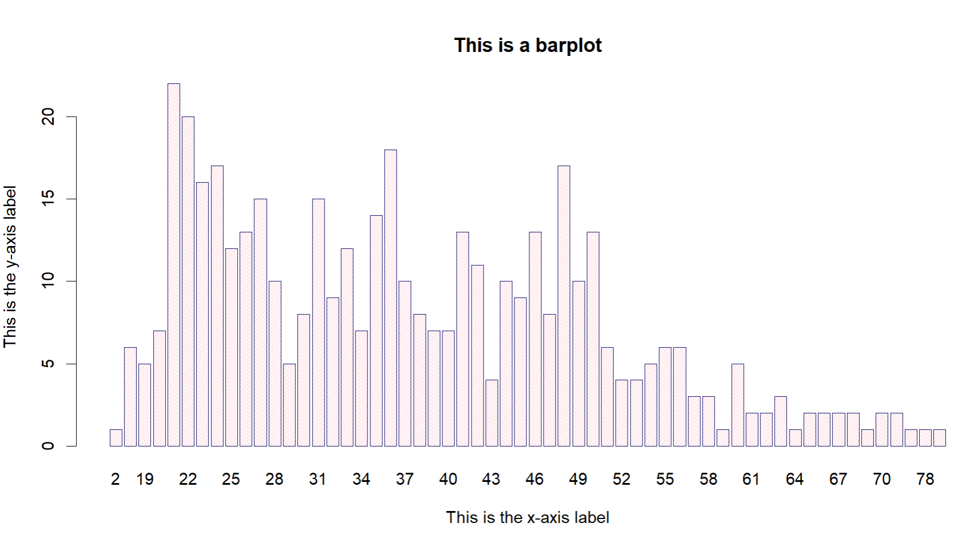

Slide 21
Histogram
hist(error$age,
main = "This is the title!",
xlab = "Age",
xlim = c(0,100), Numerical limit for x-axis
ylab = "Frequency",
ylim = c(0,100), Numerical limit for y-axis
col = "lightblue",
breaks = 20) Number of breaks on x-axis

Slide 22
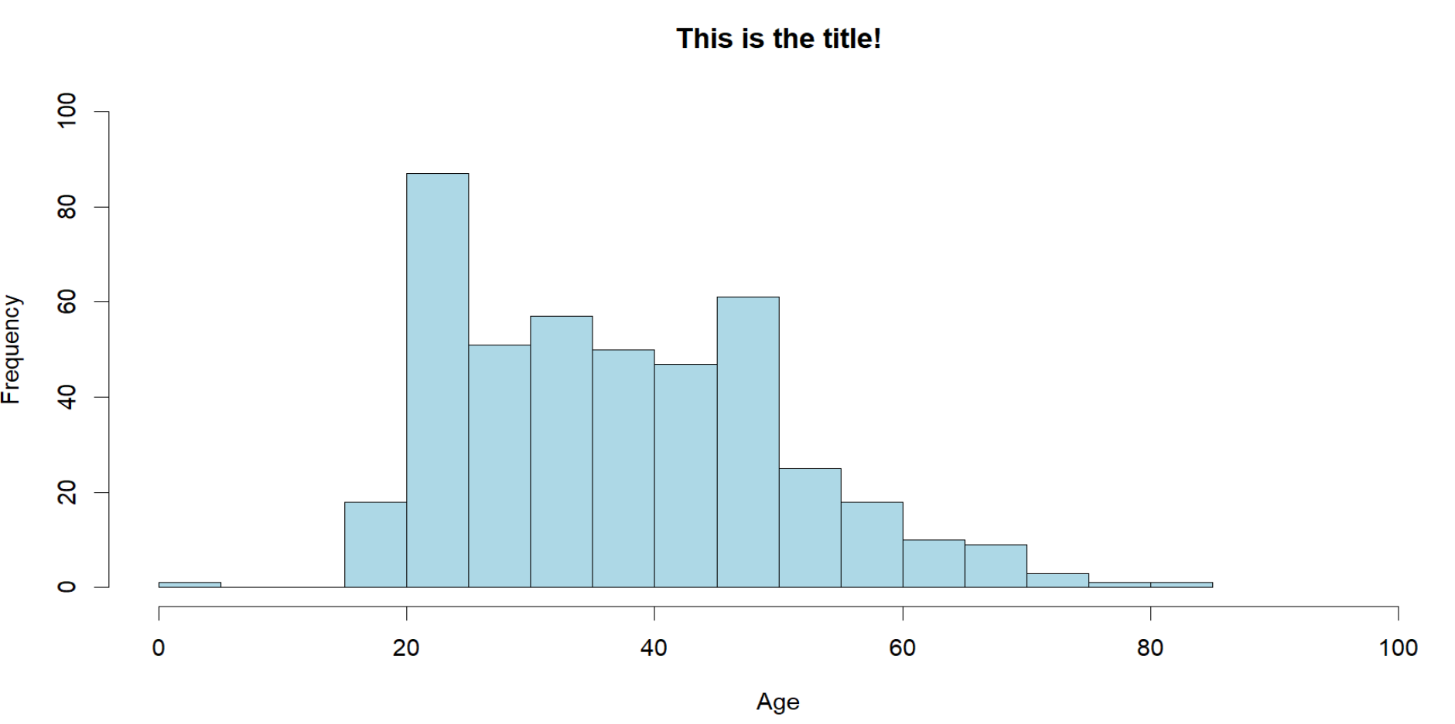

Slide 23
Boxplot
boxplot(age ~ sex,
data = error,
horizontal = FALSE,
lwd = 1,
xlab = "sex",
ylab = "age",
col = c(3,4))

Slide 24
Practical Exercise: Stent dataset
We are going to load some real clinical data and work with it. The objective is to inspect it and clean it. The STENTING dataset contains 5166 observations of patients with stroke history that have been through surgery. Some of them (STENTINTRAsino = 0) receive aspiration surgery, and some of them (STENTINTRAsino = 1) go through stent surgery. The variables are the following:
IdPatient
Sex
EscalaRACE
CodiIctusdespertariniciincert
Edat
NIHSSinicial
ASPECTscore
tPAsino
ACIT
CodiACMM1
CodiACMM2
CodiAB
STENTINTRAsino
CodiHipertensió
CodiFibril-lacióauricular

Slide 25
Practical Exercise: Stent
The exercises will be available in three formats:
Empty (Exercise some R skills here)
With suggested functions that have to be filled (Exercise some R skills here light version)
Correction (R script located in your main folder)

