Slide 1

BLOQUE 2. STATISTICS IN R

Slide 2

Bloque 2: Estadística aplicada en R
Summary statistics
Parametric assumptions
Inference on quantitative data
  Covariance and correlation
Inference on qualitative data

Slide 3
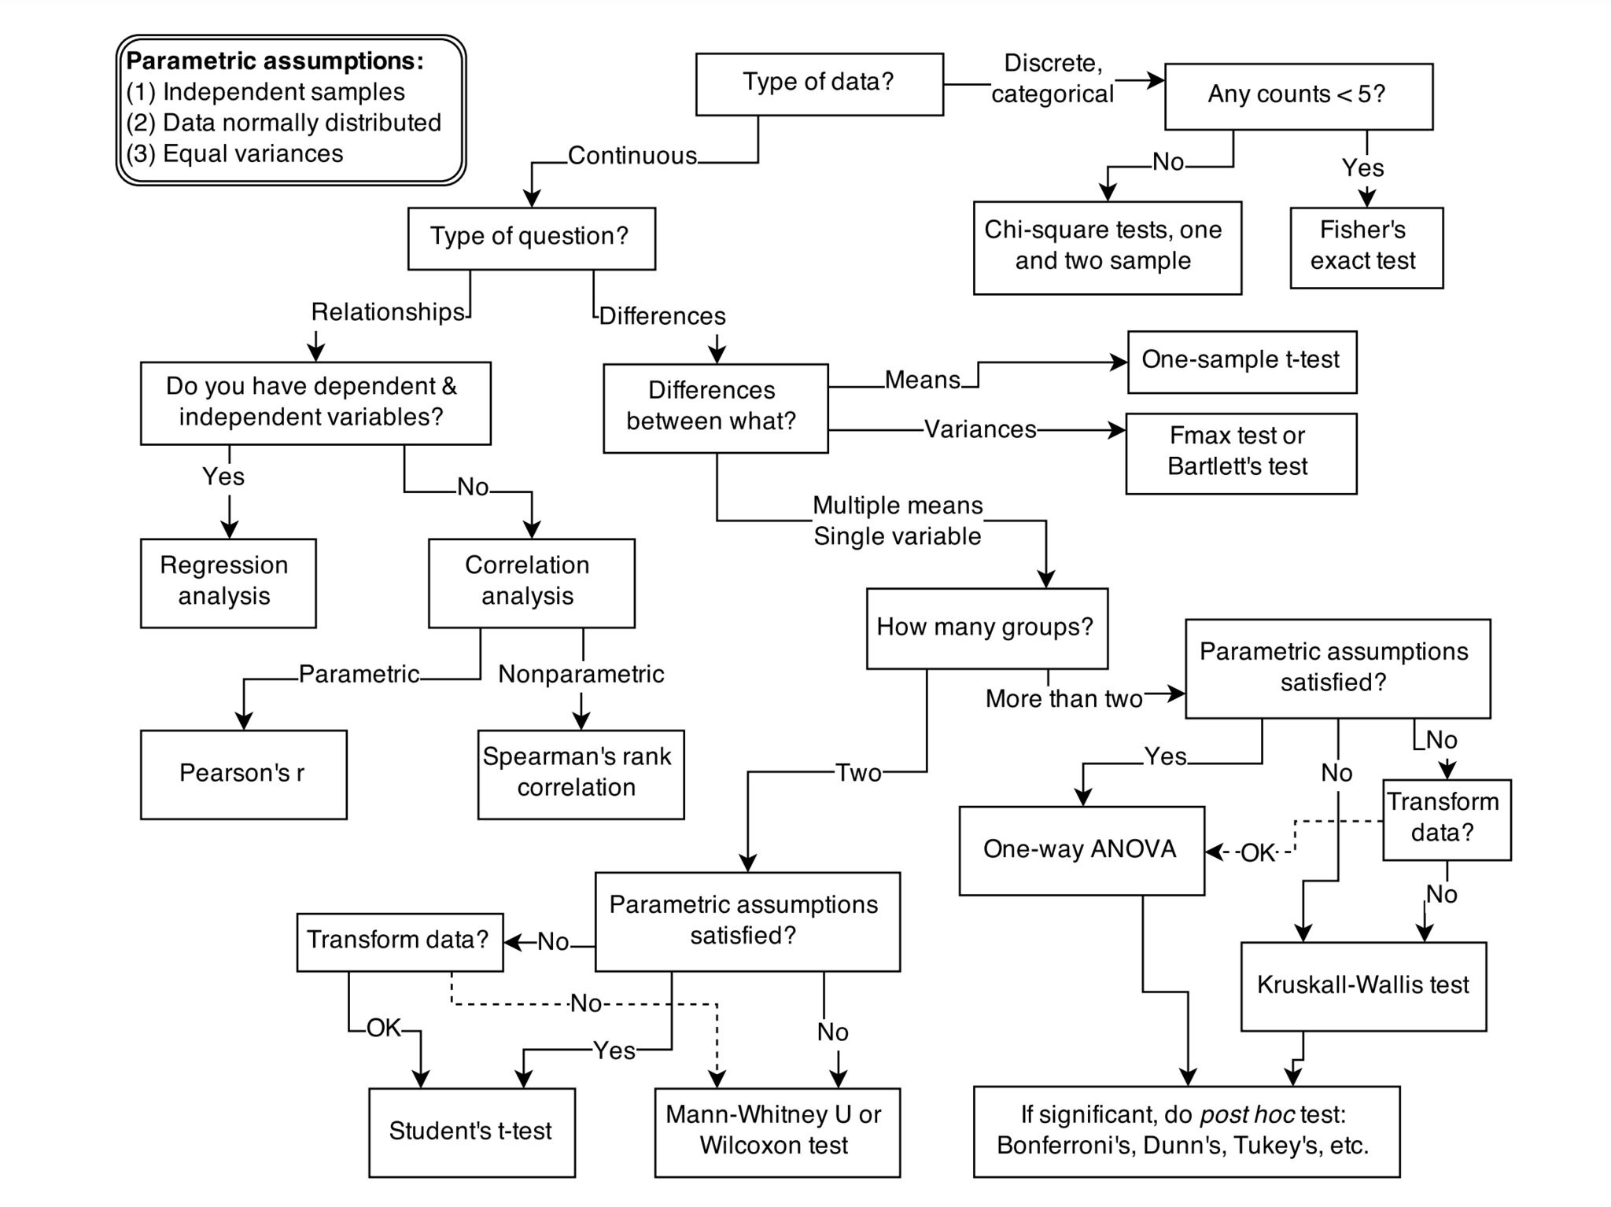

Slide 5
Inference on quantitative data

Slide 6
Parametric Assumptions
When we are dealing with quantitative data, the first thing we should look at is how they are distributed, what they look like. The distribution of our data will tell us if there is something wrong in the way we collected them and it will also tell us what kind of test we can apply.
T-test, analysis of variance and correlation tests belong to the family of parametric tests and to be able to use them our data must comply with 4 assumptions:
- The data has to be normally distributed
- Homogeneity in variance: the variance should not change systematically throughout the data.
- Interval data: the distance between points of the scale should be equal at all parts along the scale
- Independence: data from different subjects are independent so that values corresponding to one subject do not influence the values corresponding to another subject.

Slide 7
How to check for normality
- Graphic methods: histogram and QQ-plot
- Analytical methods: Shapiro-Wilk ( < 50 samples) and Lilliefors (> 50 samples)

Slide 8
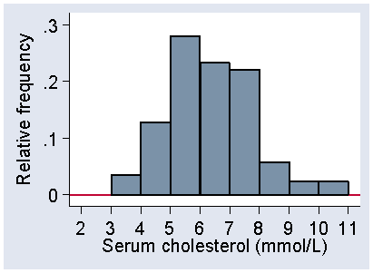
How to check for normality
HISTOGRAM

Slide 9
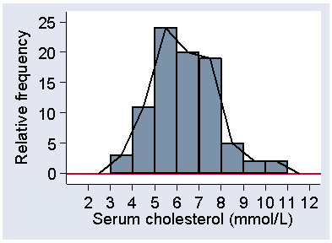
How to check for normality
HISTOGRAM

Slide 10
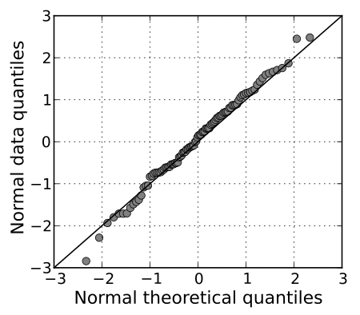
How to check for normality
QQPLOT

Slide 11
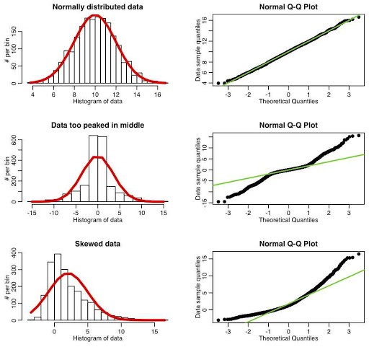

Slide 12
How to check for normality (analytical methods)
Analytical methods stablish a H0: data comes from a normal distribution, HA: data does not come from a normal distribution.
Shaphiro-Wilk test
shapiro.test(variable_of_interest)

Slide 13

Parametric assumptions example
Imageine we have a poplation of n = 86 coyotes where lenghts of males (n = 43) and females (n = 43) are measured in cm.
Male (n = 43) | Female (n = 43)
92,05 | 89,71
6,69 | 6,54

Slide 14
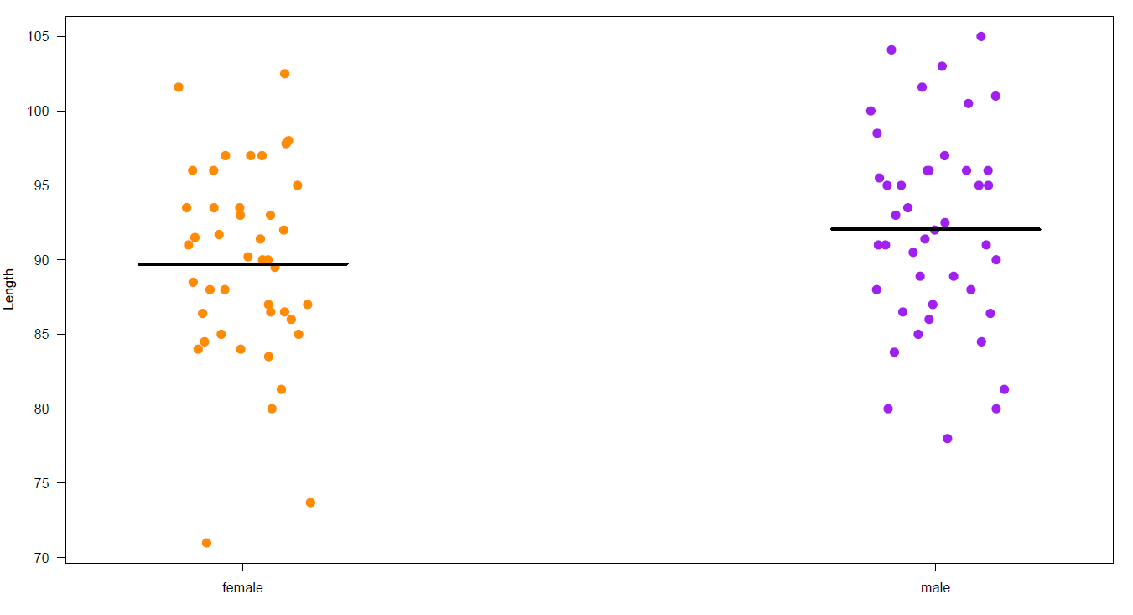

Slide 15
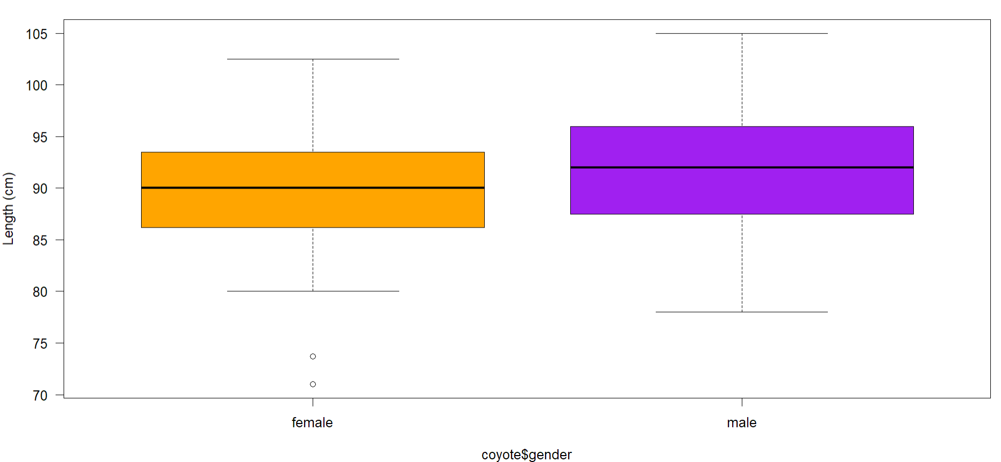

Slide 16
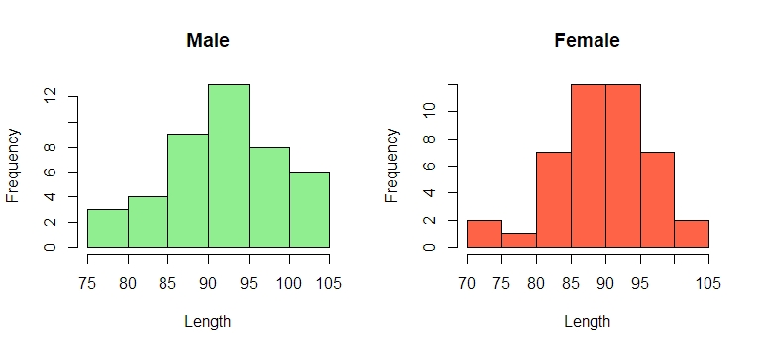
Visually we can expect normality and homocedasticity.

Slide 17
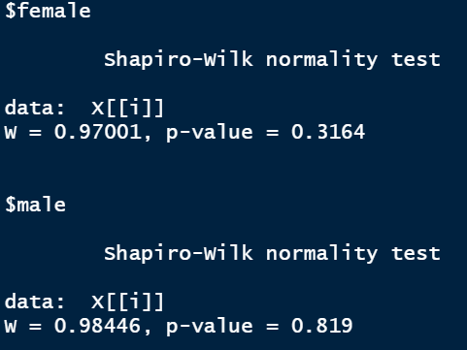
Shapiro-Wilk test
We can test if both male and female lenghts come from a normal distribution.
tapply(coyote$length, coyote$gender, shapiro.test)
Data comes from a normal distribution
Data comes from a normal distribution

Slide 18
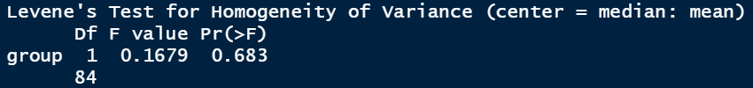
Levene’s Test
We should also check por variance homogeneity within each group.
leveneTest(coyote$length, coyote$gender, centre=mean)
Variances are homogeneus

Slide 20
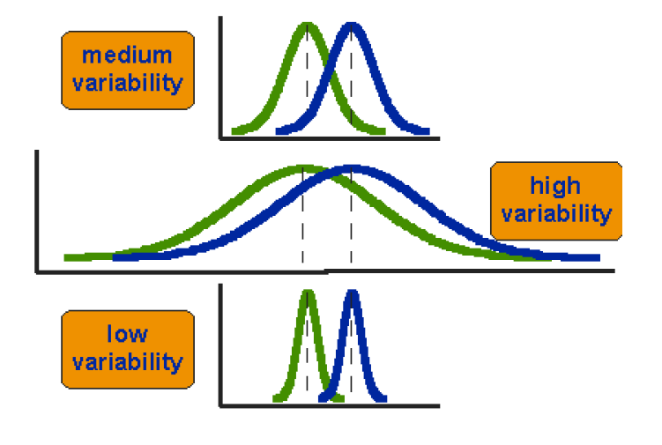
Comparing two means with t-test

Slide 21
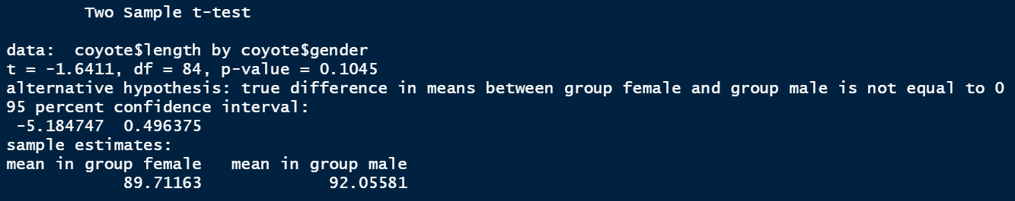
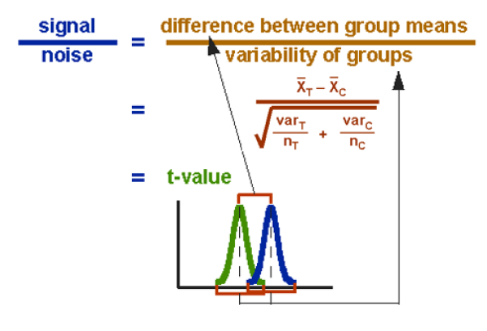
Comparing two means with t-test
t.test(coyote$length ~ coyote$gender, var.equal = T)
The difference is not significant

Slide 23

Comparing two means with Wilcoxon Test
What about when parametric assumptions are not satisfied?
Some may argue that, when in doubt, it is more valid to use nonparametric methods because they are "always valid, but not always efficient," while parametric methods are "always efficient, but not always valid" (Nahm, 2016).

Slide 24
Comparing two means with Wilcoxon Test
In a study designed to assess whether group body odour is less disgusting when it is associated with an in-group member versus an out-group member, researchers presented two groups of Cambridge University students with one of two smelly, worn t-shirts. One t-shirt bore the logo of Cambridge University and the other bore the logo of Oxford University. The students were asked to rate their disgust on a 7-point ordinal scale. Higher ratings indicate greater levels of disgust.

Slide 25
Comparing two means with Wilcoxon Test

Slide 26
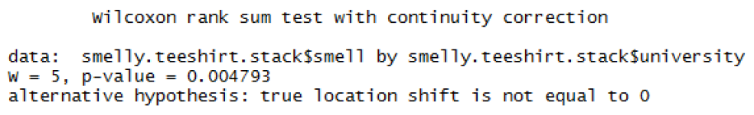

Comparing two means with Wilcoxon Test
wilcox.test(smelly.teeshirt.stack$smell~smelly.teeshirt.stack$university)
Cambridge students found Oxford t-shirt’s smell more disgusting!!

Slide 28
Comparing more tan two means with ANOVA
When we want to compare more than 2 means (e.g. more than 2 groups), we cannot run several t-test because it increases the familywise error rate which is the error rate across tests conducted on the same experimental data.
Now, let’s take an example: say we want to compare 3 groups (1, 2 and 3) and we carry out 3 t-tests (groups 1-2, 1-3 and 2-3), each with an arbitrary 5% level of significance, the probability of not making the type I error is 95% (= 1 - 0.05). The 3 tests being independent, we can multiply the probabilities (multiplicative rule), so the overall probability of no type I errors is: 0.95 * 0.95 * 0.95 = 0.857. Which means that the probability of making at least one type I error (to say that there is a difference whereas there is not) is 1 - 0.857 = 0.143 or 14.3%. So the probability has increased from 5% to 14.3%. If we compare 5 groups instead of 3, the family wise error rate is 40%

Slide 29
Comparing more tan two means with ANOVA
To overcome the problem of multiple comparisons, we need to run an Analysis of variance (ANOVA) followed by post-hoc tests. Actually, there are many different ways to correct for multiple comparisons and different statisticians have designed corrections addressing different issues (e.g.: unbalanced design, heterogeneity of variance, liberal vs conservative). However, they all have one thing in common: the more tests, the higher the familywise error rate: the more stringent the correction.
Conservative: Bonferroni
Less conservative: TukeyHSD, FDR
ANOVA assumptions:
- Independence of observations
- Normally-distributed response variable
- Homogeneity of variance

Slide 30
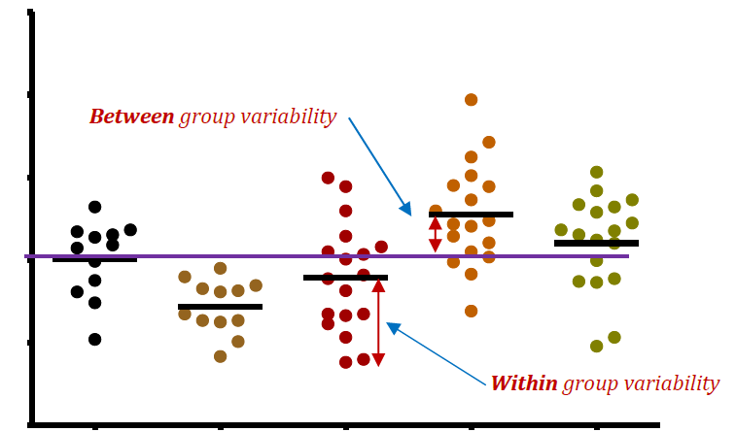
Comparing more tan two means with ANOVA
ANOVA compares variances through the F-test. The F-test compares the variance in each group from the overall group variance. If the variance within groups is smaller than the variance between groups, the F-test will find a higher F-value, and therefore a higher likelihood that the difference observed is real and not due to chance.

Slide 31
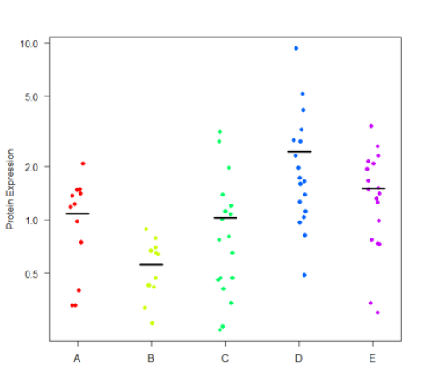
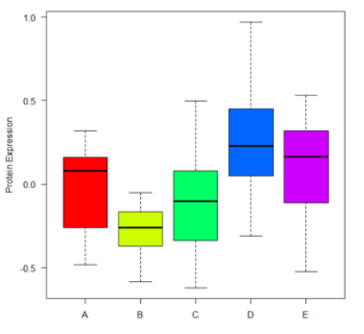
Comparing more tan two means with ANOVA
In a experiment, protein expresión was measured between five different tissues.
*The red group was just near normal so data was transformed to log10. Sometimes normality can be scale-related.

Slide 32
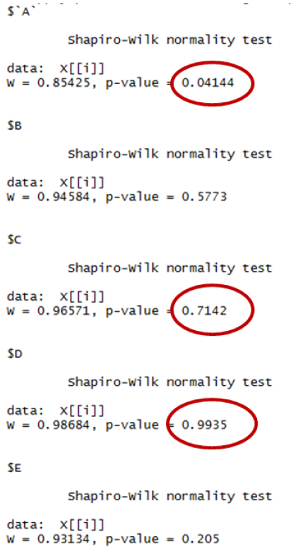
Comparing more tan two means with ANOVA
Shapiro test para normalidad
Levene test para homogeneidad de varianzas

Slide 33
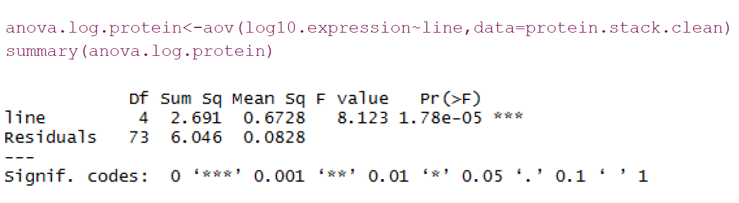

Comparing more tan two means with ANOVA
We can say that the mean of protein expresión between the five tissues is statistically significant. But now what?

Slide 35
Post hoc tests
Once we have determined that there are differences between the means, post hoc tests determine the significance group-wise.
Estos test se realizan porque existe el familywise error rate, the probability of at least one Type I error in a set (family) of comparisons.
You need to control the FWER for one main reason: If you run enough hypothesis tests (dozens, hundreds, or sometimes tens of thousands) you’re highly likely to get at least one significant result by chance where you incorrectly reject the null hypothesis.

Slide 36
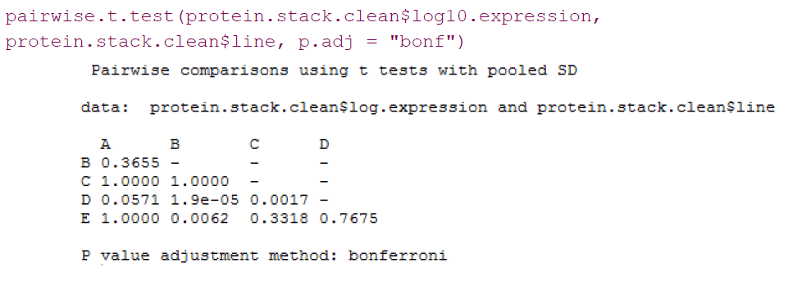
post hoc tests: Bonferroni
We just divide the p-value by the number of performed tests.

Slide 37
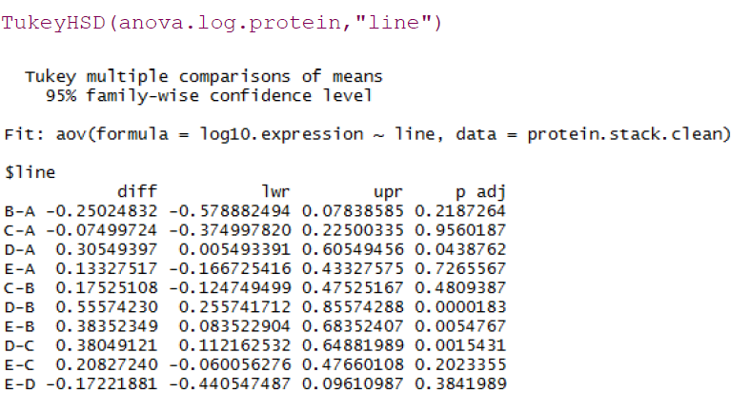
post hoc tests: Tukey HSD

Slide 39
Comparing more tan two means with Kruskal-Wallis
In an experiment, three groups are made, where one does not receive creatine supplementation, another group receives a dose in the morning, and another group, a dose in the morning and another in the afternoon.
Does the weight gain depend on the number of creatine doses?

Slide 40
Comparing more tan two means with Kruskal-Wallis

Slide 41
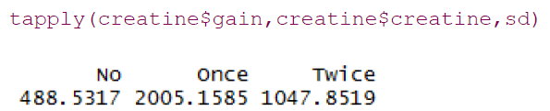
Comparing more tan two means with Kruskal-Wallis
NO HAY IGUALDAD DE VARIANZAS

Slide 42
Comparing more tan two means with Kruskal-Wallis
DATA DOESN’T SEEM NORMALLY DISTRIBUTED

Slide 43
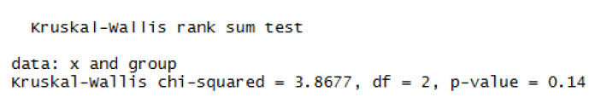
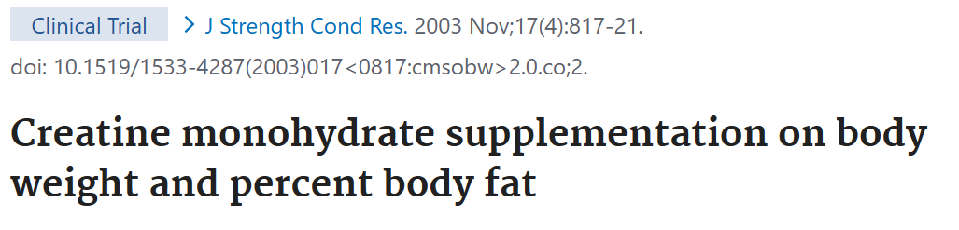
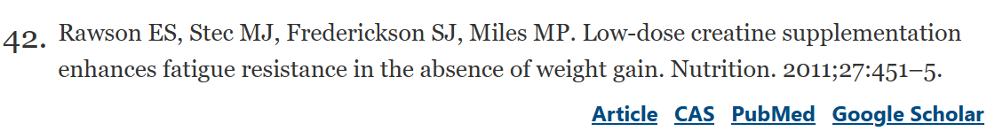
Comparing more tan two means with Kruskal-Wallis
There are not differences of weight gain between the three groups.

Slide 45
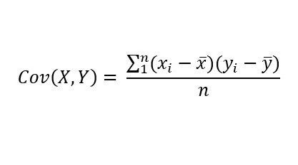

Covariance between two variables
La correlación es una forma de medir una relación lineal entre variables y su magnitud. La forma más sencilla para saber si dos variables están asociadas es calcular la covarianza.
Una covarianza positiva indica que cuando una variable se desvía de la media, la otra lo hace en la misma dirección. De forma más sencilla, si una variable crece en valor, la otra también lo hace.

Slide 46
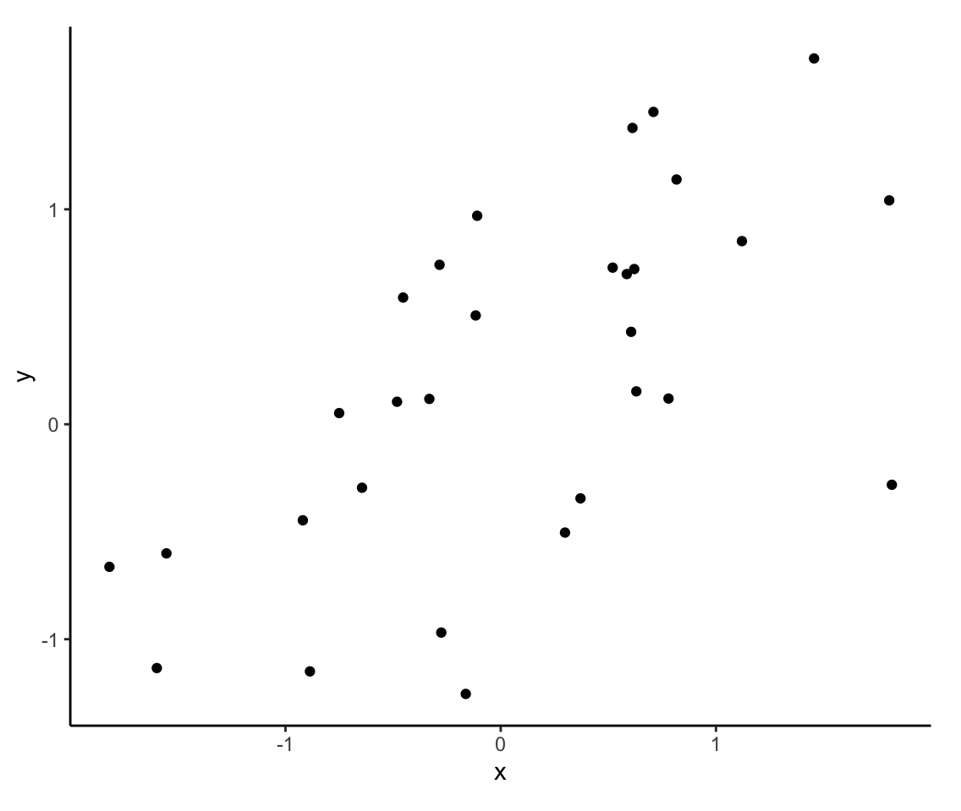
Two continuous variables

Slide 47
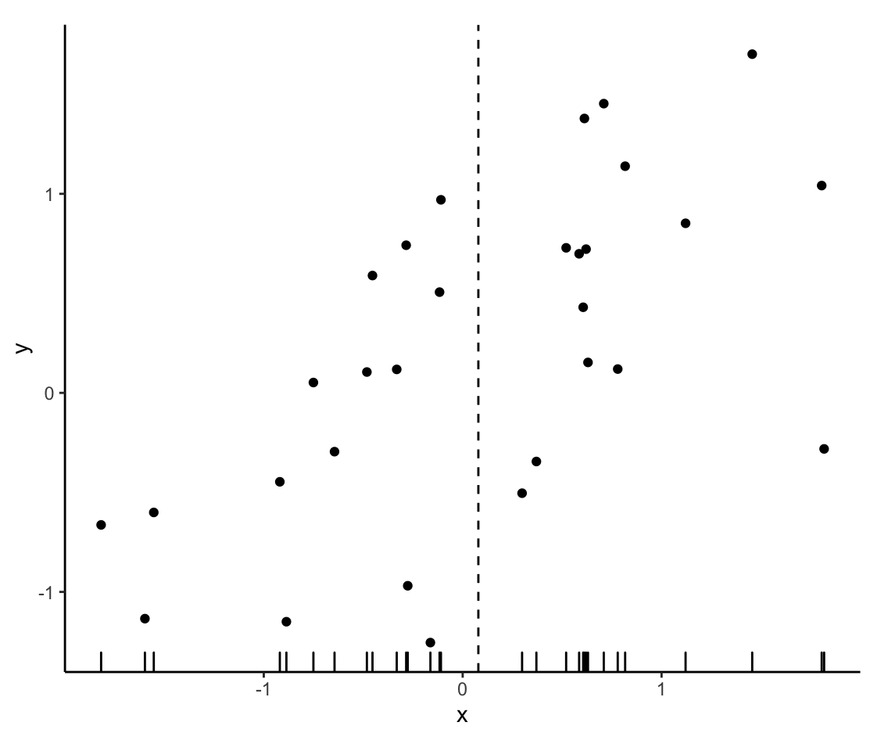
Get the mean of X

Slide 48
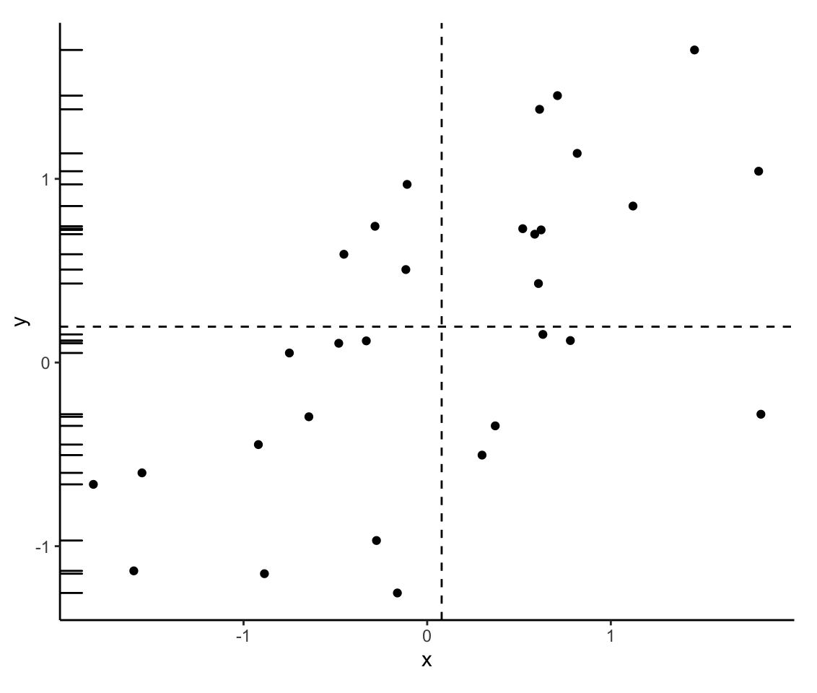
Get the mean of Y

Slide 49
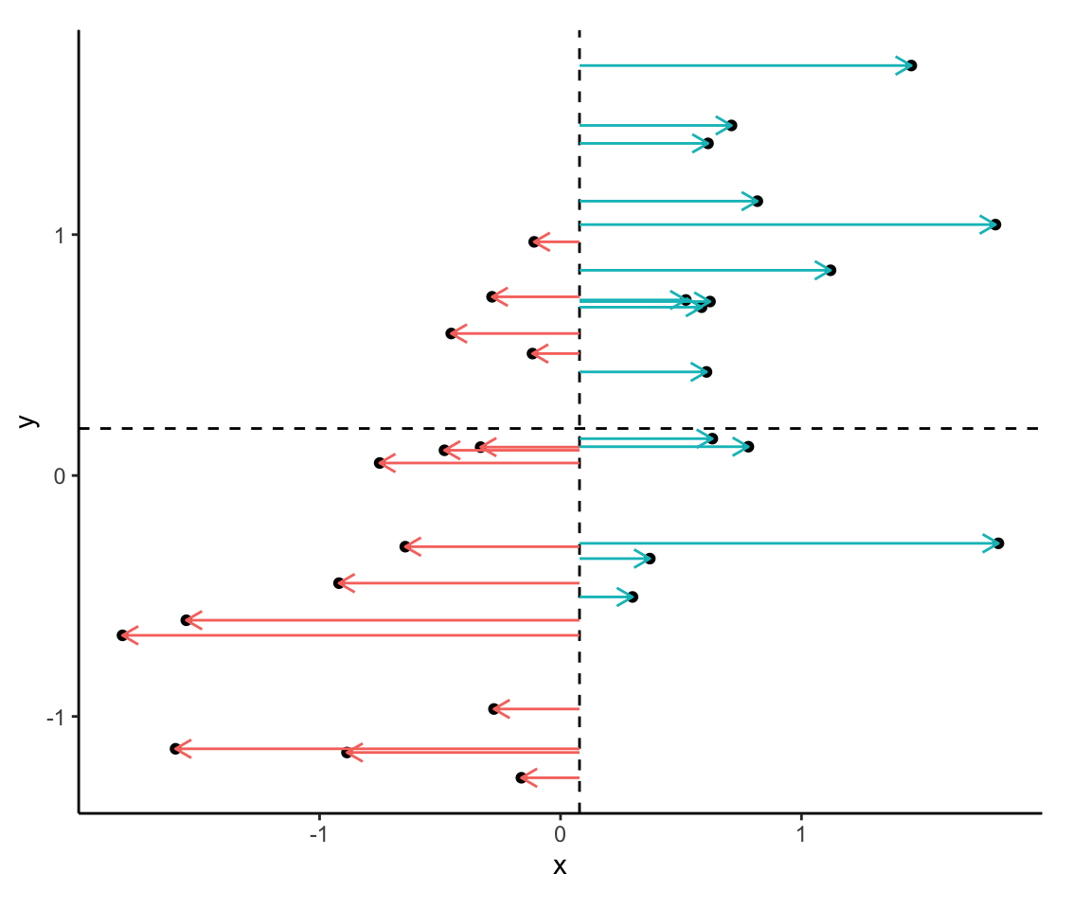
Calculate the difference between the mean of X and each observation

Slide 50
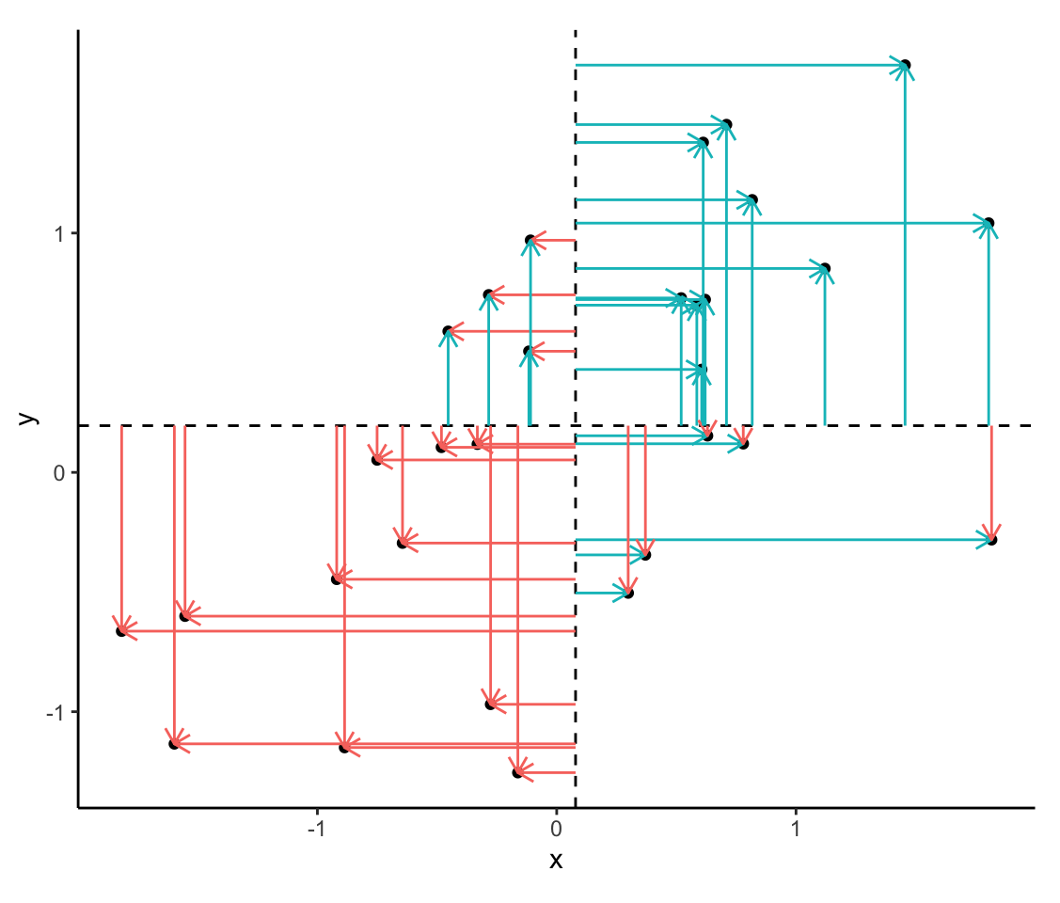
Calculate the difference between the mean of Y and each observation

Slide 51
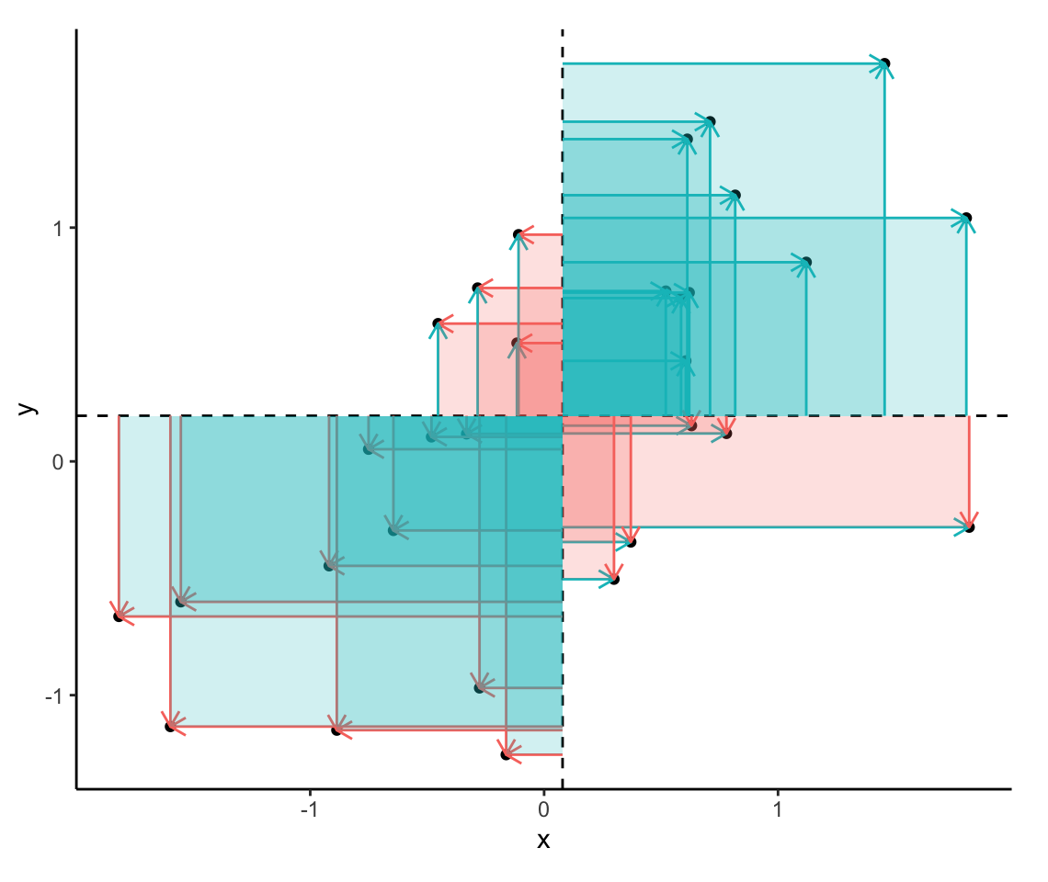
Multiply those differences

Slide 52
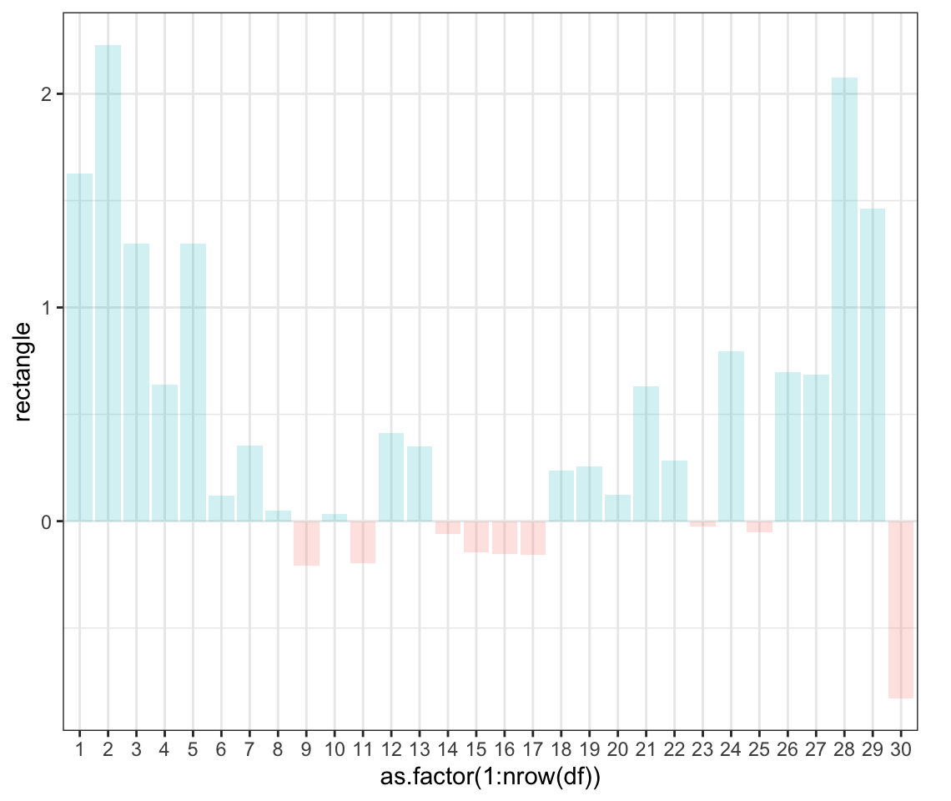
Sum the generated areas

Slide 53

Covariance between two variables
Finally, sum all the áreas and divide them by the number of observations.
sum(df$rectangle)/(nrow(df)-1) = 0,47667
cov(x, y) = 0,47667

Slide 54
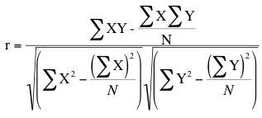

Pearson’s Correlation
The problem with covariance is that its value depends on the measurement scale used, so that we cannot compare two variables that have different measurement units. To standardize this fact, covariance is divided by the standard deviation of the two variables.

Slide 55
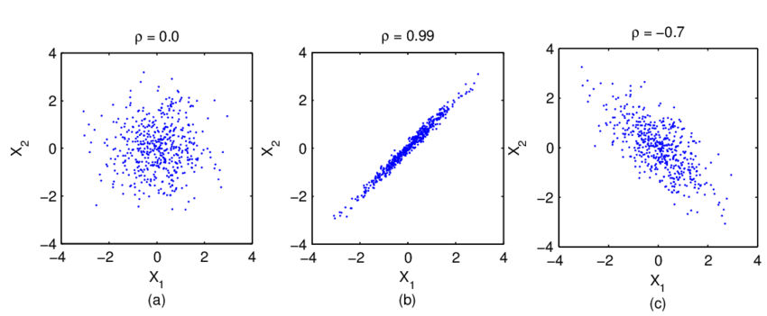
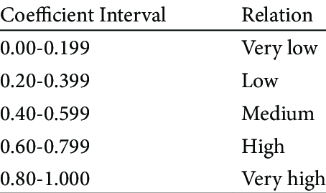
Pearson’s Correlation
Pearson’s correlation measures the magnitude and direction of a linear relationship between two variables.

Slide 56
Coeficiente de correlación de Pearson
En cualquier caso, es importante tener en cuenta algunos assumptions a la hora de calcular correlación de Pearson:
Linealidad
Homocedasticidad
Independencia
Outliers
Y RECORDAR QUE CORRELACIÓN NO IMPLICA CAUSALIDAD!!

Slide 58
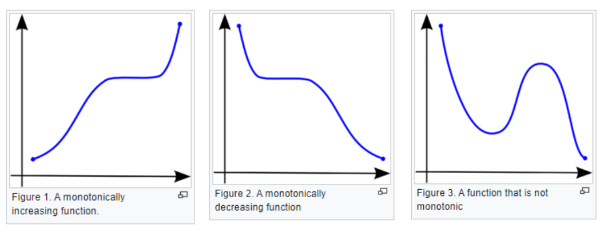
Spearman’s Correlation
Cuando no se cumplen los supuestos paramétricos, se utilizan otro tipo de métodos. Uno de ellos es la correlación de Spearman, que mide como la asociación entre dos variables puede ser descrita utilizando una función monotónica.

Slide 59
A monotonic relationship is a relationship that does one of the following:
(1) as the value of one variable increases, so does the value of the other variable, OR,
(2) as the value of one variable increases, the other variable value decreases.
BUT, not exactly at a constant rate whereas in a linear relationship the rate of increase/decrease is constant.
Pearson vs. Spearman:
La correlación de Spearman trabaja con relaciones lineales, pero además con relaciones monotónicas.
La correlación de Pearson se calcula sobre los valores raw, mientras que la correlación de Spearman trabaja con ranks.

Slide 60
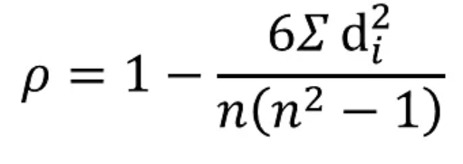
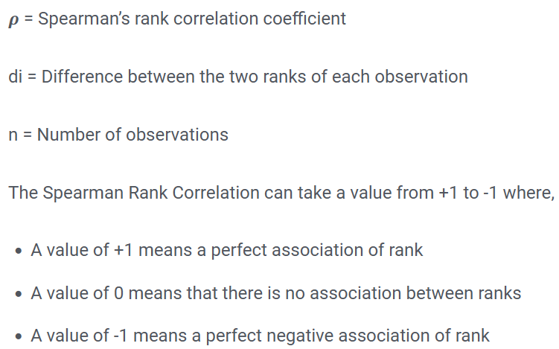

Spearman’s Correlation

Slide 61
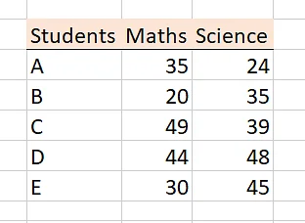
Spearman’s Correlation
Ejemplo: Queremos saber si los alumnos que sacan una nota alta en matemáticas, también lo hacen en ciencia.

Slide 62
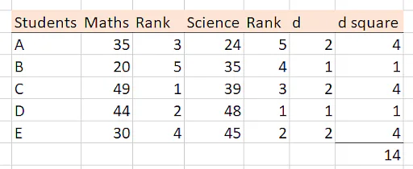
Spearman’s Correlation
Para ello ordenamos las notas por rango, calculamos la diferencia entre rangos y tomamos su valor al cuadrado.

Slide 63
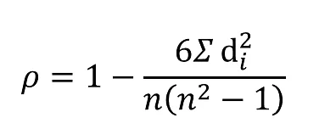
Spearman’s Correlation
Aplicando la fórmula, 1 – (6 * 14) / 5 (25 - 1) = 0,3
Con un valor de 0,3 existe una correlación de rangos de Spearman baja, no parece que sacar una nota alta en matemáticas se asocie con sacar una nota alta en ciencias.

Slide 65
Inference on qualitative data

Slide 67
Chi-square test
Chi-square test measures the difference between expected values and observed values. It’s applied to unordered categorical values.
Χ² depends on the magnitude of the effect, the number of freedom degrees and sample size.
Χ² is frequently used to test if two variables are dependent or independent of each other.
Χ² is also used to measure the goodness-of-fit between an observed frequency distribution and a theoretical frecuency distribution.

Slide 68
Chi-square test
Independence test: Is there any relationship between sex and the choice of a university degree?
-> Compare the observed frequencies between two or more groups against what would be expected by random chance. Is there association between the variables?
Goodness-of-fit: Would the coin in my hand follow a fair distribution of heads and tails, with p = 0.5?
-> Compare the observed frequency of a variable with what we could expect from a specific distribution.

Slide 69
This test tells us nothing about causality, it’s just a measure of association between two variables, and our knowledge of the biological question has to guide us in interpreting the result.
How can we calculate the expected frequency?

Slide 70

Example: a researcher is interested in knowing how to train cats to dance. For this, he trains two groups: he gives food to some, and affection to others. The question of interest is, does the type of training affect the ability of cats to learn to dance?

Slide 71
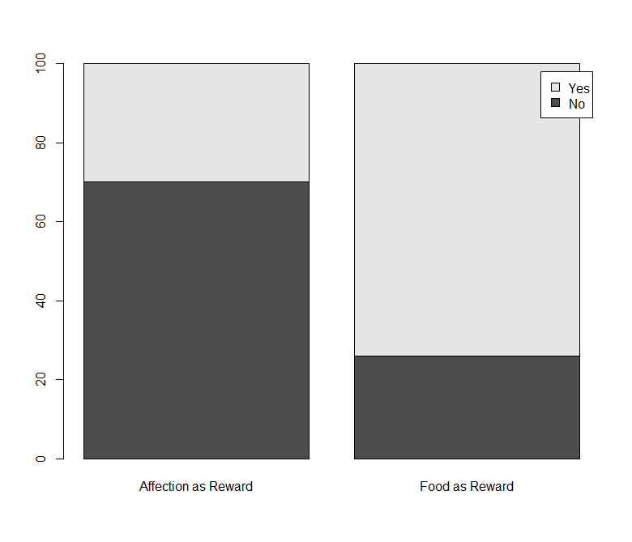
Contigency table (values)
Contigency table (proportions)

Slide 72
Chi-square test
Cats only care about food

Slide 73


Slide 74

But this doesn’t seem to make my life easier…

Slide 75
But this doesn’t seem to make my life easier…
There are many R packages that automate all of this: parametric assumptions, appropriate statistic test, plotting… and we are going to use some of them.
Be aware that you are always responsible of checking the validity and strictness of the methods and implementation of each package.
That’s a strong reason why knowing how to perform statistics calculations by hand, writing our own code, is always important.

Slide 76
Practical Exercise: Hematoma dataset
The hematoma dataset consists of 96 patients that have been through histerectomy. Some of those patients suffer from bruising after surgery. The dependent variable is Hematoma (si/no). We are mostly interested in type of surgery, Via robótica (si/no), Material sutura (stratafix/vicryl), Charlson (continuous) and Tiempo cirugía (continuous) as some important factors related to bruising. We will also check age and weight.
Is the type of surgery relevant in developing a post-surgery bruise?
Are the different suture materials important regarding bruising?
Are the lenght of the surgery and/or Charlson related to bruising?

Slide 77
Practical Exercise: Stent
The exercises will be available in three formats:
Empty (Exercise some R skills here)
With suggested functions that have to be filled (Exercise some R skills here light version)
Correction (R script located in your main folder)

