Slide 1

BLOQUE 3. DIMENSIONALITY REDUCTION

Slide 2
Dimensionality Reduction
Dimensionality reduction is the transformation of data from a high-dimensional space into a low-dimensional space so that the low-dimensional representation retains some meaningful properties of the original data. Working in high-dimensional spaces can be undesirable for many reasons. Methods that achieve dimensionality reduction are used for:
  Data compression
  Noise reduction
  Data clasification
  Data visualization

Slide 3

Dimensionality Reduction
In this course, we are going to briefly explain one of the most applied dimensionality reduction methods: Principal Component Analysis (PCA) with the purpose of data visualization, and we will extend this method to Factor Analysis of Mixed Data (FAMD) that will allow us to visualize clinical data.

Slide 4
HOW CAN THIS BE USEFUL?
We can plot high dimensional data in a two or three-dimensional space and discover patterns in our data!
High dimensional data can be: genes, methylation values, microbiome abundance, or clinical data.
Let’s see an example with the famous Iris dataset!

Slide 5
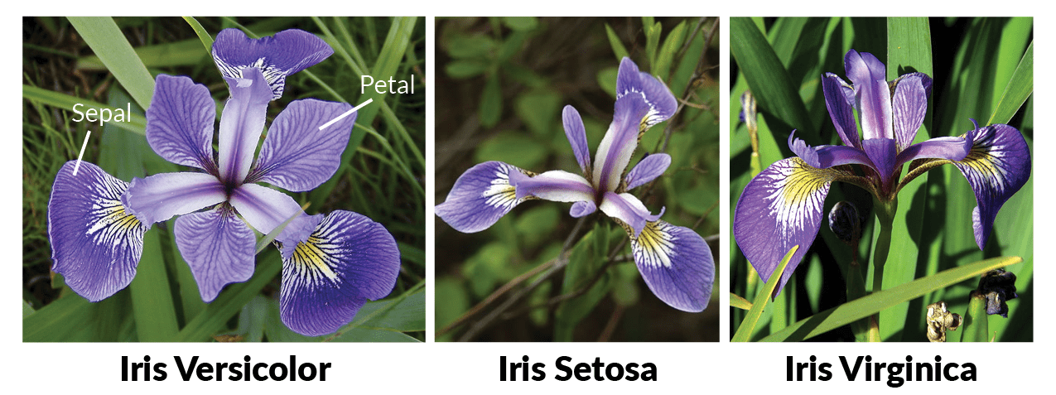
The Iris dataset
The famous iris dataset was first published in 1936 by Ronald Fisher. The use of multiple measurements in taxonomic problems as an example of linear discriminant analysis. The dataset contains 50 samples from 3 iris species: setosa, virginia, and versicolor. Four features are measured, all in cm: sepal length, sepal width, petal length, and petal width. Based on the combination of these four features, Fisher developed a linear discriminant model to distinguish the species from each other.

Slide 6
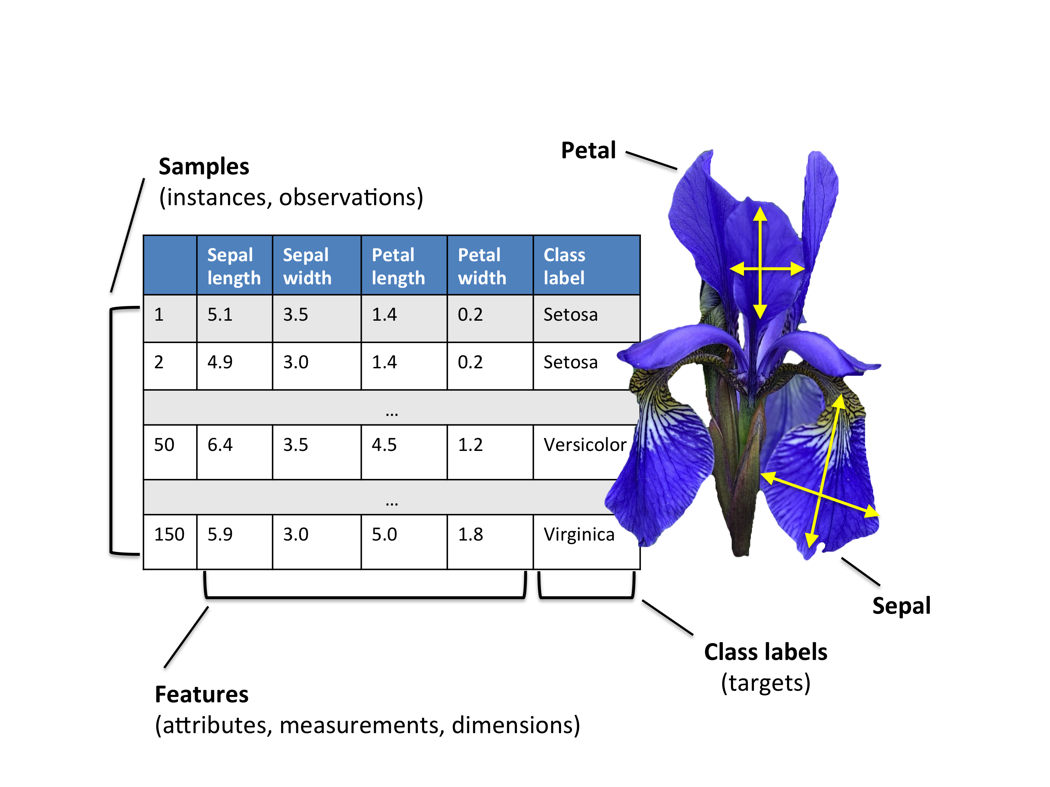

Slide 7
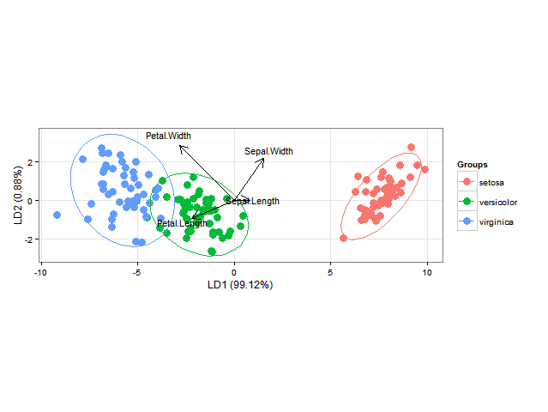

Slide 8
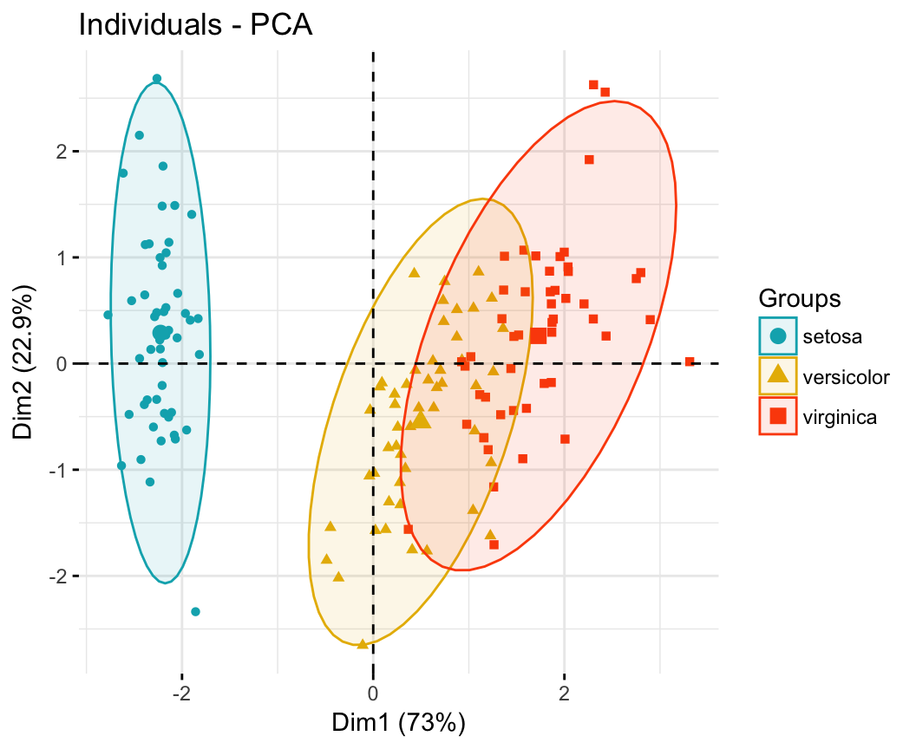

Slide 9
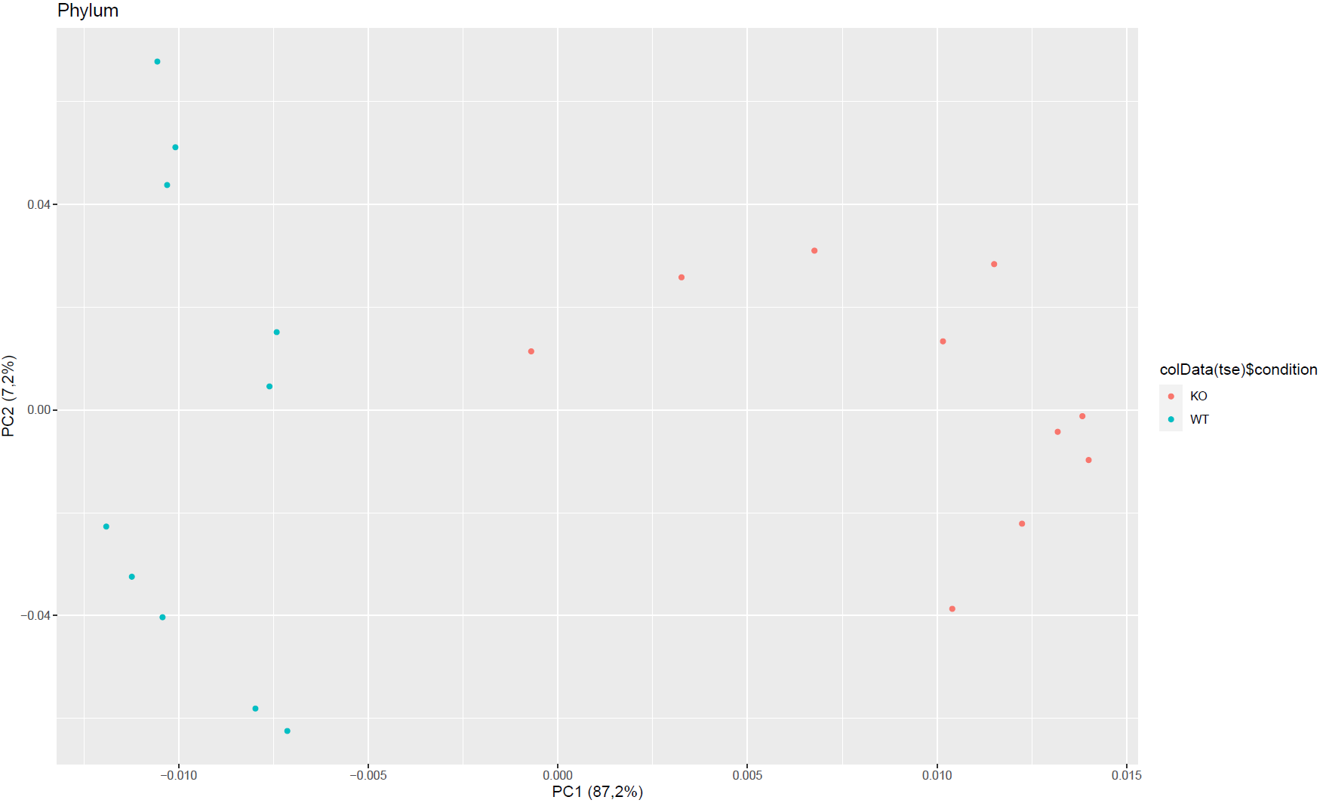

Slide 10
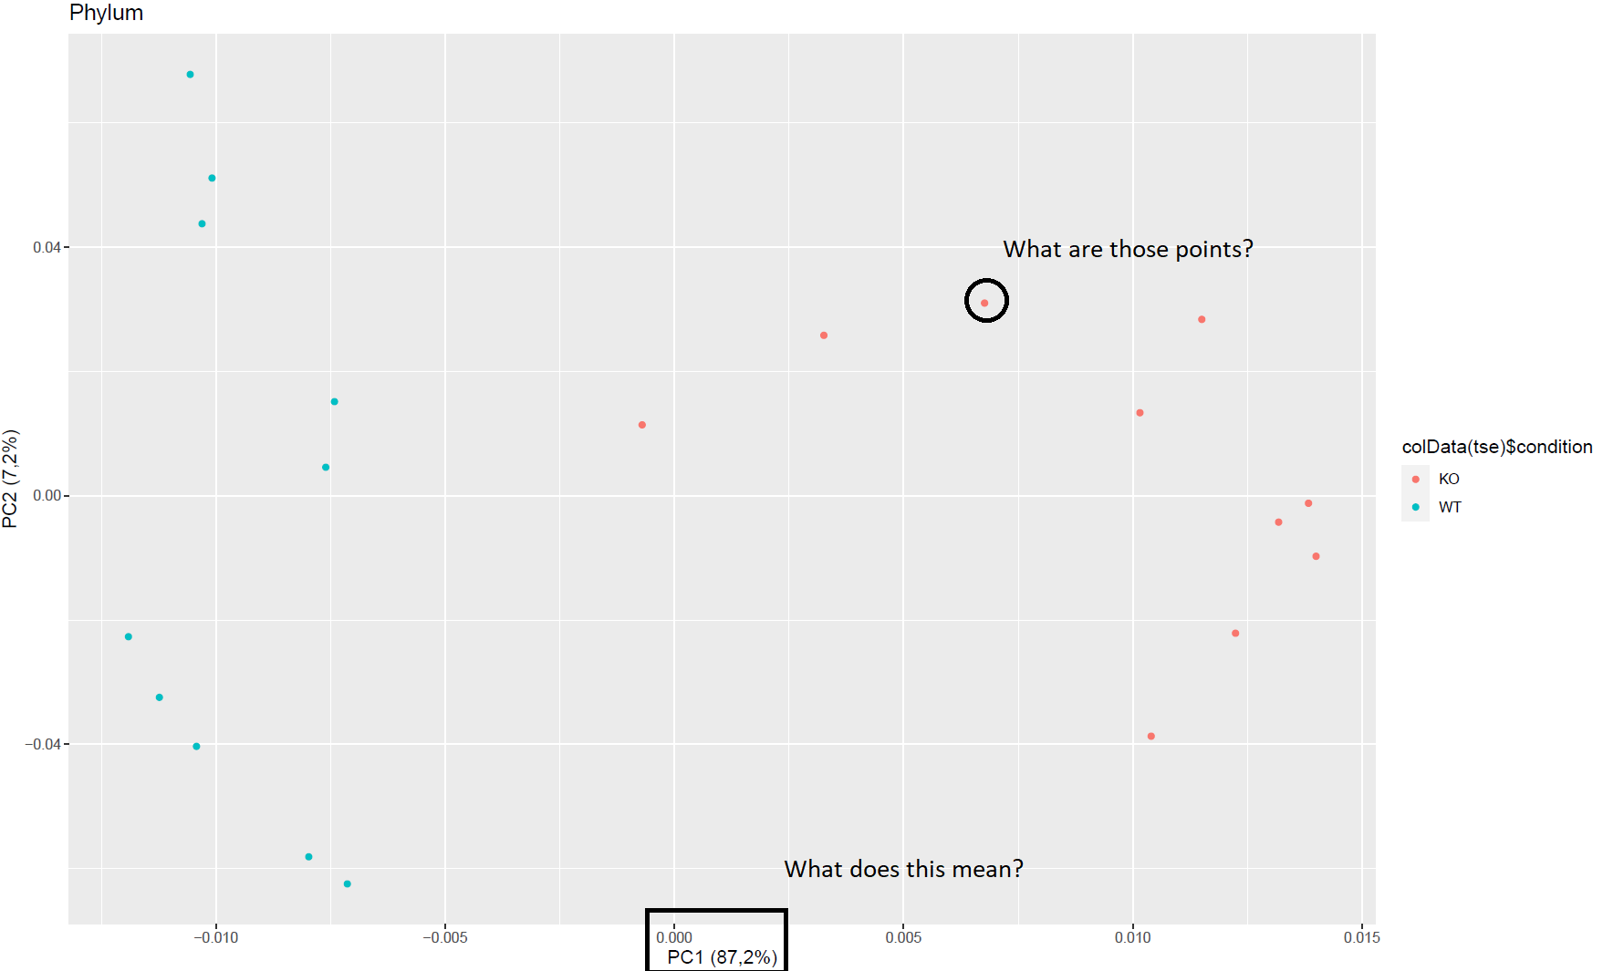
How can we construct and interpret a PCA??

Slide 11
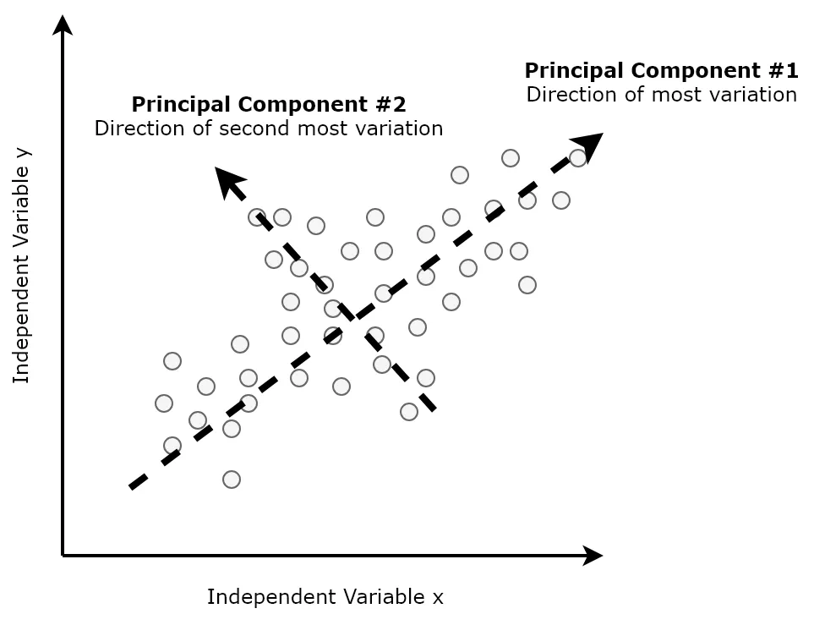
Principal Component Analysis (PCA)
Formally, PCA is a statistical technique for reducing the dimensionality of a dataset. This is accomplished by linearly transforming the data into a new coordinate system where (most of) the variation in the data can be described with fewer dimensions than the initial data.

Slide 12
Practical Exercise: Mouse microbiome
We have microbiome expression data from 35 mouses. Some of them receive a High Fat Diet (HFD) and the rest receive a Normal Chow Diet (NCD). Within these groups, there are mouses that can eat Ad libitum (AL), but some are forced to do two different fasting protocols (IF1:1 and IF2:1).
We would like to know if microbiome can differ between HFD vs NCD and also between AL vs. Fasting.
Performing a PCA analysis will allow us to plot each mouse in a two-dimensional plane, and the variables that define each mouse are different microbiome genuses.
*The data has been CLR-transformed prior to the analysis.

Slide 13
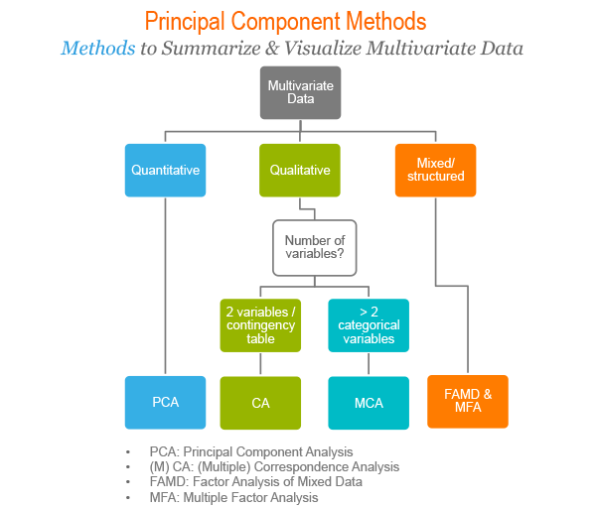

Slide 14
Factor Analysis of Mixed Data (FAMD)
FAMD is a Principal Componen method that can be seen as a mix between PCA and Multiple Correspondence Analysis (MCA). It acts as a PCA over quantitative variables and as MCA over qualitative variables.
This can be useful to visualize clinical data, which usually consists in both quantitative and qualitative variables.

Slide 15
Practical Exercise: Hematoma dataset
Before, we performed some data exploration and statistical tests with the hematoma dataset. Now it’s time to get a useful visualization using FAMD, to get some insights about our data’s structure.
* The hematoma dataset had some variables removed to simplify the analysis. Now we will have to load the original one (case_control.xlsx)

