Slide 1
Nanopore direct RNA sequencing
Kat Lee
BIMM 143 Spring 2021

Slide 2
How does Nanopore sequencing work?
https://www.youtube.com/watch?v=qzusVw4Dp8w

Slide 3
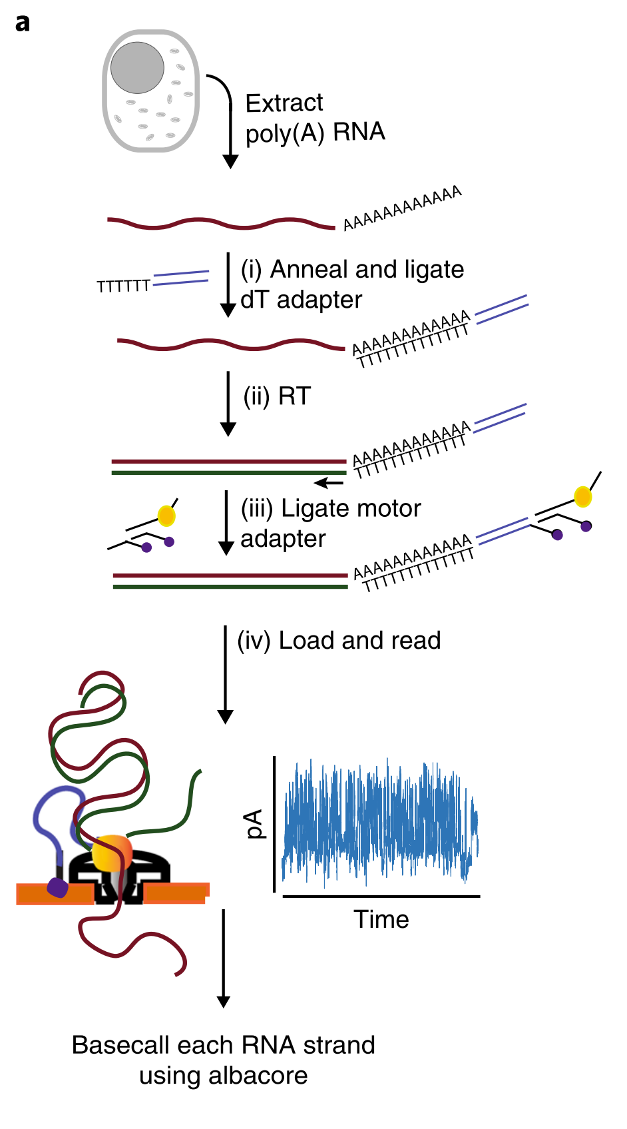
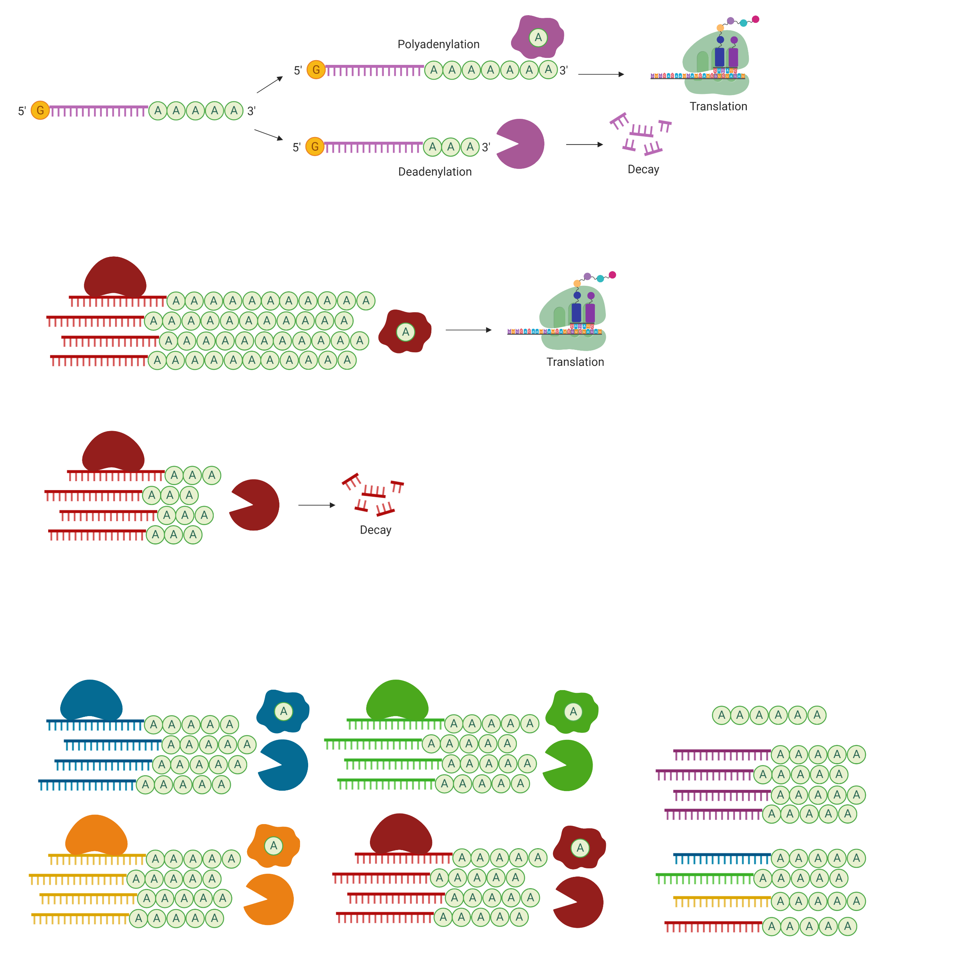
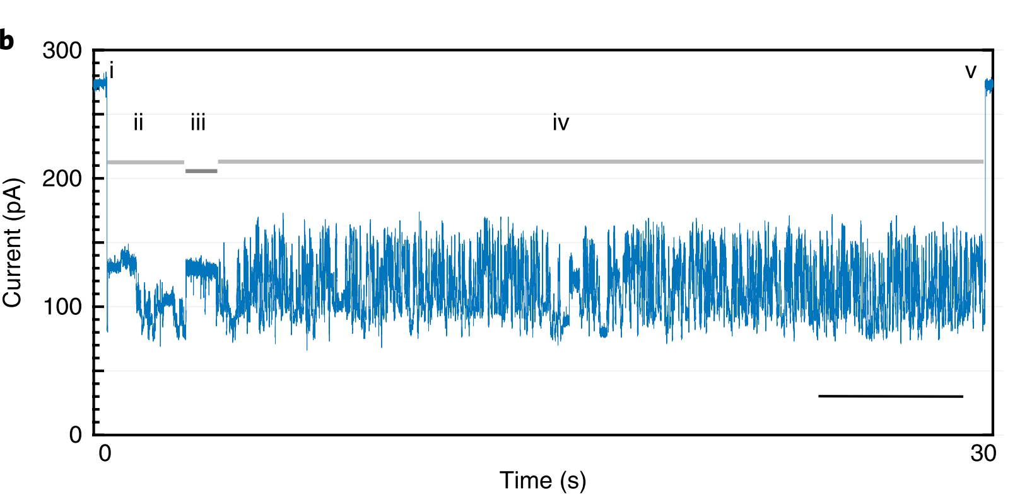
Nanopore direct RNA sequencing can measure polyA tail lengths
3’
5’
Strand capture
ONT adapter translocation
Poly(A)+ RNA tail translocation
mRNA translocation
Strand exit
Workman et al. Nature Methods, 2019.
Notes:
For those who might not be familiar with Nanopore DRS, basically, after library prep, each RNA transcript is sequenced by being strung through a nanopore, and as it travels through the nanopore, each base causes characteristic changes in the current flowing through the flow cell, such that the current readout can be used to measure the length of the polyA tail. Since the mRNA transcript travels through the nanopore at a constant speed, the length of the polyA tail correlates with the amt. of time it takes to travel through the nanopore. And so by measuring the amt. of time it takes to travel through the nanopore, the polyA tail length can be measured.

