Slide 1

@marcos_quesada

Slide 2

Who am I?
Always hungry of knowledge
Symfony 2 lover
Rigor path follower... or searcher
Google Addict
Testing believer
Backend Developer at SocialPoint
@marcos_quesada
marcos.quesadas@gmail.com

Slide 3
Index
TDD Introduction
Mockery
BDD Introduction
Behat
Mink
Selenium

Slide 4
Which is the value of testing?
TDD & Unit Tests
BDD
  SpecBDD
  StoryBDD
Acceptance Tests
Integration Tests

Slide 5
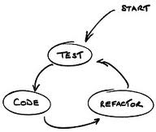
Unit Test
Driven Development
Focus on class Methods
Conceptually Isolated test
Value?

Slide 6
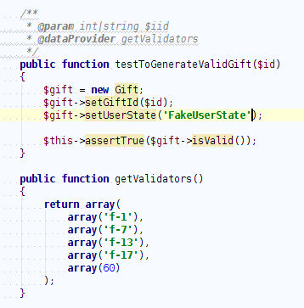
Basic Unit Test

Slide 7
TDD & Unit Testing
Development time increased
  25%-15% time when mastering
Design and Quality code is dramatically increased
Code coverage metrics
Unit Test !== Integration tests

Slide 8
Unit Testing
Class interactions:
  Things become tricky
  How much isolation we need?
  Lot's of Mocks&Stubs... But it is very Useful?

Slide 9
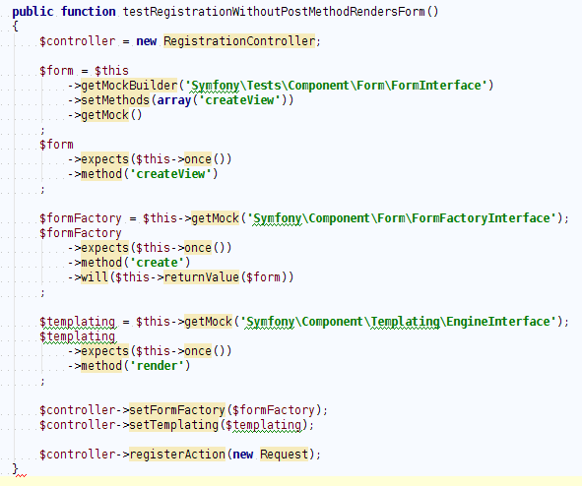
Mocking class behavior

Slide 10
Mockery
Alternative to PHPUnit
simple&flexible PHP mock object framework
Focus on Easy mocking
Great API

Slide 11
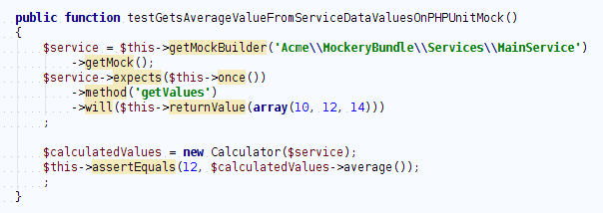
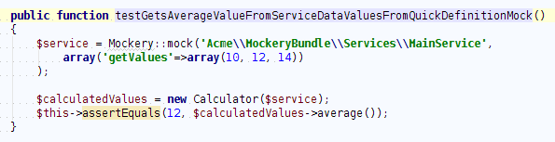
Basic Mock with Mockery
Mock Example with PHPUnit
Mock Example with Mockery

Slide 12
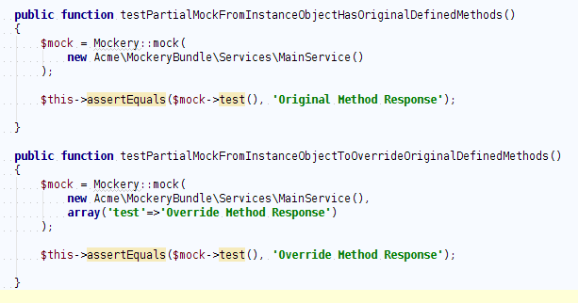
Does things that others can not
Create Mocks from object instances

Slide 13
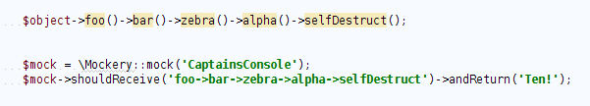
Does things that others can not
Great typeHinting definition, from Classes or interfaces, even both!!
Fluent interface definition

Slide 14
Does things that others can not
Define public attributes from Mock Class
  $this->container->get('router')
Mocking Public Static Methods
Ability to Mock Final Class
Return different Mock responses as secuence
  $this->get('router')
  $this->get('my.service')

Slide 15
OK! Great... but
Unitary Test must be ATRIP:
  Repeatable, Isolated, Independent, Automated
But It's no easy to write correct Tests
  What should I test?
  How should I name this test?
  Where do I start?
  How much to test?
  How to understand why a test fail?

Slide 16
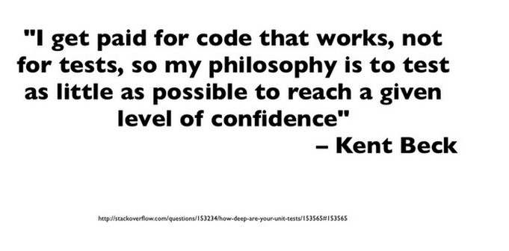
How much value has indeed?
Image taken from Alvaro Videla presentation

Slide 17

So ...

Slide 18
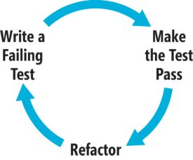
BDD
Behavior Driven Development
Created by Dan North
Migrates test focus to behavior
SpecBDD Vs StoryBDD
PHPSpec orientation

Slide 19
How much value has indeed?
We have moved our focus from methods to class interactions
Code becomes:
  Better designed
  Focused on Behavior
But ...
  AGNY No extra features are needed
  Acceptance feature is not well delimited

Slide 20
Testing is great but...
Bussines has nothing to do with that
  It should ….
Classes are for developers
What we are missing?
  As developers we create funcionallities
  How much extra work are we adding to our development cycle?

Slide 21
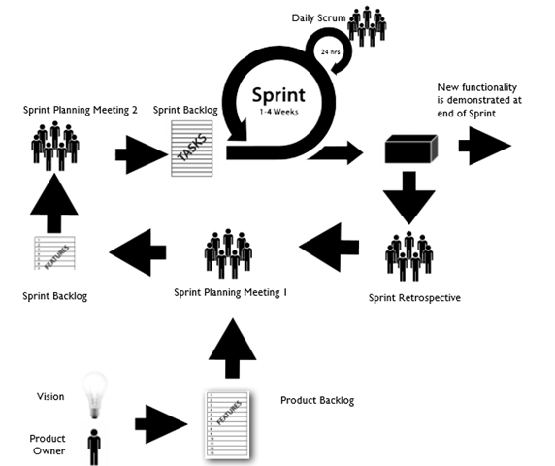
Agile Development Approach
Histories are created upon Tasks
User Stories describe a feature's benefit in context
Scenarios are executable acceptance criteria

Slide 22
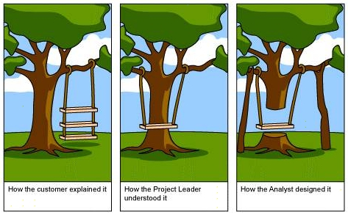
Avoid misunderstandings

Slide 23
Behat
Behat is a Bussines expectation framework
Created by @everzet
Behat is a Cucumber port to PHP
What mades that huge difference from SpecBDD to StoryBDD ?
  Feature definition
  Domain Specific Language (Gherkin)

Slide 24
Behat
Behat test a feature by executing its scenarios steps in a context
Is driven by bussines value
feature description:
  collaboration bettween developers and non-techies
Clear feature description&piorization gives as a result better estimation times

Slide 25
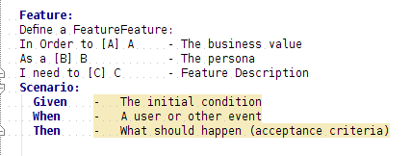
Gherkin
Easy to understand
Step definitions becomes test code

Slide 26
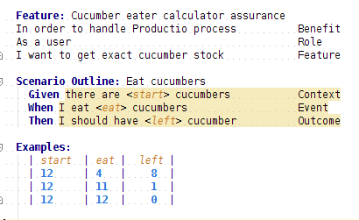
Basic Feature Description

Slide 27
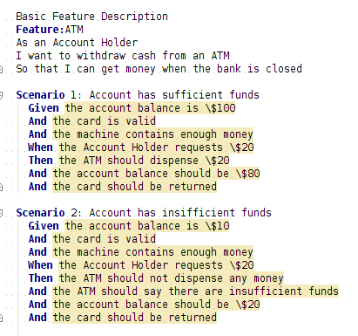
More Feature Definition

Slide 28
Let's install it
Install PHP base
  git clone git@github.com:marcosQuesada/Behat-Base.git
  curl http://getcomposer.org/installer | php
  php composer.phar install
  bin/behat --init
Or Install Sf2 Base
  git clone git@github.com:marcosQuesada/Symfony2-Behat-Base.git
  behat --init @AcmeDemoBundle

Slide 29
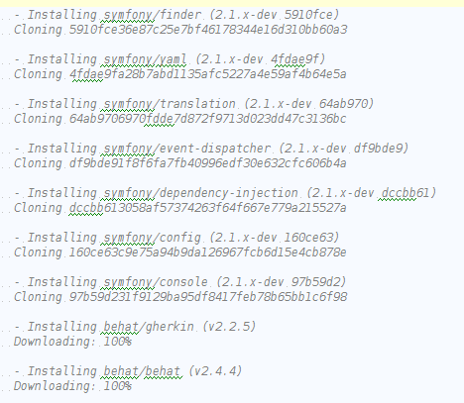
What's behind Behat

Slide 30
How does it work?
Behat give us our skeleton needs
uses Behat Known Regular Expressions
  Regex to grab test values
Uses any assertion tool to get response
  PHPUnit
  PHP Exceptions

Slide 31
API Feature Exercise
Time to code Step 1!
Example using Behat + Guzzle to test a public API (google maps postal code)
Get Feature description
  git clone git@github.com:marcosQuesada/API-Workshop-Exercise.git
Run api-geo Feature
  Behat

Slide 32

What we have?
Acceptance test pass!
Feature context steps are reusable

Slide 33
Context becomes BIG
Context segregation
  single implementation
Behat Contexts Extensions
  Behatch contexts
  DoctrineDataFixturesExtension
  MINK Context
  Common Context ...

Slide 34
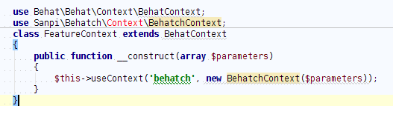
Working with Subcontexts
Adding subcontexts
Subcontext bridging
Notes:
http://docs.behat.org/guides/4.context.html

Slide 35
Refactor Your Code
Time to code Step 2!
You have tested an external api
Time to create your own implementation
  Use Your previous tests!
Run api Feature
  Behat

Slide 36
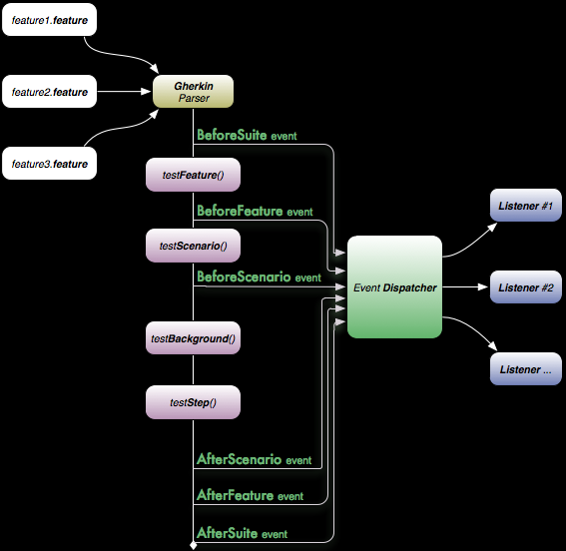
Behat Event System

Slide 37
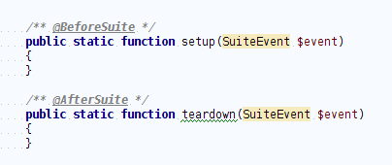
Behat Event System
Notes:
http://docs.behat.org/guides/3.hooks.html

Slide 38
Mink Context
Web Behavior expectation
Support HTML - @javascript
Lot's of drivers
  Headless Browser
    Goutte
  Browser handler
    Selenium
    Sahi
    Symfony 2 webDriver
Notes:
http://docs.behat.org/cookbook/behat_and_mink.html

Slide 39
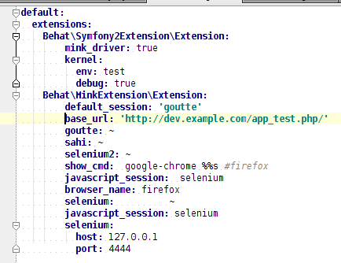
Install Mink
Behat.yml
Notes:
http://docs.behat.org/cookbook/behat_and_mink.html

Slide 40
Mink API
$this->visit($url);
$this->getSession()->getPage()->getContent()
$this->getSession()->getStatusCode()
$this->getSession()->reload()
$this->getSession()->back()
$this->getSession()->forward()evaluate JS expressions
$this->getSession()->evaluateScrip("alert('Hello'");
wait N milliseconds or till JS expression becomes true
$this->getSession()->wait(5000,
"$('.suggest_class').children().lenght > 0"
);

Slide 41
Check available definitions
Exec:
  behat –definitions l (behat -dl)
  Then /^print last response$/
  Then /^show last response$/

Slide 42
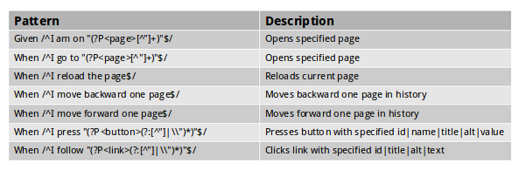
Tools to manage the web browser
Image taken from Jakub Zalas presentation

Slide 43
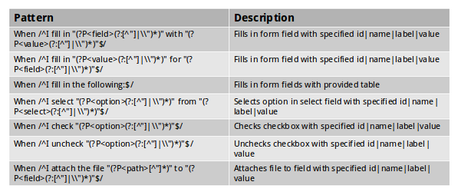
Tools to work with forms
Image taken from Jakub Zalas presentation

Slide 44
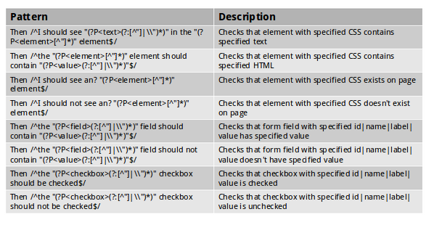
Tools for queryng the DOM
Image taken from Jakub Zalas presentation

Slide 45
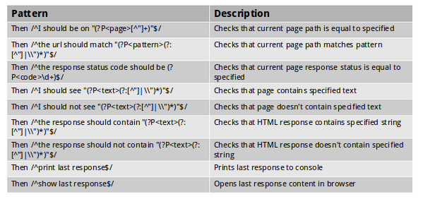
Tools to examine responses
And even more features ...
Image taken from Jakub Zalas presentation

Slide 46
Selectors
Behat driver uses Xpath Selectors
  $xpath = $handler->selectorToXpath('xpath', '//html');
CSS Selectors can be translated
  echo $cssSelector->translateToXPath('h1 > a');
Finder Methods
$fieldElement = $page->find('named',
array('field', 'id|name|value|label')
);
$elementByCss = $page->find('css', 'h3 > a');

Slide 47
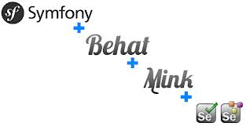
Behat+Mink+Selenium Example
Selenium server:
  Download from http://seleniumhq.org/download
  java -jar selenium-server-standalone-2.15.0.jar
Behat.yml
default:
context:
parameters:
javascript_session: selenium
base_url: http://en.wikipedia.org/
browser: firefox
show_cmd: open %s

Slide 48
Feature Description
Feature: Blog Search
In order to search blogs
As a sauce user
I need see blogs
@javascript
Scenario: Search Behat Blogs
Given I am on "/wiki/Wikipedia"
When I fill in "s" with "behat"
And I press "Search"
Then I should see "Behat"

Slide 49
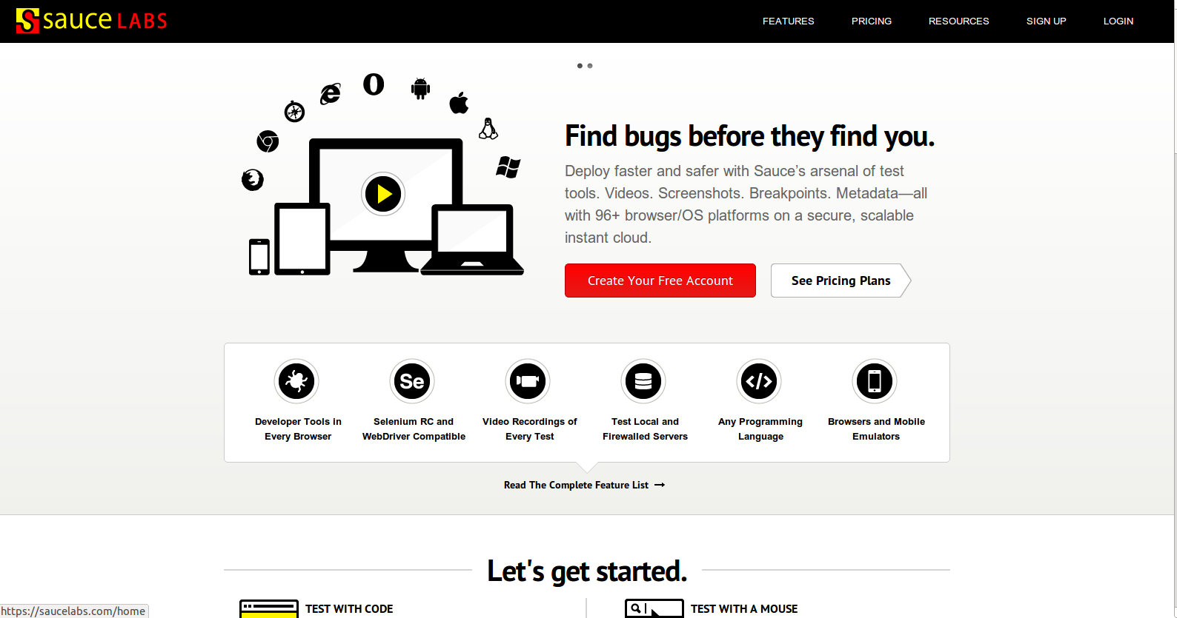
Adding Sauce

Slide 50
Adding Sauce
Sauce Labs easy integration
  Username & API key
Create sauce.yml
default:
context:
parameters:
default_session: selenium
javascript_session: selenium
base_url: http://en.wikipedia.org/xxx
browser: firefox
selenium:
host: ondemand.saucelabs.com
port: 80
browser: >
{
"username": "name",
"access-key": "APIkey",
"browser": "firefox",
"browser-version": "7",
"os": "Windows 2003",
"name": "Testing Selenium with Behat"
}

Slide 51
Running on Sauce
exec with:
  behat -c sauce.yml
View result video of this job:
  http://snipurl.com/21huj12
reports generate in 'report/report.html'

Slide 52
Testing Javascript
Not posible on Headless Browser
  Goutte
Javascript element interaction
  Symfony 2 webdriver
  Selenium2

Slide 53
Mink Login Feature Exercise
Mink + Selenium server
Download Selenium Server
  http://seleniumhq.org/download/
Get Feature description
  git clone git@github.com:marcosQuesada/Login-Workshop-Exercise.git
Run login Feature
Do what you want …. but Pass it again

Slide 54
Conclusion
Behat features are meaningful
Behat is Driven Development
Behat is complementary to TDD and Unit testing
Best approach to service assurance
Let's use it now!

Slide 55
References
Mockery:
  https://github.com/padraic/mockery
Behat:
  http://behat.org/
Mink:
  http://mink.behat.org/

Slide 56
Workshop Links
Behat PHP Base
  https://github.com/marcosQuesada/Behat-Base.git
Symfony 2 Behat Base
  https://github.com/marcosQuesada/Symfony2-Behat-Base
Workshop Features
  https://github.com/marcosQuesada/API-Workshop-Exercise.git
  https://github.com/marcosQuesada/Login-Workshop-Exercise
Mockery Examples
  https://github.com/marcosQuesada/MockerySf2
My Exercise Solutions
  https://github.com/marcosQuesada/Api-Behat-Testing
  https://github.com/marcosQuesada/Behat-Login-Exercise

Slide 57



Thank you!
Twitter: @marcos_quesada
Linkedin: marcosquesada
marcos.quesadas@gmail.com

