Slide 1

Lab Book 3. Interferometers I – MZI
Student: Marcos Carañana Castillo

Slide 2




Instructions General
SOFTWARE
Python notebook supplied by instructors
SCRIPTS
From Poliformat → download the 030_INTERFEROMETERS_v2025_Student_UPDATE2.ipynb
https://github.com/cccanvas-upv/pic-upv-lab3.git
COMPONENT to be studied: Mach-Zendher Interferometer (MZI)
$β_{u}$, $L_{u}$
In2
Out2
$$k_{a}$$
$$k_{b}$$
In1
Out1
$β_{d}$, $L_{d}$

Slide 3

ASSESSMENT #1 – Recap from theory – MZI configurations
Provide one example of implementation for each one of the configurations studied during MZI lecture:
Balanced configuration
2. Unbalanced configuration:
2.1. Phase difference
2.2. Delay imbalance
Compute also some examples with $α≠0$ and $γ≠0$
Document all your results (neff, alpha, gamma, transfer function plots, etc.) and comment on the obtained results (in terms of FSR, amplitude, losses, etc.).

Slide 4
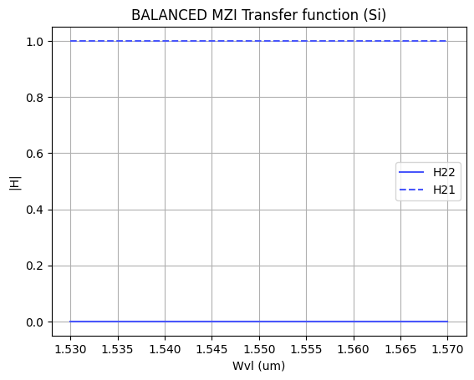




1. Balanced Configuration
$α=0$ and $γ_{a, b}=0$
$k_{a}=0.5$ and $k_{b}=0.5$
$${n_eff}_{u}={n_eff}_{l}$$
$L_{u}=L_{l }$ $=5 um$
Al medir lo mismo los brazos, la luz de cualquier longitud de onda interferirá de la misma manera, en este caso toda la potencia por el puerto cross.

Slide 5
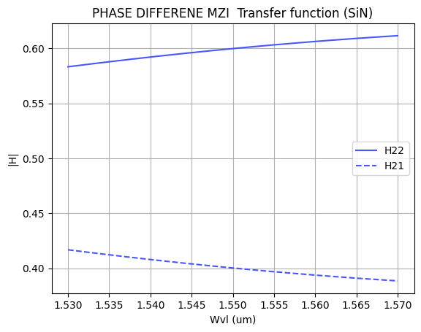
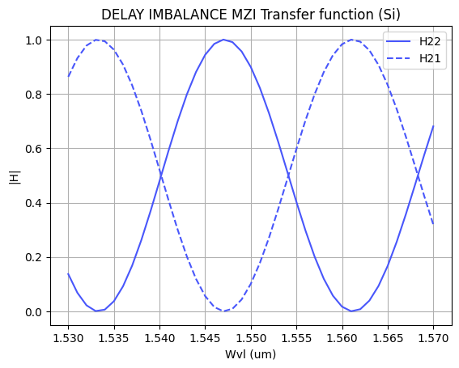








2. Unbalanced Configuration
2.1 Phase difference
$α=0$ and $γ_{a, b}=0$
$k_{a}=0.5$ and $k_{b}=0.5$
$${n_eff}_{u }!={n_eff}_{l}$$
$L_{u}=L_{l }$ $=25 um$
En este caso, al tener los brazos, distinto índice efectivo, al variar la longitud de onda de la fuente, si habrá dependencia de la interferencia con la longitud de onda. Esto se debe a que la luz se propagará de distinta manera en cada brazo.
2.2 Delay imbalance (Si)
$α=0$ and $γ_{a, b}=0$
$k_{a}=0.5$ and $k_{b}=0.5$
$${n_eff}_{u }={n_eff}_{l}$$
$L_{u}={ 5 and L}_{l }$ $=25 um$
Al haber una diferencia de caminos, se introduce un desfase entre brazos haciendo la interferencia dependiente de la longitud de onda.

Slide 6
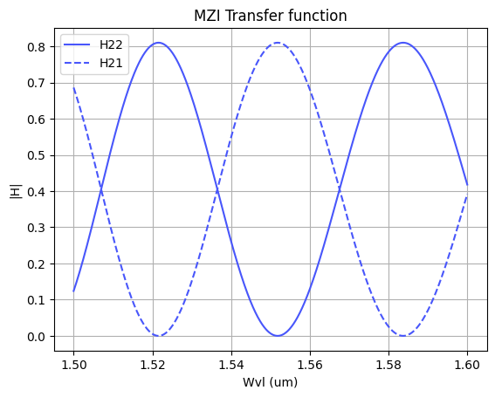
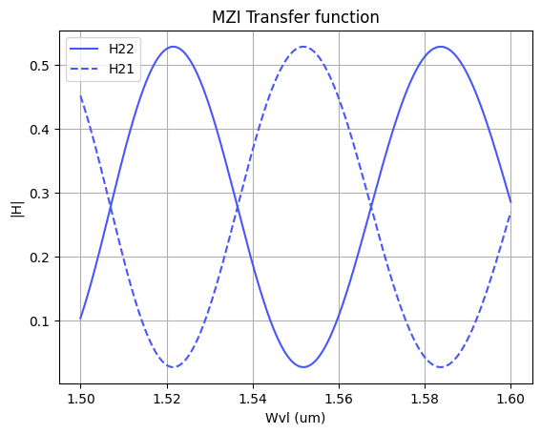
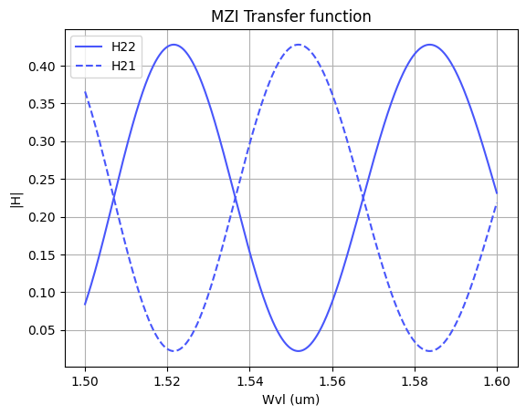












3. $γ≠0 and α≠0 ,$SiN platform
$α_{a,b}=0$ and $γ_{a, b}=0.1$
$α_{a,b}=0.1$ and $γ_{a, b}=0$
$α_{a,b}=0.1$ and $γ_{a, b}=0.1$
$${n_eff}_{u }={n_eff}_{l}$$
$${n_eff}_{u }={n_eff}_{l}$$
$${n_eff}_{u }={n_eff}_{l}$$
$k_{a}=0.5$ and $k_{b}=0.5$
$k_{a}=0.5$ and $k_{b}=0.5$
$k_{a}=0.5$ and $k_{b}=0.5$
$L_{u}={ 25 and L}_{l }$ $=5 um$
$L_{u}={ 25 and L}_{l }$ $=5 um$
$L_{u}={ 25 and L}_{l }$ $=5 um$
De estas 3 simulaciones, se puede interpretar que las pérdidas por propagación predominan sobre las pérdidas de exceso; por que, al introducir unas pérdidas de propagación del 10% la potencia máxima de salida es menor que al introducir un 10% en las pérdidas de exceso.

Slide 7
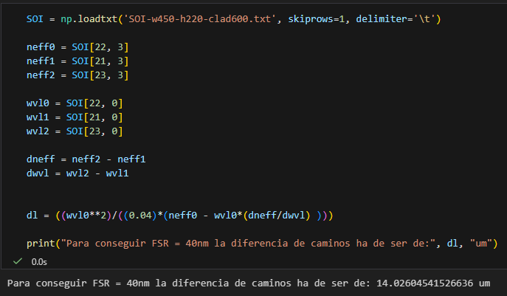
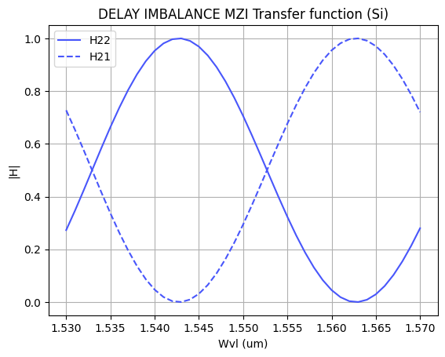
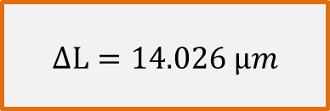
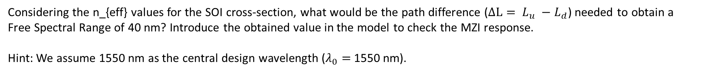
ASSESSMENT #2 – Recap from theory – Calculation of $ΔL$
Considering the n_{eff} values for the SOI cross-section, what would be the path difference ($ΔL= L_{u} −L_{d}$) needed to obtain a Free Spectral Range of 40 nm? Introduce the obtained value in the model to check the MZI response.
Hint: We assume 1550 nm as the central design wavelength ($λ_{0}=$1550 nm).
$$ΔL=14.026 μm$$

Slide 8
ASSESSMENT #3 – SAX implementation
Now, we are going to implement the design parameters in the MZI model developed in SAX and compare the response obtained with the one simulated by mathematical formulation. This will help us to identify any error in the definition of the SAX model single components.
In order to implement the SAX model, take as example the following lines:
mzi_test = mzi(wl=wl,
coup_a = ...
wvg_d={"length": l_d, "neff": ...},
wvg_u={"length": l_u, "neff": ...},
coup_b = ... )
H00 = mzi_test["in0", "out0"]
Document all your results (copy here the code employed to obtain the transfer function employing SAX modeling and include the comparative plot of the models)

Slide 9
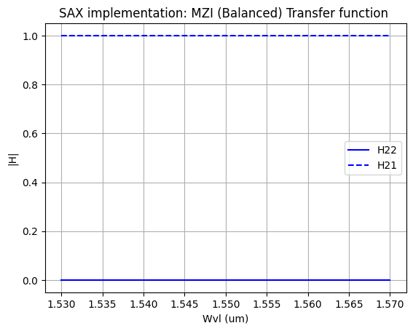
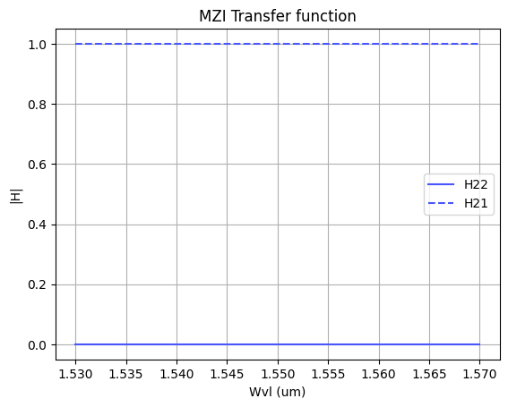
3. SAX implementation vs. Mathematical formulation
3.1 Balanced configuration
Ciñiendonos a los resultados podemos concluir que la implementación SAX funciona correctamente. No obstante, voy a hacer más simulaciones para comprobar su comportamiento en otras configuraciones.

Slide 10
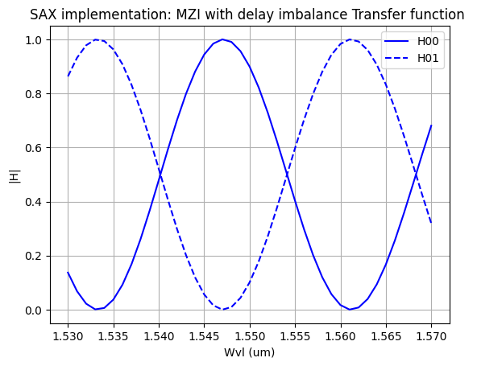
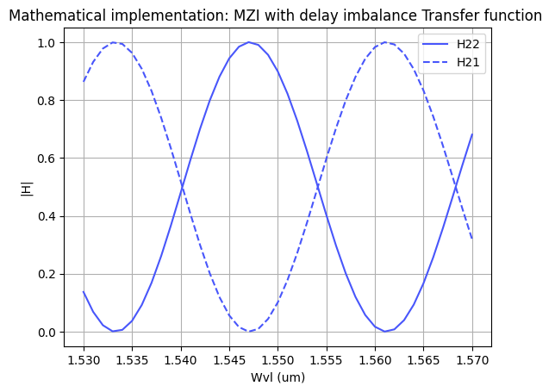




3. SAX implementation vs. Mathematical formulation
3.1 Unbalanced configuration:
$α=0$ and $γ_{a, b}=0$
$k_{a}=0.5$ and $k_{b}=0.5$
$${n_eff}_{u }={n_eff}_{l}$$
$L_{u}={ 5 and L}_{l }$ $=25 um$
Con esta simulación se comprueba que la matriz de transferencia de un MZI se modela de igual manera con la implementación matemática que mediante SAX.

Slide 11
Extra assessments
Assessment 4. Design an MZI for filtering at a specific wavelength. Calculate and adjust the arm lengths to configure the MZI to have a maximum transmission at 1550 nm.
Assessment 5. Let's see how the response of the MZI varies with the effective index. Vary the effective index of one of the arms and analyze how the spectrum shifts. To do this, you can use the data provided in the .txt files entitled ‘SiN’. Can you give an example of an application where this configuration is used?
Advanced level assessment. Explore how cascading two MZIs affects the transmission spectrum. To do so, design a system in which two MZIs are cascaded. Simulate and observe the spectrum, explaining how the transmission peaks behave.
Document all your results

Slide 12
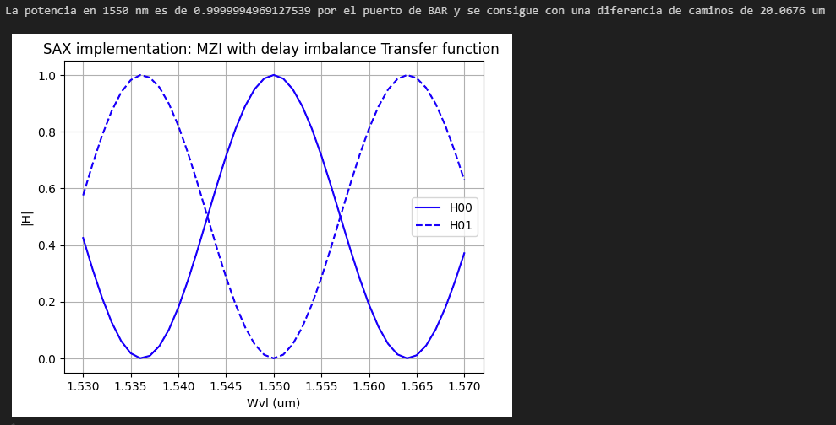
Assessment 4. Design an MZI for filtering at a specific wavelength. Calculate and adjust the arm lengths to configure the MZI to have a maximum transmission at 1550 nm.

Slide 13


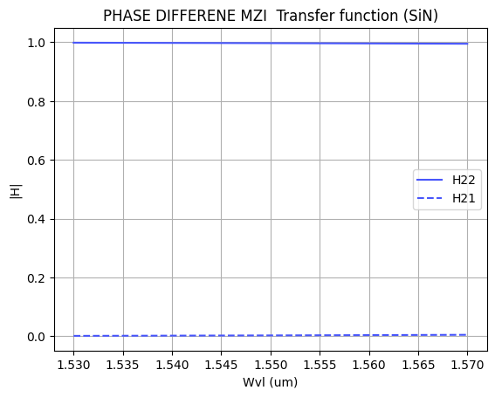
Assessment 5. Let's see how the response of the MZI varies with the effective index. Vary the effective index of one of the arms and analyze how the spectrum shifts. To do this, you can use the data provided in the .txt files entitled ‘SiN’. Can you give an example of an application where this configuration is used?
El gráfico de la izquierda muestra la respuesta del MZI si uno de sus brazos es expuesto a agua y el de la derecha si uno de sus brazos se expone al aire. Vemos como hay más variación a la longitud de onda con el aire, esto se debe a una mayor diferencia de índices de refracción.
Esta configuración es muy interesante en el diseño de los sensores de alta precisión, ya que si una partícula de distinto índice al del medio se posa sobre este brazo haría cambiar la función de transferencia del MZI.

Slide 14

Thank you

