Slide 1
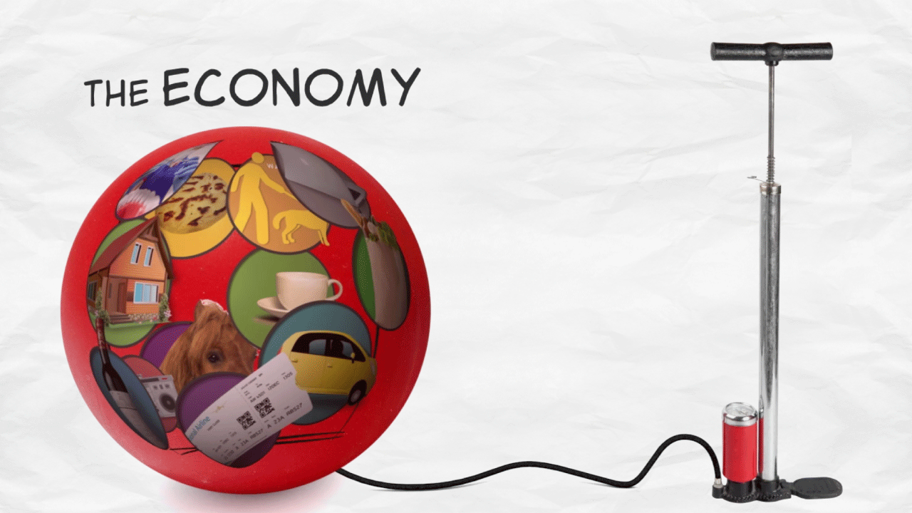

INFLATION ARE TWITTER USERS NOTICING INFLATION?
PATRICIA MARTINEZ SANZ
ANA PACELLA
MARCOS CASTILLO

Slide 2
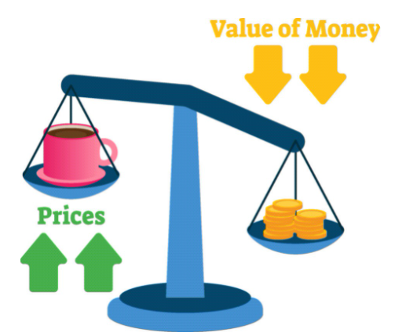
INFLATION
Rate of increase in prices over a given period of time.
Typically, a broad measure, such as the overall increase in prices or the increase in the cost of living in a country.
THE ANNUAL RATE OF INFLATION IN THE US HIT 6.2 %IN OCTOBER 2021

Slide 3
methods
DATA COLLECTION:
We collected over 119.000 tweets over the course of a week.
We used Twitter API to collect the tweets.
TEXT ANALYSIS
DIFFERENT MODELS
ASSOCIATION RULES

Slide 4
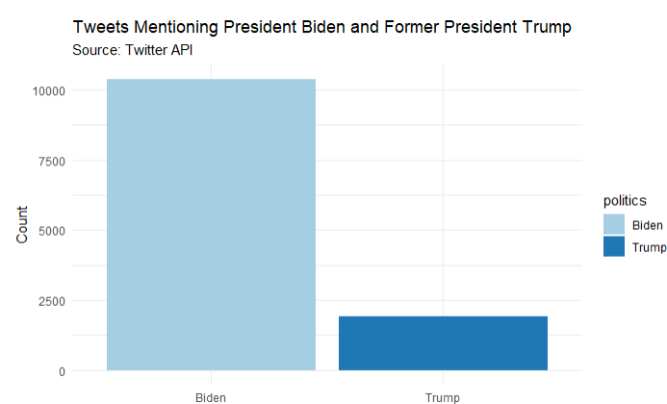
findings

Slide 5
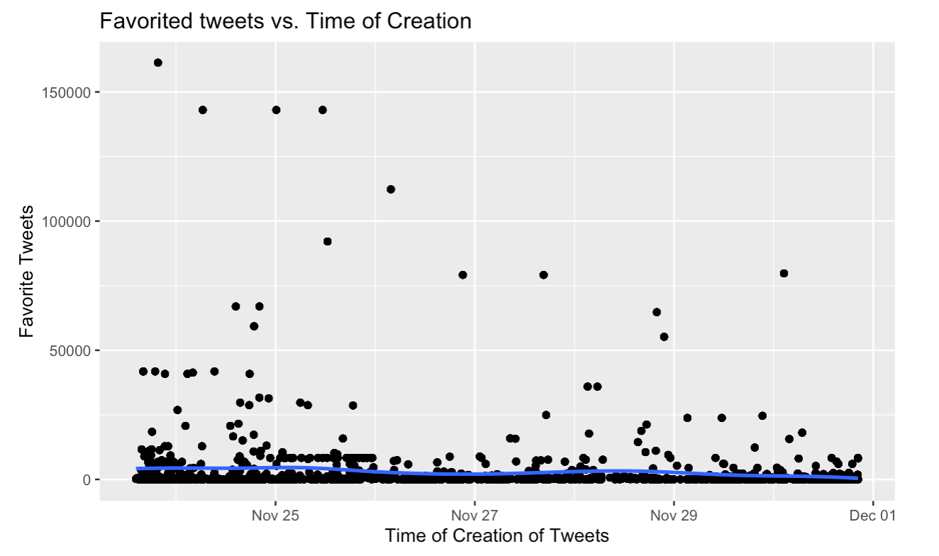
Text analysis

Slide 6
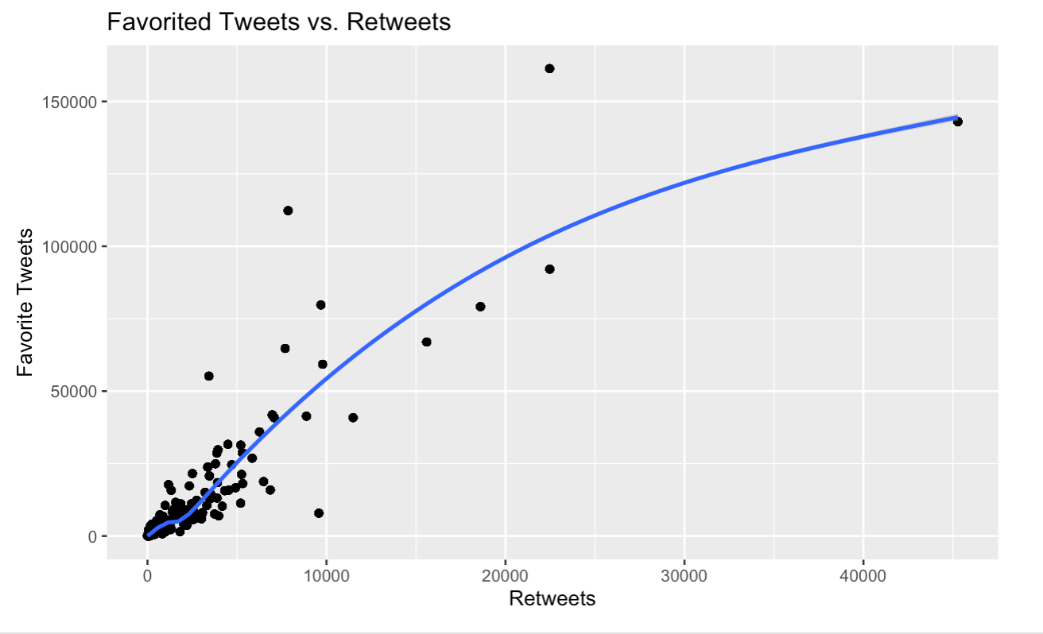
Text analysis

Slide 7
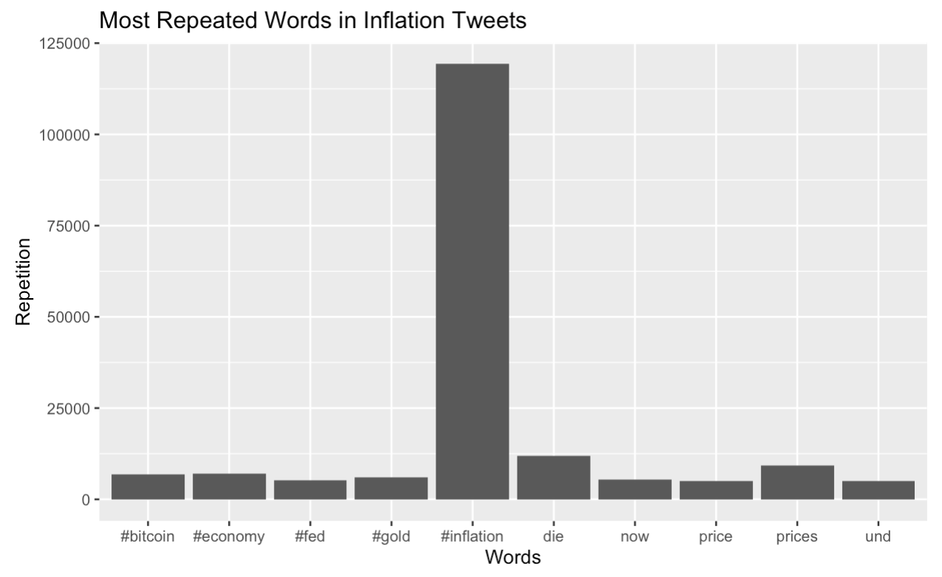
Text analysis

Slide 8
Text analysis
119,884
Hashtags
36,284
Mentions

Slide 9
Text analysis
7,296
Bitcoin
2,052
Bidenflation

Slide 10
ASSOCIATION rULES
DATA
@SenateDems | It | is | the
It | is | funny | how
@MSNBC | The | best | is
@MSNBC | The | $USDis | very
#DowJones | Dives | As | #Powell
Hey | St. | Louis | Fed!â€¦
Canadian | HELOC | Balances | Rise
The | Fed's | Moral | Hazard
U.S. | Inflation | Pressures | Grow
The | Nearing | Energy | Cliff

Slide 11
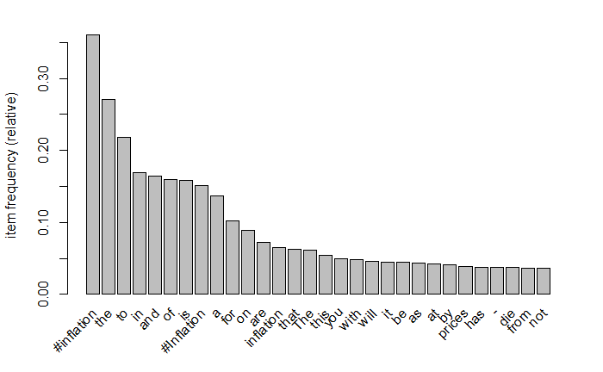
findings

Slide 12
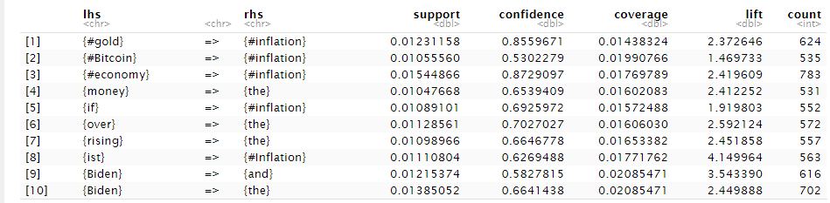
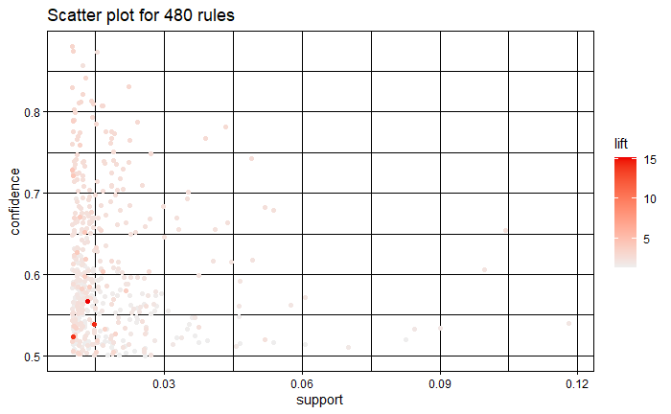
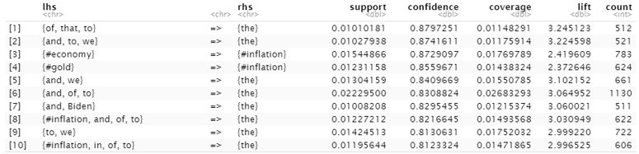
FINDINGS

Slide 13
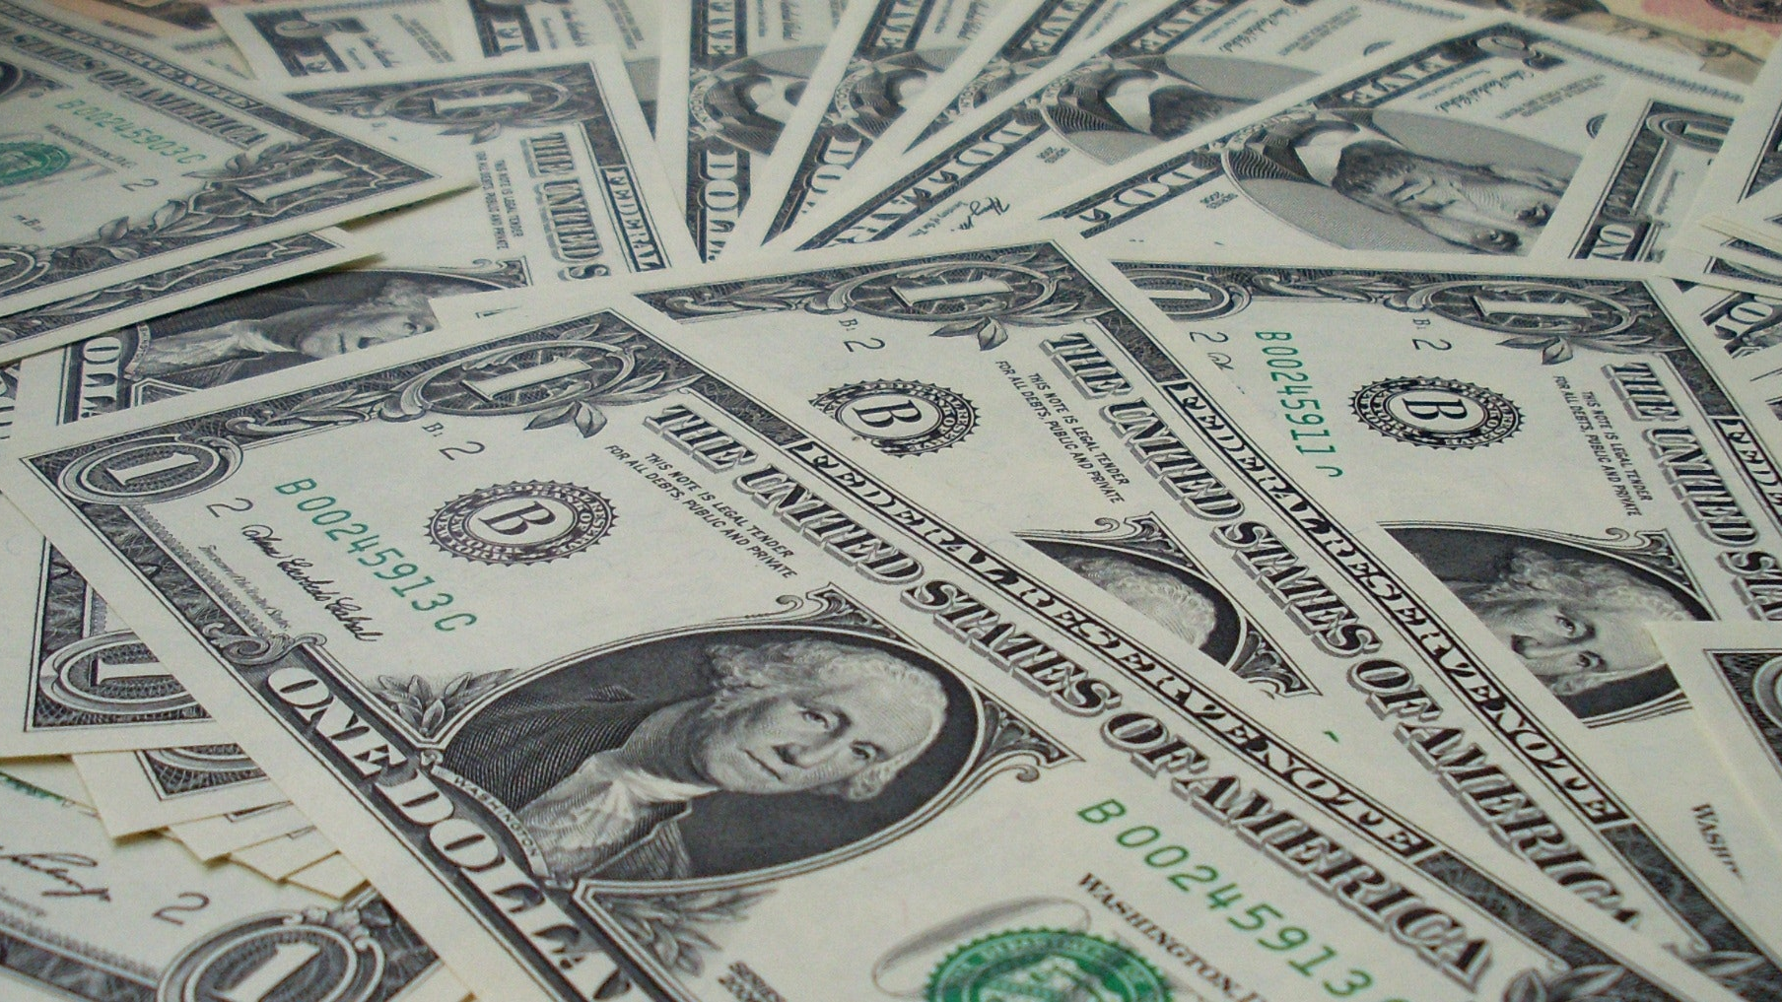
Thank you

