Slide 1
Kubernetes, AWS, ALBs, Terraform and no Helm

Slide 2
About me
Bachelor in Computer Science
DevOps at ModusCreate.com ( Remote First Consulting Company )
AWS Certified
https://github.com/marcosdiez/
Pull Requests relevant to this talk:
Minikube (more than 10)
https://github.com/kubernetes/minikube/pulls?q=is%3Apr+author%3Amarcosdiez
Kubernetes Dashboard (more than 30)
https://github.com/kubernetes/dashboard/pulls?q=is%3Apr+author%3Amarcosdiez
terraform-provider-kubernetes
https://github.com/hashicorp/terraform-provider-kubernetes/pulls?q=is%3Apr+author%3Amarcosdiez
terraform-provider-aws
https://github.com/hashicorp/terraform-provider-aws/pulls?q=is%3Apr+author%3Amarcosdiez

Slide 3
About Modus Create
https://moduscreate.com/
Great Company to work at !
I’ve been there for 5 years and loving it!
Remote First Consulting Company
Offices in the US, Costa Rica and Romania
More than 650 people world wide.
More than 160 open positions (as of 2022-09-16): https://moduscreate.com/careers/
They pay us 4 digits for people we refer (and get hired)!
Everybody there but me is smart, so whenever you have questions, there will be people to answer.
They sponsor conferences (this one for example)
They invest in their team!
Just last month they payed for:
The renewal of my AWS certification
My flight and hotel to this conference

Slide 4
Disclaimer
For simplicity’s sake and time constraints, during this talk I will not talk about:
AWS Security Groups
VPC NACLs
Security in General
Also, I believe that something similar can be done with other clouds. It’s just not my area of expertiese

Slide 5


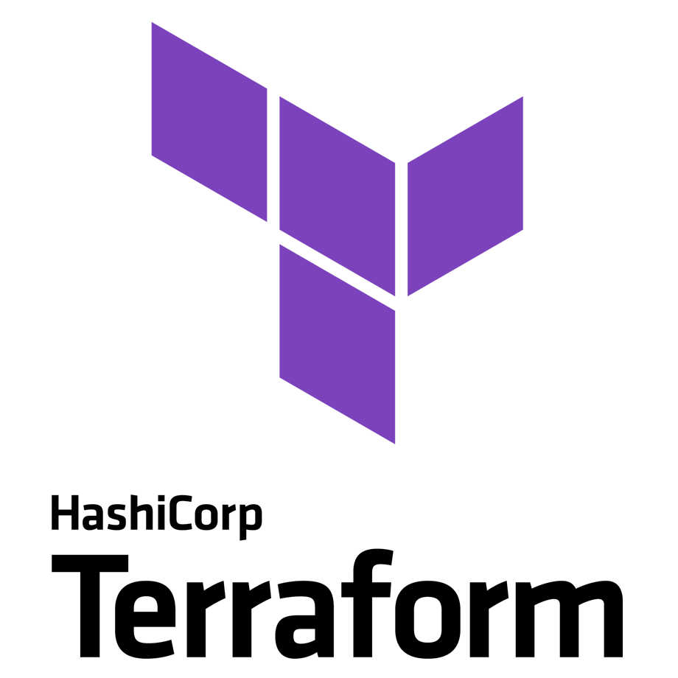
Part 1: Helm vs Terraform

Slide 6
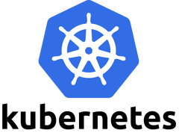
Kubernetes, AWS, ALBs, Terraform and no Helm
Cloud Agnostic
That’s a myth but…
It’s a standard !
It’s employer and employee agnostic…
Somebody who works with k8s in AWS can work with k8s in Azure or Google Cloud (and the other way around)

Slide 7
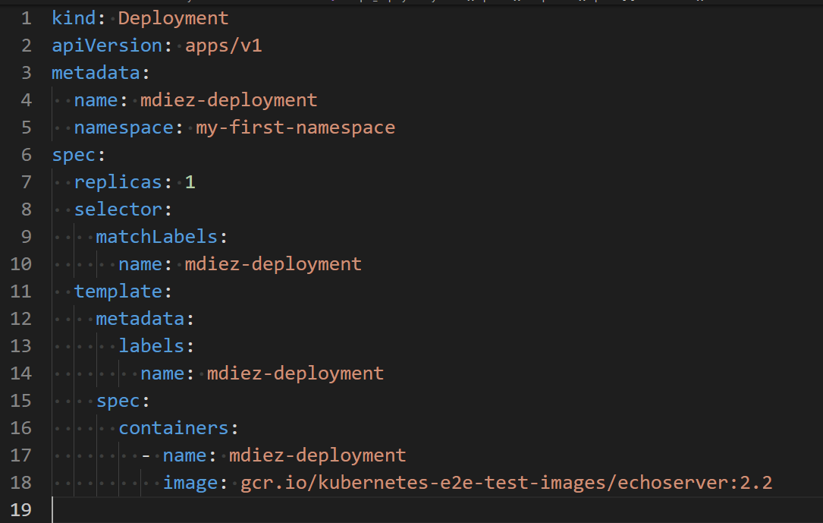
Kubernetes, AWS, ALBs, Terraform and no Helm
deployment.yaml

Slide 8
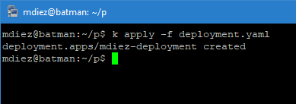
Kubernetes, AWS, ALBs, Terraform and no Helm

Slide 9
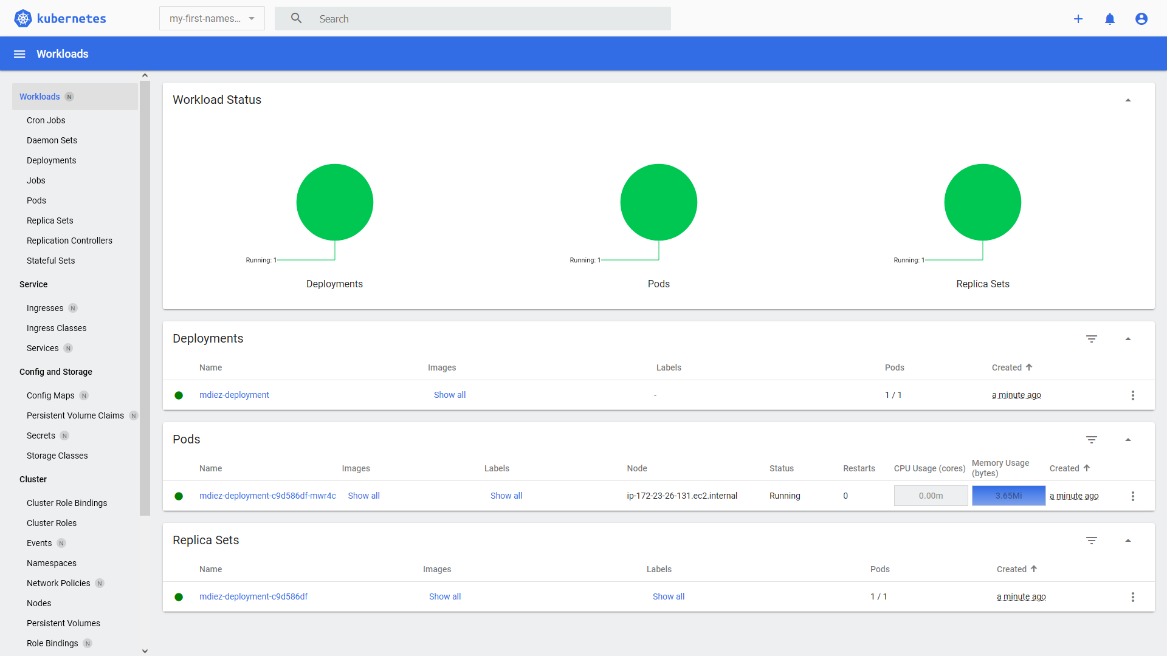
Kubernetes, AWS, ALBs, Terraform and no Helm

Slide 10
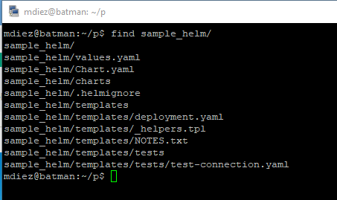
helm upgrade -n my-first-namespace --install sample ./sample_helm

Slide 11
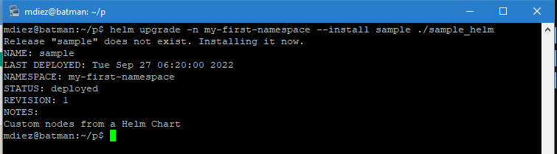
helm upgrade -n my-first-namespace --install sample ./sample_helm

Slide 12
Kubectl vs Helm
Kubectl is simpler
Helm supports a (little bit confusing) template language
Helm remembers what it created (because it has a state), so it can destroy objects it previously created
Helm makes it easier to have a different set of variables for different environments (prod/stage/qa/etc)

Slide 13
Helm Limitations
Can only deal with k8s objects (no AWS/Google/Azure)
Does not allow to see the changes it will make
Yes, you can see all the YAMLs it plans to push to k8s, but not the diff itself.
This, for me is a showstopper.
Horror Story
Once, it was decided the namespace should not be created by helm anymore.
Hence the file namespace.yaml was deleted.
Whenever the helm chat was applied to k8s, helm deleted the namespace.
It is not Helm’s fault. It did what it should. But… it does not confirm.
It was production. The whole namespace and everything within was deleted.
It was a very long night. Never again.

Slide 14
Terraform
Can deal with k8s objects, cloud AWS/Google/Azure objects and MANY other things at the same time
Allows you to see exactly what changes will be made
The k8s resources are almost 1 to 1 YAMLs.
Actually, there is a free tool called k2tf (https://github.com/sl1pm4t/k2tf) that converts YAMLs for you.
Take a look at deployment.tf, created from deployment.yaml

Slide 15
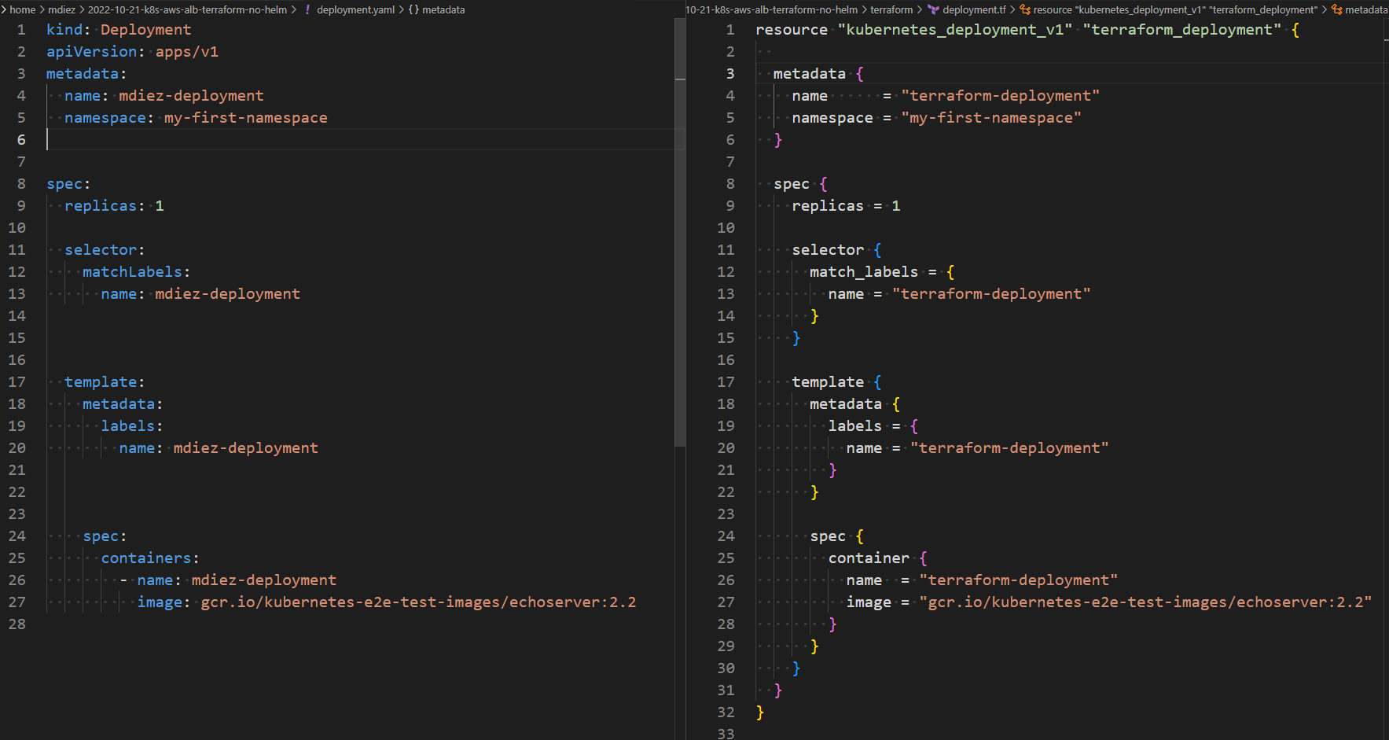
Kubectl vs helm

Slide 16
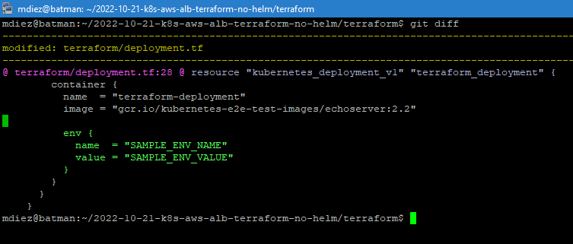
Terraform
Let’s add some environmental variables to our deployment !

Slide 17
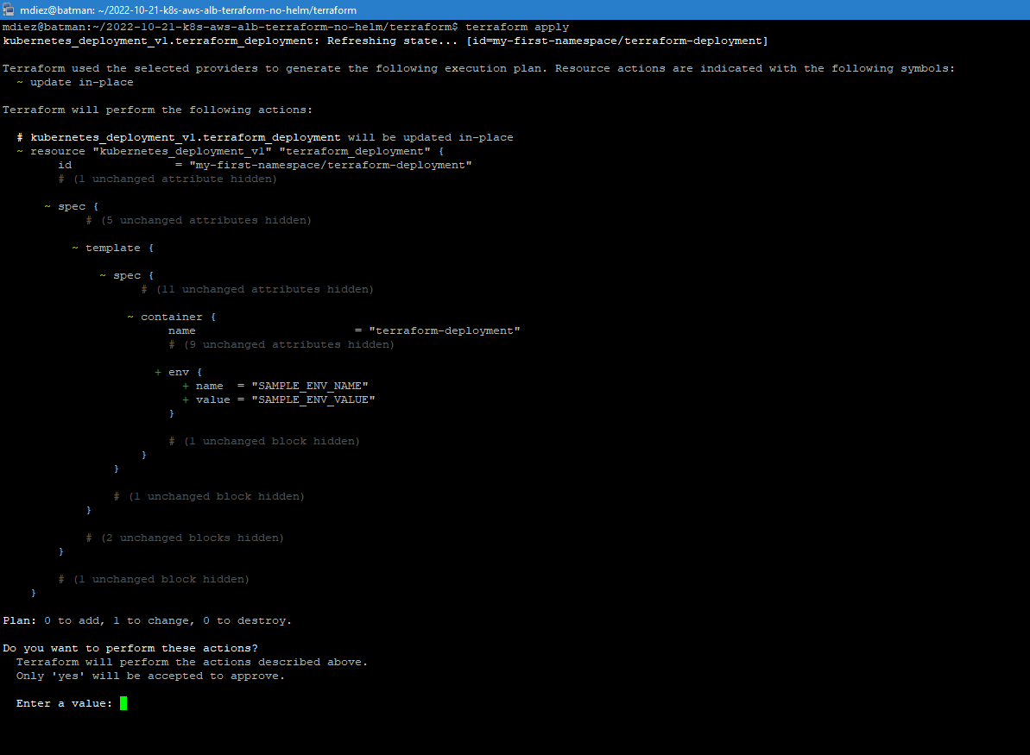

Slide 19
Terraform
The confirmation of what terraform plans to do before actually doing is golden!
But it does more! It integrates with other parts of the infrastructure.
Your cloud provider
Your DNS
Jenkins
Active Directory
Kong
Whatever else is here: https://registry.terraform.io/browse/providers
Whatever else you write!

Slide 20
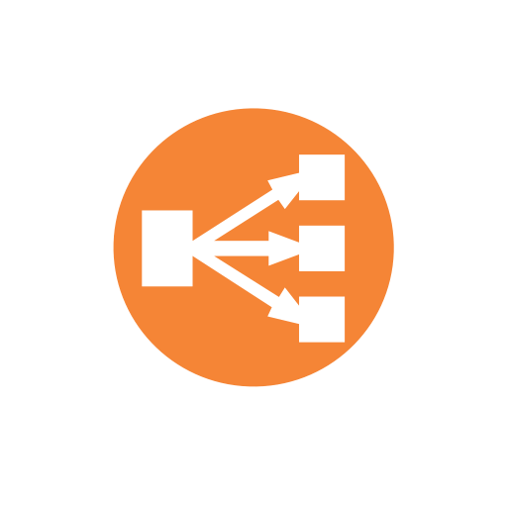
Part 2: K8s, Terraform and AWS Load Balancers

Slide 21
AWS Load Balancer
The Load Balancer Itself
Listeners
Usually one for port 80 and one for port 443
Listener SSL Certificates
Secondary SSL certs bound to an AWS Listener
Target Group
A container of EC2 instances, IPs or a lambda function
Listener Rule
A rule that tells the ALB when (domain, path, etc) to route traffic to a Target Group

Slide 22
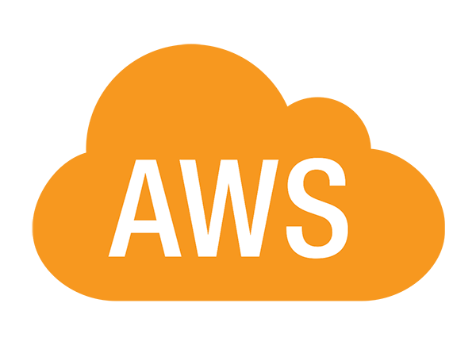

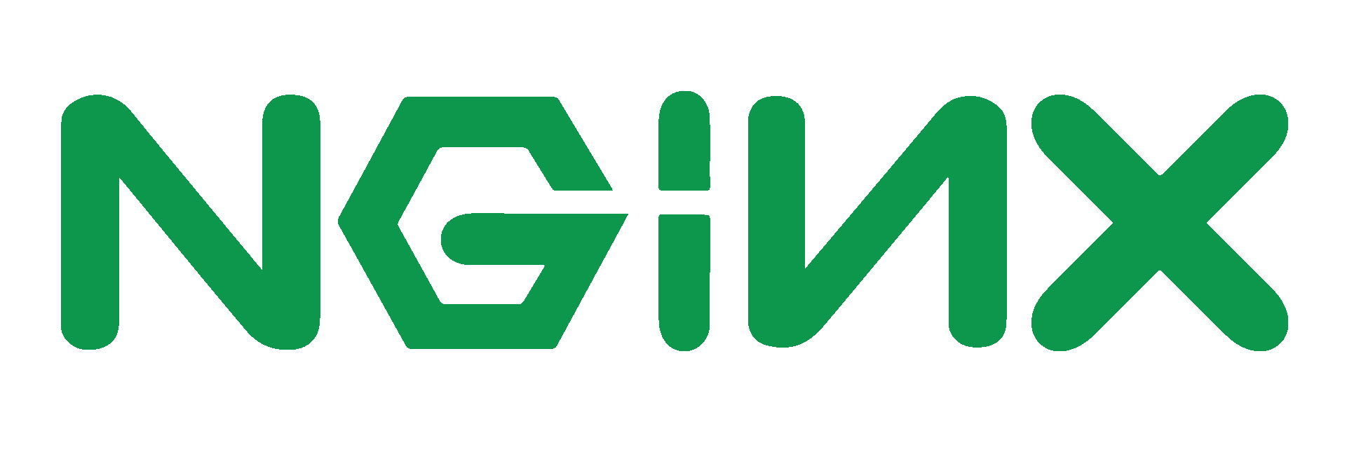
“Normal” K8S at AWS
AWS VPC
Public Subnets
Private Subnets
Public Subnets
Browser to Pod: 4 hops
K8S Service
K8S Deployment
Application
Load
Balancer
Replica Set
Pod 1
Pod 2
K8S Ingress
(usually nginx on NodePort)
Pod 3

Slide 23
K8s AWS Load Balancer Controller
Free: https://github.com/kubernetes-sigs/aws-load-balancer-controller
Links AWS Load Balancers to K8S
Usually it:
Spawns load balancer(s) for you
Sets Route53 DNS for you
But it
Sometimes destroys load balancers at will
A new ALB take time to spawn
DNS takes time to propagate
Sometimes lets load balancers lingering, burning money

Slide 24
K8s AWS Load Balancer Controller
Assuming we have:
An AWS Load Balancer
Which that redirects port 80 to 443
Which already have our wildcard SSL certificate
I recommend creating it with AWS ACM.
It’s free and auto renews.

Slide 25
K8s AWS Load Balancer Controller
Then we can use terraform to:
In AWS
Create the ALB Target Group
Create the ALB Target Group Route
Create the DNS entry (for example route53)
In K8S:
Create the K8S Service
K8S ALB Controller Target Group Binding
It tells the AWS ALB Controller to put the IPs of the PODs into the AWS Target Group
It needs IAM permissions for that.
https://kubernetes-sigs.github.io/aws-load-balancer-controller/v2.4/deploy/installation/#option-b-attach-iam-policies-to-nodes
The IP list is updated when PODs are created/destroyed (by events, no query loop!)

Slide 26
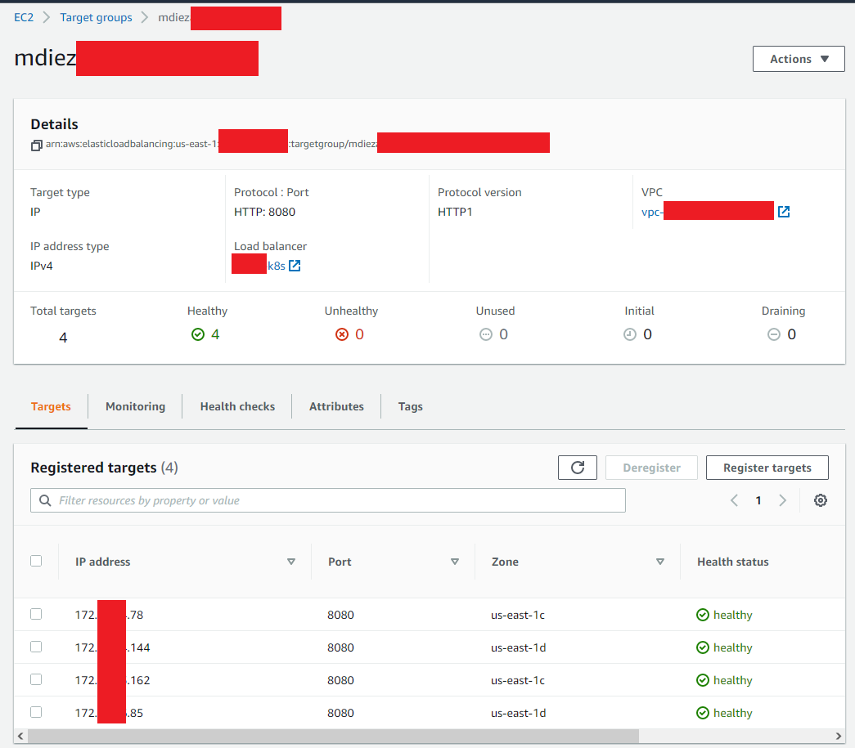

Slide 27
K8s Ingress with AWS ALB Ingress Controller
AWS VPC
Public Subnets
Private Subnets
Public Subnets
Browser to Pods: 2 hops!
K8S Deployment
Application
Load
Balancer
(one
target group
per k8s
deployment)
Replica Set
Pod 1
Pod 2
AWS K8S ALB Controller
Pod 3
K8S Service

Slide 28
How do I get that ?
Using my terraform module in GitHub !
https://github.com/marcosdiez/presentations

Slide 29
Questions ?
https://github.com/marcosdiez/presentations
(has this presentation and a terraform module does what I showed here)
https://moduscreate.com/careers/

