Slide 1
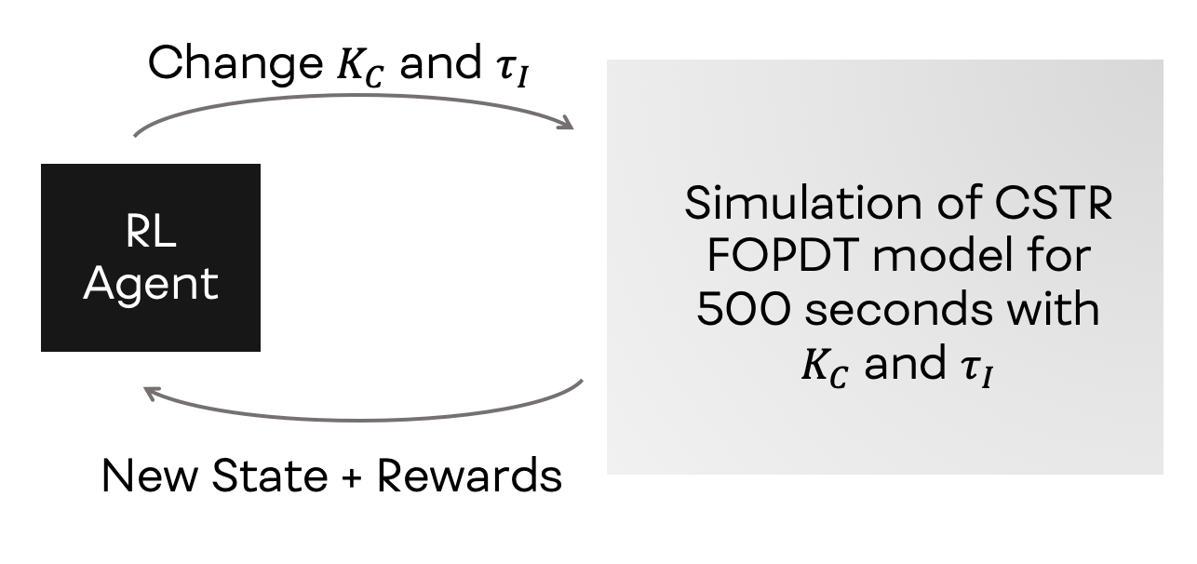
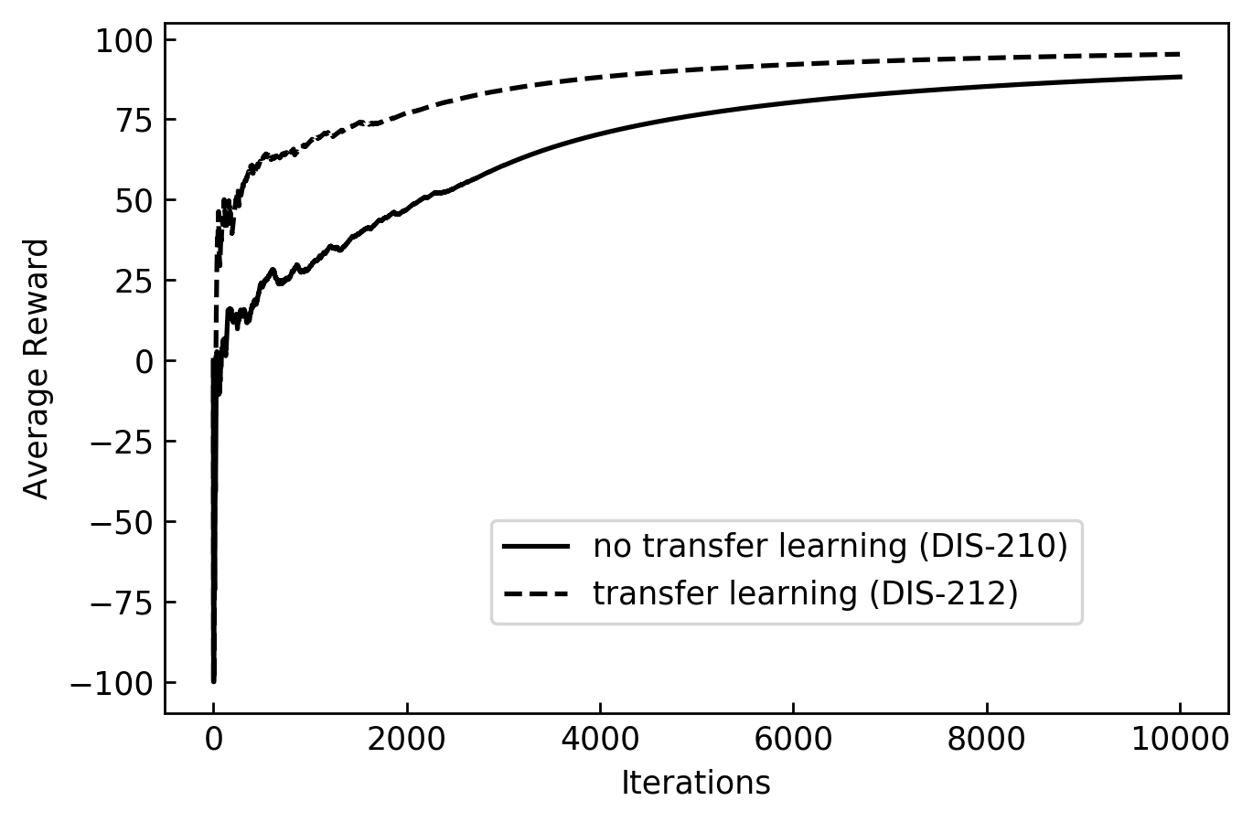
Transfer learning for SISO Tuning
Distillation tuning using RL
Steps for multivariable tuning:
Set RR, N_{T}, feed, holdups and setpoints for distillate/bottoms composition
Calculate nominal values for reflux, distillate, bottoms, & boilup using S.S.
Run dynamic simulation in LV configuration to get initial values for internal flow
Loop:
Add composition controller and introduce disturbances in feed, reboiler heating and condenser cooling
RL algorithm receives reward of negative of ITAE in distillate/bottoms + observes state of (PV, SP, feed) history + PID parameters
Pre-trained agent on a new problem
Notes:
Notes:
The figure in the bottom left comes from the git repository sustainable-processes/distillation_control/RL/experiments/analysis/20200303-transfer_learning_corrected.ipynb
To-do on SISO: more reading about tuning maps, outline paper and more verification experiments: add deadtime, noise.

Slide 2
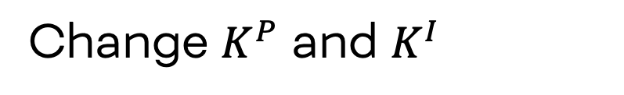
Methodology
Change $K^{P}$ and $K^{I}$
RL Agent
Process Simulation
New State + Rewards

Slide 3
Reinforcement learning enables control through feedback
Set control structure
RL Agent
Process Simulation
Error from setpoint

Slide 4
Train then apply
Training
New Process
1
2
RL Agent

Slide 5
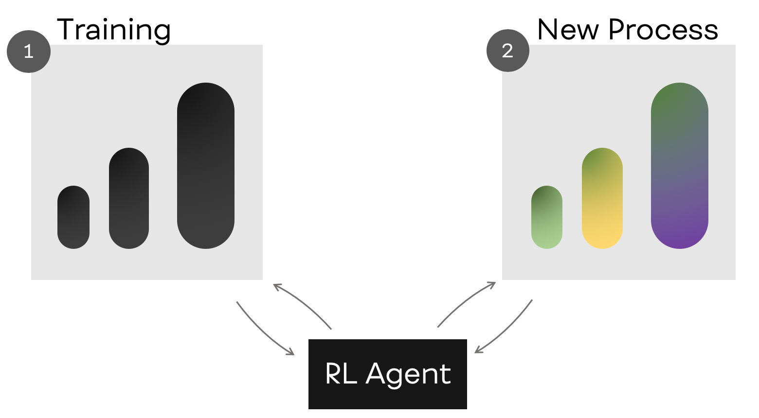
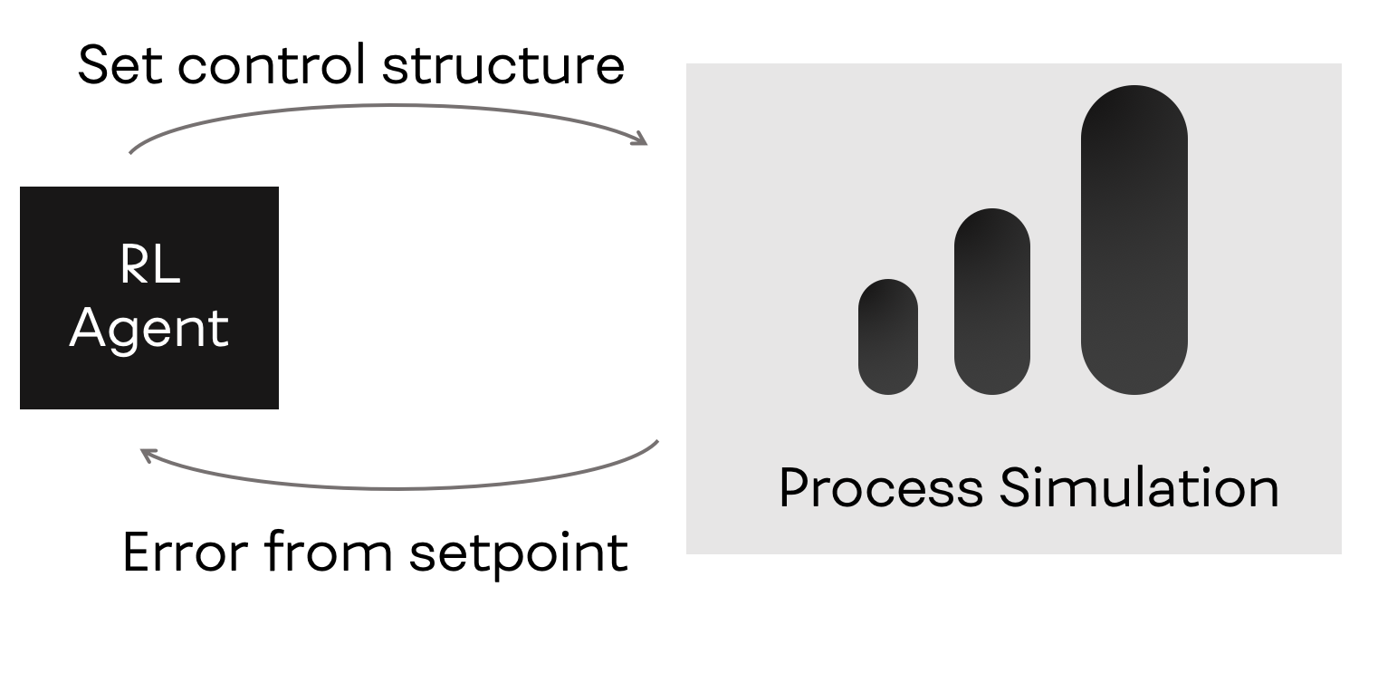
(a)
(b)

