Slide 1
G3
Marcos, Rishi, Edwin
January 29, 2026

Slide 2
Executive Summary
Dataset: CIFAR-10
Test Accuracy: 87.13%
Best Model: VGG16 (ImageNet)
Alternatives: Scratch CNN variants with different preprocessing, architecture and training strategy.

Slide 3
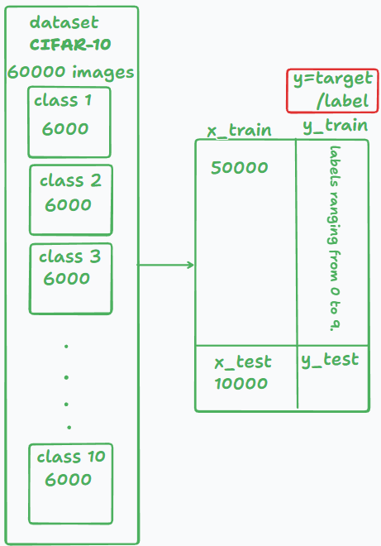
Dataset choice: cifar-10
Structured
Familiarity—Reduced overhead on data processing
Allows more focus on model development
Challenges faced with Animals Dataset
Inconsistent image sizes in the data
Consumes additional time for data cleaning

Slide 4
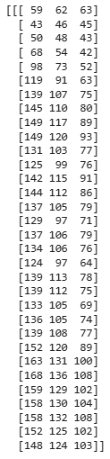
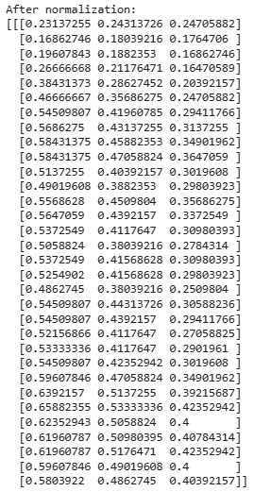
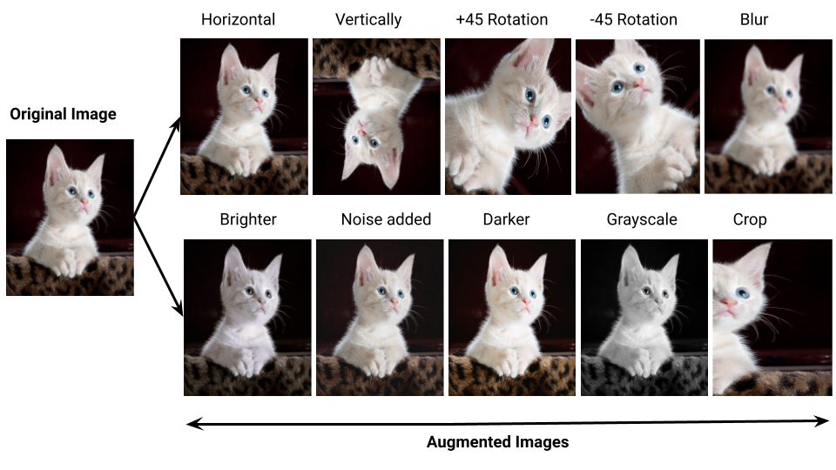
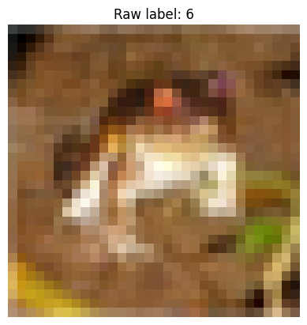

Data Preprocessing
Normalization - RGB of first pixel 32*32
Label shape
before squeezing.
Data augmentation
Assigning class labels
(50000, 1)
[[6],
[9],
[1],
...
]
https://ubiai.tools/
After squeezing
(50000,)
[6, 9, 1, 0, ...]
Models train better with normalized floating-point inputs

Slide 5
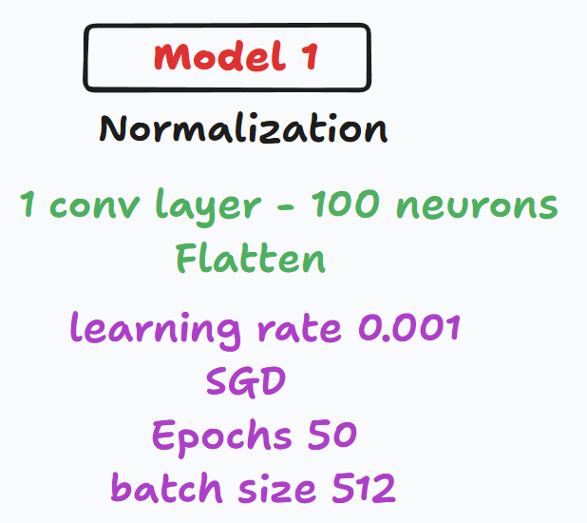
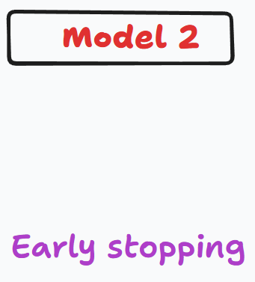
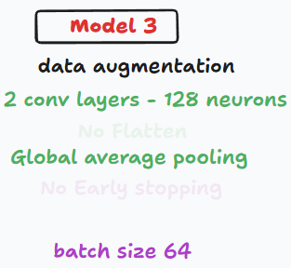
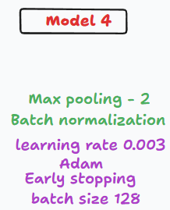
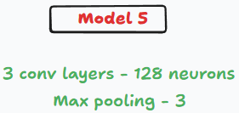


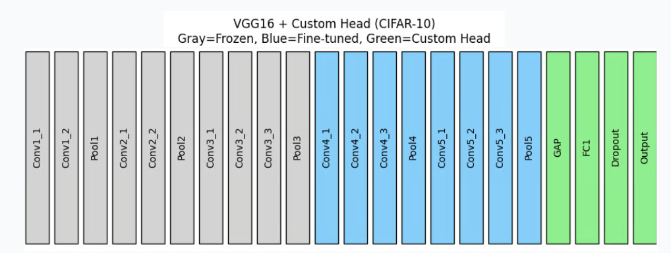
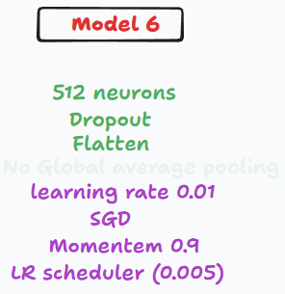
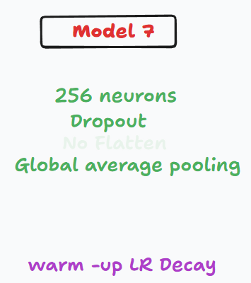


CNN architecture of models
16 Epochs

Slide 6
Optimization techniques
Techniques:
SGD - baseline
Adam + Learning rate tuning
LR Decay
LR Schedule
momentum
Notes:
Warmup LR Decay
LR Schedule
Momentum

Slide 7
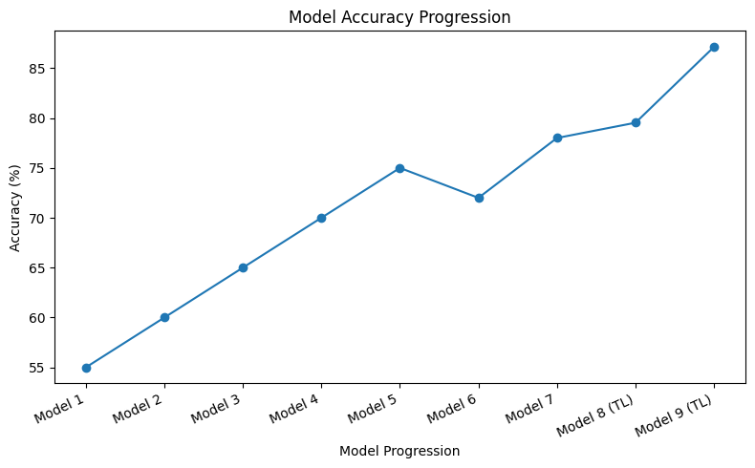
Model accuracy progression

Slide 8
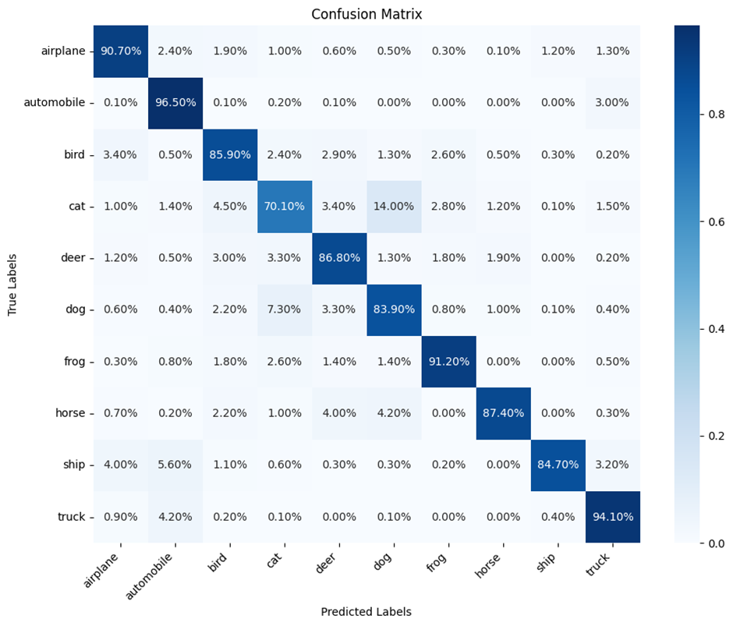
Evaluation Metrics
Strong diagonal line shows good overall class separation
Most errors occur between visually similar classes (cat <-> dog, ~14%)
Vehicle classes show very high precision and recall
35
25

Slide 9
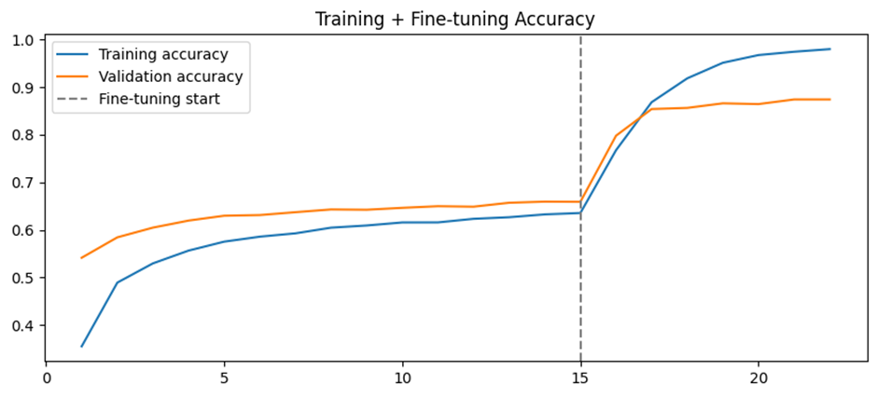
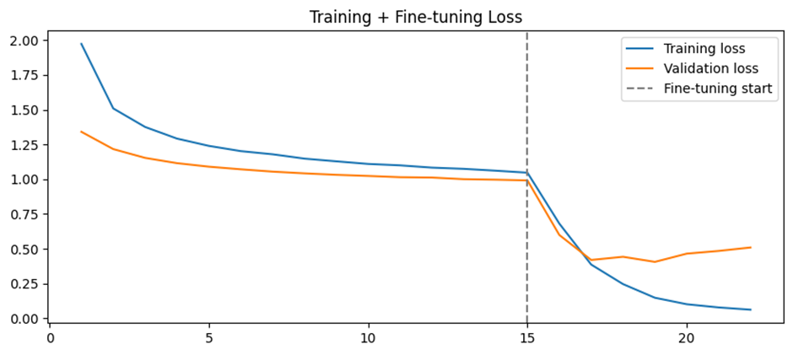
Evaluation Metrics
Training (feature extraction):
Early stabilization with limited validation gains
Validation performance plateaus
Fine-Tuning:
Significant accuracy boost & loss reduction
Confirms effectiveness of transfer learning

Slide 10
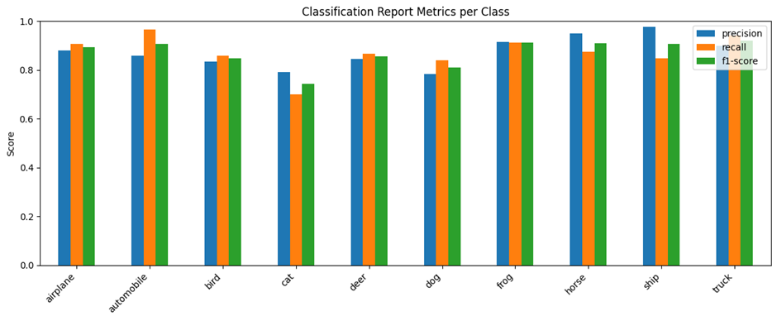
Evaluation Metrics
Prediction confidence is well balanced across classes (no extremes)
Consistent class-wise performance
Higher ambiguity due to resolution + visual similarity
Model learns meaningful features
Expected CIFAR-10 difficulty limits with higher confusion among visually similar animals categories

Slide 11
Key Takeaways
Model performance improves consistently with architectural and training refinement
Model performance improves consistently with architectural and training refinement but scratch CNNs plateau early
Transfer learning significantly outperforms custom CNSs
Final results show dataset-related difficulties rather than modeling flaws

Slide 12
Q & A

Slide 13
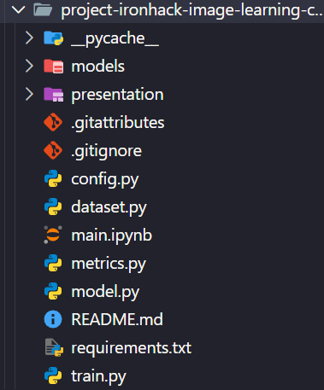
For the medal
File Structure
Main.ipynb supported by helper .py files
Separation of concerns
Helper files -> Logic
Jupyter Notebook -> Visualization
Avoids messy conflicts with Versioning Control Systems

