Slide 1
Chapter 4 :: Hardware Description Languages
Digital Design and Computer Architecture
David Money Harris and Sarah L. Harris

Slide 2
Chapter 4 :: Topics
Introduction
Combinational Logic
Structural Modeling
Sequential Logic
More Combinational Logic
Finite State Machines
Parameterized Modules
Testbenches

Slide 3
Introduction
Hardware description language (HDL): allows designer to specify logic function only. Then a computer-aided design (CAD) tool produces or synthesizes the optimized gates.
Most commercial designs built using HDLs
Two leading HDLs:
Verilog
developed in 1984 by Gateway Design Automation
became an IEEE standard (1364) in 1995
VHDL
Developed in 1981 by the Department of Defense
Became an IEEE standard (1076) in 1987

Slide 4
HDL to Gates
Simulation
Input values are applied to the circuit
Outputs checked for correctness
Millions of dollars saved by debugging in simulation instead of hardware
Synthesis
Transforms HDL code into a netlist describing the hardware (i.e., a list of gates and the wires connecting them)
IMPORTANT:
When describing circuits using an HDL, it’s critical to think of the hardware the code should produce.

Slide 5
Verilog Modules
Two types of Modules:
Behavioral: describe what a module does
Structural: describe how a module is built from simpler modules

Slide 6
Behavioral Verilog Example
Verilog:
module example(input a, b, c,
output y);
assign y = ~a & ~b & ~c | a & ~b & ~c | a & ~b & c;
endmodule

Slide 7
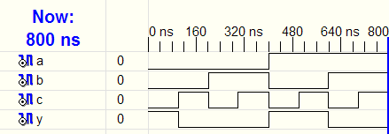
Behavioral Verilog Simulation
Verilog:
module example(input a, b, c,
output y);
assign y = ~a & ~b & ~c | a & ~b & ~c | a & ~b & c;
endmodule

Slide 8
Behavioral Verilog Synthesis
Verilog:
module example(input a, b, c,
output y);
assign y = ~a & ~b & ~c | a & ~b & ~c | a & ~b & c;
endmodule
Synthesis:

Slide 9
Verilog Syntax
Case sensitive
Example: reset and Reset are not the same signal.
No names that start with numbers
Example: 2mux is an invalid name.
Whitespace ignored
Comments:
// single line comment
/* multiline
comment */

Slide 10
Structural Modeling - Hierarchy
module and3(input a, b, c,
output y);
assign y = a & b & c;
endmodule
module inv(input a,
output y);
assign y = ~a;
endmodule
module nand3(input a, b, c
output y);
wire n1; // internal signal
and3 andgate(a, b, c, n1); // instance of and3
inv inverter(n1, y); // instance of inverter
endmodule

Slide 11
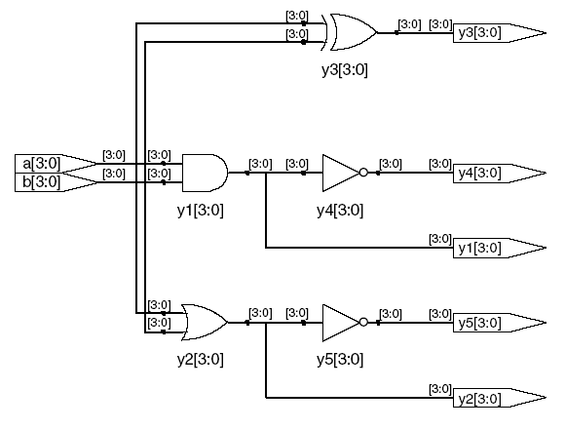
Bitwise Operators
module gates(input [3:0] a, b,
output [3:0] y1, y2, y3, y4, y5);
/* Five different two-input logic
gates acting on 4 bit busses */
assign y1 = a & b; // AND
assign y2 = a | b; // OR
assign y3 = a ^ b; // XOR
assign y4 = ~(a & b); // NAND
assign y5 = ~(a | b); // NOR
endmodule
// single line comment
/*…*/ multiline comment

Slide 12
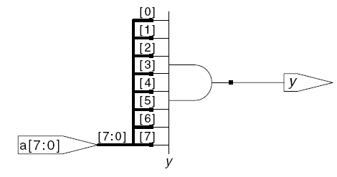
Reduction Operators
module and8(input [7:0] a,
output y);
assign y = &a;
// &a is much easier to write than
// assign y = a[7] & a[6] & a[5] & a[4] &
// a[3] & a[2] & a[1] & a[0];
endmodule

Slide 13
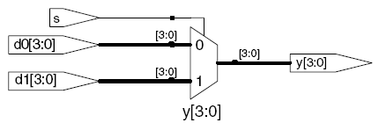
Conditional Assignment
module mux2(input [3:0] d0, d1,
input s,
output [3:0] y);
assign y = s ? d1 : d0;
endmodule
? : is also called a ternary operator because it
operates on 3 inputs: s, d1, and d0.

Slide 14
Internal Variables
module fulladder(input a, b, cin, output s, cout);
wire p, g; // internal nodes
assign p = a ^ b;
assign g = a & b;
assign s = p ^ cin;
assign cout = g | (p & cin);
endmodule

Slide 15
Precedence
Defines the order of operations
Highest
~ | NOT
*, /, % | mult, div, mod
+, - | add,sub
<<, >> | shift
<<<, >>> | arithmetic shift
<, <=, >, >= | comparison
==, != | equal, not equal
&, ~& | AND, NAND
^, ~^ | XOR, XNOR
|, ~| | OR, NOR
?: | ternary operator
Lowest

Slide 16
Numbers
Format: N'Bvalue
N = number of bits, B = base
N'B is optional but recommended (default is decimal)
Number | # Bits | Base | Decimal Equivalent | Stored
3’b101 | 3 | binary | 5 | 101
‘b11 | unsized | binary | 3 | 00…0011
8’b11 | 8 | binary | 3 | 00000011
8’b1010_1011 | 8 | binary | 171 | 10101011
3’d6 | 3 | decimal | 6 | 110
6’o42 | 6 | octal | 34 | 100010
8’hAB | 8 | hexadecimal | 171 | 10101011
42 | Unsized | decimal | 42 | 00…0101010

Slide 17
Bit Manipulations: Example 1
assign y = {a[2:1], {3{b[0]}}, a[0], 6’b100_010};
// if y is a 12-bit signal, the above statement produces:
y = a[2] a[1] b[0] b[0] b[0] a[0] 1 0 0 0 1 0
// underscores (_) are used for formatting only to make it easier to read. Verilog ignores them.

Slide 18
Bit Manipulations: Example 2
Verilog:
module mux2_8(input [7:0] d0, d1,
input s,
output [7:0] y);
mux2 lsbmux(d0[3:0], d1[3:0], s, y[3:0]);
mux2 msbmux(d0[7:4], d1[7:4], s, y[7:4]);
endmodule
Synthesis:

Slide 19
Z: Floating Output
Verilog:
module tristate(input [3:0] a,
input en,
output [3:0] y);
assign y = en ? a : 4'bz;
endmodule
Synthesis:

Slide 20
Delays
module example(input a, b, c,
output y);
wire ab, bb, cb, n1, n2, n3;
assign #1 {ab, bb, cb} = ~{a, b, c};
assign #2 n1 = ab & bb & cb;
assign #2 n2 = a & bb & cb;
assign #2 n3 = a & bb & c;
assign #4 y = n1 | n2 | n3;
endmodule

Slide 21
Delays
module example(input a, b, c,
output y);
wire ab, bb, cb, n1, n2, n3;
assign #1 {ab, bb, cb} =
~{a, b, c};
assign #2 n1 = ab & bb & cb;
assign #2 n2 = a & bb & cb;
assign #2 n3 = a & bb & c;
assign #4 y = n1 | n2 | n3;
endmodule

Slide 22
Sequential Logic
Verilog uses certain idioms to describe latches, flip-flops and FSMs
Other coding styles may simulate correctly but produce incorrect hardware

Slide 23
Always Statement
General Structure:
always @ (sensitivity list)
statement;
Whenever the event in the sensitivity list occurs, the statement is executed

Slide 24
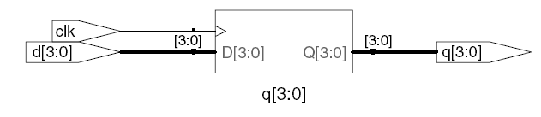
D Flip-Flop
module flop(input clk,
input [3:0] d,
output reg [3:0] q);
always @ (posedge clk)
q <= d; // pronounced “q gets d”
endmodule
Any signal assigned in an always statement must be declared reg. In this case q is declared as reg
Beware: A variable declared reg is not necessarily a registered output.
We will show examples of this later.

Slide 25
Resettable D Flip-Flop
module flopr(input clk,
input reset,
input [3:0] d,
output reg [3:0] q);
// synchronous reset
always @ (posedge clk)
if (reset) q <= 4'b0;
else q <= d;
endmodule

Slide 26
Resettable D Flip-Flop
module flopr(input clk,
input reset,
input [3:0] d,
output reg [3:0] q);
// asynchronous reset
always @ (posedge clk, posedge reset)
if (reset) q <= 4'b0;
else q <= d;
endmodule

Slide 27
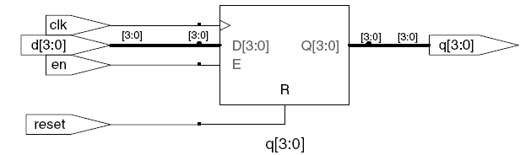
D Flip-Flop with Enable
module flopren(input clk,
input reset,
input en,
input [3:0] d,
output reg [3:0] q);
// asynchronous reset and enable
always @ (posedge clk, posedge reset)
if (reset) q <= 4'b0;
else if (en) q <= d;
endmodule

Slide 28
Latch
module latch(input clk,
input [3:0] d,
output reg [3:0] q);
always @ (clk, d)
if (clk) q <= d;
endmodule
Warning: We won’t use latches in this course, but you might write code that inadvertently implies a latch. So if your synthesized hardware has latches in it, this indicates an error.

Slide 29
Other Behavioral Statements
Statements that must be inside always statements:
if / else
case, casez
Reminder: Variables assigned in an always statement must be declared as reg (even if they’re not actually registered!)

Slide 30
Combinational Logic using always
// combinational logic using an always statement
module gates(input [3:0] a, b,
output reg [3:0] y1, y2, y3, y4, y5);
always @(*) // need begin/end because there is
begin // more than one statement in always
y1 = a & b; // AND
y2 = a | b; // OR
y3 = a ^ b; // XOR
y4 = ~(a & b); // NAND
y5 = ~(a | b); // NOR
end
endmodule
This hardware could be described with assign statements using fewer lines of code, so it’s better to use assign statements in this case.

Slide 31
Combinational Logic using case
module sevenseg(input [3:0] data,
output reg [6:0] segments);
always @(*)
case (data)
// abc_defg
0: segments = 7'b111_1110;
1: segments = 7'b011_0000;
2: segments = 7'b110_1101;
3: segments = 7'b111_1001;
4: segments = 7'b011_0011;
5: segments = 7'b101_1011;
6: segments = 7'b101_1111;
7: segments = 7'b111_0000;
8: segments = 7'b111_1111;
9: segments = 7'b111_1011;
default: segments = 7'b000_0000; // required
endcase
endmodule

Slide 32
Combinational Logic using case
In order for a case statement to imply combinational logic, all possible input combinations must be described by the HDL.
Remember to use a default statement when necessary.

Slide 33
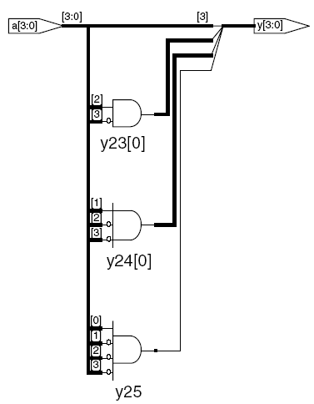
Combinational Logic using casez
module priority_casez(input [3:0] a,
output reg [3:0] y);
always @(*)
casez(a)
4'b1???: y = 4'b1000; // ? = don’t care
4'b01??: y = 4'b0100;
4'b001?: y = 4'b0010;
4'b0001: y = 4'b0001;
default: y = 4'b0000;
endcase
endmodule

Slide 34
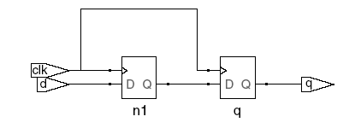

Blocking vs. Nonblocking Assignments
<= is a “nonblocking assignment”
Occurs simultaneously with others
= is a “blocking assignment”
Occurs in the order it appears in the file
// Good synchronizer using
// nonblocking assignments
module syncgood(input clk,
input d,
output reg q);
reg n1;
always @(posedge clk)
begin
n1 <= d; // nonblocking
q <= n1; // nonblocking
end
endmodule
// Bad synchronizer using
// blocking assignments
module syncbad(input clk,
input d,
output reg q);
reg n1;
always @(posedge clk)
begin
n1 = d; // blocking
q = n1; // blocking
end
endmodule

Slide 35
Rules for Signal Assignment
Use always @(posedge clk) and nonblocking assignments (<=) to model synchronous sequential logic
always @ (posedge clk)
q <= d; // nonblocking
Use continuous assignments (assign …)to model simple combinational logic.
assign y = a & b;
Use always @ (*) and blocking assignments (=) to model more complicated combinational logic where the always statement is helpful.
Do not make assignments to the same signal in more than one always statement or continuous assignment statement.

Slide 36
Finite State Machines (FSMs)
Three blocks:
next state logic
state register
output logic

Slide 37
FSM Example: Divide by 3
The double circle indicates the reset state

Slide 38
FSM in Verilog
module divideby3FSM (input clk,
input reset,
output q);
reg [1:0] state, nextstate;
parameter S0 = 2'b00;
parameter S1 = 2'b01;
parameter S2 = 2'b10;
// state register
always @ (posedge clk, posedge reset)
if (reset) state <= S0;
else state <= nextstate;
// next state logic
always @ (*)
case (state)
S0: nextstate = S1;
S1: nextstate = S2;
S2: nextstate = S0;
default: nextstate = S0;
endcase
// output logic
assign q = (state == S0);
endmodule

Slide 39
Parameterized Modules
2:1 mux:
module mux2
#(parameter width = 8) // name and default value
(input [width-1:0] d0, d1,
input s,
output [width-1:0] y);
assign y = s ? d1 : d0;
endmodule
Instance with 8-bit bus width (uses default):
mux2 mux1(d0, d1, s, out);
Instance with 12-bit bus width:
mux2 #(12) lowmux(d0, d1, s, out);

Slide 40
Testbenches
HDL code written to test another HDL module, the device under test (dut), also called the unit under test (uut)
Not synthesizeable
Types of testbenches:
Simple testbench
Self-checking testbench
Self-checking testbench with testvectors

Slide 41
Example
Write Verilog code to implement the following
function in hardware:
y = bc + ab
Name the module sillyfunction

Slide 42
Example
Write Verilog code to implement the following
function in hardware:
y = bc + ab
Name the module sillyfunction
Verilog
module sillyfunction(input a, b, c,
output y);
assign y = ~b & ~c | a & ~b;
endmodule

Slide 43
Simple Testbench
module testbench1();
reg a, b, c;
wire y;
// instantiate device under test
sillyfunction dut(a, b, c, y);
// apply inputs one at a time
initial begin
a = 0; b = 0; c = 0; #10;
c = 1; #10;
b = 1; c = 0; #10;
c = 1; #10;
a = 1; b = 0; c = 0; #10;
c = 1; #10;
b = 1; c = 0; #10;
c = 1; #10;
end
endmodule

Slide 44
Self-checking Testbench
module testbench2();
reg a, b, c;
wire y;
// instantiate device under test
sillyfunction dut(a, b, c, y);
// apply inputs one at a time
// checking results
initial begin
a = 0; b = 0; c = 0; #10;
if (y !== 1) $display("000 failed.");
c = 1; #10;
if (y !== 0) $display("001 failed.");
b = 1; c = 0; #10;
if (y !== 0) $display("010 failed.");
c = 1; #10;
if (y !== 0) $display("011 failed.");
a = 1; b = 0; c = 0; #10;
if (y !== 1) $display("100 failed.");
c = 1; #10;
if (y !== 1) $display("101 failed.");
b = 1; c = 0; #10;
if (y !== 0) $display("110 failed.");
c = 1; #10;
if (y !== 0) $display("111 failed.");
end
endmodule

Slide 45
Testbench with Testvectors
Write testvector file: inputs and expected outputs
Testbench:
Generate clock for assigning inputs, reading outputs
Read testvectors file into array
Assign inputs, expected outputs
Compare outputs to expected outputs and report errors

Slide 46
Testbench with Testvectors
Testbench clock is used to assign inputs (on the rising edge) and compare outputs with expected outputs (on the falling edge).
The testbench clock may also be used as the clock source for synchronous sequential circuits.

Slide 47
Testvectors File
File: example.tv – contains vectors of abc_yexpected
000_1
001_0
010_0
011_0
100_1
101_1
110_0
111_0

Slide 48
Testbench: 1. Generate Clock
module testbench3();
reg clk, reset;
reg a, b, c, yexpected;
wire y;
reg [31:0] vectornum, errors; // bookkeeping variables
reg [3:0] testvectors[10000:0]; // array of testvectors
// instantiate device under test
sillyfunction dut(a, b, c, y);
// generate clock
always // no sensitivity list, so it always executes
begin
clk = 1; #5; clk = 0; #5;
end

Slide 49
2. Read Testvectors into Array
// at start of test, load vectors
// and pulse reset
initial
begin
$readmemb("example.tv", testvectors);
vectornum = 0; errors = 0;
reset = 1; #27; reset = 0;
end
// Note: $readmemh reads testvector files written in
// hexadecimal

Slide 50
3. Assign Inputs and Expected Outputs
// apply test vectors on rising edge of clk
always @(posedge clk)
begin
#1; {a, b, c, yexpected} = testvectors[vectornum];
end

Slide 51
4. Compare Outputs with Expected Outputs
// check results on falling edge of clk
always @(negedge clk)
if (~reset) begin // skip during reset
if (y !== yexpected) begin
$display("Error: inputs = %b", {a, b, c});
$display(" outputs = %b (%b expected)",y,yexpected);
errors = errors + 1;
end
// Note: to print in hexadecimal, use %h. For example,
// $display(“Error: inputs = %h”, {a, b, c});

Slide 52
4. Compare Outputs with Expected Outputs
// increment array index and read next testvector
vectornum = vectornum + 1;
if (testvectors[vectornum] === 4'bx) begin
$display("%d tests completed with %d errors",
vectornum, errors);
$finish;
end
end
endmodule
// Note: === and !== can compare values that are
// x or z.

