Slide 1

TECNOLOGÍA
Técnicas Digitales I
Luis Eduardo Toledo

Slide 2
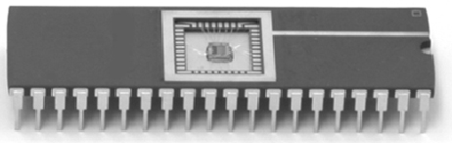
CIRCUITO INTEGRADO

Slide 3
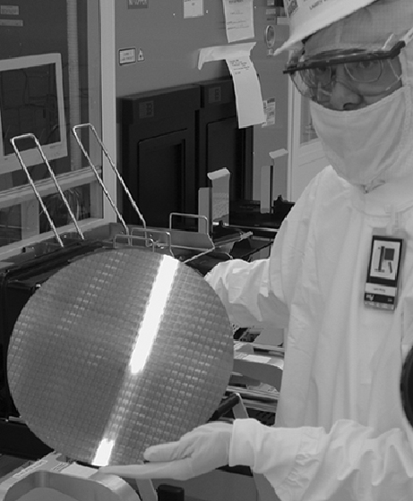
OBLEA DE SILICIO

Slide 4
Logic Levels
Discrete voltages represent 1 and 0
For example:
0 = ground (GND) or 0 volts
1 = V_{DD} or 5 volts
What about 4.99 volts? Is that a 0 or a 1?
What about 3.2 volts?

Slide 5
Logic Levels
Range of voltages for 1 and 0
Different ranges for inputs and outputs to allow for noise

Slide 6
What is Noise?

Slide 7
What is Noise?
Anything that degrades the signal
E.g., resistance, power supply noise, coupling to neighboring wires, etc.
Example: a gate (driver) outputs 5 V but, because of resistance in a long wire, receiver gets 4.5 V

Slide 8
The Static Discipline
With logically valid inputs, every circuit element must produce logically valid outputs
Use limited ranges of voltages to represent discrete values

Slide 9
Logic Levels

Slide 10
Noise Margins
NM_{H} = V_{OH} – V_{IH}
NM_{L} = V_{IL} – V_{OL}

Slide 11
DC Transfer Characteristics
Ideal Buffer: Real Buffer:
NM_{H} = NM_{L} = V_{DD}/2
NM_{H} , NM_{L} < V_{DD}/2

Slide 12
DC Transfer Characteristics

Slide 13
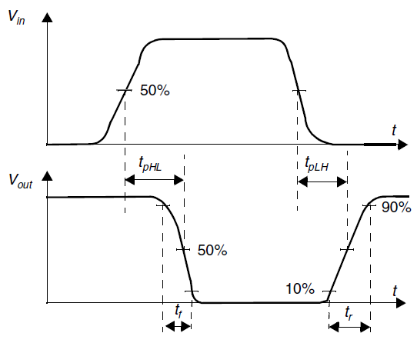

DEFINICIÓN DE RETARDO DE PROPAGACIÓN

Slide 14
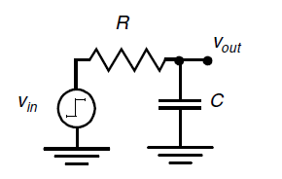

RETARDO DE PROPAGACIÓN DE UN CIRCUITO RC DE PRIMER ORDEN
LOS CIRCUITOS DIGITALES SE PUEDEN MODELAR COMO SIMPLES CIRCUITOS RC
CUANDO SE APLICA UN ESCALON A Vin (DE 0 A V), LA RESPUESTA TRANSITORIA ES:

Slide 15
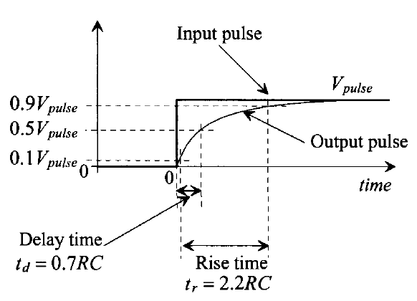




RETARDO DE PROPAGACIÓN DE UN CIRCUITO RC DE PRIMER ORDEN

Slide 16
V_{DD} Scaling
In 1970’s and 1980’s, V_{DD} = 5 V
V_{DD} has dropped
Avoid frying tiny transistors
Save power
3.3 V, 2.5 V, 1.8 V, 1.5 V, 1.2 V, 1.0 V, …
Be careful connecting chips with different supply voltages
Chips operate because they contain magic smoke
Proof:
if the magic smoke is let out, the chip stops working

Slide 17
Logic Family Examples
Logic Family | V_{DD} | V_{IL} | V_{IH} | V_{OL} | V_{OH}
TTL | 5 (4.75 - 5.25) | 0.8 | 2.0 | 0.4 | 2.4
CMOS | 5 (4.5 - 6) | 1.35 | 3.15 | 0.33 | 3.84
LVTTL | 3.3 (3 - 3.6) | 0.8 | 2.0 | 0.4 | 2.4
LVCMOS | 3.3 (3 - 3.6) | 0.9 | 1.8 | 0.36 | 2.7

Slide 18
Transistors
Logic gates built from transistors
3-ported voltage-controlled switch
2 ports connected depending on voltage of 3rd
d and s are connected (ON) when g is 1

Slide 19
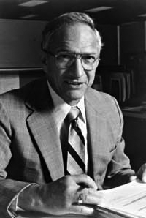
Robert Noyce, 1927-1990
Nicknamed “Mayor of Silicon Valley”
Cofounded Fairchild Semiconductor in 1957
Cofounded Intel in 1968
Co-invented the integrated circuit

Slide 20
Silicon
Transistors built from silicon, a semiconductor
Pure silicon is a poor conductor (no free charges)
Doped silicon is a good conductor (free charges)
n-type (free negative charges, electrons)
p-type (free positive charges, holes)

Slide 21
MOS Transistors
Metal oxide silicon (MOS) transistors:
Polysilicon (used to be metal) gate
Oxide (silicon dioxide) insulator
Doped silicon

Slide 22
Transistors: nMOS
Gate = 0
OFF (no connection between source and drain)
Gate = 1
ON (channel between source and drain)

Slide 23
Transistors: pMOS
pMOS transistor is opposite
ON when Gate = 0
OFF when Gate = 1

Slide 24
Transistor Function

Slide 25
Transistor Function
nMOS: pass good 0’s, so connect source to GND
pMOS: pass good 1’s, so connect source to V_{DD}

Slide 26
CMOS Gates: NOT Gate
A | P1 | N1 | Y
0
1

Slide 27
CMOS Gates: NOT Gate
A | P1 | N1 | Y
0 | ON | OFF | 1
1 | OFF | ON | 0

Slide 28
CMOS Gates: NAND Gate
A | B | P1 | P2 | N1 | N2 | Y
0 | 0
0 | 1
1 | 0
1 | 1

Slide 29
CMOS Gates: NAND Gate
A | B | P1 | P2 | N1 | N2 | Y
0 | 0 | ON | ON | OFF | OFF | 1
0 | 1 | ON | OFF | OFF | ON | 1
1 | 0 | OFF | ON | ON | OFF | 1
1 | 1 | OFF | OFF | ON | ON | 0

Slide 30
CMOS Gate Structure

Slide 31
NOR Gate
How do you build a three-input NOR gate?

Slide 32
NOR3 Gate

Slide 33
Other CMOS Gates
How do you build a two-input AND gate?

Slide 34
AND2 Gate

Slide 35
Transmission Gates
nMOS pass 1’s poorly
pMOS pass 0’s poorly
Transmission gate is a better switch
passes both 0 and 1 well
When EN = 1, the switch is ON:
EN = 0 and A is connected to B
When EN = 0, the switch is OFF:
A is not connected to B

Slide 36
Pseudo-nMOS Gates
Replace pull-up network with weak pMOS transistor that is always on
pMOS transistor: pulls output HIGH only when nMOS network not pulling it LOW

Slide 37
Pseudo-nMOS Example
Pseudo-nMOS NOR4

Slide 38
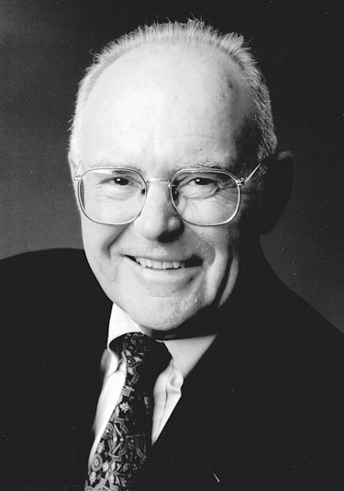
Gordon Moore, 1929-
Cofounded Intel in 1968 with Robert Noyce.
Moore’s Law: number of transistors on a computer chip doubles every year (observed in 1965)
Since 1975, transistor counts have doubled every two years.

Slide 39
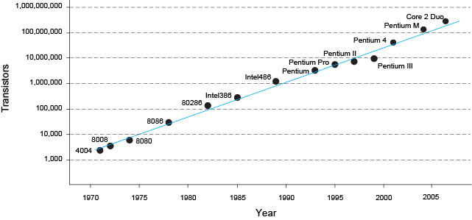
Moore’s Law
“If the automobile had followed the same development cycle as the computer, a Rolls-Royce would today cost $100, get one million miles to the gallon, and explode once a year . . .”
– Robert Cringley

Slide 40
Power Consumption
Power = Energy consumed per unit time
Dynamic power consumption
Static power consumption

Slide 41
Dynamic Power Consumption
Power to charge transistor gate capacitances
Energy required to charge a capacitance, C, to V_{DD} is CV_{DD}²
Circuit running at frequency f: transistors switch (from 1 to 0 or vice versa) at that frequency
Capacitor is charged f/2 times per second (discharging from 1 to 0 is free)
Dynamic power consumption:
P_{dynamic} = ½CV_{DD}²f

Slide 42
Static Power Consumption
Power consumed when no gates are switching
Caused by the quiescent supply current, I_{DD} (also called the leakage current)
Static power consumption:
P_{static} = I_{DD}V_{DD}

Slide 43
Power Consumption Example
Estimate the power consumption of a wireless handheld computer
V_{DD} = 1.2 V
C = 20 nF
f = 1 GHz
I_{DD} = 20 mA

Slide 44
Power Consumption Example
Estimate the power consumption of a wireless handheld computer
V_{DD} = 1.2 V
C = 20 nF
f = 1 GHz
I_{DD} = 20 mA
P = ½CV_{DD}²f + I_{DD}V_{DD}
= ½(20 nF)(1.2 V)²(1 GHz) +
(20 mA)(1.2 V)
= (14.4 + 0.024) W ≈ 14.4 W

