Slide 1

Azure Serverless
What The Hack - Azure Serverless
Notes:
This deck is a template for What The Hack lectures.
It is recommended that Coaches deliver mini-lectures ahead of each Challenge that set context for the challenge and introduce & explain any key technologies.
At a minimum, it is handy to have a slide with the key goals of each challenge to display on the screen when running the hack in-person.

Slide 2

Azure Serverless
Welcome & Intros
<Coach Name>
<Coach Name>
<Coach Title>
<Coach Title>
<Coach Name>
<Coach Name>
<Coach Title>
<Coach Title>
Notes:
Coaches/Presenters for THIS hack/lecture event should be listed on this slide.
Original contributors to the hack content & these slides include:
Please list original contributors to this hack here in the speaker notes and give them credit when delivering this content.
<Original Author 1>
<Original Author 2>
…
<Original Author N>

Slide 3
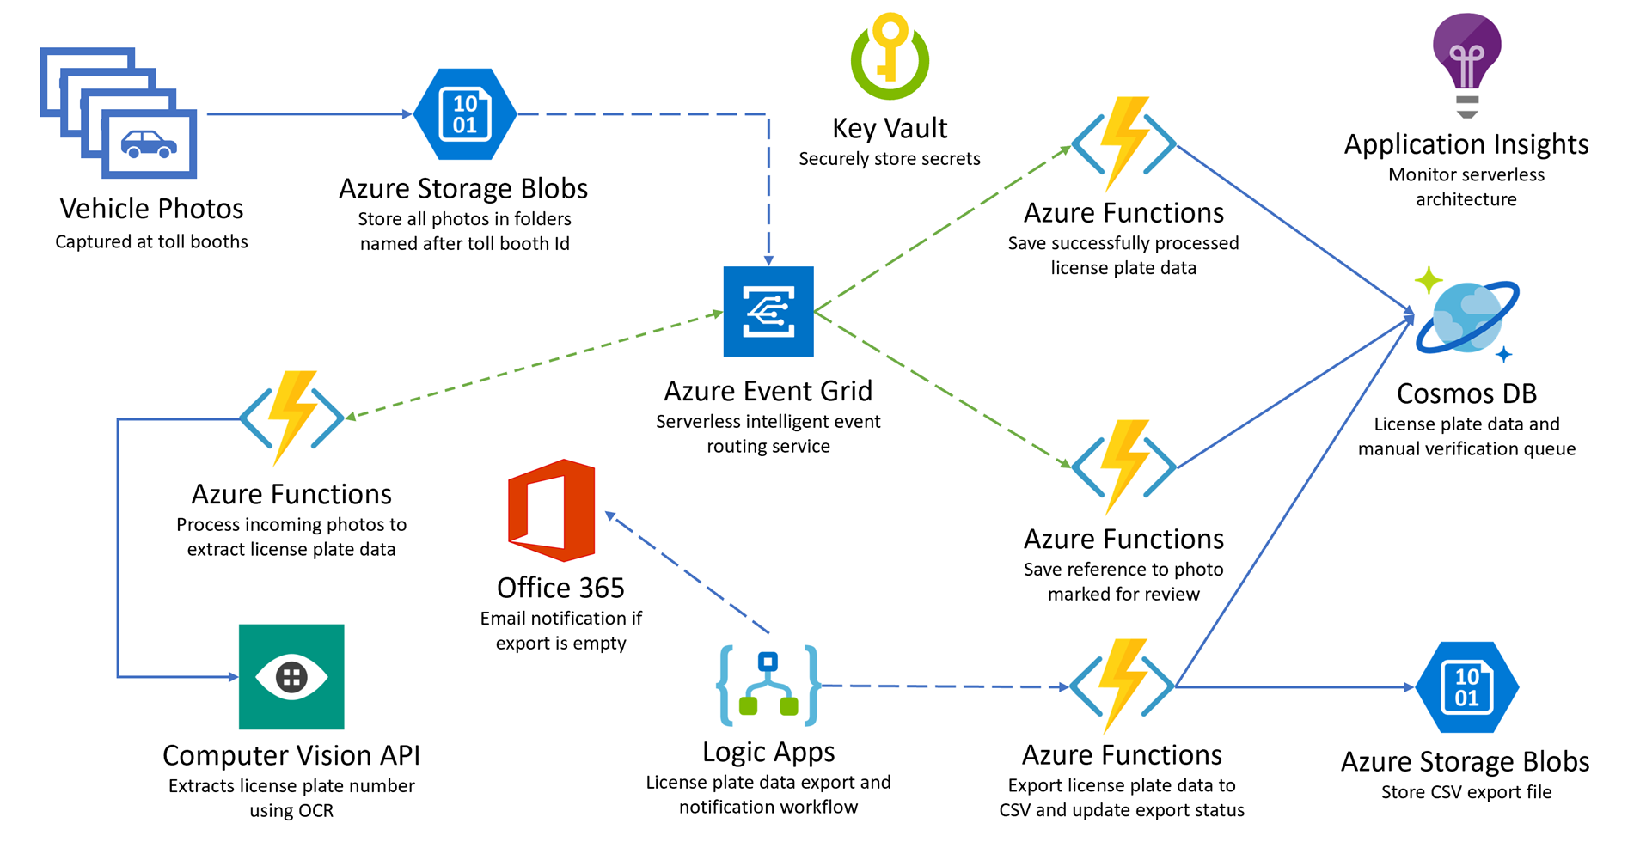
Click here for Overview Slides on Azure Serverless

Slide 4
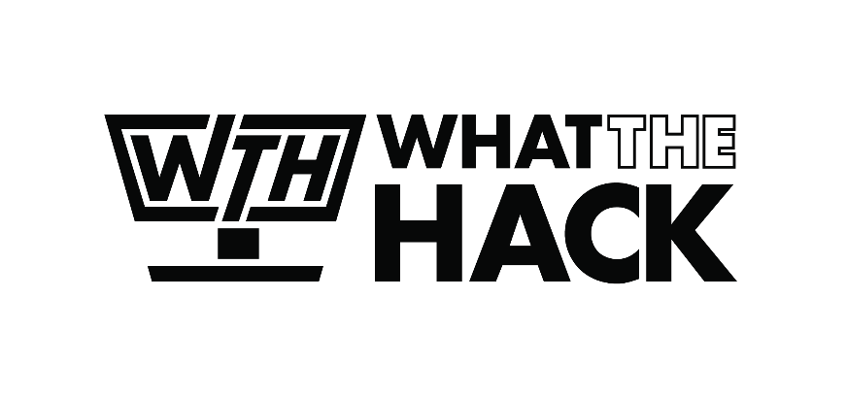
Challenge Zero Pre-requirements
Your laptop: Win, MacOS or Linux with administrator rights.
Active Azure Subscription with contributor level access or equivalent
Notes:
Modify this slide and add the pre-reqs specific to your hack here.
Each challenge slide should list the key goals for the challenge.

Slide 5

Challenge 1 Setup Local Environment
Notes:
For each “mini-lecture”, have a topic title and/or sub-topic title.
Each mini-lecture should be no longer than 5-10 minutes in length.
Only deliver one lecture ahead of each challenge.
Do not attempt to present all of the lectures before students start hacking.

Slide 6
Challenge #1 Local Setup
VS Code or Visual Studio
Azure Functions
Node.js 8+
.NET 6 SDK
VS Code Todo Tree
Resources.zip file
Notes:
For each challenge, list out the key high-level goals.
If there are important specifications, list them here, or remind students to “read the student guide!”

Slide 7
Challenge 2 Create a Hello World function
Notes:
For each “mini-lecture”, have a topic title and/or sub-topic title.
Each mini-lecture should be no longer than 5-10 minutes in length.
Only deliver one lecture ahead of each challenge.
Do not attempt to present all of the lectures before students start hacking.

Slide 8
Challenge #2 Hello World function
Success Criteria
Verify that you are able to open your function in a browser and pass your name in the query string. You should see a message like: Hello, YourName. This HTTP triggered function executed successfully.
Understand the basic parts of an Azure Function’s code and how to publish it to Azure
Notes:
For each challenge, list out the key high-level goals.
If there are important specifications, list them here, or remind students to “read the student guide!”

Slide 9
Challenge 3 Create Resources
Notes:
For each “mini-lecture”, have a topic title and/or sub-topic title.
Each mini-lecture should be no longer than 5-10 minutes in length.
Only deliver one lecture ahead of each challenge.
Do not attempt to present all of the lectures before students start hacking.

Slide 10
Challenge #3 Create Resources
Cosmos DB
Storage Account (INIT)
Function app “App”, .NET
Function app “Events”, Node.js
Event Grid topic
Computer Vision API service
KeyVault
Notes:
For each challenge, list out the key high-level goals.
If there are important specifications, list them here, or remind students to “read the student guide!”

Slide 11
Challenge 4 Configure the App
Notes:
For each “mini-lecture”, have a topic title and/or sub-topic title.
Each mini-lecture should be no longer than 5-10 minutes in length.
Only deliver one lecture ahead of each challenge.
Do not attempt to present all of the lectures before students start hacking.

Slide 12
Challenge #4 Configuration
Add Application settings for “App” in Azure Portal
Go over each TO-DO in the .NET code and re-build
Notes:
For each challenge, list out the key high-level goals.
If there are important specifications, list them here, or remind students to “read the student guide!”

Slide 13
Challenge 5 Deployment
Notes:
For each “mini-lecture”, have a topic title and/or sub-topic title.
Each mini-lecture should be no longer than 5-10 minutes in length.
Only deliver one lecture ahead of each challenge.
Do not attempt to present all of the lectures before students start hacking.

Slide 14
Challenge #5 Deployment
Deploy the Toolbooth project to the App function
Add Event Grid Subscription
Notes:
For each challenge, list out the key high-level goals.
If there are important specifications, list them here, or remind students to “read the student guide!”

Slide 15
Challenge 6 Create Functions in the Portal
Notes:
For each “mini-lecture”, have a topic title and/or sub-topic title.
Each mini-lecture should be no longer than 5-10 minutes in length.
Only deliver one lecture ahead of each challenge.
Do not attempt to present all of the lectures before students start hacking.

Slide 16
Challenge #6 Create two new functions
Create a Node.JS function “SavePlateData” triggered by an Event Grid Subscription
Create a Node.JS function “QueuePlateForManualCheckup” triggered by an Event Grid Subscription
Both have CosmosDB as outputs
Notes:
For each challenge, list out the key high-level goals.
If there are important specifications, list them here, or remind students to “read the student guide!”

Slide 17
Challenge 7 Monitoring
Notes:
For each “mini-lecture”, have a topic title and/or sub-topic title.
Each mini-lecture should be no longer than 5-10 minutes in length.
Only deliver one lecture ahead of each challenge.
Do not attempt to present all of the lectures before students start hacking.

Slide 18
Challenge #7 Monitoring
Provision a new Application Insights account
Configure your Function Apps to send telemetry to it
Notes:
For each challenge, list out the key high-level goals.
If there are important specifications, list them here, or remind students to “read the student guide!”

Slide 19
Challenge 8 Data Export workflow
Notes:
For each “mini-lecture”, have a topic title and/or sub-topic title.
Each mini-lecture should be no longer than 5-10 minutes in length.
Only deliver one lecture ahead of each challenge.
Do not attempt to present all of the lectures before students start hacking.

Slide 20
Challenge #8 Data Export
Create a Logic App that calls ExportLicensePlates, sends an email if there were no records to export
Go over TODO in the code to upload the exported data, republish the app
Notes:
For each challenge, list out the key high-level goals.
If there are important specifications, list them here, or remind students to “read the student guide!”

Slide 21

Thank You for Attending! https://aka.ms/wth
Notes:
Thank students for attending and share the link to the What The Hack website with them.

Slide 22
Azure Serverless

Slide 23
Before cloud
What is the right size of
servers for my business needs?
How do I deploy new code to my server?
What media should I
use to keep backup?
What happens in case of
server hardware failure?
Which packages should be on my server?
What size of servers
should I buy?
Who monitors
my App?
How often should I backup my server?
How can I scale my app?
How can I increase server utilization?
Who has physical
access to my servers?
Which OS should I use?
Do I need secondary network connection?
Are my server in a
secure location?
What happens if the
power goes out?
Who monitors
my Servers?
Do I need a UPS?
What storage I need to use?
How many servers
do I need?
How can I dynamically configure my app?
It takes how long to provision a new server?
How often should
I patch my servers?
Notes:
Talking points: (New)
Note to speaker: no extra clicks needed, all visuals will fly in on their own at page load time.
Before Cloud (or even now), let’s say you run a successful business and you try to build business apps, you have two options. You can either build on premises or co-location. You will go and buy servers and infrastructure to run your business applications.
With that came many questions when you build and manage your own server. From what servers to buy, how to provision my new server, what do I do if there is hardware failure, to how to deploy my code and patch my servers, there are simply too many things to consider.
It can be overwhelming when you manage your own physical servers.

Slide 24
The “evolution” of application platforms
On-Premises
IaaS
PaaS
Serverless

Slide 25
Then came IaaS—table stakes for digital business
What is the right size of servers for my business needs?
How can I increase server utilization?
How many servers do I need?
How can I scale my app?
How often should I patch my servers?
How do I deploy new code to my server?
How often should I backup my server?
Which OS should I use?
Which packages should be on my server?
Who monitors my App?
Notes:
points: (New)
Note to speaker: no extra clicks needed
Well, a much cleaner picture, isn’t it? A few years later, there is this thing called “IaaS”. The idea is, you don’t need to buy or build your own servers, use our infrastructure service, aka IaaS.
With that, you don’t have to worry about provisioning your servers, or securing the physical location of your server farm. Many questions go away.
But, there is but… you still need to think about which IOS to use, how to patch the server, in addition to managing your business apps. Can those tedious tasks be taken care of as well?

Slide 26
Modernize your apps with PaaS
Value to business
Innovation
PaaS
Efficiency
IaaS
Time

Slide 27
Then PaaS, critical for digital transformation
What is the right size of “servers” for my business needs?
How can I increase “server” utilization?
How many “servers” do I need?
How can I scale my app?
Notes:
Talking points: (New)
Yes. We have this service called Platform as a Service, PaaS. What is great about it is, VM patching, IOS selection, back up and code deployment are all built into PaaS platform for you. Isn’t that great?
Now only four questions remain,
How many servers do I need?
What is the right size of server for my biz? S1, P3?
How can I increase server utilization?
More importantly, how I scale my app?
Let’s see how everything works together so far --- transition into the IaaS & PaaS chart.

Slide 28
Serverless, the future platform for next gen apps
How do I architect my app to become Serverless?
Notes:
Talking points: (New)
What do we go from here?
Introducing Serverless, an event-driven process, which will grow and scale on demand.
The only remaining question now becomes: How I architect my app to become Serverless? Pretty neat, right?
It all sounds great, naturally, you may ask, how does Serverless fit into the picture?

Slide 29
What is Serverless?
Abstraction of servers
Event-driven/ instant scale
Micro-billing
Notes:
Abstraction of servers, infrastructure and configuration of operating system
Event-driven scale
Sub-second billing
Stateless
Serverless compute is a fully managed service. Some refer to it as Functions as a Service
OS and Framework patching is performed for you
There is zero administrative tasks and no need to manage any infrastructure
You just deploy your code (function) and it runs
Your code runs within seconds and for very short period of time
Serverless compute scales quickly (almost instantly) and vastly
Automatically scales within seconds
No scale configuration is required (there is no way to configure scale or limits)
Scales to match any given workload. Scales from zero to handle tens of thousands concurrent functions invocations within seconds
Pay only for the time your code is running
Serverless compute reacts to events
React, in near real-time, to events and triggers
Triggered by virtually any event from Azure service or 3rd party services

Slide 30
Benefits of Serverless
Manage apps not servers
Reduced DevOps
Faster time to market
Notes:
“Pinnacle of PaaS compute”
Not just hardware “servers”, but software servers are also managed for you
Focus on business logic, not solving technical problems not core to business
Lower effort to get started makes it easier to experiment (bots, etc.)
Benefits of “Serverless”

Slide 31
Build apps faster with Serverless
Serverless
Value to business
Innovation
PaaS
Efficiency
IaaS
Time
Notes:
In today’s cloud enabled world, businesses are solving for maximum efficiency and faster time to market, while reducing IT spend.
Over the years we have seen businesses evolve from spinning VMs to leveraging the benefits of PaaS cloud such as managed infrastructure, scalability, high availability and cost.
Today, more businesses are trying to solve for what is core to their business focus – delivering services faster to their customers, while reducing IT spend significantly. The answer comes in the form of Serverless application platform.
In industry terms, when you hear someone say “Serverless” more often than not they are talking about Serveless Compute services which form the glue that enable developers to build their apps faster leveraging a variety of other PaaS services.
Serverless lets businesses maximize their benefits of the PaaS cloud by offering a fully managed infrastructure, with no servers to manage, provision and patch; hence reducing management overhead significantly. The event triggered programming model, allows for continuous auto-scaling and micro billing capabilities. Event-triggered compute and event-triggered scaling allows businesses to pay only for the compute power that was used, depending on the size of the workload.

Slide 32

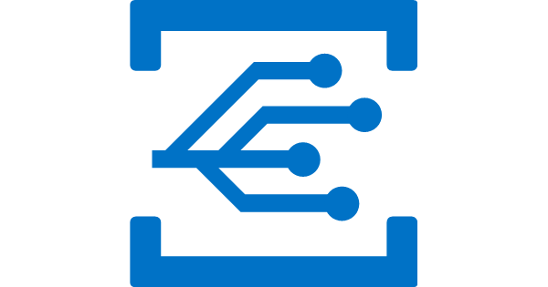

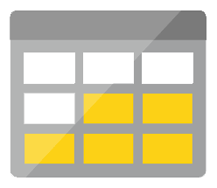
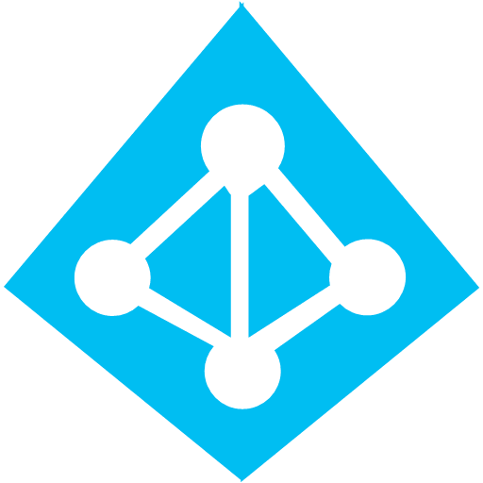
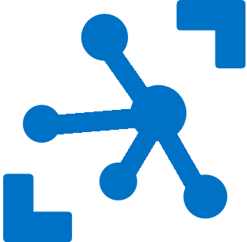


Serverless application platform components
Development
Platform
IDE support
Functions
Logic apps
Event Grid
Integrated DevOps
Developer productivity
Visual designer
Manage all events in one place
Triggers and Bindings
100+ connectors
Near real-time delivery
Local development
Flexible deployment options
Functions orchestration
Broad coverage
Monitoring
Database
Storage
Security & Access Control
IoT
Analytics
Intelligence
Visual Debug History
Notes:
Lets talk about what really makes up MSFT’s Serverless platform: At the center of the Serverless platform, is our compute offerings: Azure Functions and Azure Logic Apps. Azure Functions is an event based Serverless compute experience that helps you accelerate your development. Logic Apps is a powerful orchestration tool. It enables building a Serverless app in minutes – by orchestrating multiple functions using a visual workflow tool.
Say you have your apps up and running using Serverless. Congratulations! You now need to collect intelligence from different apps across platforms to take actions upon. There are a few essential components which we think are core to building Serverless applications are:
Data/ Storage –Functions has triggers and bindings with Azure document DB and Azure Blob storage
** Triggers: Triggers are event responses used to trigger your custom code. They allow you to respond to events across the Azure platform or on premise.
** Bindings: Bindings represent the necessary meta data used to connect your code to the desired trigger or associated input or output data.
Messaging such as queues and topics using Azure Service Bus and Azure Event Hubs
Integration – that includes core LOB apps and SaaS apps integration via Azure Logic Apps.
Intelligence on data and sentiment/ predictive analysis using Cognitive services and Machine learning
Conversation as a service – how do we equip developers to build apps that offer an end-to-end experience for their end users – Azure Bot Service offers a Serverless interactive bot experience.
More, developers are spending more time writing code that allows them to add huge business impact with Serverless. MSFT offers numerous development tools such as IDE Support for Visual Studio in functions and Logic Apps, enables local development (vs web browser coding environment), visual debugging capability, all with your tools of choice.
Lastly, I also want to highlight top scenarios and use cases for Serverless:
Real-time Stream analytics: Customers can use Functions to feed real-time streams of data from application tracking into structured data and store it in SQL online.
SaaS event processing: Customers can use Functions and Logic Apps to analyze data from an excel file in Onedrive and perform validation, filtration, sorting and convert data into consumable business charts
Web app architecture: Used a lot in creating targeted marketing collaterals – when a customer clicks on a webpage, it triggers a webhook, that uses a function to create an ad that matches the customer profile and displays a completed webpage.
Real-time bot messaging: When customers send a message to a chatbox, Functions calls Cortana analytics to generate appropriate answers and sends a response back.
//from before: Customers have different paths to build a Serverless app – start by building the distributed application components using functions by leveraging the numerous templates and declarative bindings Or
Start with the workflow and orchestration of Serverless application using Azure Logic Apps. The visual designer enables developers to quickly and easily author, edit and visualize orchestration of multiple functions and workflow.

Slide 33
Scenarios
Anything that needs to respond to events
Real-time stream processing
Timer-based processing
Millions of devices feed into Stream Analytics
Transform to structured data
Store data in SQL DB
Every 15 minutes
Find and clean invalid data
Clean table
Mobile app backends
Real-time bot messaging
?
...
Photo taken and WebHook called
Stores in blob storage
Produces scaled images
Message sent to Chatbot
Chatbot sends
response
Cortana Analytics answers questions
Notes:
So what kind of apps and scenarios can be built using serverless technologies?
The answer is anything where there is need to run some logic in response to an event.
Some of you might be surprised to learn that, the above definition covers a big portion of the computing universe. Modern computing is all about events:
An IoT device sending data to analyze and store in real-time is an event. There are billions of those. Handling of such data such as enriching, analyzing or filtering is best done using serverless functions which can be spun up on demand.
Almost every web based application needs to run some regular maintenance task like cleaning up a database or synchronizing data between two systems. All of these times are events. Such tasks that need to be run only at specific times, don’t call for dedicated infrastructure. They are best left to serverless solutions.
A mobile app clicking a picture and submitting to backend is an event. There are billions of such apps. In many cases developers building such apps want to focus on delighting their customers using clients app experience. Serverless technology can easily take away the burden of building mobile backends.
Automated response systems receiving a customer request is an event. Building intelligent bots for such scenarios using serverless technology is again a great example where the focus needs to be on logic instead of infrastructure.
These are only some of the many examples which fit well with serverless.

Slide 34
Azure Functions

Slide 35
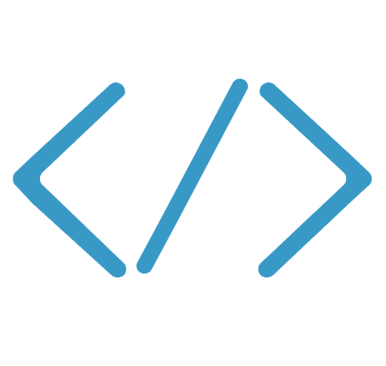

Introducing Functions
Code
Azure Functions
Events + data

Slide 36
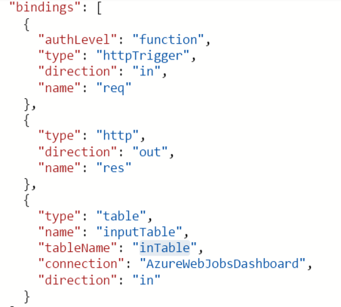
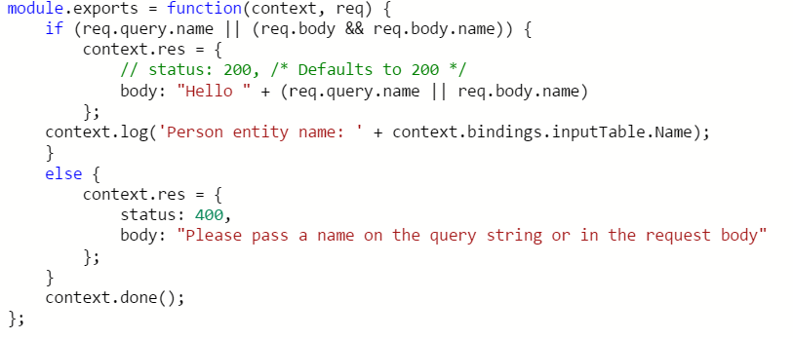
Use bindings in your code
Input
Trigger (data)
Output

Slide 37
Triggers and Bindings
Type | Service | Trigger | Input | Output
Schedule | Azure Functions | ü
HTTP (REST or webhook) | Azure Functions | ü |  | ü
Blob Storage | Azure Storage | ü | ü | ü
Events | Azure Event Hubs | ü |  | ü
Queues | Azure Storage | ü |  | ü
Queues and topics | Azure Service Bus | ü |  | ü
Storage tables | Azure Storage |  | ü | ü
SQL tables | Azure Mobile Apps |  | ü | ü
No-SQL DB | Azure DocumentDB |  | ü | ü
Push notifications | Azure Notification Hubs |  |  | ü
Twilio SMS Text | Twilio |  |  | ü
SendGrid email | SendGrid |  |  | ü

Slide 38



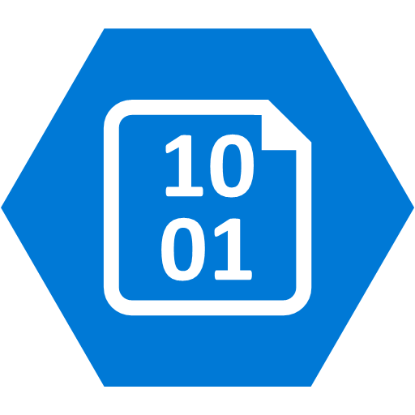
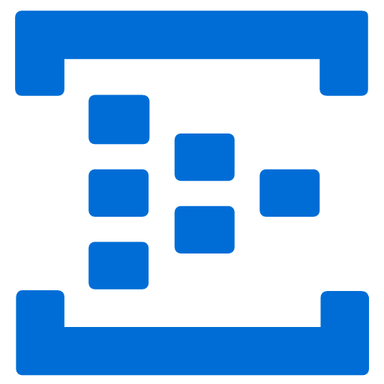
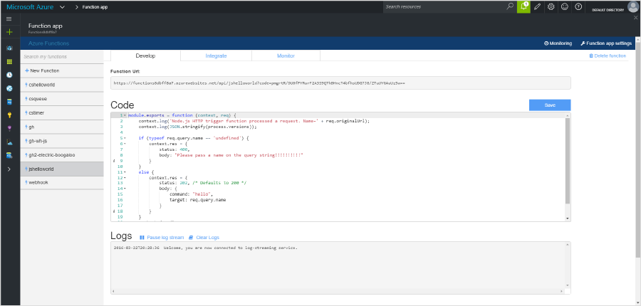
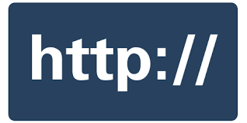
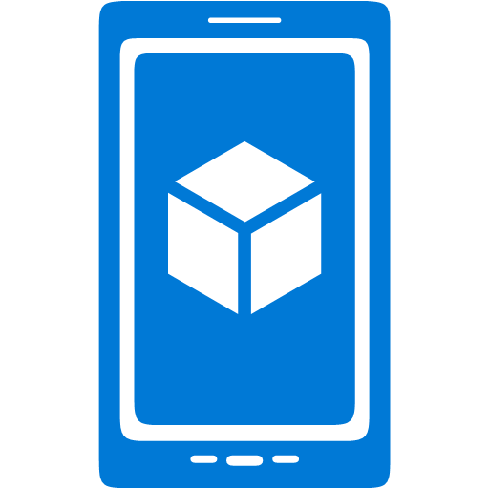
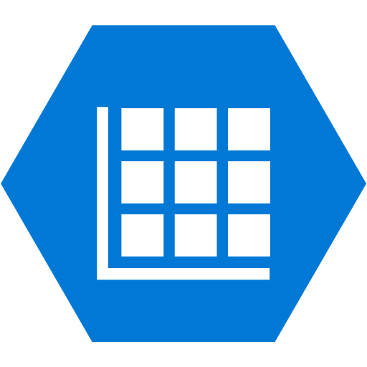
Seamless DevOps experience with Functions
1) Trigger
2) Input binding
3) Develop
4) Execute
5) Output binding
Web Hooks
App Services
Hosting Plans
Azure Services
Azure Services
Azure Services
7) Develop locally
6) Monitor and improve
Notes:
This is the whole (top level) Dev Ops story where Dev build wounderful apps, using CI they mange their code, builds, and releases. Connecting to a repository, they can deploy to Azure Websites, build in the cloud, deploy to a slot to test and validate, swap into production, deployed across the globe as needed, monitor and get feedback, on which devs can make updates. Rinse and repeat

Slide 39
Azure Logic Apps

Slide 40
Azure Logic Apps
Powerful Integration and Workflow Engine born in Azure
Fast integrations using a visual designer and workflow creation with triggers and actions
Connect applications, data and services
Connect and orchestrate Azure Functions

Slide 41
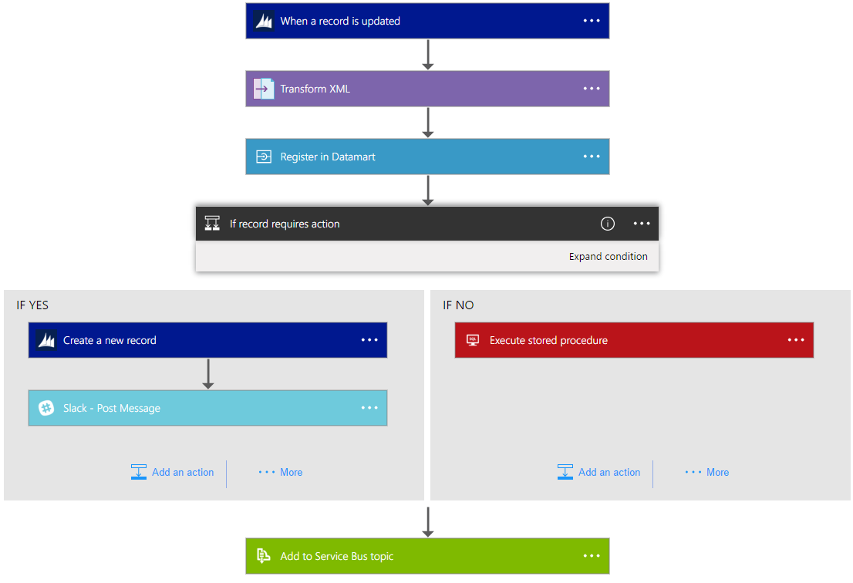
Logic Apps Workflow Designer
Workflow in the cloud
Powerful control flow
Connect disparate applications
No code designer for rapid creation
Also works within Visual Studio for added CI/CD

Slide 42
Logic Apps
SaaS
Protocols/native
appFigures
Asana
Azure API Management
Azure App Services
Azure Automation
Azure Cognitive Face API
Azure Cognitive LUIS
Azure Cognitive Text Analytics
Azure Cognitive Vision
Azure Data Lake Store
Azure Document DB
Azure Event Hub
Azure Functions
Azure Machine Learning
Azure Resource Manager
Azure Service Bus
Azure SQL
Azure Storage Blob
Azure Storage Queues
Basecamp
Bing Search
BitBucket
Bitly
Blogger
Box
Buffer
Campfire
Chatter
Common Data Service
Disqus
DocuSign
Dropbox
Dynamics AX Online
Dynamics CRM Online
Dynamics CRM Service Bus
Dynamics Financials
Dynamics Operations
Easy Redmine
Eventbrite
Facebook
FreshBooks
Freshdesk
GitHub
Gmail
Google Calendar
Google Contacts
Google Drive
Google Sheets
Google Tasks
GoTo Meeting
GoTo Training
GoTo Webinar
Harvest
HelloSign
Infusionsoft
JIRA
Insightly
Instagram
Instapaper
MailChimp
Mandrill
Medium
Microsoft Project Online
Microsoft Translator
MSN Weather
Muhimbi PDF
Office 365
Office 365 Users
Office 365 Video
OneDrive
OneDrive for Business
OneNote
Outlook.com
Outlook Tasks
PagerDuty
Pinterest
Pipedrive
Pivotal Tracker
Power BI
Project Online
Redmine
Salesforce
Salesforce Chatter
SendGrid
SharePoint Online
Slack
SmartSheet
SparkPost
Stripe
Survey Monkey
Todoist
Toodledo
Trello
Twilio
Twitter
Typeform
UserVoice
VS Team Services
Webmerge
Wordpress
Wunderlist
Yammer
YouTube
Zendesk
HTTP, HTTPS
HTTP Webhook
FTP, SFTP
SMTP
RSS
Compose, Query, Parse JSON
Wait
Terminate
Workflow
Cloud APIs and platform functionality
Over 120 built-in connectors
Hosted and managed within the platform
Scales to meet your needs
First class designer experience
Rapid development
XML and EDI
XML Validation
Transform XML (+Mapper)
Flat File Encode
Flat File Decode
X12
EDIFACT
AS2
Integration Account Artifact Lookup
API connections
Authenticate once and reuse
Differentiate connection configuration
Simple to deploy
Portal experience for managing API Connections
Hybrid
BizTalk Server
File System
IBM DB2
Informix
Oracle DB
SharePoint Server
SQL Server
SAP
Websphere MQ
Notes:
Call out that we now support stored procs on-prem

Slide 43
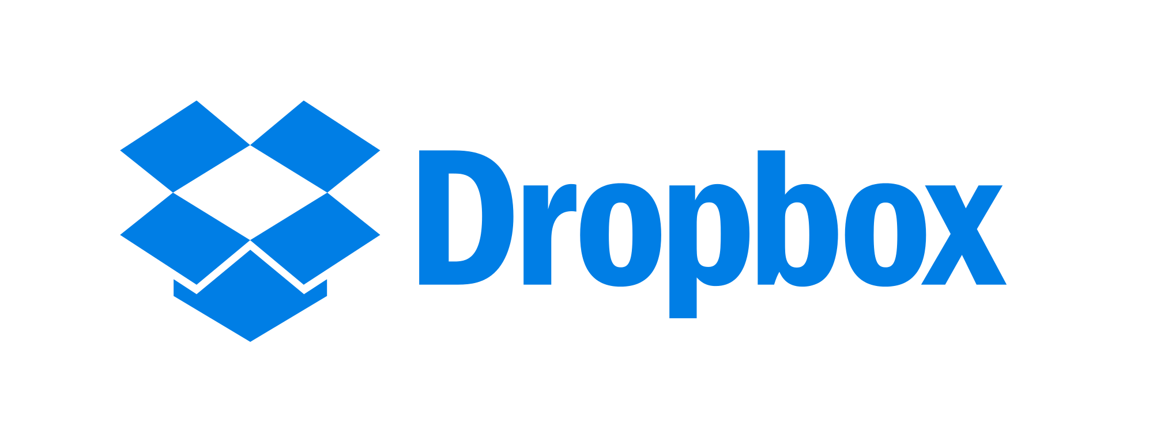

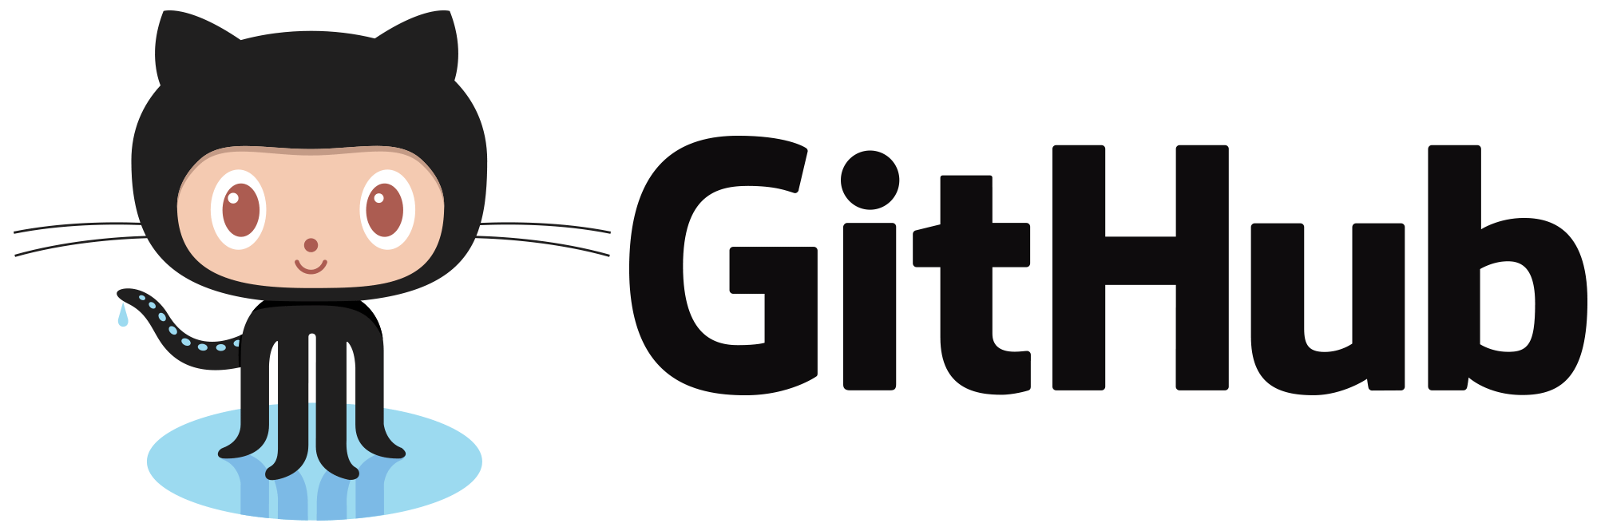
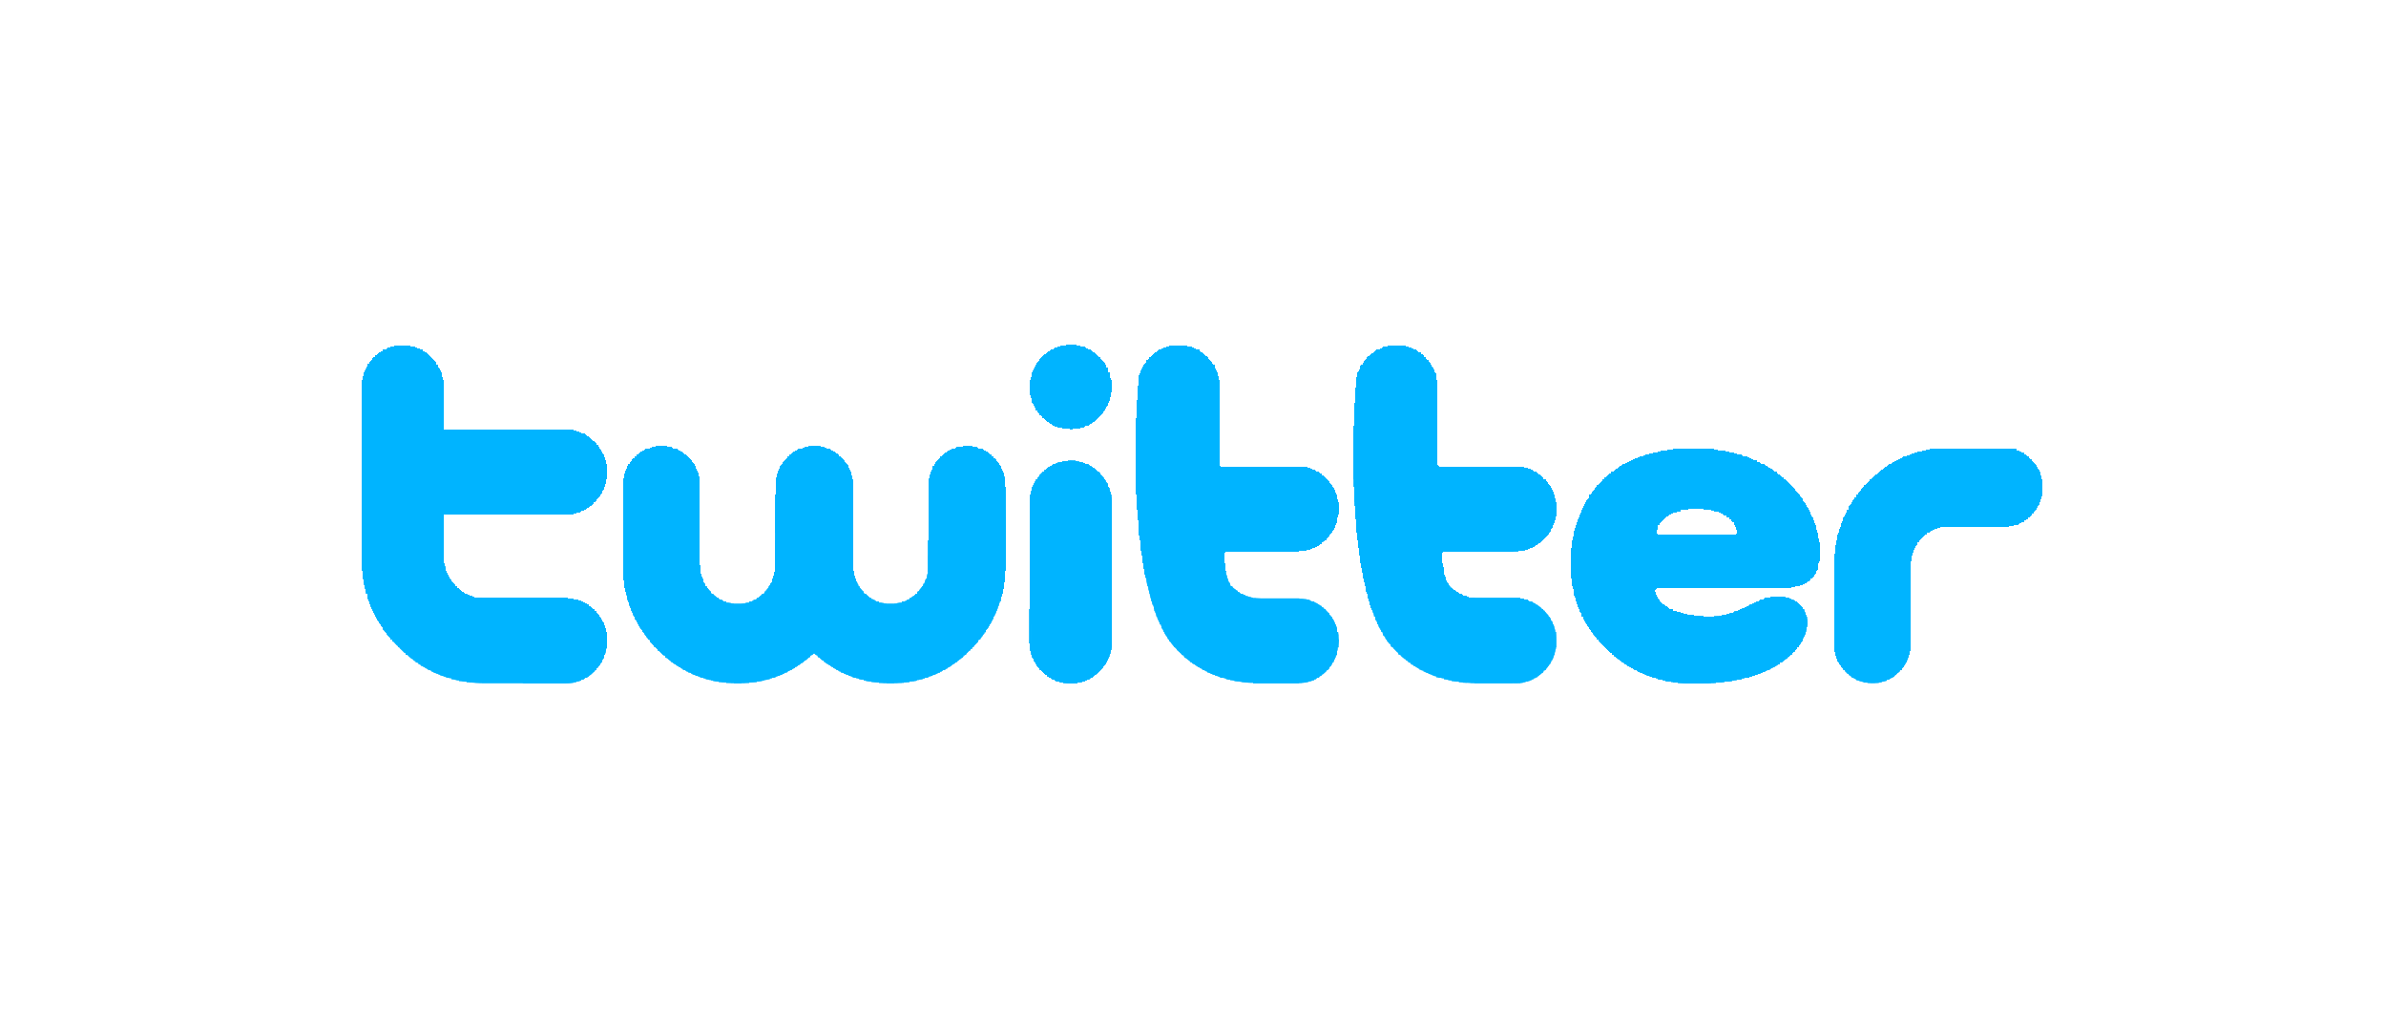

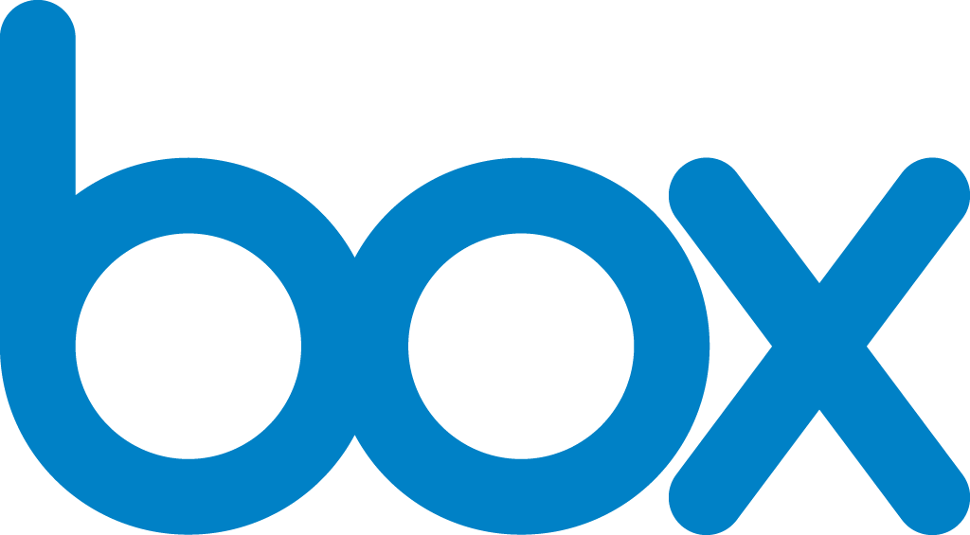
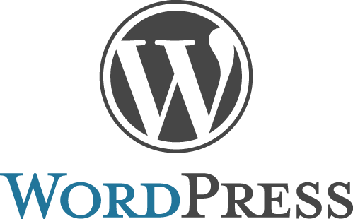
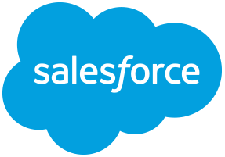
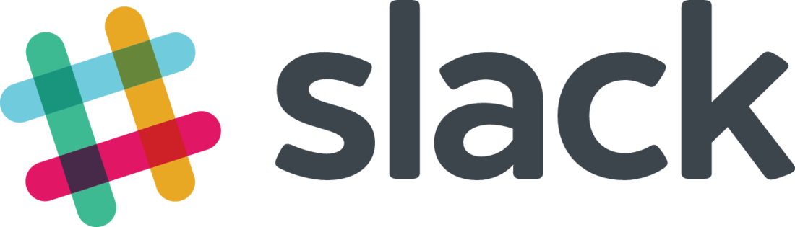
Logic Apps connectors— Over 100 and growing
….and more!

Slide 44
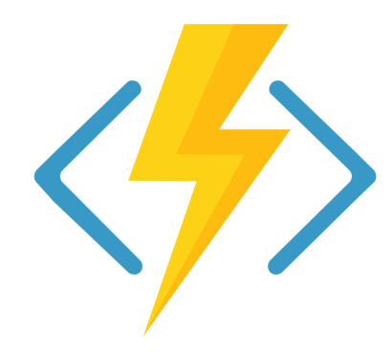
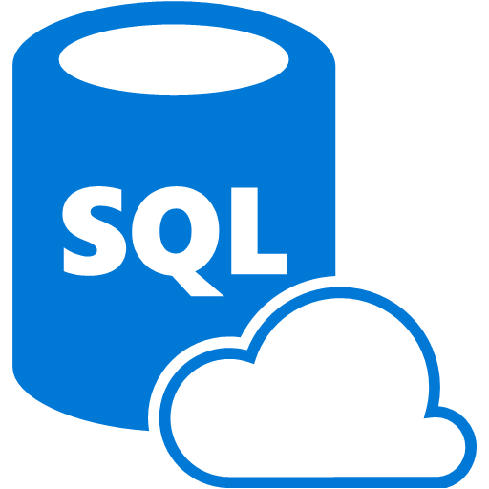

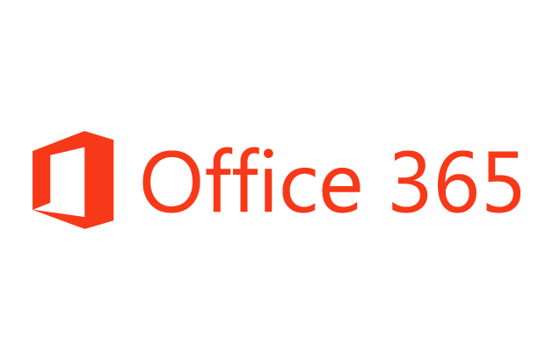
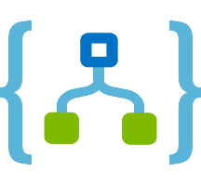
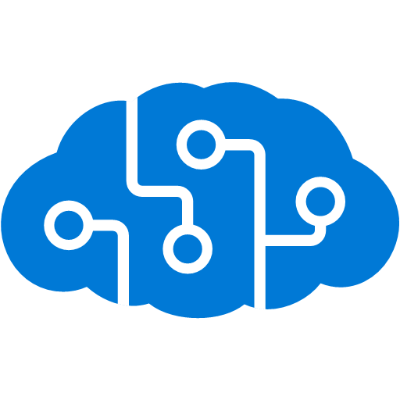
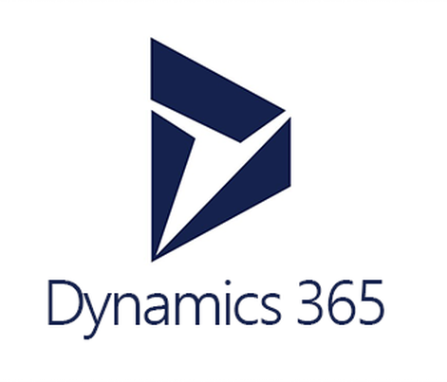

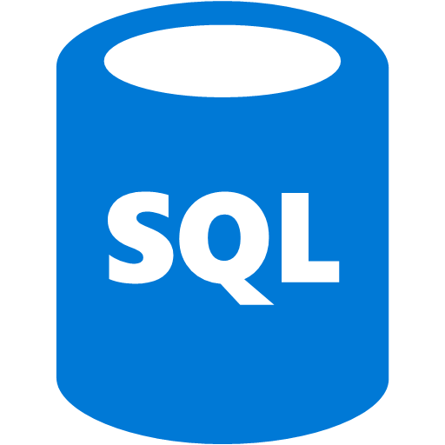
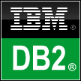
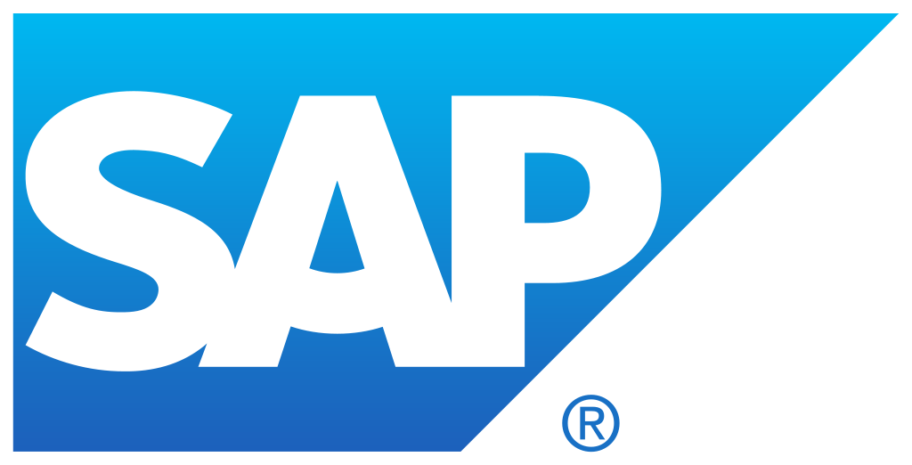


Logic Apps connects everything
Azure Functions
Service bus
Cognitive services
Logic Apps
Machine learning
On-premises data gateway
BizTalk server
Notes:
Logic Apps can integrate with “anything” (APIs) and solve small or complex problems. Automation in a secure and reliable environment fast and easy.
Connect Anything:
On-premises, hybrid and cloud
Mission critical, complex integration scenarios
Business productivity
Agile Business:
Quickly create workflows
Position to the future API centric
Transform Business:
Extract value from both (on-premises and cloud apps)
Build Holistic integration solutions.

Slide 45
Azure Event Grid

Slide 46

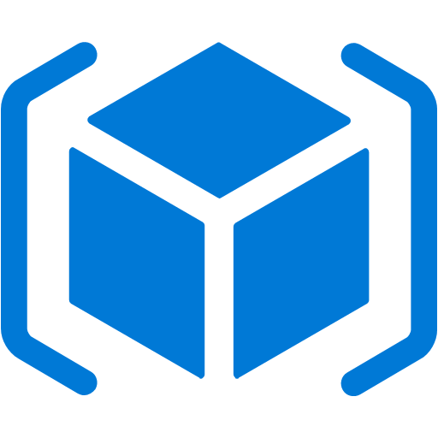

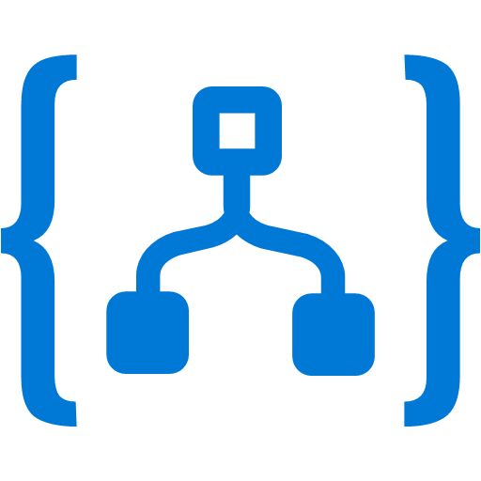
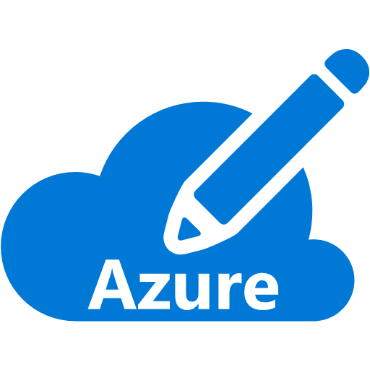

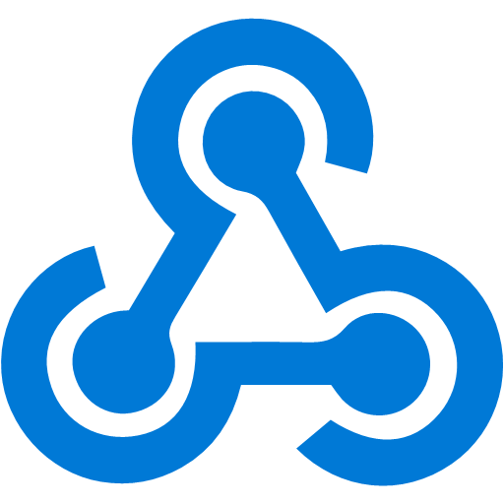

Manage all events in one place
Event publishers
Event handlers
Blob Storage
Azure Functions
Resource Groups
Logic Apps
Azure Subscriptions
Azure Automation
Event Hubs
WebHooks (anything)
Custom Events (anything)

Slide 47
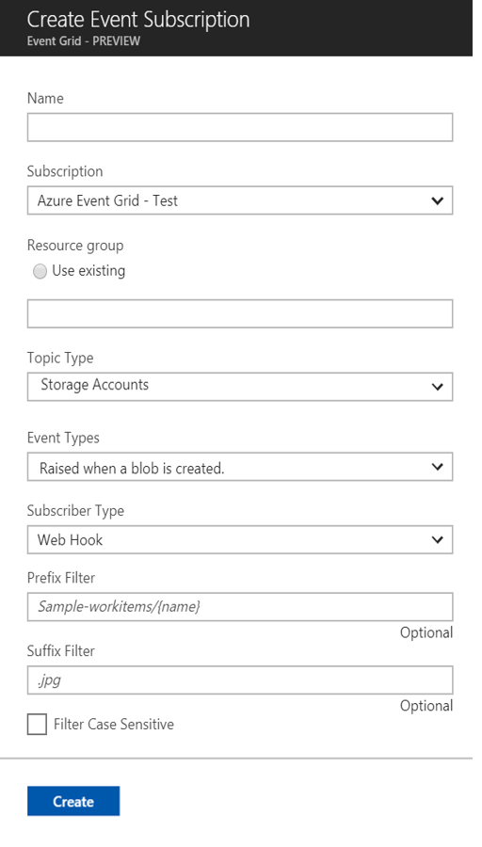
Manage all events in one place
Event publishers
Event handlers
Subscribe to pre-defined system events in Azure or create your own custom topics
Route events to any end-points, Azure or even beyond
Enable filtering and efficient routing of events

Slide 48
Ensure reliability and performance in your apps
Sub-second end-to-end latency in the 99th percentile
10,000,000 events per second per region
24-hour retry with exponential back off for events not delivered
Near real-time
Massive scale-out
High reliability

